Slide 1
Call centre assignment Part 1
For Top Mentor
Sadhana R

Slide 2
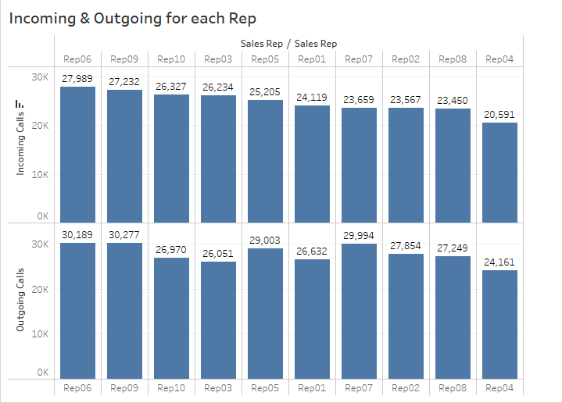

Slide 3
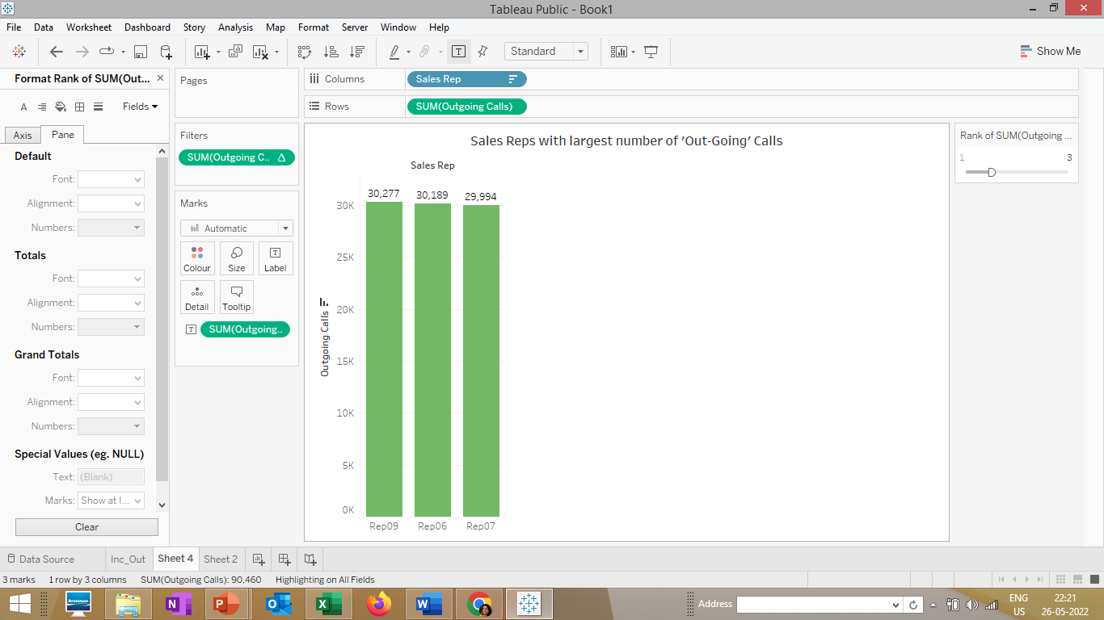
Top 3 Sales Reps with largest Number of Out-going calls

Slide 4
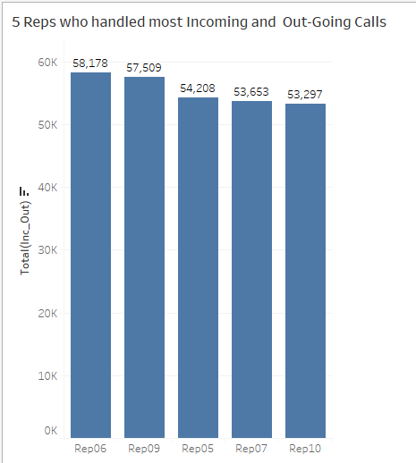

Slide 5
