Slide 1
CSCE350: Data Structures and Algorithms
Instructor: Dr. Jianjun Hu
Fall 2009
http://mleg.cse.sc.edu/edu/csce350
Department of Computer Science and Engineering
University of South Carolina

Slide 2
Today’s Agenda
Welcome to CSCE350
Why CSCE350 may change your life?
Various administrative issues.
What is algorithm?
What is this course about?
Send an email to me at: jianjunh@cse.sc.edu so I will set up a mailing list.

Slide 3

Welcome to CSCE350
About me: Who is Hu?
Dr. Hu, doing research in AI, Machine learning, Bioinformatics…. Mostly all kinds of algorithms..
What you can expect from me:
Helpful, encouraging; inspiring and enjoying class
Good grades if u really work hard.
What I expect from you:
Turn in all homework and participate classes
You learn some critical techniques from this course
You show signs to be able to invent new algorithms
Algorithms may change your life, don’t think so?

Slide 4
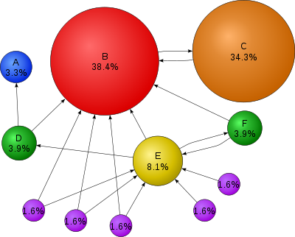

Why you want to study Algorithms?
Making a lot of money out of a great algorithm…
$1,000,000,000?
Example: PageRank algorithm by Larry Page—The soul of Google search engine
Google total assets: $31 billions on 2008

Slide 5
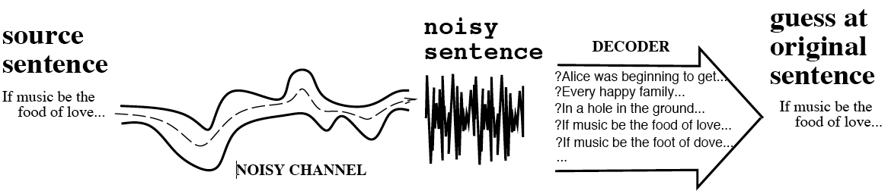
Why you want to study Algorithms?
Make significant contribution to the society
Viterbi algorithm --→ How much it is worth?
Dynamic programming algorithm for finding the most likely sequence of hidden states
Cell Phone, wireless network, modem, etc…

Slide 6
Why you want to study Algorithms?
Viterbi algorithm conceived by Andrew Viterbi in 1967 as an error-correction scheme for noisy digital communication links, finding universal application in decoding the convolutional codes used in both
Viterbi algorithm is a standard component of tens of millions of high-speed modems. It is a key building block of modern information infrastructure
  CDMA and GSM digital cellular,
  dial-up modems, satellite, deep-space communications, and
  802.11 wireless LANs. It is now also commonly used in
  speech recognition, keyword spotting,
  computational linguistics, and
  bioinformatics.

Slide 7
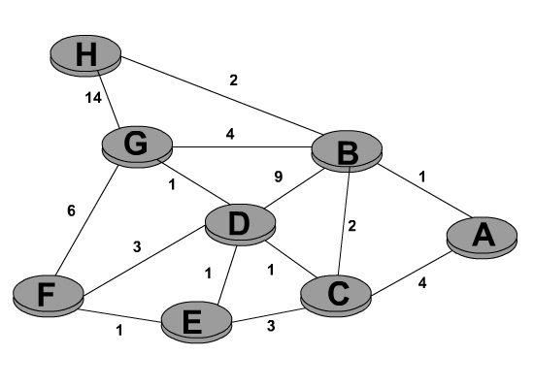
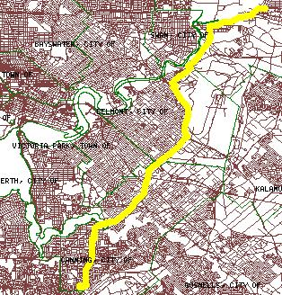
Why you want to study Algorithms?
Simply to be cool to invent something in computer science
Example: Shortest Path Problem and Algorithm
Used in GPS and Mapquest or Google Maps

Slide 8
Algorithm and Data Structures
An algorithm is a sequence of unambiguous instructions/operations for solving a problem, i.e., for obtaining a required output for any legitimate input in a finite amount of time.
Map Navigation A→B
problem
algorithm
Data Structures
“computer”+
programs
input
output
Graphs
Path

Slide 9
On This Course
Time and Place: TTh 2:00PM-3:15PM, in SWGN 2A21
Instructor: Jianjun Hu, SWGN 3A66, 803-777-7304, jianjunh@cse.sc.edu
Office Hours: TTh3:30PM-5:00 PM
NO TA… The department is poor-☺
Course Webpage:
http://mleg.cse.sc.edu/edu/csce350
  check this regularly for important announcement related to this course
  some useful links and additional readings

Slide 10
On the Tentative Syllabus
See the distributed sheet for details
Grading Policy:
  A (90-100%)
  B+ (85-90%)
  B (80-85%)
  C+ (75-80%)
  C (70-75%)
  D+ (65-70%)
  D (60-65%)
  F (0-60%)
  Your scores on homework, exams, etc. will be available to you at the dropbox system http://dropbox.cse.sc.edu

Slide 11
Your Grade Consists of
In-class midterm exams (2) (20 %)
Final exam (35%)
Homework assignments (35%)
Quizzes (5%) randomly scheduled.
Attendance (5%)
Both midterm and final exams are closed to books and notes, except for a single-side letter-size cheat sheet for each midterm and a double-side one for the final exam.

Slide 12
Notes:
Attendance grade based on
  random written quizzes (<10 mins) in the class
  my records from other sources (questioning, collecting or giving back homework or exams, etc.)
  Visits to my office with questions
Homework
  must be completed independently by yourself while peer discussion is encouraged….
    How to test: can u solve a similar problem independently?
  homework due at the beginning of the class (program code needs to turned in through departmental dropbox system)
  no late homework will be accepted without the special permission from the instructor in advance.

Slide 13
Code of Student Academic Responsibility
Please check this for detailed requirements on academic integrity
The departmental chair emphasized this issue and required all the violation behavior will be reported to the department chair
I can easily use Google and a special software to figure your any plagiarism.

Slide 14
The Nature of This Course
This is one of the most important courses of computer science
  It plays a central role in both the science and the practice of computing
  It tells you how to design a program to solve important problems efficiently, effectively and professionally
  The knowledge in this course differentiates a ‘real’ computer-science student from other students
What you are going to learn is independent of any specific commercial software
  You can implement the data structures and algorithms you learned in this course by any computing languages, such as C, C++, Java, Pascal, Fortran, etc.
  Some homework questions need programming. We require all codes to be written in C or C++ or java in Linux.

Slide 15
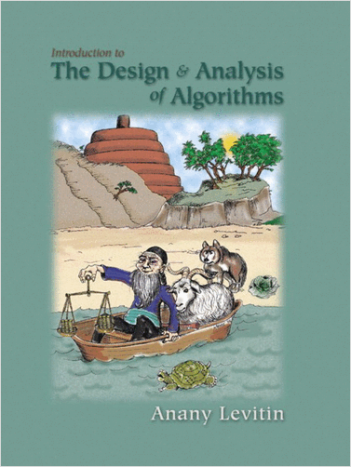
Required Textbook
Introduction to the Design and Analysis of Algorithms, 2006
Anany V. Levitin, Villanova University
Addison Wesley
  we try to cover all material
  we may involve additional material not covered in this book
  we will assign some readings in this book
Questions?

Slide 16
How to study algorithms?
Problem
Representation/data structure in computer
Operations on representations

Slide 17
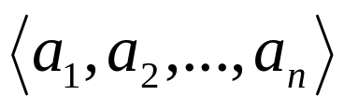

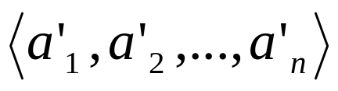
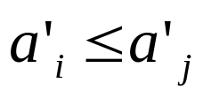

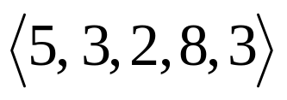
Example: Sorting
Statement of problem:
  Input: A sequence of numbers
  Output: A reordering of the input sequence
  so that whenever
Instance: The sequence
Algorithms:
  Selection sort
  Insertion sort
  Merge sort
  (many others)

Slide 18


Selection Sort
Input: array
Output: array a[1..n] sorted in non-decreasing order
Algorithm:
for i =1 to n
swap a[i] with smallest of
see also pseudocode, section 3.1
Notes:
The algorithm is given *very* informally here. Show students the pseudocode in
section 3.1.
This is a good opportunity to discuss pseudocode conventions.

Slide 19
Some Important Points
Each step of an algorithm is unambiguous
The range of inputs has to be specified carefully
The same algorithm can be represented in different ways
The same problem may be solved by different algorithms
Different algorithms may take different time to solve the same problem – we may prefer one to the other

Slide 20
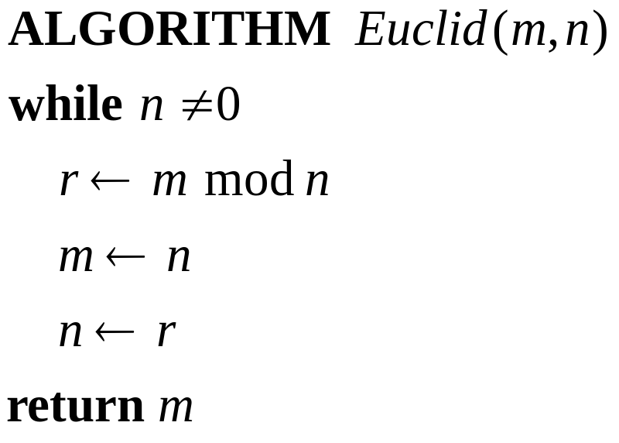
Example: Finding gcd(m,n)
Input: m and n are two nonnegative, not-both-zero integers (Note: the range of input is specified)
Output: gcd(m,n), the greatest common divisor, i.e., the largest integer that divides both m and n
Euclid algorithm: Based on gcd(m,n)=gcd(n, m mod n)
  For example:
  gcd(60, 24)
  =gcd(24,12)
  =gcd(12,0)
  =12
  Will this algorithm eventually
  comes to a stop? Why?

Slide 21

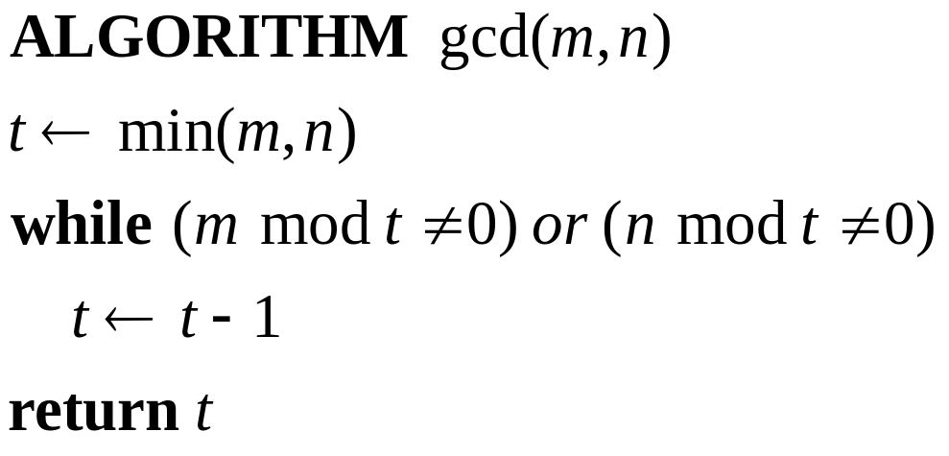
Another Algorithm for Finding gcd(m,n)
Note that , the pseudocode is
What is the range of input for this algorithm? Can one of them to be zero? – No, both m and n must be positive.
In this course, you usually write the algorithm in pseudocode instead of the real code in some special language.

Slide 22
Fundamentals of Algorithmic Problem Solving
Understanding the problem
Ascertaining the capabilities of a computational device
  Random-access machine (RAM) → sequential algorithms
Choose between exact and approximate problem solving
Deciding on appropriate data structure
Algorithm design techniques
Methods of specifying an algorithm
  Pseudocode (for, if, while, //, ←, indentation…)
Prove an algorithm’s correctness – mathematic induction
Analyzing an algorithm – Simplicity, efficiency, optimality
Coding an algorithm

Slide 23
In general
A good algorithm is a result of repeated effort and rework
  Better data structure
  Better algorithm design
  Better time or space efficiency
  Easy to implement
  Optimal algorithm

Slide 24
Some Well-known Computational Problems
Sorting
Searching
Shortest paths in a graph
Minimum spanning tree
Primality testing
Traveling salesman problem
Knapsack problem
Chess
Towers of Hanoi
Notes:
1-4 have well known efficient (polynomial-time) solutions
5: primality testing has recently been found to have an efficient solution
This is a great problem to discuss because it has recently been in the news
(see mathworld news at: http://mathworld.wolfram.com/news/2002-08-07_primetest/
or original article: http://www.cse.iitk.ac.in/primality.pdf)
6(TSP)-9(chess) are all problems for which no efficient solution has been found
it is possible to informally discuss the “try all possibilities” approach that is required
to get exact solutions to such problems
10: Towers of Hanoi is a problem that has only exponential-time solutions (simply
because the output required is so large)
11: Program termination is undecidable

Slide 25
This Course is Focused on
How to design algorithms
How to express algorithms -- pseudocode
Proving correctness
Efficiency Analysis
  Theoretical analysis
  Empirical analysis
Optimality

Slide 26
Algorithm Design Strategies
Brute force
Divide and conquer
Decrease and conquer
Transform and conquer
Greedy approach
Dynamic programming
Backtracking and branch and bound
Space and time tradeoffs
Invented or applied by many genius in CS

Slide 27
Analysis of Algorithms
How good is the algorithm?
  Correctness
  Time efficiency
  Space efficiency
Does there exist a better algorithm?
  Lower bounds
  Optimality

Slide 28
In general: What is an Algorithm?
Recipe, process, method, technique, procedure, routine,… with following requirements:
Finiteness: terminates after a finite number of steps
Definiteness: rigorously and unambiguously specified
Input: valid inputs are clearly specified
Output: can be proved to produce the correct output given a valid input
Effectiveness: steps are sufficiently simple and basic
Notes:
The formalization of the notion of an algorithm led to great breakthroughs in the
foundations of mathematics in the 1930s.

Slide 29
Next Time
Background on Data Structures
  Array
  Linked list (queue, stack, heap, …)
  Graph
  Tree
  Set
  …

