Slide 1
Now, Chapter 5: Decrease and Conquer
Reduce problem instance to smaller instance of the same problem and extend solution
Solve smaller instance
Extend solution of smaller instance to obtain solution to original problem
Also referred to as inductive or incremental approach

Slide 2
Examples of Decrease and Conquer
Decrease by one:
  Insertion sort
  Graph search algorithms:
    DFS
    BFS
    Topological sorting
  Algorithms for generating permutations, subsets
Decrease by a constant factor
  Binary search
  Fake-coin problems
  multiplication à la russe
  Josephus problem
Variable-size decrease
  Euclid’s algorithm
  Selection by partition

Slide 3
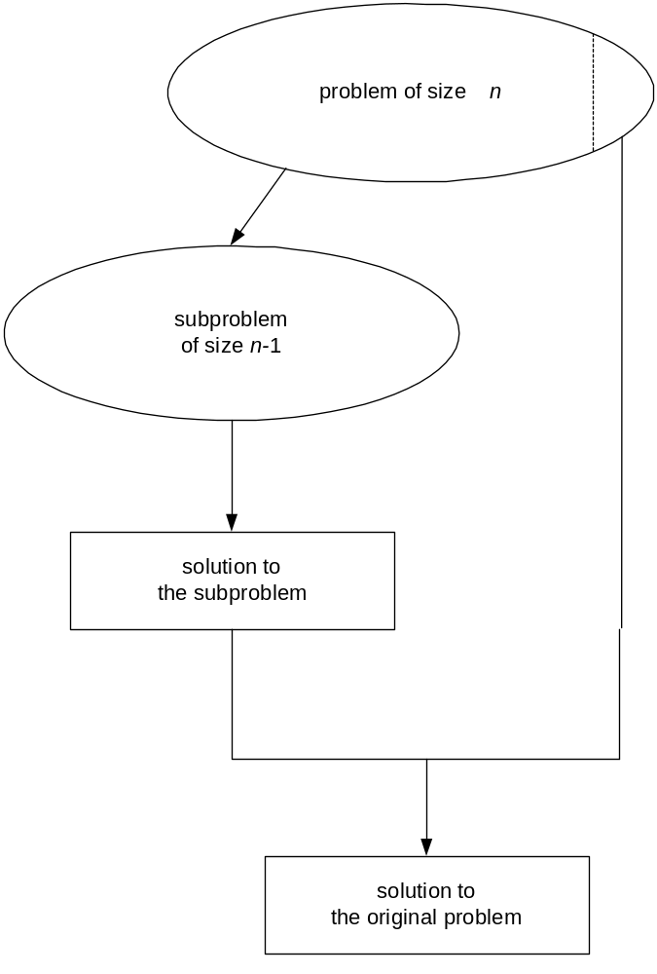
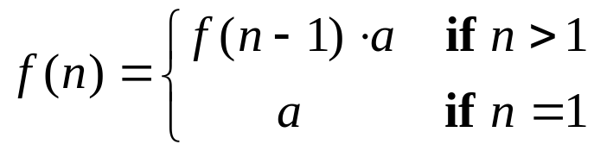
What’s the difference?
Consider the problem of exponentiation: Compute a^{n}
Decrease-by-a-constant
Notes:
Try to get the students involved in coming up with these:
Brute Force:
a^{n}= a*a*a*a*...*a
n
Divide and conquer:
a^{n}= a^{n/2} * a^{n/2}
Decrease by one:
a^{n}= a^{n-1}* a (one hopes a student will ask what is the difference with brute force here
there is none in the resulting algorithm, of course, but you can arrive
at it in two different ways)
Decrease by constant factor:
a^{n}= (a^{n/2})² (again, if no student asks about it, be sure to point out the difference
with divide and conquer. Here there is a significant difference that leads to a
much more efficient algorithm – in divide and conquer we re-compute a^{n/2)}

Slide 4
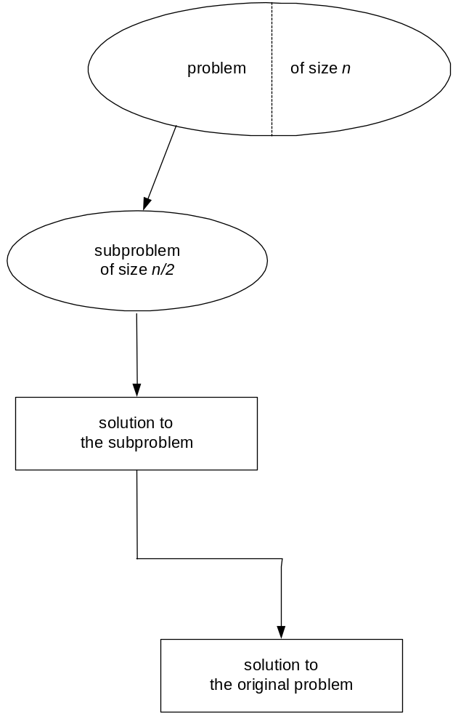
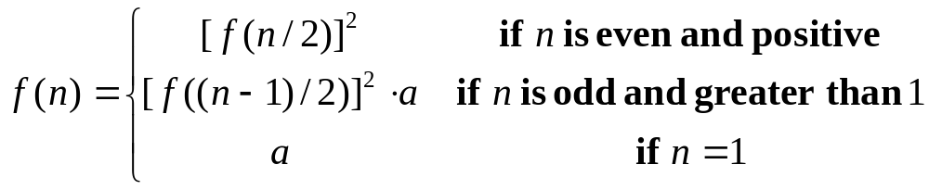
Decrease-by-a-constant-factor

Slide 5
Variable-size-decrease
A size reduction pattern varies from one iteration of an algorithm to another
Example: Euclid’s algorithm for computing the greatest common divisor
gcd(m,n) = gcd(n, m mod n)
The arguments on the right-hand side are always smaller than those on the left-hand side
But they are not smaller neither by a constant nor by a constant factor

Slide 6
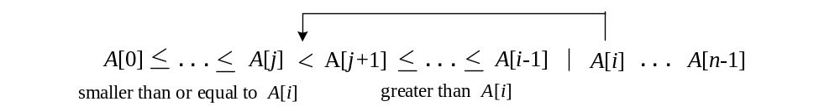

Insertion Sort
We have talked about this algorithm before
This is a typical decrease-by-one technique
Assume A[0..i-1] has been sorted, how to achieve the sorted A[0..i]?
Solution: insert the last element A[i] to the right position
Algorithm complexity:

Slide 7
Graph Traversal
Many problems require processing all graph vertices in systematic fashion
Graph traversal algorithms:
  Depth-first search (DFS)
  Breadth-first search (BFS)
They can be treated as decrease-by-one strategy.

Slide 8
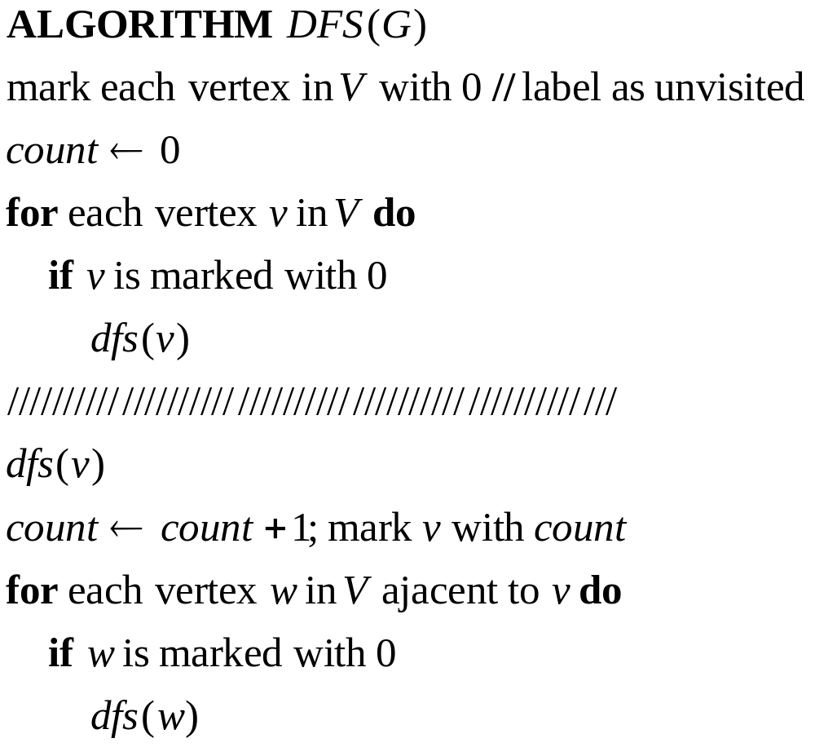
Depth-first search (DFS)
Explore graph always moving away from last visited vertex, similar to preorder tree traversals
Pseudocode for Depth-first-search of graph G=(V,E)

Slide 9
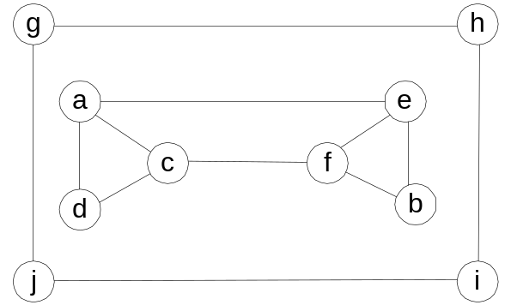
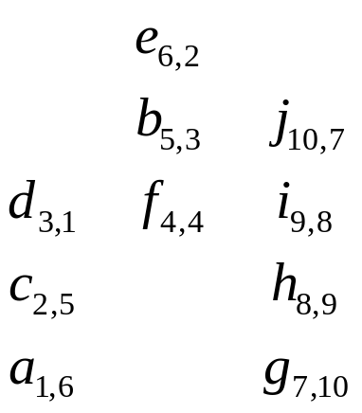
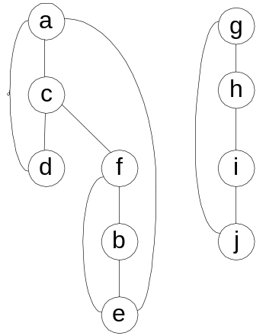
Example – Undirected Graph
Input Graph
(Adjacency matrix / linked list
Stack push/pop
DFS forest
(Tree edge / Back edge)
Notes:
Traversal using alphabetical order of vertices. Work through this example in detail,
showing the traversal by highlighting edges on the graph and showing how the stack
evolves:
8 h 3
7 d 4 stack shown growing upwards
4 e 1 6 c 5 number on left is order that vertex was pushed onto stack
3 f 2 5 g 6 number on right is order that vertex was popped from stack
2 b 7 overlap is because after e, f are popped off stack, g and c
1 a 8 are pushed onto stack in their former locations.
order pushed onto stack: a b f e g c d h
order popped from stack: e f h d c g b a
* show dfs tree as it gets constructed, back edges

Slide 10
Example – Directed Graph (Digraph)
a
b
c
d
e
f
g
h
DFS forest may also contain forward edges: edges to descendants (digraphs only) and cross edges (all the edges that are not tree/back/forward edges)

Slide 11
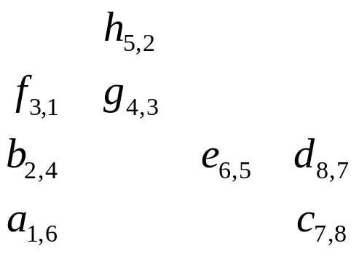
DFS Forest and Stack
a
c
b
e
d
f
g
Stack push/pop
h

Slide 12
DFS: Notes
DFS can be implemented with graphs represented as:
  Adjacency matrices: Θ(V²)
  Adjacency linked lists: Θ(V+E)
Yields two distinct ordering of vertices:
  preorder: as vertices are first encountered (pushed onto stack)
  postorder: as vertices become dead-ends (popped off stack)
Applications:
  checking connectivity, finding connected components
  checking acyclicity
  searching state-space of problems for solution (AI)

Slide 13
Problem 3
Design a decrease-by-one algorithm for generating power set of a set of n elements.
{a, b, c}
{} {a} {b} {c} {ab} {ac} {bc} {a b c}

