Slide 1
CSCE350 Algorithms and Data Structure
Lecture 13
Jianjun Hu
Department of Computer Science and Engineering
University of South Carolina
2009.10.

Slide 2
Problem 3
Design a decrease-by-one algorithm for generating power set of a set of n elements.
{a, b, c}
{} {a} {b} {c} {ab} {ac} {bc} {a b c}
==={a,b}
{} {a} {b} {ab}
==={a, b, c}
{c} {ac} {bc} {abc} -----< added when solving {a, b, c}

Slide 3
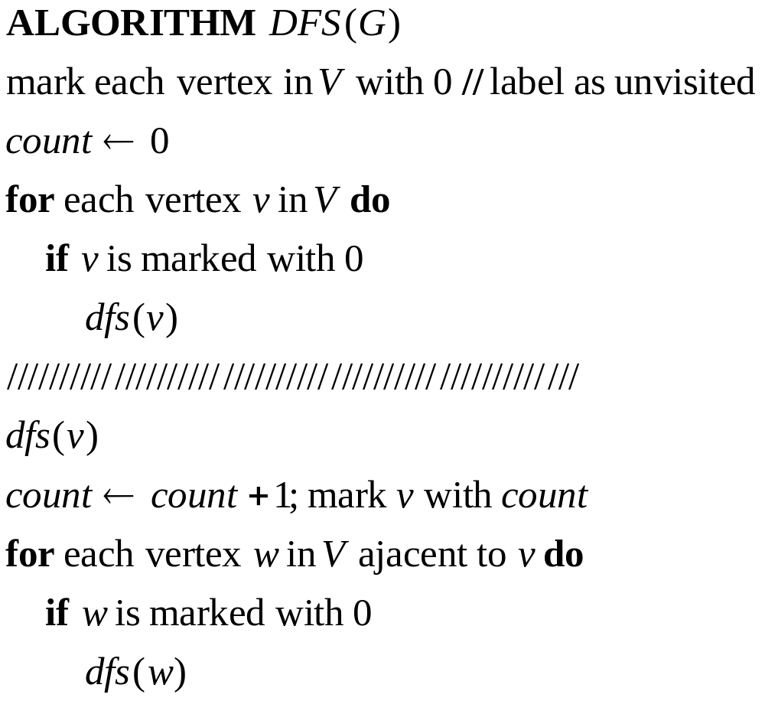
Depth-first search (DFS)
Explore graph always moving away from last visited vertex, similar to preorder tree traversals
Pseudocode for Depth-first-search of graph G=(V,E)

Slide 4
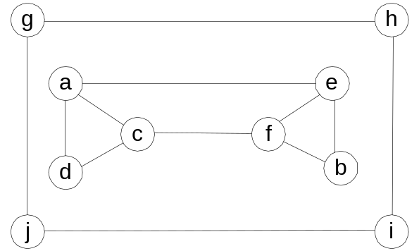
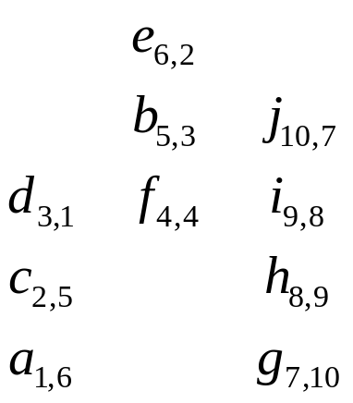
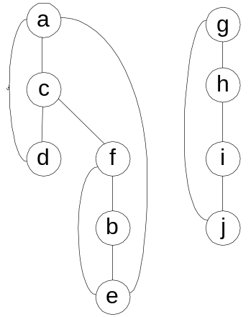
Example – Undirected Graph
Input Graph
(Adjacency matrix / linked list
Stack push/pop
DFS forest
(Tree edge / Back edge)
Notes:
Traversal using alphabetical order of vertices. Work through this example in detail,
showing the traversal by highlighting edges on the graph and showing how the stack
evolves:
8 h 3
7 d 4 stack shown growing upwards
4 e 1 6 c 5 number on left is order that vertex was pushed onto stack
3 f 2 5 g 6 number on right is order that vertex was popped from stack
2 b 7 overlap is because after e, f are popped off stack, g and c
1 a 8 are pushed onto stack in their former locations.
order pushed onto stack: a b f e g c d h
order popped from stack: e f h d c g b a
* show dfs tree as it gets constructed, back edges

Slide 5
Example – Directed Graph (Digraph)
a
b
c
d
e
f
g
h
DFS forest may also contain forward edges: edges to descendants (digraphs only) and cross edges (all the edges that are not tree/back/forward edges)

Slide 6
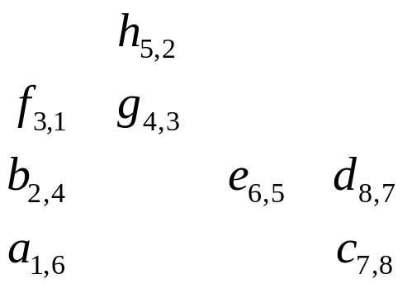
DFS Forest and Stack
a
c
b
e
d
f
g
Stack push/pop
h

Slide 7
DFS: Notes
DFS can be implemented with graphs represented as:
  Adjacency matrices: Θ(V²)
  Adjacency linked lists: Θ(V+E)
Yields two distinct ordering of vertices:
  preorder: as vertices are first encountered (pushed onto stack)
  postorder: as vertices become dead-ends (popped off stack)
Applications:
  checking connectivity, finding connected components
  checking acyclicity
  searching state-space of problems for solution (AI)

Slide 8
Breadth-First Search (BFS)
Explore graph moving across to all the neighbors of last visited vertex
Similar to level-by-level tree traversals
Instead of a stack (LIFO), breadth-first uses queue (FIFO)
Applications: same as DFS

Slide 9
BFS algorithm
  bfs(v)
  count ← count + 1
  mark v with count
  initialize queue with v
  while queue is not empty do
    a ← front of queue
    for each vertex w adjacent to a do
      if w is marked with 0
        count ←count + 1
        mark w with count
        add w to the end of the queue
    remove a from the front of the queue
  BFS(G)
  count ← 0
  mark each vertex with 0
  for each vertex v in V do
  if v is marked with 0
  bfs(v)

Slide 10
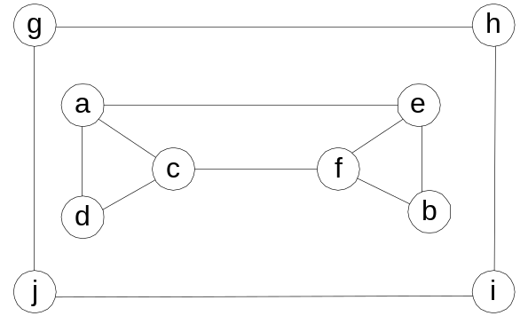
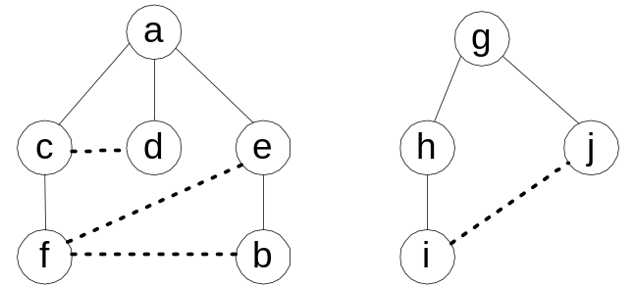
BFS Example – undirected graph
Input Graph
(Adjacency matrix / linked list
BFS forest
(Tree edge / Cross edge)
Queue

Slide 11
Example – Directed Graph
a
b
c
d
e
f
g
h
BFS traversal:

Slide 12

BFS Forest and Queue
a
c
b
e
f
d
g
BFS forest
Queue
h

Slide 13
Breadth-first search: Notes
BFS has same efficiency as DFS and can be implemented with graphs represented as:
  Adjacency matrices: Θ(V²)
  Adjacency linked lists: Θ(V+E)
Yields single ordering of vertices (order added/deleted from queue is the same)

Slide 14
Directed Acyclic Graph (DAG)
A directed graph with no cycles
Arise in modeling many problems, eg:
  prerequisite structure
  food chains
A digraph is a DAG if its DFS forest has no back edge.
Imply partial ordering on the domain

Slide 15
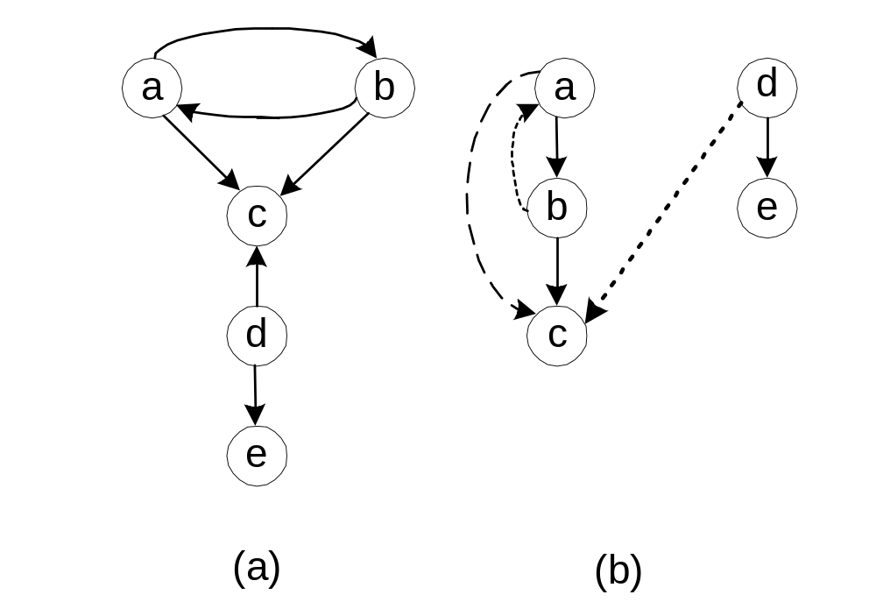
Example:

Slide 16
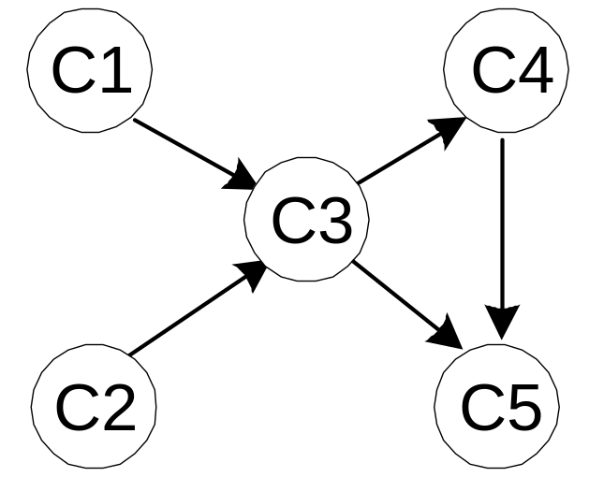
Topological Sorting
Problem: find a total order consistent with a partial order
Example:
Five courses has the prerequisite relation shown in the left. Find the right order to take all of them sequentially
Note: problem is solvable iff graph is dag
Notes:
The significance of topological sorting is not brought out in this whimsical example,
so it is important to introduce it with a sort of disclaimer and point out the importance
of the topological sorting problem. On the other hand, it is more fun to go over this
kind of example in class, because you can’t help feeling involved when your turn
of getting eaten is being deliberated!
It is a good idea to go over the solution using both algorithms and show that you
get a different solution. Using alphabetical order to break ties:
dfs-based algorithm: traversal yields the components (order popped from stack):
tiger- human- fish
shrimp-plankton
sheep
wheat
reversing the order we obtain the topological sorting:
wheat sheep plankton shrimp fish human tiger
2) source removal algorithm:
plankton shrimp fish wheat sheep human tiger

Slide 17
Topological Sorting Algorithms
DFS-based algorithm:
  DFS traversal: note the order with which the vertices are popped off stack (dead end)
  Reverse order solves topological sorting
  Back edges encountered?→ NOT a DAG!
Source removal algorithm
  Repeatedly identify and remove a source vertex, ie, a vertex that has no incoming edges
Both Θ(V+E) using adjacency linked lists

Slide 18
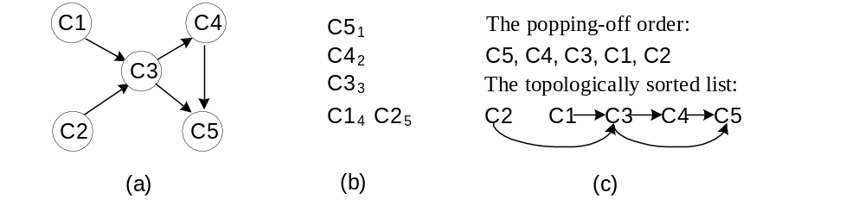
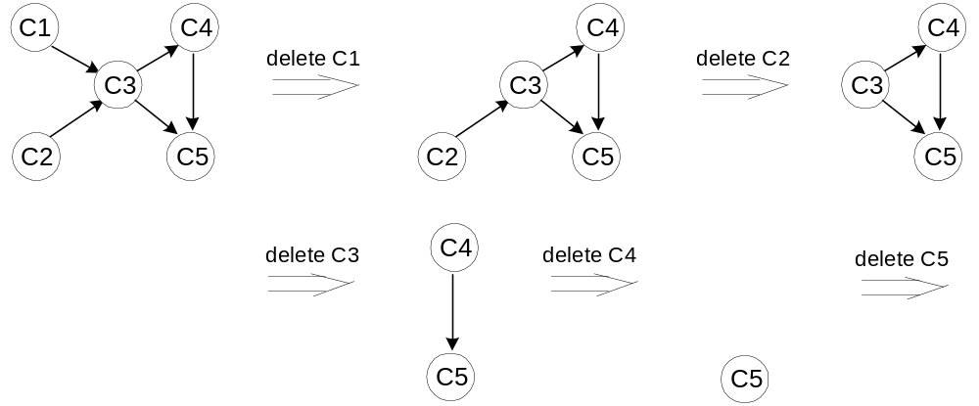
An Example

Slide 19
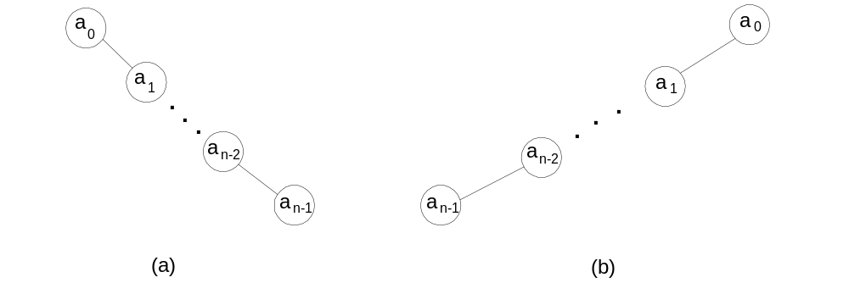
Variable-Size-Decrease: Binary Search Trees
Arrange keys in a binary tree with the binary search tree property:
Example 1: 5, 10, 3, 1, 7, 12, 9
Example 2: 4, 5, 7, 2, 1, 3, 6
k
<k
>k

Slide 20
Searching and insertion in binary search trees
Searching – straightforward
Insertion – search for key, insert at leaf where search terminated
All operations: worst case # key comparisons = h + 1
lg n ≤ h ≤ n – 1 with average (random files) 1.41 lg n
Thus all operations have:
  worst case: Θ(n)
  average case: Θ(lgn)
Bonus: inorder traversal produces sorted list (treesort)
Notes:
1.41 lg n = 2 ln n

Slide 21
Finding Kth smallest number
Sort and check
Smarter algorithm using idea from Quick sort
p
A[i] ≤ p
A[i] p
s
If s<K, then we search right half
Otherwise, we search left half

Slide 22
Next Class
Balanced trees (Transform-and-Conquer)

