Slide 1
Important Problem Types and Fundamental Data Structures
CSCE350 Algorithms and Data Structures
Department of Computer Science and Engineering
http://mleg.cse.sc.edu/edu/csce350
Important problems types
  Sorting, searching, string processing, graph problems
Fundamental data structures
  Linear data structures
  Stacks, queues, and heaps
  Graphs
  Trees
University of South Carolina

Slide 2
Expected Outcomes
Student should be able to
  List the various problem types and their meanings
  Explain each data structures introduced in the lecture

Slide 3
Sorting
Rearrange the items of a given list in ascending/descending order.
  Input: A sequence of n numbers <a₁, a₂, …, a_{n}>
  Output: A reordering <a´₁, a´₂, …, a´_{n}> of the input sequence such that a´₁≤ a´₂ ≤ … ≤ a´_{n.}
Why sorting?
  Help searching
  Algorithms often use sorting as a key subroutine.
Sorting key
  A specially chosen piece of information used to guide sorting. I.e., sort student records by names.

Slide 4
Sorting
Examples of sorting algorithms
  Bubble sort
  Selection sort
  Insertion sort
  Merge sort
  Quick sort
  Heap sort …
Evaluate sorting algorithm complexity: the number of key comparisons.
Two properties
  Stability: A sorting algorithm is called stable if it preserves the relative order of any two equal elements in its input.
  In place : A sorting algorithm is in place if it does not require extra memory, except, possibly for a few memory units.

Slide 5
Searching
Find a given value, called a search key, in a given set.
Examples of searching algorithms
  Sequential searching
  Binary searching…

Slide 6
String Processing
A string is a sequence of characters from an alphabet.
Text strings: letters, numbers, and special characters.
String matching: searching for a given word/pattern in a text.
String alignment:
  ACCTCTC
  A_CTCNC

Slide 7
Graph Problems
Informal definition
  A graph is a collection of points called vertices, some of which are connected by line segments called edges.
Modeling real-life problems
  Modeling WWW
  communication networks
  Project scheduling …
Examples of graph algorithms
  Graph traversal algorithms
  Shortest-path algorithms
  Topological sorting

Slide 8
Other algorithm problems
Combinatorial problems
  Find a combinatorial object: permutation, combination, subset that satisfies constraints and objectives
Geometric problems
  Closest-pair problem: given n points in the plane, find the closest pair
Numerical problems
  Solving equations
Department of Computer Science and Engineering, USC

Slide 9
Data Structures for Algorithms
Lists
Graphs
Trees
Sets and dictionaries
Department of Computer Science and Engineering, USC

Slide 10
Linear Data Structures
Arrays
  A sequence of n items of the same data type that are stored contiguously in computer memory and made accessible by specifying a value of the array’s index.
Linked List
  A sequence of zero or more nodes each containing two kinds of information: some data and one or more links called pointers to other nodes of the linked list.
  Singly linked list (next pointer)
  Doubly linked list (next + previous pointers)
Arrays
  fixed length (need preliminary reservation of memory)
  contiguous memory locations
  direct access
  Insert/delete
Linked Lists
  dynamic length
  arbitrary memory locations
  access by following links
  Insert/delete

Slide 11
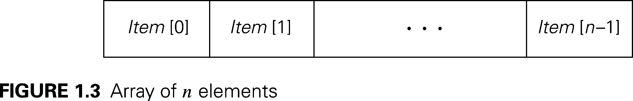
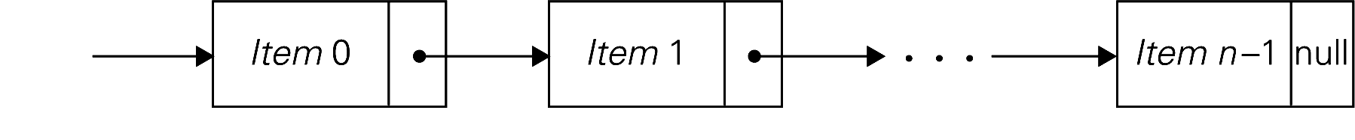
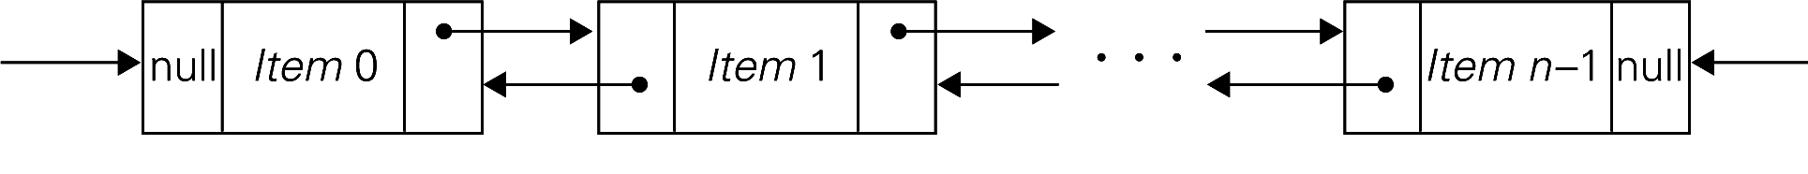
Array of n elements
Singly linked list of n elements
Double linked list of n elements

Slide 12
Stacks, Queues, and Heaps (1)
Stacks
  A stack of plates
    insertion/deletion can be done only at the top.
    LIFO/FILO
  Two operations (push and pop)
Queues
  A queue of customers waiting for services
    Insertion/enqueue from the rear and deletion/dequeue from the front.
    FIFO
  Two operations (enqueue and dequeue)
Application: recursive function to save parameters

Slide 13
Stacks, Queues, and Heaps (2)
Priority queues (implemented using heaps)
  A data structure for maintaining a set of elements, each associated with a key/priority, with the following operations
    Finding the element with the highest priority
    Deleting the element with the highest priority
    Inserting a new element
  Scheduling jobs on a shared computer.

Slide 14
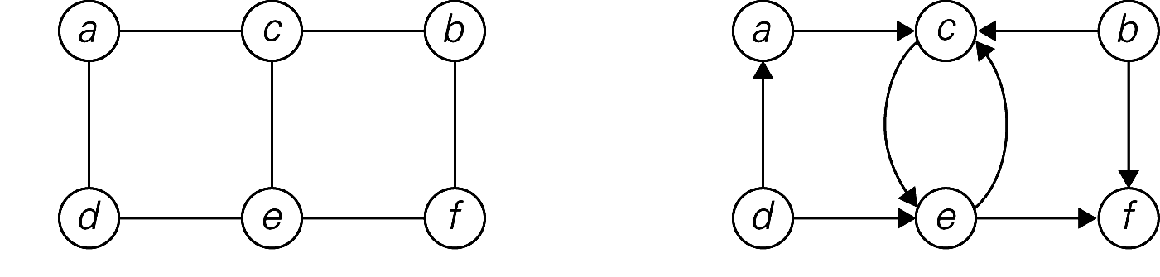
Graphs
Formal definition
  A graph G = <V, E> is defined by a pair of two sets: a finite set V of items called vertices and a set E of vertex pairs called edges.
Undirected and directed graphs (digraph).
What’s the maximum number of edges in an undirected graph with |V| vertices?
Complete, dense, and sparse graph
  A graph with every pair of its vertices connected by an edge is called complete. K_{|V|}
(a)
(b)

Slide 15
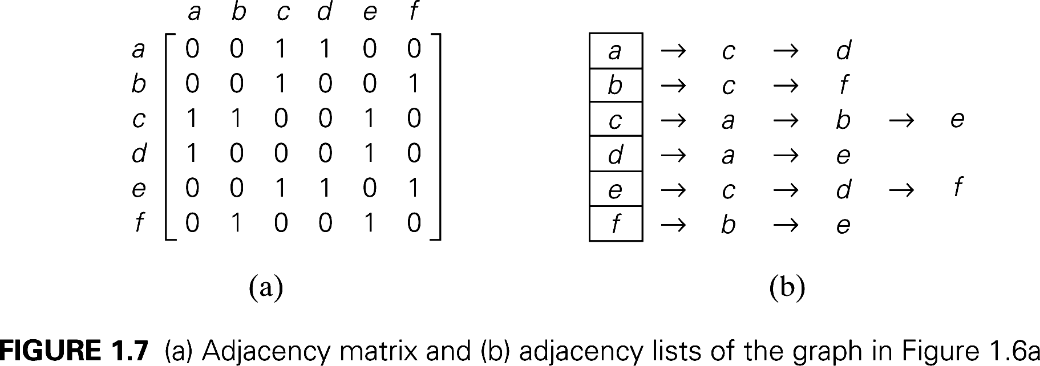

Graph Representation
Adjacency matrix
  n x n boolean matrix if |V| is n.
  The element on the ith row and jth column is 1 if there’s an edge from ith vertex to the jth vertex; otherwise 0.
  The adjacency matrix of an undirected graph is symmetric.
Adjacency linked lists
  A collection of linked lists, one for each vertex, that contain all the vertices adjacent to the list’s vertex.
Which data structure would you use if the graph is a 100-node star shape?

Slide 16
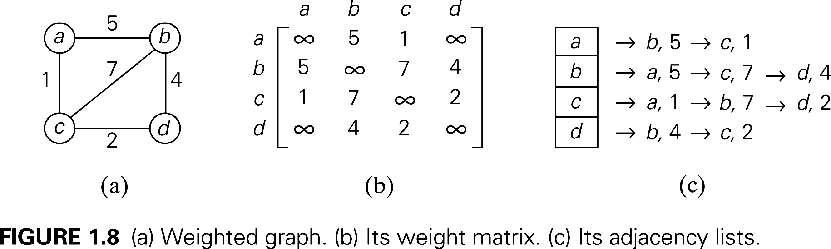
Weighted Graphs
Weighted graphs
  Graphs or digraphs with numbers assigned to the edges.

Slide 17
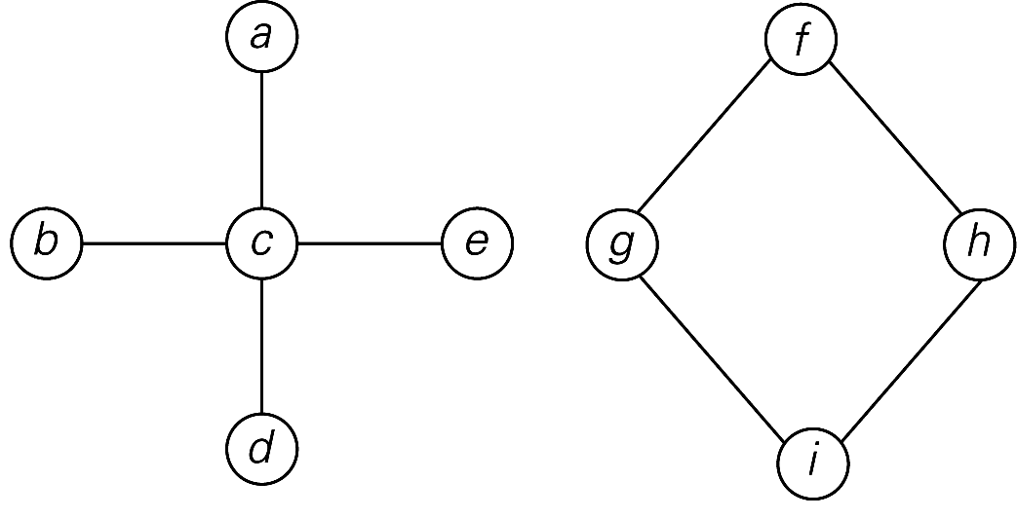
Graph Properties -- Paths and Connectivity
Paths
  A path from vertex u to v of a graph G is defined as a sequence of adjacent (connected by an edge) vertices that starts with u and ends with v.
  Simple paths: All edges of a path are distinct.
  Path lengths: the number of edges, or the number of vertices – 1.
Connected graphs
  A graph is said to be connected if for every pair of its vertices u and v there is a path from u to v.
Connected component
  The maximum connected subgraph of a given graph.
Graph that is not connected
Notes:
Examples of a simple path and a not simple path.
Connected graphs: starting from any vertex, we can always find a path to reach all the other vertices. (Ball-String example.)
From NIST:
Connected graphs:
Definition: An undirected graph that has a path between every pair of vertices.
Strongly connected graphs:
Definition: A directed graph that has a path from each vertex to every other vertex.
Connected component: …
Strongly connected component:
a strongly connected component of a digraph G is a maximal strongly connected subgraph of G.

Slide 18
Graph Properties -- Acyclicity
Cycle
  A simple path of a positive length that starts and ends a the same vertex.
Acyclic graph
  A graph without cycles
  DAG (Directed Acyclic Graph)

Slide 19
Trees
Trees
  A tree (or free tree) is a connected acyclic graph.
  Forests: a graph that has no cycles but is not necessarily connected.
Properties of trees
  |E| = |V| - 1
  For every two vertices in a tree there always exists exactly one simple path from one of these vertices to the other. Why?
    Rooted trees: The above property makes it possible to select an arbitrary vertex in a free tree and consider it as the root of the so-called rooted tree.
    Levels of rooted tree.

Slide 20
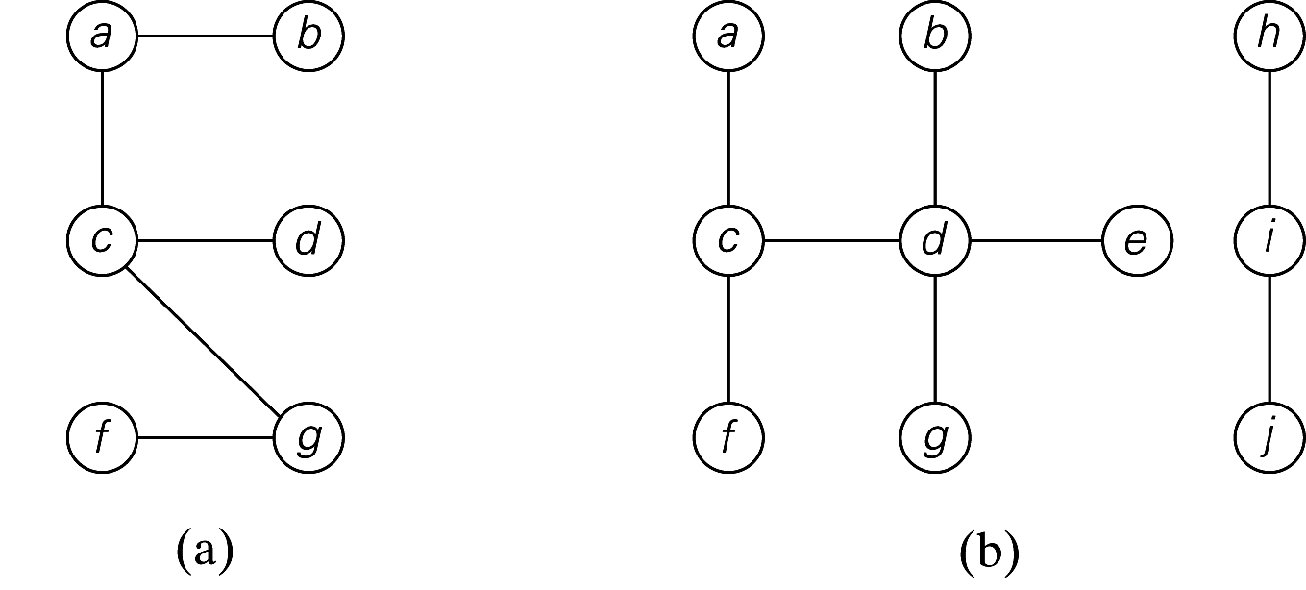
A tree and a forest

Slide 21
Rooted Trees
ancestors
  For any vertex v in a tree T, all the vertices on the simple path from the root to that vertex are called ancestors.
descendants
  All the vertices for which a vertex v is an ancestor are said to be descendants of v.
parent, child and siblings
  If (u, v) is the last edge of the simple path from the root to vertex v (and u ≠ v), u is said to be the parent of v and v is called a child of u.
  Vertices that have the same parent are called siblings.
Leaves
  A vertex without children is called a leaf.
Subtree
  A vertex v with all its descendants is called the subtree of T rooted at v.

Slide 22
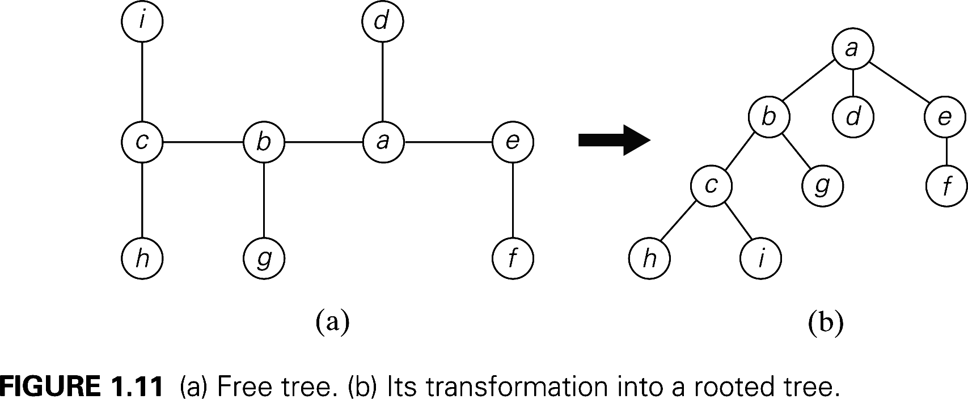
Transformation of a free tree into a rooted tree

Slide 23
Trees
Depth of a vertex
  The length of the simple path from the root to the vertex.
Height of a tree
  The length of the longest simple path from the root to a leaf.

Slide 24
Ordered Trees
Ordered trees
  An ordered tree is a rooted tree in which all the children of each vertex are ordered.
Binary trees
  A binary tree is an ordered tree in which every vertex has no more than two children and each children is designated as either a left child or a right child of its parent.
Binary search trees
  Each vertex is assigned a number.
  A number assigned to each parental vertex is larger than all the numbers in its left subtree and smaller than all the numbers in its right subtree.
⎣log₂n⎦ ≤ h ≤ n – 1, where h is the height of a binary tree.

Slide 25
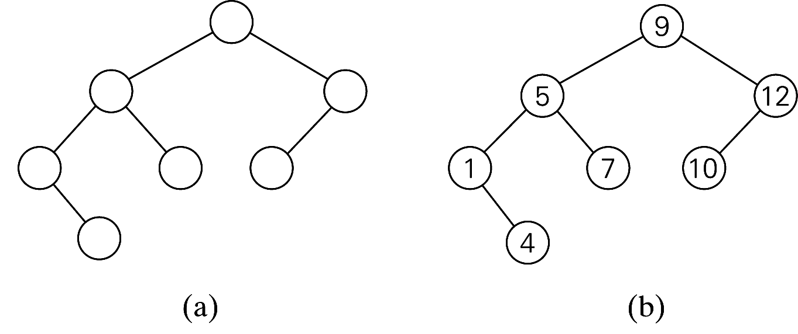
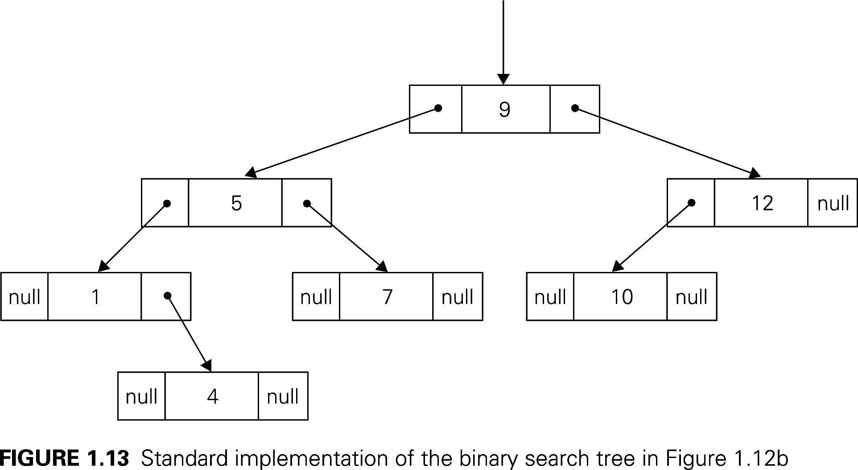
A binary tree and a binary search tree
Standard implementation of (b)

Slide 26
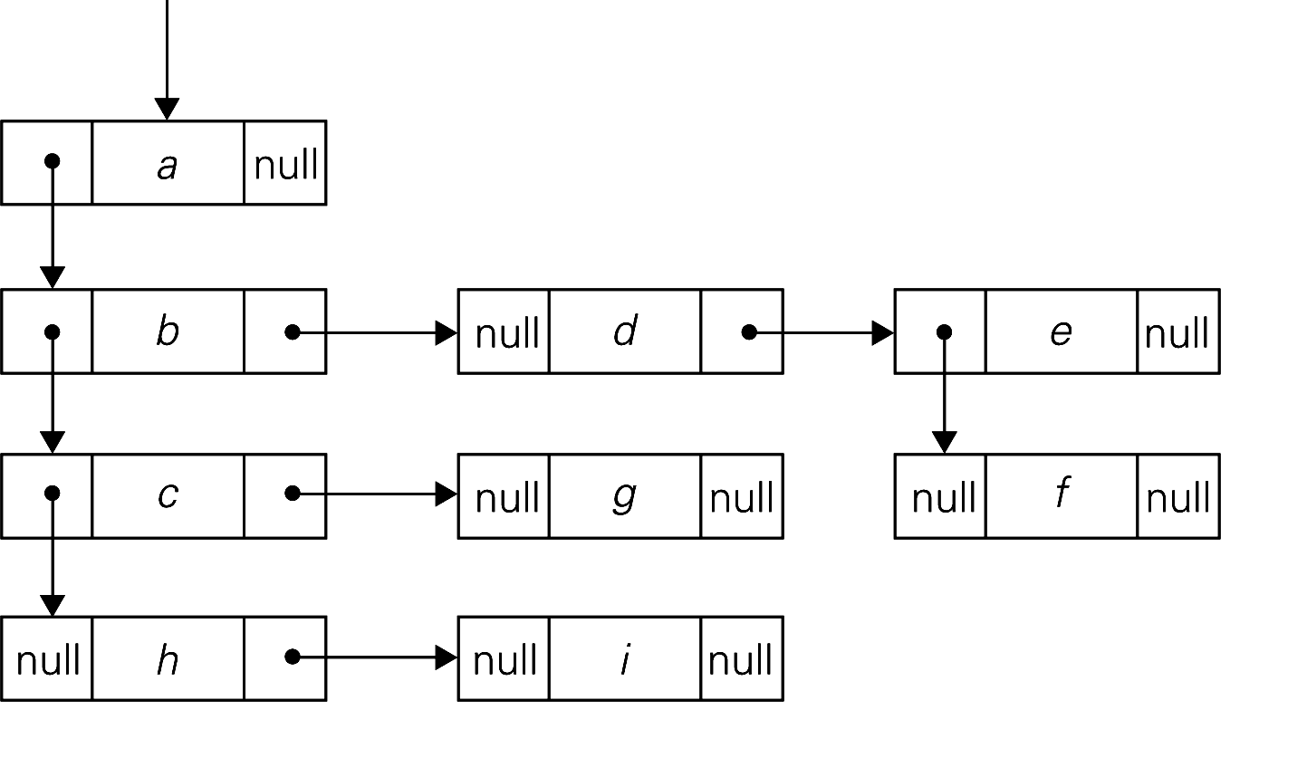
A rooted tree and its first child-next sibling representation

Slide 27
Sets and Dictionaries
Set---union, intersection
Multi-set/Bag
Dictionary: search for a given item, add new item, delete item
Department of Computer Science and Engineering, USC

