Slide 1
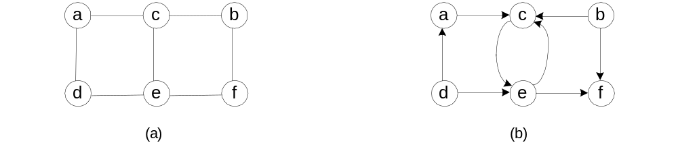
Last Class: Graph
Undirected and directed (digraph): G=<V,E>, vertex and edge
Adjacency matrix and adjacency linked list
a
c
d
0 0 1 1 0 0
0 0 1 0 0 1
1 1 0 0 1 0
1 0 0 0 1 0
0 0 1 1 0 1
0 1 0 0 1 0
b
c
f
c
a
b
e
d
a
e
e
c
d
f
f
b
e

Slide 2
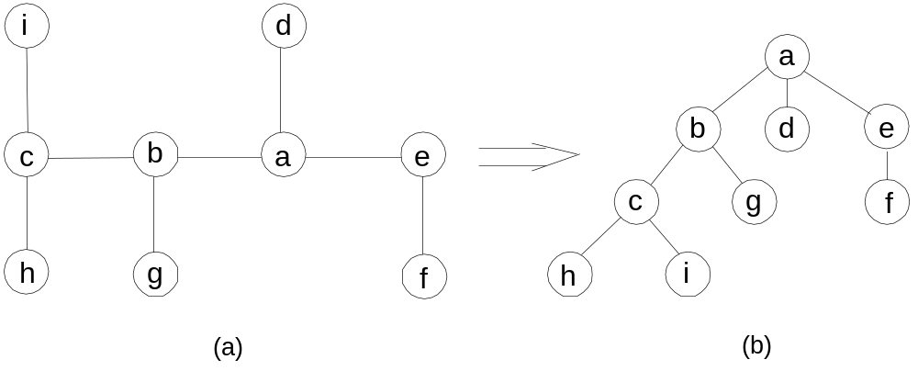
Tree
Free tree → rooted tree
Depth of a vertex (path-length to the root)
Height of a tree (longest-path-length from the root to the leaf)

Slide 3
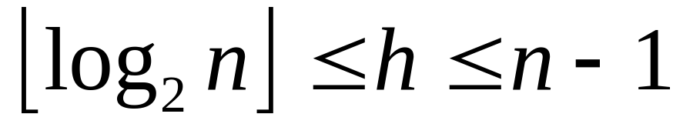
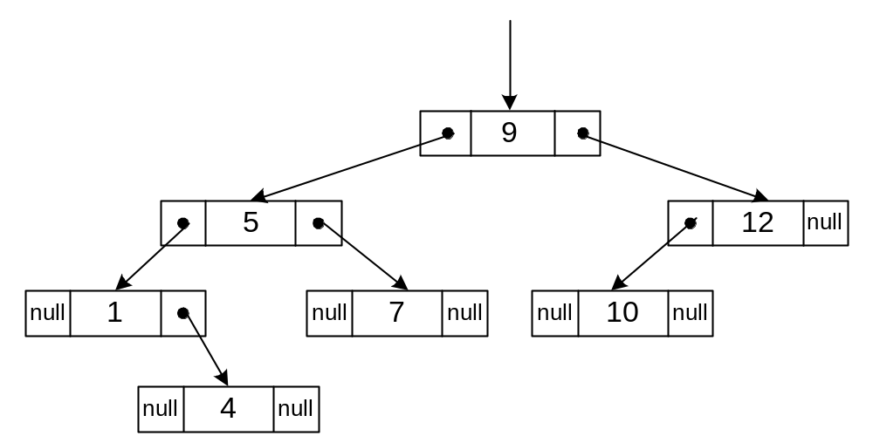
Binary Search Tree

Slide 4
Today 1: Pseudocode
A mixture of natural language and programming language constructs
“structured English for describing algorithms”
“simplified, half-English, half-code outline of a computer program”
________________________________
An algorithm is a sequence of steps taken to solve a problem.

Slide 5
Definition
pseudo –
  prefix, meaning “similar”
Pseudocode should not resemble any particular programming language
  ignore syntax and particulars of a language
  structured, formalized, condensed English
You can design solutions without knowing a programming language

Slide 6
Basic Constructs
SEQUENCE one task is perfomed sequentially after another
IF-THEN-ELSE decision between two alternative courses of action
CASE multiway branch decision based on value of an expression
WHILE loop with conditional test at beginning
FOR loop for counting loops
REPEAT-UNTIL loop with conditional test at bottom of loop

Slide 7
Common Action Keywords
Input: READ, OBTAIN, GET
Output: PRINT, DISPLAY, SHOW
Compute: COMPUTE, CALCULATE, DETERMINE
Initialize: SET, INIT
Add One: INCREMENT, ADD one
Call subroutine
In our textbook, we use indentation to show scope of blocks of for, if, and while
We use //this is …
for comments, same as in C++

Slide 8
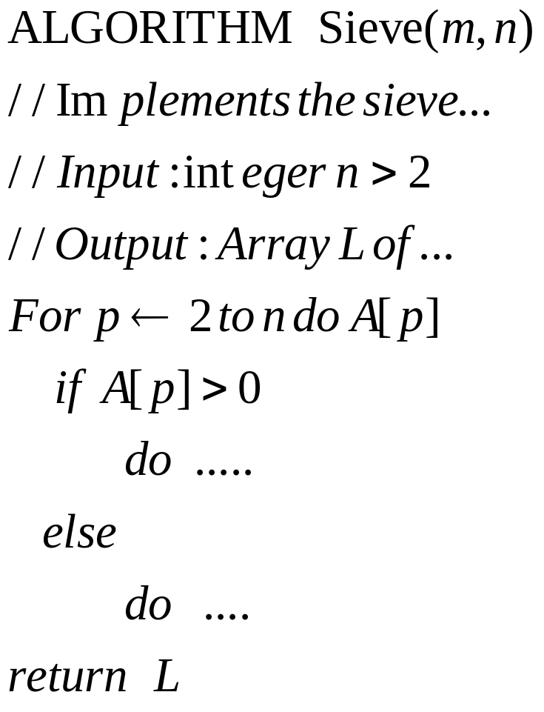
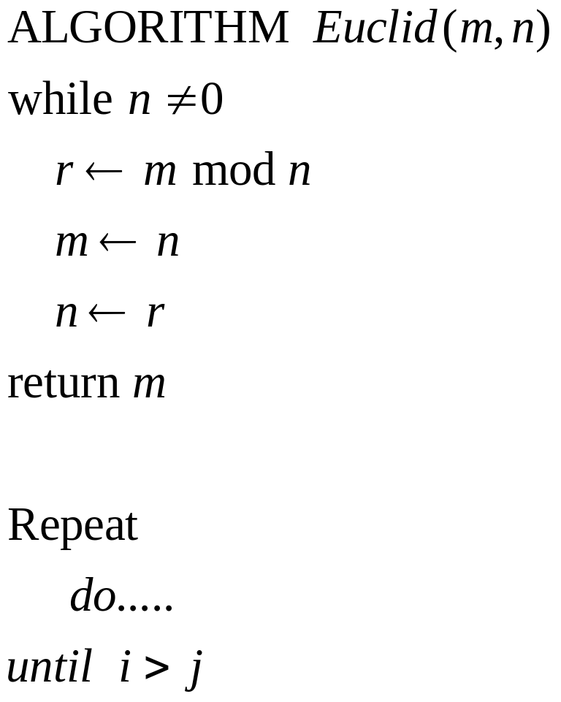
Pseudocode examples

Slide 9
CASE Example
CASE Title OF
Mr : Print “Mister”
Mrs : Print “Missus”
Miss : Print “Miss”
Dr : Print “Doctor”
OTHERS : Print “M.”

Slide 10
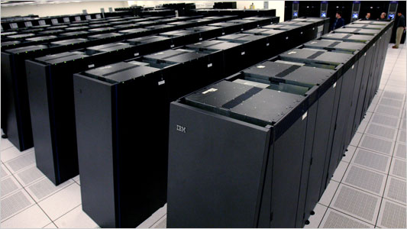
Do we need to care about running time of our program?

Slide 11
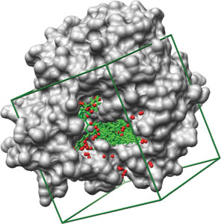
Real-world computing problems are challenging
Anybody has a program running days?
Real-world problem:
  Large data
  Complex computation/simulation
  Many repetitions: monte carlo simulation
Drug design: select 10 drug candidates out of 8 millions molecules…
  Each comparison takes 5 minute,
  CEC have 100 cpus
  Total running time: 277 days! Give up….

Slide 12
Today: Theoretical Analysis of Time Efficiency
Time efficiency is analyzed by determining the number of repetitions of the basic operation as a function of input size n
Basic operation: the operation that contributes most towards the running time of the algorithm.
T(n) ≈ c_{op}C(n)
input size
running time
execution time
for basic operation
Number of times basic operation is executed

Slide 13
Input size and basic operation examples
Problem | Input size measure | Basic operation
Search for key in list of n items | Number of items in list n | Key comparison
Multiply two matrices of floating point numbers | Dimensions of matrices | Floating point multiplication
Compute a^{n} | n | Floating point multiplication
Graph problem | #vertices and/or edges | Visiting a vertex or traversing an edge
Notes:
regarding a^{n} point out that the input size measure is more properly measured by
number of bits:
b= ⌊log₂ n⌋ + 1
Graph problems are mentioned here just to give me an opportunity to discuss
them in general. Typically this will depend on graph representation and the specific
problem.

Slide 14
Best-case, Average-case, Worst-case
For some algorithms efficiency depends on type of input:
Worst case: W(n) – maximum over inputs of size n
Best case: B(n) – minimum over inputs of size n
Average case: A(n) – “average” over inputs of size n
  Number of times the basic operation will be executed on typical input
  NOT the average of worst and best case
  Expected number of basic operations repetitions considered as a random variable under some assumption about the probability distribution of all possible inputs of size n

Slide 15
Sequential Search Algorithm
ALGORITHM SequentialSearch(A[0..n-1], K)
//Searches for a given value in a given array by sequential search
//Input: An array A[0..n-1] and a search key K
//Output: Returns the index of the first element of A that matches K or –1 if there are no matching elements
i ←0
while i < n and A[i] ‡ K do
i ← i + 1
if i < n //A[I] = K
return i
else
return -1

Slide 16
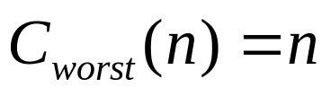
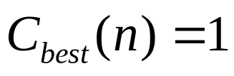
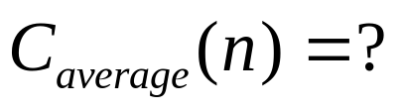
Example: Sequential Search
Problem: Given a list of n elements and a search key K, find an element equal to K, if any.
Algorithm: Scan the list and compare its successive elements with K until either a matching element is found (successful search) of the list is exhausted (unsuccessful search)
Worst case
Best case
Average case

Slide 17
Types of formulas for basic operation count
Exact formula
e.g., C(n) = n(n-1)/2
Formula indicating order of growth with specific multiplicative constant
e.g., C(n) ≈ 0.5 n²
Formula indicating order of growth with unknown multiplicative constant
e.g., C(n) ≈ cn²

Slide 18
Summary of the Analysis Framework
Both time and space efficiencies are measured as functions of input size.
Time efficiency is measured by counting the number of basic operations executed in the algorithm. The space efficiency is measured by the number of extra memory units consumed.
The framework’s primary interest lies in the order of growth of the algorithm’s running time (space) as its input size goes infinity.
The efficiencies of some algorithms may differ significantly for inputs of the same size. For these algorithms, we need to distinguish between the worst-case, best-case and average case efficiencies.
Copyright  Li Zimao @ 2007-2008-1 SCUEC

Slide 19
Order of growth
Most important: Order of growth within a constant multiple as n→∞
Example:
  How much faster will algorithm run on computer that is twice as fast?
  How much longer does it take to solve problem of double input size?
See table 2.1
Notes:
Example: cn²
how much faster on twice as fast computer? (2)
how much longer for 2n? (4)

Slide 20
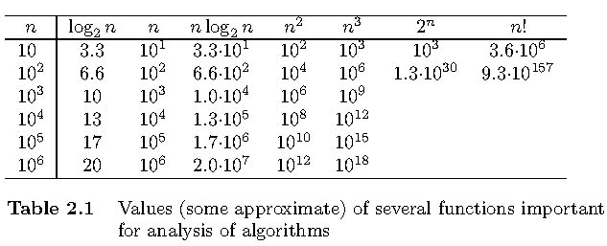
Table 2.1

Slide 21
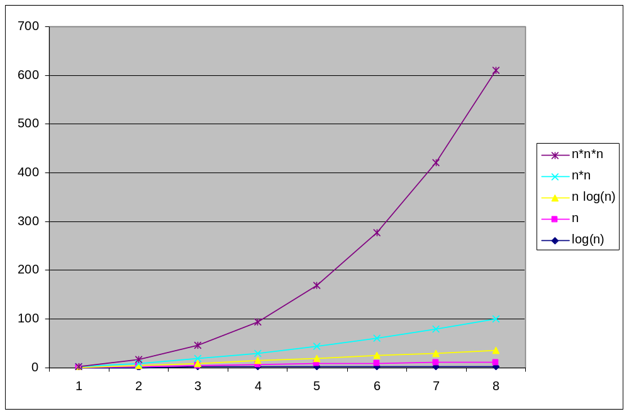

Slide 22
Sample Run Time – Importance of Algorithm Design
n | ALPHA 21164A, C, Cubic Alg. (n³) | TRS-80, BASIC, Linear Alg. (n)
10 | 0.6 microsecs | 200 millisecs
100 | 0.6 millisecs | 2.0 secs
1000 | 0.6 secs | 20 secs
10,000 | 10 mins | 3.2 mins
100,000 | 7 days | 32 mins
1,000,000 | 19 yrs | 5.4 hrs

Slide 23
Asymptotic Growth Rate
A way of comparing functions that ignores constant factors and small input sizes
O(g(n)): class of functions f(n) that grow no faster than g(n)
Θ (g(n)): class of functions f(n) that grow at same rate as g(n)
Ω(g(n)): class of functions f(n) that grow at least as fast as g(n)
t(n)<=c g(n) for all n>=n0
c2g(n)<=t(n)<=c1 g(n) for all n>=n0
t(n)>=c g(n) for all n>=n0

Slide 24
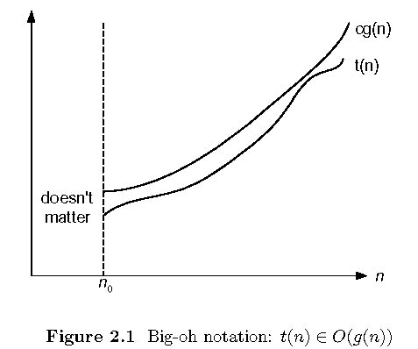
Big-oh

Slide 25
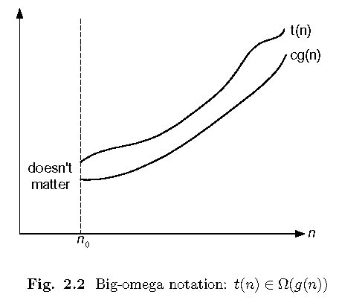
Big-omega

Slide 26
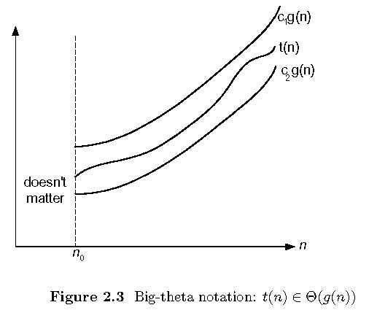
Big-theta

Slide 27
Establishing rate of growth: Method 1
Using mathemtical proof by definition
100 n+5 ∈ O (n^2)
100n+5<=100n+n for all n>=5
100n+5<=100n+n=101n <=101 n^2 = c. n^2
Exercises: prove the following using the above definition
  10n² ∈ O(n²)
  10n² + 2n ∈ O(n²)
  100n + 5 ∈ O(n²)
  5n+20 ∈ O(n)
  10n² ∈ Ω(n²)
  10n² + 2n ∈ Ω(n²)
  10n³ ∈ Ω(n²)
  10n² ∈ Θ(n²)
  10n² + 2n ∈ Θ(n²)
  (1/2)n(n-1) ∈ Θ(n²)

Slide 28
Establishing rate of growth: Method 2
– using limits
0 order of growth of T(n) ___ order of growth of g(n)
c>0 order of growth of T(n) ___ order of growth of g(n)
lim_{n→∞} T(n)/g(n) =
∞ order of growth of T(n) ___ order of growth of g(n)
Examples:
10n vs. 2n²
n(n+1)/2 vs. n²
log_{b} n vs. log_{c} n (b>c>1)
Notes:
Instert <, =, > in the ____ spaces respectively as you discuss the intuition behind it.
For last example remind students of the formula:
log_{b}n = log_{c}n / log_{c}b

Slide 29
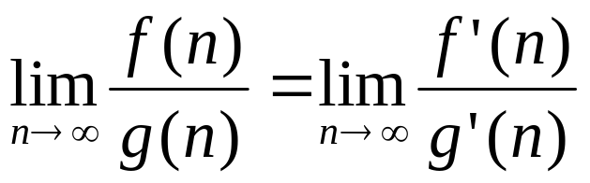
L’Hôpital’s Rule
If
lim_{n→∞} f(n) = lim_{n→∞} g(n) = ∞
The derivatives f´, g´ exist,
Then
Example:
logn vs n
2^{n} vs. n!
Example:
log₂n vs. n
2^{n} vs. n!
Stirling’s formula: n! ≈ (2πn)^{1/2} (n/e)^{n}

