Slide 1
CSCE350 Algorithms and Data Structure
Lecture 4
Jianjun Hu
Department of Computer Science and Engineerintg
University of South Carolina
2009.9.

Slide 2
Outline
Review of last lecture
Properties of Asymptotic classes
Asymptotic classes of time/space complexity
How to analyze the Time Efficiency of non-recursive algorithms

Slide 3
Last Lecture: Theoretical Analysis of Time Efficiency
Time efficiency is analyzed by determining the number of repetitions of the basic operation as a function of input size
Basic operation: the operation that contributes most towards the running time of the algorithm.
T(n) ≈ c_{op}C(n)
input size
running time
execution time
for basic operation
Number of times basic operation is executed

Slide 4
Asymptotic Growth Rate
A way of comparing functions that ignores constant factors and small input sizes
O(g(n)): class of functions f(n) that grow no faster than g(n)
Θ (g(n)): class of functions f(n) that grow at same rate as g(n)
Ω(g(n)): class of functions f(n) that grow at least as fast as g(n)

Slide 5
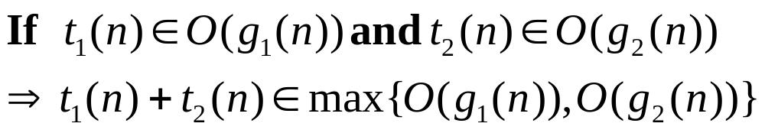
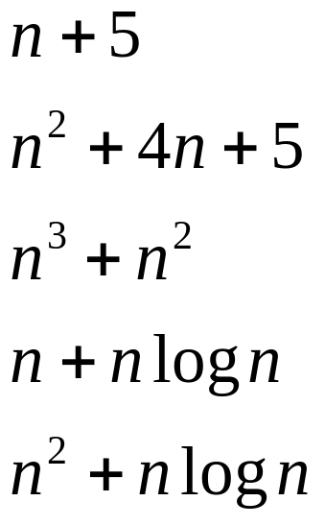
A Useful Property
How about the growth order of

Slide 6
Basic Asymptotic Efficiency Classes
1 | constant
log n | logarithmic
n | linear
n log n | n log n
n² | quadratic
n³ | cubic
2^{n} | exponential
n! | factorial

Slide 7
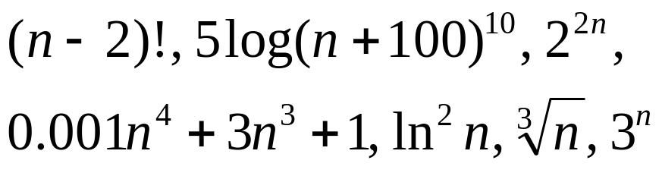
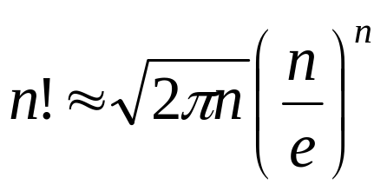
You Should Know How to
sort the different asymptotical efficiency functions, such as Exercise 2.3.5.
A useful formula: Stirling’s formula

Slide 8
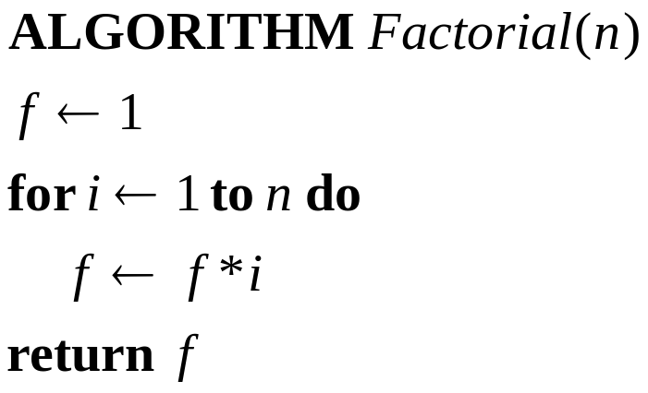
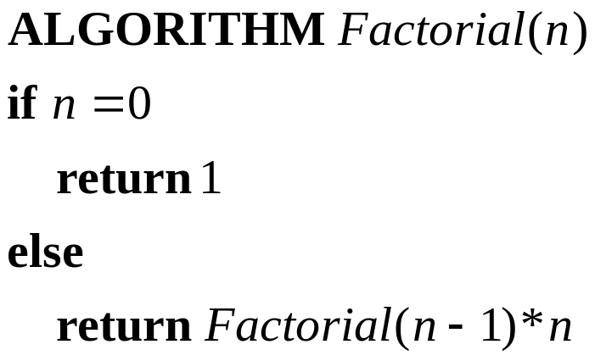
Analyze the Time Efficiency of An Algorithm
Nonrecursive Algorithm
Recursive Algorithm

Slide 9
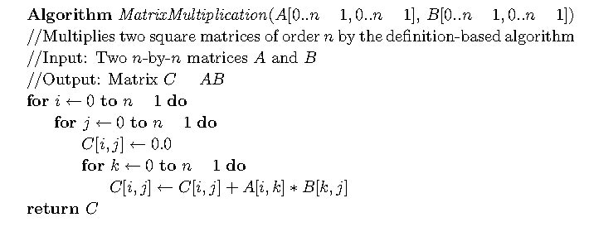
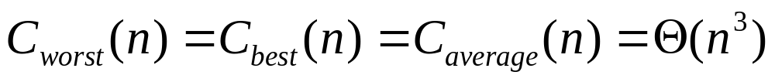
Matrix Multipliacation

Slide 10
Time efficiency of Nonrecursive Algorithms
Steps in mathematical analysis of nonrecursive algorithms:
  Decide on parameter n indicating input size
  Identify algorithm’s basic operation
  Determine worst, average, and best case for input of size n
  Set up summation for C(n) reflecting algorithm’s loop structure
  Simplify summation using standard formulas (see Appendix A)

Slide 11
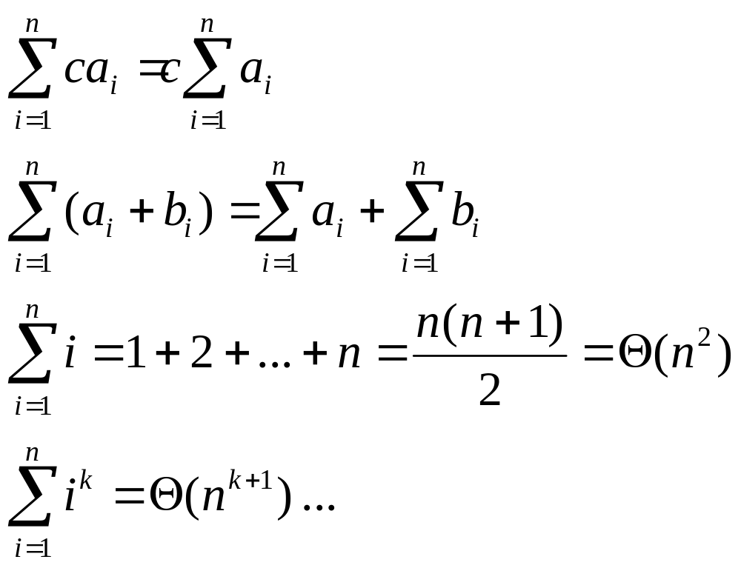
Useful Formulas in Appendix A
Make sure to be familiar with them
Prove by Induction

Slide 12
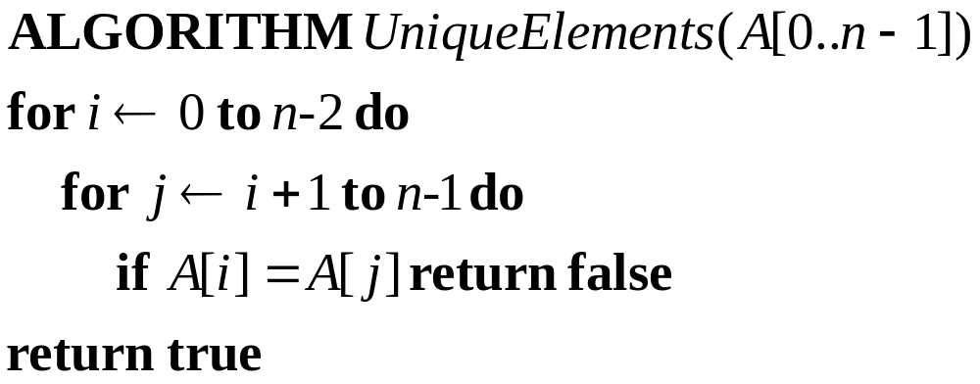
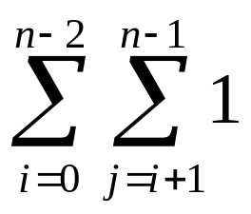
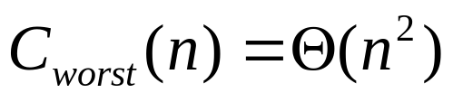
Element Uniqueness
Check whether all the elements in a given array are distinct
  Input: An array A[0…n-1]
  Output: Return “true” if all the elements in A are distinct and “false” otherwise

Slide 13
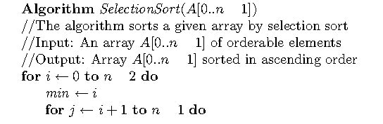

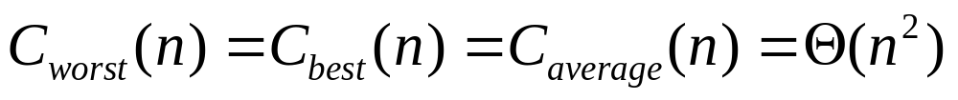
Selection sort

Slide 14
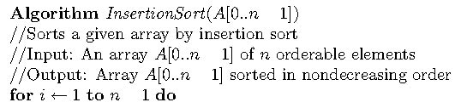
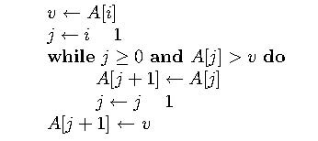
Insertion Sort

Slide 15
Insert Sorting—running time cases
The best case input is an array that is already sorted. In this case insertion sort has a linear running time (i.e., O(n)). During each iteration, the first remaining element of the input is only compared with the right-most element of the sorted subsection of the array.
The worst case input is an array sorted in reverse order. In this case every iteration of the inner loop will scan and shift the entire sorted subsection of the array before inserting the next element. For this case insertion sort has a quadratic running time (i.e., O(n²)).
The average case is also quadratic, which makes insertion sort impractical for sorting large arrays. However, insertion sort is one of the fastest algorithms for sorting arrays containing fewer than ten elements.

Slide 16
Improvement of Insert sorting
Shell sort: two simple variants requiring O(n^{3/2}) and O(n^{4/3}) running time.
binary insertion sort
In 2004 Bender, Farach-Colton, and Mosteiro published a new variant of insertion sort called library sort or gapped insertion sort high probability in O(n log n) time

Slide 17
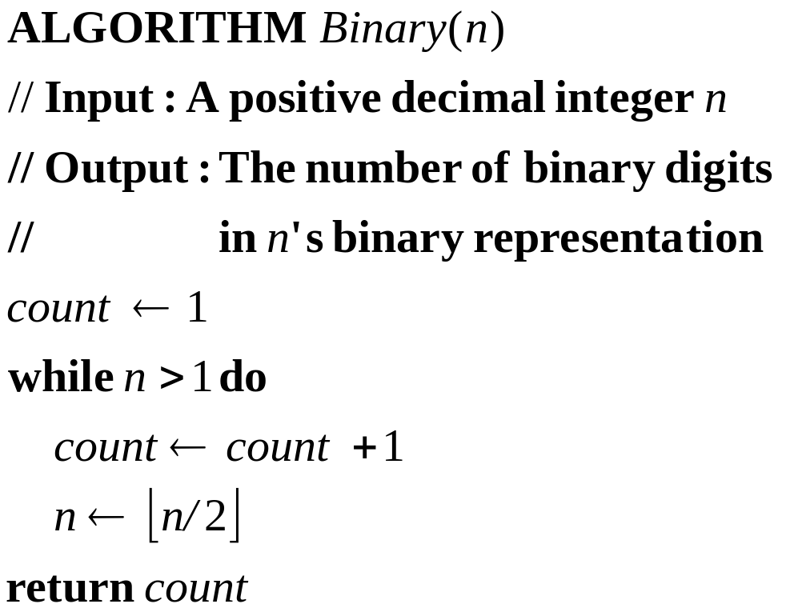
Example: Find the Number of Binary Digits
Find the Number of Binary Digits in the Binary Representation of a Positive Decimal Integer

Slide 18
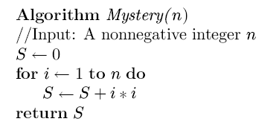

How to identify inefficiency and speed it up?
What is it doing?
Time complexity?
How to speed it up?

Slide 19
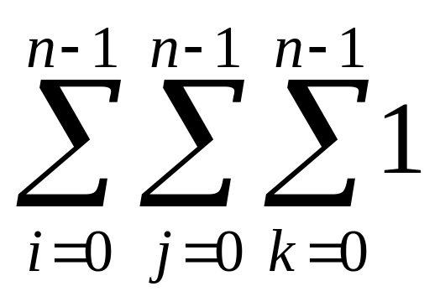
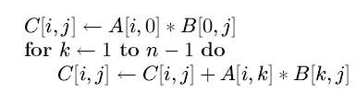
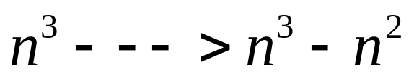
How to identify inefficiency and speed it up?
2.4.7 Matrix multiplication
For i←0 to n-1 do
for j← 0 to n-1 do
C[i,j]←0
for k←0 to n-1 do
C[i,j]← C[i,j]+A[i,k]*B[k,j]

