Slide 1
CSCE350 Algorithms and Data Structure
Lecture 8
Jianjun Hu
Department of Computer Science and Engineering
University of South Carolina
2009.9.

Slide 2
Outline
Brute Force Strategy for Algorithm Design
  Exhaustive search
Divide and Conquer for algorithm design

Slide 3
Exhaustive Search
A brute-force approach to combinatorial problem
  Generate each and every element of the problem’s domain
  Then compare and select the desirable element that satisfies the set constraints
  Involve combinatorial objects such as permutations, combinations, and subsets of a given set
  The time efficiency is usually bad – usually the complexity grows exponentially with the input size
Three examples
  Traveling salesman problem
  Knapsack problem
  Assignment problem

Slide 4
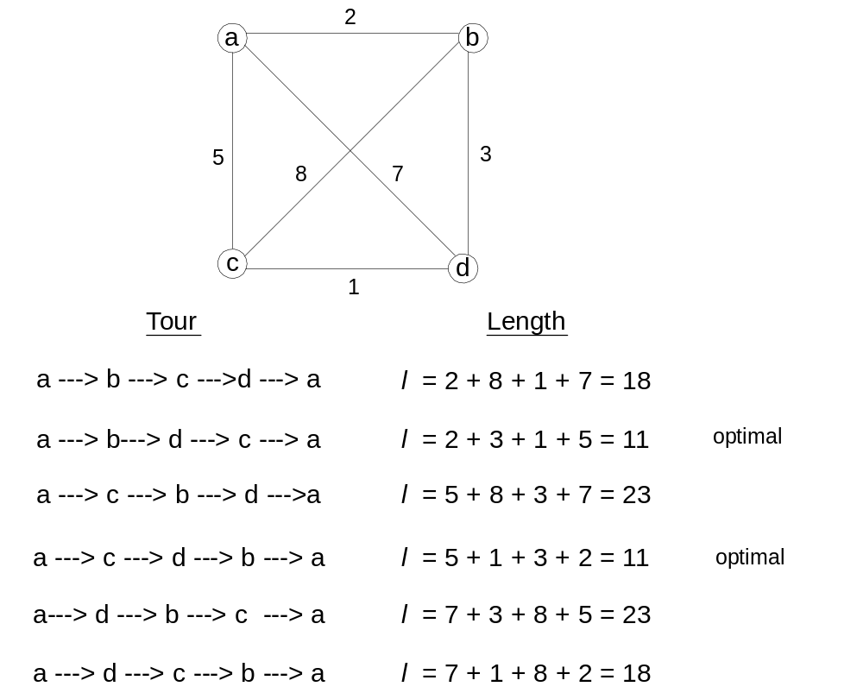
TSP Example

Slide 5
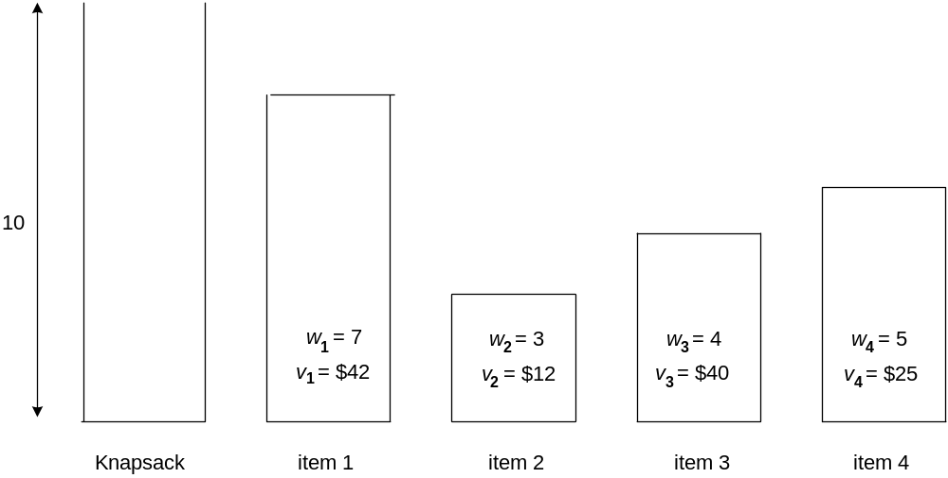
Knapsack Example

Slide 6
Divide and Conquer Strategy for Algorithm Design
The most well known algorithm design strategy:
Divide instance of problem into two or more smaller instances of the same problem, ideally of about the same size
Solve smaller instances recursively
Obtain solution to original (larger) instance by combining these solutions obtained for the smaller instances
problem
subp
subp
subS
subS
Solution

Slide 7
Polynomial and non-polynomial Complexity
1 | constant
log n | logarithmic
n | linear
n log n | n log n
n² | quadratic
n³ | cubic
2^{n} | exponential
n! | factorial

Slide 8
Assignment Problem
n people to be assigned to execute n jobs, one person per job. C[i,j] is the cost if person i is assigned to job j. Find an assignment with the smallest total cost
Exhaustive search
  How many kinds of different assignments?
  The permutation of n persons → n! Very high complexity
  Hungarian method – much more efficient → polynomial
 | Job 1 | Job 2 | Job 3 | Job 4
Person 1 | 9 | 2 | 7 | 8
Person 2 | 6 | 4 | 3 | 7
Person 3 | 5 | 8 | 1 | 8
Person 4 | 7 | 6 | 9 | 4

Slide 9
From Assignment Problem, We Found That
If the exhaustive-search (brute-force) strategy takes non-polynomial time, it does not mean that there exists no polynomial-time algorithm to solve the same problem
In the coming lectures, we are going to learn many such kinds of strategies to design more efficient algorithms.
These new strategies may not be as straightforward as brute-force ones
One example, the log n –time algorithm to compute a^{n}
That’s called divide-and-conquer strategy – the next topic we are going to learn

Slide 10
Divide-and-conquer technique
a problem of size n
Possible? HOW?
subproblem 1
of size n/2
subproblem 2
of size n/2
a solution to
subproblem 1
a solution to
subproblem 2
HOW?
a solution to
the original problem

Slide 11
An Example
Compute the sum of n numbers a₀, a₁, …, a_{n-1}.
Question: How to design a brute-force algorithm to solve this problem and what is its complexity?
Use divide-and-conquer strategy:
What is the recurrence and the complexity of this recursive algorithm?
Does it improve the efficiency of the brute-force algorithm?

Slide 12
General Divide and Conquer Recurrence:
T(n) = aT(n/b) + f (n) where f (n) ∈ Θ(n^{k})
a < b^{k} T(n) ∈ Θ(n^{k})
a = b^{k} T(n) ∈ Θ(n^{k} log n )
a > b^{k} T(n) ∈ Θ(n^{log b a})
Note: the same results hold with O instead of Θ.
Notes:
This is the same slide from chapter 2 (analysis of recursive algorithms)
It is a good idea to remind students at this point and do some examples especially
if you went over this quickly and did not do examples the previous time.
Here are examples from before:
T(n) = T(n/2) + 1
T(n) = 2T(n/2) + n
T(n) = 3 T(n/2) + n
=> this last example is important to mention at some point:
Θ(n^{log}₂³)
NB: cannot “eliminate” or simplify this constant

Slide 13
Divide and Conquer Examples
Sorting: mergesort and quicksort
Tree traversals
Binary search
Matrix multiplication - Strassen’s algorithm
Convex hull - QuickHull algorithm

Slide 14
Mergesort
Algorithm:
Split array A[1..n] in two and make copies of each half in arrays B[1.. n/2 ] and C[1.. n/2 ]
Sort arrays B and C
Merge sorted arrays B and C into array A as follows:
  Repeat the following until no elements remain in one of the arrays:
    compare the first elements in the remaining unprocessed portions of the arrays
    copy the smaller of the two into A, while incrementing the index indicating the unprocessed portion of that array
  Once all elements in one of the arrays are processed, copy the remaining unprocessed elements from the other array into A.

Slide 15
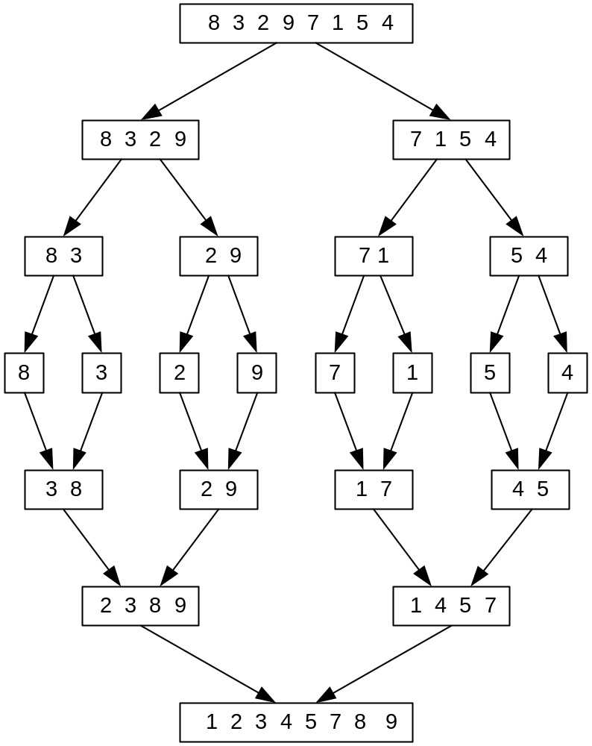
Mergesort Example
Notes:
Go over this example in detail, then do another example of merging, something like:
(1 2 5 7 9)
(3 4 6)

Slide 16
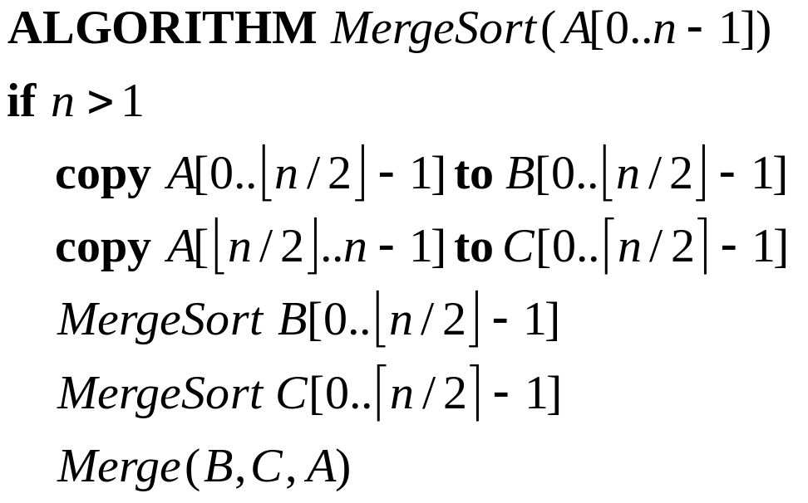
Algorithm in Pseudocode

Slide 17
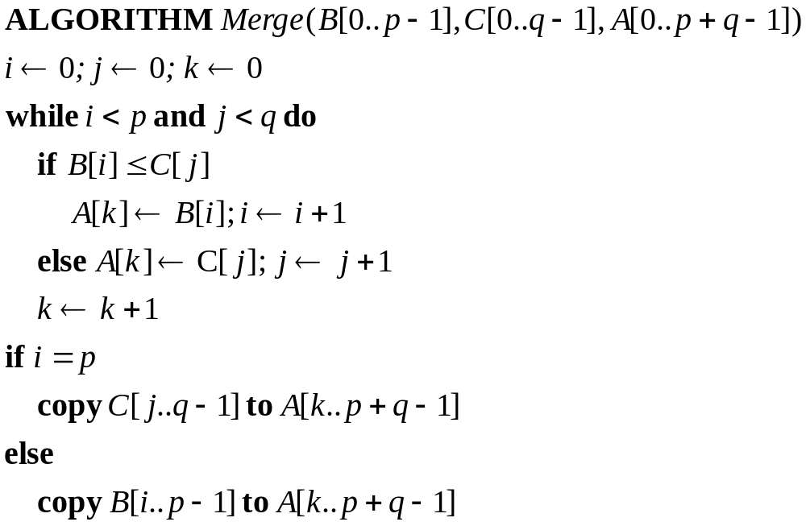
Merge Algorithm in Pseudocode

Slide 18
Efficiency
Recurrence
C(n)=2C(n/2)+C_{merge}(n) for n>1, C(1)=0
Basic operation is a comparison and we have
C_{merge}(n)=n-1
Using the Master Theorem, the complexity of mergesort algorithm is
Θ(n log n)
It is more efficient than SelectionSort, BubbleSort and InsertionSort, where the time complexity is Θ(n²)
Notes:
even if not analyzing in detail, show the recurrence for mergesort in worst case:
T(n) = 2 T(n/2) + (n-1)
worst case comparisons for merge

Slide 19

Quicksort
Select a pivot (partitioning element)
Rearrange the list so that all the elements in the positions before the pivot are smaller than or equal to the pivot and those after the pivot are larger than or equal to the pivot
Exchange the pivot with the last element in the first (i.e., ≤ sublist) – the pivot is now in its final position
Sort the two sublists
p
A[i] ≤ p
A[i] p

Slide 20
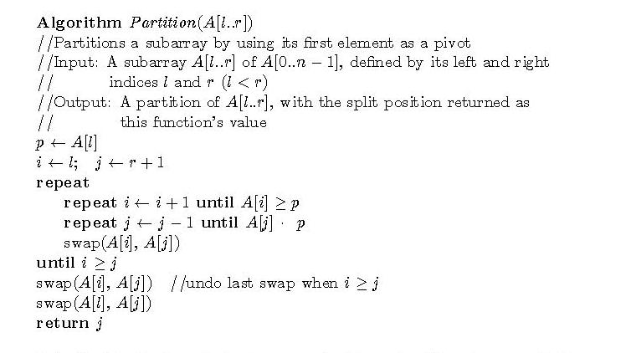

The partition algorithm
or i = r

Slide 21
Illustrations
→ i
j ←
p all are ≤ p ≥ p . . . ≤ p all are ≥ p
j ←
→ i
p all are ≤ p ≤ p ≥ p all are ≥ p
→ i=
j ←
p all are ≤ p = p all are ≥ p

Slide 22
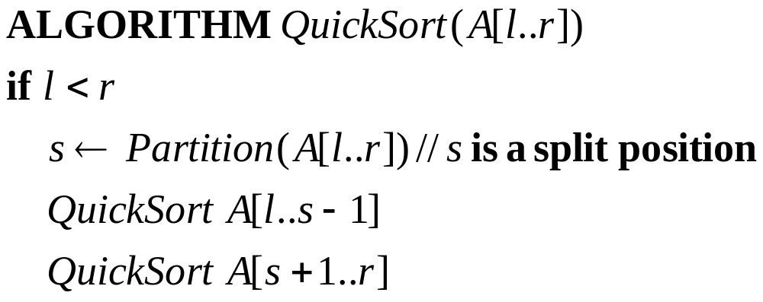
QuickSort Algorithm

Slide 23
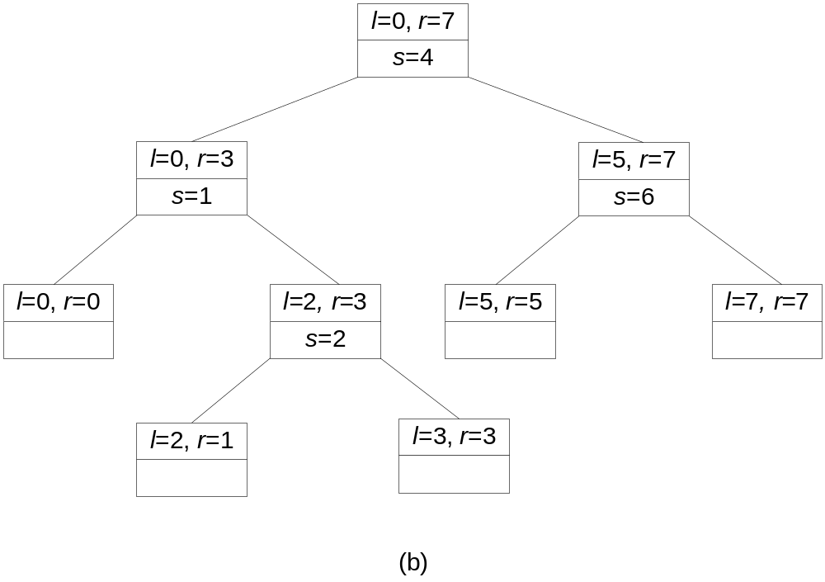
Quicksort Example
5 3 1 9 8 2 4 7

Slide 24
Efficiency of Quicksort
Basic operation: key comparison
Best case: split in the middle — Θ( n log n)
Worst case: sorted array! — Θ( n²)
Average case: random arrays — Θ( n log n)
Improvements:
  better pivot selection: median of three partitioning avoids worst case in sorted files
  switch to insertion sort on small subfiles
  elimination of recursion
  these combine to 20-25% improvement

