Slide 1
CSCE350 Algorithms and Data Structure
Lecture 9
Jianjun Hu
Department of Computer Science and Engineering
University of South Carolina
2009.9.

Slide 2
Outline
Divide and Conquer for algorithm design
QuickSort algorithm
Binary Search
Binary Tree traversal

Slide 3
Annoucement: Algorithm Problems
http://projecteuler.net/index.php?section=problems
list of 255 math/programming problems that are excellent practice with algorithms

Slide 4

Quicksort
Select a pivot (partitioning element)
Rearrange the list so that all the elements in the positions before the pivot are smaller than or equal to the pivot and those after the pivot are larger than or equal to the pivot
Exchange the pivot with the last element in the first (i.e., ≤ sublist) – the pivot is now in its final position
Sort the two sublists
p
A[i] ≤ p
A[i] p

Slide 5
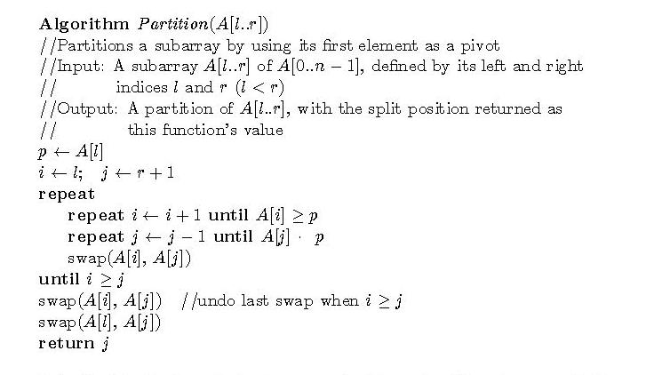

The partition algorithm
or i = r

Slide 6
Illustrations
→ i
j ←
p all are ≤ p ≥ p . . . ≤ p all are ≥ p
j ←
→ i
p all are ≤ p ≤ p ≥ p all are ≥ p
→ i=
j ←
p all are ≤ p = p all are ≥ p

Slide 7
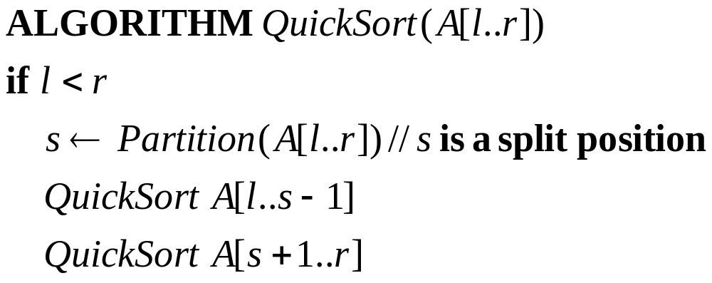
QuickSort Algorithm

Slide 8
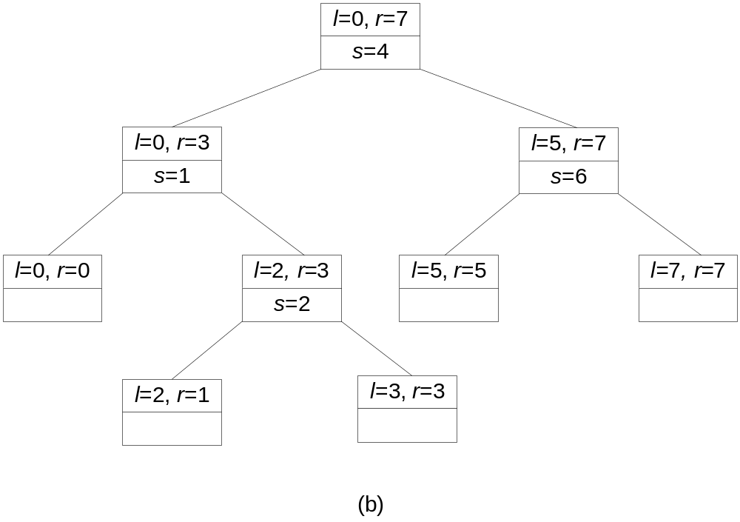
Quicksort Example
5 3 1 9 8 2 4 7

Slide 9
Efficiency of Quicksort
Basic operation: key comparison
Best case: split in the middle — Θ( n log n)
Worst case: sorted array! — Θ( n²)
Average case: random arrays — Θ( n log n)
Improvements:
  better pivot selection: median of three partitioning avoids worst case in sorted files
  switch to insertion sort on small subfiles
  elimination of recursion
  these combine to 20-25% improvement

Slide 10
Binary Search
Brute Force sequential search -- Θ(n)
Binary Search – searching in a sorted array
Basic idea
  Compare a search key K with the array’s middle element A[m]
  If they match, the algorithm stops
  Otherwise, repeat the same operation recursively for the first half of the array if K<A[m], and for the second half if K>A[m]
  K
  A[0] … A[m-1] A[m] A[m+1] … A[n-1]
  search here if search here if
  K<A[m] K>A[m]

Slide 11
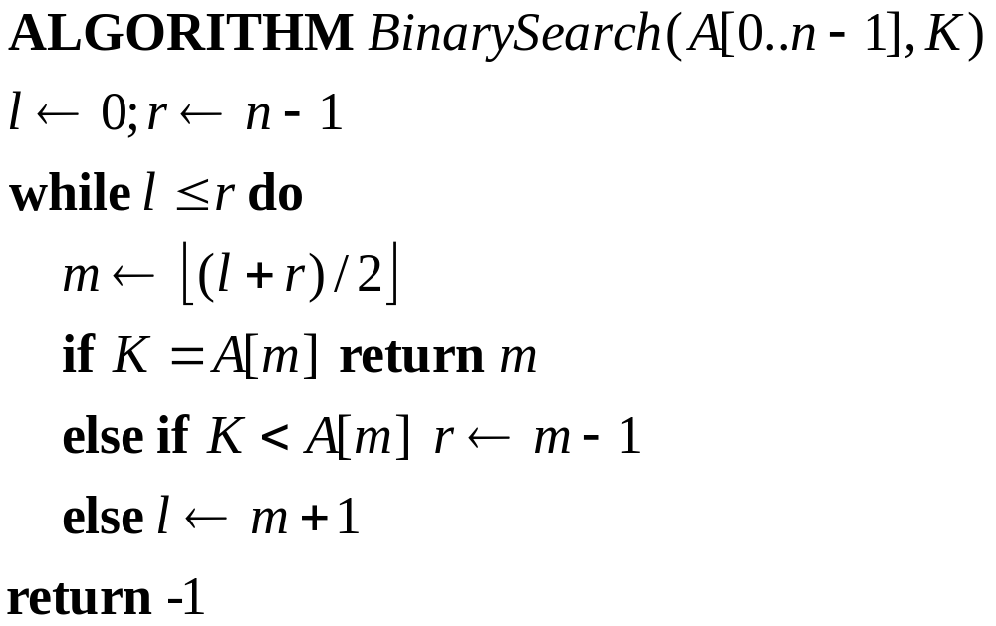
Algorithm

Slide 12
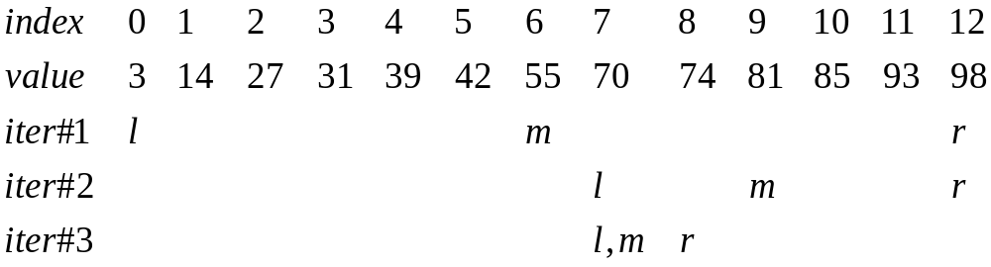
Example
Search for K=70

Slide 13

Time Efficiency
In the worst case, no key K exists in this array
Although this is an nonrecursive algorithm, we can see that the time efficiency can be analyzed using the recurrence relation
T(n)=T(n/2)+1 for n>1, T(1)=1
T(n) --- Θ(logn)
Exact solution:
Binary search is in fact not a typical example of divide and conquer because it does not solve two subproblems.

Slide 14
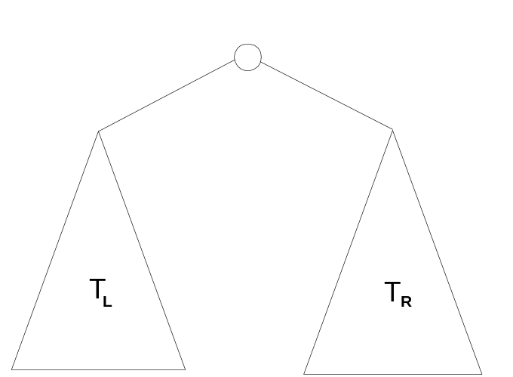
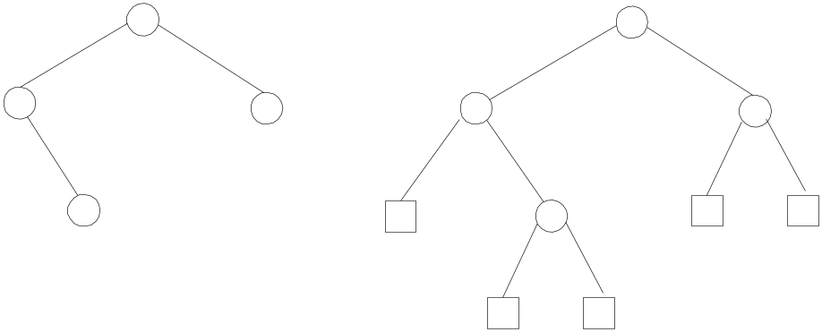
Binary Tree Traversals
A binary tree T is defined as a finite set of nodes that is either empty or consists of a root and two disjoint binary trees T_{L} and T_{R} called the left and right subtree of the root
Internal and external nodes: #ext_node = #internal_node+1

Slide 15
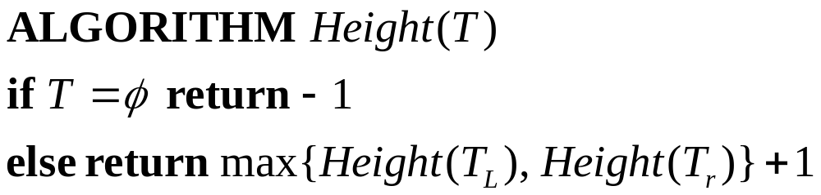
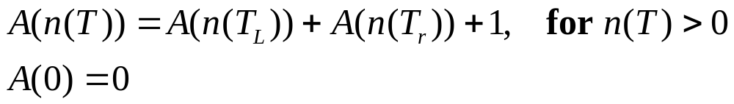
Height of a binary tree
Input size n(T): # nodes in T, basic operation: “+”
Recurrence
A(n)=n why?
If the basic operation is the line to check whether a tree is empty → A(n)=2n+1 why?

Slide 16
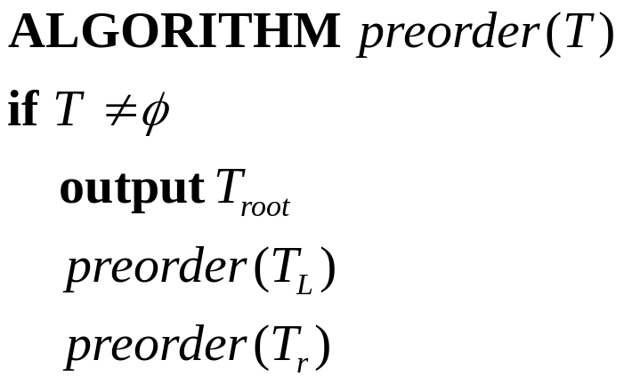
Traverse the binary tree
List all the nodes
Preorder traversal: root → left subtree → right subtree
Inorder traversal: left subtree → root → right subtree
Postorder traversal: left subtree → right subtree → root
What is the efficiency?

Slide 17
Large Integer Multiplication
Some applications, notably modern cryptology, require manipulation of integers that are over 100 decimal digits long
Such integers are too long to fit a single word of a computer
Therefore, they require special treatment
Consider the multiplication of two such long integers
If we use the classic pen-and-pencil algorithm to multiply two n-digit integers, we need n² digit multiplications
Can we design a divide-and-conquer algorithm to solve this problem with better efficiency?

Slide 18
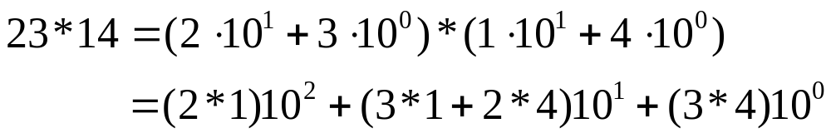
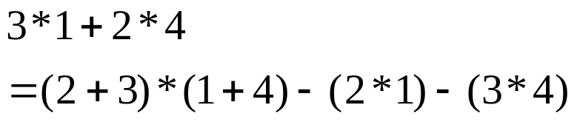
The Basic Idea
We want to calculate 23 x 14
Since
We have
Which includes four digit multiplications (n²)
But
Therefore, we only need three digit multiplications

Slide 19
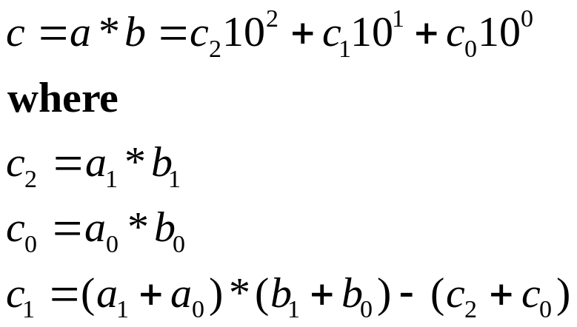
One Formula
Given a=a₁a₀ and b=b₁b₀, compute c=a*b
We have
That means only three digit multiplications are needed to multiply two 2-digit integers

Slide 20

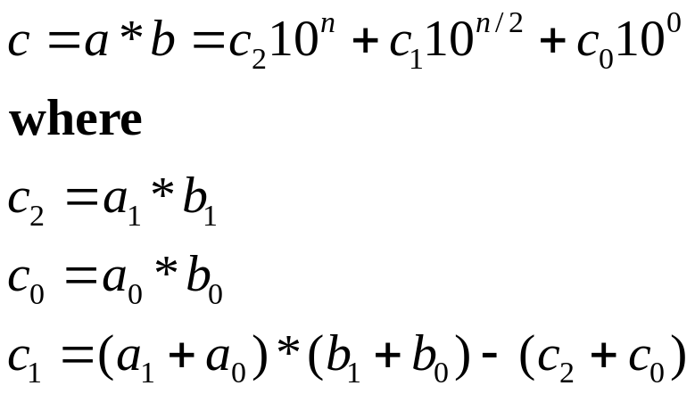
To Multiply Two n-digit integers
Assume n is even, write
Then
To calculate the involved three multiplications – recursion! Stops when n=1

Slide 21
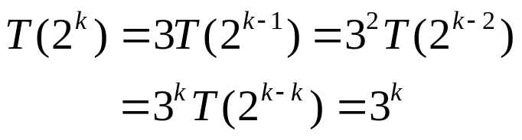
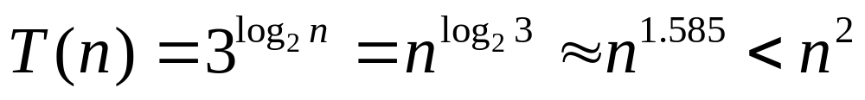
Efficiency
The recurrence relation is
Solving it by backward substitution for n=2^{k} yields
Therefore,

