Slide 1
Replacement of Low Voltage Ride Through (LVRT) using reinforcement learning
B.Tech Project Presentation
On
By
Bikas Singh (B21EE015)
Anushka Barkade (B21EE080)
Supervisor: Dr. Ravi Yadav
Teaching Assistant: Goteti Bharadwaj (M23EEC006)

Slide 2
Objective
Our aim is replace the conventional LVRT by Reinforcement Learning model (RL based LVRT).

Slide 3

Introduction

Slide 4
Electrical Fault
An electrical fault occurs when voltages and currents deviate from their nominal values, causing damage to equipment and devices. Under normal conditions, power system equipment or lines carry normal voltages and currents, but when a fault occurs, excessive currents flow, necessitating the design of suitable switch gear equipment, electromechanical relays, circuit breakers, and other protection devices.
Types of Faults in Electrical Power Systems:
In power system the faults majorly classified into two types.
Symmetrical Fault
Unsymmetrical Fault

Slide 5
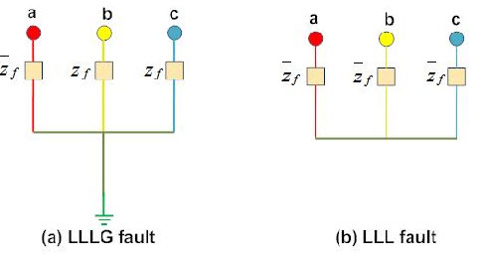
Symmetrical Fault
Symmetrical faults are a type of electrical fault in which all three phases of a power system are affected equally.
This results in the system remaining balanced even during the fault, meaning the voltages and currents in all three phases are identical in magnitude and equally displaced in phase by 120°.
The symmetrical faults are classified into two types
Line – Line – Line Fault
Line – Line – Line – Ground Fault

Slide 6
Unsymmetrical Fault
Unsymmetrical faults are less severe than symmetrical faults.
Unsymmetrical faults, also known as unbalanced faults, cause impedance values to differ in each phase, causing unbalance current to flow.
These faults are more difficult to analyse and are carried on a per-phase basis, similar to three-phase balanced faults.
The L-G fault is the most common, causing the conductor to contact the earth or ground.
Double line to ground faults occurs when two conductors make contact during line swinging due to winds.
Line to line faults occur when two conductors make contact during wind swinging.

Slide 7
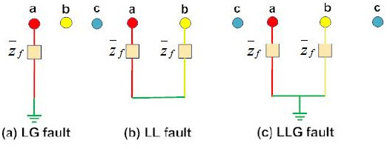
The unsymmetrical faults are classified into two types
Single L – G (Line-to-Ground) Fault
L – L (Line-to-Line) Fault
Double L – G (Line-to-Ground) Fault

Slide 8
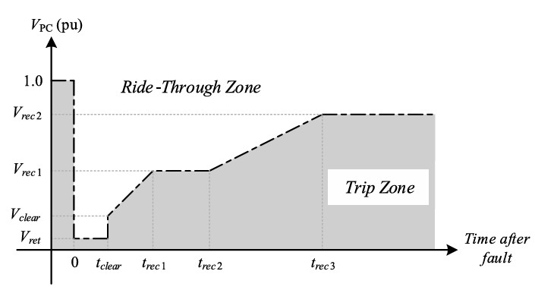
Fault Ride Through
Fault Ride-Through (FRT) capability is crucial for maintaining a reliable and continuous power supply, as it allows the power system to endure temporary voltage dips caused by faults without resulting in widespread outages.
This is particularly important with the increasing integration of renewable energy sources like wind and solar, which often depend on power electronics converters that might disconnect during voltage dips if they lack proper FRT features.

Slide 9
Low Voltage Ride Through (LVRT)
According to CEA regulations, converter-based generating stations connected to the grid must remain connected even if the voltage at the interconnection point drops, as long as the voltage dip follows the levels specified in the relevant curve, where Vt is the actual voltage and Vn is the nominal voltage.
During a voltage dip, the priority is to supply reactive power, followed by active power.
While maintaining active power during voltage drops is preferred, a temporary reduction in active power is acceptable within the plant’s design limits.
Once the voltage is restored, the plant should return to at least 90% of the pre-fault active power level within 1 second.

Slide 10
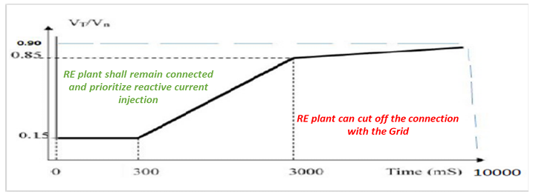

Slide 11

Methodology

Slide 12
Conventional LVRT
The PPC gives reactive power reference point as per the grid voltage and as per the droop setting in the steady state, as illustrated in Figure
The PPC also provides the active power reference and reactive power reference to individual inverters.
The phase-locked loop (PLL) in the inverter guarantees the phase and frequency synchronization between the inverter’s output and its point of synchronization voltage. It supplies the waveform reference for the PWM generator that controls the insulated-gate bipolar transistors (IGBTs) in the inverter.
The PLL also provides the phase angle references needed for the dq0 calculations as well as the internal frequency measurements of the inverter. The PLL’s operation is often crucial in deciding.

Slide 13
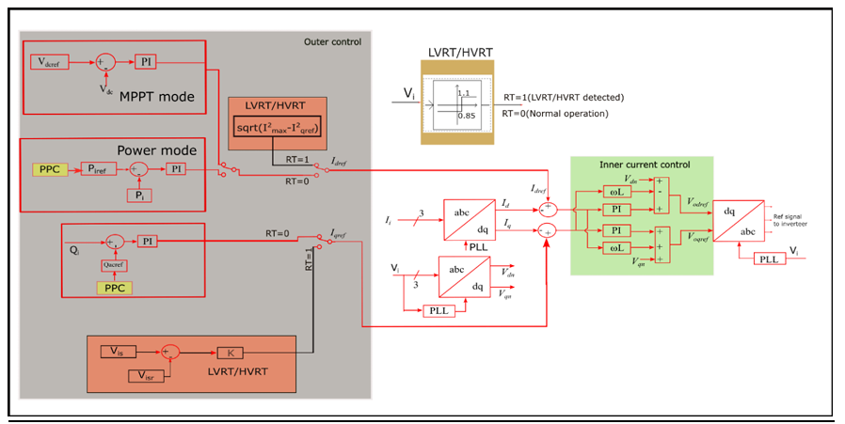

Slide 14
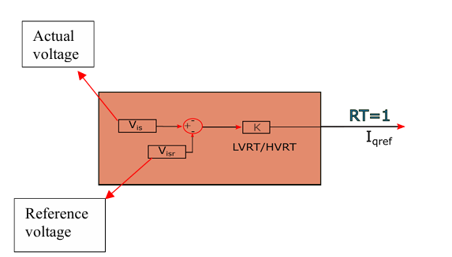
During a fault, the inverter switches to ride-through mode (LVRT/HVRT) and provides reactive power based on the K-factor setting, which determines the amount of reactive current (Iq) to be injected, as shown in above Figure . The reactive power output is adjusted according to this setting.
When the inverter terminal voltage falls below the ride-through threshold, the inverter bypasses its outer control loop and enters ride-through mode. In this mode, the reference for reactive current (Iqref) is set based on the K-factor within the inner control loop.
The amount of active current (Id) injected depends on the remaining capacity of the inverter, ensuring reactive power takes priority when the inverter operates in Q-priority mode.

Slide 15
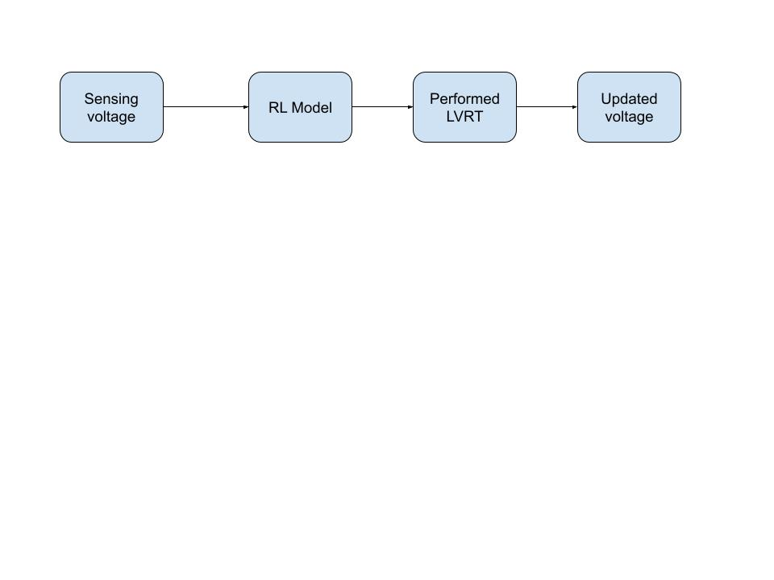
RL-Based LVRT

Slide 16
Implementation of LVRT
Utilizes gym open AI library and Typhoon.api.hil to simulate grid behavior, faults, and recovery.
The agent performs actions in the environment and observes changes in the environment's state.
Uses continuous observation space and discrete action space for observing.
Designates a reward system based on voltage recovery.
Implements faults by reducing grid voltage to a predefined level.
Uses Proximal Policy Optimization (PPO) for policy optimization.
Trains the PPO agent by simulating multiple LVRT scenarios.
Tests the trained agent on new fault scenarios to evaluate its ability to restore grid stability effectively.

Slide 17
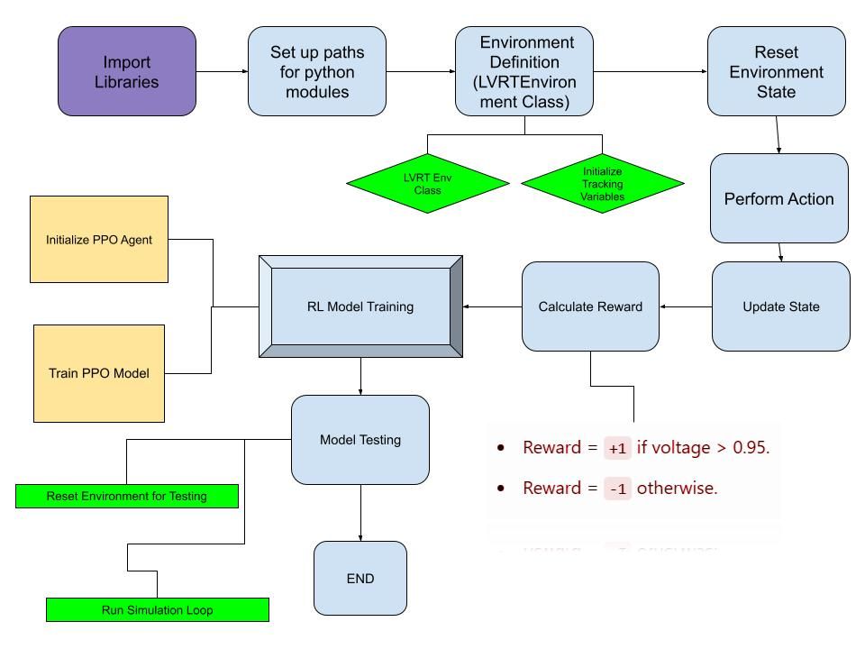

Slide 18
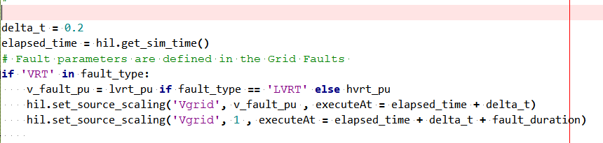
Integration RL-Based LVRT with the simulation model
We have written code in the panel initialization. Here just we implemented the model and trained.
Using the Widget Library and created the widget for LVRT. (for more info visit Create and edit Widget Library )

Slide 19
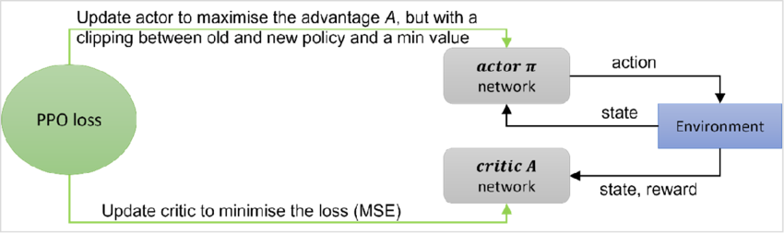
Why PPO ?
Proximal Policy Optimization (PPO) is a RL algorithm that optimizes policies to maximize rewards while maintaining stability and robustness.
When applied to creating a custom LVRT, PPO works by learning an optimal control policy for stabilizing the system during voltage sags or grid faults.

Slide 20
Handles continuous action spaces, ensuring stability in learning.
Adapts to complex, dynamic systems like power grids.
Leverages reinforcement learning to learn optimal control policies based on grid behavior.
Balances exploration and exploitation to avoid system destabilization.
Clipped objective function adds stability against overfitting or excessive policy changes.
Efficiently learns in high-variance environments like grid faults.
Generalizes learned policy to diverse fault conditions.
Ideal for real-time decision-making and system stability in LVRT applications.

Slide 21
Comparison

Slide 22
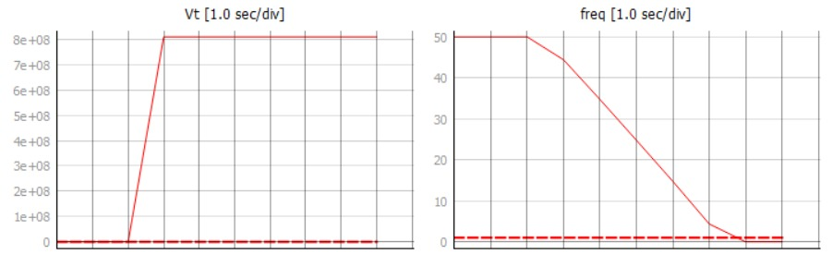
Conventional LVRT

Slide 23
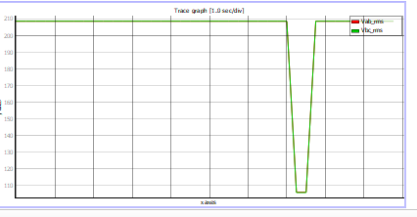
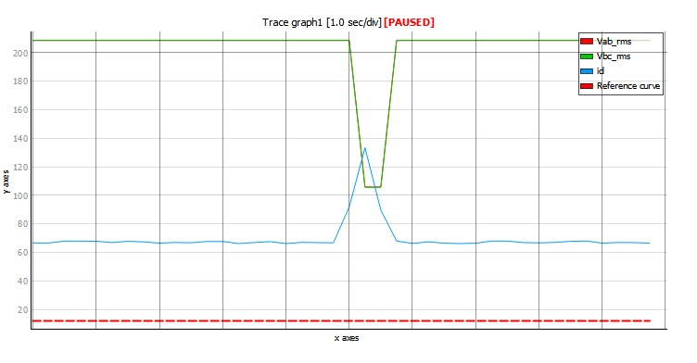
RL – Based LVRT

Slide 24
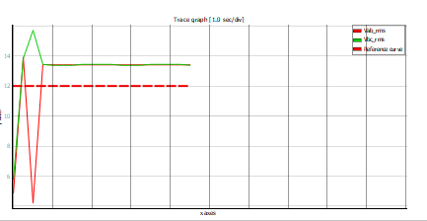
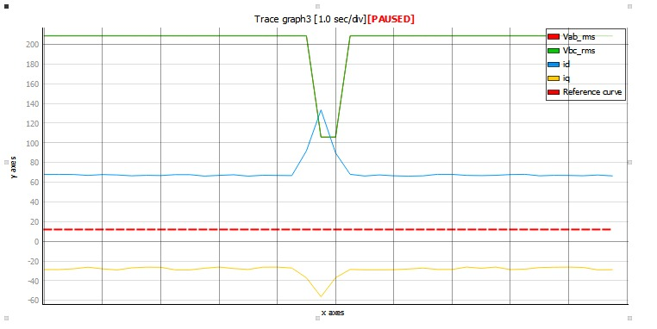

Slide 25
Voltage Recovery Time:
RL-based LVRT: Should dynamically adapt and recover voltage faster by learning fault-specific patterns.
Conventional LVRT: Often fixed and may require longer recovery times.
2. Voltage Stability During Fault
RL-based LVRT: Expected to better mitigate voltage drops by taking optimized actions learned during training.
Conventional LVRT: Relies on predefined thresholds and may result in more significant voltage deviations.
3. Power Losses During Fault
RL-based LVRT: Can minimize losses by intelligently managing power flow.
Conventional LVRT: May experience higher power losses due to less optimized responses.

Slide 26
Assumption and Limitation
For RL based LVRT we assumed that the during fault there is drop of 70-75% voltage, which may not be happen. In real-time this can be high or low based on the fault severity
We are increasing the voltage signal value continuously during fault to reach initial value (connected to grid).
Current model is only applicable for the “Three-phase grid-connected inverter with PQ control”. The model may or may not be compatible with other system.
There might be library and python interpreter compatibility issues during simulation. Because Typhoon offer two types interpreter one is mutable (can be changed i.e. external libraries can be installed) and another immutable (cannot be change i.e. external libraries cannot be installed).

Slide 27
Future
Extension to Other Fault Ride-Through Capabilities: Expand methodology to include High Voltage Ride Through (HVRT) and frequency ride-through capabilities.
Scalability for Larger Systems: Test the reinforcement learning-based LVRT on larger power systems or multi-area grids to assess its scalability and performance in more complex environments.
Real-Time Hardware Testing: Implement trained RL agent in hardware-in-the-loop systems for real-time validation and testing under physical grid conditions.
Cybersecurity Considerations: Investigate security implications of RL-based LVRT systems in the context of cyberattacks on modern grids.
Development of Generalized RL Environments: Create a generalized RL environment to model various types of grid disturbances and scenarios.
Multi-Agent Reinforcement Learning (MARL): Explore the use of MARL to coordinate multiple agents controlling different parts of the grid.

Slide 28
Conclusion
RL-based LVRT mechanism improves grid stability and fault recovery during voltage sags.
Outperforms conventional methods in fault recovery time and voltage stability.
RL approach adapts to diverse fault scenarios and extends to other fault ride-through capabilities.
Supports renewable energy integration by ensuring grid stability during severe voltage fluctuations.
Challenges include refinement of grid parameters and computational complexity.
Despite challenges, represents a significant advancement in AI-driven power system control strategies.

Slide 29
Contribution
Bikas Singh (B21EE015):
Worked on literature review
Conventional LVRT
Designing a RL Based LVRT
Anushka Barkade (B21EE080):
Worked on the background study of project
Comparing Conventional LVRT and RL-Based LVRT

Slide 30


