Slide 1
Print Instructions
Do not print the following hidden slides in SSG: 0 and 35
Print a standalone copy of ‘Memory Analysis with Volatility’ ppt for each student and one copy of instructor notes
Use associated cover
Notes:
Print instructions.

Slide 2
Notes:
CWU919KD, Threat Detection: Linux Defensive Capabilities.
This lesson takes a different approach than many defensive capability lessons. This lesson will delve into Linux defensive capabilities from an environment perspective looking at how the operating system works and what ‘good’ looks like, using the person as the main defensive tools. Many of the ‘tools’ outlined throughout the lesson are already built into Linux or are prevalent in most environments. Since many of you have little to no experience in Linux defense, its more important to understand how they operate and where they can be taken advantage of than to understand the buttonology of a specific defense tool.

Slide 3
So What?
Linux systems make up a small portion of the AFNet, but make up a large portion of non-AFNet CPT missions
To be an effective defender you must know how to use the tools available to you effectively and what normal looks like
There are a plethora of capabilities indigenous on most Linux platforms and knowing how to use them can allow you to mitigate most threats
“If you know the enemy and know yourself, you need not fear the result of a hundred battles”
– Sun Tzu
Notes:
So why are we getting this lesson? If we have never had to defend a Linux system, why is it important now? The Air Force network from a host perspective is almost all Windows environments and Windows domains, these are what tend to get hit the most simply because standard non-IT smart personnel are working on them and they create a huge risk to the system. The Air Force does have Linux operating systems; however, they tend to be almost all servers and therefore are logged into less, have less ‘standard users’ logging into them directly even though a standard user may be using one of their services. Additionally, as the AF continues to contract out a lot of cloud infrastructure, a lot of the commercial sector has Linux running on their cloud servers, and so it is becoming more and more important to understand the different environments. In order to be an effective defender on Linux you need to know the tools available to you to help you identify bad, but even more important is understanding what ‘good’ looks like. While defensive tools are useful, it is the human-in-the-loop that gives credence to the gathered information and adds context and remediation. 100s of 1000s of Linux open-source tools are available and useful to a defender, but we will only hit a few big ones that will assist you during the course.
There is a famous quote from Sun Tzu, “if you know your enemy and know yourself, you need not fear the result of a hundred battles”, so we will focus in on knowing ourselves for this lesson.

Slide 4
Objectives
List and illustrate the boot sequence for a Linux Operating System
Describe the daemon start sequence
Describe why defenders care about patching configuration / events
List eight native commands that can be used during an investigation
Describe FLUFFE
Notes:
Objectives for the lesson.

Slide 5
Overview
System hardening
Software patching
Integrity checking
System auditing
Investigation
Notes:
This lesson is structured similar to the major steps one would take to fortify a system. Understanding all of the weak points in a system will allow us to understand where the adversary may strike, and identify what ‘good’ looks like, so we know when a system deviates from that. The major steps we identified in fortifying a system include:
System hardening: Locking down any services or configurations that may leave us vulnerable.
Software patching: Looking at what vulnerabilities might exist on our system that may have been used for compromise.
Integrity checking: Validating that critical binaries within a compromised system are still valid.
System auditing: Leveraging events logged to piece together a timeline of what may have happened. We then end with some investigation tools that could help in gathering additional evidence.

Slide 6
Overview
System hardening
Software patching
Integrity checking
System auditing
Investigation
Notes:
Be minimalist – keep it simple stupid.
Defense-in-depth – take a layered approach.
Vigilance – no matter how secure you are today, eventually new vulnerabilities will be discovered and you must constantly be assessing your security state.

Slide 7
Boot Sequence
1. Basic Input Output System (BIOS) / Unified Extensible Firmware Interface (EUFI)
2. Master Boot Record (MBR)
3. GRand Unified Bootloader (GRUB) / Linux Loader (LILO)
4. Kernel
5. Initialization Daemon (systemd)
Parent process to all Linux daemons
6. Run Level System Scripts (rcX.d)
System Daemons
Notes:
Its important to understand the standard boot sequence for a Linux platform as there are many ways an attacker can take advantage of this sequence. Knowing the sequence of events will allow you as a defender to notice when something is amiss and investigate it further. By injecting themselves in the boot sequence or rearranging the sequence, an attacker can bypass security procedures, logs, elevate privileges and even boot their own kernel! We will take a deeper look into some of these shortly, but for now, it is important to understand the high-level sequence of events that any Linux system will go through on startup.

Slide 8
Boot Sequence
BIOS / EUFI
systemd
MBR
default.target
symlink
Run Level System Scripts (rcX.d)
GRUB / LILO
Kernel
multi-user. target
basic.target
sysinit.target
rescue.target
Unit
Unit
Unit
Unit
Notes:
This is a graphical depiction of the boot sequence we just went over. The graphic adds in some of the additional complexities of the boot sequence as systemd will need to start all services (daemons) associated with the target environment that it needs to get to. The target environment always starts with the default target to load required daemons for any low-level operation, and then will boot up to the target environment needed, which is usually run level 3 (server) or run level 5 (multi-user mode). We will talk about run levels in a second, but for the test, you will be required to recreate this diagram to include all lines, labels and boxes. Make sure to spell out any acronyms.

Slide 9
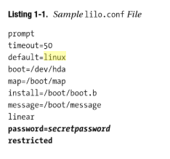
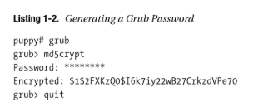
Bootloaders
Linux uses one of two bootloaders
GRand Unified Bootloader (GRUB) or Linux Loader (LILO)
Linux allows a lot of access to someone who can control the boot sequence
Attackers who can reboot your system can:
Choose which kernel to boot into
Allows for:
Single-user boot – which gives default root privileges
Command-line access!
Cause a denial-of-service by taking the system offline
Mitigation: Add a password to the bootloader
Notes:
For Linux there are generally two main boot loaders that are used; GRUM and LILO. Linux allows anyone who can control to boot sequence to boot into single-user mode, which gives root privileges or direct command line access, so anyone who can cause a system reboot might be able to take advantage of vulnerable or nonconfigured bootloaders. For LILO, there is a configuration file that defines whether there is a password applied to your bootloader. By default it is not set. As a defender going into a possibly compromised host this is a great place to start to see if there is anything odd in the conf file. For GRUB, there is a similar capability; however, you configure it from a script that can be called by typing ‘grub’ and then adding a password using md5crypt.

Slide 10
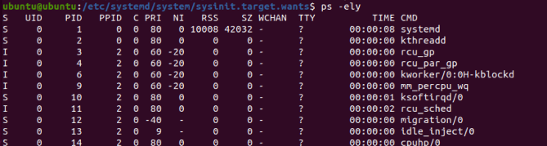
Daemons
Daemon start sequence is IMPORTANT!
Can create security vulnerabilities (e.g., starting the IPTables and Syslog Daemons after your network daemon could lead to unblocked and unlogged connections)
1. Systemd executed
Parent over all processes
Limited processes without a parent
What about kthreadd?
2. Mounts the filesystems as defined by /etc/fstab
Notes:
Once the bootloaders have loaded a kernel, the kernel will kick off a daemon (service) called systemd. Systemd is the critical service that is in charge of spawning all required services to run your operating system and to start things like the command-line interface, networking services and even the graphical user interface. Systemd should be the parent service over all other services running on your system. While there may be some orphan processes and one off, in general all processes should have a parent tree that leads back to systemd. In the example, there is also a kthreadd that has a PPID of 0 (i.e., no parent). In this case its okay. Kthreadd is responsible for loading software that is responsible for a lot of your hardware to be able to talk to the kernel. Just make sure when you are looking through your services, that you carefully research the purpose of each to determine how that service should look and act to ensure it matches the proper behavior. Otherwise it is something you should note and possibly vector your investigation towards. In order to start all of the required services, systemd needs to mount the file system first which it uses /etc/fstab to accomplish. Once the file system is mounted, systemd can start kicking off daemons.

Slide 11
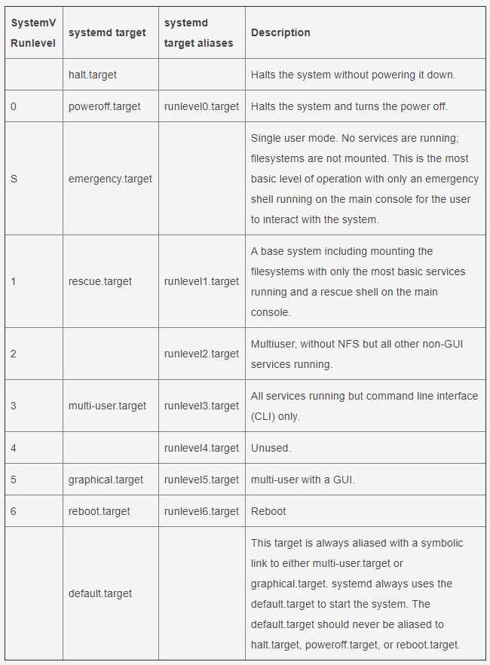
Daemons
UNCLASSIFIED
3. Starts reading configuration files from /etc
4. Reads default.target file to determine target environment to boot into
By default, desktop will be run level 5, servers are run level 3
5. Starts at default (lower functionality services) and executes all system scripts until target environment reached
UNCLASSIFIED
10
Notes:
The order in which systemd launches daemons revolves around two major things:
What target environment do I need to boot up to?
And what dependencies exist within each of the services that need to be started first?
In order to do this, the first target systemd boots up to is the default.target. Regardless of what target environment the user or system is requesting to boot into, systemd starts with the default target and continues up the run level until it reaches the desired target environment.

Slide 12
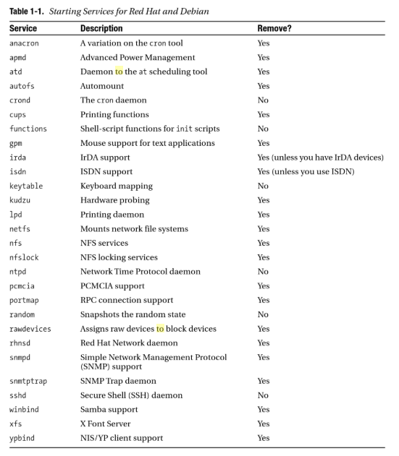
Daemons
UNCLASSIFIED
So what can we do with this information?
We can use it to:
Know what ‘Good’ looks like to start identifying possible bad
Know what services we can turn off to harden
‘Minimalist’ security strategy
Unused services create unnecessary risks
UNCLASSIFIED
11
Notes:
So what can we do with this information as defenders?
Well, understanding what daemons should be running based on your run level will enable two things:
First, it will allow you to know what services are normal and which are abnormal, in which you can redirect your investigation.
Secondly, it can assist in hardening the host by shutting down services that are not needed, which will reduce the attack surface for an attacker.

Slide 13
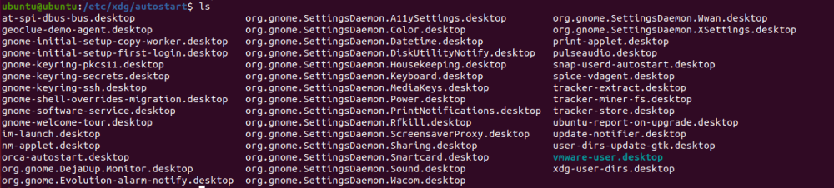
Auto-Start Programs
Once all the daemons are started and we are booted into our target environment, auto-start programs will be executed by systemd
NOTE: Great place to store persistence mechanisms …
Auto-start location
/etc/xdg/autostart/
Notes:
Once booted to your target environment, auto-start programs are going to start executing. Auto-starts are a great place for attackers to create execution mechanisms or persistence mechanisms to ensure their malware kicks off everytime the system reboots. Auto-starts can be found in /etc/xdg/autostart for Debian systems, but the location may shift a bit in Red Hat-type systems. The important thing to know as a defender is that a folder exists under /etc that holds all initial startup program links and needs to be investigated during any investigation. In this slide you can see the auto-starts for a brand new Ubuntu distribution. This should allow you to start getting comfortable with what should generally tend to be there. From here, you can identify any deviations and start investigating further.

Slide 14
Cronjobs
Cronjobs are equivalent to schtasks on Windows
Crontab can be used to list all cronjobs
Crontab –l
Lists root cronjobs
Crontab –u username –l
Lists specified user cronjobs
Cronjobs are located in:
/etc
/cron.d
/cron.hourly
/cron.daily
/cron.weekly
/cron.monthly
Notes:
Cronjobs are similar to auto-start programs except they are time triggered versus event-based triggers. Similar to auto-starts, cronjobs are a great place for adversaries to store execution or persistence mechanisms and should thus always be looked at during an investigation. Cronjobs are synonymous with Windows scheduled tasks (schtasks). Red Hat distributions may differ slightly, but for Debian distributions root-level cronjobs should be located within the /etc folder. Its important to note that individual cronjobs are located in each individual user profile /usr/… and so you will need to look in each users’ folder to gather all possible cronjobs. Crontabs can be used to query these folders directly, but for user cronjobs the username will need to be input manually to see their cronjobs. The easiest way to pull everyone's at once is to write a script to scrape local users and input all users one at a time into crontab using some type of loop until all users have been executed. To run crontab –l, you need to be root (or run sudo).

Slide 15
Executable Program Locations
/bin
/sbin
/usr/bin
/usr/sbin
/usr/local/bin
/usr/local/sbin
/usr/share
/home/$USER/.local/share/applications
Notes:
This is a list of all locations where programs are allowed by the operating system to execute programs out of. This is just generally good to know information for any environment, so you can initially scope down your investigation if you are looking for possible malicious files and do not have a lot of info to go off of.

Slide 16
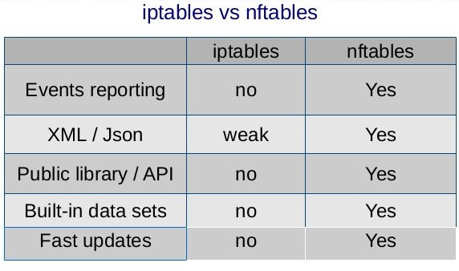
IPTables / NFTables
Command-line firewall utility that uses policy chains to allow or block traffic
IPTables is slowly being replaced by NFTables (network filter tables)
Connection tries to establish itself on system, iptables / nftables looks for a rule match
Does not find one, resorts to the default action
Almost always comes preinstalled on any Linux distribution
List policy chains:
# iptables or # ip6tables or # nft
Location:
/etc or /etc/alternatives or /etc/sysconfig
Adversaries will create or delete firewall rules to enable communication!
Notes:
IPTables, now known as NFTables is a command-line host-based firewall utility that is installed by default on most Linux distributions. Knowing how to check host firewall rules is important to see if there are either missing rules that may show malign intent or additional rules that may have been created to allow either malware the ability to reach back to a C2 server/downloader or that allows incoming traffic that is meant to trigger specific malware.

Slide 17
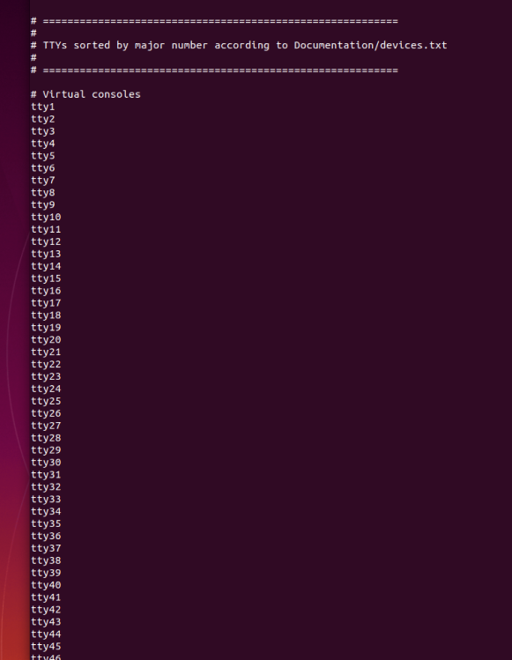
Console
Remote access like SSH and FTP is crucial to control / manage, but removing is not the only solution
Console connections can also be restricted from the system level
By default LOTS of root consoles are authorized!
Linux systems authorize remote console connections via the configuration file found at: /etc/securetty
Notes:
Console allows remote access like SSH and FTP to connect to the host, but manages the virtual connections at system-level. By default, Ubuntu allows more virtual terminals to be open than I can even show on my screen! In many cases, as a defender you will want to see what types of virtual connections are allowed – to see what type of attack surface was available to an attacker. This might allow you to determine initial access vectors. By default you should turn off any remote services that you are not using, but console will allow you to also limit the number of simultaneous connections if you do need some of these services. To remove these you can either delete the whole line or comment out with ‘#’.

Slide 18
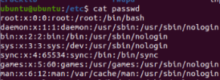
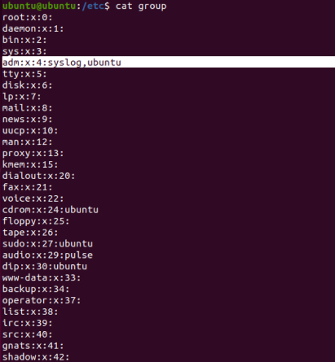
Users / Groups
Three locations to look for malicious accounts
/etc/password
Username : password : UID : GID : GECOS :
… Home Directory : Shell
/etc/shadow
Username : Pass : Date pass changed : min days between
… pass change : pass expiry time: pass expiry warning :
… number of days after pass : expiry account is disabled :
… date since account disabled
/etc/group
Name : pass : GID : member , member
Notes:
Users and groups should be part of any standard investigation to look for both persistence mechanisms, as well as possible unsecured accounts.
Some things to note: Root should be the only user with the UID and GID set to ‘0’ and the shell is required for login. Any account that ends in /nologin will not only stop that account from logging in, but will also log the attempt.
If you suspect a compromised system, you will also want to pull all users to determine the possible size of compromise, so you can lock down or reset any accounts that may be used elsewhere. Another good technique is to do a hashdump of any accounts stored in memory for domain users that may have been logged in whose accounts may also be compromised.

Slide 19
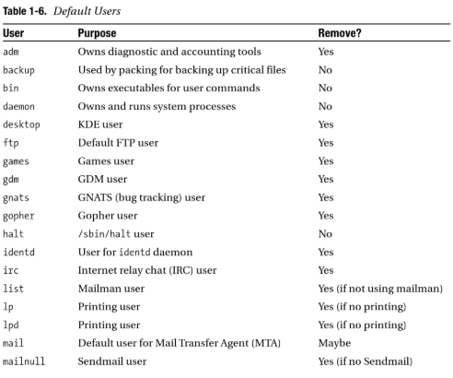
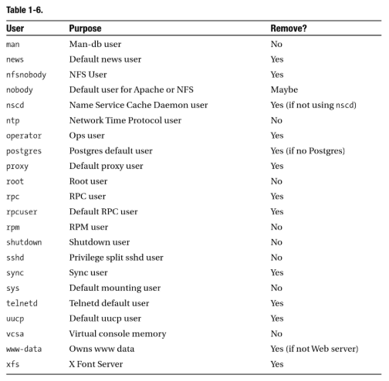
Users / Groups
Why do we care about understanding users / groups?
Notes:
Here is a list of default users for a Debian distribution to help identify any accounts that should not be there. It also identifies which accounts are usually not needed if you want to harden your system.

Slide 20
Users / Groups
Groups that can be removed:
Lp
News
Uucp
Proxy
Postgres
www-data
Backup
Operator
List
Irc
Src
Gnats
Staff
Games
Users
Gdm
TelnetD
Gopher
ftp
Nscd
Rpc
Rpcuser
Nfsnodboy
Xfs
Desktop
Notes:
Here is a list of groups that can usually be removed.

Slide 21
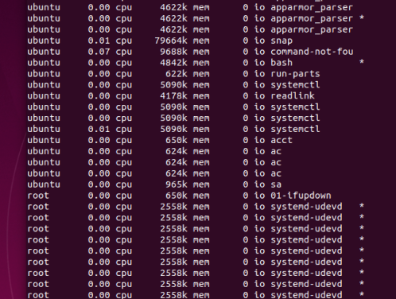

Process Accounting
Process accounting (psacct or acct)
/var/log/account/pacct or savacct or usracct
Install
Sudo apt-get install acct
cd /etc/init.d
Account log-in times
ac
Summary of account commands
sa –u
Pull details associated with the last time a specified command was run
Lastcomm sudo
Notes:
Process accounting is a way to see what processes and times a user ran a specific process to include the last commands the user may have run like ‘sudo’. Depending on the distribution there are two programs that can be used to show the last run processes; psacct or acct. In the screenshots to the right you can see a list of all the processes that were run and by which user to determine a compromised account or which user folder to start digging into for more information. The lower screenshot shows all of the users and the times a user executed the ‘sudo’ command.

Slide 22
Compilers / Dev Tools
rpm / yast / dselect Tools allow you to find compilers currently installed
Install
Apt-get install rpm
Find compilers / dev tools
Rpm -qg Developers/Languages Developers/Compilers
Why would I care if a system had development tools installed on it?
Notes:
There are a couple of open-source tools available to a defender to identify any compiler or development tools, such as cpp, gcc, etc. But why would a defender care if there were developer tools installed on a host?
Generally these tools can be used by adversaries to craft and run programs directly off the system. While not directly useful to many investigations, something that is useful to know if you see signs of odd executables being run. The crazy thing about compilers is many times you can run them without root privileges, so they can often be used for privilege escalation. Code can be written and compiled and if the user has writes to file locations, such as cron.d they can get their code to be executed by root and thus gain root privileges.

Slide 23
Overview
System hardening
Software patching
Integrity checking
System auditing
Investigation
Notes:
Review slide.

Slide 24
Updates / Patching
There are lots of different update / patching options on Linux depending on the distribution but the main ones are:
Apt-get, yum and Red Hat Package Manager (RPM)
A major security vulnerability in many operating systems is simply the lack of updating software with current patches / bug fixes
From a defensive perspective
Unscheduled update may be a sign that a system has been compromised
Adversaries will patch systems after compromise to ensure no cohab
Last patch date may show a system that is vulnerable
Can validate with vulnerability scan
Repository addition might be used for persistence
Notes:
Review slide.

Slide 25
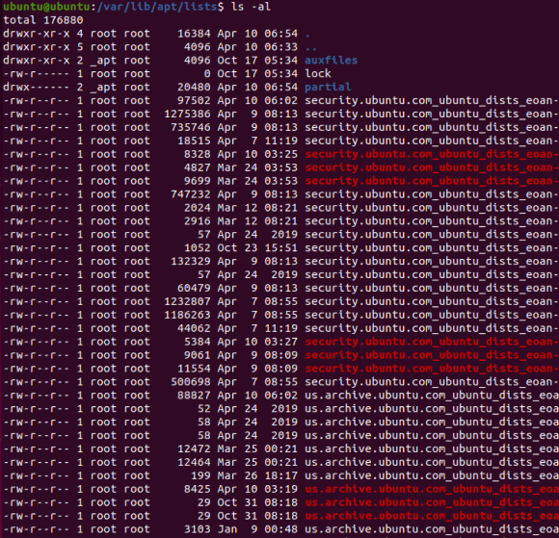
Updates / Patching Apt-Get
There are a lot of places you can look to see when the last apt-get was run and by whom:
You can use acct (discussed previously) to see when the apt-get / apt-config command was run
You can look at the access times in the /var/lib/apt/lists folder to see when they were accessed last
You can look in the apt-get file repository / log folders to pull information that may be useful
Notes:
Review slide.

Slide 26
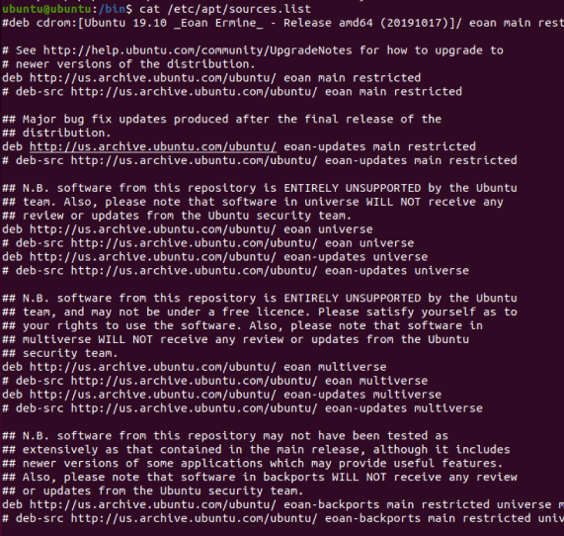
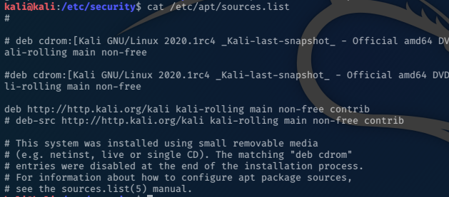
Updates / Patching Apt-Get
/etc/apt/sources.list
/etc/apt/sources.list.d
/var/lib/apt/lists
/var/lib/apt/lists/partial
/var/cache/apt/archives
/etc/apt/apt.conf
/etc/apt/apt.conf.d
Notes:
Besides seeing when it was run and what patches were pulled down it is also important to see what repositories apt-get might be pulling from to ensure you are not referenced to a malicious repository. Malware can use update functions as both persistence mechanisms, as well as updates and C2 mechanisms.

Slide 27
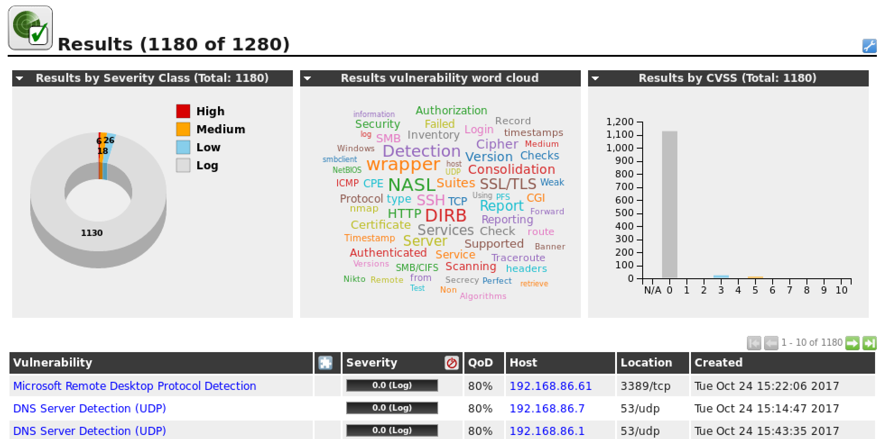
OpenVAS
Existing vulnerabilities of a possible compromised system helps identify initial access vectors and direct the investigation
OpenVAS is a freeware vulnerability scanner that gives current vulnerabilities associated with a system
Benefits:
Initial access artifacts are often gone by the time a response is initiated
Identifies avenues to direct the next step in the investigation
Notes:
OpenVAS is an open-source vulnerability scanner that can assist with identifying what types of patches were either done or even worse not done. Knowing what vulnerabilities exist on a system can help identify initial access vectors that can inform the investigation.

Slide 28
Overview
System hardening
Software patching
Integrity checking
System auditing
Investigation
Notes:
Review slide.

Slide 29
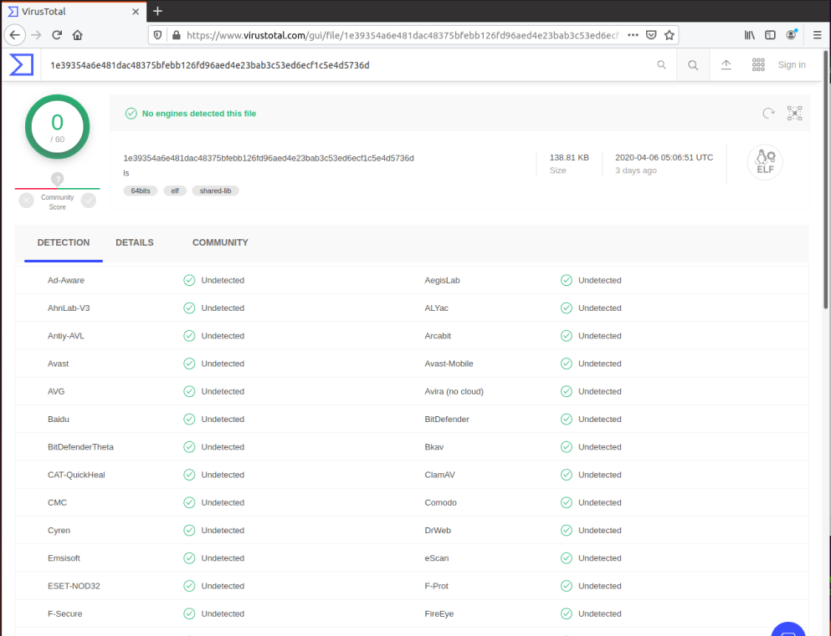
File Integrity
Assume root compromise!
Validate required binaries:
md5sum
sha(1, 224, 256, 384 or 512)sum
Pair with Virus Total or similar
Scan with AV engine
Notes:
Integrity checking it critical to any investigation. When you pull information from a system you believe has been compromised, you have to take all the information you are getting back with a grain of salt, until you can verify that all of the programs you are using to pull that information are not compromised themselves. In order to get around this, there are a lot of ways you can start. The first, and probably the best way is to bring your own ‘known good’ binaries with you. If you bring your own ‘ls’ binary, you can be relatively sure that when you try to list out the directory contents using your ls, that what you are getting back is probably the correct contents of that folder. Another option is to use hashing tools that can hash all of your needed binaries, so you can check them against a database such as VirusTotal to see if they are correct or not. Lastly, there are freeware virus antiviruses that can be used to scan all files on disk looking for known bad hash signatures.

Slide 30
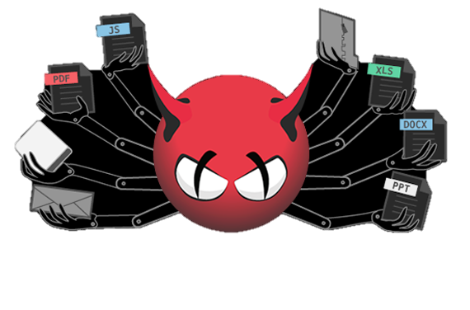
File Integrity ClamAV
Open-source antivirus engine for detecting Trojans, viruses and malware
Command-line interface
Can be used for desktops, servers or even on e-mail gateways
Supports multiple file formats, file and archive unpacking and multiple signature languages
NOTE: ClamTK is the GUI version
Notes:
Below contains a few commands to download, install, use and remove Clam AV:
Sudo apt-get update
Sudo apt-get install clamav clamav-daemon
Clamscan –-version
Clamscan –-help
Sudo clamscan --infected --remove --recursive ./ (scans current directory)
Sudo clamscan --infected --remove --recursive / (scans entire filesystem)
Sudo apt-get remove clamav clamav-daemon
Source: https://vitux.com/secure-ubuntu-with-clamav-antivirus/.

Slide 31
Overview
System hardening
Software patching
Integrity checking
System auditing
Investigation
Notes:
Review slide.

Slide 32
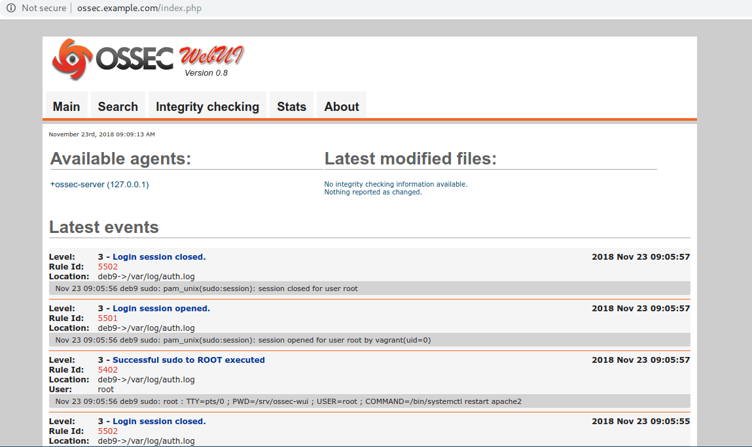
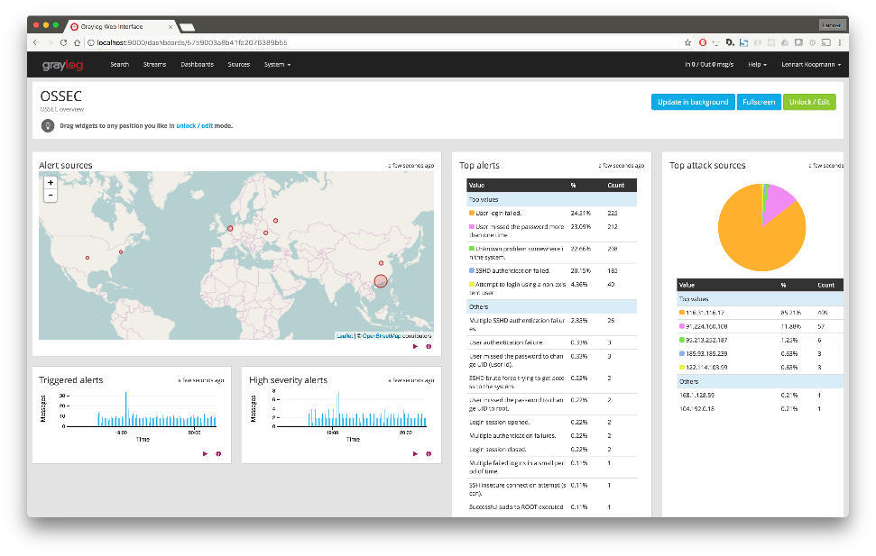
OSSEC
Host Intrusion Protection System
OSSEC is a freeware open source scalable, multiplatform, host-based intrusion detection system
Capabilities
Log-based intrusion detection
Rootkit and malware detection
Active response
Compliance auditing
File integrity monitoring
System inventory
Notes:
Lastly, it is always useful to go to the system logs! Linux by default logs a lot of different events and these logs can be aggregated and displayed using a lot of different tools that can help inform an investigation. OSSEC is a popular open-source host intrusion protection system that actively monitors these logs and can respond in near-real-time to stop execution of certain processes.
Log based Intrusion Detection (LID): Actively monitors and analyzes data from multiple log data points in real-time.
Rootkit and malware detection: Process- and file-level analysis to detect malicious applications and rootkits.
Active response: Respond to attacks and changes on the system in real-time through multiple mechanisms including firewall policies, integration with third-parties, such as CDN’s and support portals, as well as self-healing actions.
Compliance auditing: Application- and system-level auditing for compliance with many common standards, such as PCI-DSS and CIS benchmarks.
File Integrity Monitoring (FIM): For both files and Windows Registry settings in real-time, not only detects changes to the system it also maintains a forensic copy of the data as it changes over time.
System inventory: Collects system information, such as installed software, hardware, utilization, network services, listeners and other information.
Can populate to a Splunk dashboard.
Source: https://www.ossec.net/about/.

Slide 33
Plaso
Computer forensic tool for timeline generation and analysis of system logs
Pulls and analyzes logs from suspect host for timeline analysis and correlation
Written in Python
Modules include:
Image_export: Exports file content based on criteria (e.g. extention, path, etc)
Log2timeline: Extracts events from individual files, recursing a directory or device
Pinfo: Command-line to allow for parsing information from plaso storage file
Psort: CLI to post-process plaso storage files to sort and run auto analysis
Psteal: CLI combines log2timeline and psort
Notes:
Plaso is an open-source software that pulls system logs and displays events in an easy to follow way that can highlight malicious activity and pairing like activity together in once easy to view list of events. Plaso is made up of a bunch of different modules.
Sources:
https://plaso.readthedocs.io/en/latest/sources/user/Users-Guide.html#the-tools.
https://github.com/log2timeline/plaso/releases.
https://medium.com/dfclub/how-to-use-log2timeline-54377e24872a.
https://www.dropbox.com/sh/q0w7fy25qyltalh/AAD_VbL27cpa2bKuCtKaCuhaa?dl=0.

Slide 34
Overview
System hardening
Software patching
Integrity checking
System auditing
Investigation
Notes:
Review slide.

Slide 35
Native Commands
A lot of information can be gathered using native Linux shell commands:
… just to name a few …
Warning: If adversary has root, the binaries may be compromised!
It is best practice to run known good binaries to pull artifacts
crontab
ps
Netstat / SS
Ls
Cat
Service
Iptables
Hostname
Uname
Uptime
Date
Showmount
Mount
Ifconfig
Who
Lsof
Dmesg
Md5sum
Sha256sum
Sha512sum
dd
Notes:
Now that we have armed you with the knowledge and know how to identify bad (by knowing what good looks like), there are a couple of generic tools/commands that can help you pull the information to analyze. The first are standard Linux native commands. Remember, it is best to bring your own binaries with you when you run these commands!
Many of these commands should have already been covered in the Linux OS Environment Lesson, but if not here is a quick cheat sheet (many of these commands will require an argument or flag to work properly):
Crontab: Lists all scheduled tasks (Windows: schtask) (scheduled tasks in Linux are called cronjobs).
Ps: Lists all running processes (Windows: tasklist).
Netstat: List all network connections (Windows: netstat).
SS: Sockets, lists network connections … follow-on to netstat, which is now antiquated on many Linux systems.
Ls: List file contents (Windows: dir).
Cat: Concatenate a file to view it.
Service: List running services (Windows: sc).
Iptables: Host firewall.
(Notes continued on next page).

Slide 36
Native Commands
A lot of information can be gathered using native Linux shell commands:
… just to name a few …
Warning: If adversary has root, the binaries may be compromised!
It is best practice to run known good binaries to pull artifacts
crontab
ps
Netstat / SS
Ls
Cat
Service
Iptables
Hostname
Uname
Uptime
Date
Showmount
Mount
Ifconfig
Who
Lsof
Dmesg
Md5sum
Sha256sum
Sha512sum
dd
Notes:
(Notes continued from previous page).
Hostname: Display hostname.
Uname: Displays current operating system details.
Uptime: Shows how long machine has been running.
Date: Shows system date.
Showmount: Shows all remotely mounted drives.
Mount: Shows mounted drives.
Ifconfig: Shows network address (Windows: ipconfig).
Who: Displays current user.
LSOF: Lists open file handles.
Dmesg: Lists recent kernel messages.
XXX###sum: Hashes file for comparison.
Dd: Copies files, but can also be used to create an image of an entire hard drive for forensic analysis (https://blog.kintoandar.com/2010/02/how-to-disk-dump-dd.html#transfer-a-disk-image).

Slide 37
System Utilities
Linux distributions use systemd to initialize and start all services for boot
Systemd comes with multiple built-in utilities, which can be used to collect artifacts to inform an investigation
Systemd utilities:
Systemctl
Networkctl
Loginctl
Journalctl
Notify
Analyze
Cgls
Cgtop
Notes:
Systemd also initializes a lot of utilities during startup that can be used to pull information:
Systemctl: Can be used to inspect systemd manager and systemd core functions.
Networkctl: Used to inspect network sockets/connections.
Loginctl: Lists current log-in sessions.
Jounalctl: Queries the systemd journal contents.
Analyze: Used to determine system boot-up performance statistics and retrieve other state and tracing information from the system and service manager, and to verify the correctness of unit files. It is also used to access special functions useful for advanced system manager debugging. Analyze has a lot of options for investigating a system. Some of them can be found here: https://www.freedesktop.org/software/systemd/man/ systemd-analyze.html.
CGLS: Maps services to processes and displays in a tree.
CGTOP: Synonymous with a Windows Task Manager. Shows tasks, CPU %, memory usage, inputs and outputs continuously.

Slide 38
FLUFFE (v1.2)
First Look Unix Field Forensic Examiner (FLUFFE): Initial forensic analysis tool written in BASH for Linux systems
Used for initial incident response to gather artifacts from live hosts, enable initial triage and determine the next best step in the investigation
Leverages known-good binaries of common Linux commands via BusyBox, as well as on disk system utilities to gather artifacts from the potentially infected host
Warning: System utilities leveraged by FLUFFE use on disk binaries
Activity: Open FLUFFE and review the BASH script
Notes:
Lastly, FLUFFE was created as an initial response tool to gather some of this information quickly and easily. Initially created by the 33 NWS as a FRED equivalent for Linux. It has been updated by the 32 WPS to add additional contextual information to assist in initial triage.
Instructor note: As an activity and to ensure the students understand what FLUFFE will provide to them, open the latest version of FLUFFE and review the commands run and the outputs. If the students have laptops and the correct VM (Kali VM and FLUFFE) they can run this themselves and review what they found.
Audit File: Lists all files and creation times from critical system paths to identify if there is anything out of the ordinary.
SysInfo File: Gathers a lot of useful contextual information about the system and environment.
Dmesg: Looks through recent kernel messages to see if there is anything unusual.
SystemCtl/LoginCtl/JounalCtl: Lists more details than sysinfo, but is unvalidated. Will want to cross-reference with sysinfo.

Slide 39
BusyBox
Designated as the ‘Swiss Army knife’ for embedded Linux, BusyBox combines tiny versions of many common Unix utilities into a single executable
100s of Linux commands are contained in BusyBox
FLUFFE uses its own BusyBox binaries to ensure known good info is passed back from the target
To invoke BusyBox:
1. Define absolute path for Linux command to BusyBox each time you call
/bin/busybox ls
2. Create a symbolic link for required commands
ln –s /bin/busybox ls
Notes:
BusyBox combines tiny versions of many common UNIX utilities into a single small executable. It provides replacements for most of the utilities you usually find in GNU fileutils, shellutils, etc. The utilities in BusyBox generally have fewer options than their full-featured GNU cousins; however, the options that are included provide the expected functionality and behave very much like their GNU counterparts. BusyBox provides a fairly complete environment for any small or embedded system.
BusyBox has been written with size-optimization and limited resources in mind. It is also extremely modular so you can easily include or exclude commands (or features) at compile time. This makes it easy to customize your embedded systems. To create a working system, just add some device nodes in /dev, a few configuration files in /etc and a Linux kernel.
To see a live version of busybox in your browser visit this site: https://www.busybox.net/live_bbox/live_bbox.html.
Source: https://www.busybox.net/about.html.

Slide 40
Summary
System hardening
Software patching
Integrity checking
System auditing
Investigation
Notes:
Be minimalist – keep it simple stupid.
Defense-in-depth – take a layered approach.
Vigilance – no matter how secure you are today, eventually new vulnerabilities will be discovered and you must constantly be assessing your security state.

Slide 41
Objectives
List and illustrate the boot sequence for a Linux Operating System
Describe the daemon start sequence
Describe why defenders care about patching configuration / events
List eight native commands that can be used during an investigation
Describe FLUFFE
Notes:
Objectives for the lesson.

Slide 42
Notes:
Questions?

Slide 43
References
https://books.google.com/books?id=K7mOQ2CCH-IC&pg=PA219&lpg=PA219&dq=understanding+what+ %22right%22+looks+like+on+linux+for+defense&source=bl&ots=o-sYKpjFQP&sig=ACfU3U2Z0yiBoC3i2WhfQDavC uZEk--9NA&hl=en&sa=X&ved=2ahUKEwj43Ymr5tvoAhVRKH0KHWWbAZ4Q6AEwCnoECA0QKQ#v=onepage&q= understanding%20what%20%22right%22%20looks%20like%20on%20linux%20for%20defense&f=false
https://books.google.com/books?id=PyqjvNNltqYC&pg=PR26&lpg=PR26&dq=understanding+normal+to+defend+linux&source=bl&ots=XFpLbASIfM&sig=ACfU3U2st1ZsegdN3by8UhDiukPY8Z0MEA&hl=en&sa=X&ved=2ahUKEwjB6ra_5tvoAhXKFTQIHd72CbUQ6AEwCXoECAwQKQ#v=onepage&q=understanding%20normal%20to%20defend%20linux&f=false
https://ftp.kh.edu.tw/Linux/Redhat/en_6.2/doc/ref-guide/s1-sysadmin-boot.htm
https://github.com/log2timeline/plaso/releases
https://linux-audit.com/security-defenses-to-fortify-your-linux-systems/
https://opensource.com/article/17/2/linux-boot-and-startup
https://plaso.readthedocs.io/en/latest/sources/user/Users-Guide.html#the-tools
https://vitux.com/secure-ubuntu-with-clamav-antivirus/
https://www.ossec.net/about/
https://www.busybox.net/about.html
Notes:
References.

Slide 44
References
https://www.dropbox.com/sh/q0w7fy25qyltalh/AAD_VbL27cpa2bKuCtKaCuhaa?dl=0
https://www.ghacks.net/2009/04/04/get-to-know-linux-the-etcinitd-directory/
https://www.kali.org/tutorials/configuring-and-tuning-openvas-in-kali-linux/
https://www.linux.com/training-tutorials/linux-101-updating-your-system/
https://medium.com/dfclub/how-to-use-log2timeline-54377e24872a
https://www.tecmint.com/how-to-monitor-user-activity-with-psacct-or-acct-tools/
Notes:
References.

Slide 45
Notes:
CWU919KD, Threat Detection: Linux Defensive Capabilities.

