Slide 1
Notes:
CWU911KD, Threat Detection: Windows Command Line Interface Resources.

Slide 2
So What?
Shake off the rust
Do you wanna pass TA phase???
Notes:
Unrealistic to take on a full-up mission without any tools at your disposal – this lesson will even talk about some add-on tools later in this lesson. However, given some challenges our DCO force has faced with system owners being uncooperative or risk averse, as well as instances of tools not covering every one of over a half a million endpoints, knowing what you have in the CLI may be all you have on short notice.
CLI utilities can give an initial look at what is happening with an individual system, and give you an idea of what additional tools you might want to install to give you the visibility that a CLI could not.

Slide 3
Overview
PowerShell
Metasponse
Sysinternals
FRED
Notes:
Review slide.

Slide 4
PowerShell
Modern command shell that includes best features of other popular shells
Command-line history
Supports Tab completion and command prediction
Pipeline for chaining commands
In-console help system
Commonly used to build, test, and deploy solutions
Built on the .NET Common Language Runtime (CLR)
All inputs and outputs are .NET objects
No need to parse text output to extract information from output
Built-in support for common data formats like CSV, JSON, XML

Slide 5
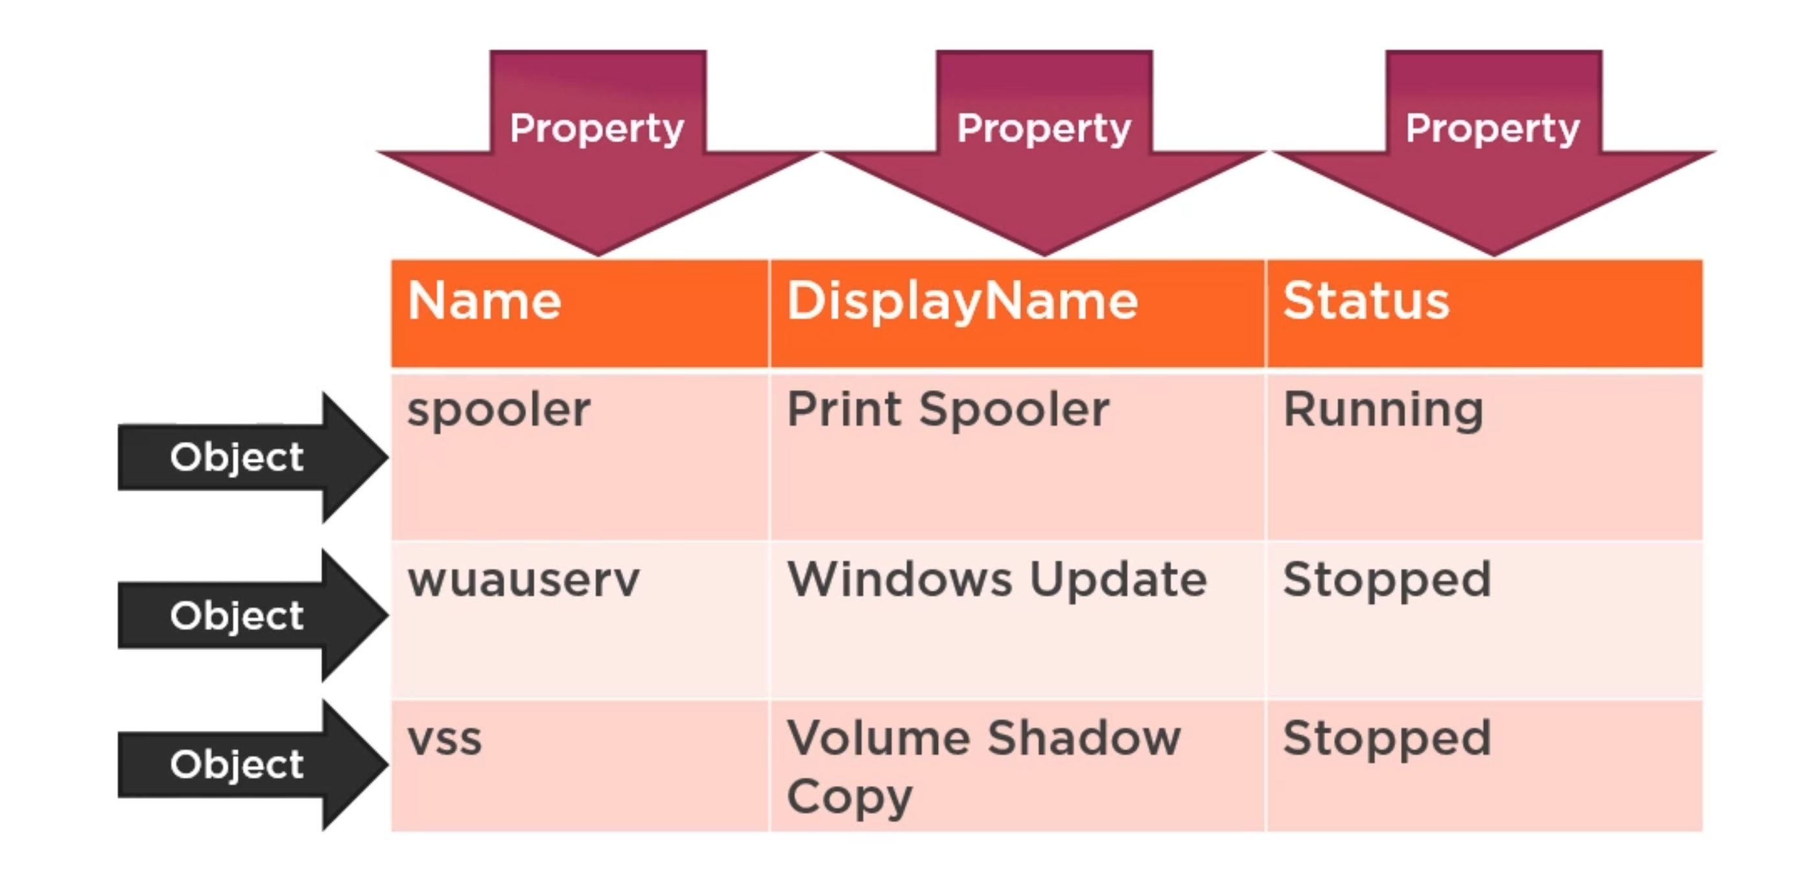
PowerShell Treats Data as Objects

Slide 6
3 Important Commands
Get-Command
Used to search for installed commands
Get-Help
Displays how-to information for commands
Get-Member
Displays properties and methods of objects

Slide 7
Documentation
Get-History
Gets a list of the commands executed
Invoke-history –id #
Out-File to text
Start-Transcript
Creates a record of all or part of a PowerShell into a text file
Start-Transcript –path {PATH} -append

Slide 8
Slice & Dice
Where-Object
Selects objects from a collection based on their property values
Select-Object
Select objects or object properties
Sort-Object
Sorts objects by property value

Slide 9

DEMO
Find a cmdlet to display all the services on your ops station
Using that same cmdlet slice & dice the output to only show running services
Sort your services by Status and select 3 properties of your choosing and then save it to a CSV

Slide 10
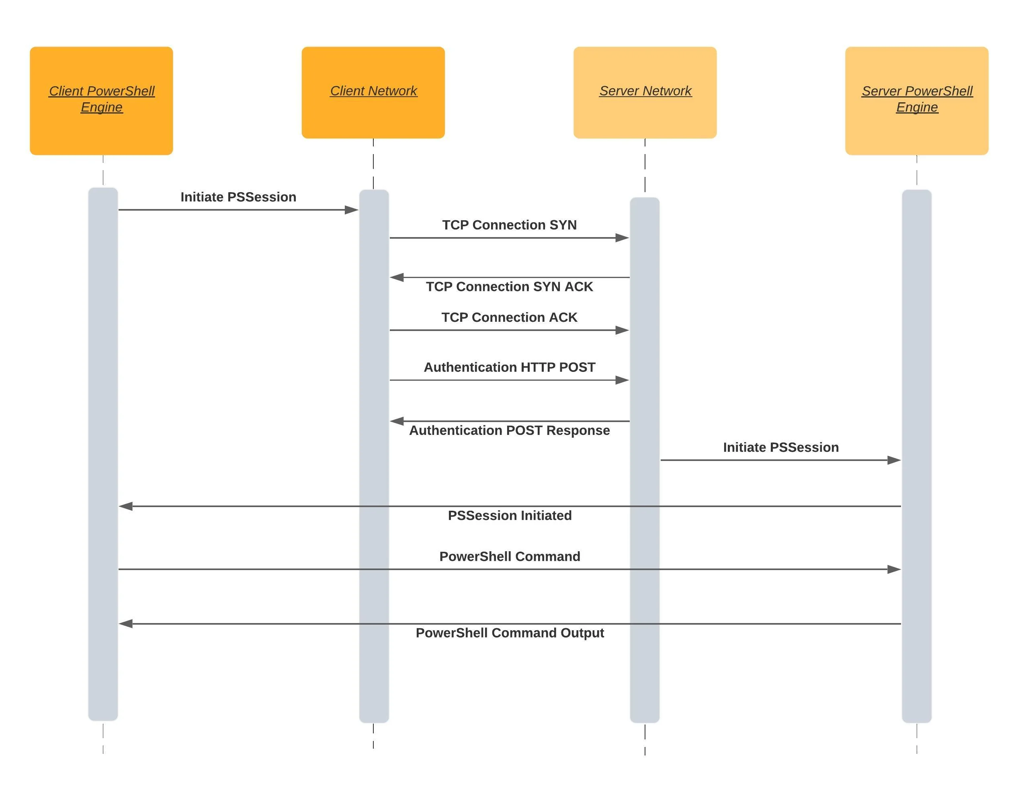
PSRemoting
Enables you to run commands on remote computers
Client connects to destination on a WinRM listener
Client connects over HTTP or HTTPs and authenticates
Once complete a session is established

Slide 11
PSRemoting Dependencies
Trusted Hosts
Set-Item WSMan:\localhost\Client\TrustedHosts –Value *
Basic Authentication not secure
Creds
Get-Credential
Gets a credential object based on a user name and password
Stored as a Secure String
WinRM
Windows Remote Management
Must be running and allowed through the firewall
Winrm qc

Slide 12
How Do We Make a Connection
New-PSSession
Creates a persistent connection to a local or remote computer
Enter-PSSession
Starts an interactive session with a remote computer
Can utilize session id’s to enter a persistent connection
$cred = Get-Credential
$Session = New-PSSession –ComputerName [IP] –Credential $cred
Enter-PSSession –id #

Slide 13
File Traversal in PSSession
Copy-item
cmdlet copies an item from one location to another location in the same namespace
Copying an item to a Remote System
$Session = New-PSSession -ComputerName [IP] -Credential $cred
Copy-Item "D:\Folder004\scriptingexample.ps1" -Destination "C:\Folder004_Copy\scriptingexample_copy.ps1" -ToSession $Session
Copying an item from a Remote System
$Session = New-PSSession -ComputerName [IP] -Credential $cred
Copy-Item "C:\MyRemoteData\test.log" -Destination "D:\MyLocalData\" -FromSession $Session

Slide 14

DEMO
Create a session on Workstation 1 using PSRemoting
Copy any item on your ops station to Workstation 1 and then validate using Get-ChildItem
On the remote system get the list of running services, export it to CSV and copy from the session to your ops station
Using GCM find a cmdlet to invoke commands on the remote computer using your session
Hint: help [cmdlet] –Examples
Use –ScriptBlock to determine the PSVersion of Workstation 1

Slide 15
Overview
PowerShell
Metasponse
Sysinternals
FRED
Notes:
Review slide.

Slide 16
MetaWhat? MetaWho?
Cyber-Operations mission distribution framework that enables incident responders and network defense personnel to collect, normalize, and analyze defensive and IR data
Agentless Solution
GUI and command-line based capability
Pre-built collectors perform data retrieval
Multiple built-in remediation options (Windows)
Delete file, service removal, driver uninstallation
Windows Firewall rule modification
Forcefully disconnect user or shutdown system
Outputs in Table View and JSON View, Elasticsearch, or Splunk

Slide 17
Metasponse Dependencies
Supported OS:
Windows Server 2000/2003/2008/2012
Windows XP, Vista, 7, 8, 8.1, 10, 11
Linux, Solaris (Limited Collectors)
Will not run with FIPS compliance enabled
Domain Admin/SSH Credentials
Each Transport has its own dependency/requirement

Slide 18
Collectors Vs Transport
Collectors
Plugin that executes on the remote system
Native PowerShell scripts, native executables, Python scripts, WMI scripts, .NET binaries, or Batch scripts
Reliant on Metasponse Transports
Transports
Plugin that provides communication methods to remote system
Configuration changes may be required
Certain Collectors require specific transports

Slide 19
Common Collectors
Accounts
Autoruns
Logins
USB Drive
SysInfo
NetStat
Survey

Slide 20
Rapid Analysis For Incident Response (RAIR) Collector
Collector enumerates the memory of each process and loaded module
Uses the process’s Virtual Address Descriptor (VAD) tree enumerate allocated memory
Performs deep inspection to detect generic indicators of:
Hidden and injected modules
Code modifications
Weak or modified memory region protection
Hidden processes
Function hooks
Dynamically allocated code
Packed Code
Output only readable in JSON

Slide 21
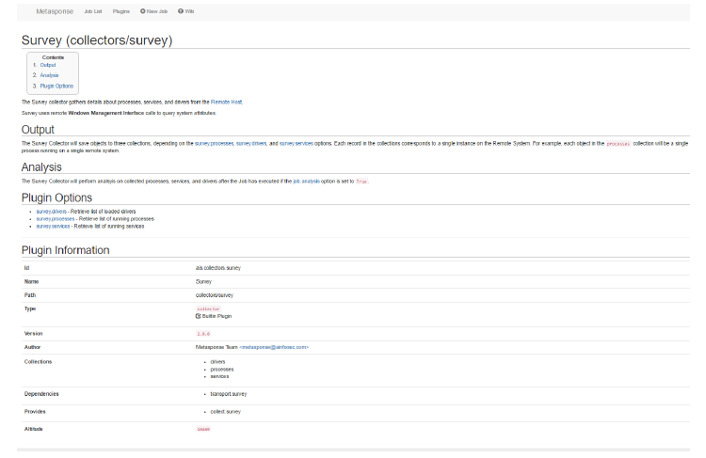
Help
All pre-installed plugins have READMEs
Included in Metasponse Folder
Web UI host a Wikipage

Slide 22
If You Can’t Get A Job Create One!
Show collectors
Displays all the collectors available (optional if you know which one you want)
Use collectors/accounts
Use transports/mswmi
Use transports/smb
Set job.rhost [IP]
Can be a subnet, list (set job.rhost < ip.txt), or a single command separated by a white space
Set job.domain [domain name]
Set job.user [username]
Set job.password

Slide 23
If You Can’t Get A Job Create One!
Set job.log.level debug
Job rename [name]
Must be unique
Check deps
Show options
Schedule now
Jobs are set for auto pickup completion time varies per collector

Slide 24
Where Dat Data At?
Data that is collected during Job execution is enumerated, normalized, and saved to the Metasponse Datastore.
The Metasponse Provider is the official method of interacting with the Metasponse Datastore.
Hint: If you can use PowerShell you can use the Provider
Existing PowerShell cmdlets work within the Provider
Execution Policy must be set or the Provider will fail to launch
The Metasponse Provider, which transparently wraps the Datastore collected objects and structures as PowerShell objects and provides a physical filesystem interface

Slide 25
Metasponse Provider File Structure

Slide 26

Demo
Execute the Accounts Collector against Workstation 1
In the Provider Slice & Dice your output to show you only the local admin account
Execute the Survey Collector against Workstation 1
In the Provider Slice & Dice your output to show only 5 services, PID, Path, and HostIP then export your results into a CSV

Slide 27
You Wanna Get Fancy Lets Get Fancy
Metasponse Macros are a quick way of automating a list of steps by typing a single command
Macros will allow the use of macro arguments and variables
Macros are built similar to jobs
macro autoruns
use collectors/autoruns
use transports/mswmi
use transports/smb
job rename $1
set job.rhost [IP] or $hosts
End
Var host = “host-1 192.168.0.100”
Optional not required

Slide 28
You Wanna Get Fancy Lets Get Fancy
To Run your Macro
[Macro Name] [Macro Argument 1] …
Schedule now
Automate your execution by saving your Macros in a script file
Path: C:\Program Files\Metasponse\Core
Extension: .rc
In the console type:
Include [macro script name]
Check to ensure your macros are loaded
Macro –s [macro name]
Gives a description
Macro –l
List all macros

Slide 29

Demo
Build a Macro using any collector and execute it against Workstation 1

Slide 30
Overview
PowerShell
Metasponse
Sysinternals
FRED
Notes:
Review slide.

Slide 31
SysInternals Demo
Copy the SysInternals Suite Folder onto Workstation 1
Execute Strings against a file on the workstation
Execute autoruns via the command line on Workstation 1
Delete SysInternals Suite Folder on Workstation 1

Slide 32
Overview
PowerShell
Metasponse
Sysinternals
FRED
Notes:
Review slide.

Slide 33
FRED Demo
Copy FRED 3.3 onto Workstation 1
Execute FRED on Workstation 1
Familiarize yourself with its output

Slide 34
Summary
PowerShell
Metasponse
Sysinternals
FRED
Notes:
Review slide.

Slide 35
Notes:
Questions?

Slide 36
Notes:
CWU911KD, Threat Detection: Windows Command Line Interface Resources.

