Slide 3
Disclaimer
These lessons are not testable and are designed only for your benefit during mission planning and execution for
Plans & Threats 2.

Slide 4
So What?
Build your TTP’s in preparation for P&T 2
This presentation will serve as an introduction to concepts as well as reference material for flight level planning
Applying Windows logging and network capture tools with a basic understanding of how to investigate a network intrusion
Notes:
The purpose of these academics is to introduce students to all the tools necessary to be successful on P&T 2. (PS-Session, Command Line Event Viewer, Wireshark)
Even if you’ve never been in defensive operations, a basic understanding of Windows logs and network traffic is a foundational knowledge concept of a Cyber Weapons Officer. This lesson isn’t designed to make you a DCO operator, and there will be many future academics on theory and best practices for hunt missions.
Read last line, this is what students should be able to leave this lesson with.

Slide 5
Overview
Schedule
Windows Logs
Command Line Tools
Basic Collection & Analysis
Case Study
Environment
Lab Guide/Assessment
Notes:
Review slide.

Slide 6
Schedule
Guided (2 hours)
WST-2 Academics (45 min)
Break (15 min)
WST-2 Lab Guide (1hr)
Unguided (2 hour)
WST-2 Assessment
Instructors will be available for troubleshooting only

Slide 7
Overview
Schedule
Windows Logs
Command Line Tools
Basic Collection & Analysis
Case Study
Environment
Lab Guide/Assessment
Notes:
Review slide.

Slide 8
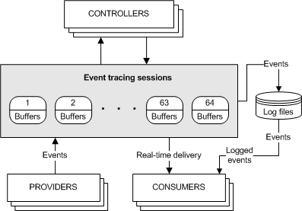
Windows Logs
Windows Event Logs
Providers
Configures the Event Tracing for Windows (ETW) user-mode provider
Writes events to an ETW session and adds more information
E.g., Sysmon
Controllers
Applications that define log/tracing parameters
Logs
Locations where Providers write log information
Consumers
E.g., Event Viewer, SIEM, etc.
Notes:
https://learn.microsoft.com/en-us/windows-hardware/test/wpt/eventprovider
https://learn.microsoft.com/en-us/windows/win32/etw/about-event-tracing

Slide 9
Sysmon
Dump current Sysmon configuration
sysmon -c
On Vista and higher, events are stored in Applications and Services Logs/Microsoft/Windows/Sysmon/Operational
On older systems events are written to the System log
Timestamps are in UTC by default
Notable capabilities:
Logs process creation with full command line for both current and parent processes
Includes a process GUID in process create events to allow for correlation of events even when Windows reuses process IDs
Notes:
https://learn.microsoft.com/en-us/sysinternals/downloads/sysmon#overview-of-sysmon-capabilities

Slide 10
Command Line Tools
PowerShell
PS-Session
Get-WinEvent
Windows Command Line
Wireshark

Slide 11
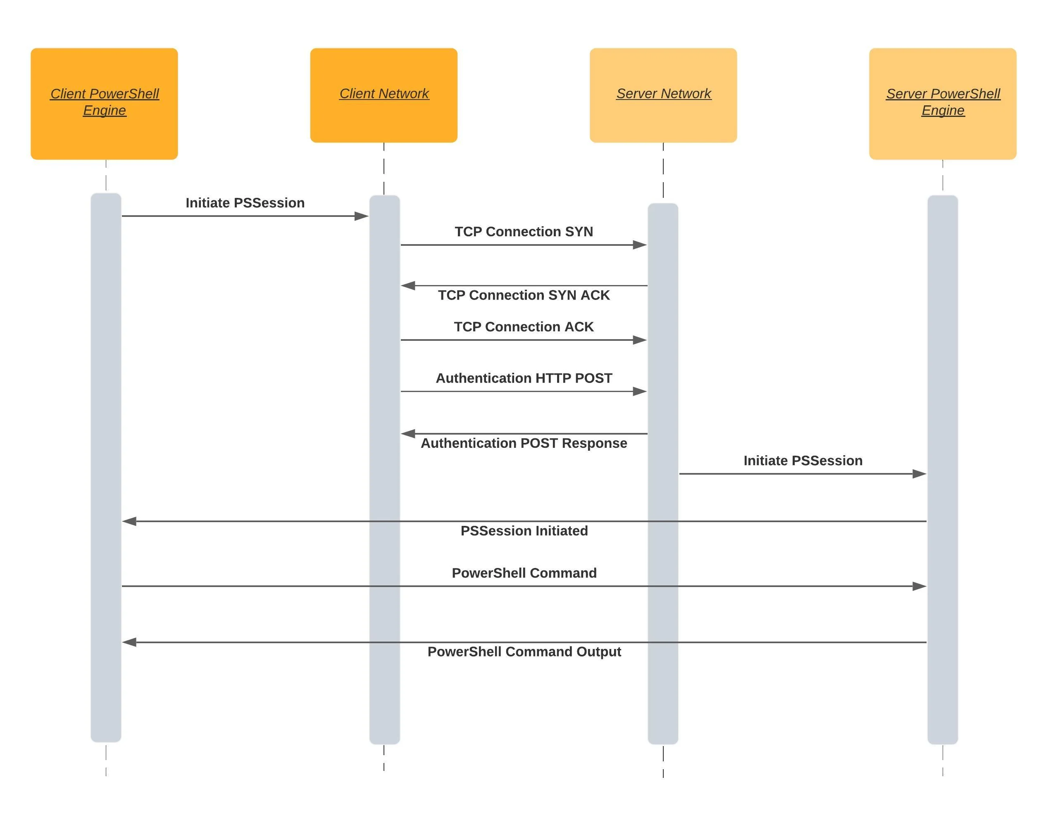
PSRemoting
Enables you to run commands on remote computers
Client connects to destination on a WinRM listener
Client connects over HTTP or HTTPs and authenticates
Once complete a session is established
Notes:
Slide 9 from DHT-1

Slide 12
PSRemoting Dependencies
Trusted Hosts
Set-Item WSMan:\localhost\Client\TrustedHosts –Value *
Basic Authentication not secure
Creds
Get-Credential
Gets a credential object based on a user name and password
Stored as a Secure String
WinRM
Windows Remote Management
Must be running and allowed through the firewall
Winrm qc

Slide 13
PSSession
New-PSSession
Creates a persistent connection to a local or remote computer
Enter-PSSession
Starts an interactive session with a remote computer
Can utilize session ID’s to enter a persistent connection
$cred = Get-Credential
$Session = New-PSSession –ComputerName [IP] –Credential $cred
Enter-PSSession –id #
Notes:
Slide 11 from DHT-1

Slide 14
WinEvent
Get-WinEvent
Gets events from event logs and event tracing log files on local and remote computers
Get-WinEvent Parameters:
-LogName <string>
-MaxEvents <Int64>
-ComputerName <string>
-Credential <PSCredential>
-ListProvider <string>
Notes:
https://learn.microsoft.com/en-us/powershell/module/microsoft.powershell.diagnostics/get-winevent?view=powershell-7.3

Slide 15
Using Get-WinEvent
Get all the logs from a local computer
Get-WinEvent -ListLog *
Get event logs from a remote computer that are not empty
Get-WinEvent -ListLog * -ComputerName Client01 | Where-Object { $_.RecordCount }
Get event logs from multiple remote computers
$S = 'Server01', 'Server02', 'Server03’ ForEach ($Server in $S) { Get-WinEvent -ListLog Application -ComputerName $Server | Select-Object LogMode, MaximumSizeInBytes, RecordCount, LogName, @{name='ComputerName'; expression={$Server}} | Format-Table -AutoSize }
Notes:
https://learn.microsoft.com/en-us/powershell/module/microsoft.powershell.diagnostics/get-winevent?view=powershell-7.3

Slide 16
Get-WinEvent Providers
Get event log providers and log names
Get-WinEvent -ListProvider *
Get all event log providers that write to a specific log
(Get-WinEvent –ListLog Application).ProviderNames
Get Event ID information from a provider
(Get-WinEvent –ListProvider Microsoft-Windows-GroupPolicy).Events | Format-Table Id, Description
Notes:
https://learn.microsoft.com/en-us/powershell/module/microsoft.powershell.diagnostics/get-winevent?view=powershell-7.3

Slide 17
Get-WinEvent Advanced
Get log information from event object properties
$Event = Get-WinEvent -LogName 'Windows PowerShell' $Event.Count $Event | Group-Object -Property Id -NoElement | Sort-Object -Property Count -Descending $Event | Group-Object -Property LevelDisplayName –NoElement
Using Where-Object
$Yesterday = (Get-Date) - (New-TimeSpan -Day 1) Get-WinEvent -LogName 'Windows PowerShell' | Where-Object { $_.TimeCreated -ge $Yesterday }
Notes:
https://learn.microsoft.com/en-us/powershell/module/microsoft.powershell.diagnostics/get-winevent?view=powershell-7.3

Slide 18
Powershell Reconstruction
Get-History
Gets a list of the commands executed
Invoke-history
Run a sequence of commands from history: 16..24 | ForEach {Invoke-History -Id $_ }
Start-Transcript
Creates a record of all or part of a PowerShell into a text file
Start-Transcript –path <PATH> –append
Stop-Transcript
PowerShell transcripts does not record commands on the distant end! Use Invoke-Command to accomplish this on remote targets
Notes:
- Slide 6 from DHT-1

Slide 19
Command Line Tools
PowerShell
PS-Session
Get-WinEvent
Windows Command Line
Wireshark

Slide 20
Windows Command Line Pre-Vista
Use the ‘cscript’ interpreter to execute ‘eventquery.vbs’
cd C:\WINDOWS\system32 cscript eventquery.vbs /L Application /V
Refine your search by including a search pattern
cscript eventquery.vbs /L Application /V | findstr /C:"Performance counters for the WmiApRpl“
Further refine your search by specifying the level of the event
cscript eventquery.vbs /L Application /V /FI "Type eq Information"| findstr /C:"Performance counters for the WmiApRpl"
Notes:
https://www.qualitestgroup.com/insights/technical-hub/how-to-query-logs-in-event-viewer-using-the-command-line/

Slide 21
Windows Command Line Post Vista
Query a specific log
wevtutil qe System
List the names of all logs
wevtutil el
Display the three most recent events from the Application log in text format
wevtutil qe Application /c:3 /rd:true /f:text
Notes:
https://learn.microsoft.com/en-us/windows-server/administration/windows-commands/wevtutil

Slide 22
Command Line Tools
PowerShell
PS-Session
Get-WinEvent
Windows Command Line
Wireshark

Slide 23
Wireshark Queries
Use your WUG mates to get past the basics
Match HTTP packets where the HOST header contains several case-sensitive fields
http.host matches “acme\\.(org|com|net)”
Inclusive or ‘set items’ search
tcp.port in {80, 443, 8080}
Note: This is equivalent to tcp.port == 80 || tcp.port == 443 || tcp.port == 8080
Match IP addresses ending in 255 in a block of subnets (172.16 to 172.31)
string(ip.dst) matches r"^172\.(1[6-9]|2[0-9]|3[0-1])\.[0-9]{1,3}\.255"
Notes:
https://www.wireshark.org/docs/wsug_html_chunked/ChWorkBuildDisplayFilterSection.html
https://unit42.paloaltonetworks.com/using-wireshark-display-filter-expressions/

Slide 24
Overview
Schedule
Windows Logs
Command Line Tools
Basic Collection & Analysis
Case Study
Environment
Lab Guide/Assessment
Notes:
Review slide.

Slide 25
Basic Collection & Analysis
DCO track will expand on this content in the future
Use previous experience, but most of all use logic and be prepared to explain
Create a hypothesis
Time is a factor; you must start somewhere!
A basic hypothesis can be broken down into:
“<Adversary> uses <Tool/Technique> to accomplish <Tactic>” based on the MITRE ATTCK Framework
You must consider all three elements and how they work together (e.g. adversary known to use Python tools, but Python does not exist on the network)

Slide 26
Basic Collection & Analysis cont.
Identify data points
Take stock of the data you have available
What data is necessary to pursue your hypothesis?
How will you collect and use the data in a time constrained environment?

Slide 27
Basic Collection & Analysis cont.
Analyze the collected data
What conclusions can you draw from the data collected?
Ambiguous vs. Unambiguous
Ambiguous: Event ID 4688 powershell.exe process created
Unambiguous: Event ID 4697 service created with random character name

Slide 28
Basic Collection & Analysis cont.
Investigations
Once ambiguous or unambiguous indicators have been identified what do you do next? Who does it? How much time should they spend on the determination?
You’ve found an unambiguous indicator! Now what…
Is your gameplan to pivot on the first shiny artifact or do you continue with the plan even in the face of overwhelming evidence?

Slide 29
Overview
Schedule
Windows Logs
Command Line Tools
Basic Collection & Analysis
Case Study
Environment
Lab Guide/Assessment
Notes:
Review slide.

Slide 30
Case Study
Hypothesis
ThirtySecond uses Indirect Command Execution to accomplish Execution and Defense Evasion
Identify Data Points
Windows Logs, Event ID (4688)
Analyze Collected Data
If powershell.exe that is executed from anywhere other than C:\Windows\System32\WindowsPowerShell\v1\ is found, annotate time of execution
Investigate
Determine follow adversary follow on actions (Kill-Chain analysis)

Slide 31
Environment
ROE
All the labs will take place in the P&T range
Two students per range
Deconflict DCO Ops station with your partner
Time window:
dc01
WinSvr2016
dco1
Win11
fs01
WinSvr2016
dco2
Win11
CLIENT1-4
Win10
CLIENT5
XP

Slide 32
Lab Guide/Assessment
The lab guide is intended to provide hands-on experience utilizing the skills taught in this academics
The assessment will provide questions for you to answer to aid in identifying a network intrusion
Treat the assessment as a practice for P&T-2 and plan/document your process in order to be more successful

Slide 33
Overview
Schedule
Windows Logs
Command Line Tools
Basic Collection & Analysis
Case Study
Environment
Lab Guide/Assessment
Notes:
Review slide.

Slide 34
Notes:
Questions.

