Slide 3
Disclaimer
These lessons are not testable and are designed only for your benefit during mission planning and execution.

Slide 4
Motivation
You will be working with ELK during this WST
Anything you build today can be used during the mission tomorrow
I will help you build anything you want so long as you can show me how it supports a hypothesis you have about some adversary activity

Slide 5
Overview
Schedule
Purpose
Tools
Environment
Pipeline
Time Windows
ROEs
Notes:
Review slide.

Slide 6
Schedule
Guided (5 hours)
WST-2 Introduction
WST-2 Kibana User Interface and Components
WST-2 Dashboard Workflow
WST-2 Lab 2
WST-2 Lab 3
WST-2 Lab 4
Unguided (1 hour)
You can work on building your own custom visualizations and analytics
Consider splitting out tasks/work
I will here to help answer questions

Slide 7
Purpose
Give students baseline proficiency with tools that are commonly used throughout USAF DCO units.
Demonstrate the implementation of generic threat hunting analysis techniques applicable outside of the tools we will use to implement them.

Slide 8
Tools
SecurityOnion
A free, open source appliance (OS distribution with pre-packaged software) for threat hunting, network security monitoring, and log analysis.
ElasticSearch, Logstash, and Kibana (ELK stack)
ElasticSearch: Search and analytics engine for both structured and unstructured data.
Logstash: Performs log aggregation, storage, and enrichment.
Kibana: Web interface for visualizations and analysis.
ELK is a component of SecurityOnion and is commonly used as a Security Information and Event Manager (SIEM).
Winlogbeat
An agent that that collects, normalizes, enriches, and ships logs from Windows systems to an ELK server.

Slide 9
Why these tools?
ELK
ELK is a commonly used SIEM across several DCO units
It is free and open-source, therefore no cost to this unit
The concepts we teach you will be applicable to other SIEMs
Very flexible to the data you can ingest and analyze
Good for analyzing both host and network events
Winlogbeat
Beats are a generic agent that are commonly deployed to collect events
EDRs such as Endgame are not authorized in every environment

Slide 10
Environment
All of the labs will take place in the P&T-1/2 range.
One student per range
One SecurityOnion instance per range
SecurityOnion
WinSvr2016
ELK
Winlogbeat Traffic
HTTP 5044 Logstash
dc01
WinSvr2016
SecurityOnion
HTTPS 443
Kibana
HTTPS 5601
dco1
Win11
fs01
WinSvr2016
dco2
Win11
CLIENT1-4
Win10
CLIENT5
XP
No central logging as Winlogbeats does not support XP and Catapult failed to properly configure event forwarding.

Slide 11
Ingestion Pipeline
Windows Event Log
Winlogbeat
ElasticSearch
JavaScript Augmentation Script
Logstash
Collects and stores events on the host
Service executable
Reads from YAML config to figure out which logs/events to ship to ELK
Retrieves logs from Windows Event Log
Ships to ELK
Normalizes the data to standard field definitions (e.g. winlog.event_data.ProcessId to process.pid)
Enriches the data with new fields (e.g. file hashes)
Collects, parses, and transforms logs
Buffers data to help prevent ElasticSearch from being overloaded
Stores and indexes data
Provides query and search abilities
This pipeline has been pre-configured for this WST and P&T-2
You may choose to modify this pipeline for future missions as you have a need

Slide 12
Time Windows
There are two timelines that you will narrow your search windows to:
13 Jan 2022 1000 – 1300: Instructor SoM
13 Jan 2022 0840 – 1000: P&T-1 Execution
You can see what your attack in the last mission looked like from a DCO perspective
Think about what queries and filters you might apply to detect your activity if you were a network defender

Slide 13
End State
By the end of today, you will:
Be familiar with navigating Kibana
Create two dashboards for threat hunting and investigation
Create visualizations implementing frequency analysis to detect abnormal activity
Create visualizations to analyze process parent/child relationships
Create custom drill down events to pass filters and queries from one dashboard to another
Create filters and queries to identify specific adversary TTPs
Use what you’ve created to detect the two previously mentioned attacks
Key analytic techniques:
Frequency Analysis / Long-tail Analysis
Timeline Analysis

Slide 14
ROEs
Add your last name to your saved visualizations, dashboards, and queries
Do not search past 18 July 2022 in your time filters
Reference the implementation details of instructor created dashboards and visualizations only if you get stuck
Instructor dashboards and visualizations have “(Instructor)” in the title

Slide 15
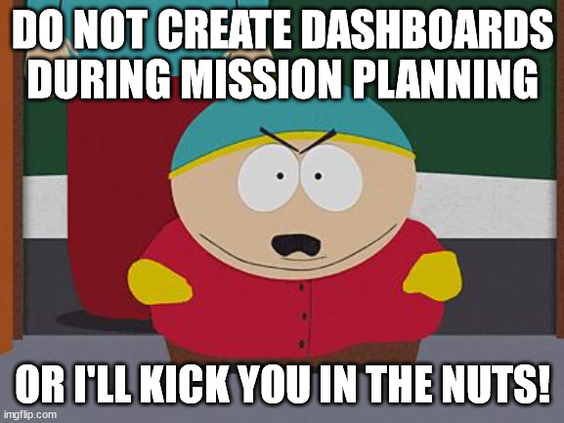
Mission Day ROEs
During mission planning:
Start with your hypotheses
Determine what events you need to look at, what fields in those events matter
Determine how you are going to analyze those events
Build filters, queries, and dashboards during flight line by line (these will be made by yourself)
#FOOTSTOMP

Slide 16
ROEs
✅ | Note | Detailed information that is required to fully understanding the concept or to be able to execute a procedure but is not necessarily related to a key learning objective.
💡 | Learning Point | Information related to key learning objectives.
⚠️ | Warning | Important information related to safety and security.
✋ | Raise Hand | Raise your hand for instructor assistance. This is often used at critical points to validate your understanding of the material.

Slide 17
Overview
Schedule
Purpose
Tools
Environment
Pipeline
Time Windows
ROEs
Notes:
Review slide.

Slide 18
Notes:
Questions.

