Slide 1
Height Balanced Trees
Martín Hernández
Juan Mendivelso

Slide 2
CONTENTS
Height-Balanced Trees.
  What’s an Height-Balanced Tree.
  Structure and Properties of Height-Balanced Trees.
  Height and Number of Leafs Theorem.
  Cases of Rebalancing Trees.
  Implementation of the Insert method in Height-Balanced Trees.
  Other implementations of Height-Balanced Trees

Slide 3
1. Height-Balanced Trees

Slide 4
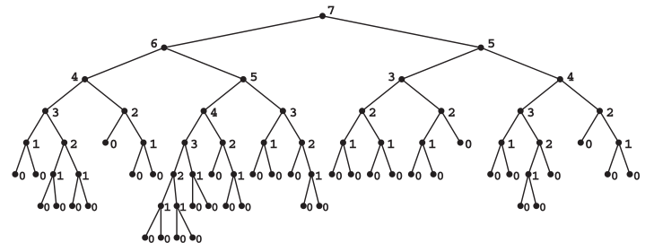
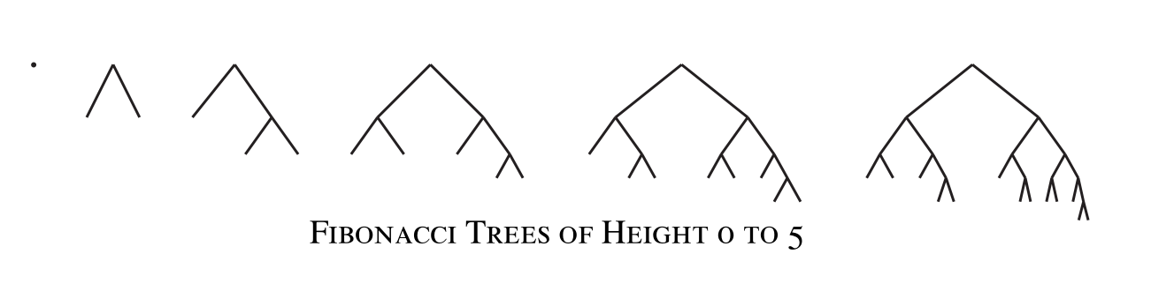
Height Balanced Trees
Most common type of Balanced trees.
Also the Oldest type of Balanced trees, introduced and analyzed by G.M. Adel’son-Vel’skiı̆ and E.M. Landis (1962).
At most has a difference of 1 in the height of the left and right subtrees.
Most of the Search Trees implementation and operations have slight changes.
Presentation made by Hernández & Mendivelso. Contents and figures extracted from the book: Advanced Data Structures. Peter Brass. Cambridge University Press. 2008.

Slide 5
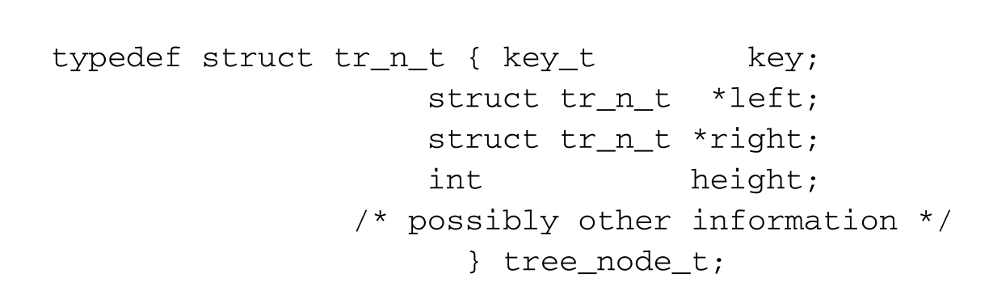
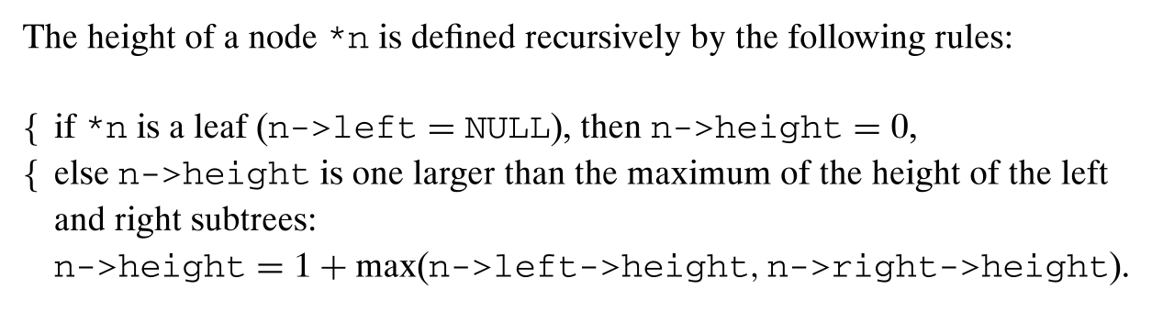
Structure and Properties
Define an int for the height for each node
Emphasis on the definition of the height of a node
Presentation made by Hernández & Mendivelso. Contents and figures extracted from the book: Advanced Data Structures. Peter Brass. Cambridge University Press. 2008.

Slide 6
Structure and Properties
Presentation made by Hernández & Mendivelso. Contents and figures extracted from the book: Advanced Data Structures. Peter Brass. Cambridge University Press. 2008.

Slide 7
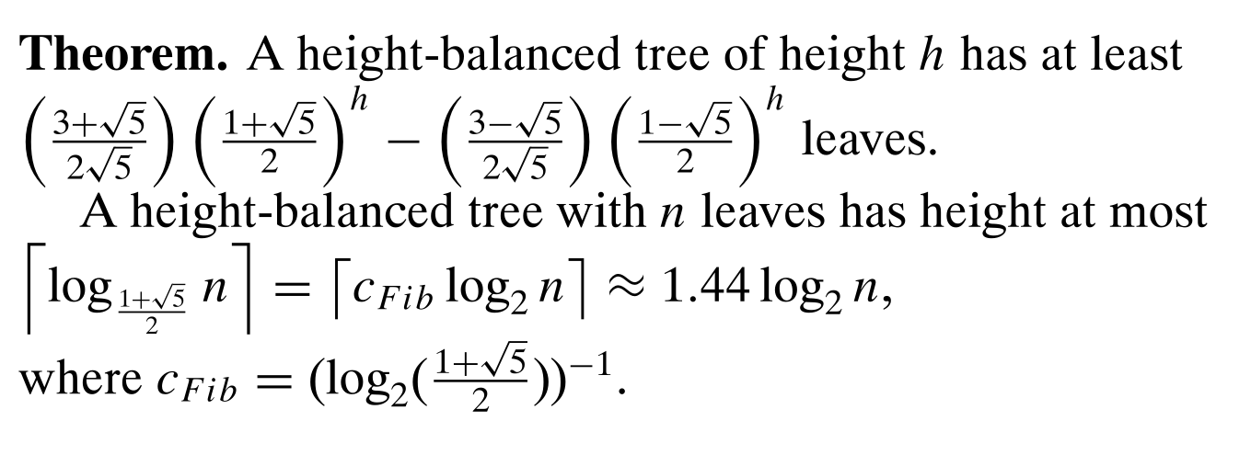
Height and Num. Leaves Theorem
height = 7, then the tree has at least leaves = 34
leaves = 37, then the tree has at most height ≈ 7.5
Presentation made by Hernández & Mendivelso. Contents and figures extracted from the book: Advanced Data Structures. Peter Brass. Cambridge University Press. 2008.

Slide 8
Height and Num. Leaves Theorem
We have to prove part of this theorem.
Suppose that we have a height balanced tree F with height h, then the left or right subtree must have at least a height of h – 1, and the other subtree must also have at least a height of h – 2.
Then we can calculate the number of leaves on the tree F by using recursion with two cases:
    leaves(Fh) = leaves(Fh-1) + leaves(Fh-2)
With the cases:
    leaves(0) = 1
    leaves(1) = 2
h
h-2
h-1
Presentation made by Hernández & Mendivelso. Contents and figures extracted from the book: Advanced Data Structures. Peter Brass. Cambridge University Press. 2008.

Slide 9
Height and Num. Leaves Theorem
These cases come from the definition of Height Tree:
Where if a node has a height of 0 then is a leaf
And where a tree with height of 1 has at least 2 leaves.
0
1
0
0
Presentation made by Hernández & Mendivelso. Contents and figures extracted from the book: Advanced Data Structures. Peter Brass. Cambridge University Press. 2008.

Slide 10
Height and Num. Leaves Theorem
If we continue to calculate the cases where the height of the balanced tree is greater than 1, we will see that the number of leaves of the tree has the same behavior as the Fibonacci Sequence:
Presentation made by Hernández & Mendivelso. Contents and figures extracted from the book: Advanced Data Structures. Peter Brass. Cambridge University Press. 2008.

Slide 11

Height and Num. Leaves Theorem
Then by solving linear recurrence of this function we will reach the solution and what we have to prove:
Presentation made by Hernández & Mendivelso. Contents and figures extracted from the book: Advanced Data Structures. Peter Brass. Cambridge University Press. 2008.

Slide 12

Cases of Balancing
Trivial case (doesn’t balance anything):
Examples:
General cases:
2
2
1
h
h
0
1
1
0
0
0
h-2
h-1
h-1
h-2
0
0
0
0
h
h-1
h-1
Presentation made by Hernández & Mendivelso. Contents and figures extracted from the book: Advanced Data Structures. Peter Brass. Cambridge University Press. 2008.

Slide 13
Cases of Balancing
Balancing the tree is required:
From this case, there’s 4 cases
Examples:
General cases:
3
3
h
h
h-1
h-3
h-1
h-3
0
2
2
0
h-3
h-2
h-2
h-2
1
1
0
1
h-3
h-3
h-3
h-3
h-3
h-3
0
0
0
0
0
0
Presentation made by Hernández & Mendivelso. Contents and figures extracted from the book: Advanced Data Structures. Peter Brass. Cambridge University Press. 2008.

Slide 14
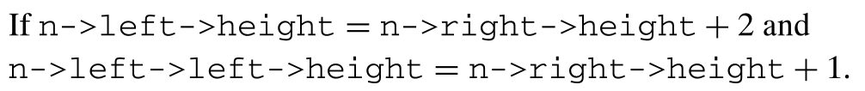
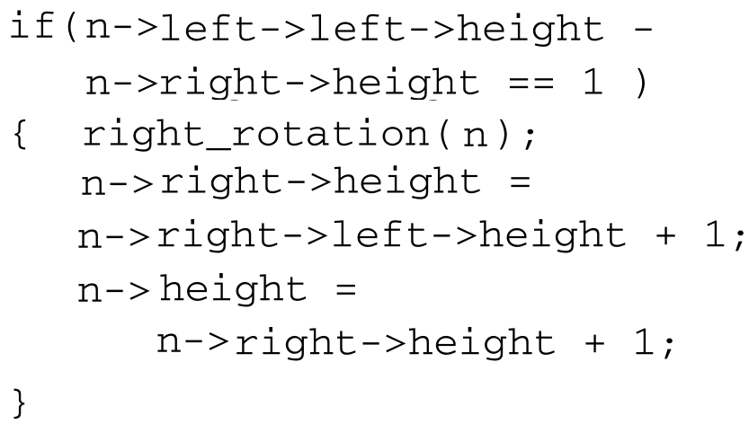
Cases of Balancing
Right Simple Rotation (type 2.1):
Rotates right the current *n node, and recomputes the height on *n and the rotated side.
3
2
3
2
0
1
3
1
2
1
1
0
0
1
0
0
0
1
0
0
0
0
0
0
0
0
0
Presentation made by Hernández & Mendivelso. Contents and figures extracted from the book: Advanced Data Structures. Peter Brass. Cambridge University Press. 2008.

Slide 15
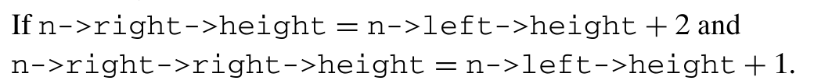
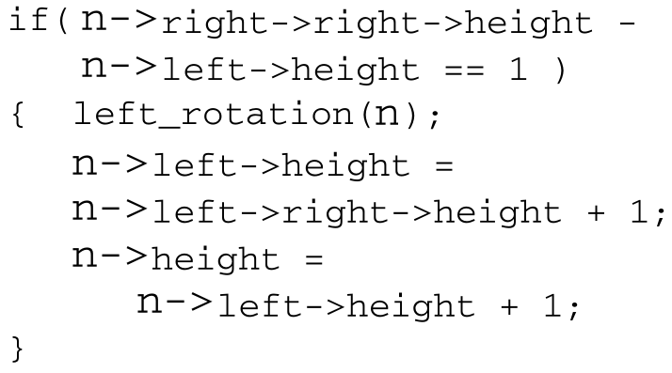
Cases of Balancing
Left Simple Rotation (type 2.3):
Rotates left the current *n node, and recomputes the height on *n and the rotated side.
3
2
3
3
1
2
1
0
2
1
1
0
1
0
0
0
1
0
0
0
0
0
0
0
0
0
0
Presentation made by Hernández & Mendivelso. Contents and figures extracted from the book: Advanced Data Structures. Peter Brass. Cambridge University Press. 2008.

Slide 16
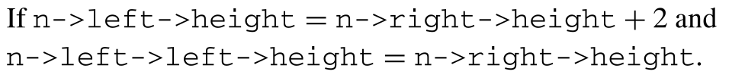
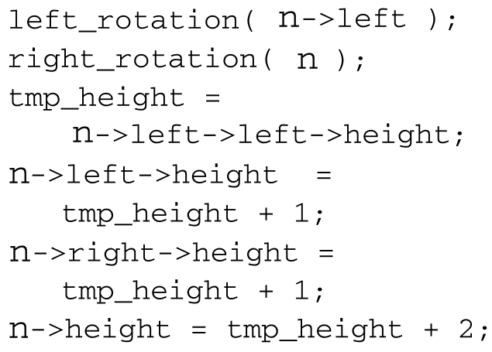
Cases of Balancing
Left Double Rotation (types 2.2):
First, rotates left on the left node, then rotates right on *n.
Finally, recomputing the height in the rotated nodes.
3
3
1
2
2
3
1
1
2
0
1
0
0
1
2
0
0
0
0
0
0
0
0
0
0
0
0
0
Presentation made by Hernández & Mendivelso. Contents and figures extracted from the book: Advanced Data Structures. Peter Brass. Cambridge University Press. 2008.

Slide 17
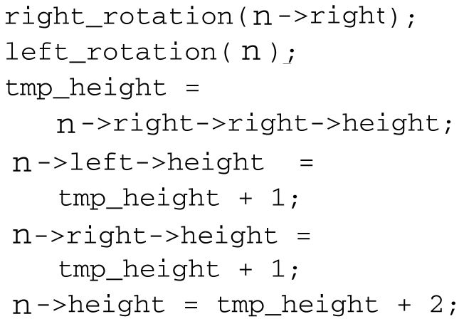
Cases of Balancing
Right Double Rotation (types 2.4):
First, rotates right on the right node, then rotates left on *n.
Finally, recomputing the height in the rotated nodes.
3
3
1
2
3
2
1
1
0
2
0
1
1
0
0
2
0
0
0
0
0
0
0
0
0
0
0
0
Presentation made by Hernández & Mendivelso. Contents and figures extracted from the book: Advanced Data Structures. Peter Brass. Cambridge University Press. 2008.

Slide 18
Cases of Balancing
The cases 2.1 and 2.3, 2.2 and 2.4 have the same logic, but the inverse execution.
At most in the balancing we have to do two rotations and three recomputations of the height on a node, making up to O(logn) time.
Yet, we have to prove that this
process balances the tree.
Presentation made by Hernández & Mendivelso. Contents and figures extracted from the book: Advanced Data Structures. Peter Brass. Cambridge University Press. 2008.

Slide 19
Cases of Balancing
Let *n^{old} a node which is height balanced but the subtrees’ height differs by 2.
Let *n^{new} the same node after the rebalancing step.
*n^{old}
*n^{new}
*n^{new}
b
b
or
b
b-1
b-1
b-2
b-1
b-1
b-3
Presentation made by Hernández & Mendivelso. Contents and figures extracted from the book: Advanced Data Structures. Peter Brass. Cambridge University Press. 2008.

Slide 20

Cases of Balancing
Then we can assume that:
Let
Then
*n^{old}
*n^{old}
*n^{new}
*n^{new}
h+3
h+1
or
h+3
h+1
h+1
h-2
h+2
h
h
h+2
h
*n^{old}
h-1
h
h
h
h-1
h+1
h-1
h+1
h+3
or
h+2
h
h
h+1
Presentation made by Hernández & Mendivelso. Contents and figures extracted from the book: Advanced Data Structures. Peter Brass. Cambridge University Press. 2008.

Slide 21
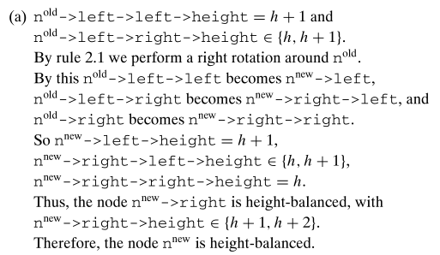
Cases of Balancing
*n^{old}
*n^{old}
Then we have the next cases:
h+3
h+3
h+2
h
h+1
h+2
h+1
h+1
h+1
h
*n^{old}
h+3
*n^{old} = *n^{new}
h+3
h+1
h+2
h+1
h+2
h+1
h
Presentation made by Hernández & Mendivelso. Contents and figures extracted from the book: Advanced Data Structures. Peter Brass. Cambridge University Press. 2008.

Slide 22
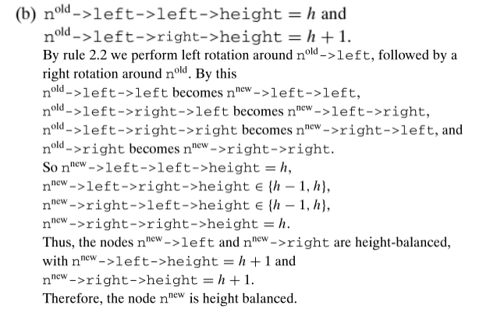
Cases of Balancing
*n^{old}
*n^{old}
h+3
h+3
h+2
h
h+1
h
h
h+1
h+2
h
*n^{old}
h+2
*n^{old} = *n^{new}
h+2
h+1
h+1
h
h+1
h+1
h
Presentation made by Hernández & Mendivelso. Contents and figures extracted from the book: Advanced Data Structures. Peter Brass. Cambridge University Press. 2008.

Slide 23
Implementation of the Insert Method
The insert method has a lot of similarities with the insert on search trees.
The main addition to the method is a stack based rebalancing process.
In this rebalancing process we make use of the previously mentioned cases of rebalancing.
Presentation made by Hernández & Mendivelso. Contents and figures extracted from the book: Advanced Data Structures. Peter Brass. Cambridge University Press. 2008.

Slide 24
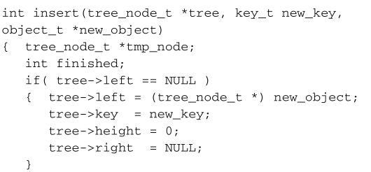
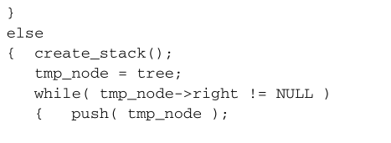
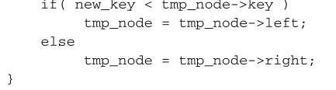
Implementation of the Insert Method
First thing is setting up local variables and checking the case where the tree is empty.
Iter through the tree until we reach a leaf.
Pushing each visited node in a stack.
Presentation made by Hernández & Mendivelso. Contents and figures extracted from the book: Advanced Data Structures. Peter Brass. Cambridge University Press. 2008.

Slide 25
Implementation of the Insert Method
tree
5
4
4
2
10
3
2
1
4
0
8
2
12
1
1
0
2
0
7
1
8
0
10
0
12
0
5
0
7
0
new_object = 6
tmp_node = NULL
finished = NULL
Presentation made by Hernández & Mendivelso. Contents and figures extracted from the book: Advanced Data Structures. Peter Brass. Cambridge University Press. 2008.

Slide 26
Implementation of the Insert Method
tree
tmp
5
4
4
2
10
3
2
1
4
0
8
2
12
1
1
0
2
0
7
1
8
0
10
0
12
0
5
0
7
0
5
new_object = 6
tmp_node = 5
finished = NULL
Presentation made by Hernández & Mendivelso. Contents and figures extracted from the book: Advanced Data Structures. Peter Brass. Cambridge University Press. 2008.

Slide 27
Implementation of the Insert Method
tree
5
4
4
2
tmp
10
3
2
1
4
0
8
2
12
1
1
0
2
0
7
1
8
0
10
0
12
0
5
0
7
0
5
10
new_object = 6
tmp_node = 10
finished = NULL
Presentation made by Hernández & Mendivelso. Contents and figures extracted from the book: Advanced Data Structures. Peter Brass. Cambridge University Press. 2008.

Slide 28
Implementation of the Insert Method
tree
5
4
4
2
10
3
2
1
4
0
tmp
8
2
12
1
1
0
2
0
7
1
8
0
10
0
12
0
5
0
7
0
5
10
8
new_object = 6
tmp_node = 8
finished = NULL
Presentation made by Hernández & Mendivelso. Contents and figures extracted from the book: Advanced Data Structures. Peter Brass. Cambridge University Press. 2008.

Slide 29
Implementation of the Insert Method
tree
5
4
4
2
10
3
2
1
4
0
8
2
12
1
1
0
2
0
tmp
7
1
8
0
10
0
12
0
5
0
7
0
5
10
8
7
new_object = 6
tmp_node = 7
finished = NULL
Presentation made by Hernández & Mendivelso. Contents and figures extracted from the book: Advanced Data Structures. Peter Brass. Cambridge University Press. 2008.

Slide 30
Implementation of the Insert Method
tree
5
4
4
2
10
3
2
1
4
0
8
2
12
1
1
0
2
0
7
1
8
0
10
0
12
0
tmp
5
0
7
0
5
10
8
7
new_object = 6
tmp_node = 5
finished = NULL
Presentation made by Hernández & Mendivelso. Contents and figures extracted from the book: Advanced Data Structures. Peter Brass. Cambridge University Press. 2008.

Slide 31
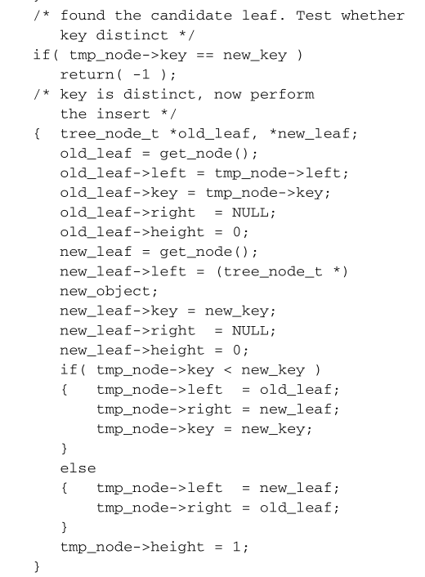
Implementation of the Insert Method
Check if the key already exists, if it does, return error.
Otherwise, insert the new leaf node to the tree.
Setting the height of the new leaf and the previous node.
Presentation made by Hernández & Mendivelso. Contents and figures extracted from the book: Advanced Data Structures. Peter Brass. Cambridge University Press. 2008.

Slide 32
Implementation of the Insert Method
tree
5
4
4
2
10
3
2
1
4
0
8
2
12
1
1
0
2
0
7
1
8
0
10
0
12
0
tmp
6
1
7
0
5
0
6
0
5
10
8
7
new_object = 6
tmp_node = 6
finished = NULL
Presentation made by Hernández & Mendivelso. Contents and figures extracted from the book: Advanced Data Structures. Peter Brass. Cambridge University Press. 2008.

Slide 33
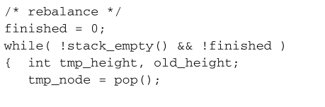
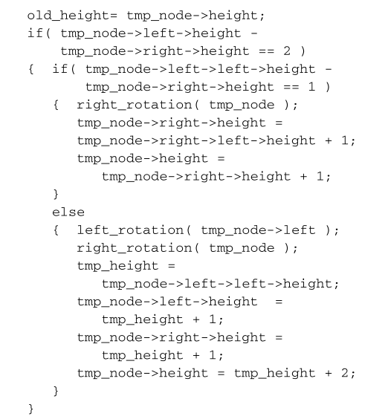
Implementation of the Insert Method
Start the rebalancing of the tree using the path of previous nodes stored in a stack.
Check, and if needed apply, the balancing cases of a height tree.
(Case 2.1)
(Case 2.2)
Presentation made by Hernández & Mendivelso. Contents and figures extracted from the book: Advanced Data Structures. Peter Brass. Cambridge University Press. 2008.

Slide 34
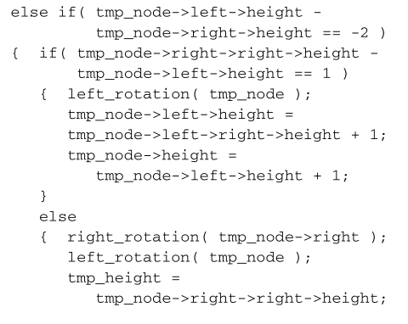
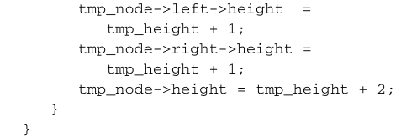
Implementation of the Insert Method
(Case 2.3)
(Case 2.4)
Presentation made by Hernández & Mendivelso. Contents and figures extracted from the book: Advanced Data Structures. Peter Brass. Cambridge University Press. 2008.

Slide 35
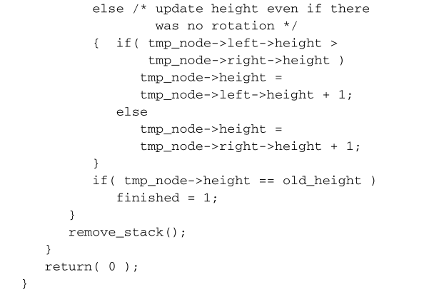
Implementation of the Insert Method
(Trivial case) In this case we still recompute the height of the node.
Ensure that the loop will stop after the balancing and not only after emptying the stack.
Remove stack from memory and return.
Presentation made by Hernández & Mendivelso. Contents and figures extracted from the book: Advanced Data Structures. Peter Brass. Cambridge University Press. 2008.

Slide 36
Implementation of the Insert Method
tree
5
4
4
2
10
3
2
1
4
0
8
2
12
1
1
0
2
0
tmp
7
1
8
0
10
0
12
0
6
1
7
0
5
0
6
0
5
10
8
7
new_object = 6
tmp_node = 7
finished = 0
old_height = 1
Presentation made by Hernández & Mendivelso. Contents and figures extracted from the book: Advanced Data Structures. Peter Brass. Cambridge University Press. 2008.

Slide 37
Implementation of the Insert Method
tree
5
4
4
2
10
3
2
1
4
0
8
2
12
1
1
0
2
0
tmp
7
2
8
0
10
0
12
0
6
1
7
0
5
0
6
0
5
10
8
7
new_object = 6
tmp_node = 7
finished = 0
old_height = 1
Presentation made by Hernández & Mendivelso. Contents and figures extracted from the book: Advanced Data Structures. Peter Brass. Cambridge University Press. 2008.

Slide 38
Implementation of the Insert Method
tree
5
4
4
2
10
3
2
1
4
0
tmp
8
2
12
1
1
0
2
0
7
2
8
0
10
0
12
0
6
1
7
0
5
0
6
0
5
10
8
new_object = 6
tmp_node = 8
finished = 0
old_height = 2
Presentation made by Hernández & Mendivelso. Contents and figures extracted from the book: Advanced Data Structures. Peter Brass. Cambridge University Press. 2008.

Slide 39
Implementation of the Insert Method
tree
5
4
4
2
10
3
tmp
2
1
4
0
7
2
12
1
1
0
2
0
6
1
8
1
10
0
12
0
5
0
6
0
7
0
8
0
5
10
8
new_object = 6
tmp_node = 8
finished = 0
old_height = 2
Presentation made by Hernández & Mendivelso. Contents and figures extracted from the book: Advanced Data Structures. Peter Brass. Cambridge University Press. 2008.

Slide 40
Implementation of the Insert Method
tree
5
4
4
2
tmp
10
3
2
1
4
0
7
2
12
1
1
0
2
0
6
1
8
1
10
0
12
0
5
0
6
0
7
0
8
0
5
10
new_object = 6
tmp_node = 10
finished = 1
old_height = 3
Presentation made by Hernández & Mendivelso. Contents and figures extracted from the book: Advanced Data Structures. Peter Brass. Cambridge University Press. 2008.

Slide 41
Implementation of the Insert Method
5
4
4
2
10
3
2
1
4
0
7
2
12
1
1
0
2
0
6
1
8
1
10
0
12
0
5
0
6
0
7
0
8
0
Presentation made by Hernández & Mendivelso. Contents and figures extracted from the book: Advanced Data Structures. Peter Brass. Cambridge University Press. 2008.

Slide 42
Other Implementations
In the end, height-balanced trees are a good type of balanced tree by it’s relative simplicity.
Although a little slower than a good search tree, it’s structure makes them better than the average search tree.
Other implementation that use the height-balanced trees are often slower and use more memory.
These other implementations change mainly on the restriction of difference between the heights of the subtrees of a node.
Presentation made by Hernández & Mendivelso. Contents and figures extracted from the book: Advanced Data Structures. Peter Brass. Cambridge University Press. 2008.

Slide 43
BIBLIOGRAPHY
Brass, P. (2008). Advanced Data Structures. Cambridge University Press.

