Slide 1
Sistemas Operativos
Martín Steven Hernández Ortiz
24 August 2023

Slide 2
Sistemas Operativos (OS)
Qué son?
Qué tienen, o Cómo funcionan?
De donde vienen?
Cuales OS hay hoy en día?
Subtemas ¿Estoy Seguro con mi OS?

Slide 3




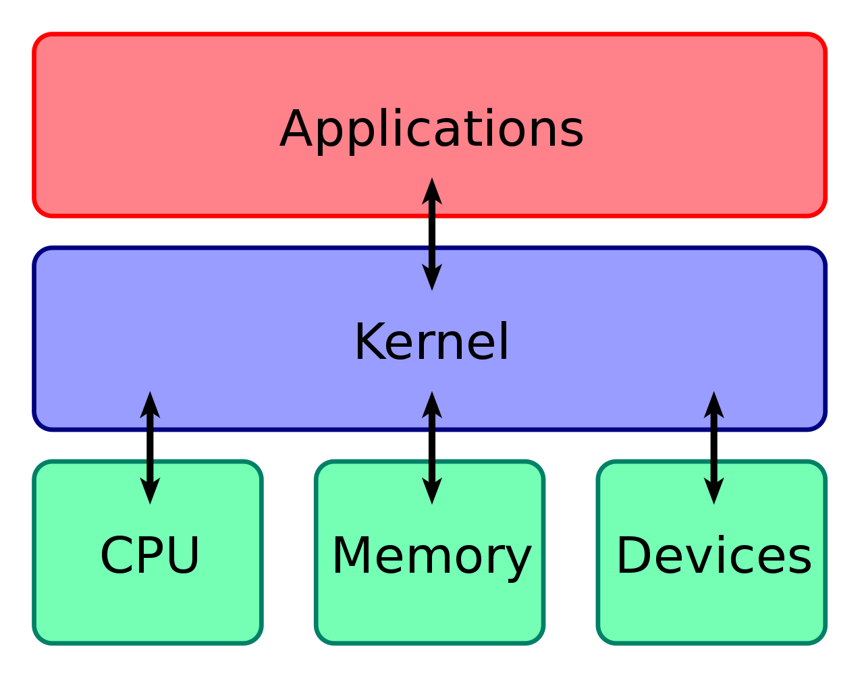
¿Qué son?
OS
I / O
Hardware
Software y Recusos

Slide 4
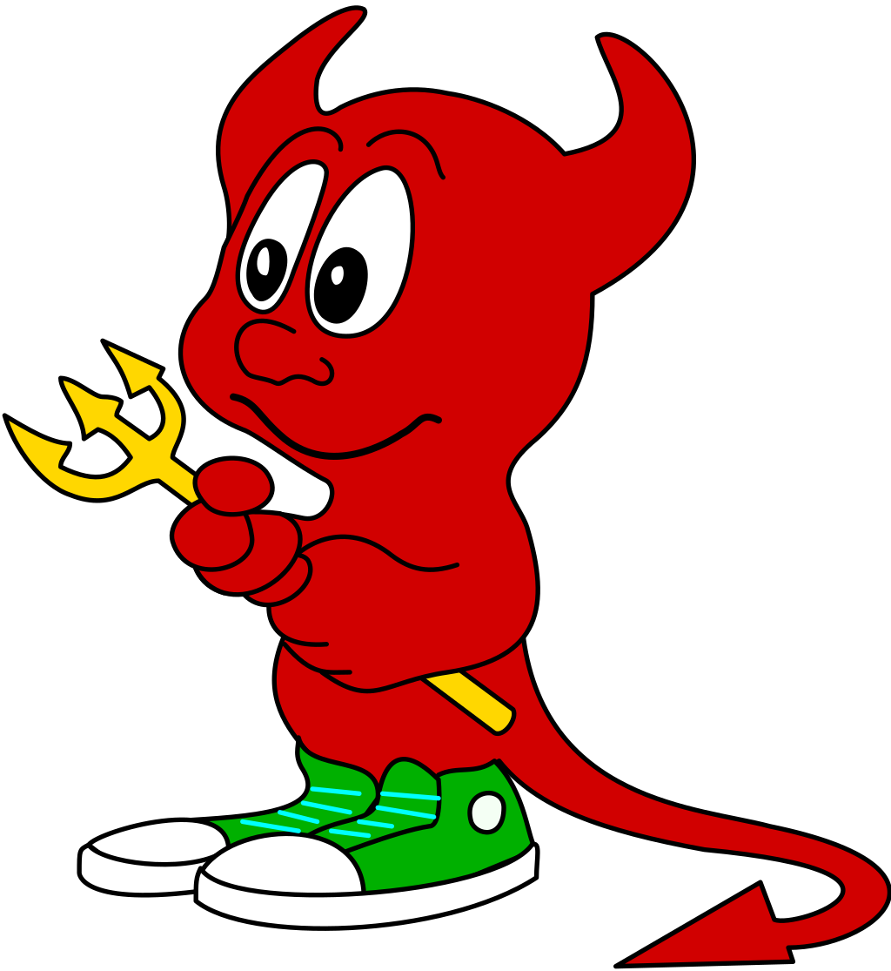
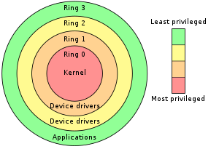
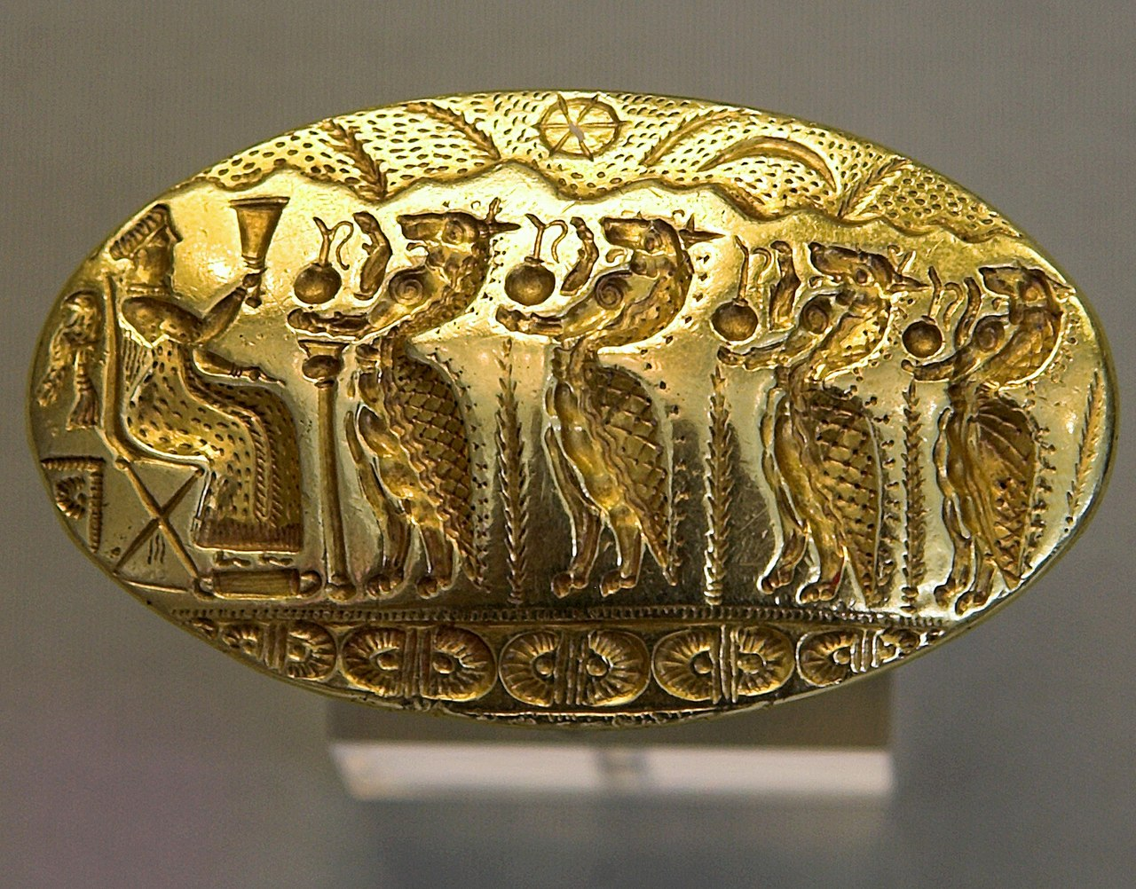
Componentes del OS
Kernel
Daemon
Daimon

Slide 5
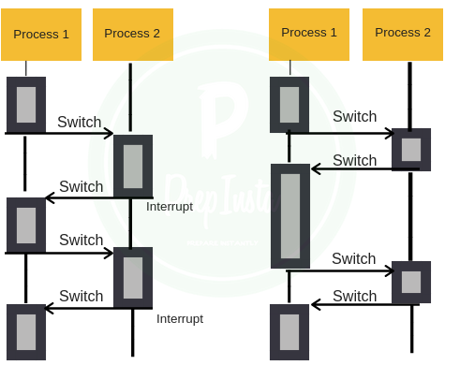
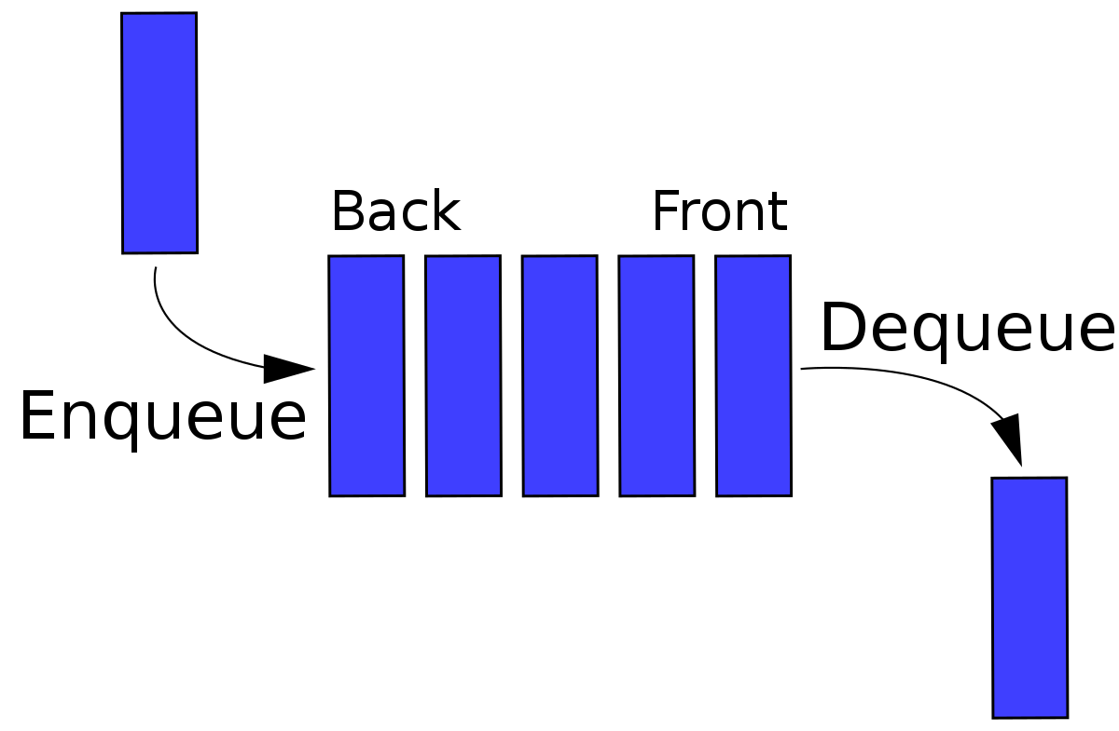
Schedulers y Tasking
Single
Tasking
Preemptive
MultiTasking
Cooperative
MultiTasking

Slide 6
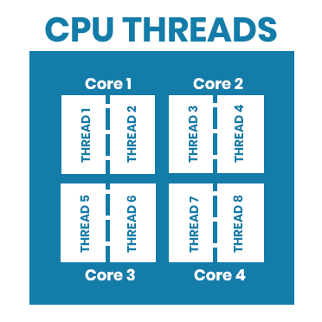
Schedulers y Tasking

Slide 7
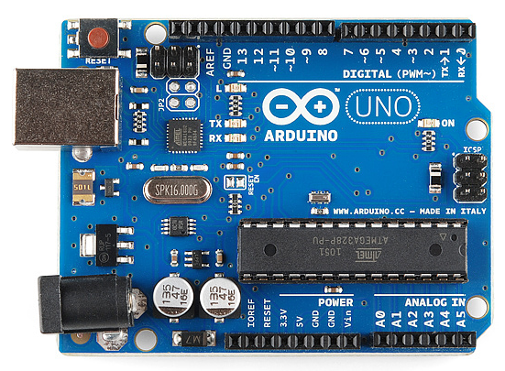
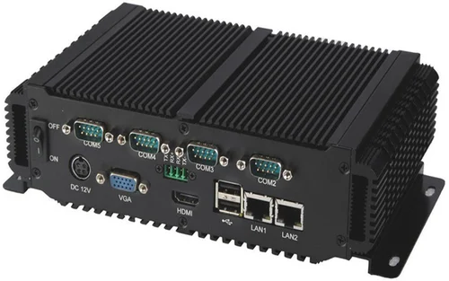
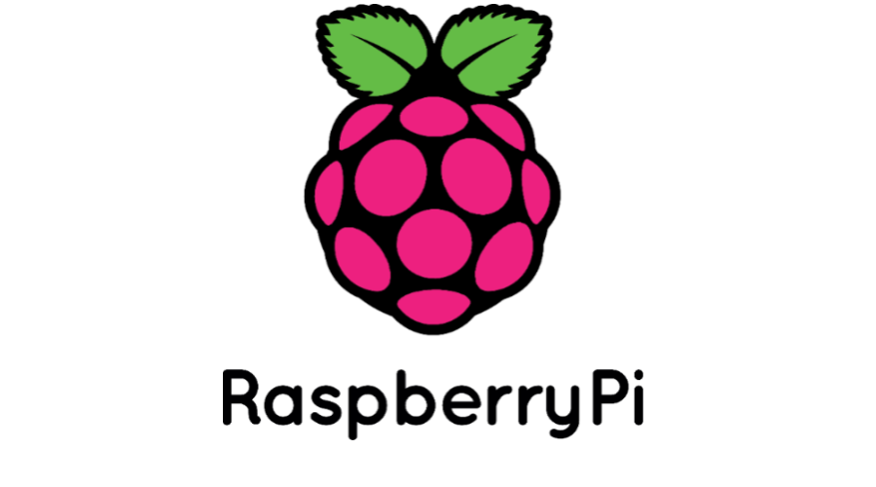
Otros tipos de OS
Real Time Systems
Embedded Systems

Slide 8
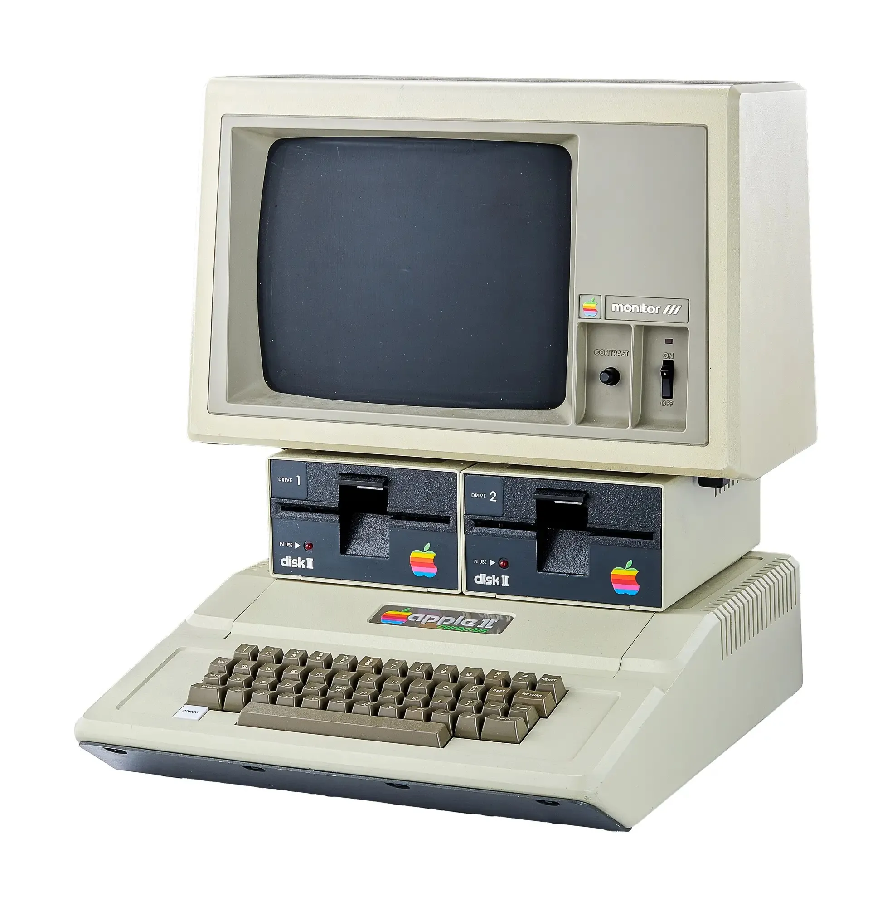
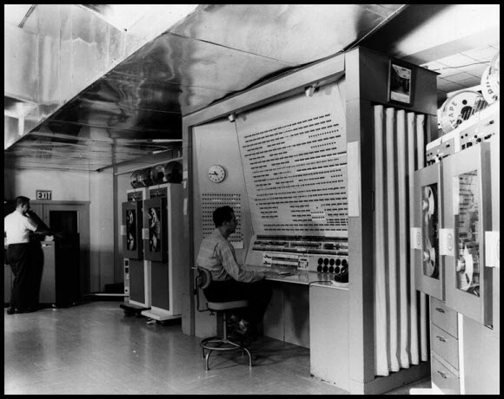
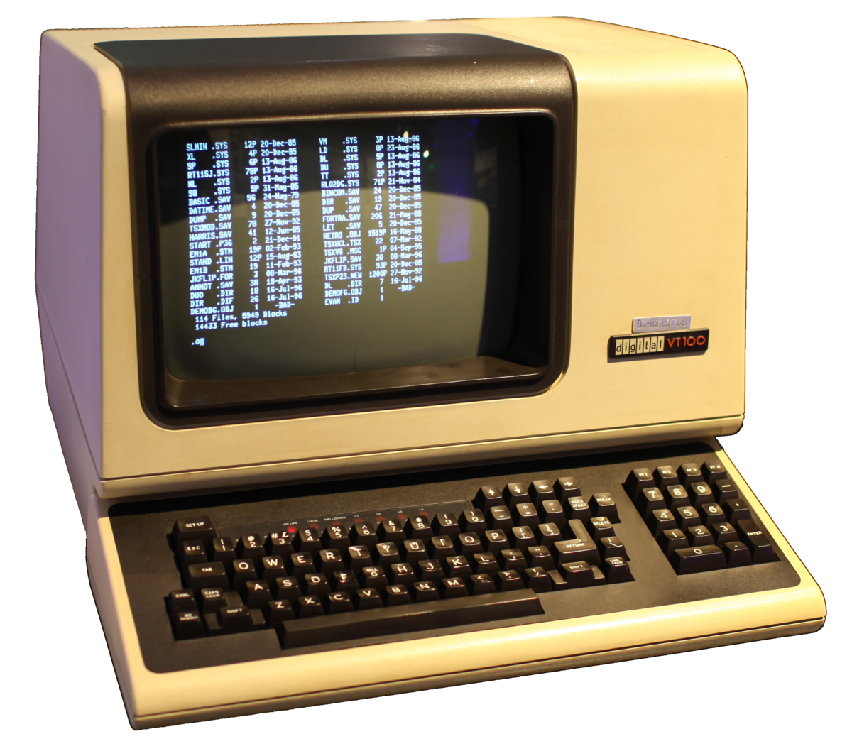

Historia de los OS (Parcialmente)
40s
60s
80s

Slide 9
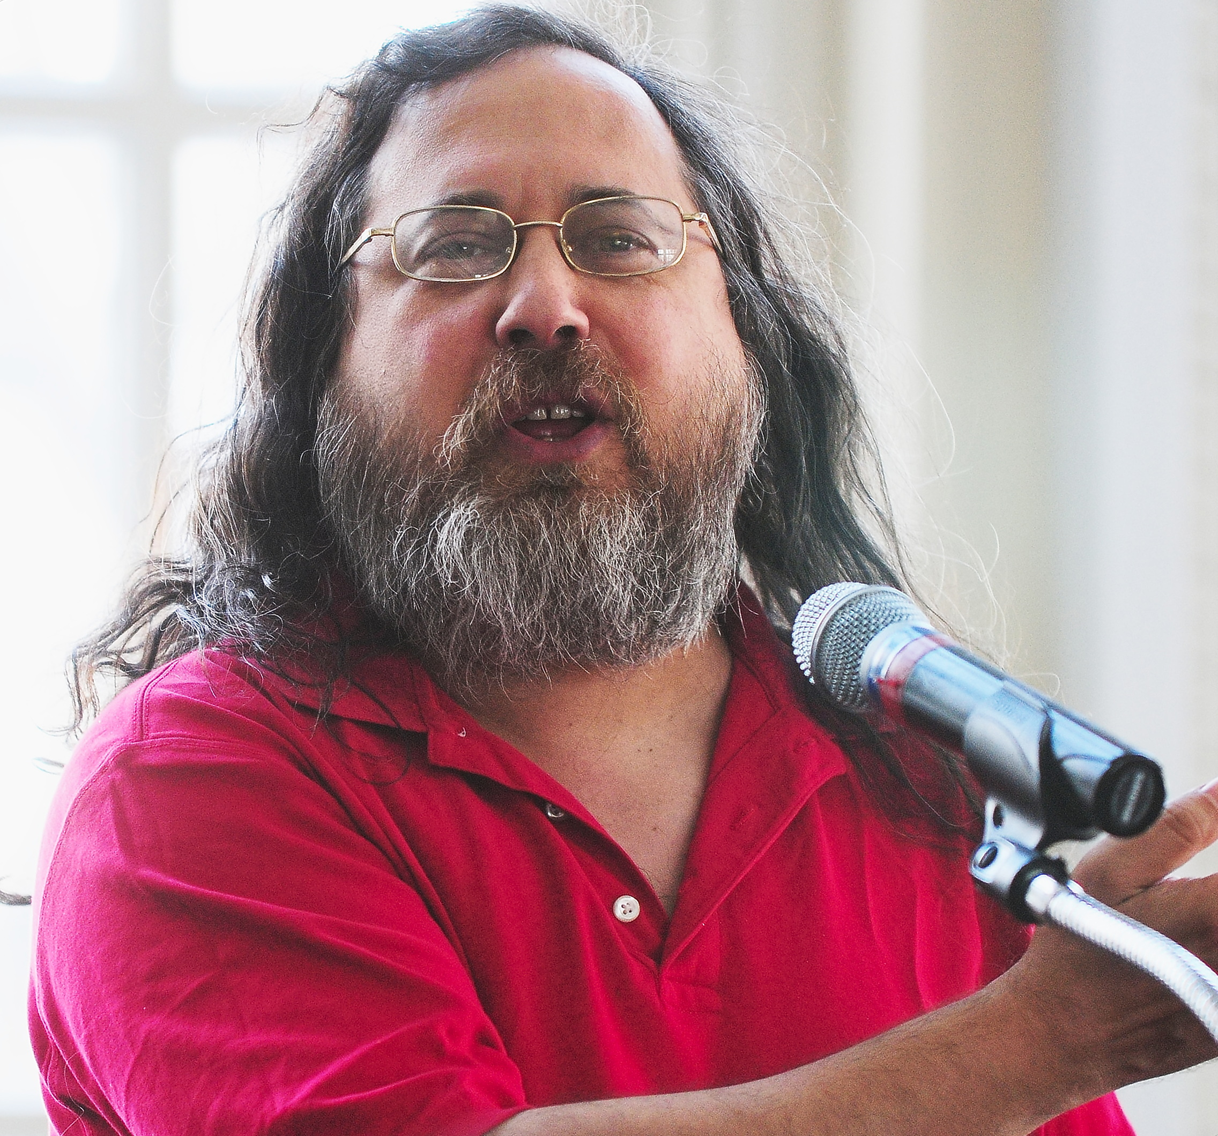

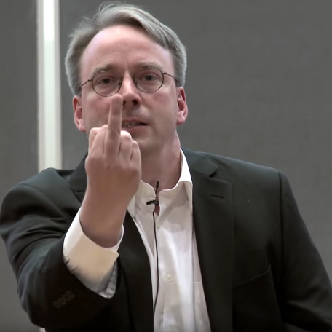

90s GNU / Linux
Gnu
Richard Stallman
Linux (Tux)
Linus Trovalds

Slide 10


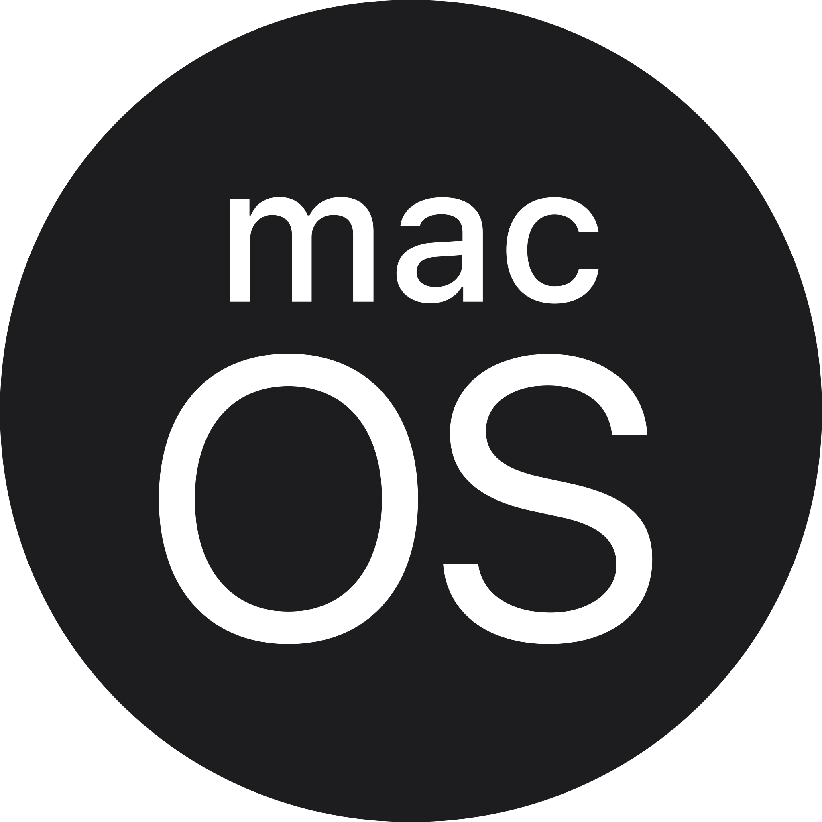


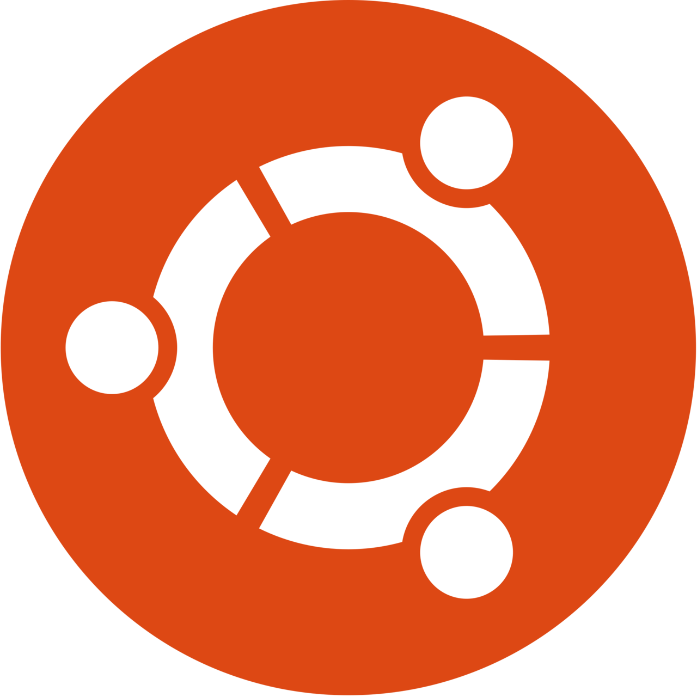
Algunos Sistemas Operativos Actuales

Slide 11
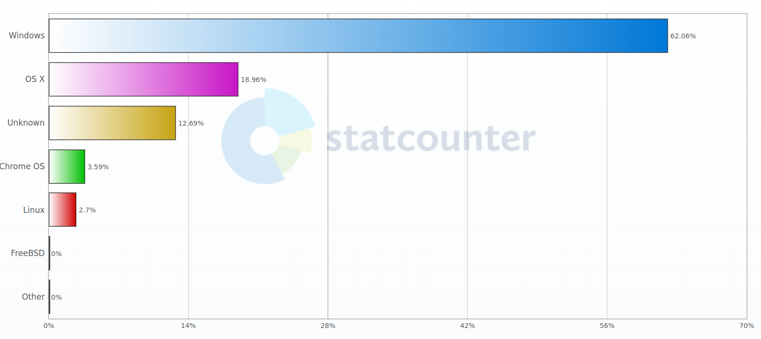

Slide 12
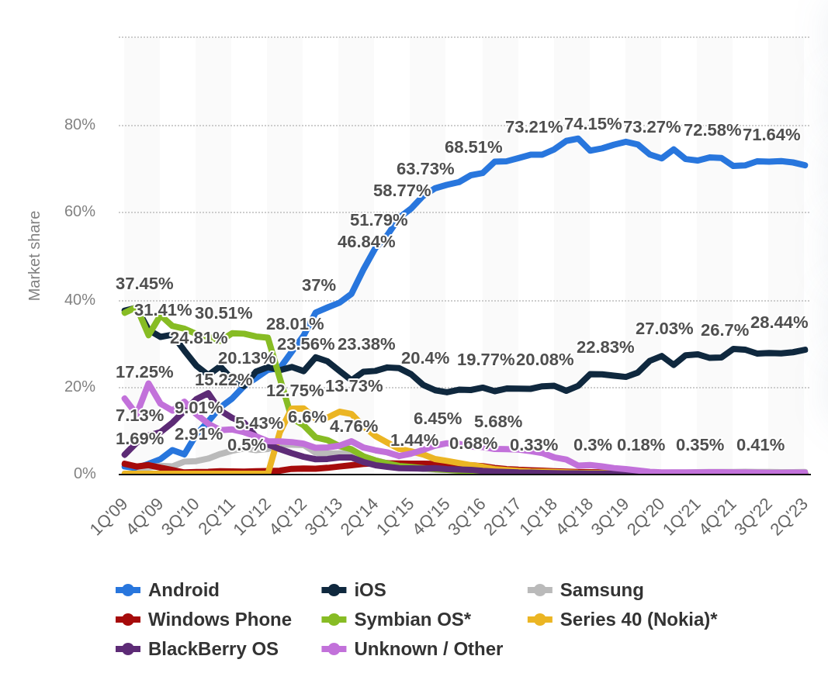

Slide 13
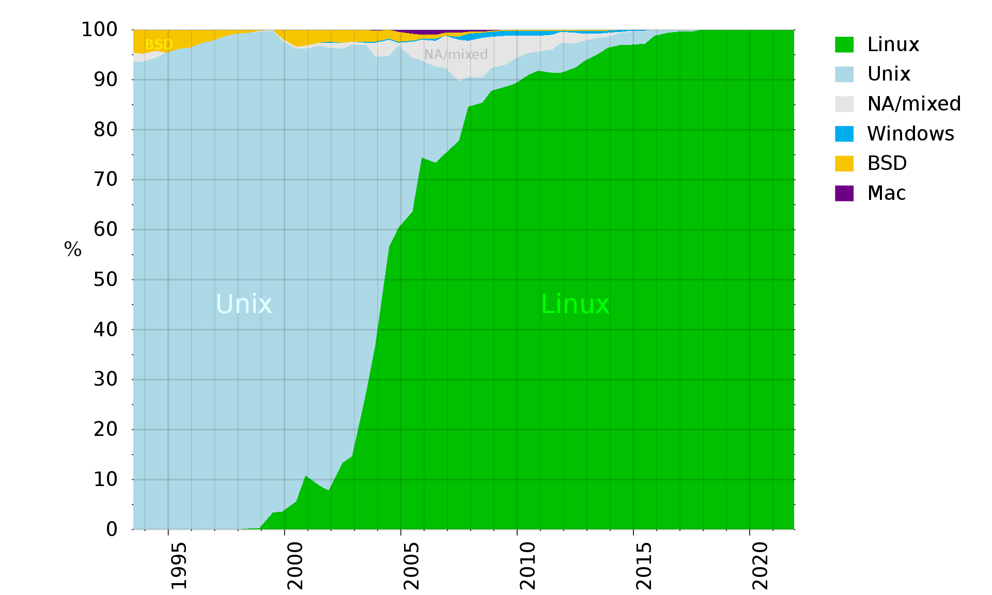

Slide 14
Referencias
https://en.wikipedia.org/wiki/Operating_system
https://en.wikipedia.org/wiki/Computer_multitasking
https://en.wikipedia.org/wiki/Preemption_(computing)
https://en.wikipedia.org/wiki/Embedded_operating_system
https://en.wikipedia.org/wiki/Richard_Stallman
https://en.wikipedia.org/wiki/Linus_Torvalds
https://en.wikipedia.org/wiki/Kernel_(operating_system)
https://en.wikipedia.org/wiki/Daemon_(computing)
https://en.wikipedia.org/wiki/Daimon
https://en.wikipedia.org/wiki/Linux_kernel
https://en.wikipedia.org/wiki/Linux
https://en.wikipedia.org/wiki/Microsoft_Windows
https://www.statista.com/statistics/272698/global-market-share-held-by-mobile-operating-systems-since-2009/
https://gs.statcounter.com/os-market-share/desktop/worldwide/#monthly-202305-202305-bar
https://en.wikipedia.org/wiki/Usage_share_of_operating_systems#/media/File:Operating_systems_used_on_top_500_supercomputers.svg

