Slide 2
How Much Power Must We Extract From a Receiver Antenna to Effect Communications?

Slide 3

Evaluating the Necessity of Power Extraction in
Receiver Antennas via Gradient Descent
Optimization
Vũ Nguyễn Anh Tuân 202417212
Nguyễn Phan Vĩ 202417218
Phan Công Trường Sơn 202417190
Phạm Huy Khánh 202417137

Slide 4
Table of contents
Overview of the original paper
Optimization objectives and method
Obtained results
Conclusions

Slide 5
Overview of the original paper

Slide 6
Paper’s goals:
Challenge the common technical assumptions and practices that power extraction as essential
Highlight the distinction between what is physically mandatory and what is merely a convenience in design

Slide 7
Summary
Rejects the notion that extracting power from a receiver antenna is imperative
Shannon information theory is purely mathematical and does not represent the physical world
Presents amplifier circuits capable of measuring the open-circuit voltage without extracting power
Impedance matching does not necessarily result in optimized SNR value
Noise figure is merely a standard definition and is not a physical principle
Impedance matching and power extraction can sometimes be used advantageously to obtain noise-free voltage gain prior to the preamplifier, but is impractical
Suggests applying lessons learned to broad-band receiver antenna arrays and possible advantages of measuring open-circuit voltages on the antenna ports as opposed to drawing current from the antennas

Slide 8
Paper’s conclusion
How much power must we extract from a receiver antenna to effect communications?
Answer:
Subject to the laws of classical physics:
None!

Slide 9
Optimization objectives and method

Slide 10

Objectives
Maximize the signal-to-noise ratio (SNRo) relative to the complex antenna impedance (ZR) and complex load impedance (ZL)

Slide 11

Objectives
Maximize Friis gain (G)

Slide 12

Objectives
Maximize the signal-to-noise ratio (SNRo) relative to the source resistance (RS) and the load resistance (RL)

Slide 13

Objectives
Maximize output signal voltage (Vso) relative to the source resistance (Rs) and the load resistance (RL)

Slide 14

Objectives
Maximize output signal power (Pso) relative to the source resistance (Rs) and the load resistance (RL)

Slide 15

Objectives
Minimize the output signal’s noise power (Pno) relative to the source resistance (Rs) and the load resistance (RL)

Slide 16
Objectives
SNRo: retain signal integrity for decoding
G: maximize signal strength
Vso, Pso: obtain the strongest output signal
Pno: retain signal integrity

Slide 17

Optimization method
Gradient Descent: $g_{t} = ∇_{θ}​f(θ_{t} − 1​)$

Slide 18
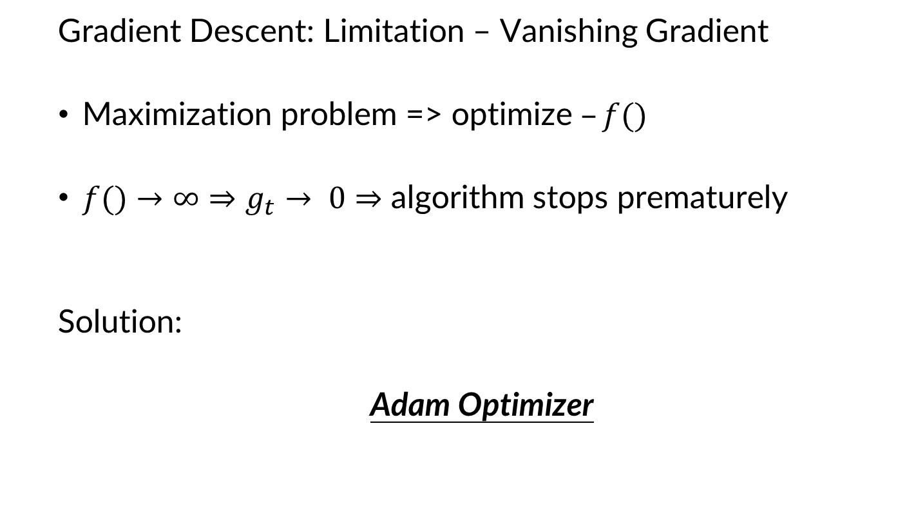
Optimization method
Gradient Descent: Limitation – Vanishing Gradient
Maximization problem => optimize $–f()$
$f()→∞⇒$ $g_{t}→ 0⇒$ algorithm stops prematurely
Solution:
Adam Optimizer

Slide 19
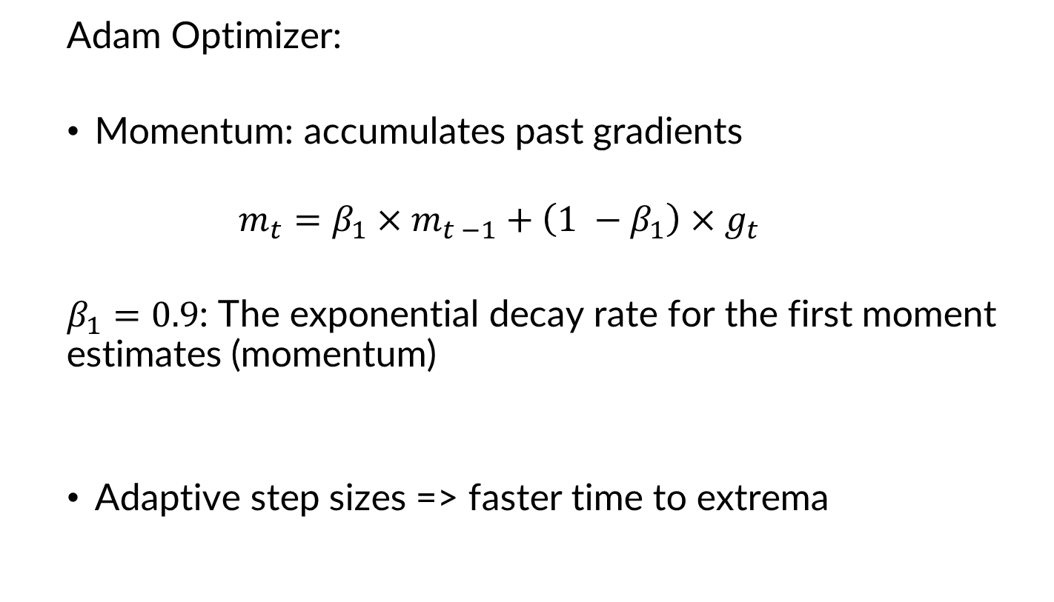
Optimization method
Adam Optimizer:
Momentum: accumulates past gradients
$$m_{t}=β_{1}×m_{t −1}+\left(1 −β_{1}\right)×g_{t}$$
$β_{1}=0.9$: The exponential decay rate for the first moment estimates (momentum)
Adaptive step sizes => faster time to extrema

Slide 20
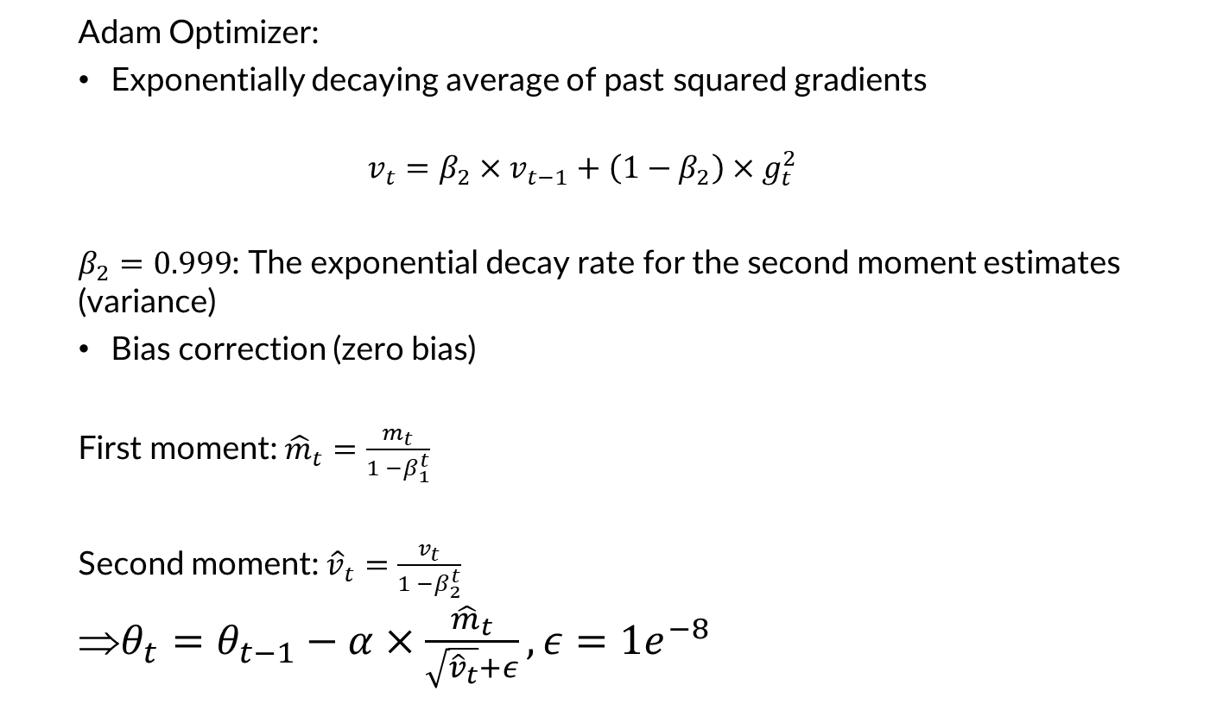
Optimization method
Adam Optimizer:
Exponentially decaying average of past squared gradients
$$v_{t}=β_{2}×v_{t−1}+\left(1−β_{2}\right)×g_{t}^{2}$$
$β_{2}=0.999$: The exponential decay rate for the second moment estimates (variance)
Bias correction (zero bias)
First moment: ${\hat{m}}_{t}=\frac{m_{t}}{1 −β_{1}^{t}}$
Second moment: ${\hat{v}}_{t}=\frac{v_{t}}{1 −β_{2}^{t}}$
$θ_{t}=θ_{t−1}−α×\frac{{\hat{m}}_{t}}{\sqrt{{\hat{v}}_{t}}+ε}, ε=1e^{−8}$

Slide 21
Obtained results

Slide 22
Obtained results
SNRo (equation 9):
ZR:
Real bound: [10; 1500]
Imaginary coefficient bound: [-1500; 1500]
ZL:
Real bound: [10; 1500]
Imaginary coefficient bound: [-1500; 1500]
Other parameters:
g: 10
Nna: 1e-9
k: 1.38e-23
T: 300
SIT: 1.26e-4
=> Obtained value: 91.48 dB at
ZR = 10 + 1500j
ZL = 10 - 1500j

Slide 23
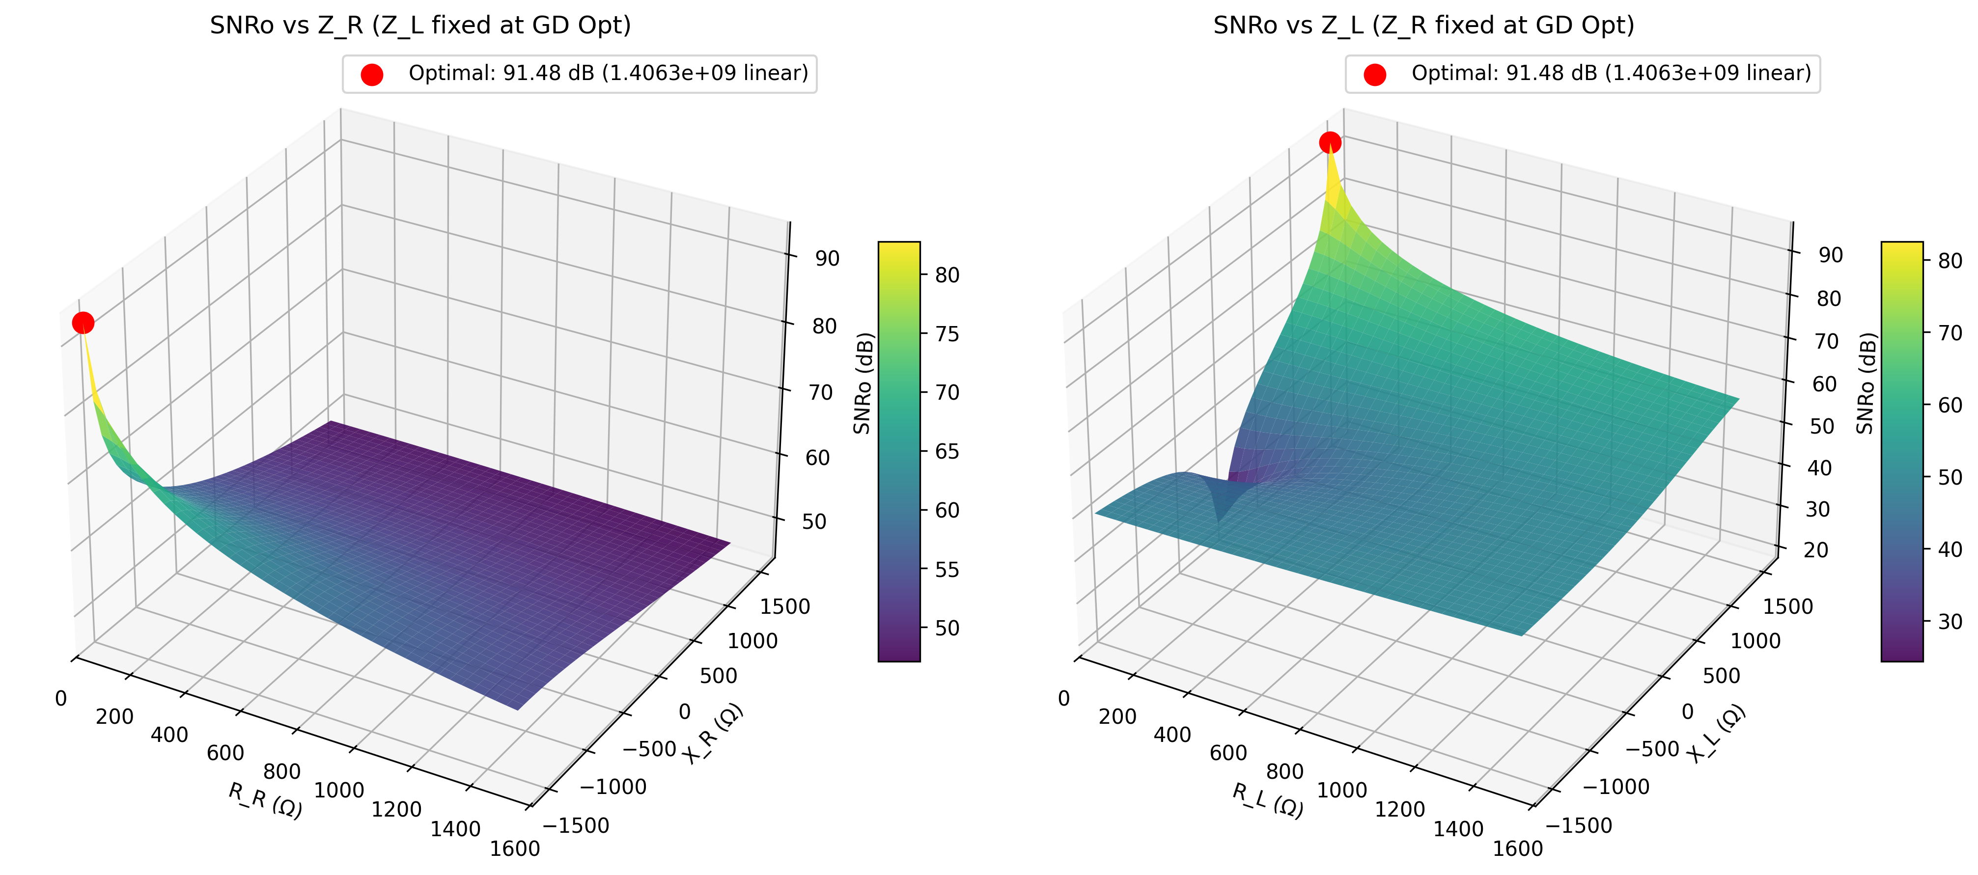
Obtained results

Slide 24
Obtained results
SNRo (equation 9):
Real bound: [0.01; 1e9]
Imaginary coefficient bound: [-1500; 1500]
Other parameters:
g: 10
Nna: 1e-9
k: 1.38e-23
T: 300
SIT: 1.26e-4
=> Obtained value: 53.98 dB at
ZR = 0.01 + 1352.14j
ZL = 1e9 + 295.98j

Slide 25
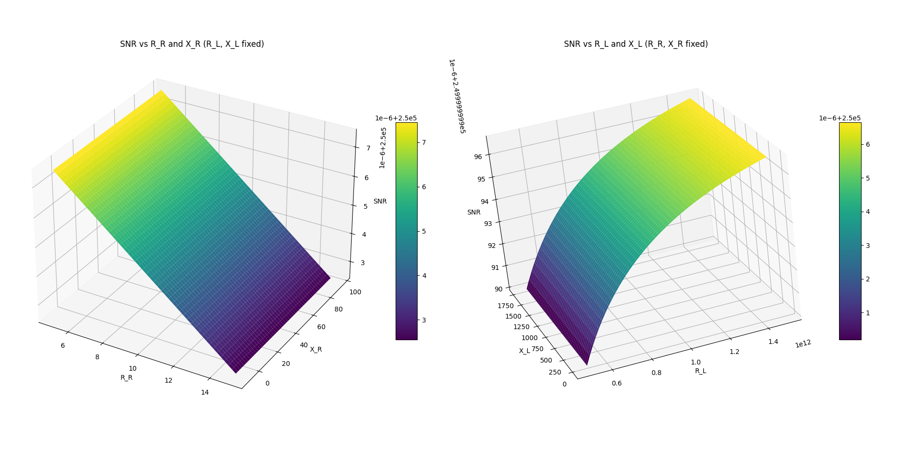
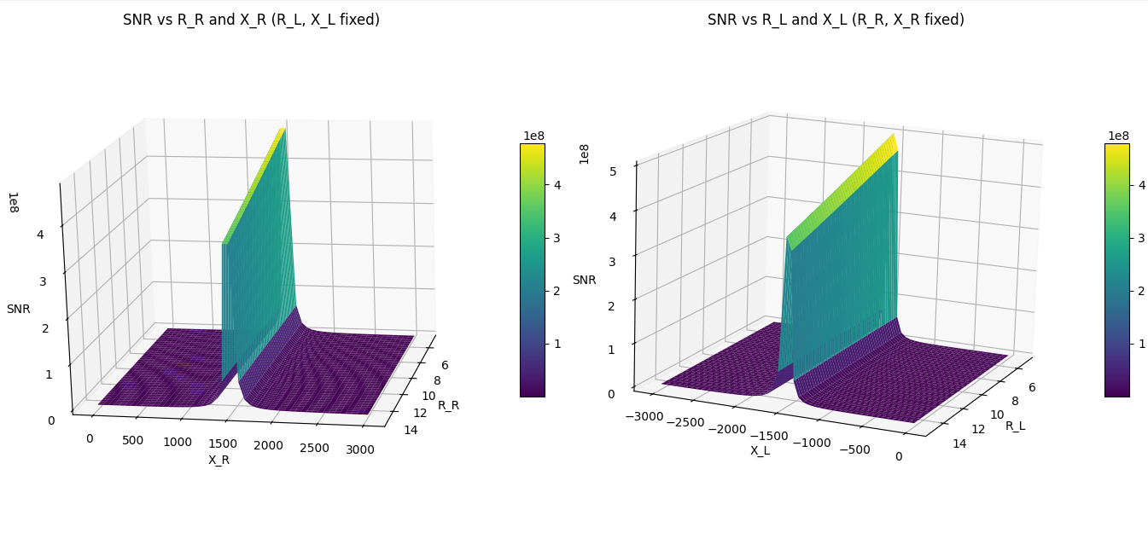
Obtained results

Slide 26
Obtained results
G (equation 18):
Rs ∈ [0.01, 1e6]
RL ∈ [0.01, 1e9]
Other parameters:
Other parameters:
g: 10
Rs: 50 Ω
Optimal Gain: 63.00 dB | Rs = 1000000.00 Ω | Rl = 1000000000.00 Ω

Slide 27
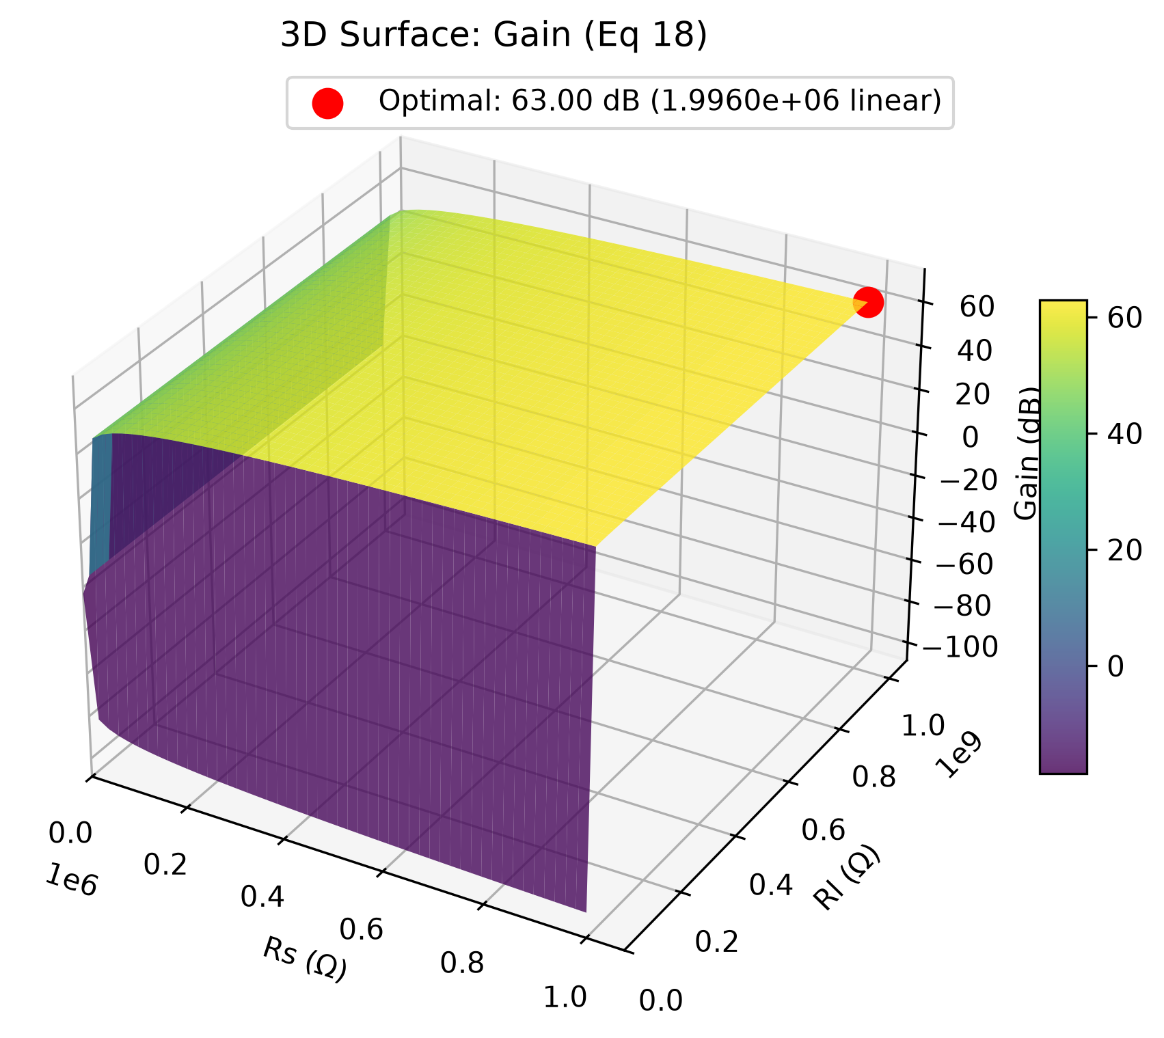
Obtained results

Slide 28
Obtained results
G (equation 18):
Rs = 100 Ω
RL ∈ [0.01, 1e9]
Other parameters:
Other parameters:
g: 10
Rs: 50 Ω
Optimal Gain (Fixed Rs): 23.01 dB | Rl = 1000000000.00 Ω

Slide 29
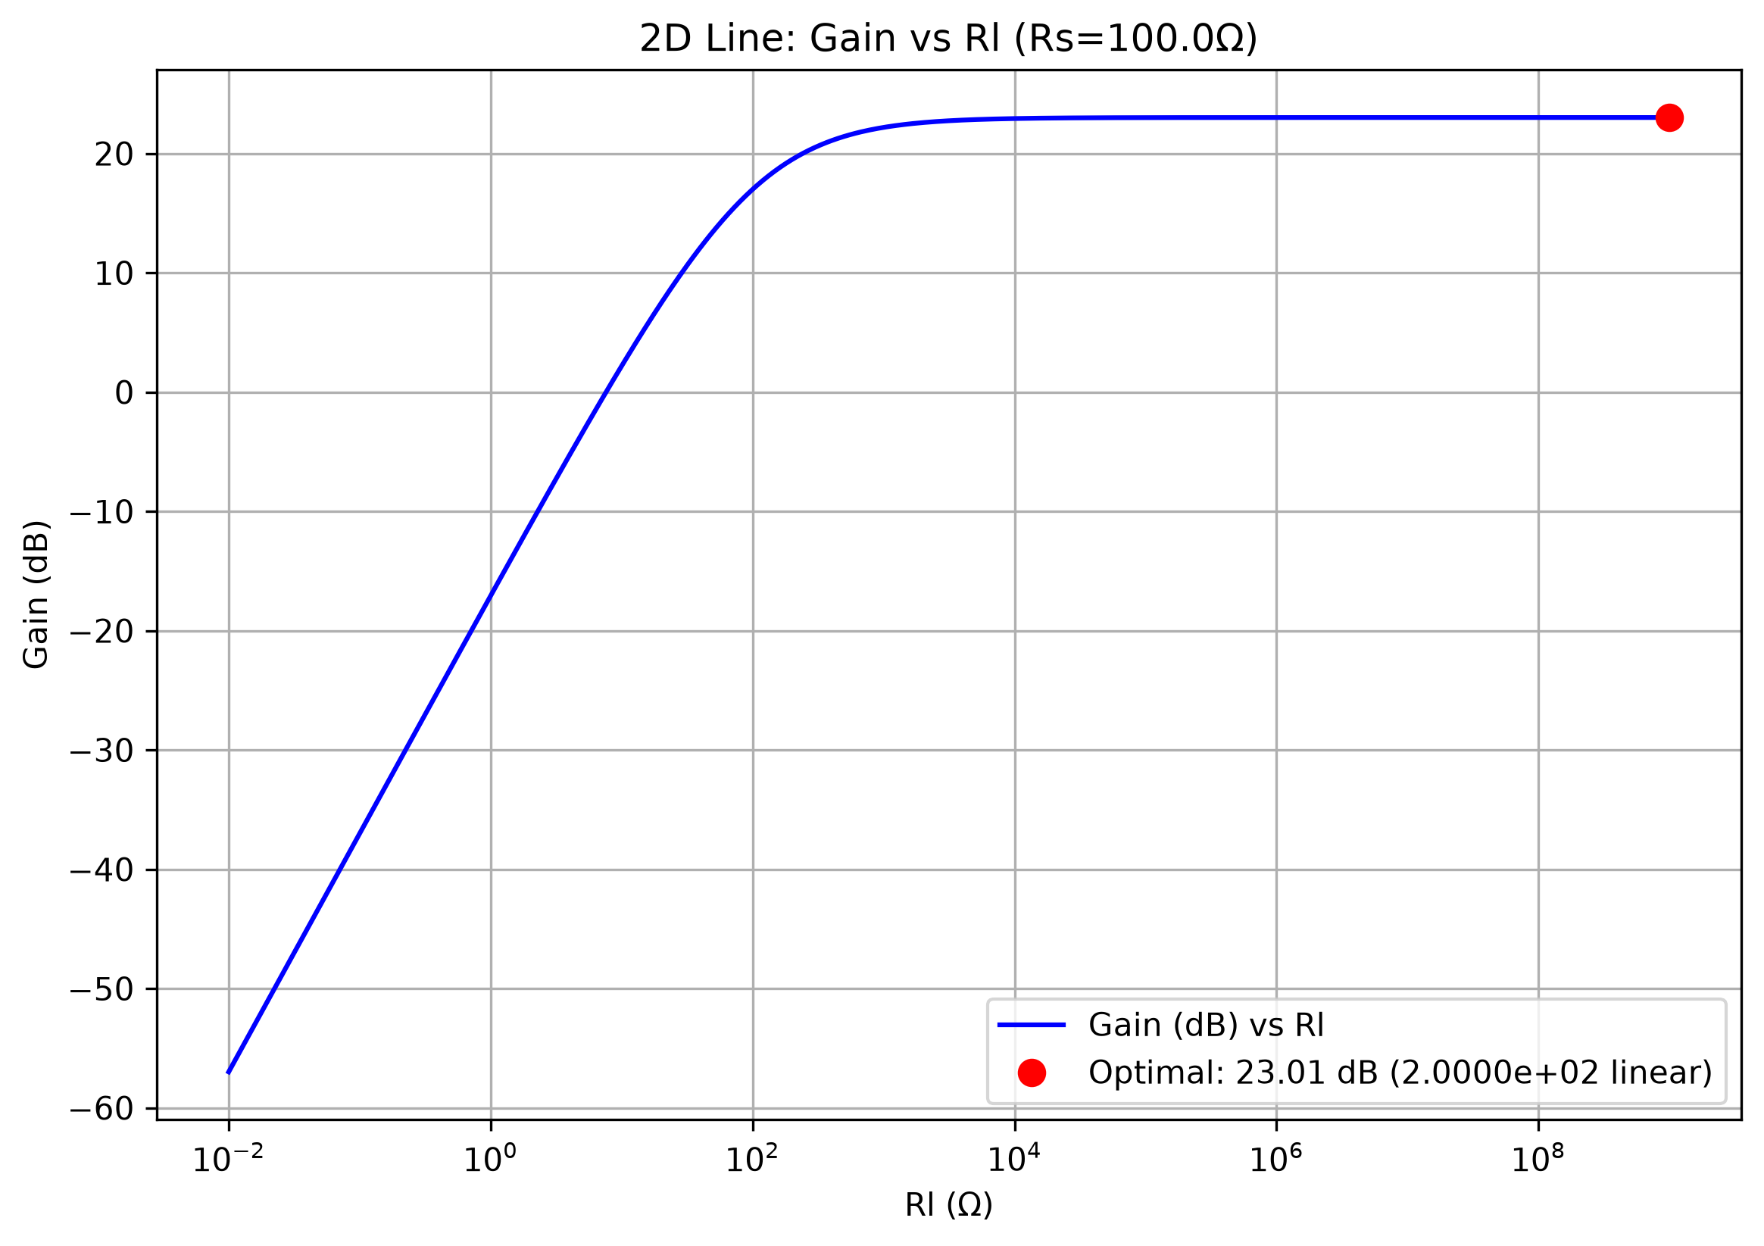
Obtained results

Slide 30
Obtained results
SNRo (equation 20):
Rs ∈ [0.01; 1e6]
RL ∈ [0.01; 1e9]
Other parameters:
Vs = 1.0 V
T = 300.0K
Nna = 1e-12 W/Hz
k = 1.38e-23 J/K
g = 10.0
Obtained value: 140.00 dB at
Rs = 0.01Ω and RL = 1e9Ω

Slide 31
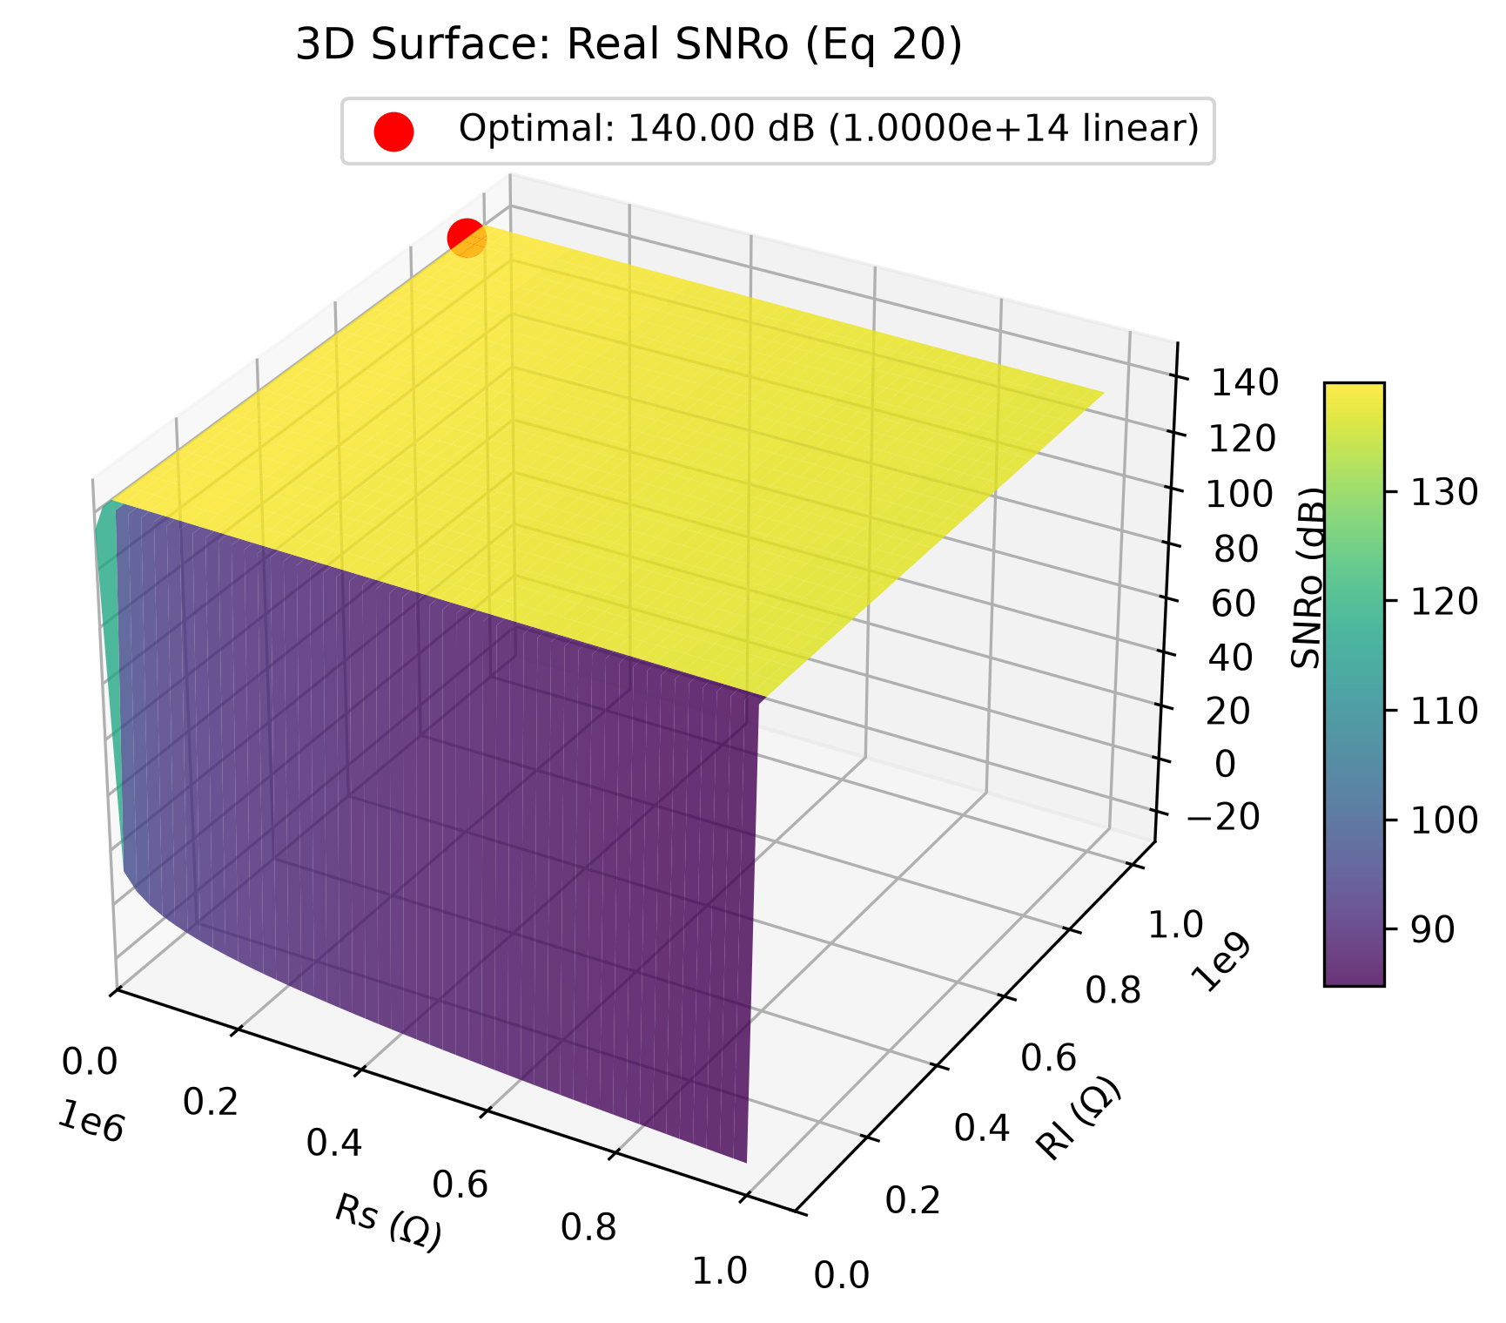
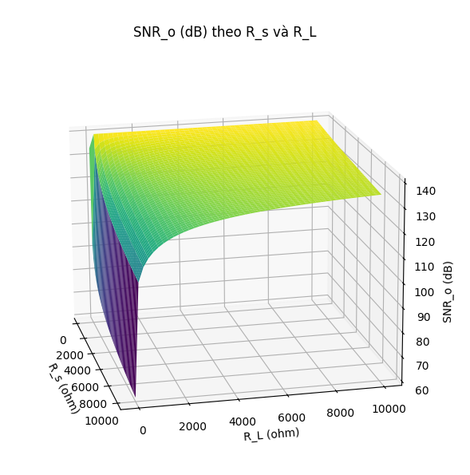
Obtained results

Slide 32
Obtained results
Vso (equation 17-1):
Rs ∈ [0.01; 1e6]
RL ∈ [0.01; 1e9]
Other parameters:
Vs = 1.0 V
g = 10.0
Obtained value: 10V at
Rs = 0.01Ω and RL = 1e9 Ω

Slide 33
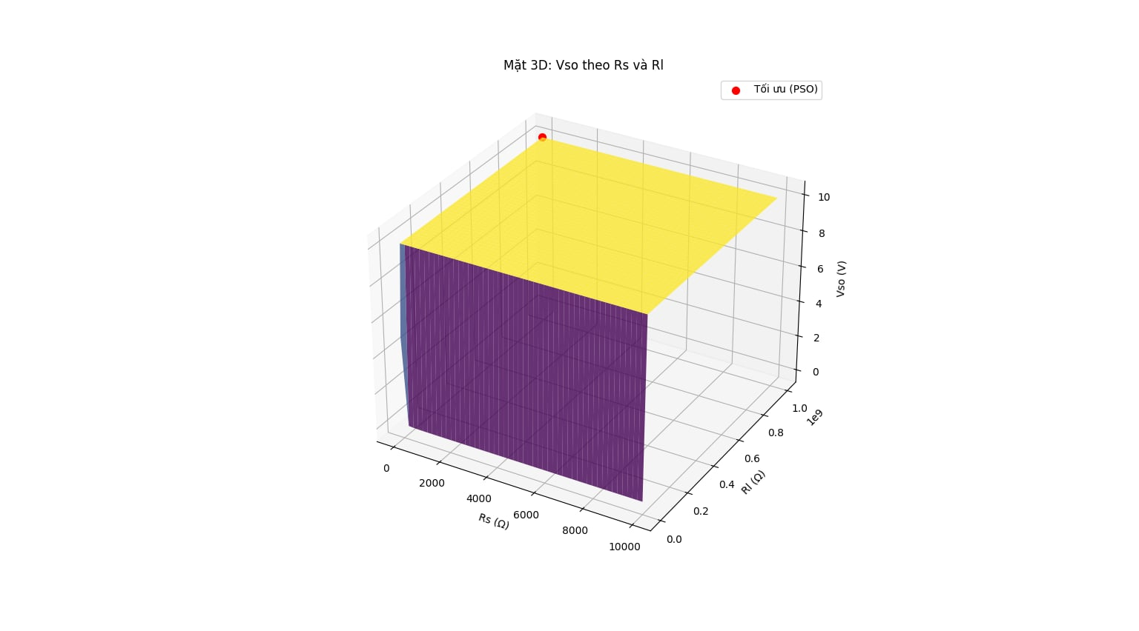
Obtained results

Slide 34
Obtained results
Pso (equation 17-2):
Rs ∈ [0.01; 1e6]
RL ∈ [0.01; 1e9]
Other parameters:
Vs = 1.0 V
g = 10.0
Ro = 50Ω
Obtained value: 0.5 W at
Rs = 0.01Ω and RL = 1e9Ω

Slide 35
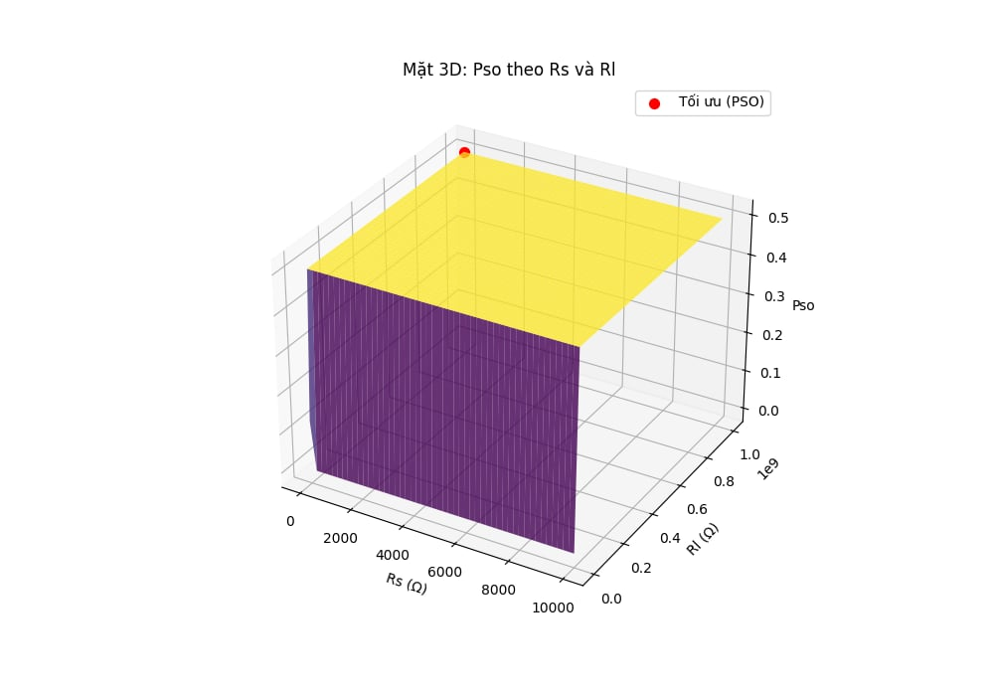
Obtained results

Slide 36
Obtained results
Pno (equation 19):
Rs ∈ [0.01; 1e6]
RL ∈ [0.01; 1e9]
Other parameters:
Ro = 50Ω
T = 300.0K
Nna = 1e-12 W/Hz
k = 1.38e-23 J/K
g = 10.0
Minimum Pno: 5.0000e-15 W | Rs = 0.01 Ω | Rl = 950714306.39 Ω

Slide 37
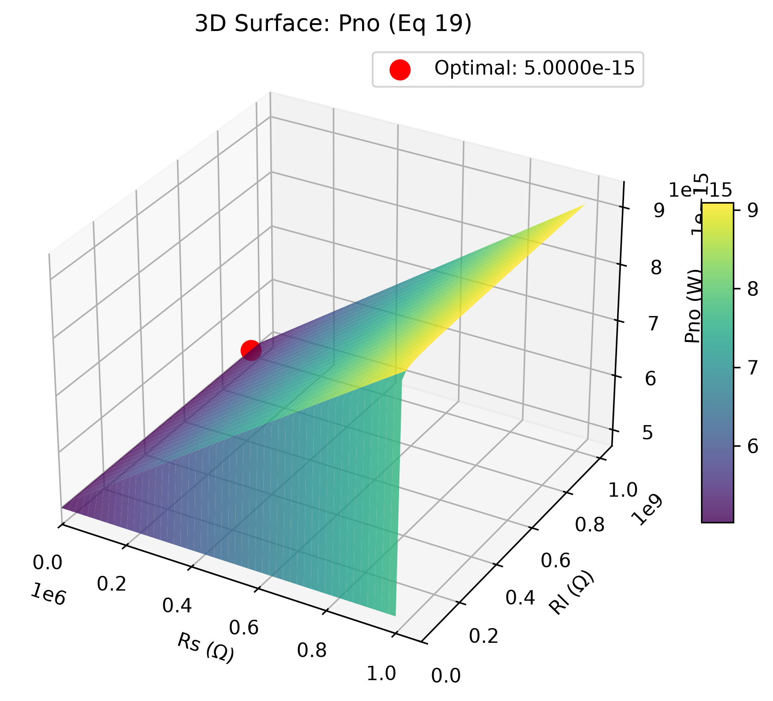
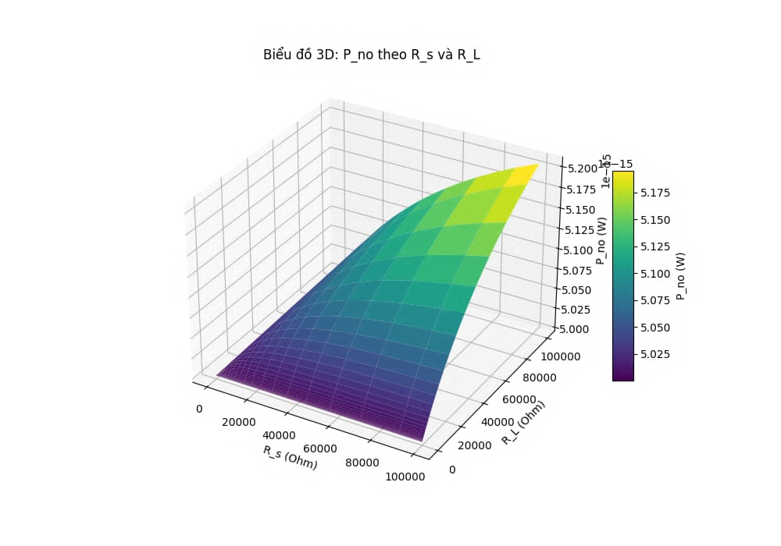
Obtained results

Slide 38
Conclusions

Slide 39
Conclusions
From (9), while impedance matching result in an optimized SNR, it is limited to a specific reactance, meaning broadband is not supported
From the obtained results of eq 18, to achieve the maximum signal voltage, we should connect the antenna (the source) to an amplifier with an infinite input impedance (an open circuit). This is equivalent to drawing no current or power from the antenna.
Obtained results directly challenges the conventional wisdom that there must be power transfer (i.e., there must be current and a finite load) for the amplifier to operate effectively

Slide 40
THANK YOU !

