Slide 1
DSA Self Paced
A 6 weeks summer training course

Slide 2

Mentor in Course

Slide 3

Certificate
Certificate of the successfully Completion of the Course

Slide 4
Contents in Course
Introduction to DSA (what & why)
Analysis of Algorithm
Mathematics
Bit Magic
Recursion
Arrays
Searching
Sorting
Matrix
Hashing
Strings

Slide 5
Linked List
Stack
Queue
Dequeue
Tree
Binary Search Tree
Heap
Graph
Greedy
Backtracking
Dynamic Programming
Trie
Segment and Binary Indexed Trees
Disjoint Set

Slide 6
Analysis of Algorithms
Algorithm analysis is an important part of computational complexity theory, which provides theoretical estimation for the required resources of an algorithm to solve a specific computational problem. Analysis of algorithms is the determination of the amount of time and space resources required to execute it.
Why Analysis of Algorithms is important?
To predict the behavior of an algorithm without implementing it on a specific computer.
It is much more convenient to have simple measures for the efficiency of an algorithm than to implement the algorithm and test the efficiency every time a certain parameter in the underlying computer system changes.
It is impossible to predict the exact behaviour of an algorithm. There are too many influencing factors.
The analysis is thus only an approximation; it is not perfect.
More importantly, by analyzing different algorithms, we can compare them to determine the best one for our purpose.
Types of Algorithm Analysis:
Best case
Worst case
Average case

Slide 7
Asymptotic Notations
Asymptotic notations are mathematical tools to represent the time complexity of algorithms for asymptotic analysis. The following 3 asymptotic notations are mostly used to represent the time complexity of algorithms:
Θ Notation: The theta notation bounds a function from above and below, so it defines exact asymptotic behavior. A simple way to get the Theta notation of an expression is to drop low-order terms and ignore leading constants. For example, consider the following expression. 3n³ + 6n² + 6000 = Θ(n³) Dropping lower order terms is always fine because there will always be a number(n) after which Θ(n³) has higher values than Θ(n²) irrespective of the constants involved. For a given function g(n), we denote Θ(g(n)) is following set of functions.

Slide 8
2) Big O Notation: The Big O notation defines an upper bound of an algorithm, it bounds a function only from above. For example, consider the case of Insertion Sort. It takes linear time in best case and quadratic time in worst case. We can safely say that the time complexity of Insertion sort is O(n^2). Note that O(n^2) also covers linear time. If we use O notation to represent time complexity of Insertion sort, we have to use two statements for best and worst cases: 1. The worst case time complexity of Insertion Sort is O(n^2). 2. The best case time complexity of Insertion Sort is O(n).
The Big O notation is useful when we only have upper bound on time complexity of an algorithm. Many times we easily find an upper bound by simply looking at the algorithm.
3) Ω Notation: Just as Big O notation provides an asymptotic upper bound on a function, Ω notation provides an asymptotic lower bound. Ω Notation can be useful when we have lower bound on time complexity of an algorithm. The Omega notation is the least used notation among all three. For a given function g(n), we denote by Ω(g(n)) the set of functions.

Slide 9
Introduction to DSA(Data Structures and Algorithms)
Data Structures and Algorithms (DSA) form the fundamental building blocks of computer science and software development. They are at the core of solving complex computational problems efficiently and effectively. DSA is an essential field of study for anyone aspiring to become a proficient programmer, software engineer, or computer scientist.
Data structures are containers that organize and store data in a structured manner to enable efficient access, modification, and retrieval of information. They provide a way to manage and organize data, ensuring that it can be processed and manipulated effectively. Common data structures include arrays, linked lists, stacks, queues, trees, graphs, and more.
Problem Solving: DSA provides a systematic approach to problem-solving. It equips you with the tools and techniques necessary to tackle complex computational challenges.
Efficiency: Knowledge of DSA enables you to write code that runs faster and consumes fewer system resources. This is critical in today's world of resource-intensive applications.
Scalability: DSA helps you design software that can handle large amounts of data and scale to meet the demands of real-world applications.
Foundation for Other Fields: DSA serves as the foundation for various other computer science fields, such as machine learning, artificial intelligence, and database management.
Coding Interviews: DSA concepts are a common topic in technical interviews for software development roles. A strong grasp of DSA is essential for landing prestigious job opportunities.

Slide 10
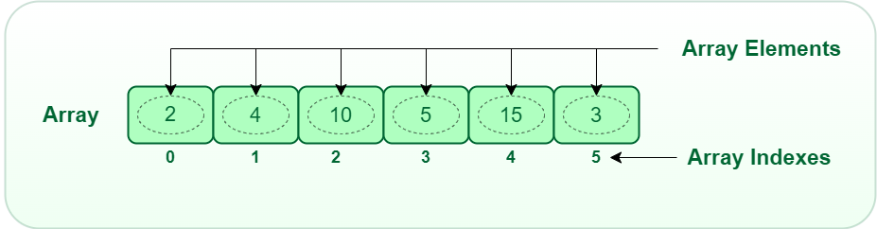
Arrays
An array is a collection of items of same data type stored at contiguous memory locations.
Basic terminologies of array
Array Index: In an array, elements are identified by their indexes. Array index starts from 0.
Array element: Elements are items stored in an array and can be accessed by their index.
Array Length: The length of an array is determined by the number of elements it can contain.

Slide 11
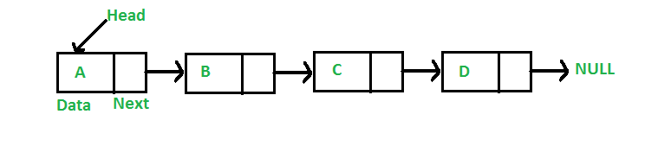
Linked List
Linked Lists are linear or sequential data structures in which elements are stored at non-contiguous memory locations and are linked to each other using pointers.
Like arrays, linked lists are also linear data structures but in linked lists elements are not stored at contiguous memory locations. They can be stored anywhere in the memory but for sequential access, the nodes are linked to each other using pointers.
Each Element in the Linked List contain two main pointers:-
Data: This part stores the data value of the node. That is the information to be stored at the current node.
Next Pointer: This is the pointer variable or any other variable which stores the address of the next node in the memory.

Slide 12
Advantages of Linked List
Advantages of Linked Lists over Arrays: Arrays can be used to store linear data of similar types, but arrays have the following limitations:
The size of the arrays is fixed, so we must know the upper limit on the number of elements in advance. Also, generally, the allocated memory is equal to the upper limit irrespective of the usage. On the other hand, linked lists are dynamic and the size of the linked list can be incremented or decremented during runtime.
Inserting a new element in an array of elements is expensive, because a room has to be created for the new elements, and to create room, existing elements have to shift. For example, in a system, if we maintain a sorted list of IDs in an array id[].
Disadvantages of Linked List
Random access is not allowed in Linked Lists. We have to access elements sequentially starting from the first node. So, we cannot do a binary search with linked lists efficiently with its default implementation. Therefore, lookup or search operation is costly in linked lists in comparison to arrays.
Extra memory space for a pointer is required with each element of the list.
Not cache-friendly. Since array elements are present at contiguous locations, there is a locality of reference which is not there in the case of linked lists.

Slide 13
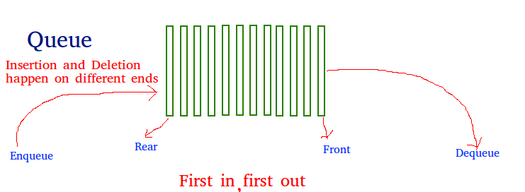
Introduction to Queues
Like Stack data structure, Queue is also a linear data structure that follows a particular order in which the operations are performed. The order is First In First Out (FIFO), which means that the element that is inserted first in the queue will be the first one to be removed from the queue. A good example of queue is any queue of consumers for a resource where the consumer who came first is served first. The difference between stacks and queues is in removing. In a stack, we remove the most recently added item; whereas, in a queue, we remove the least recently added item. Operations on Queue: Mainly the following four basic operations are performed on queue: Enqueue: Adds an item to the queue. If the queue is full, then it is said to be an Overflow condition.
Dequeue: Removes an item from the queue. The items are popped in the same order in which they are pushed. If the queue is empty, then it is said to be an Underflow condition.
Front: Get the front item from queue.
Rear: Get the last item from queue.

Slide 14
Stack Data Structure
Stack
It is a linear data structure that follows a particular order in which the operations are performed.
LIFO( Last In First Out ):
This strategy states that the element that is inserted last will come out first. You can take a pile of plates kept on top of each other as a real-life example. The plate which we put last is on the top and since we remove the plate that is at the top, we can say that the plate that was put last comes out first.
Basic Operations on Stack
In order to make manipulations in a stack, there are certain operations provided to us :-
push() to insert an element into the stack
pop() to remove an element from the stack
top() Returns the top element of the stack.
isEmpty() returns true if stack is empty else false.
size() returns the size of stack.
Application of Stack Data Structure:
Stack is used for evaluating expression with operands and operations.
Matching tags in HTML and XML
Undo function in any text editor.
Infix to Postfix conversion.
Stacks are used for backtracking and parenthesis matching.
Stacks are used for conversion of one arithmetic notation to another arithmetic notation.

Slide 15
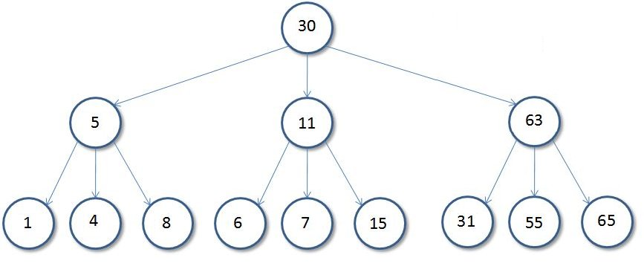
Introduction to Trees
A sample tree as shown below:-

Slide 16
Basic Tree Termonlogies:-
Root: The root of a tree is the first node of the tree. In the above image, the root node is the node 30.
Edge: An edge is a link connecting any two nodes in the tree. For example, in the above image there is an edge between node 11 and 6.
Siblings: The children nodes of same parent are called siblings. That is, the nodes with same parent are called siblings. In the above tree, nodes 5, 11, and 63 are siblings.
Leaf Node: A node is said to be the leaf node if it has no children. In the above tree, node 15 is one of the leaf nodes.
Height of a Tree: Height of a tree is defined as the total number of levels in the tree or the length of the path from the root node to the node present at the last level. The above tree is of height 2.
Binary Tree
A Tree is said to be a Binary Tree if all of its nodes have atmost 2 children. That is, all of its node can have either no
child, 1 child, or 2 child nodes.
The maximum number of nodes at level 'l' of a binary tree is (2^{l - 1}). Level of root is 1. This can be proved by induction. For root, l = 1, number of nodes = 2¹⁻¹ = 1 Assume that the maximum number of nodes on level l is 2^{l-1}. Since in Binary tree every node has at most 2 children, next level would have twice nodes, i.e. 2 * 2^{l-1}.
Maximum number of nodes in a binary tree of height 'h' is (2^{h} – 1). Here height of a tree is the maximum number of nodes on the root to leaf path. The height of a tree with a single node is considered as 1. This result can be derived from point 2 above. A tree has maximum nodes if all levels have maximum nodes. So maximum number of nodes in a binary tree of height h is 1 + 2 + 4 + .. + 2^{h}-1. This is a simple geometric series with h terms and sum of this series is 2^{h} – 1. In some books, the height of the root is considered as 0. In that convention, the above formula becomes 2^{h+1} – 1.

Slide 17
Binary Search Tree
In a BST, each node has at most two children.
The left subtree contains nodes with values less than the root node, and the right subtree contains nodes with values greater than the root node.
BSTs are commonly used for searching, insertion, and deletion operations.
Balanced Binary Trees:
These are binary trees where the height of the left and right subtrees of any node differ by at most one.
Examples include AVL trees and Red-Black trees.
Balanced trees ensure efficient operations like insertion, deletion, and searching.
Full Binary Tree:
In a full binary tree, each node has either 0 or 2 children.
Every level of the tree is completely filled except possibly for the last level, which is filled from left to right.
Full binary trees are used in heap data structures.

Slide 18
Graph
A graph is a collection of nodes (vertices) and edges that connect these nodes.
Nodes represent entities, and edges represent relationships between these entities.
Types of Graphs:
Undirected Graph:
In an undirected graph, edges have no direction.
Directed Graph:
In a directed graph, edges have direction. They go from one node to another.
If there is an edge from node A to node B, it doesn't imply an edge from B to A.
Weighted Graph:
In a weighted graph, each edge has a numerical value associated with it, called a weight or cost.

Slide 19
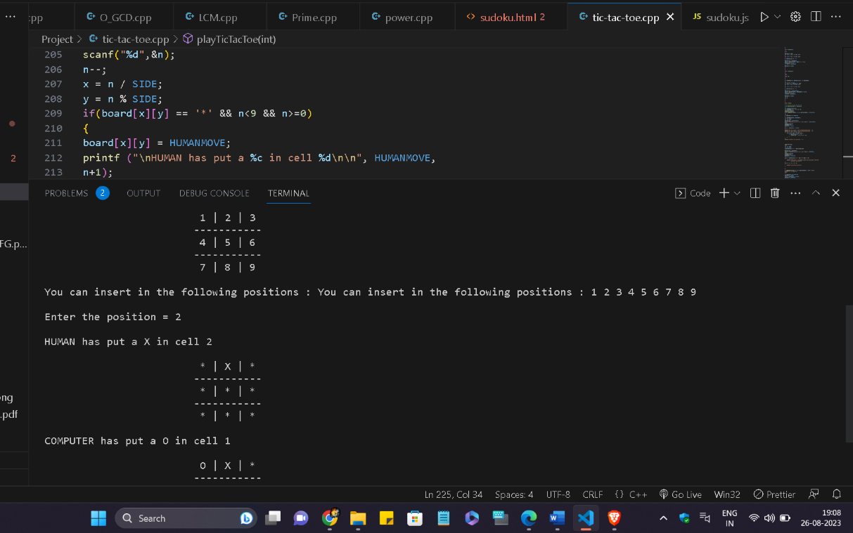
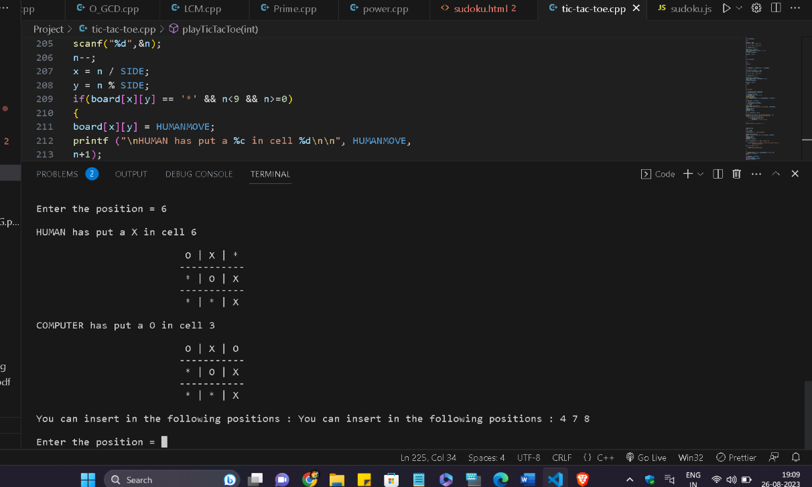
Project
Developed a Tic-Tac-Toe game with an AI opponent using the Minimax algorithm.
Implemented a command-line interface for user interaction.
Users can choose to play as either the human or let the computer make moves.
The computer opponent makes intelligent moves to maximize its chances of winning or forcing a draw.
The game provides a challenging and interactive experience for players.
Key Features:
Choice for users to play as the human or computer.
Interactive command-line interface.
Keeps track of game results, including wins, draws, and losses.
Details of Code:-
Programming Language used is CPP.
Code contain many Functions like void intiaize,void declare winner,void columncrossed,void rowcrossed.

Slide 20
Conclusion
The study of Data Structures and Algorithms is a fundamental and essential aspect of computer science and software engineering. Throughout this course, we've delved into various data structures like arrays, linked lists, trees, and graphs, as well as algorithms for searching, sorting, and optimizing.
These concepts not only form the building blocks of efficient and effective software but also play a crucial role in solving real-world problems. Understanding how to select the right data structure and algorithm for a given task is a skill that every programmer should master.
As in journey of computer science, remember that DSA is not just about coding—it's about problem-solving, optimization, and critical thinking. The knowledge gained in this course will empower you to tackle complex challenges in the field of computing.
Keep practicing, exploring, and applying these concepts in your projects, and you'll be well-equipped to excel in your future endeavors in the world of technology. Thank you for your dedication to this course, and we wish you success in your ongoing exploration of Data Structures and Algorithms!"

Slide 21
Thank You

