Slide 1

3BEES&ME
Bert V. M.
Bram V.
Brend L.
Mattijs S.
HOWESTSTONE

Slide 2
3BEES&ME
HARDEST CODE

Slide 3
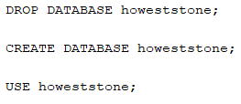
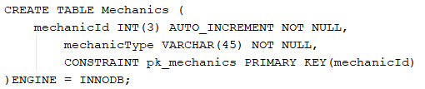
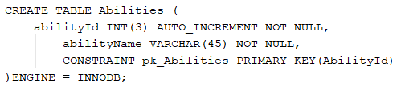
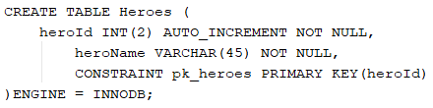
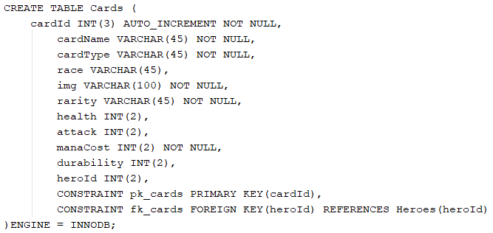
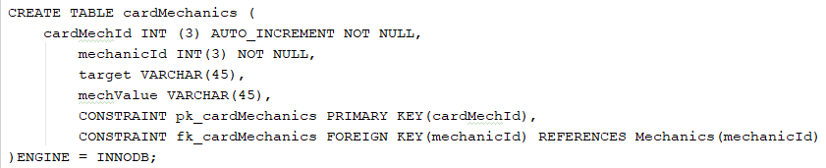
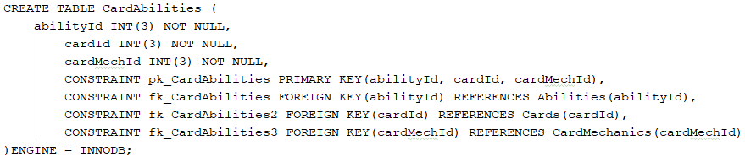
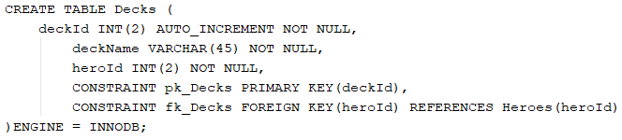
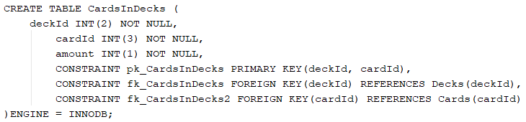
3BEES&ME
HARDEST CODE
BRAM
‘s hardest code was

Slide 4
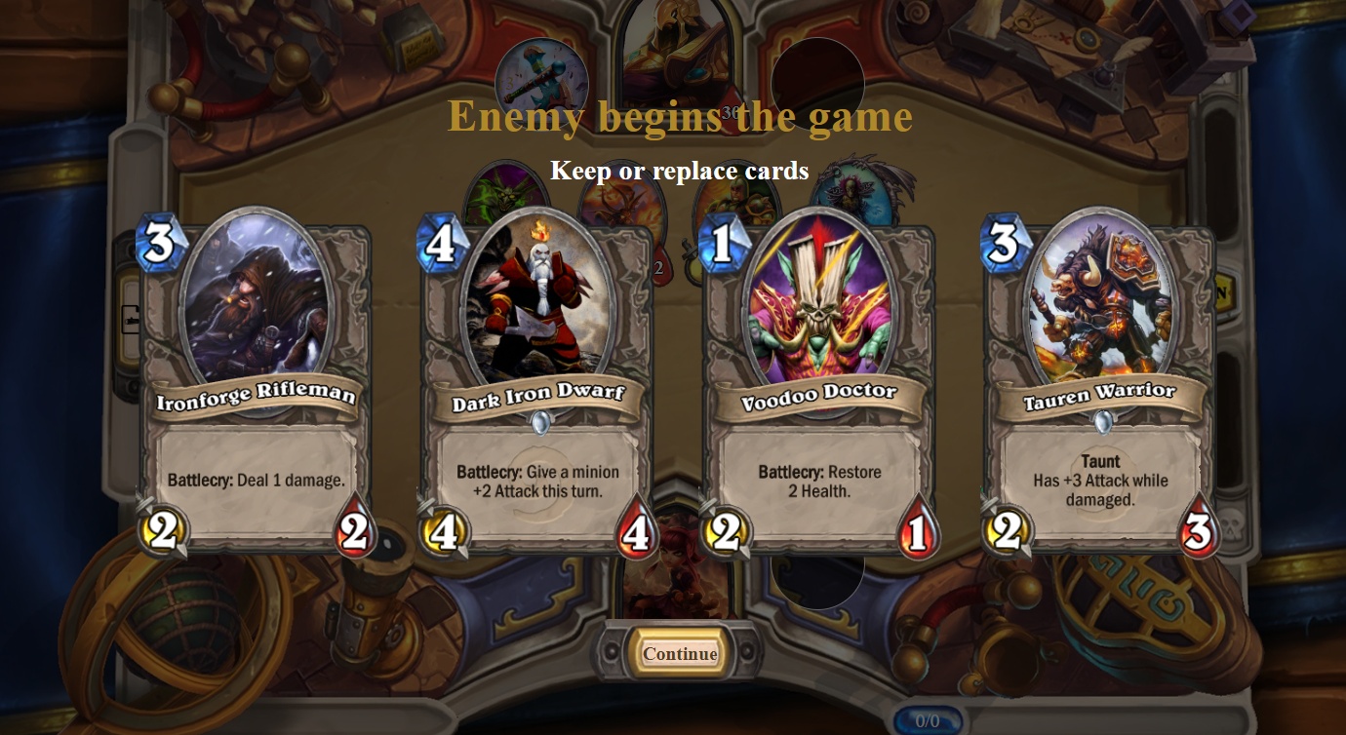
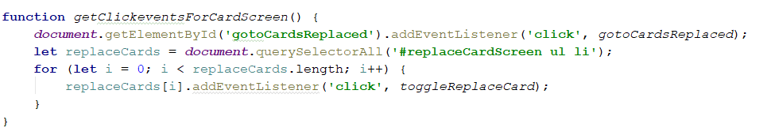
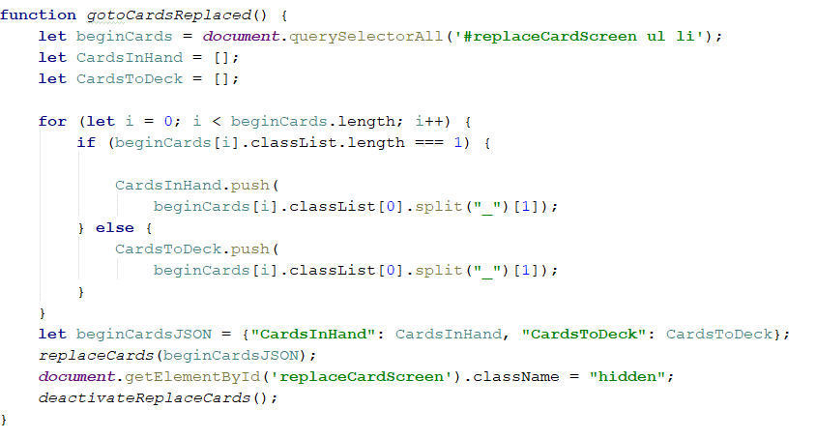
3BEES&ME
BERT
‘s hardest code was

Slide 5
3BEES&ME
BREND
‘s hardest code was

Slide 6
3BEES&ME
MATTIJS
‘s hardest code was

Slide 7
3BEES&ME
WE ARE PROUD

Slide 8
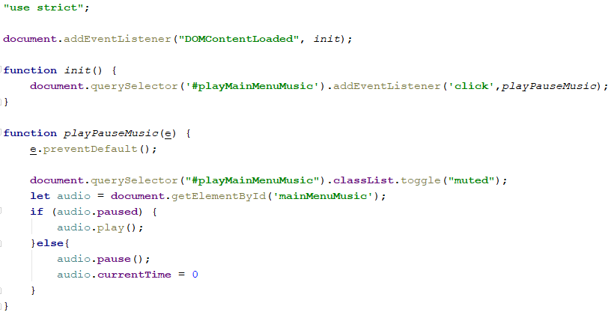
3BEES&ME
BRAM
is proud of
his coach Badlapje

Slide 9
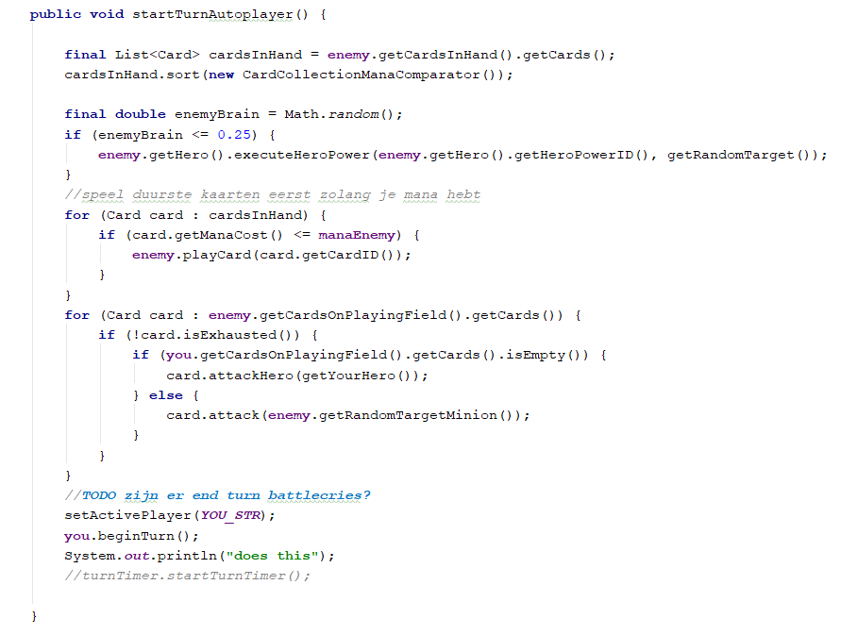
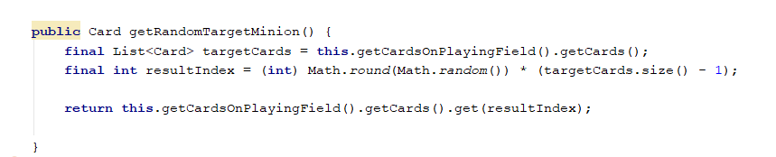
3BEES&ME
BERT
is proud of
his coach Badlapje

Slide 10
3BEES&ME
BREND
is proud of
his coach Badlapje

Slide 11
3BEES&ME
MATTIJS
is proud of
his coach Badlapje

