Slide 1
Predicting Violent Threat of Agents within a Terrorist Network
Blaine Haws
Capstone Unit 3

Slide 2
Research question:
Given a set of characteristics for an agent within a terrorist network, can we predict with high accuracy (> 90%) the probability the given agent is about to commit a violent action?

Slide 3
Data Set
This data set was created using distributions that were researched using various other data sets.
The training test set has 10,000 agents with 10 characteristics and 2 pre-determined outcomes.
The prediction set also has 10,000 agent with 10 characteristics but no determined outcomes.

Slide 4
What characteristics?
Ages (ages): The current age of the agent, ranges from 17-56. Average age: 36. ((Static))
Gender (gender): The gender of the agent. 0 – Male, 1 – Female. Split: 90/10((Static))
Religion (religion): The claimed religion of the agent. 0 – Islam, 1 – Other. Split: 80/20((Static))
Role (role): The role of the agent within the network. 0 – Fighter, 1 – Funding, 2 – Intel, 3 – Command. Split: 50/22/22/6 ((Static))

Slide 5
Characteristics Cont.
Aggressive Behavior (agr_bhv): The natural tendency of the agent towards hostility. Ranges: 0 – 1, Mean: 0.388, Std: .210 ((Static))
Religious Fanaticism (rel_fnt): How strictly adherent to the agent’s religion is the agent. Ranges: 0 – 1, Mean: 0.596, Std: 0.146 ((Static))
Hatred Toward Foreigners (hst_twd_for): The natural tendency for hatred towards foreigners. Ranges: 0 – 1, Mean: 0.469, Std: 0.239 ((Static))
Religious Agression (rel_agr): How aggressive an agent is in forwarding their religion. Calculated by Aggressive Behavior x Religious Fanaticism. Ranges: 0 – 1, Mean: 0.251, 0.152 ((Static))

Slide 6
Characteristics Cont.
Level of Recent Activity* (lvl_rct_act): When was the last terrorist action taken by the agent, diminishes with time. Each terrorist action resets the value to 1. Ranges: 0 – 1, Mean: 0.394, Std: 0.241 ((Variable))
Current Aggression Level* (crt_agr_lvl): Regardless of the agent’s natural aggressive tendencies, how currently aggressive is the agent. Fluctuates in response to outside forces and other variables. Ranges: 0 – 1, Mean: 0.543, Std: 0.258 ((Variable))

Slide 7
What are we testing for?
This dataset contains 2 possible outcomes, a categorical or a continuous outcome.
Is the agent a current threat? This is a categorical label, 0 – No, 1 – Yes. Informative, but not very useful.
What is the probability of being a threat? This is a continuous variable, ranging from 0 to 1. This is informative, and much more useful.

Slide 8
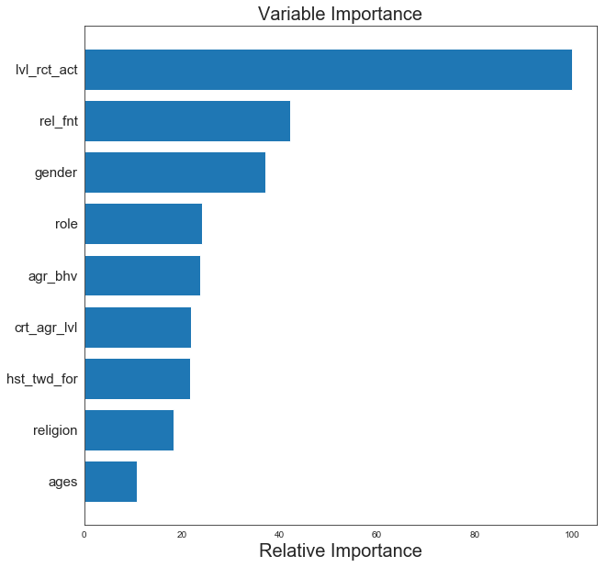
What does PCA tell us?
The current dataset has 10 characteristics. PCA tells us that 95% of the variance in our data is described by 9 of them.

Slide 9
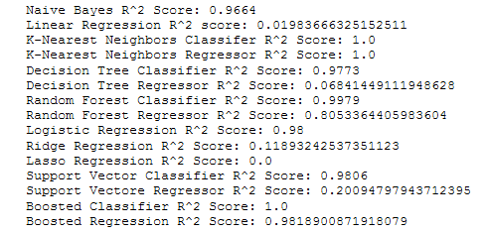
Choosing a model

Slide 10
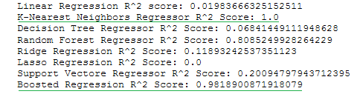
Narrowing it down

Slide 11
Chosen model
In the end, I chose to use the Gradient Boosted Regression for my prediction. Though GBRs have a possibility for over-fitting, using a small learning rate helped to ensure that no iteration outweighed the others. I believe both a GBR or a K-NN are a good option for future testing when introduced into an agent-based model system.

Slide 12
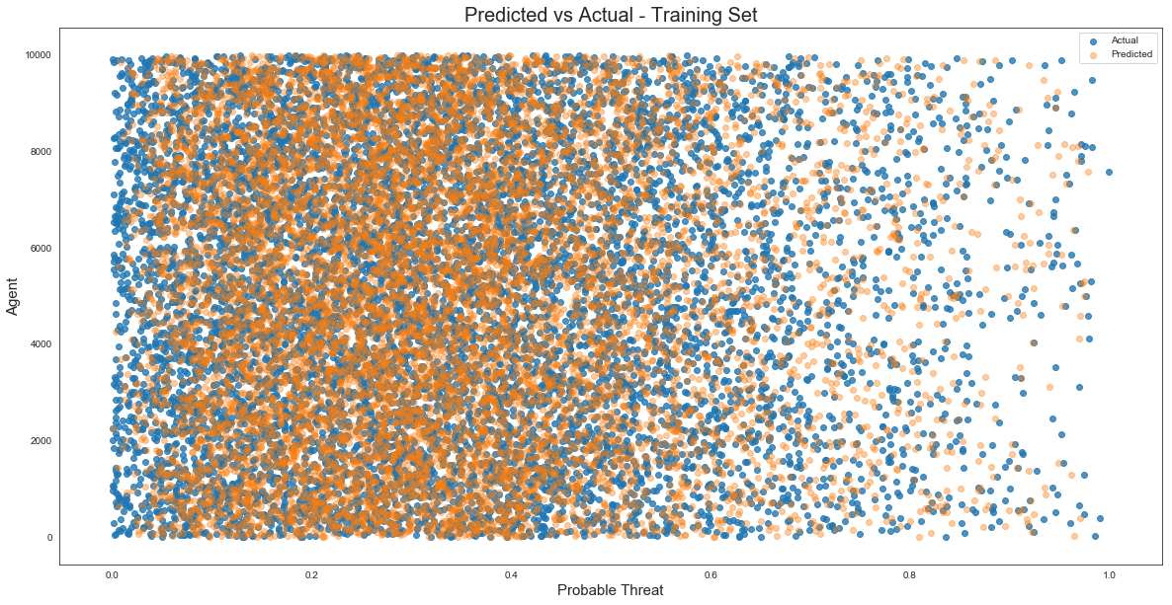
Predicted vs Actual Training Set

Slide 13
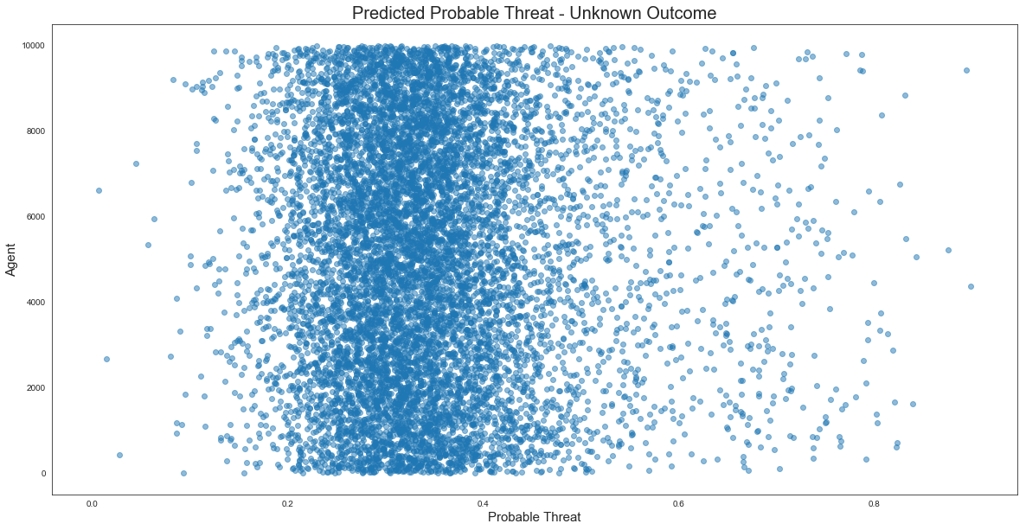
Predicted – Unknown Result

Slide 14
Who cares?
These predictions are meant to be of interest and value to those in the national defense and military logistics fields, which includes agencies such as the Department of Defense and the Defense Intelligence Agency.

Slide 15
Why should we use this information?
With the increase of terror attacks around the globe, the United States military forces are being deployed in response. It costs $2,100,00 to deploy just 1 soldier to Afghanistan. This does not include any redeployment cost should the soldier be required to move to a new hot spot. If we are able to predict the dangerous areas before deployment, we could deploy our forces more effectively and efficiently.

Slide 16
Where can this data go?
Using an agent-based model, we can predict each agent’s probability to commit a violent action within a specific region (e.g., a city), sum all agents’ probability, and calculate the overall probability of a violent action occurring for that region. This is particularly useful when testing for the most efficient deployment of military forces, determining whether the region’s probability rises or falls.

Slide 17
Bibliography
John Jay & ARTIS Transnational Terrorism Database: http://doitapps.jjay.cuny.edu/jjatt/attributes.php
Yahoo! News: https://www.yahoo.com/news/it-costs--2-1-million-per-year-for-each-soldier-deployed-in-afghanistan--report-133150602.html
Combatting Global Terrorist Networks and Hostile Areas of Concern: https://github.com/BlaHaws/Thinkful/blob/master/Reports/AnalyticReport.ipynb

Slide 18
Economics of National Security: Data Set Index 1.1
2.1 Defense Investment: www.nber.org/ens/feldstein/DOD_DATASETS/White%20House/defense%20investment%20by%20year.xls
9.6 Suicide Attack Database: www.nber.org/ens/feldstein/ENSA_Sources/CPOST/cpost_summaryList.csv
6.1.1 Armed Conflict UCDP: www.nber.org/ens/feldstein/ENSA_Sources/UCDP_PRIO/ArmedConflict/ucdp-onset-conf-2014.csv
9.8 High Casualty Terrorism Bombings: www.nber.org/ens/feldstein/ENSA_Sources/CSP/HCTB/HCTB2014.xls

