Slide 1
Predicting Violent Threat of Agents within a Terrorist Network
Blaine Haws

Slide 2
Research question:
Given a set of characteristics for an agent within a terrorist network, can we predict with high accuracy (> 90%) the probability the given agent is about to commit a violent action?

Slide 3
What characteristics?
Ages (ages): The current age of the agent, ranges from 17-56. Average age: 36. ((Static))
Gender (gender): The gender of the agent. 0 – Male, 1 – Female. Split: 90/10((Static))
Religion (religion): The claimed religion of the agent. 0 – Islam, 1 – Other. Split: 80/20((Static))
Role (role): The role of the agent within the network. 0 – Fighter, 1 – Funding, 2 – Intel, 3 – Command. Split: 50/22/22/6 ((Static))

Slide 4
Characteristics Cont.
Aggressive Behavior (agr_bhv): The natural tendency of the agent towards hostility. Ranges: 0 – 1, Mean: 0.388, Std: .210 ((Static))
Religious Fanaticism (rel_fnt): How strictly adherent to the agent’s religion is the agent. Ranges: 0 – 1, Mean: 0.596, Std: 0.146 ((Static))
Hatred Toward Foreigners (hst_twd_for): The natural tendency for hatred towards foreigners. Ranges: 0 – 1, Mean: 0.469, Std: 0.239 ((Static))
Religious Agression (rel_agr): How aggressive an agent is in forwarding their religion. Calculated by Aggressive Behavior x Religious Fanaticism. Ranges: 0 – 1, Mean: 0.251, 0.152 ((Static))

Slide 5
Characteristics Cont.
Level of Recent Activity* (lvl_rct_act): When was the last terrorist action taken by the agent, diminishes with time. Each terrorist action resets the value to 1. Ranges: 0 – 1, Mean: 0.394, Std: 0.241 ((Variable))
Current Aggression Level* (crt_agr_lvl): Regardless of the agent’s natural aggressive tendencies, how currently aggressive is the agent. Fluctuates in response to outside forces and other variables. Ranges: 0 – 1, Mean: 0.543, Std: 0.258 ((Variable))

Slide 6
What are we testing for?
Is the agent a current threat? This is a categorical label, 0 – No, 1 – Yes. Informative, but not very useful.
What is the probability of being a threat? This is a continuous variable, ranging from 0 to 1. This is informative, and much more useful.

Slide 7
What does PCA tell us?
The current dataset has 10 characteristics. PCA tells us that 95% of the variance in our data is described by 9 of them.

Slide 8
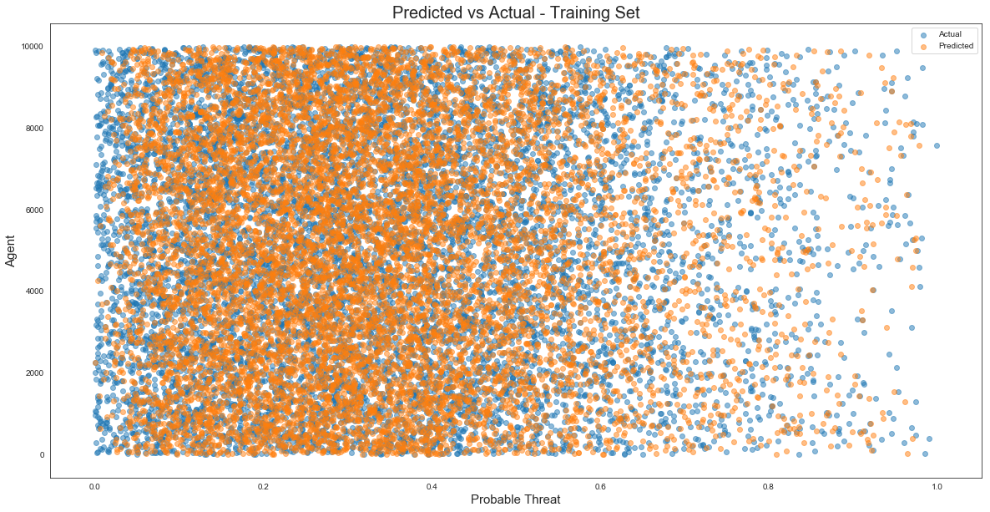
Predicted vs Actual Training Set

Slide 9
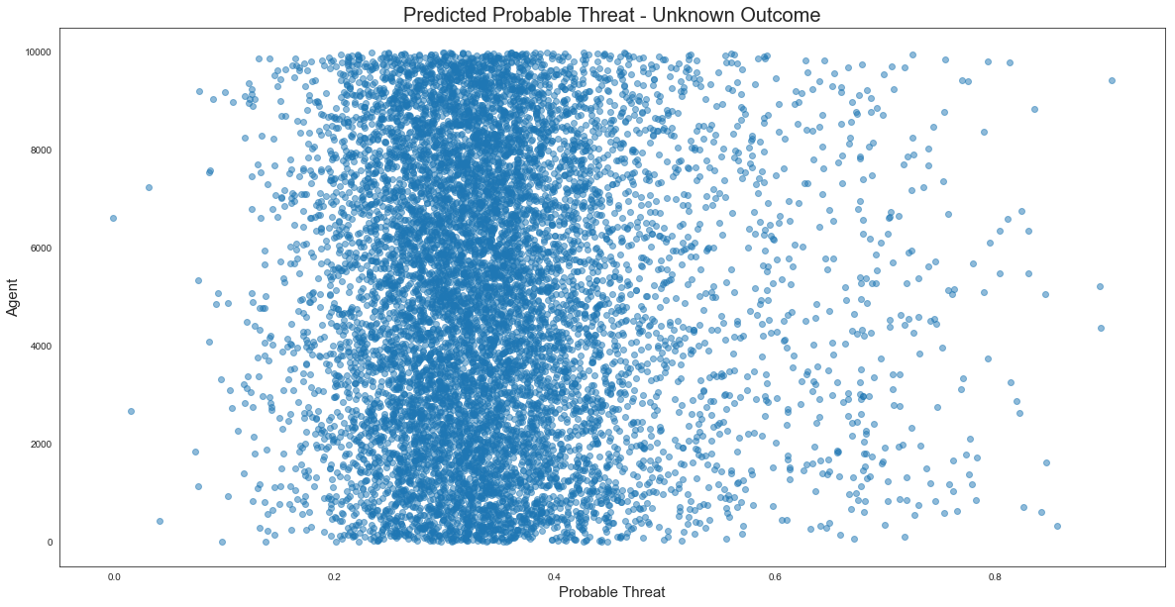
Predicted – Unknown Result

Slide 10
Who cares about this data?
With the increase of terror attacks around the globe, the United States military forces are being deployed in response. It costs $X to deploy just 1 soldier. This does not include any redeployment cost should the soldier be required to move to a new hot spot. If we are able to predict the dangerous areas before deployment, we could deploy our forces more effectively and efficiently.

Slide 11
Where can this data go?

