Slide 1
NO MORE SERVERS
Notes:
Hello and a waerm welcome to the first serverless meetup in 2019..
I hope everybody was provided with beer and pizza
Once short notice before we start…
Why we do this? a lot of hype, a lot of blogs and colleagues saying try it out or you will be disrupted… We are a group of people, who want to bring light into this
everybody is a contributer
open for every serverless solution
the plan is we want to do this every quarter and next time in a different location in an other company
today you are hosted by maibornwolff
Another notice, you are not the only guests who listen to this meetup, there are colleagues in the chat
We dont record it, so speak frankly
orga
another small thing, please use the main lift – the others are alarm secured
car
Ok this words upfront, lets talk about the Agenda
1. Will will have a more or less short intro into SLS for those who are not so familiar with it
2. Guest from AWS
! BioBreak
3. Practical part
4. Last but not least
5. at the end we fade out with a beer, hope this is ok for everybody
Any questions till now? Then we start with the intro

Slide 2

Michael Abey
IT Architect @maibornwolff
@shadowmulder
Notes:
kitten pictures or serverless comments
small word of warning I am a minimalist, this means:
I know only one color: thats blue
I normally processing 2 slides per minute
speaks faster than I should.
Summa summarum I am a talking microservice, lucky for you that I didnt reached the level of a serverless function till now

Slide 3
NO MORE SERVERS
Notes:
now that we are done with organisational stuff, we start right away with a question
Ironie
less server to care or cared by somebody else
FaaS + BaaS

Slide 4
SERVERLESS
Events
FaaS
BaaS
API
Notes:
What is FaaS: you have a managed runtimeenvironment for your business code in form of a function - every thing else is cared by an API (BaaS)
SLS = combines this

Slide 5
VELOCITY
(look in your master plan)
Notes:
lets have a look from the business side of SLS first
usual suspect:
reduce cost
When you ask how:
reducing things – which things: less servers, less dev, no ops, …
ok this is not the real goal of sls, you will have less costs, but because of an other payment model
Better argument is
speed on the road
T2M
leave buzzword
measure from idea to production, feedback from real customer
how: we code this idea into code – but there is a lot of other stuff preventing us from it (boilercode, infrastructure,…)
Development velocity
look into your project master plan
Back to a definition is SLS: sls is an sw architecture design, which provides a fully abstracted services for your business code and let you access all needed standard services as a API
The only thing what you write is this idea, the complete rest is handled by a vendor. If you need a persistence this is also only a line of code without more setup (ok maybe a little configuration before)
Technical side
give away responsibility and control
HW, OS, maintainance,… partly security
less Ops tasks
less boilderplate
how cool is that, a dream come true

Slide 6
(inofficial)
MANIFESTO

Slide 7
FUNCTION
PERSISTENCE
SCALE
IDLE
BYOC
LOGGING & METRICS
Notes:
Function
unit to deploy and scale - concentrate on the business code (no boilerplate)
stateless + persistence elsewhere
Scales per request
Never pay for idle
BYOC
- Kelsey Hightower from Google - Fortran
Metrics and logging is an universal right
eventdriven

Slide 8
DOES IT SCALE?
Notes:
Remind yourself of a situation everybody had a least once in your carrer. You are sitting in a room
and the first time in your live you can say with absolutely certainty – YES IT DOES

Slide 9
(you Wookie)
YES IT DOES!
Notes:
and the first time in your live you can say with absolutely certainty – YES IT DOES
…and yes sorry I lied about my color usage
The reason is simple
its unlimited by cloud providers
its managed, scale by design (by default dont configure it)
its fault tolerance ( high available )

Slide 10
time
LIMITS
memory
500 ms
512 MB
1 million invocations
----------------
4,3 $
250 ms
2048 MB
1 million invocations
----------------
8,5 $
For the sake of an example
1.
invocations
2.
coldstart
Notes:
Assume functions as a prison of time, memoryspace and lines of code per invocation
– wake up time the same, dinner, lunch and even the toilette time is stricly limited – 5minutes
cell has 5sqm – thats better than the average roomsize in munich – 3 GB
how much prisoners/code you get into one cell - (50mb)
Coldstart
its like a managed container, with a limited access to OS
Weakness
costs are hard to predict and can explode! Play around with it
Vendor lock-in – BUT think about what it costs you setup, before you can write one line of code
https://s3.amazonaws.com/lambda-tools/pricing-calculator.html
request costs
execution costs GB/s
There are more Weakness, but not this time

Slide 11
time
PA¥ P€R R€QU€$T
cost
3.
1.
pay per usage e.g. VM
2.
pay per request
Notes:
container at least one is running
For every request the costs are rising
Half the truth
Dont forget BaaS - this comes on top

Slide 12
BREAK IT DOWN
- Usermgmt
- User create
- Sales
- Store
- Usermgmt
- User retrieve
- Sales
- Store
- User update
Notes:
functional example
monolith
most of you know this from designing microservice
different teams
different compute/memory
network complexity is rising
pet – cattle - butterflies

Slide 13
(more WTF moments)
WHAT AWAITS US?
Notes:
high learning curve (slow down, to go fast)
- a lot of services
variety
- big 4
opensource
Kubernetes (Knative)
CNCF

Slide 14
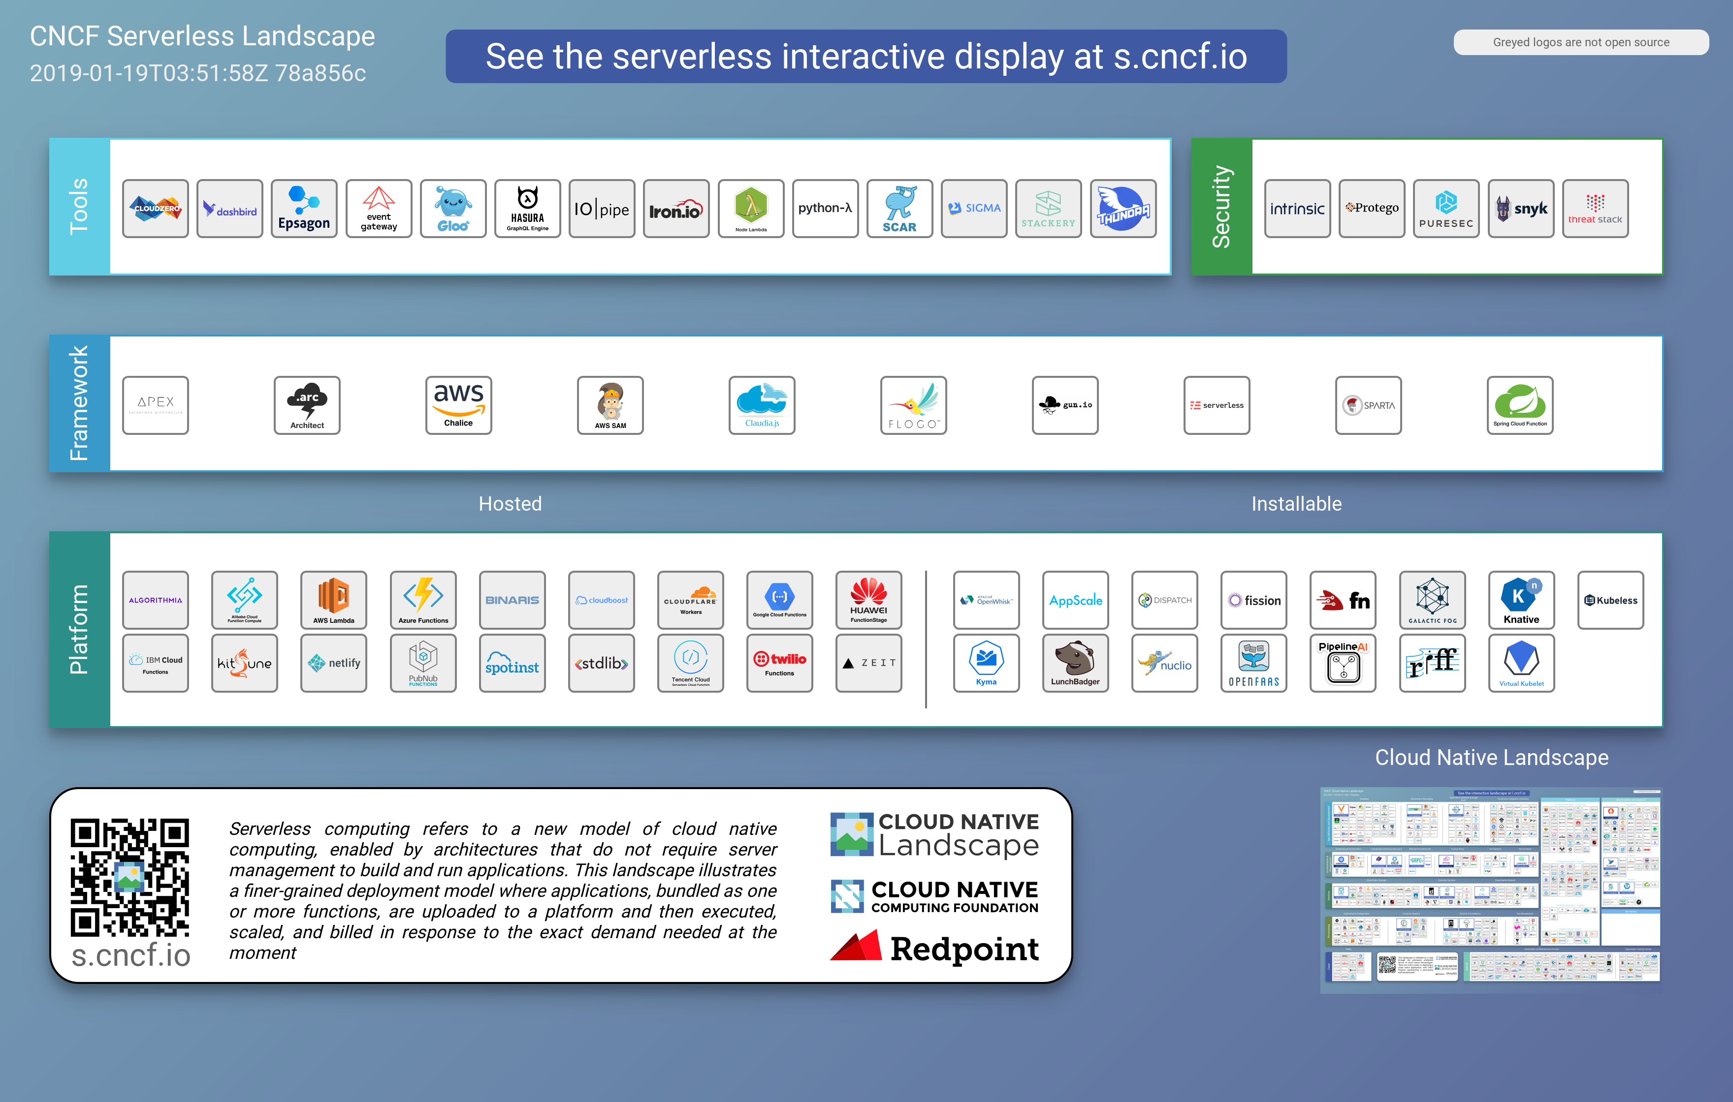

Slide 15
NO MORE OPS
Notes:
Ironie again
big letters means ironie
- security
- you will have more to control
- system architecture
- observerbality
=> more efficience
=> you will grow
=> from pet to cattle to butterflie trainer

Slide 16
DOES IT FIT FOR ME?
(It depends... is not the answear)
Notes:
Last question for today
The answear is not it depends – its try it out!
Why? Generic concept – a around your programming language (not an domain specific language)
startup
gluecode for cloud services
archive, cleanup,…
single page apps – REST + Angular
rapid prototype
Event Based – Pipelines
Future: ML, edge computing

Slide 17
#2019
Notes:
Why? There are three good reasons
First is you are already familiar with concept of Cloud, Kubernetes and other Scalable or managed services (mindset changed towards more smaller code, which is more unpredictable in large scale)
very big commitment in sls (also in money) – we came here to stay – e.g. managed db there can be a trigger
because the guru of SLS Simon Wardley itself said so – so please believe

Slide 18
<
3 SLS
@maibornwolff
@shadowmulder
Notes:
and love SLS
many thanks, time for questions

Slide 19
time * invocations
ITS ABOUT €
cost
Notes:
The answear is not it depends – its try it out!

Slide 21







Slide 22
? INSTALL CONFIGURE

Slide 23





