Slide 1
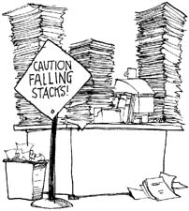
The GRACE team presents…
Procrastination
A topic we have been meaning to cover all year.

Slide 2
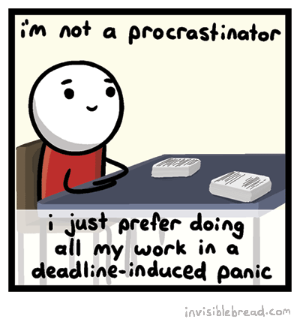
Procrastination and Giftedness
Why does it seem like a lot of gifted children are procrastinators?
Fear: some people might wait until the last minute because they’re afraid to tackle something difficult.
Confidence: perhaps they’re overconfident, thinking the task will truly only take that last minute.
Busy-ness: maybe the child is over-committed and waits until the last minute because that’s the only minute they have.
From Joanne Foster’s Not Now, But Maybe Later and www.birdseed.com

Slide 3
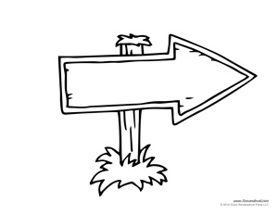


Signs of Procrastination
Your child’s work load seems to go from none at all to way too much and back again often.
Your child starts to cry or get upset when you mention a project that needs to be done.
Your child’s grades are in 3 sections: 100s, 50%s, or 0%s.
You have had more than 2 “Oh no! My big project you never heard of is due tomorrow!” nights this year.
After I do…
Not Now
Later

Slide 4


Tim Urban: Inside the mind of a master procrastinator
11 minutes

Slide 5
Procrastination vs. Precrastination
Ok, so is it even a word? Spell check says “no”, but the internet says “yes”.
“Precrastination” is the act of jumping on every task or assignment the minute it is given. “Prerastinators” do things quickly and are efficient, but they do not always put enough thought into the task before checking it off their “to do” list.

Slide 6
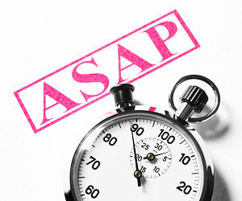
Procrastination vs. Precrastination
Examples of Precrastination
Answering emails as soon as they enter your inbox
Handing in assignments a week before the due date
Dangers of Precrastinators
Less thoughtful
Less creative
Not prioritizing
More errors- not waiting for all the information
More likely to butt heads with a procrastinator!

Slide 7
Benefits of Procrastination
Here are five benefits to procrastinating and putting off a dreaded (or not so dreaded) task.
Active procrastinators can often create better work under pressure.
2. Procrastinating allows time for ideas to ruminate and flourish on their own.
3. Relaxation can be more beneficial in the long-run than working harder and longer.
4. Procrastination can cut down on busy work.
5. Procrastination offers a chance to plan ahead.
From workawesome.com/productivity/the-benefits-of-procrastinating

Slide 8
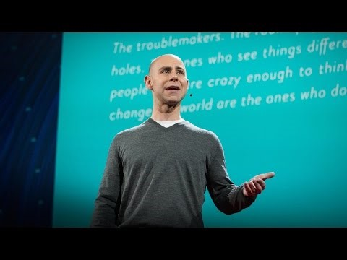
Adam Grant: The Surprising Habits of Original Thinkers

Slide 9
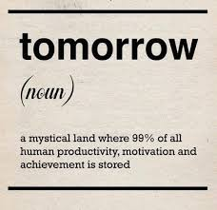
When to worry…
If your child is pulling all nighters more often than not
When there are fights and tears over assignments on a regular basis
When the quality of work goes down on delayed assignments
When your child is losing points and their grades are dropping due to late or poor quality work
When you child waits until last minute and does not complete the assignment
When your procrastinator starts to develop into an underachiever

Slide 10
Ideas to Balance Procrastination
Set S.M.A.R.T Goals
  Specific, Measurable, Ambitious, Realistic, Time-bound
  Teach kids to set specific goals with specific end times.
Be mindful of Motivation/Mindset
  Help students with growth mindset!
  Positive, encouraging, but HONEST words.
Help with Planning & Routines
  Teach kids HOW to plan, don’t plan everything for them.
  Create action steps and monitor progress
  Have kids help plan and monitor new routines
Acknowledge Success and Challenge!
  Rewards – Intrinsic or Extrinsic
  Celebrations vs. Consequences

Slide 11
Procrastination Situations
What does procrastination look like to your student? (List behaviors you see when you KNOW he/she is procrastinating)

Slide 12
Procrastination Situations
When does your student procrastinate?
(Times of year, subject areas, etc.)

Slide 13
Procrastination Situations
Why do you think your child procrastinates?
(Think about motivation & mindset)

Slide 14
Procrastination Situations
What are the typical consequences of procrastination for your student?
(What happens as a result of procrastination)

Slide 15
Procrastination Situations
What are the typical rewards of not procrasting for your student?
(Think about planning and routines that go well)

Slide 16
What’s the difference…
Between Procrastination and Prioritization?

