Slide 1
Plan and Do What Needs to Be Done Now
(or how to overcome procrastination)
LSE Student Counselling Service

Slide 2
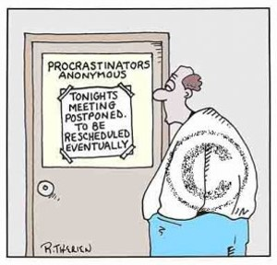

Slide 3
What is Procrastination?
Procrastination is the avoidance of doing a task that
needs to be done.
Emotions create the blockage, and reasons for procrastination which include:
feelings of guilt; inadequacy; depression; and self-
doubt.
Poor organizational skills compound the
problem by making even small steps to complete the
task difficult-to-seemingly impossible.

Slide 4
Causes:
Personality - Psychological
Fear of Failure
Perfectionism
Fear of success
Adrenaline addiction
Low self-esteem
Peter Pan syndrome
Hoping someone else will do it

Slide 5
Causes:
Social- Situational
Lack of skill
Decision making
No deadline
Overwhelmed
Wrong temperament
Too little to do
Authority resistance

Slide 6
How do we procrastinate?
When did you last procrastinate?
What triggers it?

Slide 7
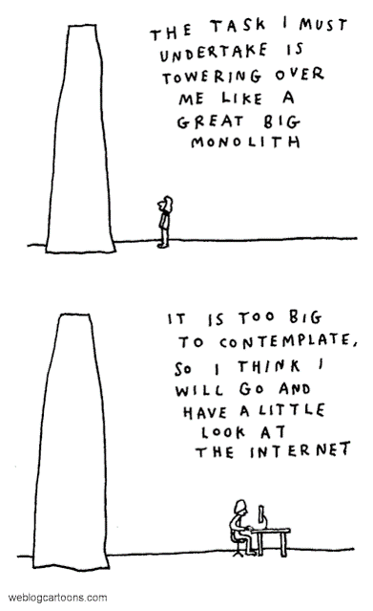
Overcoming Procrastination
TIME MANAGEMENT
TASK MANAGEMENT
MIND MANAGEMENT

Slide 8
DBT: Emotional Regulation Model
Procrastination temporary relief from negative emotions
Linehan’s Dialectical Behavior Therapy (DBT)
  Inability to bear difficult emotions are seen as core problem.
Procrastination relief from negative emotions.
IN THE SAME WAY AS
Impulsive behaviours, (e.g. time wasting)
are a relief from other, more difficult emotions.

Slide 9
Time Management
Do unpleasant tasks first
Set a starting time
Assign a time slot for work on a task
Develop a daily priority list
Utilize memory joggers
Guard against diversions
Always have your organizer with you
Use an occasional time log

Slide 10
Mind Management
Admit procrastination
Be good to yourself by removing the anxiety of procrastination
Don’t use fatigue or illness as an escape
Live for the present
Give self rewards
Refrain from self punishment
Appreciate the intermediate steps/accomplishments

Slide 11

Understanding emotions: basic
Identifying and accepting basic emotions
“Mad / bad / sad / glad”
Shame

Slide 12
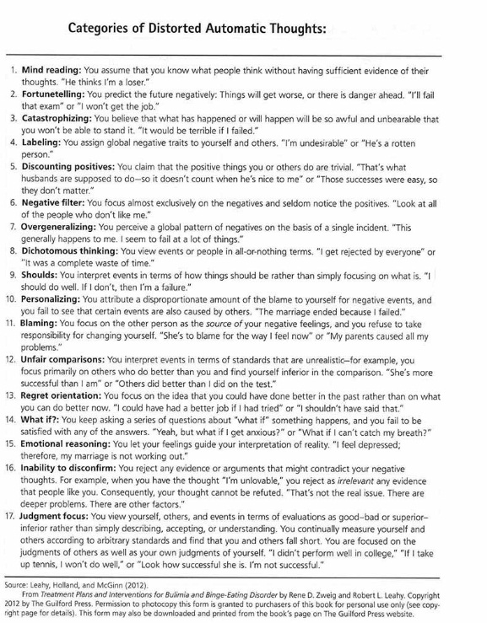
Automatic Thoughts
Notes:
This next section will look at the unhelpful hypnotic scripts that DE patients may run in one of two ways:
1) Automatic Thoughts:
2) Unhelpful Mindsets: we will discuss ways of challenging unhelpful mindsets

Slide 13
Process of Conquering Procrastination
A three stage solution:
Diagnosis of cause
Identification of appropriate cure
Implementation of plan
Personal timetable

Slide 14
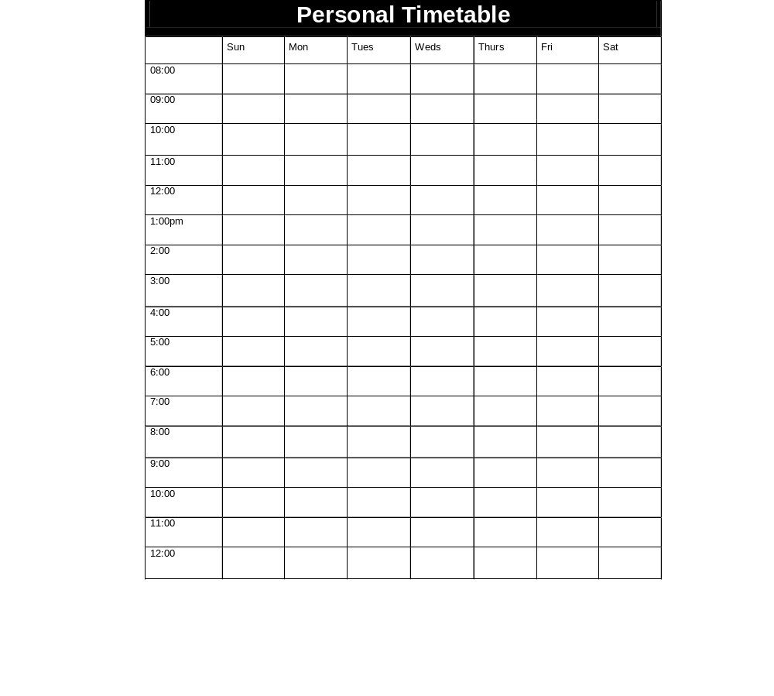

Slide 15
Use personal timetabling to:
acknowledge what you have achieved
save mental energy
be purposeful and realistic
meet deadlines and keep up with work
have effective study time and effective relaxation
Enjoy yourself without guilt and worry

Slide 16
Diagnosis
Ask yourself three questions:
Are there specific tasks, or responsibilities in which I am currently procrastinating?
Are there other specific items I can recall procrastinating about in the past?
Have I developed a pattern of procrastination?

Slide 17
Appropriate Cure
Identify the correct solution to your problem (time, task or mind,)

Slide 18
Implementation
You need to implement your plan for overcoming procrastination.
You need to be committed to your plan.

Slide 19
Perfectionism issues
Identify perfectionistic standards.
Evaluate costs and benefits of perfectionistic standards.
Discuss perfectionistic beliefs.

Slide 20
Procrastination Mini Questionnaire
1.Describe the Internal Critic.
2.What does he or she say to you when you are under pressure?
(list negative thoughts)
Who’s voice is it?
3.What is the resulting self defeating behaviour (i.e. procrastination) and unhealthy emotion (i.e. anxiety, fear, panic etc)?
Self Defeating Behaviour:
Unhealthy Negative Emotions:
4. What could an alternative be to the Internal Critic? (i.e. a less judgemental voice)

Slide 21
Social Support of Task
Completion
Seek help from people who complete tasks.
Build a social network of support, so there is someone who can push you on when you lose sight of the goal.
Models of Success
Find models who know how to get things done and use them as your model. They can show you ways they use to stay on task.
Student academic skills center

Slide 22
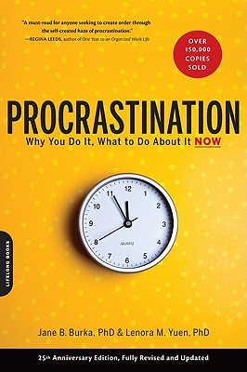
Bibliography
“PROCRASTINATION: WHY YOU DO IT, WHAT TO DO ABOUT IT ”
by Jane B. Lenora M. Burka Yuen , 2012.
NB. Only one book is given so you don’t
procrastinate by reading too much
about procrastination!

Slide 23
Bibliography: web
http://www.mindtools.com/pages/article/newHTE_96.htm
www.lse.ac.uk/intranet/students/supportServices/.../procrastination.ppt‎
www.people.stfx.ca/cgavard/procrastination.ppt‎

