Slide 1


Programming Project – Part 1
Softwaredevelopment for Industrial Robotics
Marcel Grotzke, Gabriel Kögler, Henri Hamann 19.12.2013

Slide 2
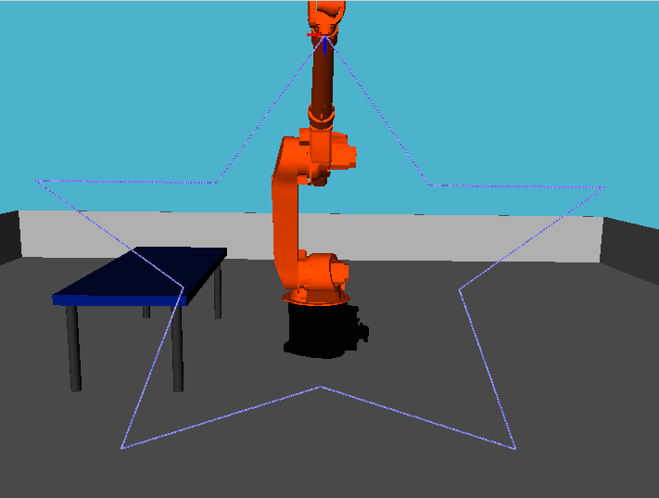
Table of content
1. Fundamentals
2. Solutions
2.1 Kinematics
2.3 Point to point movement
2.4 Linear movement
2.5 GUI settings

Slide 3
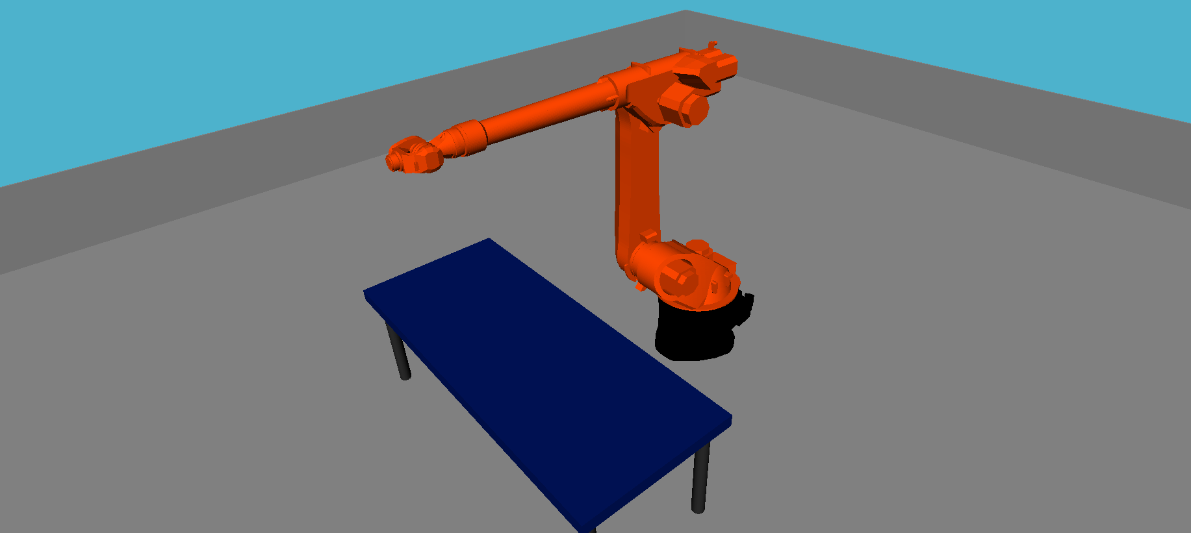
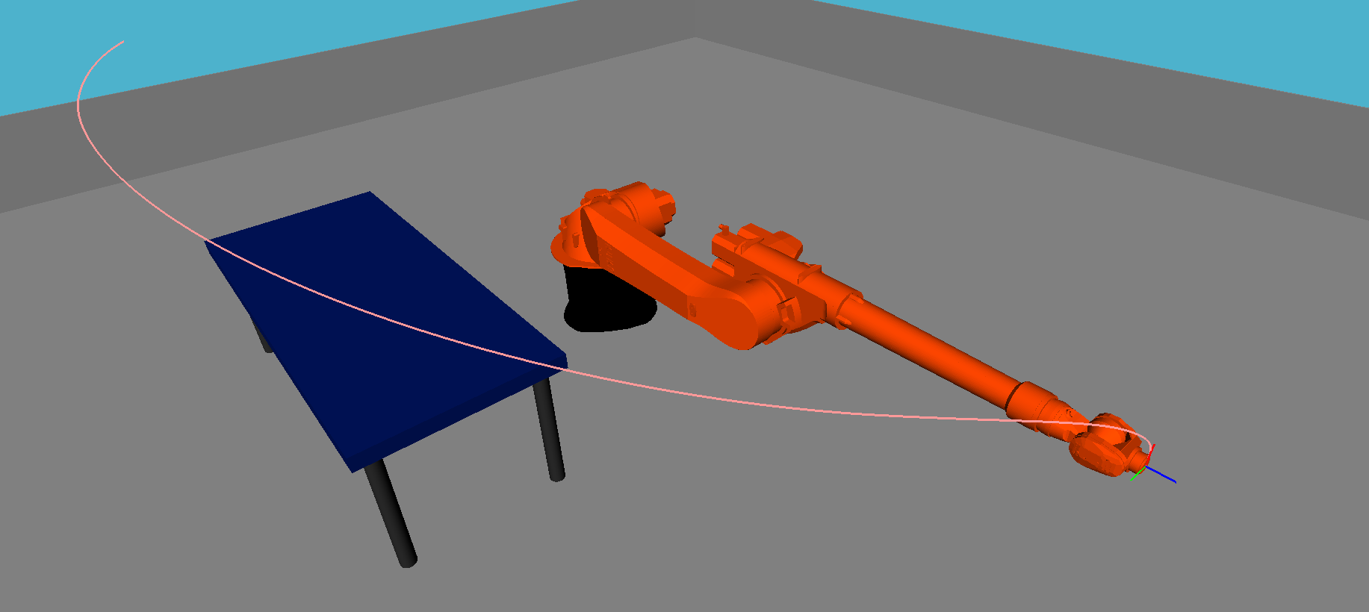
1. Fundamentals - Programming approach (1)
Basic Problem:
Offset between zero configuration and initialization configuration
init config state: zero config state:
default
given by data sheet
Offset in every calculation (IK, DK, …)
Offset even in angle constrains

Slide 4
1. Fundamentals - Programming approach (2)
“Two Worlds”: OpenRave World ↔ calculation world
two trigger: AddOffsetToAngles() – our angles to openRave
SubstractOffsetToAngles() – openRave to our angles
def AddOffsetToAngles(arr_angles):
new_arr_angles = np.array
(
[
float(arr_angles[0])-np.pi/2,
-1 * float(arr_angles[1])-np.pi/2,
-1 * float(arr_angles[2])+np.pi/2,
float(arr_angles[3]),
-1 * float(arr_angles[4]),
float(arr_angles[5])
]
)
return new_arr_angles
Offset

Slide 5
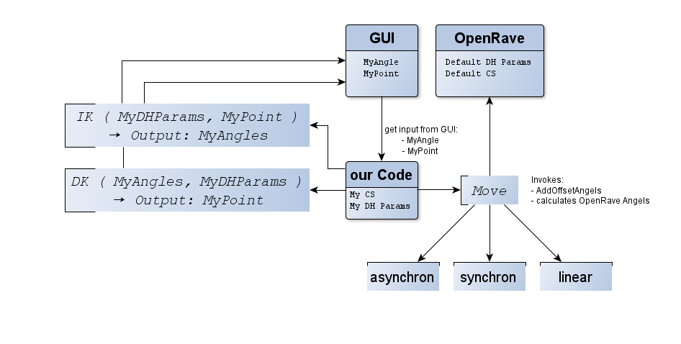
1. Fundamentals – Code structure
“Two Worlds”: OpenRave World ↔ calculation world

Slide 6
2. Solution – Kinematics
Direct Kinematics:
starting with the last cs
get DH-parameters and use DH-transformation matrix
Calculate transformation to next cs
PSEUDOCODE: CalculateDirectKinematicsTransformation(dofValues,point,origin,destination):
for i in range ( origin, destination ):
current_cs = destination - i - 1 + origin
angle = dofValues [current_cs – 1 ]
nextMatrix = GetTransformationForDh ( GetDhForJoint(angle,current_cs ))
point = nextMatrix * point
return point

Slide 7
2. Solution – Kinematics
Inverse Kinematics
Adopted from own presentation
PSEUDOCODE:
CalculateInverseKinematics ( tcp ):
Set wrist point offset;
Calculate wp in CS₀;
Transformate wp in CS₁;
SolutionsAngleOne = Calculate AngleOne;
for both: SolutionsAngleOne:
Transformate wp in CS₂;
SolutionsAngleTwo = Calculate AngleTwo;
for both: SolutionsAngleTwo:
Transformate wp in CS₃;
SolutionsAngleThree = Calculate AngleThree;
Calculate both wrist orientation solutions;

Slide 8
2. Solution – PTPMovement
Base functionality | Adv. functionality
Calculates new angles | Path interpolation
Trapezoide velocity profile | Velocity watching
def PTPtoConfiguration ( start_cfg, target_cfg, motiontype ):
:param start_cfg: Current axis angle of the robot
:param target_cfg: Target angle of the robot
:param motiontype: asynchronous, synchronous,
:returns: Array of angles of interpolated path
# calculation of step number
step_size = np.int(math.ceil(total_time * calc_frequency))
# step calculation
delta_angle = sign[j] * current_V[j,1] * time_step
trajectory[i,j] = trajectory[i-1,j] + delta_angle
Characteristics
No singularity handling needed
Velocity profile equations the same as in the lecture
Profile´s endpoint always is set to the movement´s endpoint
Velocity profile is not exact match with trapezoide profile

Slide 9
2. Solution – LINMovement
PSEUDOCODE:
LINtoConfiguration ( start_cfg, target_cfg, max_vel, max_acc ):
Calc start and end point with direct kinematics;
Calculate velocity profile{
calc time and distance for one acceleration phase
calc distance and time for the constant velocity movement
}
# Go through path from start till one step before end;
for i in range ( 0, end-1 ):
calc target point for the current step i with velocity profile;
calc inverse kinematics solutions for current step i;
select nearest solution and check for singularities{
singularity if angles exceed maximum velocity;
save position of singularity and type;
}
Set last step to end point;
select nearest solution and check for singularities();
HandleSingularities();
CheckAngleConstraints();
return finished_trajectory;

Slide 10
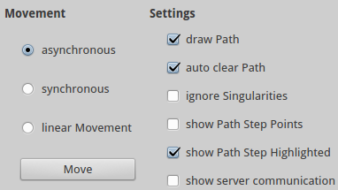
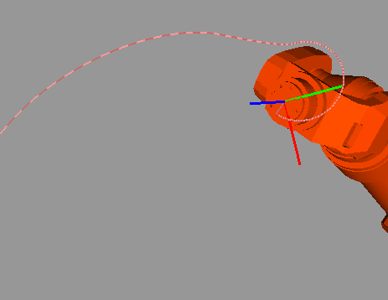
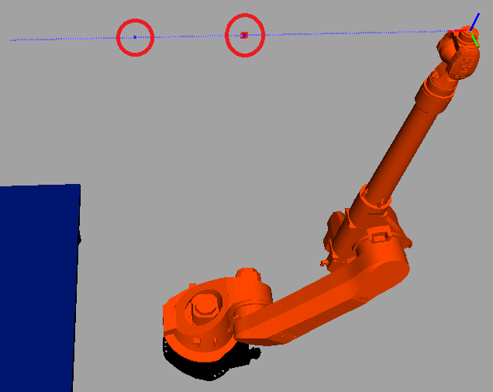
2. Solution – GUI Settings
Path visualization
Force robot movement in case of singularities for LINMovement
Show interpolated points
Toggle server communication output

Slide 11

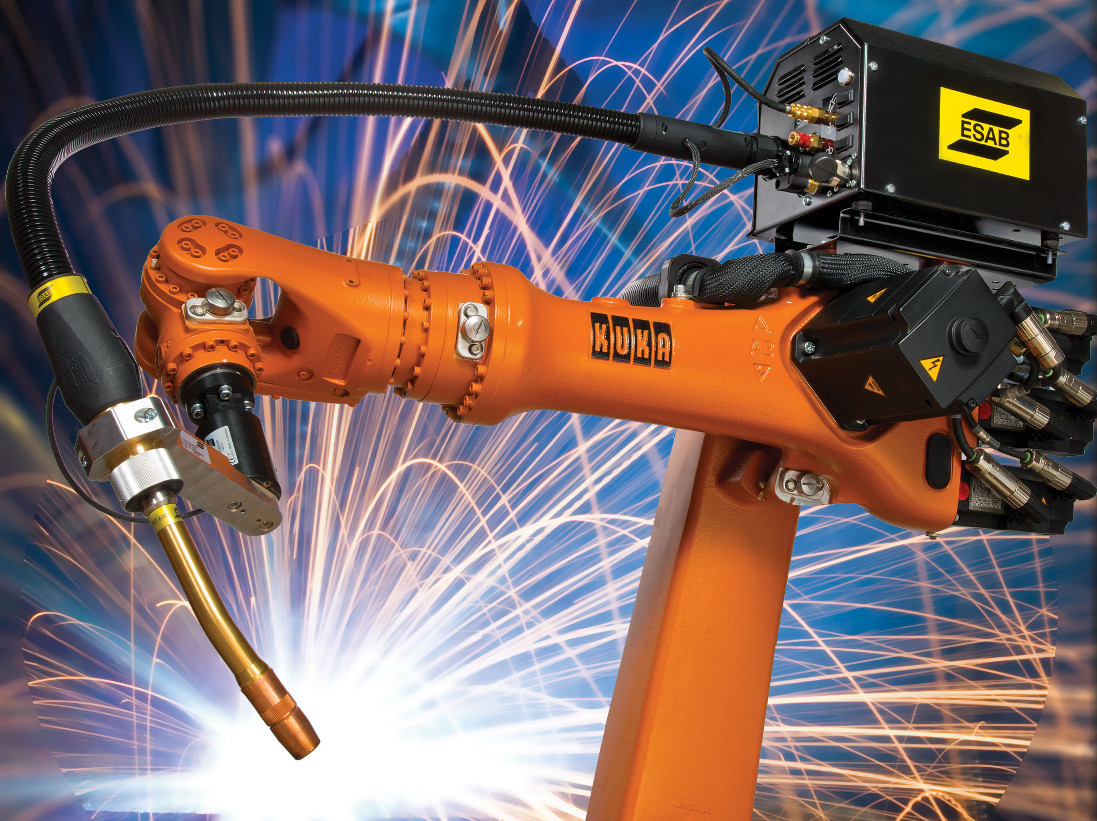
Many thanks for your attention!

Slide 12
bibliography
OpenRave logo from http://en.wikipedia.org/wiki/OpenRAVE

