Slide 1

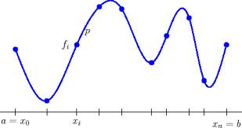
Programming Task 2:
Spline Movement
Softwaredevelopment for Industrial Robotics
Marcel Grotzke, Gabriel Kögler, Henri Hamann 30.01.2014

Slide 2
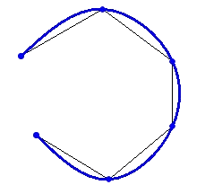
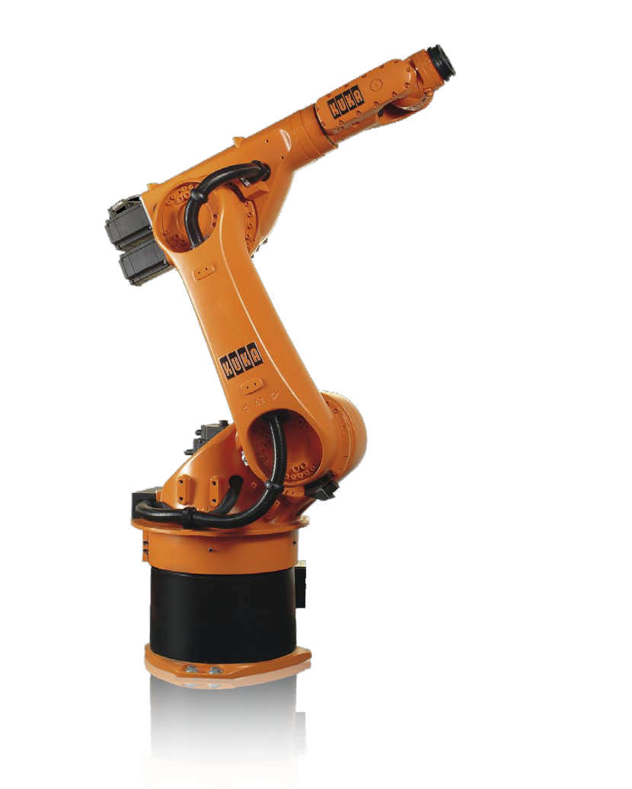
Table of content
(x₁, y₁)
1. Fundamentals
2. Spline Approximation
3. Spline Interpolation
(x₂, y₂)
(x₀, y₀)
(x₃, y₃)
(x₅, y₅)
(x₄, y₄)

Slide 3
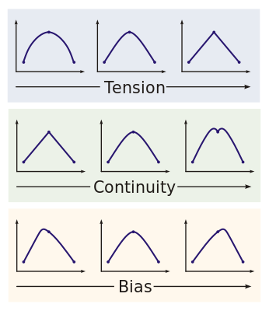
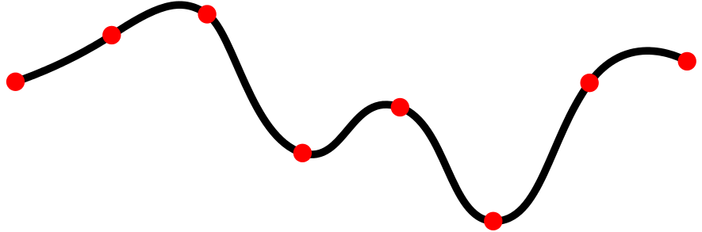
1. Fundamentals – What are splines?
Origin:
First reference in 1946 [1]
Suitable to describe curved lines → CAD (curves & freeform surfaces)
i.e. rollercoaster, automobile and shipbuilding, high-speed railways
Definition:
k knots¹ as base
k-1 continuous, smooth, polynomial segments of degree² n
commonly used splines with degree=3 (cubic) → ax³+bx²+cx+d
order = 1
order = 2
order = 3
knots
(red)
polynomial segments (black),
like ax³ + bx² + cx + d (cubic)
¹ knot = Knotenpunkt, o. Stützpunkt
² degree= Grad

Slide 4



1. Fundamentals – Splines have to be…
…continuous:
Function plot does not jump
(to get an ongoing spline)
…smooth:
every argument is calculable
(no infinity¹/overshooting)
…differentiable:
need for calculating the spline conditions
¹ Unendlichkeit

Slide 5
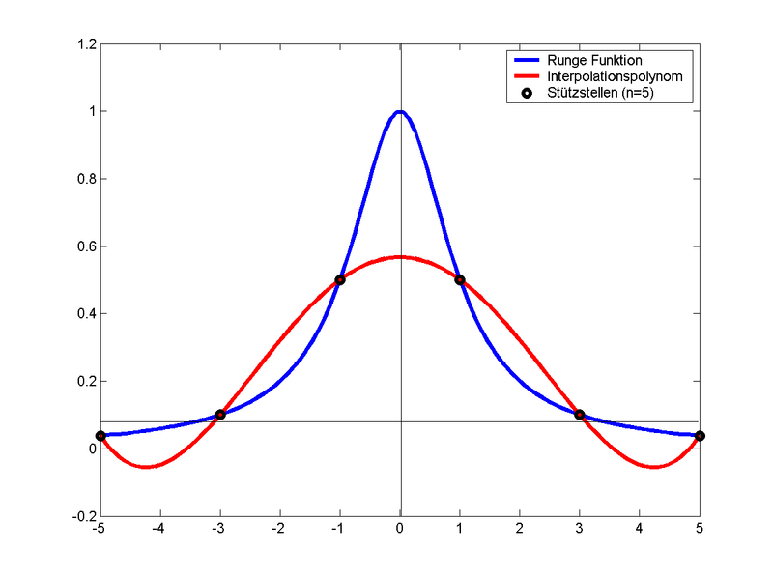
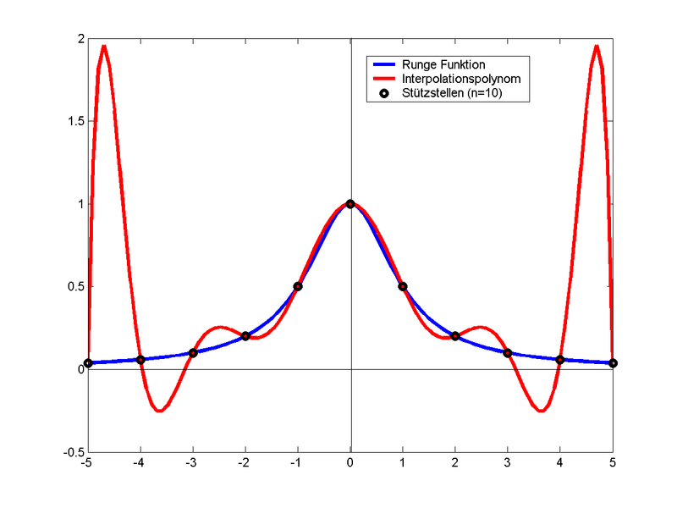
1. Fundamentals - Why Splines?
Typical Problem: Set of data points
→ ad hoc approach: one (global) polynomial passing every point
But: Increasing number of points means increasing error at interval boundary, too.
→ better use another interpolation technique, like i.e. spline interpolation
Example: Runge Function [2]
Increased number
of data points
Notes:
Typical Problem: Given set of data points from a series of measurements which is used to process a progression
→ naïve approach: one (global) polynomial which interpolates every single point.

Slide 6
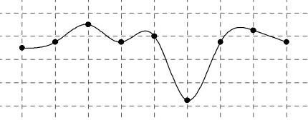
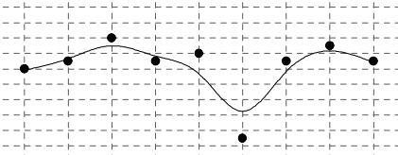
1. Fundamentals – Splines can…
…interpolate the given input points:
The given input points are part of the spline.
…approximate the given input points:
The given input points are not part of the spline (i.e. b-spline).
[2]
Interpolation with a cubic spline.
[2]
Approximation with a cubic b-spline.
¹ unendlich

Slide 7
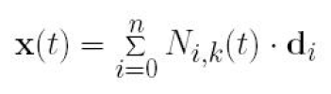
2. Spline Approximation - B-Spline
Approach:
Linear combination of all segments:
(1)
With:
Given: n+1 control points D = (d₀…d_{n}) (so called de Boor points)
Basis function N_{i,k}(t)
Order k (degree = k-1)
Time variable t represents the position on the spline
Knot vector t_{i} = (t₀,…,t_{n},…t_{n+k}) (mathematical construct)
Feature:
De Boor points influence spline´s shape

Slide 8
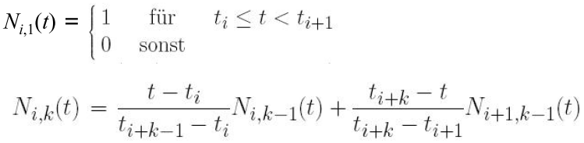
2. Spline Approximation - B-Spline
Single polynomial:
Calculated with recursive equation
Order k is a sum of two basis functions with Order k-1
recursive definition:
(2)
Workaround:
Calculate the segments considering the knot vector t_{i}= (t₀,…,t_{n},…t_{n+k})
for k>1 and i=0,…,n

Slide 9
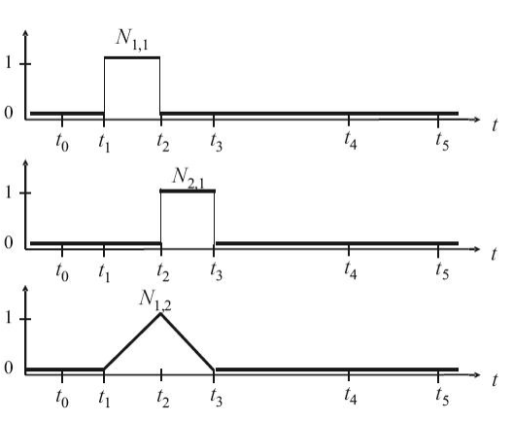
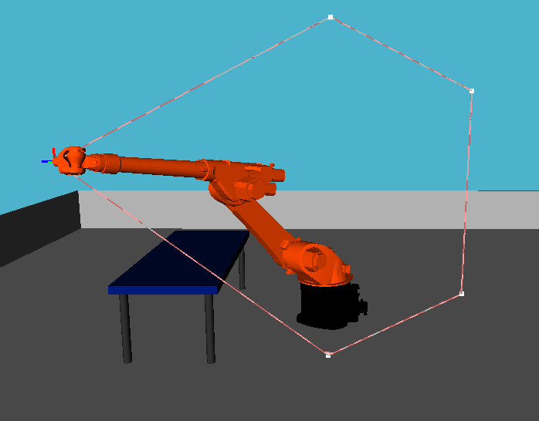
2. Spline Approximation - B-Spline
- b-spline of order k = 2
- polynom of degree 1
order 1
order 1
order 2

Slide 10
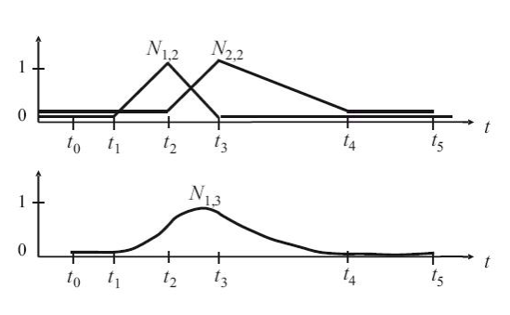
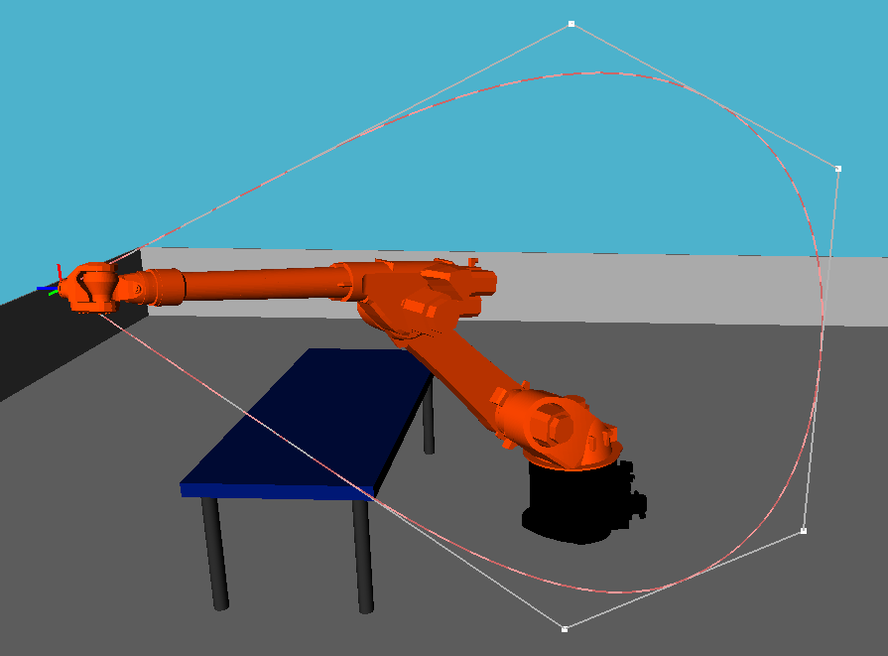
2. Spline Approximation - B-Spline
- b-spline of order k = 3
- polynom of degree 2
order 2
order 2
order 3

Slide 11
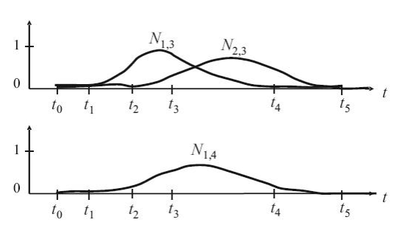
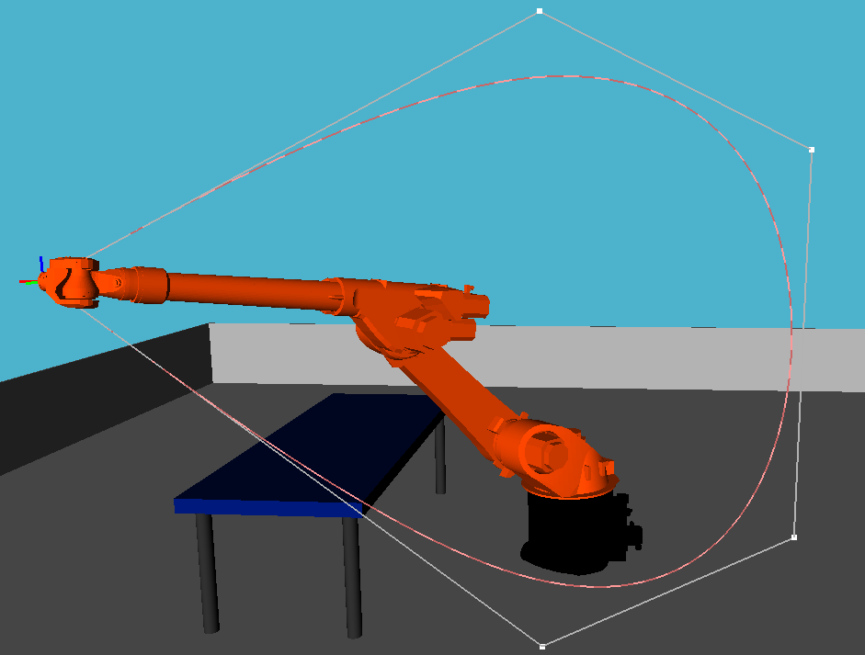
2. Spline Approximation - B-Spline
- b-spline of order k = 4
- polynom of degree 3
order 3
order 3
order 4

Slide 12
2. Spline Approximation - B-Spline
Knot vector t_{i}:
t_{i} = (t₀,…,t_{n},…t_{n+k}) condition: t_{i} <= t_{i+1}
Uniform knot vector: t_{i} = t_{i-1} + delta_t (delta_t = constant)
example: delta_t = 1; t_{i} = (t₀, t₁, t₂, t₃) = (0, 1, 2, 3)
Non-uniform: delta_t != constant
knot vector represents a wheigt for the basis functions
Factorises the influence of the
de Boor points

Slide 13
2. Spline Approximation - B-Spline
Demonstration
of B-spline movement

Slide 14
3. Spline Interpolation
System of equations: every segment has one equation!
k knots & order=n → (k-1) polynomial equations with (n+1) variables.
→ total amount of variables = (n+1) * (k-1).
→ with order = 3 → ax³+bx²+cx+d → n=4. (our case)
→ amount of variables = 4(k-1) = 4k-4
→ need for conditions to solve system of equations.
Conditions: Are given by spline´s behavior!
Every knot is part of one segment → p_{i}(x_{i})=y_{i} → k conditions
Segment´s contact points → p_{i}(x_{i+1})=p_{i+1}(x_{i+1}) → k-2 conditions
Same in first derivation → p_{i}´(x_{i+1})=p_{i+1}´(x_{i+1}) → k-2 conditions
Same in second derivation → p_{i}´´(x_{i+1})=p_{i+1}´´(x_{i+1}) → k-2 conditions
(4k-6) < (4k-4) → we still need two conditions!
Last two conditions:
Define the behavior at the spline´s start and end point (i.e. slope)
Arbitrary decision → p₀´(x₀)=0 & p_{k}´(x_{k})=0

Slide 15
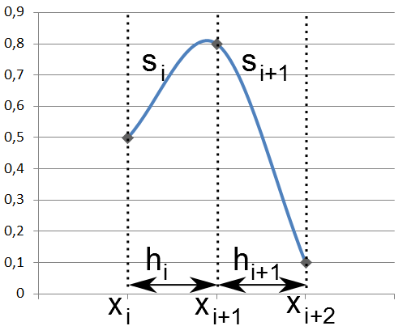
3. Spline Interpolation
With polynomial s_{i} between point (x_{i}, y_{i}) and point (x_{i+1}, y_{i+1})
→ only one polynomial is active for one input
Length of the interval h_{i} = x_{i+1} – x_{i}, where polynomial s_{i} is “active”

Slide 16
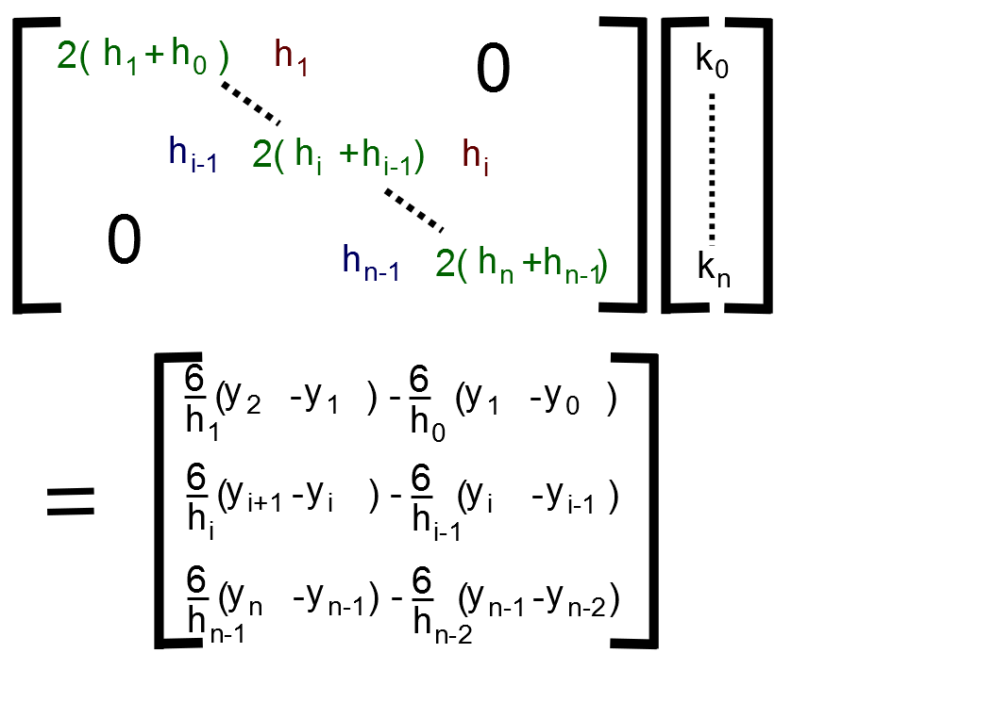





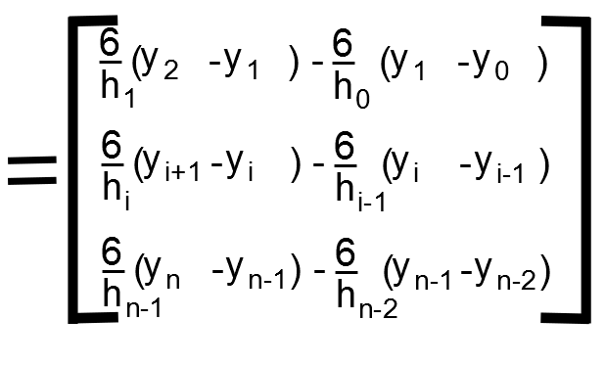
3. Spline Interpolation
Calculation of parameter a_{i}, b_{i}, c_{i} and d_{i} through curvature k_{i}
→ curvature is second derivative of a function
- Through conditions for spline we can derive this function
→ this leads to a tridiagonal linear equation system

Slide 17

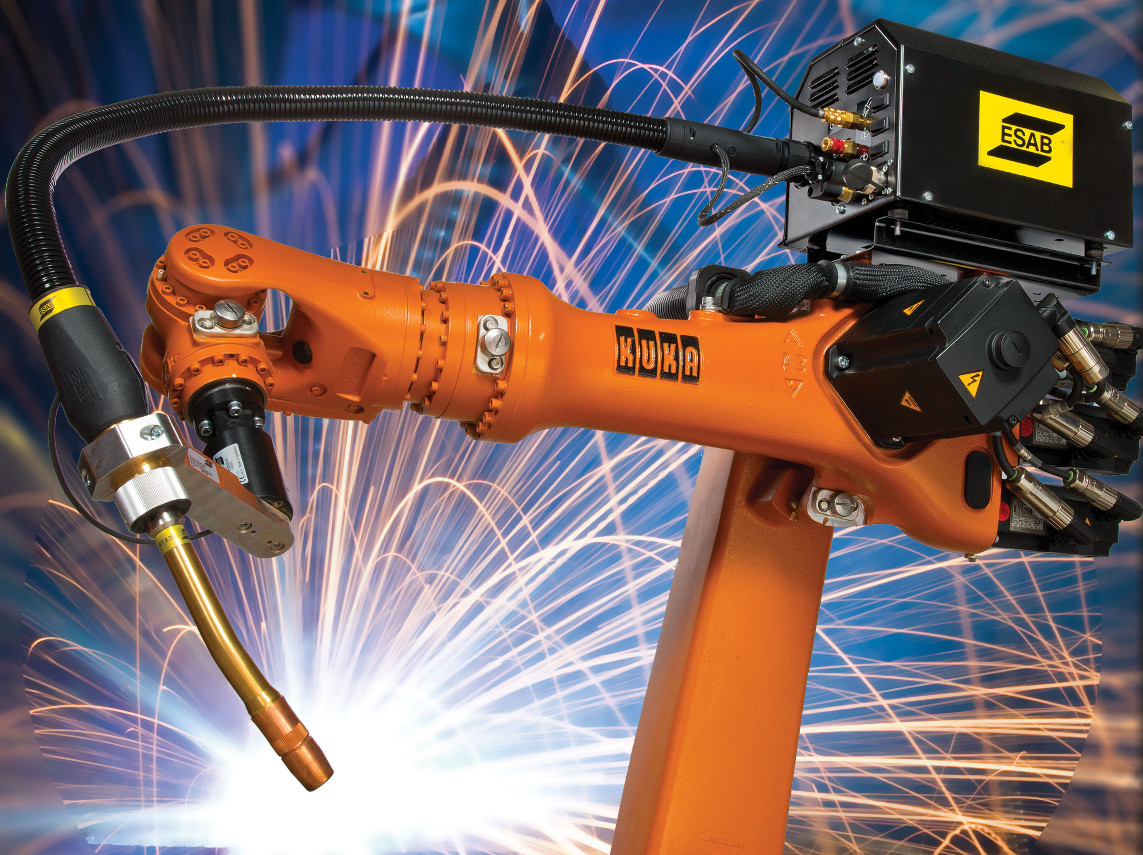
Many thanks for your attention!

Slide 18
bibliography
Schoenberg: Contributions to the problem of approximation of equidistant data by analytic functions, Quart. Appl. Math., vol. 4, pp. 45–99 and 112–141, 1946.
Wikipedia: Polynominterpolation. Abgerufen am 25.01.14.
Wikipedia: Spline. Abgerufen am 18.01.14.
Moritz Lenz: Splinefunktionen und ihre Anwendung. 2003.
Schneider: Splines. TU Chemniz. Gefunden auf http://www-user.tu-chemnitz.de/~uro/teaching/SS2002-numerik/misc/Splines.pdf. Abgerufen am 15.01.2014.
Theisel: Computer Aided Geometric Design: B-Spline. Visual Computing, University of Magdeburg. 2013.

Slide 19


A. Spline Approximation - B-Spline
Another approach:
Spline with degree=n is a linear combination from 2 splines with degree=n-1 → recursive defintion.
→ input: {Set of points | (x_{i},y_{i},z_{i})}

Slide 20
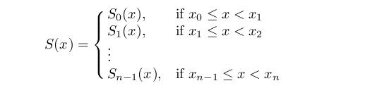
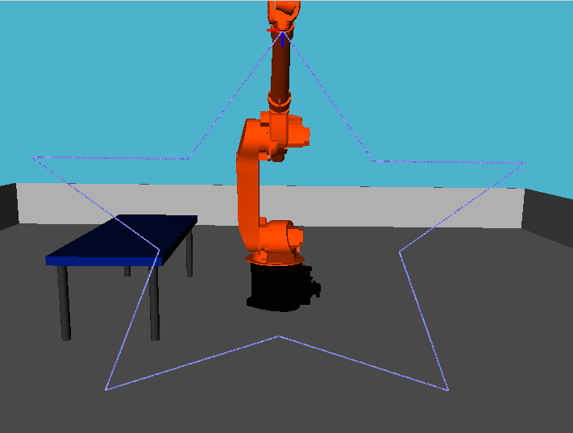
A. Fundamentals – Splines definition
Piecewise polynomial calculation of data set {(x_{i}, y_{i}), i = 0, 1, …, n}

