Slide 1
Progress Report
Until 11/02/2026

Slide 2
Motivation
6G communication systems must support ultra-reliable, low-latency, and mission-critical applications, making robustness against adversarial channel attacks essential.
Semantic communication focuses on transmitting task-relevant meaning rather than raw bits, enabling more efficient bandwidth usage and lower latency.
Existing security mechanisms are largely static, reactive, and attack-specific, limiting their ability to handle unknown or evolving threats.
A communication system that can autonomously detect attacks, assess their impact, and recover performance is therefore highly desirable.
Reinforcement learning–based action planning enables adaptive decision-making, allowing the system to learn optimal countermeasures through interaction with the environment.
This project targets a closed-loop, self-healing semantic communication architecture that enhances resilience and autonomy for future 6G networks.

Slide 3
Problem Statement
Have an end to end self healing semantic communication system.
It should first identify the type of attack being performed
Then try to evade the attack or reduce the impact of attack
Novelty part of the project: Add a feedback system for self healing based on RL to take necessary actions during and after the attack

Slide 4
Paper/Journal Survey
Paper | Type of Attack | DNN/Algo | How to Detect | Action
Adversarial Attacks and Defenses for Semantic Communication in Vehicular Metaverses | Semantic Noise Attack (SNA) | DNNs as semantic codecs (e.g., ResNet, LPRNet) | Edge servers assess data provider reliability | Semantic Distance Minimization (SDM) using KL divergence; adversarial training
Is Semantic Communications Secure? A Tale of Multi-Domain Adversarial Attacks | Multi-domain adversarial attacks (computer vision and wireless perturbations) | Autoencoder with encoder/decoder and semantic task classifiers | Not specified | Develop defense methods for safe adoption
Adversarial Attacks Against Shared Knowledge Interpretation in Semantic Communications | Channel inversion attack (targeted), naive attack (non-targeted) | SEMCOM systems with speech recognition models | Not specified | Adversarial training; removing residual values in the loss function

Slide 5
Survey continued…
Paper | Type of Attack | DNN/Algo | How to Detect | Action
Physical-layer Adversarial Robustness for Deep Learning-based Semantic Communications | Semantic-oriented physical-layer adversarial attacks | MobileSC framework with SemAdv perturbation generator | Not explicitly detailed | SemMixed adversarial training
Backdoor Attacks and Defenses on Semantic-Symbol Reconstruction in Semantic Communications | Backdoor attacks on semantic symbols (BASS) | Deep learning-enabled semantic communication systems | Reverse engineering-based and pruning-based strategies | Training framework to prevent BASS; reverse engineering and pruning defenses
Manipulating Semantic Communication by Adding Adversarial Perturbations to Wireless Channel | Adversarial perturbations on wireless channel (white-box PGD, black-box Square Attack; targeted and non-targeted) | DeepSC (Transformer-based encoder and decoder for text) | Not specified | Not proposed

Slide 6
Ideas under consideration
We plan to focus on adversarial attacks
Mainly the ones that directly uses the channel for attack, like: jamming, bit flooding, data spoofing, etc
Phase-1 will be to make a detection system to identify the type of the adversarial attack
Phase-2 will be make a set of instruction to take action from and train a RL model

Slide 7
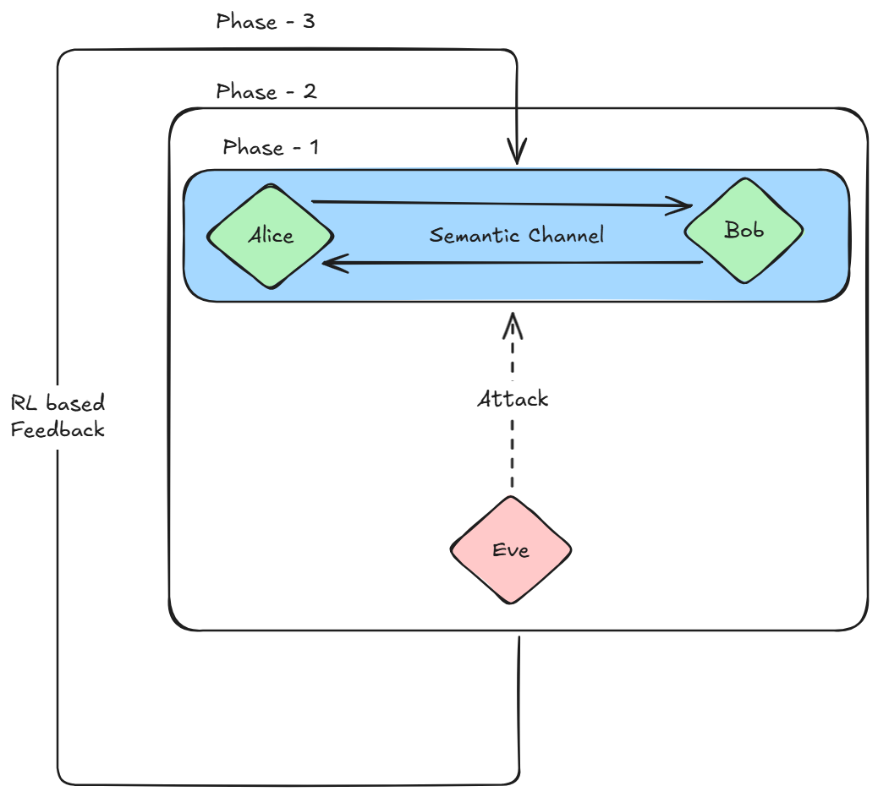
Phase 1: Setting up a semantic communication network.
Phase 2.1: Setting up an attack system for adversarial attacks on the channel.
Phase 2.2: Setting up an attack detection and identification model.
Phase 3: Add a RL based feedback loop that get information from the attack detection model and takes necessary steps to protect/restore the system.

Slide 8
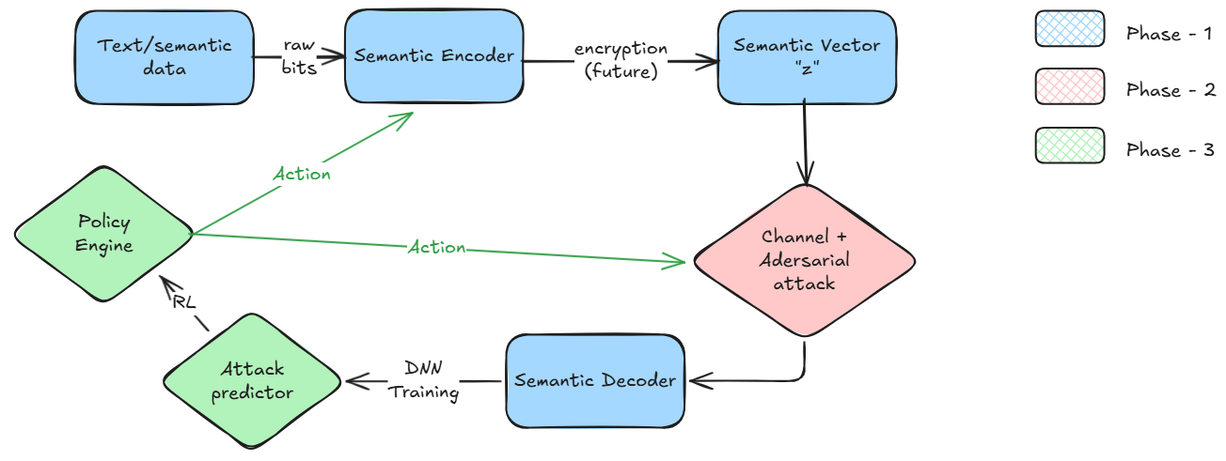
Block Diagram Overview

Slide 9
Progress till 06/05/2026

Slide 10
Introduction
We went through a literature review to find different implementation of model architecture for semantic communication for images
We also worked on an encryption algorithm to detect and potentially fix attacks while transferring information across the channel

Slide 11
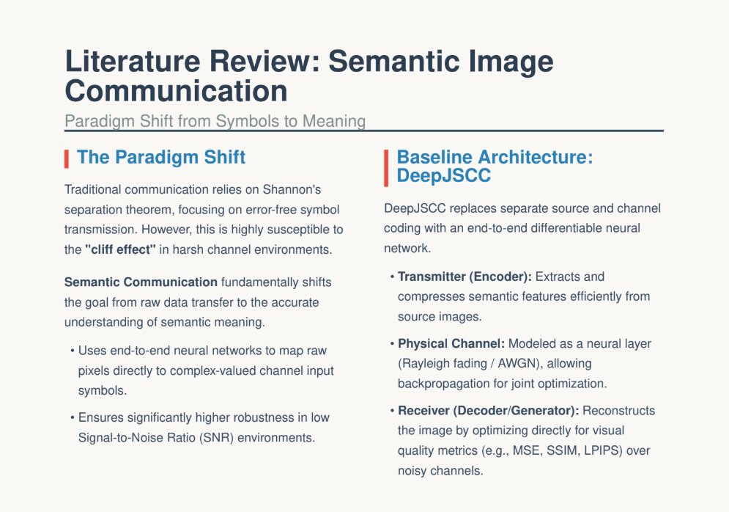

Slide 12
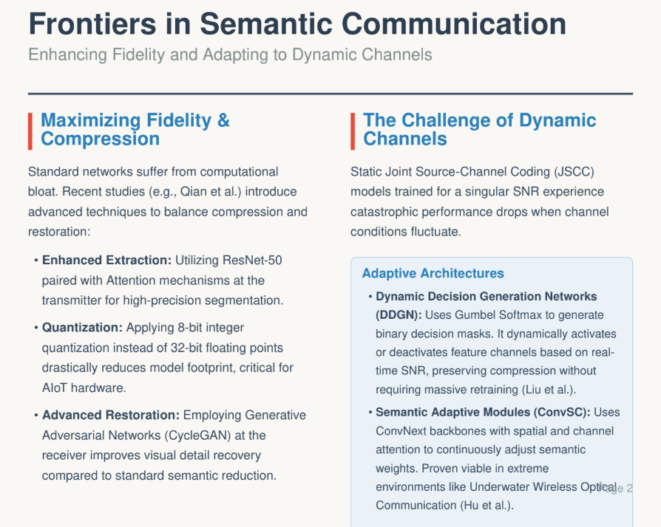

Slide 13
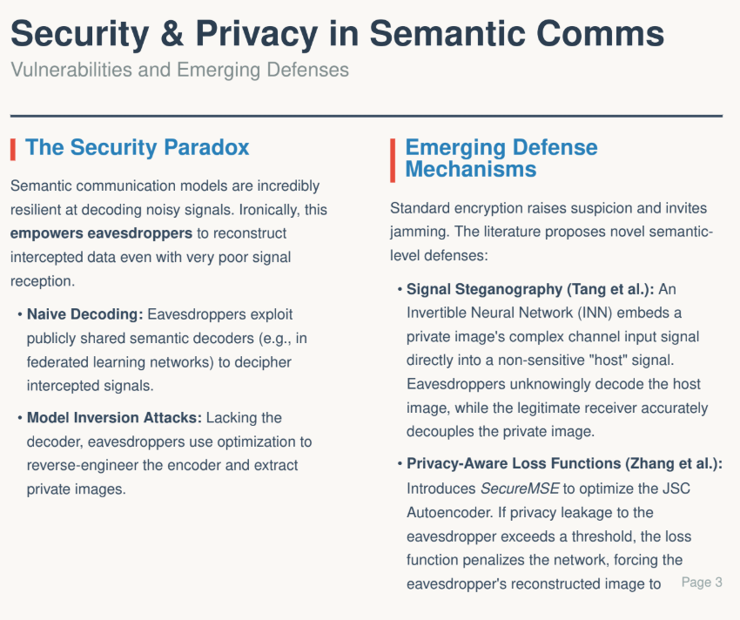

Slide 14
Why semantic communication for images
Traditional separate source and channel coding fails completely in low Signal-to-Noise Ratio (SNR) environments, but semantic communication avoids this "cliff effect" by remaining robust and delivering recognizable images even when channel conditions degrade.
By utilizing advanced deep learning models like Generative Adversarial Networks (GANs) at the receiver, it can translate highly compressed semantic features back into visually realistic, detail-rich images that align with human perception
Instead of transmitting pixel-perfect copies, it extracts only the essential core meaning and filters out irrelevant or redundant data, which drastically improves compression ratios and preserves tight spectrum resources
By minimizing data redundancy and significantly reducing the payload size, semantic communication can reduce total image transmission delays by over 95%, making it highly effective for real-time Artificial Intelligence of Things (AIoT) applications

Slide 15
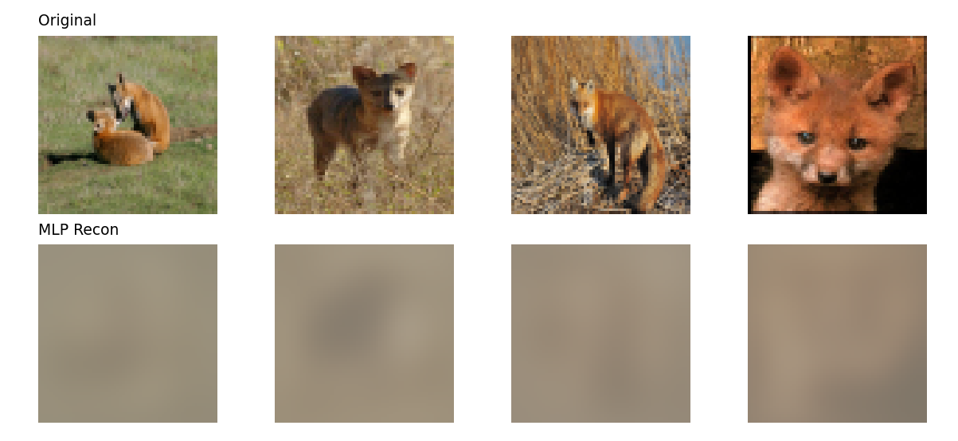
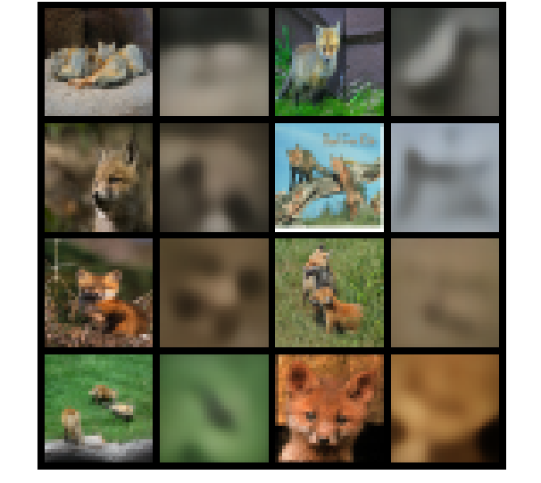
Model output comparison
Baseline MLP
VAE architecture

Slide 16
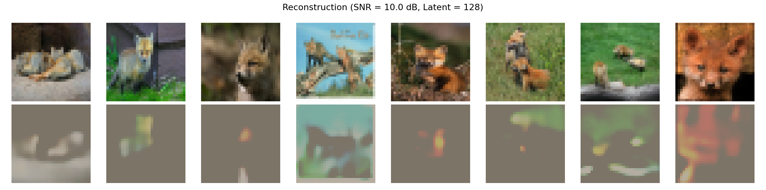
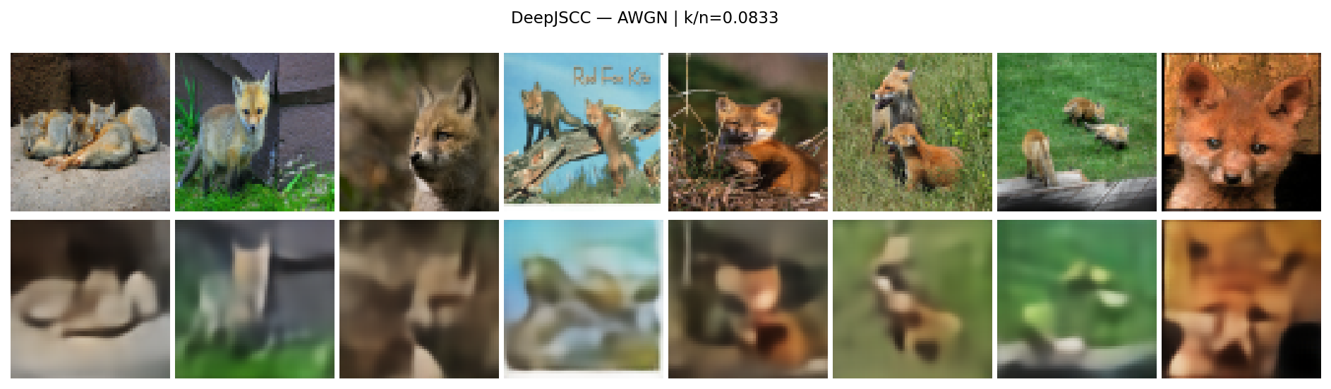
Latent Image compression

Slide 17
Model of Interest
Based on the dataset and hardware at our disposal, we decide to move forward with the DeepJSCC based model
We tried adding a transformer-layer to the model to try to improve the model performance
We tested the new model with and without encryption for quality and security of data transmission

Slide 18
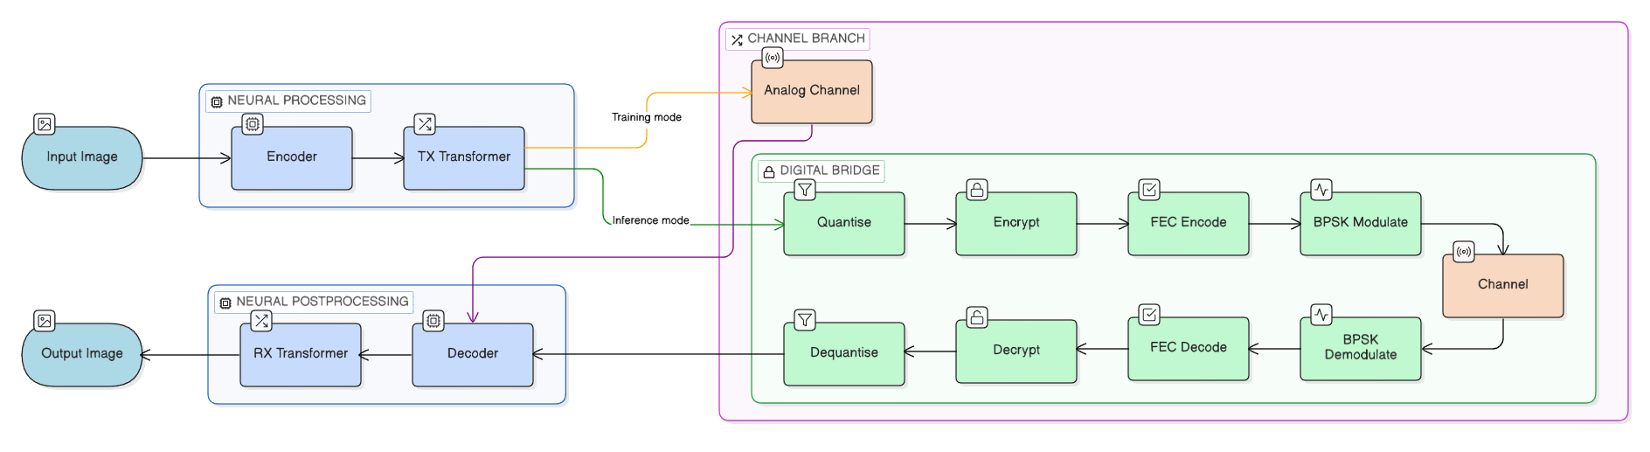
Block Diagram

Slide 19
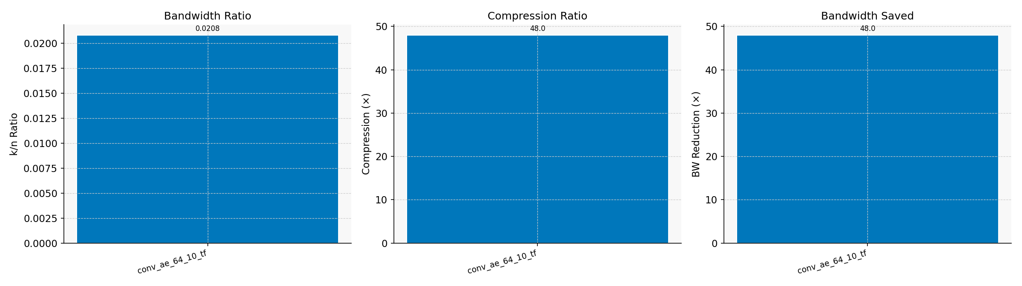
Extended metrics
Compression Ratio

Slide 20
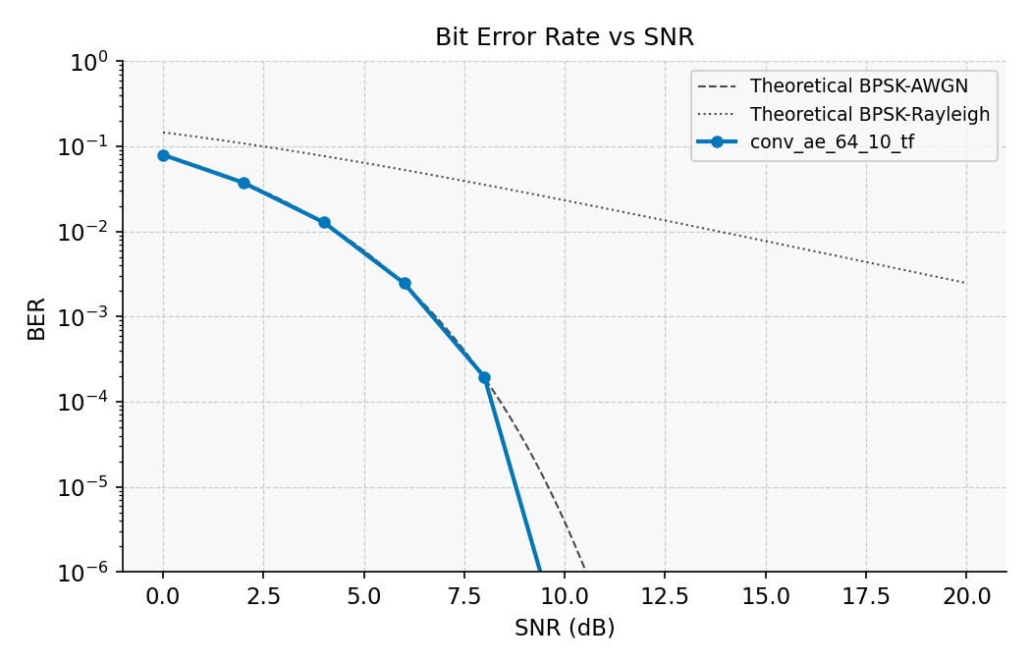
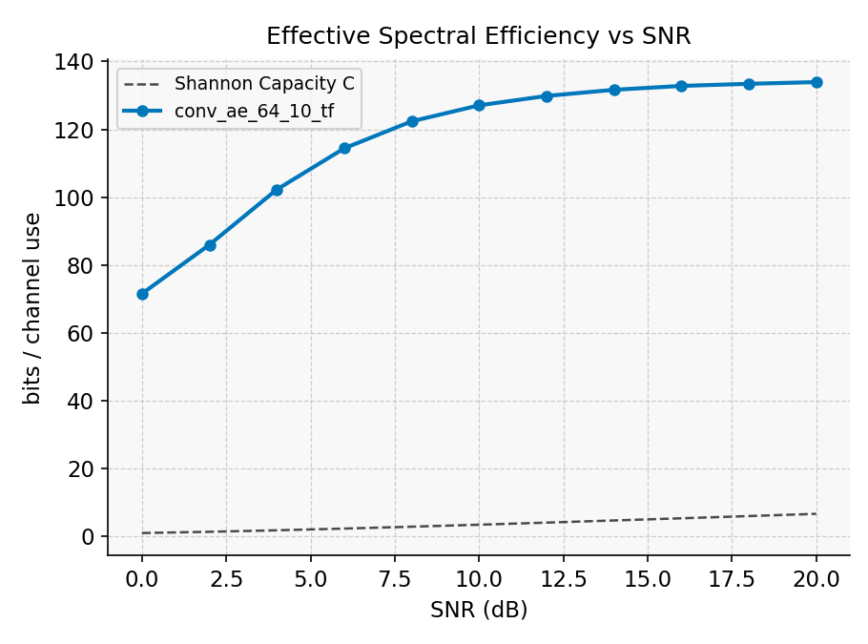
BER vs SNR and Spectral Efficiency

Slide 21
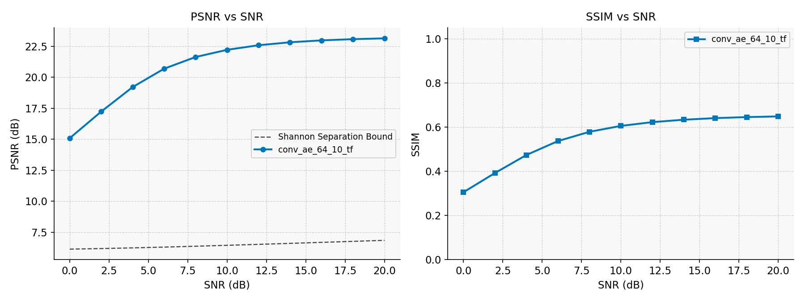
PSNR and SSIM

Slide 22
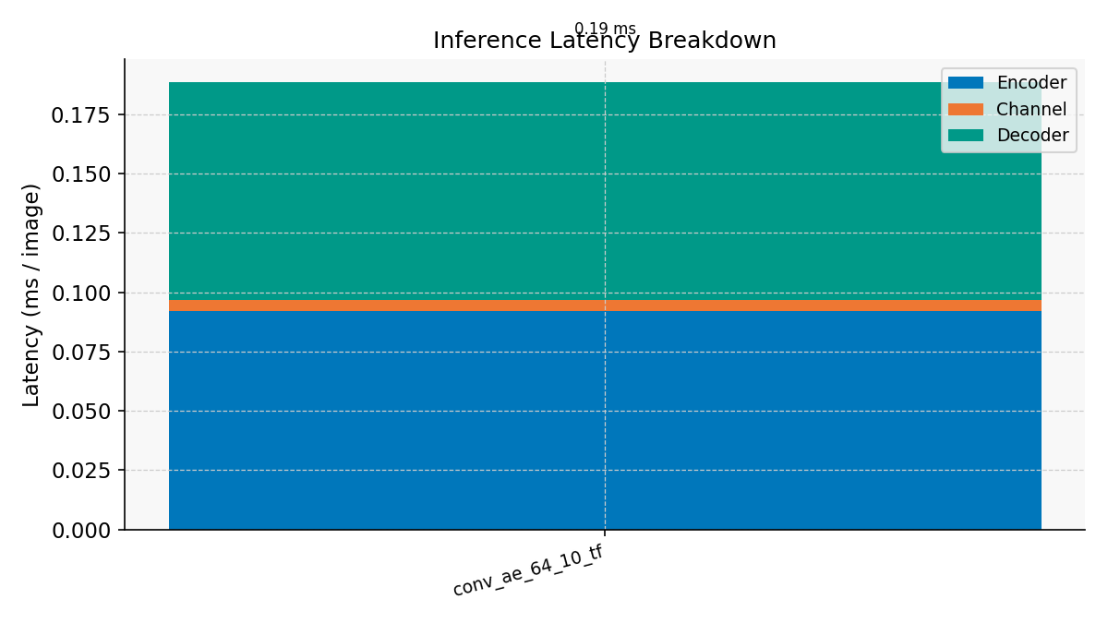
Inference Speed

Slide 23
Encryption/decryption
Methodology
explain

Slide 24
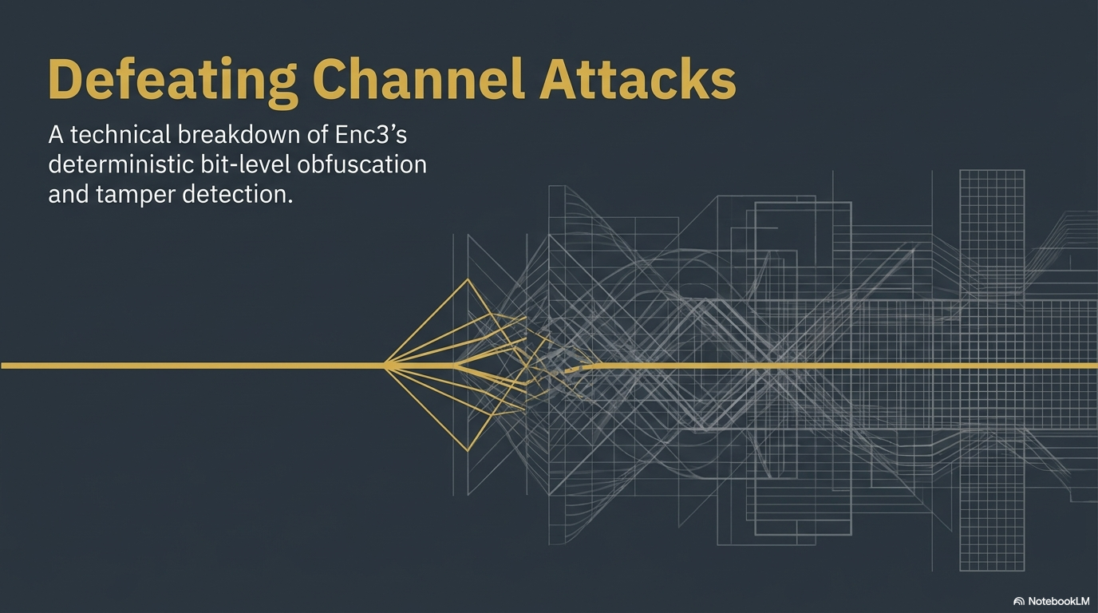

Slide 25
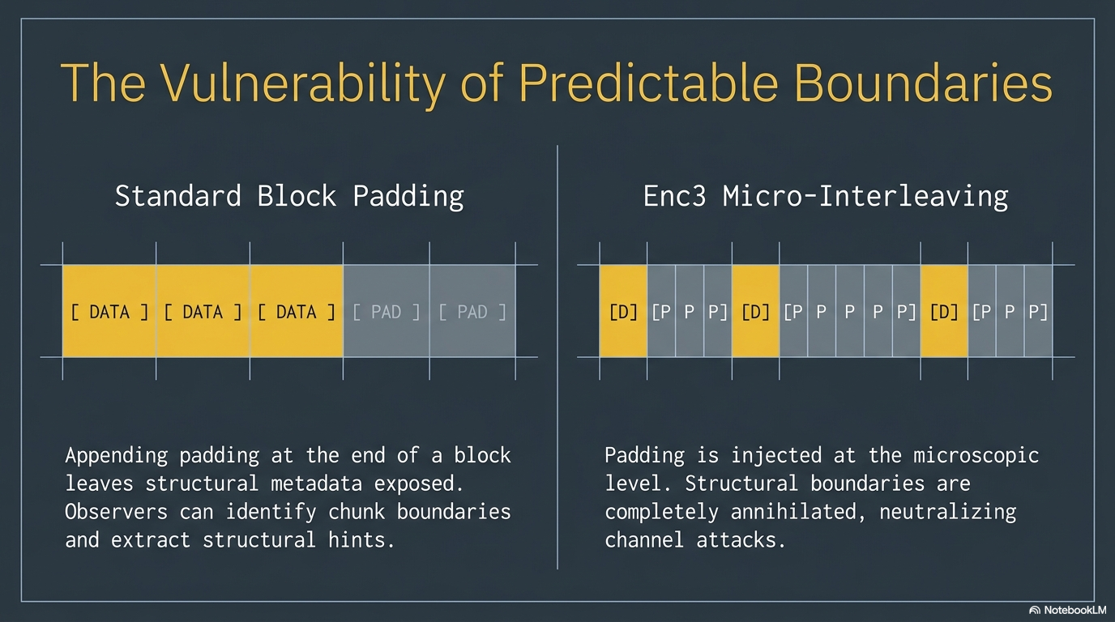

Slide 26
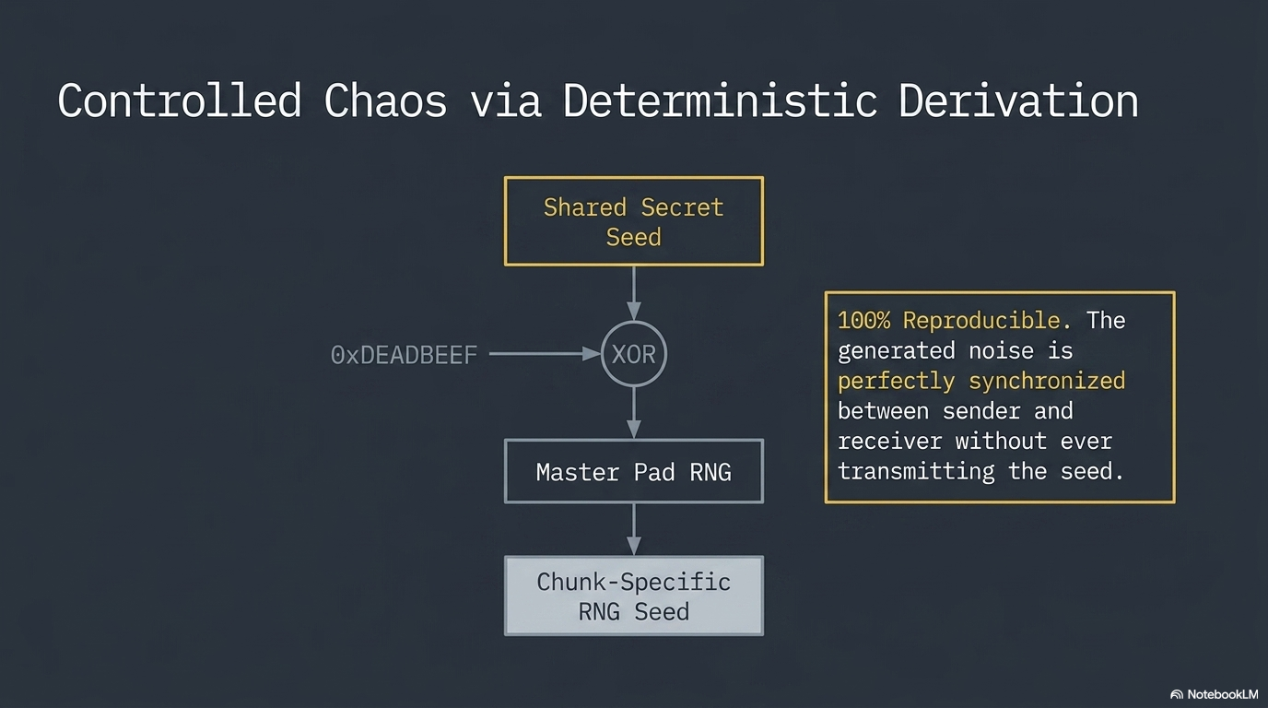

Slide 27
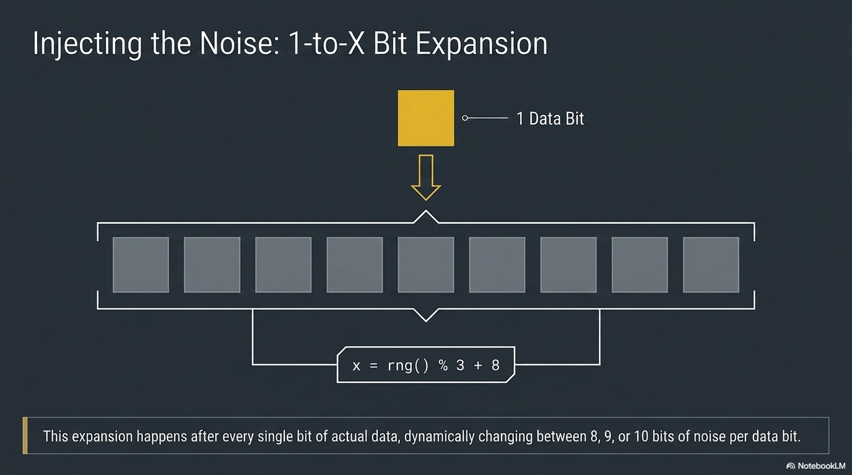

Slide 28
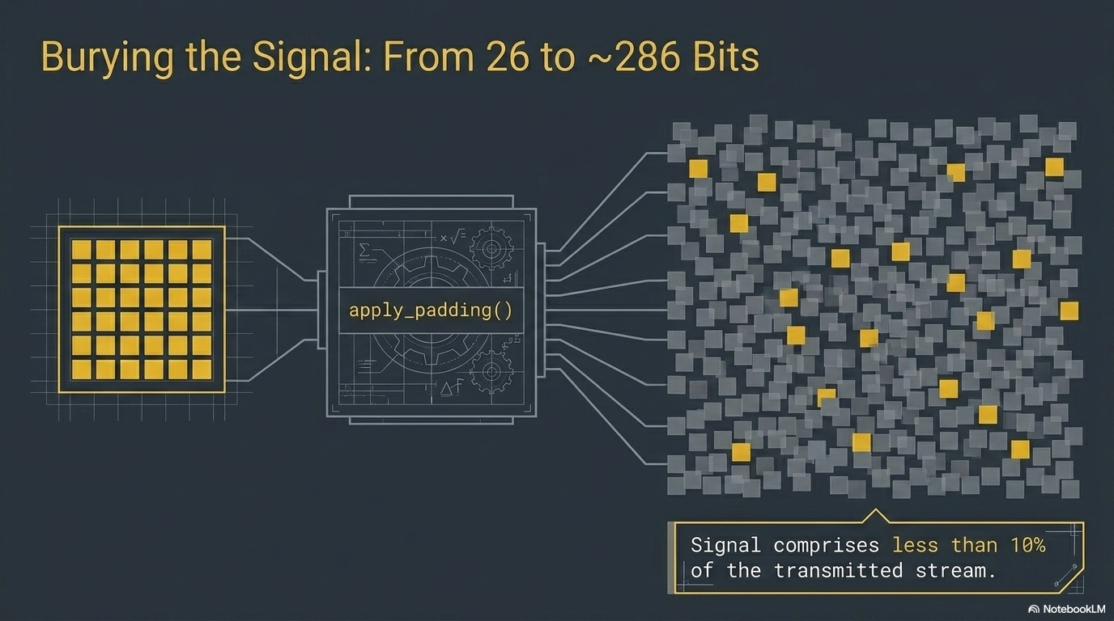

Slide 29
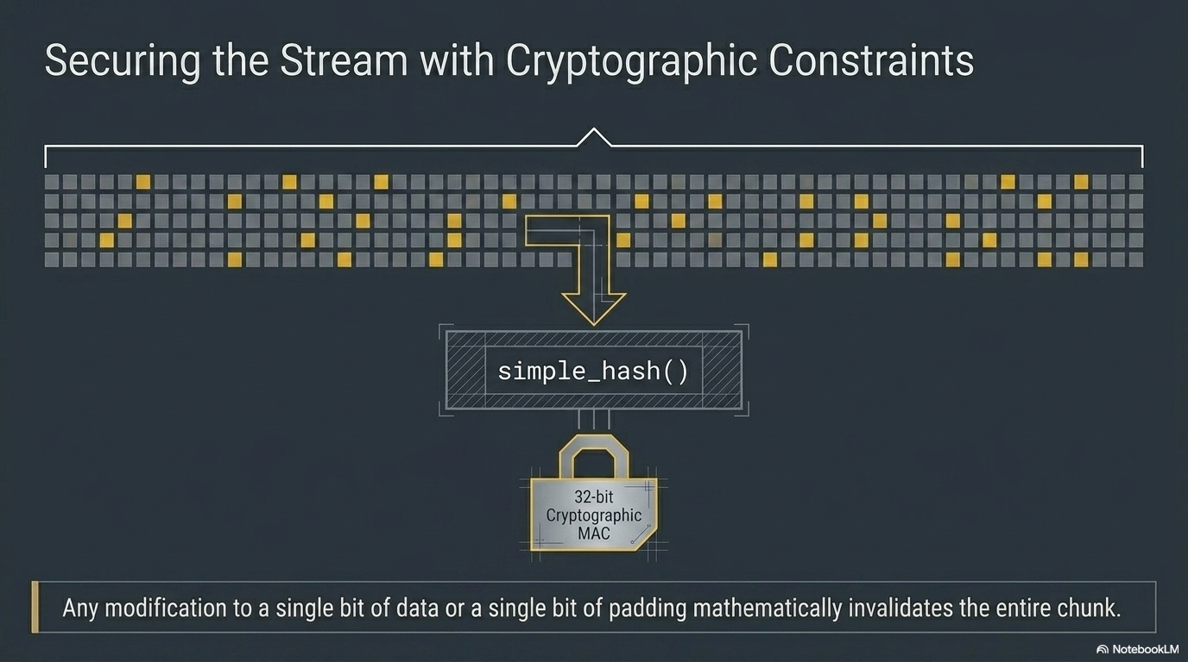

Slide 30
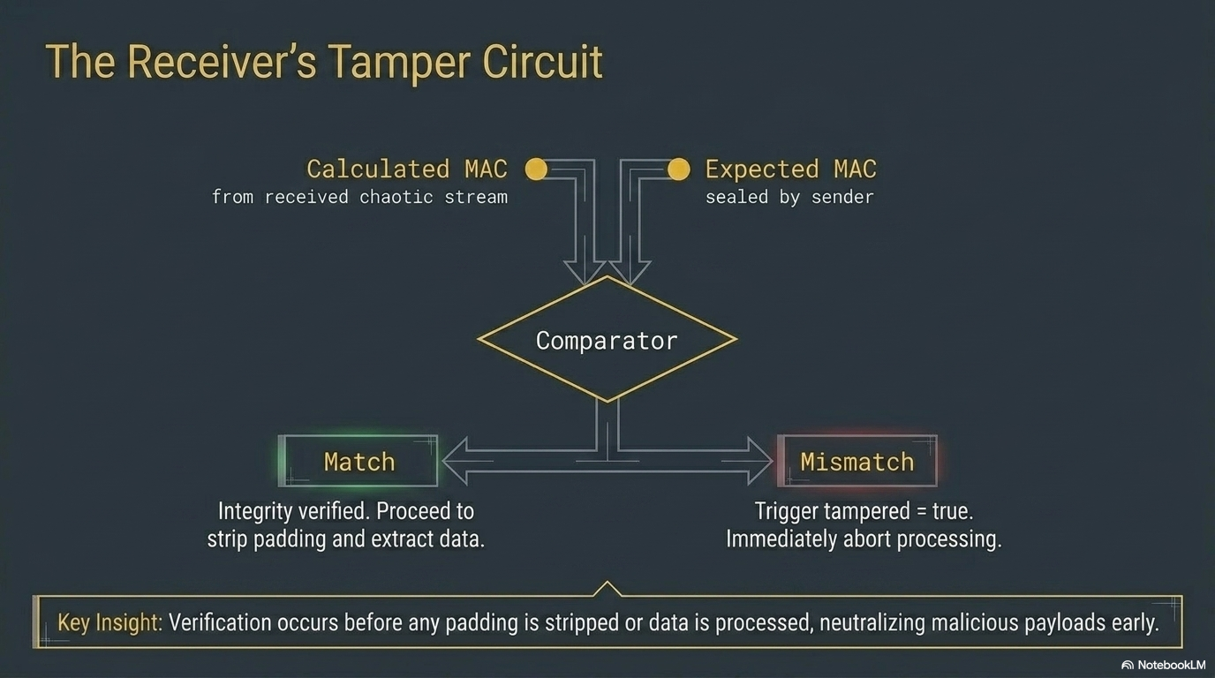

Slide 31
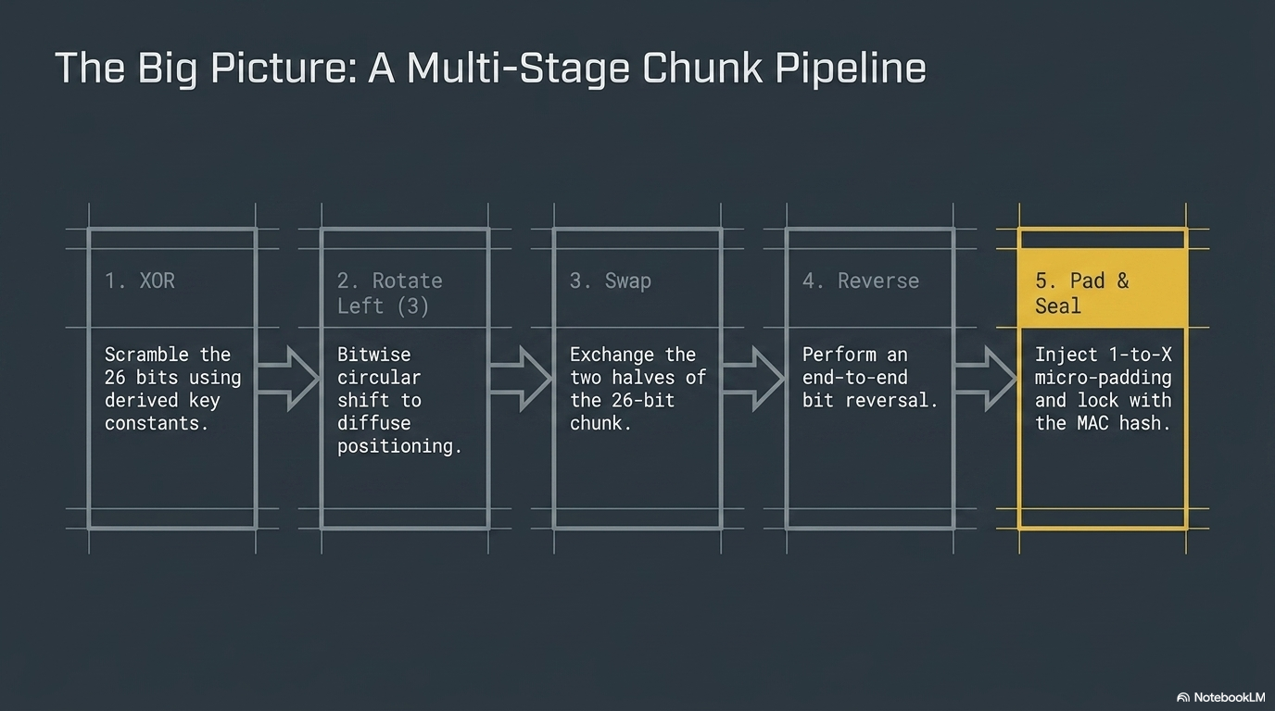

Slide 32
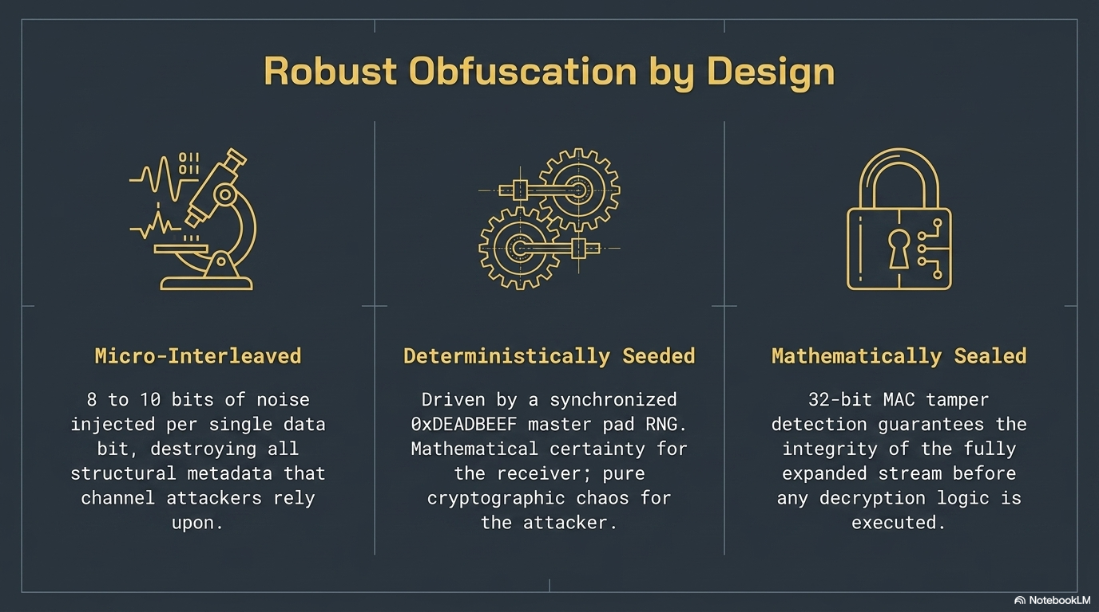

Slide 33
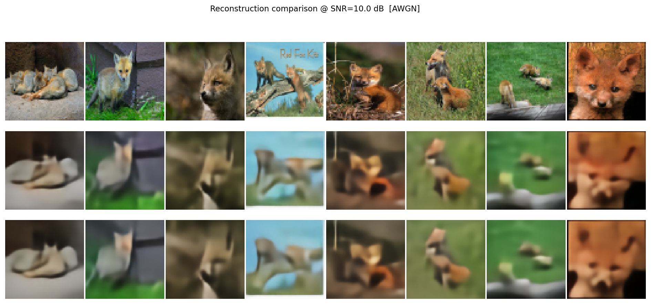
Post Encryption Result
Original
Analog channel
Secure channel

Slide 34
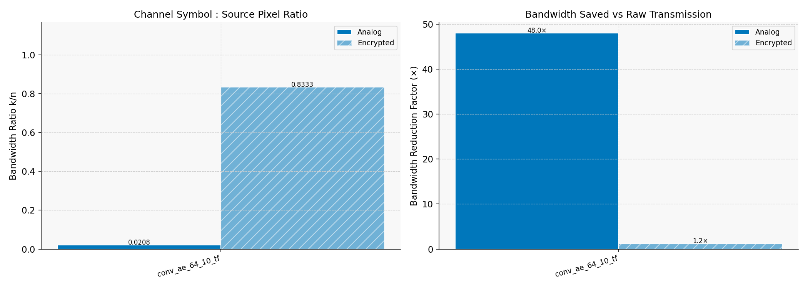
Post Encryption Metrics
Bandwidth

Slide 35
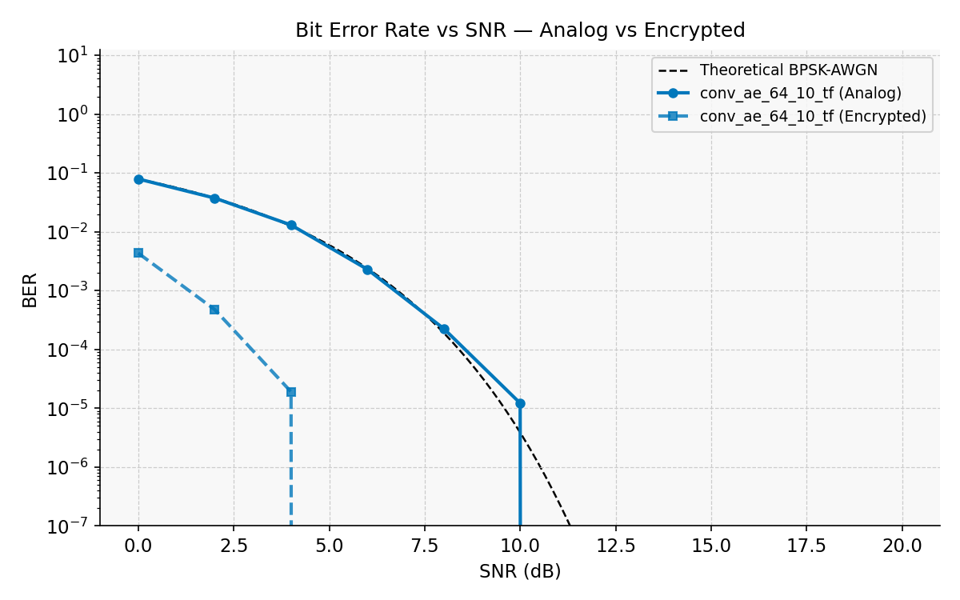
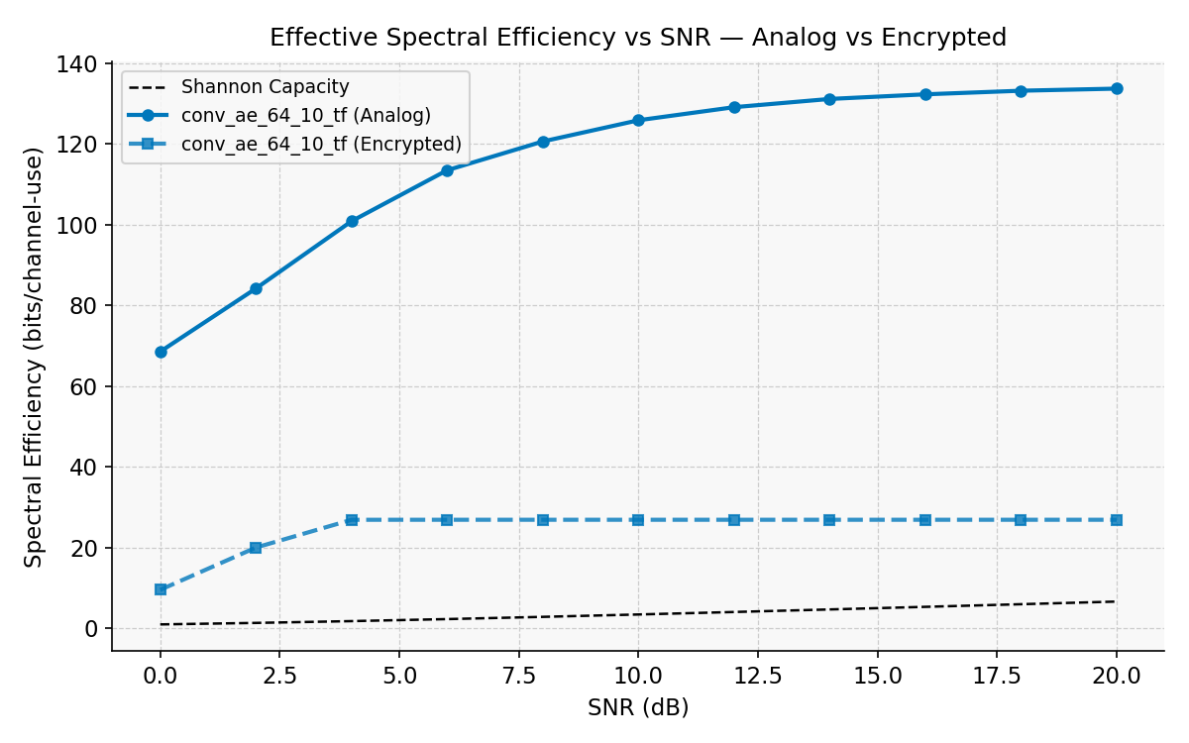
BER vs SNR and Spectral Efficiency

Slide 36
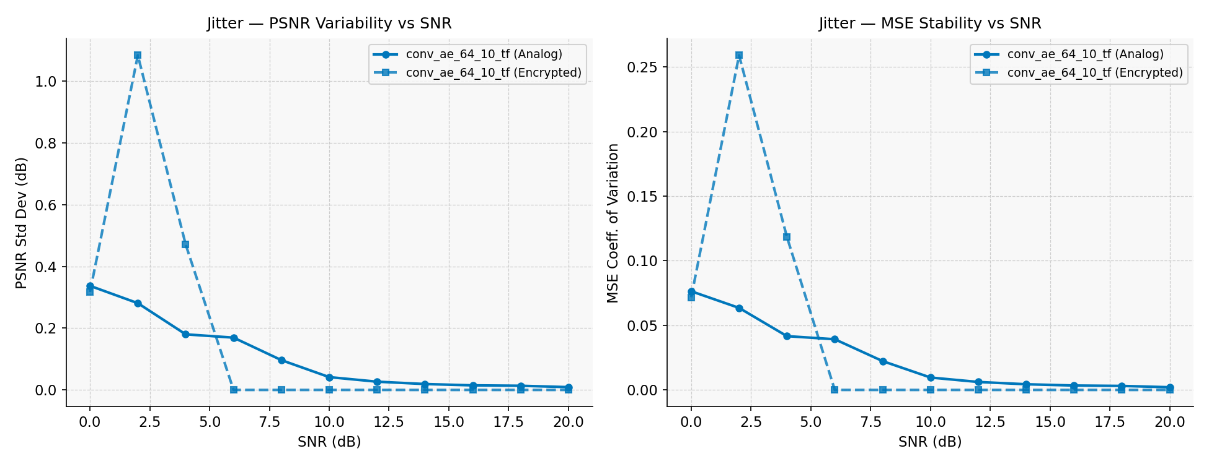
Jitter

Slide 37
Challenges Faced
One of the main challenges we faced was integrating the encryption algorithm with the pre-build model design
Trying to improve the model performance with a limited dataset and no dataset to fine-tune on
Attack simulation of bit-flooding and jamming. Finding a dataset that aligns with our project was difficult.

Slide 38
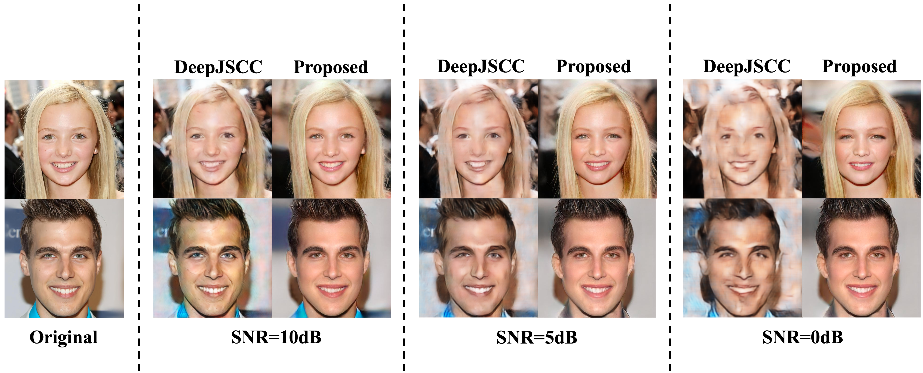
Open-source model performance
GAN_SeCom model output

Slide 39
Future Work
We plan to use open-source models made for semantic communication by leveraging transfer learning techniques for efficient training and fine-tuning
We can start working with the in-lab testbed for testing our models and getting better understanding of it’s performance
At the final stage we will start with the maths system and modelling of the entire pipeline to make a presentation ready work for this project

