Slide 1
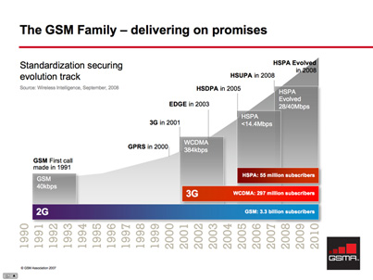
Data transmission standards over GSM/UMTS networks
CSE 237a
Topic Research
Slavik Bryksin
vbryksin@cs.ucsd.edu

Slide 2
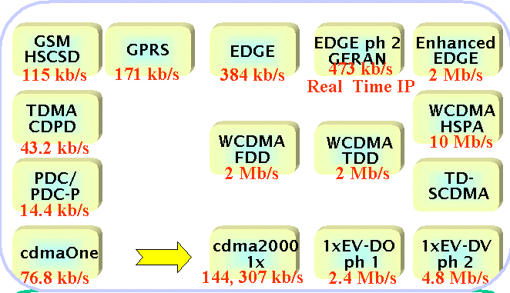
2G to 3G
xG differentiation is mostly a marketing term
GSM/UMTS compete with cdmaOne/CDMA2000 standards
Many standards and variations

Slide 3
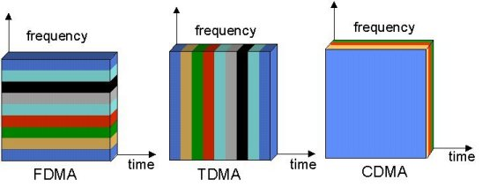
Access methods
TDMA – time division multiple access
CDMA - code division multiple access
FDMA - frequency division multiple access
W-CDMA - wideband code division multiple access

Slide 4
GSM data transmission (2G)‏
Global System for Mobile communications
FDD (frequency division duplex)‏
TDMA/FDMA
Modulation: Gaussian minimum-shift keying (GMSK)‏
Theoretical bandwidth: 9.6 Kbps

Slide 5
GPRS (2.5G)‏
General Packet Radio Service
Packet switched
Relies on FDD/FDMA for RTS/CTS and TDMA for data transfers
Theoretical maximum bandwidth of 171.2 Kbps (downlink)‏
Practical bandwidth is around 57 Kbps (downlink)‏

Slide 6
EDGE (2.75G)‏
Enhanced Data rates for GSM Evolution (a.k.a EGPRS)‏
Packet switched
Modulation
- GMSK (Gaussian Minimum Shift Keying)‏
- 8-PSK (Phase Shift Keying)
Multiple Access
- Combination of TDMA & FDMA
Can be deployed on existing GPRS networks with minimal cost
Theoretical bandwidth: 473.6 Kbps (8-PSK, 8x59.2Kbps per time slot)‏
Practical bandwidth up to 384 Kbps

Slide 7
HSCSD (2.5G)‏
High Speed Circuit Switched Data
Circuit switched
TDMA-based
Enhancement of CSD standard (allocation of a single dedicated time slot)‏
Uses multiple time slots which are reserved to 1 user
Lower latency then packet switched technologies: no need for RTS/CTS
Theoretical bandwidth: 115.2Kbps (8 x 14.4Kbps per timeslot)
Practical bandwidth: 57.6Kbps (4 time slots)‏

Slide 8
UMTS (3G)‏
Universal Mobile Telecommunications System
W-CDMA as air interface
Wide spectrum: 2x5Mhz channels for downlink/uplink
Compatible with GSM, but uses different frequency bands
  But spectrum licenses are expensive
3G+ Data transmission standards: FOMA, HSDPA/HSUPA, HSPA+, UMTS-TDD

Slide 9
W-CDMA
Wideband Code Division Multiple Access
Developed by NTT Docomo
  Broke strong stand of Qualcomm in CDMA standards
Used in FOMA network in Japan, adopted in UMTS standards
2 types of duplexing: FDD and TDD
Pair of 5Mhz channels (vs. 1x, 3x, pairs of 1.25Mhz in CDMA2000)‏

Slide 10
FOMA
Freedom of Mobile Multimedia Access
First 3G service by NTT Docomo
Launched in 2001 in Japan
Practical bandwidth (cited by Docomo): 3.6 Mbps downlink, 384Kbps uplink
Initial implementation was power inefficient
Now moved to use HSDPA/HSUPA standard over W-CDMA

Slide 11
HSDPA
High Speed Downlink Packet Access
Gaining foothold quickly: uses existing 3G netoworks infrastructure
Adaptive Modulation and Coding: based on signal quality raise to 16QAM (Quadrature Amplitude Modulation) with 3.6Mb/s and up rates, or drop back to QPSK (Quadrature Phase Shift Keying)
Fast Packet Scheduling: base station determines how much data to send to devices based on their link strength
Hybrid Automatic Repeat reQuest (HARQ): Store erroneous packets. Request retransmit of corrupt packets and combine.
Shorter TTI (Transmission Time Interval) of 2ms
High Speed Downlink Shared Channel (HS-DSCH) with constant Spreading Factor 16 (SF-16) CDMA codes (variable in CDMA)‏
  transmitted at constant power while modulation, coding and number of codes change according to signal conditions

Slide 12
HSUPA
High Speed Uplink Packet Access (aka EUL – Enhanced UpLink)‏
Same techniques as HSDPA for modulation
Dedicated uplink channel
HARQ
Fast Packet Scheduling: device initiates the transmission
  Scheduled: base station dynamically sets power level of the device transmission
  Non-Scheduled: Constant power level set by the device
Theoretical bandwidth: HSDPA 14.4Mbps/ HSUPA 5.76Mbps
Practical bandwidth is usually capped:
At&t 3G services: HSDPA: 700 Kbps—1.7 Mbps
HSUPA: 500 Kbps—1.2 Mbps

Slide 13
HSPA+
High Speed Packet Access Evolved
  Enhancement of HSDPA/HSUPA
  Currently developed/deployed
Increase data rates by addition of MIMO antennas (multiple transmit/receive antennas)‏
Continuous Packet Connectivity: reduce uplink interference of dedicated channels when no data is transmitted
64QAM modulation on downlink
16QAM modulation on uplink
Theoretical bandwidth of 42Mbps/11.5Mbps!

Slide 14
UMTS-TDD
TD-CDMA air interface (similar to W-CDMA)‏
But uses TDD unlike FDD in W-CDMA based standards
Designed to work in a single unpaired frequency band
Allows fine control over downlink/uplink bandwidth
Not compatible with UMTS W-CDMA networks
Theoretical bandwidth: 16Mbps/16Mbps

Slide 15
References
C. Foh', B. Meini, B. Wvdrowski', M Zukerman. ”Modeling and Performance Evaluation of GPRS”, Vehicular Technology Conference, 2001. VTC 2001 Spring. IEEE VTS 53rd
A. FURUSKAR, S. MAZUR, F. ULLER, H OLOFSSON, “EDGE: Enhanced Data Rates for GSM and TDMA/736 Evolution”,: Personal Communications, IEEE, Jun 1999, Vol. 6, Issue: 3 pp 56-66
EDGE white paper. http://www.ericsson.com/solutions/tems/library/tech_papers/tech_related/edge_wp_technical.pdf
Jouni Korhonen, Olli Aalto, Andrei Gurtov,Heimo Laamanen, “Measured Performance of GSM HSCSD and GPRS”, IEEE International Conference, vol. 5, pp. 1330-1334, 2001
Erik Dahlman, et al. “WCDMA—The Radio Interface for Future Mobile Multimedia Communications”, IEEE Transactions on Vehicular Technology, vol. 47, no. 4, pp. 1105-1118, Nov 1998
W-CDMA white paper. http://www.ericsson.com/technology/whitepapers/innovations_in_wcdma.pdf
T. Kolding, F. Frederiksen, P. Mogensen, “Performance Aspects of WCDMA Systems with High Speed Downlink Packet Access (HSDPA)”, Proceedings of IEEE Vehicular Technology Conference, vol1, pp 477-481, 2002
R. Love et al, “High Speed Downlink Packet Access Performance,” Proceedings of IEEE Vehicular Technology Conference (VTC), May 2001, vol. 3, pp. 2234–2238.
Gaurav Sharma & Kumar G S, “Moving towards HSUPA (High Speed Uplink packet Access): A Complete 3.5 G Wireless System”, IEEE International Conference on Personal Wireless Communications, Jan 2005. pp. 174- 177
HDSPA white paper. http://www.umts-forum.org/component/option,com_docman/task,doc_download/gid,1632/Itemid,12/

Slide 16
References
H. Holma et al., “High-Speed Packet Access Evolution in 3GPP Release 7”, Communications Magazine, IEEE, vol. 45,no. 12, Dec 2007 pp. 29 - 35
HSPA+ http://www.ericsson.com/technology/whitepapers/hspa_and_mobile_wimax.pdf
T. Ojanpera, “An Overview of Air Interface Multiple Access for I M T- 2000/UMTS”, Communications Magazine, IEEE, Sep 1998, vol 36, no. 9, pp. 82-86, 91-5
C. Mihailescu, X. Lagrange, Ph. Godlewski, “PERFORMANCE EVALUATION OF A DYNAMIC RESOURCE ALLOCATION ALGORITHM FOR UMTS-TDD SYSTEMS”, Proceedings of IEEE Vehicular Technology Conference, 2000. vol 3, pp. 2339-2343
UMTS-TDD http://www.umtstdd.org/technology.html
AT&T 3G services http://www.wireless.att.com/learn/why/technology/3g-umts.jsp

