Slide 1
DATANOVA 2026 · CYBERSECURITY & FRAUD · DN-FN-01
FraudShield
Real-time payment fraud detection that keeps false alarms low and adapts the moment fraudsters change tactics
99.2%
92.2%
0.31%
fraud caught
precision
false-positive rate
Notes:
FraudShield scores every card payment in real time, explains each decision, and retrains when a new fraud pattern appears.

Slide 2
Fraud teams lose twice: to fraud, and to their own false alarms
1
2
3
Missed fraud
False alarms
Drift
Every missed payment is a direct loss and a chargeback.
Blocking a good customer costs the sale and often the customer.
Fraudsters change tactics. A model trained last quarter goes blind to this quarter's pattern.
DN-FN-01 asks for real-time scoring with low false positives. We treat all three costs together.

Slide 3
From payment to decision in one pass
Payment
Causal features
Two models
Cost-aware threshold
Decision
amount, merchant, channel, country, device, hour
1h / 24h velocity, amount vs card average, geo mismatch, account age
class-balanced gradient boosting + isolation forest for unseen behaviour
minimise missed fraud $ + $5 per manual review
approve · review · block, with per-feature reasons
Only features known at payment time are used, so nothing leaks from the future.

Slide 4
Validated strictly in time order, like production
Train
Validation
Test A
Test B
Day 0
Day 60
80,000
2.0%
Day 45
synthetic card payments over 60 days
fraud rate across four typologies
a new mobile-travel pattern appears, unseen in training
The threshold is picked on validation only. Test A and Test B are never seen during training or tuning.

Slide 5
On the final, unseen period it catches almost everything
99.2%
92.2%
0.991
30
of fraud caught
precision at the block threshold
PR-AUC (random baseline 0.036)
false alarms in 9,644 genuine payments
Cost of fraud in the final period

Slide 6
When fraud changed, retraining closed the gap
1.6% → 100.0%
recall on the new mobile-travel pattern
The static model never saw it and waved it through. Once reviewers confirmed the first cases, one retrain was enough to catch it.

Slide 7
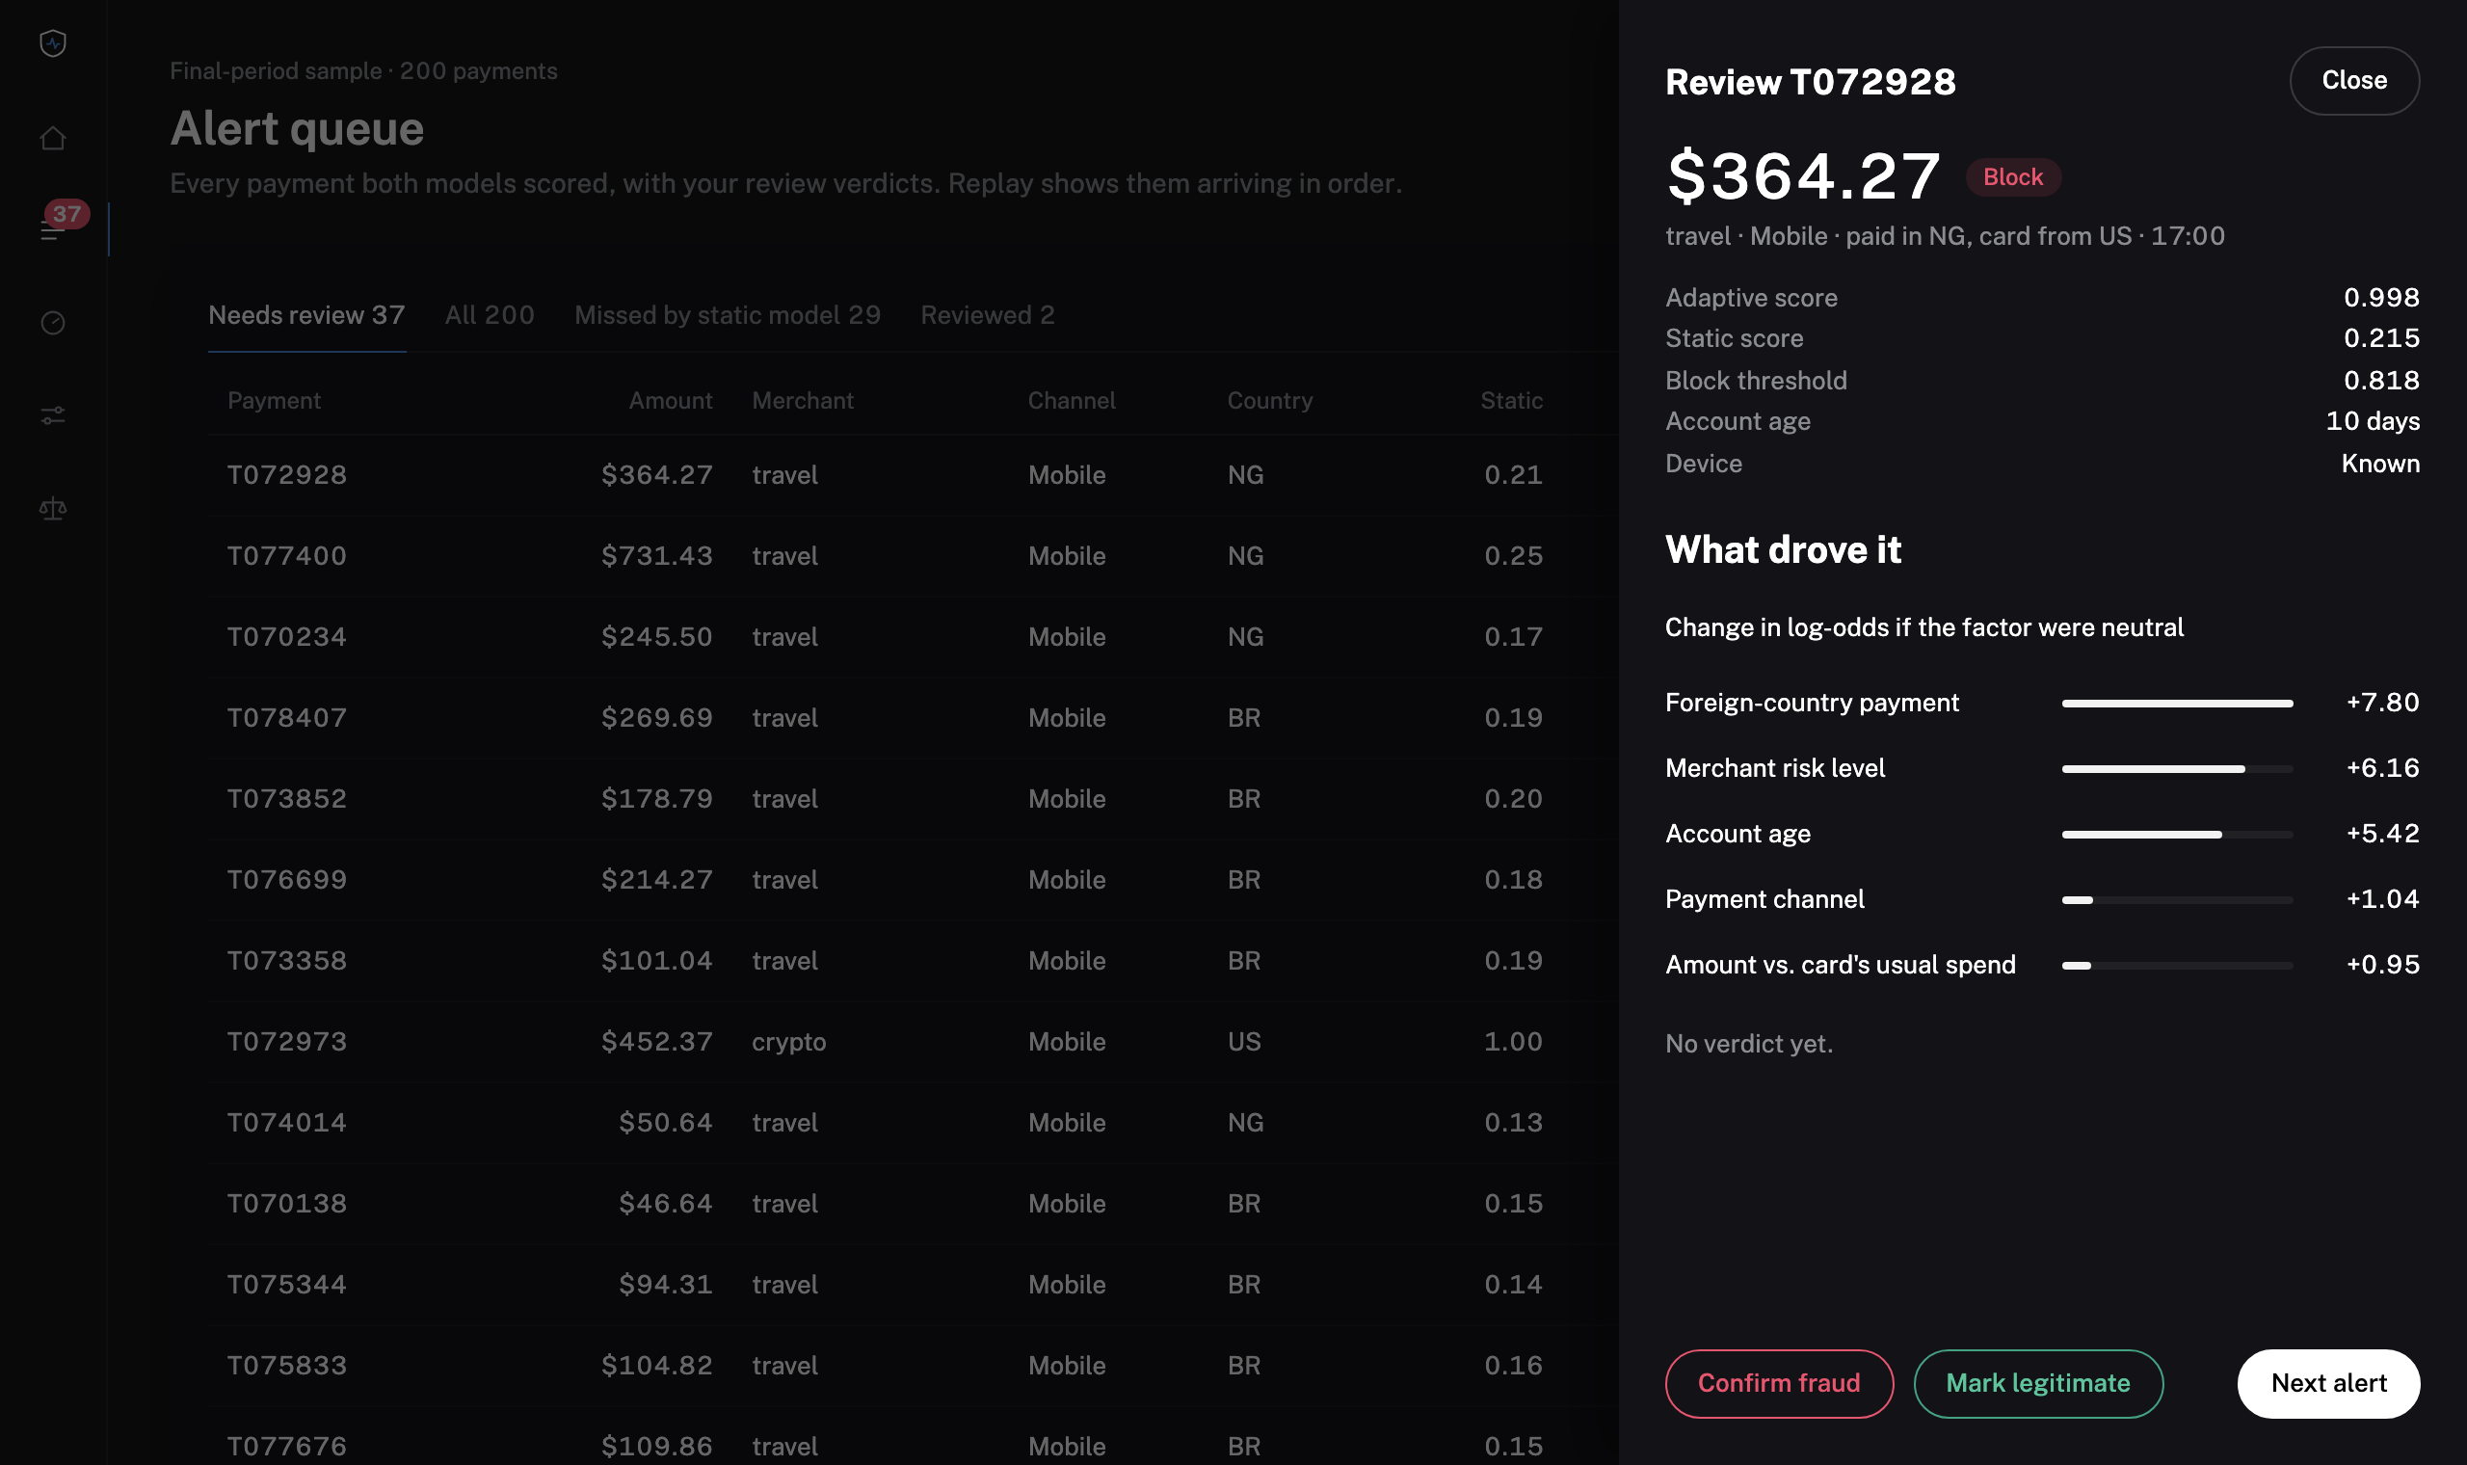
Every alert explains itself
Per-decision reasons
Occlusion attribution on the log-odds scale shows which features pushed the score up.
Reviewer verdicts
Confirm fraud or mark legitimate. Verdicts are saved and become the labels for the next retrain.
Score any payment
Analysts can test a payment on demand and see approve, review or block.

Slide 8
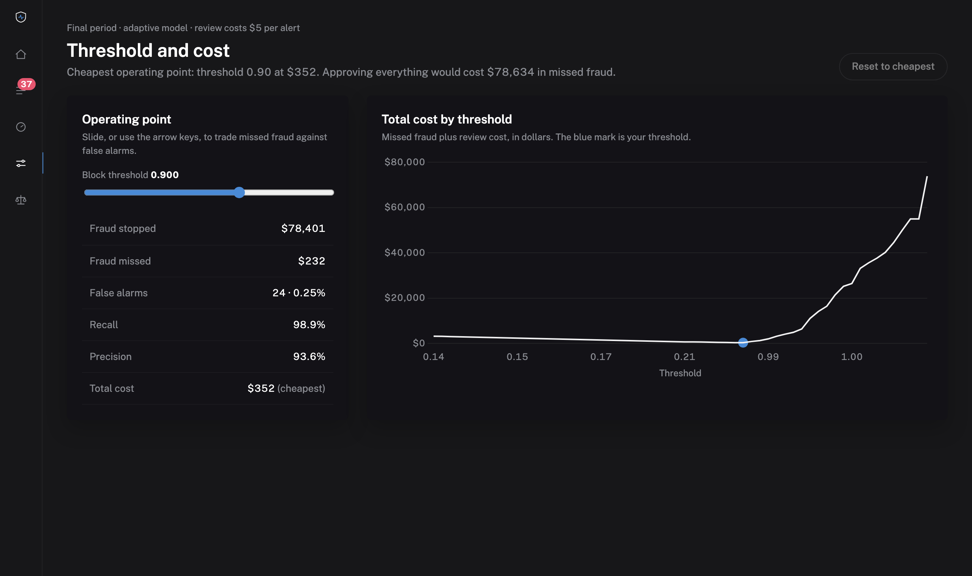
The threshold is a business decision, so we price it
Drag the block threshold and see fraud stopped, false alarms and total cost update live.
Total cost = missed fraud + $5 per manual review.
The default is the cheapest point on validation data, not an arbitrary 0.5.
Borderline scores go to a human queue, not an automatic block.

Slide 9
Checked for who pays the false alarms
No protected attributes are used as features.
False alarms stay under 1% for every channel and home country with enough data.
Recall is reported per slice in the dashboard too, so a blind spot (like mobile before retraining) is visible, not hidden in an average.

Slide 10
What this proves, and what it does not yet
Impact
Honest caveats
Next steps
$78.5k of $78.6k fraud stopped in the final period
Total cost $310 vs $45k for the static model
Reviewers see why, and their verdicts retrain the model
Data is synthetic: real data would separate less cleanly
The drift scenario is constructed to test retraining
One dataset and one random seed
Run on a public or partner payment dataset
Automatic retraining when reviewer labels drift
Stream scoring behind a message queue

Slide 11
Built by KingDavid
Solo project: every part designed and built by one person
Data
Modelling
synthetic 80k-payment generator with four fraud typologies and drift
causal features, gradient boosting + isolation forest, cost-optimal threshold
Validation
Product
time-ordered splits, drift experiment, fairness slices, explanations
Flask API, analyst dashboard, review workflow, deployment
Live demo: https://fraudshield-beta-livid.vercel.app · Code: github.com/Black-Lotus-Development/fraudshield

