Slide 1
Black Sabre Response IRTx Presentation

Slide 2
Overview
Environment setup
Scenario Overview
Lessons Learnt
Summary

Slide 3
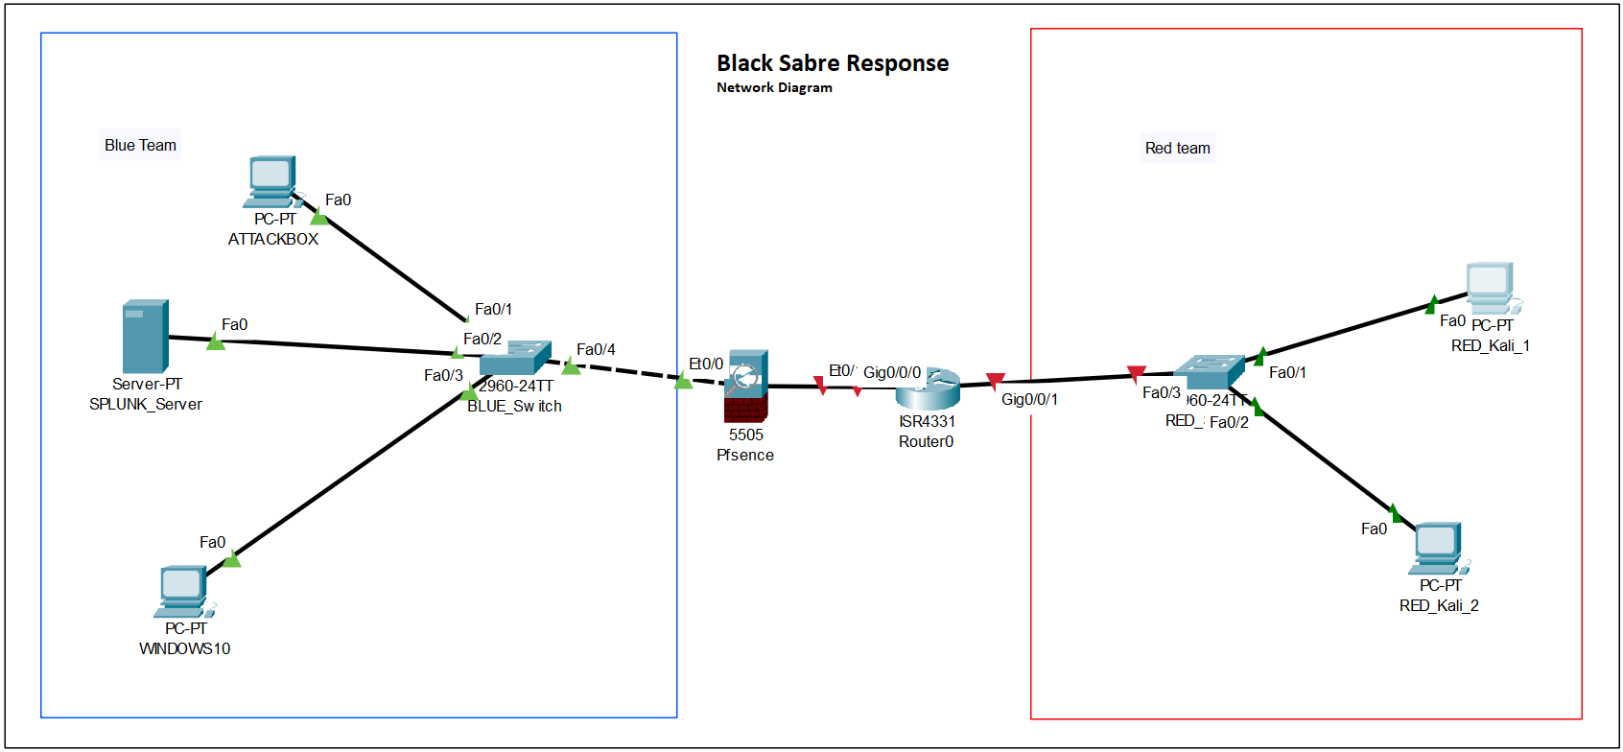
Environment

Slide 4
Scenario Overview
Blue team playbooks x3
Red team playbooks x3
Attacks:
Misconfigured Jenkins
SQL injections
Vulnerable file upload

Slide 5
Red Team Lessons
Positives
Attacks successful
Reverse shell X2
Database dump with credentials
Negatives
Reverse shell code stored on desktop
MSF module failed

Slide 6
Blue Team Lessons
Positives
Detection of all attacks
Dashboard to assist in monitoring
Negatives
Detection only, no remediation
Detection for Jenkins based on console process

Slide 7
Lessons Learnt: Syed
How projects management works with tools like Gantt chart, draw.io
Learning how to setup Splunk, Pfsense and network configuration
How real-life SOC setup looks like

Slide 8
Lessons Learnt: Dylan
How to create IRP/how it works
How to setup PFSense

Slide 9
Project Lessons
Positives
Effective communication
Teamwork
Negatives
Incorrect project timeline
Members not always present

Slide 10
Summary
Successful IRTx
Red and blue team completed tasks
Lessons learnt from both teams

Slide 11
Team Members
Project Manager – Syed
Communication Manager – Muzamil?
Blue Team Lead – Braedyn
Red Team Lead – Dylan

Slide 12
THANKYOU

