Slide 1
Copy or Collaborate in a Changing Community
Team 11
Gileesa, Sooriyaa Alara, Ivo
Notes:
Alara
Hi I am here to introduce our topic “copy or collaborate” and the details of the paper we have taken inspiration of and decided to expand on.

Slide 2
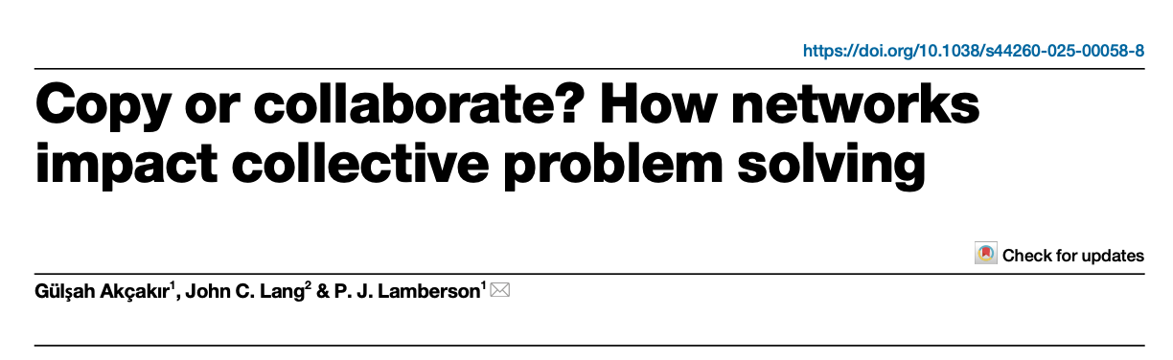
Our Inspiration
Notes:
Alara
We took inspiration from this paper with the title “copy or collaborate? How networks impact collective problem solving”, which we decided to expand on further.
In this paper it is discussed how a network of agents on a fitness landscape adapt and learn through collaboration and copying behaviour to reach an optimal fitness.

Slide 3
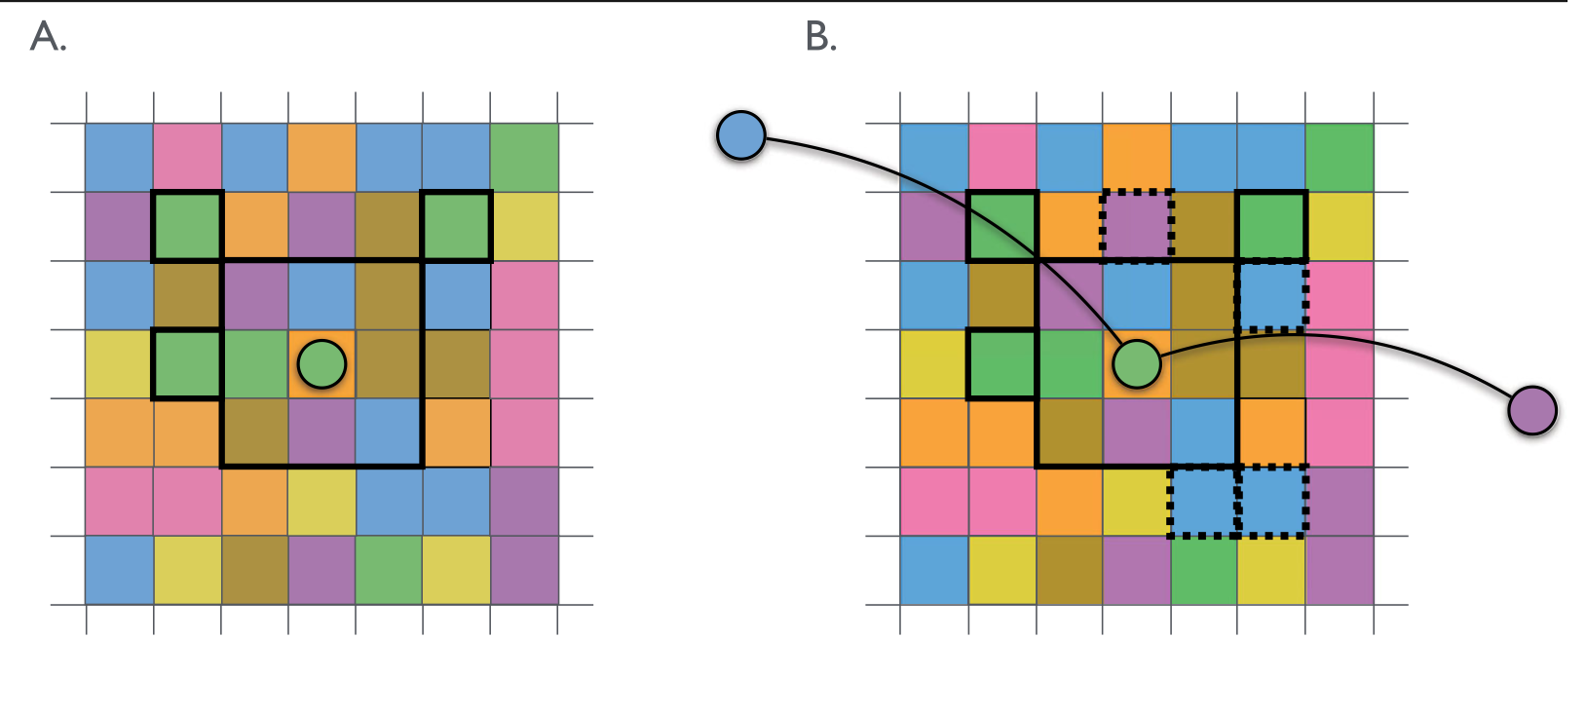
Agents on a Grid
Akçakır, G., Lang, J.C. & Lamberson, P.J. Copy or collaborate? How networks impact collective problem solving. npj Complex 2, 35 (2025). https://doi.org/10.1038/s44260-025-00058-8
Notes:
Alara
Each agent has a skill value on a board with denoted skills and is connected to each other through a network. In the paper different types of networks have been tested on, but in our project we have used a fully connected network (meaning each agent is connected to every other agent)
In the paper they use a board 100x100 with 16 agents, 100 different skills.
To get to the main movements of the agents, there are two types of behaviors for the agents:
Collaboration, which is decided with the probability p, through this behavior an agent may (talk in terms of the green agent for ease of comprehension):
Move to a cell that is direct neighbour of the cell they occupy OR
Move to a cell in radius r that is the same skill value as the agent OR
Collaborate with its network neighbours to move to a cell in radius r that is of the neighbour’s skill value.
Copying, which is decided with probability 1 - p, through this behaviour an agent may (again talk in terms of green agent)
Move to a cell that is direct neighbour of the cell they occupy OR
Move to a cell in radius r that is the same skill value as the agent OR
Copy its network neighbours to move to a cell that these neighbours occupy.

Slide 4
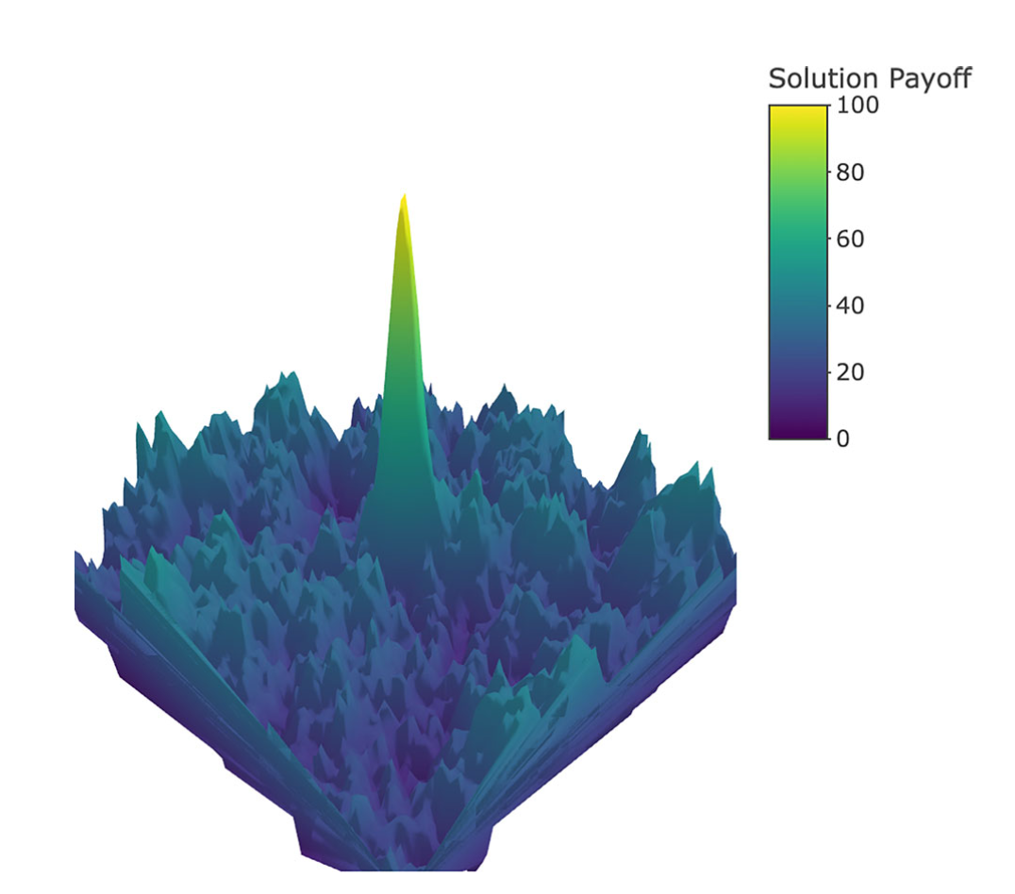
Fitness Landscape
Akçakır, G., Lang, J.C. & Lamberson, P.J. Copy or collaborate? How networks impact collective problem solving. npj Complex 2, 35 (2025). https://doi.org/10.1038/s44260-025-00058-8
Notes:
Gileesa

Slide 5
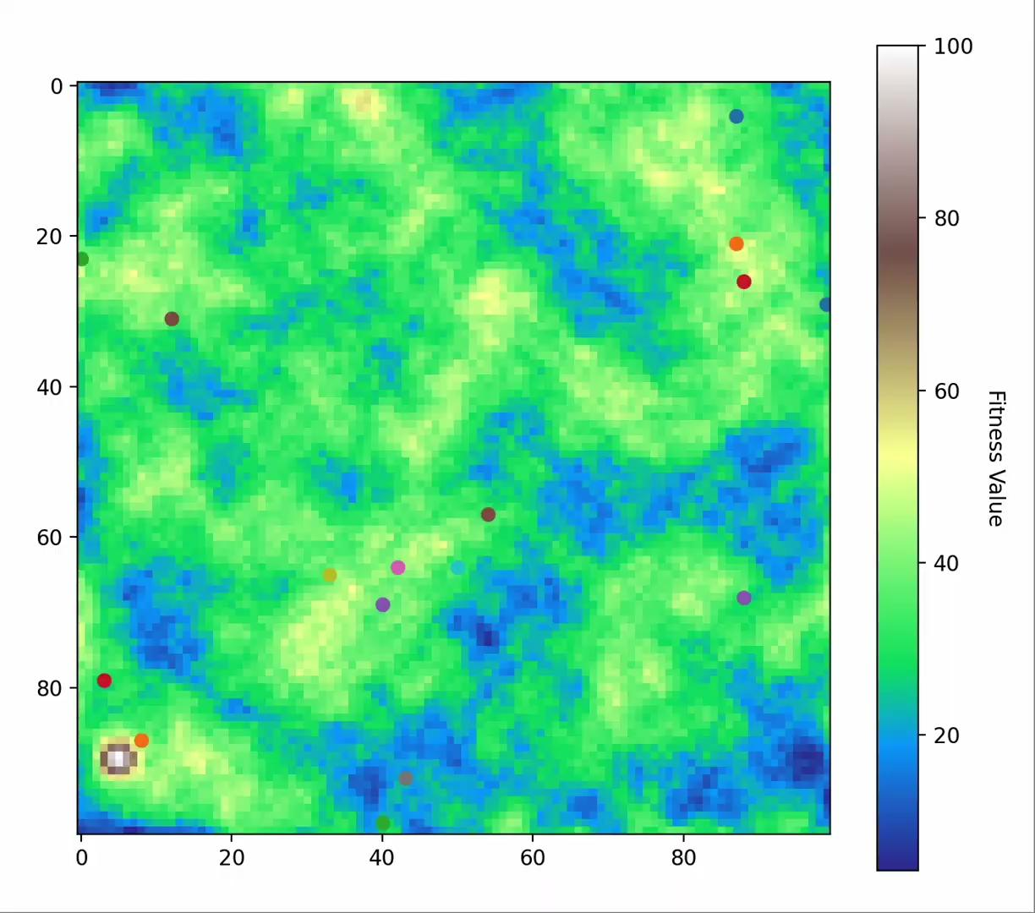
Movement each Step
Notes:
Gileesa - The agents all move independently. We cannot predict their joint behaviour. This is why the system is complex.

Slide 6
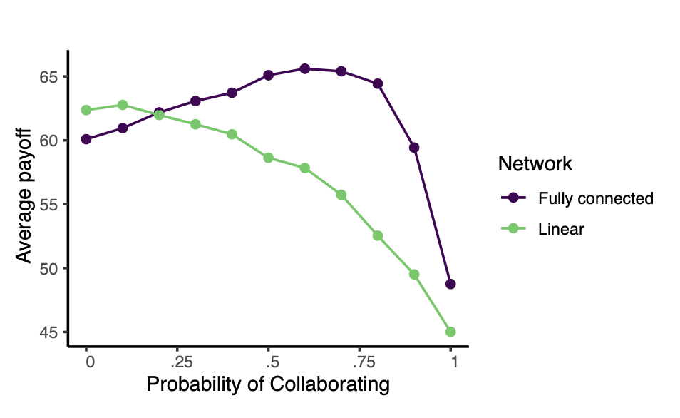
Results of Paper
Akçakır, G., Lang, J.C. & Lamberson, P.J. Copy or collaborate? How networks impact collective problem solving. npj Complex 2, 35 (2025). https://doi.org/10.1038/s44260-025-00058-8
Notes:
Gileesa

Slide 7
Results of Paper
Optimal Value
Akçakır, G., Lang, J.C. & Lamberson, P.J. Copy or collaborate? How networks impact collective problem solving. npj Complex 2, 35 (2025). https://doi.org/10.1038/s44260-025-00058-8
Notes:
Gileesa

Slide 8
What happens if we add turnover?
Notes:
Ivo
Our addition to this algorithm is the introduction of turnover
After each iteration, each agent has a chance to ‘die/leave’, and get replaced with a new random agent
The individual chance of death/leaving we denote as the turnover ratio/rate
Then we are interested in how this changes the behaviour
This leads to our research question

Slide 9
Research Question
How does a dynamic agent network involving replacement of agents affect the optimal collaboration–copying ratio between agents?
Notes:
Ivo
Our addition to this algorithm is the introduction of turnover
After each iteration, each agent has a chance to ‘die/leave’, and get replaced with a new random agent
The individual chance of death/leaving we denote as the turnover ratio/rate
Then we are interested in how this changes the behaviour

Slide 10
Hypotheses
H1: Adding turnover has a statistically significant effect on the optimal collaboration-copying ratio.
H0: Adding turnover has no statistically significant effect on the optimal collaboration-copying ratio.
Notes:
Ivo
Go over our hypotheses, and expand a tiny bit on their meaning/interpretation

Slide 11

Movement Each Step with Turnover
Notes:
Ivo
So how does this kind of behaviour look like?
Tadie, our animation with turnover 0.1 / 10%, where we can see both agents moving slowly towards their local minima, agents jumping to other agents, and agents getting replaced
So we get different behaviour, where we don’t have a clearly defined last time step, and can escape minima
But we do want to be able to directly compare to the results from no turnover, so we used the constant stopping criteria of only doing 20 iterations
More generally, to answer our hypothesis we are interested in the expected average ‘fitness’ across agents for a given turnover rate and copy-collaborate ratio, que next slide

Slide 12
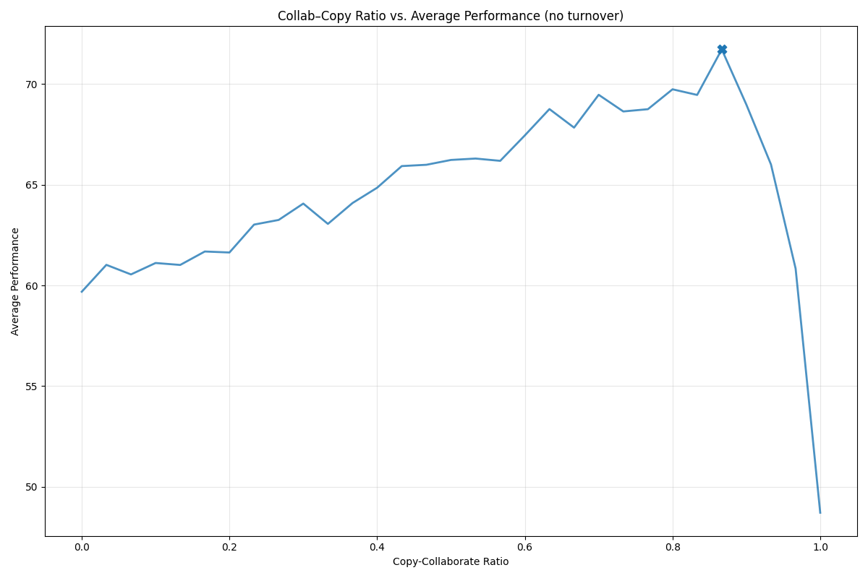
Collab-Copy Rate vs. Fitness (no turnover)
Notes:
Ivo
Since we’re interested in the optimal copy-collaborate ratio, we simulate the model for varying values.
Plotting this, with no turnover, we get a curve like this, which looks similar to that of the fully connected one from the paper shown before
And we see a well-defined optimal ratio, marked by the point on the plot
We can expand on this by doing this for varying turnover rates, which gets us these results (que next slide)

Slide 13
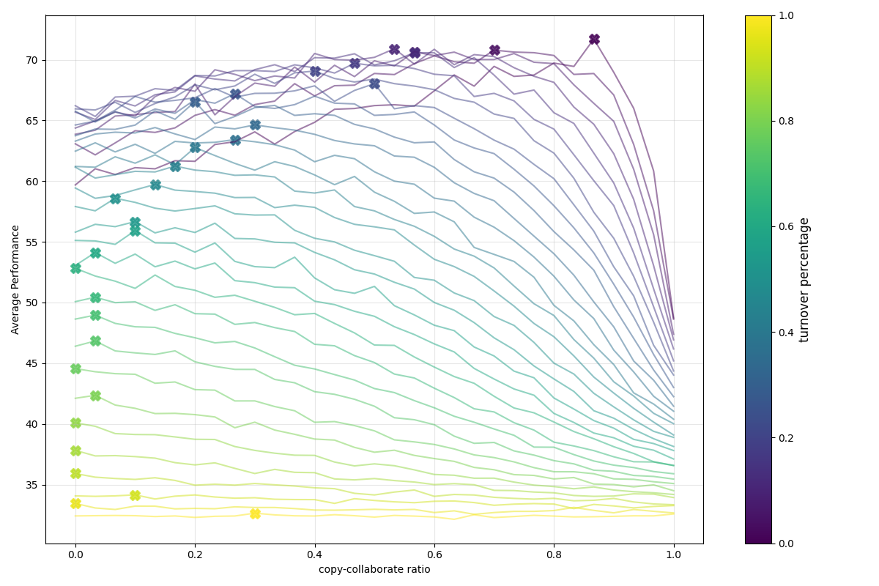
Collab-Copy Rate vs. Fitness
Notes:
Ivo
Here we again see the same thing, but now for different turnover ratios.
They are colored to indicate the turnover ratio, and again each has a marked optimal copy-collaborate ratio
For this number of iterations, we can see that the optimal ratio moves towards 0, and for very high turnover we get a nearly flat line
We can also plot this as a surface in 3D, which we have here (que next slide)

Slide 14
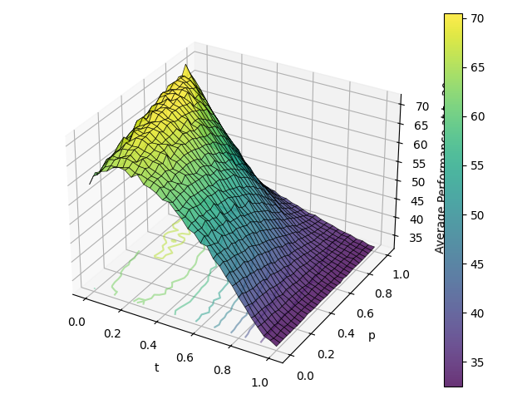
Copy-Collab Rate vs. Turnover Rate
Notes:
Ivo
Here we again see the same results, but now it might be clearer to see that the optimal ratio changes with turnover.
And again for either high turnover or high copy-collaborate ratio (or both), the function quickly flatlines, making for a badly defined ‘best’ ratio
Next we need to quantify this dependence between turnover and optimal ratio, which is what we’ll talk about in our results now.

Slide 15
Results
Notes:
Sooriyaa

Slide 16
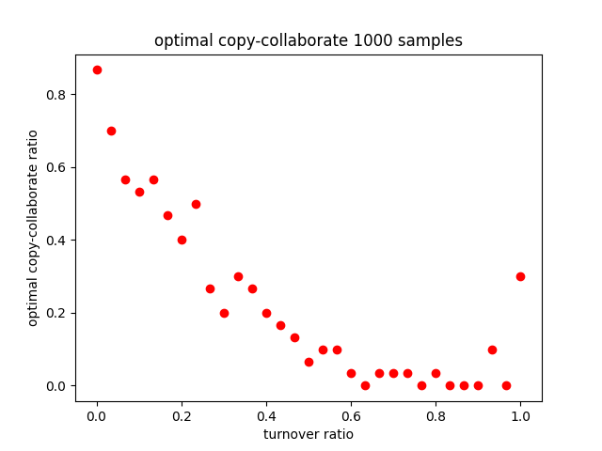
Copy-Collab Rate vs. Turnover Rate
Notes:
Sooriyaa
The following plot shows the relationship between the copy collaboration ratio vs turnover rate,
The x- axis represents the turnover rate:
how quickly agents leave and are replaced.
The y - axis represents the copy collaboration rate in our model, which as defined as:
each agent can either collaborate or copy.
Each red point represents the average optimal copy-collab rate for a given turnover rate. We observe a pattern.
As turnover changes the copy and collab ratio also changes,
moreover at low turnover rate, the collaboration level tends to be higher
as turnover increases collab ratio decreases
pointing that copy perform better by a higher turnover rate.
In other words, when agents die quickly due to a high turnover rate, they prefer copying instead of collaboration, because copying is faster and requires less time.

Slide 17
Statistics: Linear Regression
P-value: 4.2e-9
𝝰-value: 0.05
slope: -0.7
Notes:
Sooriyaa
In order to examining the relationship between turnover ratio and the optimal collaboration-copying ratio, we performed a linear regression test.
The slope of the linear regression is - 0.7, indicating a neg relationship.
As the previous pic depicted, as the turnover rate increases, the optimal coll-copy ratio tends to decrease
The p - value is 4.2 x 10 ^ - 9, which far below the significance level of 0.05

Slide 18
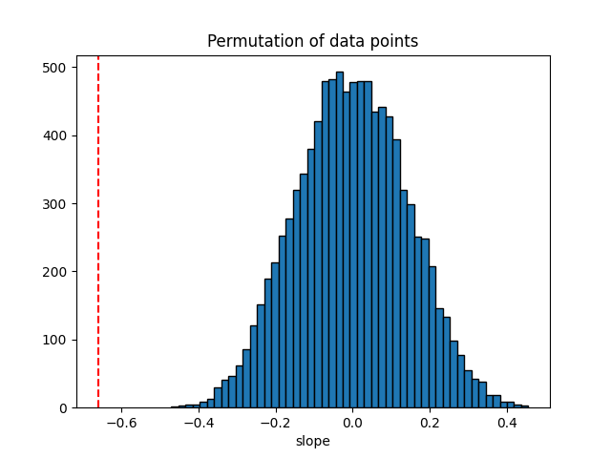
Permutation Histogram
Notes:
Sooriyaa
And in order to validate the regression result, we performed a permutation test.
We randomly shuffled the data many times and created a distribution of slopes.
The histogram shows the distribution of slopes from these random permutations.
The red dashed line represent the observed slope from the actual data
Because the observed slope lies far outside the distribution, it suggests that the relationship is not random, which supports the small p value of 4 *10 ^ - 9

Slide 19
Conclusion & Discussion
P-value: 4.2e-9
𝝰-value: 0.05
→ reject null hypothesis
➭ H1: Adding turnover has a statistically significant effect on the optimal collaboration-copying ratio.
Notes:
Sooriyaa
H1: Adding turnover has a statistically significant effect on the optimal collaboration-copying ratio.
H0: Adding turnover has no statistically significant effect on the optimal collaboration-copying ratio.
Hence the p value is much smaller then our alpha value of 0.05, we reject our null hypothesis.
This means that the turnover rate has a statistically significant effect on the optimal copy-collab ratio.
Therefore, the observed relationship is statistically significant and unlikely yo be due to random chance.
What can we conclude?
We conclude that the turnover rate significantly affects the optimal collab-copy ratio
Our data suggest that a higher turnover tends to shift the balance towards less collaboration and more copying
Limitation
We can not conclude that there is a linear relationship between turnover and collab-copy ratio.
Compared to the paper, which has a dynamic stopping criteria, we have a fixed time step - 20 steps
Maybe we reach a criticality point toward t =1, there is no differences between the whole range of copy-collab rare between 0 to 1 (slide 14) - we need to have a more depth insight to evaluate that
Future Research - Gileesa

Slide 20
Future Research
Compare fully connected vs. partially connected networks
Study how sub-hubs affect escaping local optima
Test whether limited knowledge sharing improves global search
Performance-based turnover (weak agents leave)
Reinforcement learning agents
Add more simulation steps
Notes:
Gilessa
In future work, we plan to compare different network structures,
such as fully connected networks and networks with multiple sub-hubs or partial connectivity.
This comparison could help us understand how network structure influences the fitness landscape and the ability to escape local optima.
By not sharing all knowledge and allowing agents to explore in different directions may help overcome hill-climbing limitations and lead to better global solutions.

Slide 21
Questions?
Notes:
Sooriyaa
Thank you for listening.
Do you have any questions?
Questions 13:

Slide 22
Appendix

Slide 23
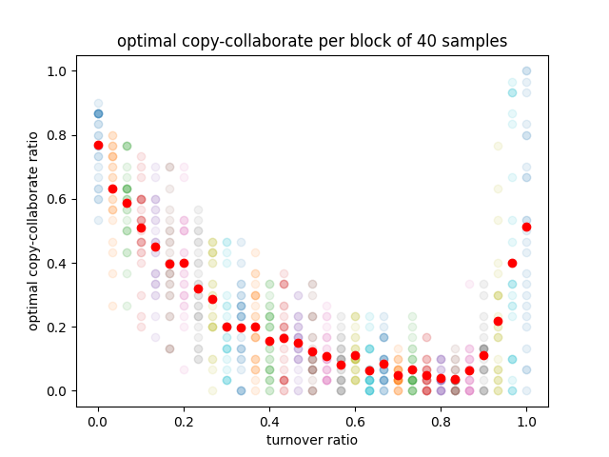
Copy-Collab Rate vs. Turnover Rate

Slide 24
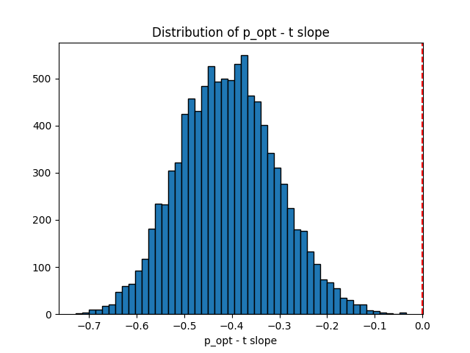
Histogram

Slide 25
One-tailed test p-value
P-value: 2.1e-9

Slide 26
Additional Slide
Notes:
-

