Slide 1
Hacking the badge

Slide 2
What ?
Based on ESP32
  Dual 240MHz core
  Wi-Fi / Bluetooth
OLED screen
  I2C connection
5 buttons

Slide 3

Firmware
Firmware is based on Micropython
Python for microcontrollers
http://docs.micropython.org/en/latest/

Slide 4
BadgeOS
Custom Python « OS » made for the badge
Provides APIs to interact with the badge features
Allows to easily add user-created « apps »

Slide 5
Workshop
Discover the basic API, based on the existing apps
For beginners : Create an analog clock
For pros : Create your own app

Slide 6
Connecting to the badge
Connect the USB cable
A serial port should be detected
  On Windows, might need to install ch340 driver
  On GNU/Linux, you might need to disable ModemManager
Use screen to connect (Putty on Windows)
  $ screen <serial> 115200

Slide 7
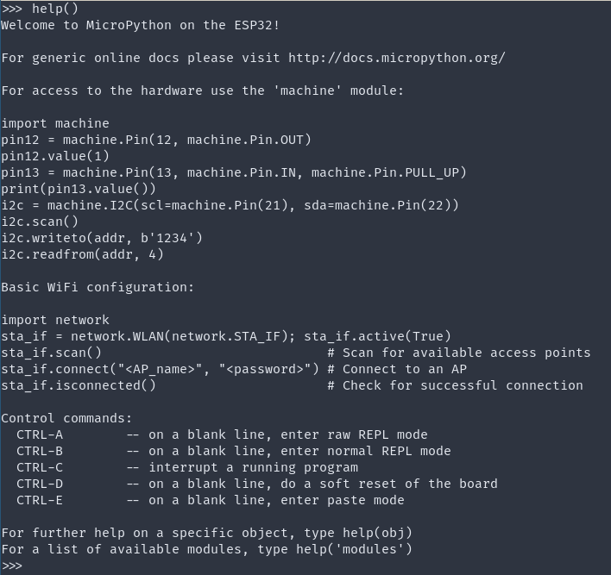
Access the REPL
Press <ctrl+c> several times to access the Python shell
Able to interact with the badge from here

Slide 8
“SDK”
Clone the badge github repo
  https://github.com/Baldanos/blackalps-19-badge
  Don’t forget to fetch the submodules
Contains the full badge source

Slide 9
Testing code
Using the REPL, it’s easy to test some features interactively
The badge instance is in the BADGE variable

Slide 10
BadgeOS API

Slide 11
Main functions
BADGE.prompt(prompt)
  Prompts the user for text, returns the input text
BADGE.menu([items])
  Displays a menu, returns the selected item
BADGE.show_text(text)
  Displays a text on the screen, with scrolling and wrapping

Slide 12
Screen API
BADGE.screen.text(text)
  Show text on the screen
BADGE.screen.textbox([text])
  Show a textbox with the text (one item per line)
BADGE.screen.show_logo()
  Show the BlackAlps logo

Slide 13
Buttons API
BADGE.buttons.wait_button()
  Blocking
  Wait for a button press, returns the pressed button
BADGE.buttons.get_button()
  Non-blocking
  Returns the pressed button, None otherwise

Slide 14
Internet API
BADGE.net.online()
  Connect to the WiFi
BADGE.net.offline()
  Disconnect the WiFi
BADGE.net.add_callback(topic, function)
  Add a callback on MQTT topic
BADGE.net.client.check_msg()
  Check for new messages on the MQTT topics

Slide 15
Screen
Uses an SSD1306 OLED controller
Resolution is 128x64 pixels, two colors
Micropython has a framebuffer support with drawing primitives
  https://docs.micropython.org/en/latest/library/framebuf.html
  Accessible in BADGE.screen.oled

Slide 16
Screen - cont
The screen does not get refreshed until you ask for it
  Use BADGE.screen.oled.show() to refresh the screen
  Refreshing the screen takes a lot of time, try to draw everything before refreshing the screen

Slide 17
Screen -Exercises
Clear the screen
Write “Hello world !” on the screen
>>> BADGE.screen.clear()
>>> BADGE.show_text("Hello world !")

Slide 18
Buttons
The badge provides 5 buttons
Button presses are triggered with interrupts
Button | GPIO
UP | 32
DOWN | 33
LEFT | 34
RIGHT | 35
ENTER | 18

Slide 19
Buttons - Exercises
Create a loop that prints which button is pressed on the screen
>>> while(True):
... btn = BADGE.buttons.wait_button()
... BADGE.screen.textbox([btn])

Slide 20
Internet
The badge is connected to the Internet
  WiFi credentials are stored in the settings.py file
See schedule.py in apps/ for an example

Slide 21
Adding apps
On the badge, every .py file stored in the apps/ directory will be loaded as an app
Use the template file provided in the repo to see how it works

Slide 22
Adding apps – cont.
Use ampy.py to push files on the badge
  Badge has to be in REPL mode
  You have to quit screen to allow ampy to push files
    <ctrl+a>K
$ python3 ampy.py -p <serial> put <src> <dst>

Slide 23
Analog clock

Slide 24
Analog clock
Create an analog clock
Use the provided template to prepare your app

Slide 25
Analog clock – Sync time
ESP32 has an internal RTC
  Has to be set at each reboot
  https://docs.micropython.org/en/latest/esp32/quickref.html#real-time-clock-rtc
Call a public time API to get current time
  $ curl "http://worldtimeapi.org/api/timezone/Europe/Zurich"

Slide 26
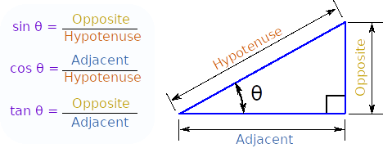
Analog clock – Clock face
Draw the clock face
  Place 12 dots around the center of the screen
Use sinus / cosinus to calculate the placement of the dots
  Note : In Python, the angle is given in radians

Slide 27
Solution
import math
p = 360/12
BADGE.screen.clear()
for i in range(12):
x = 64+int(30*math.cos(math.radians(p*i)))
y = 32+int(30*math.sin(math.radians(p*i)))
BADGE.screen.oled.pixel(x,y,1)
BADGE.screen.oled.show()

Slide 28
Analog clock - Hands
Draw the hands
  Draw a line from the center to a specific point
    self.badge.screen.oled.line(x1,y1, x2, y2, c)
  Calculate the coordinates using sinus/cosinus
Adding the seconds hand is optional

Slide 29
Analog clock - Update
As the app controls the badge, you need to run it in an infinite loop
Draw the clock, then wait for a minute (or a second) to draw the screen again.

Slide 30
Analog clock - Quit
Add a feature to quit the app when the user presses the ENTER button

