Slide 1
主成分分析
Principal Component Analysis(PCA)

Slide 2
Principal Component Analysis
Objective of PCA:
Reduce the dimensions of the Data
revealing the internal structure of the data

Slide 3
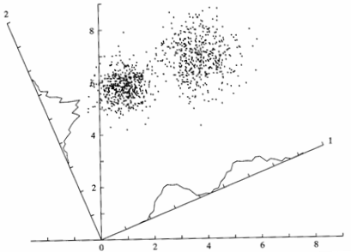
Principal Component Analysis

Slide 4

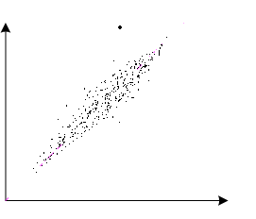
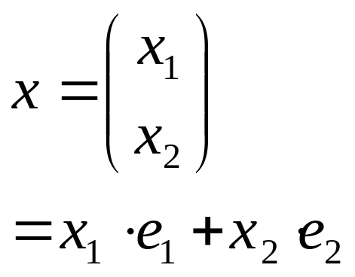

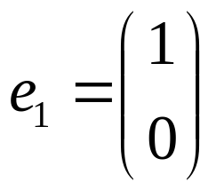
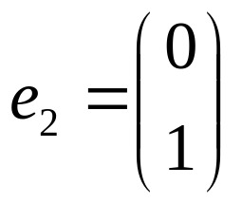
Principal Component Analysis

Slide 5
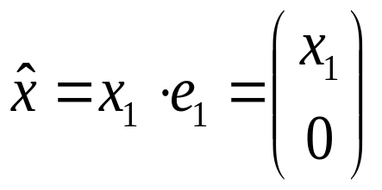
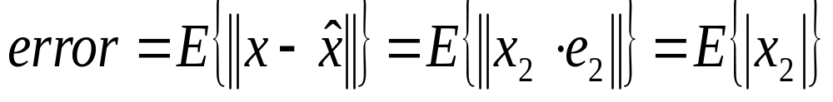
Principal Component Analysis
x

Slide 6
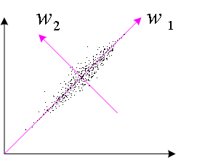
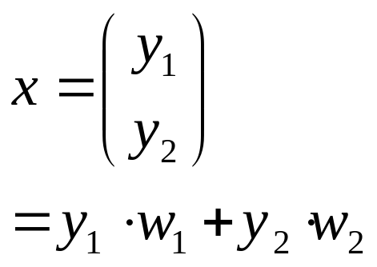


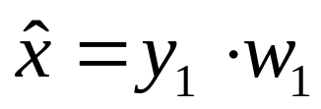
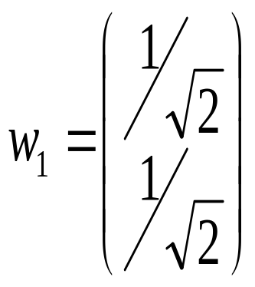
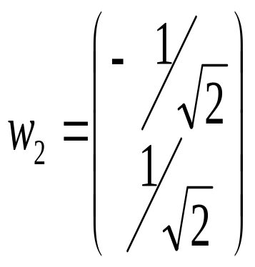
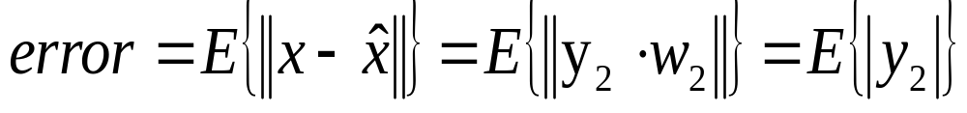
Principal Component Analysis
x

Slide 7
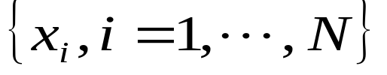
Principal Component Analysis
Data set:
…
Principal Component Analysis is to search the direction w so that the data set along this direction has the largest variation.
w is called Principal Component of the data set.

Slide 8
Minor component
Principal component

Slide 9
e2
w1
w2
e1

Slide 10
Applications
Data compression and coding;
Pattern recognition;
Image processing, etc.

Slide 11
1. Zero Mean
Principal Component Analysis
2. Find Principal Component
3. Neural Networks Approach

Slide 12
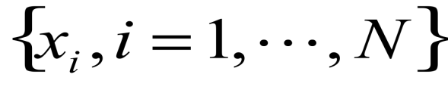



Zero Mean
Data set:
Zero mean:

Slide 13
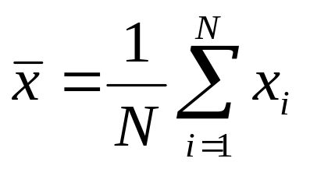
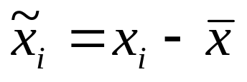
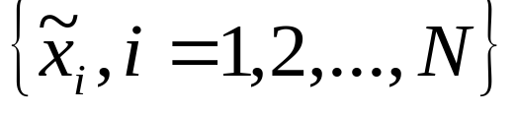
Zero Mean
Data set:

Slide 14
Principal Component Analysis
Principal Component Analysis
Principal component w makes the data set have the largest variation along its direction.
How to find Principal component?

Slide 15

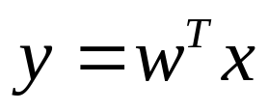
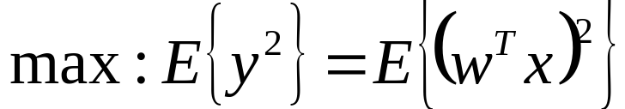
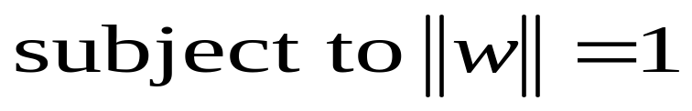
Principal Component Analysis
Data set:
Looking for the direction W so that the data set along this direction has largest variation.

Slide 16
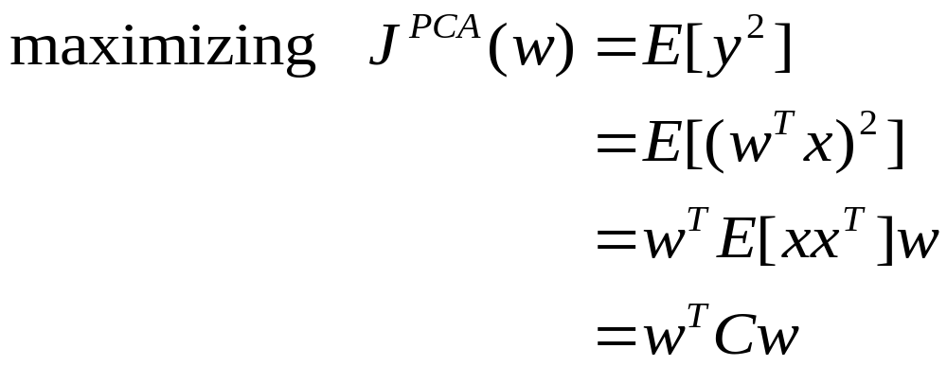
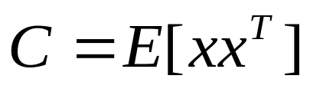
Principal Component Analysis
Looking for the direction W so that the data set along this direction has largest variation.
correlation matrix

Slide 17

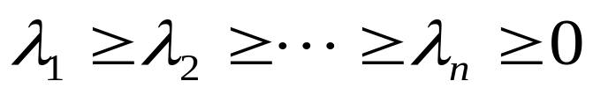
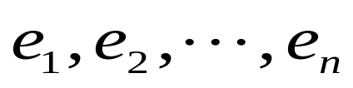
Principal Component Analysis
Correlation Matrix
Properties: (1) Symmetric; (2)Non-negative definite
Eigenvalues:
…
Eigenvectors:
…

Slide 18
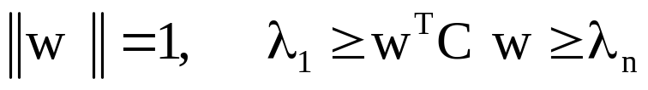


Principal Component Analysis
Conclusion: If
when w=e1,
when w=en,

Slide 19
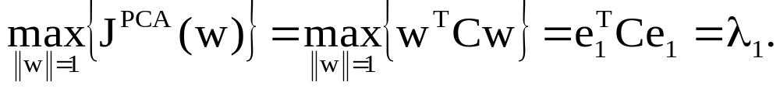
Principal Component Analysis
Then
Data set has the largest variance along the eigenvector e1 associated with
the largest eigenvalue of the correlation matrix.

Slide 20

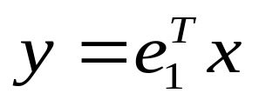
Principal Component Analysis
The PCA solution:
and

Slide 21
Principal Component Analysis
Data set:
…
1.
2. Find the largest eigenvalue
3. Find the corresponding eigenvector

Slide 22
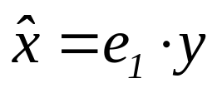
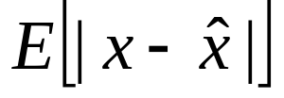
Principal Component Analysis
Reconstruction:
The input data can be reconstructed as much as possible by
a inverse process.
Error:

Slide 23
PCA Methods
The key to implement the PCA is to find the proper vector w(w=e1).
(1). Algebraic Approaches(EVD or SVD)
(2).The neural network methods

Slide 24
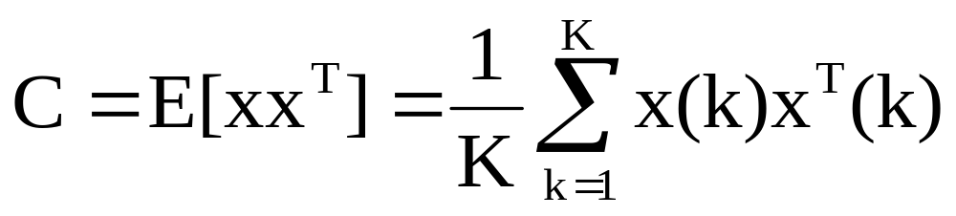
PCA Methods
(1). Algebraic Approaches(EVD or SVD)
1. Compute the correlation matrix
2. Find the largest eigenvalue
3. Find the corresponding eigenvector

Slide 25
PCA Methods
Disadvantages:
Need high Computational Complexity
(2) Unfit for online extraction of principal component

Slide 26
PCA Methods
2.The neural network methods
advantages:
  without computing the correlation matrix C to decrease the computation complexity
  especially useful for online computing

Slide 27
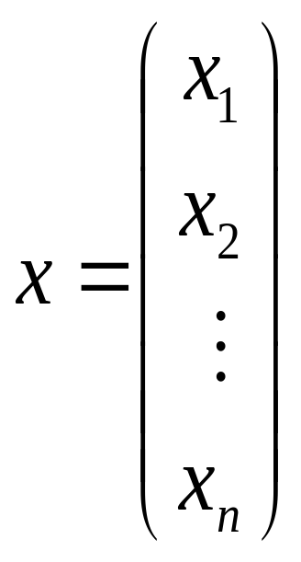

PCA Neural Networks
Neural networks
…
One dimensional data
High dimensional data

Slide 28


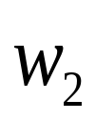



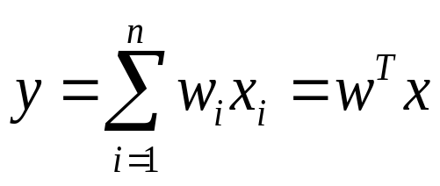
PCA Neural Networks
In 1982, Oja

Slide 29


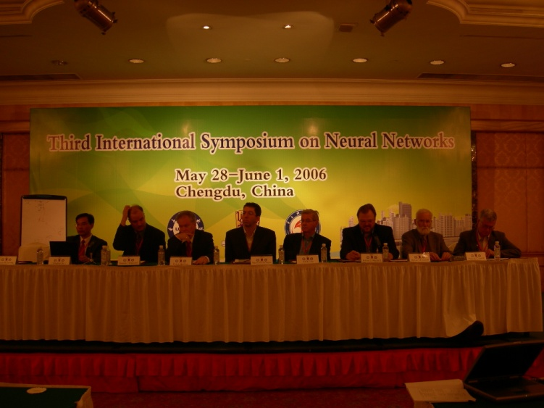
PCA Learning Algorithm - Oja
Oja, Professor, Helkinsy University, Finland
1982, Oja proposed a online PCA learning algorithm

Slide 30








PCA Learning Algorithm
PCA learning algorithm
where

Slide 31

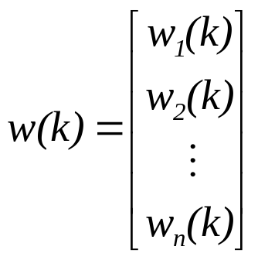
PCA Learning Algorithm
Vector form
where
…

Slide 32

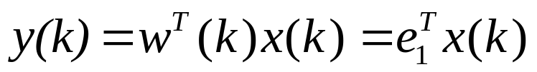

PCA Learning Algorithm
Learning Objective:
After convergence:

Slide 33
Deriving Oja’s PCA Learning Algorithm
Motivation: Hebb learning rules

Slide 34

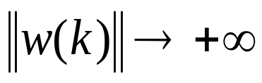
Vector form:
Problem: This learning rule leads to unlimited growth of the connection weights so that the algorithm cannot converge.

Slide 35
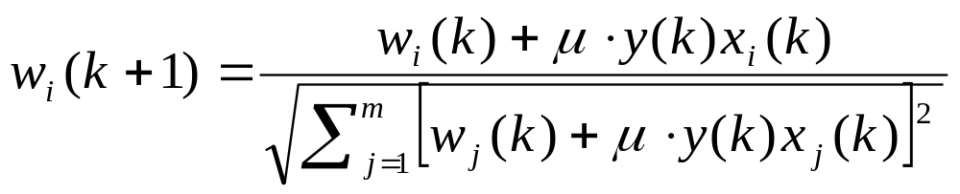
Deriving Oja’s PCA Learning Algorithm
Normalization to control divergence:

Slide 36
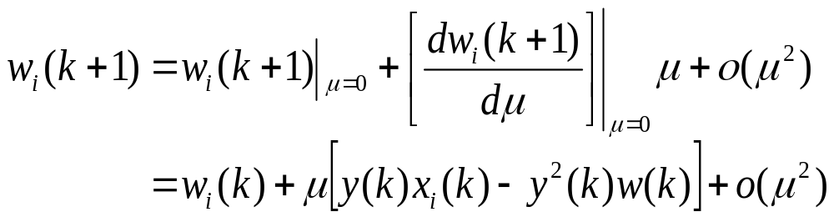
Deriving Oja’s PCA Learning Algorithm
Removing the higher-order term, it gives that

Slide 37
Convergence Analysis
Problem: Can the algorithm converge?

Slide 38
Convergence Analysis
Stochastic Discrete Time Method (SDT)
Problem: Very difficult to analyze the convergence.

Slide 39
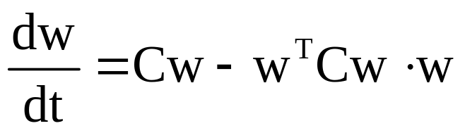
Convergence Analysis
Deterministic Continuous Time (DCT) Method
Stochastic approximation
One of the assumptions is that the learning rate must tend to zero.
However, the learning rate is often constant in practice due to the round-off
limitation and tracking requirements.

Slide 40
Convergence Analysis
Deterministic Discrete Time (DDT) method
Conditional expectation
The DDT method preserves the discrete time nature of the original learning algorithm.

Slide 41
Convergence Analysis
Zhang Yi, M. Ye, J. C. Lv and K. K. Tan
  Convergence Analysis of a Deterministic Discrete
  Time System of Oja’s PCA Learning Algorithm
  IEEE Transactions on Neural Networks
  Vol 6, no. 6, November 2005, pp. 138-1328.

Slide 42
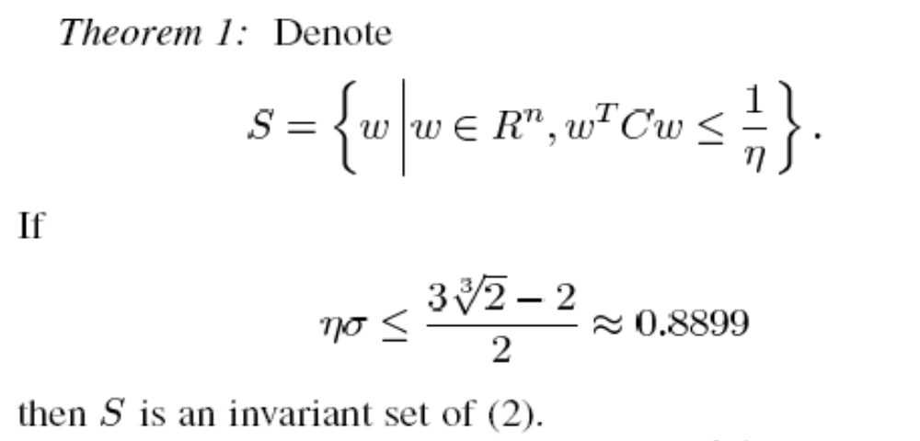
Convergence Analysis

Slide 43
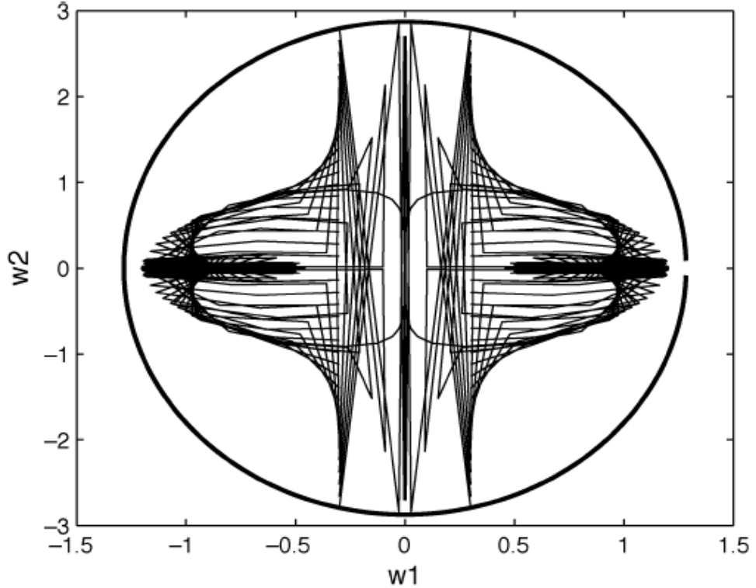
Convergence Analysis

Slide 44
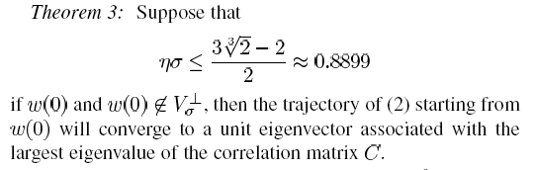
Convergence Analysis

Slide 45
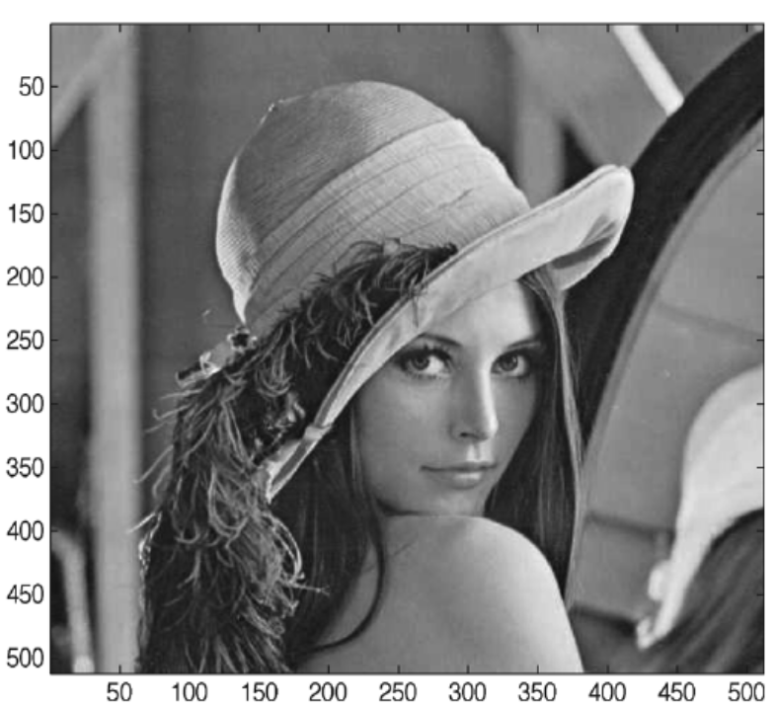
Convergence Analysis
Data Set:

Slide 46

Convergence Analysis
Data Set:

Slide 47
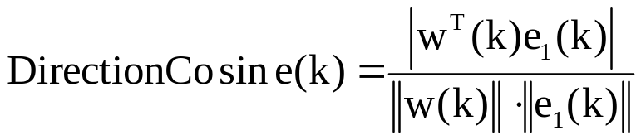
Convergence Analysis
Convergence Index:
1. Norm of the weight vector w
2. Direction cosine of the weight vector w

Slide 48
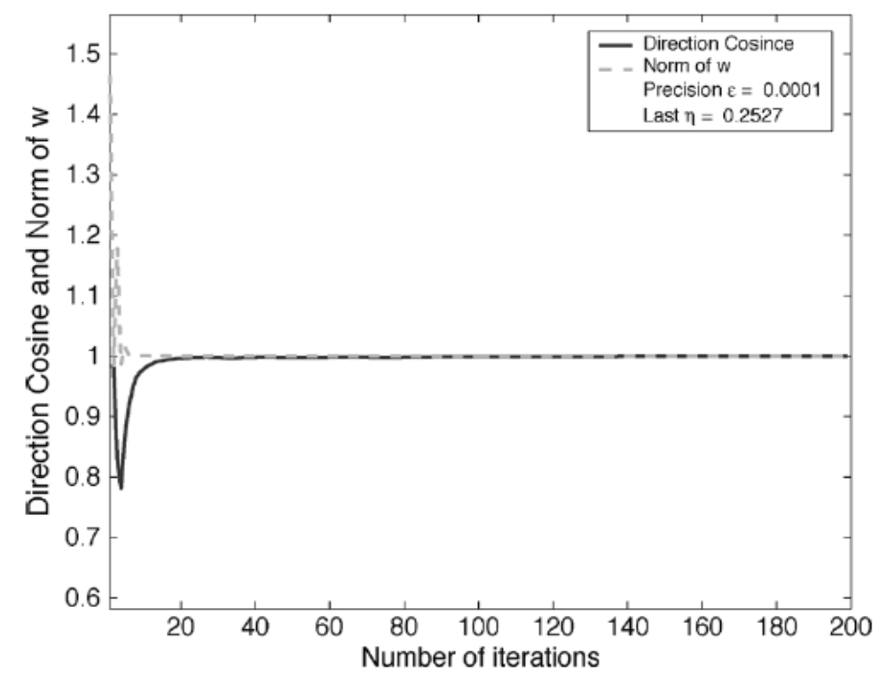


Convergence Analysis

