Slide 1
主成分分析的应用-图像压缩

Slide 2

Application: Image Compression
512 pixels
512 pixels
The original picture is a 512x512 pixel one.

Slide 3
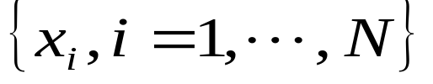

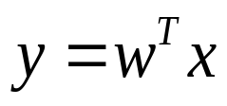

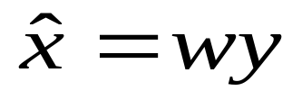

Application: Image Compression
1、Preprocess the data set (n-dimensional data )
…
2、Find the principal component w (Oja’s PCA NN algorithm).
3、Compress the image.
(x: n-dimension data,
y:1-dimension data)
4、Reconstruct the image.
: n-dimensional data
64 pages

Slide 4
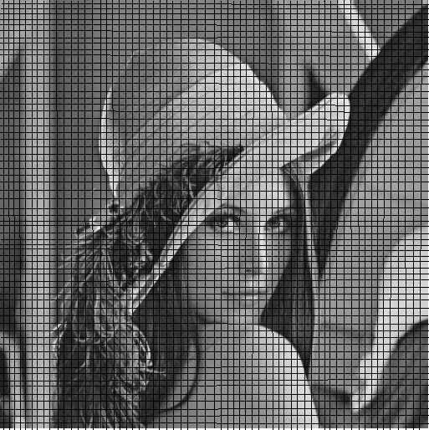
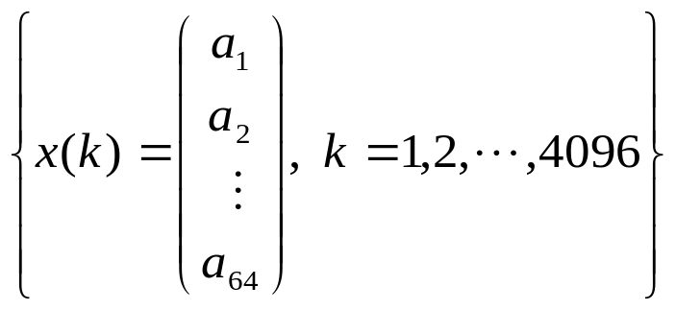
Application : Image Compression
The image is decomposed into
64x64 blocks that do not overlap
each other. Each block contains
8x8 pixels, which is digitized into a
64 dimension column vector.
…
…
The picture is described as 64x64 =4096 vectors with 64-dimension.

Slide 5







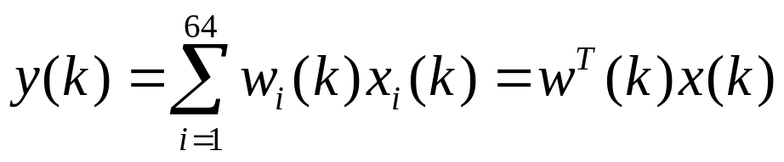
Application : Image Compression
The weight vector w(k) is initialized randomly as w(0). Input data x(k) is randomly selected to train network until w converges to a fixed vector.

Slide 6
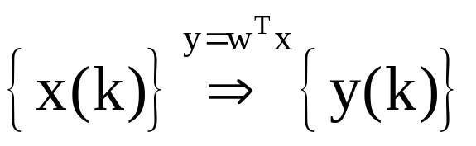

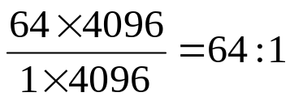
Application : Image Compression
After convergence of the weight vector, the principal component is extracted as the weight vector w of the neuron.
Compress the image:
64-dimensional
vector
1-dimensional
vector
Image Code
Compressed rate:

Slide 7
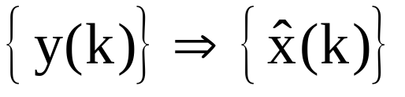
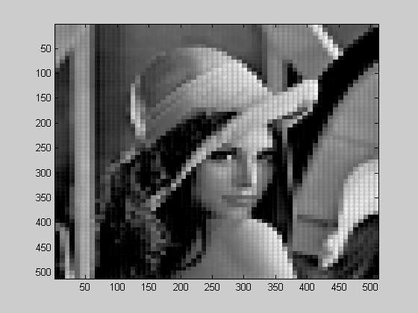

Application : Image Compression
Reconstruction
1-dimensional
vector
Image Code
64-dimensional
vector

Slide 9

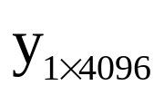
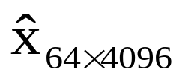


PCA Solution
Compression
Reconstruction
PCA neural networks
extract principal component w
by using Oja’s algorithm
64 pages

Slide 10
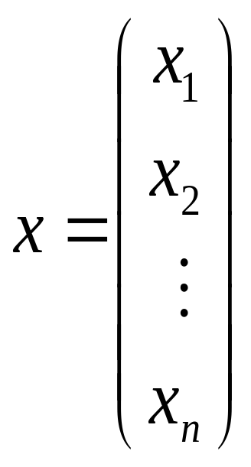

PCA Neural Networks
NN
One dimensional data
High dimensional data
64 pages

Slide 11
Extracting More Principal Components
Extracting More Principal
Components by Using
Neural Networks
64 pages

Slide 12
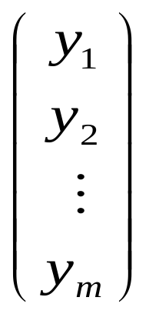

Review of PCA Concept
NN
…
…
High dimensional data
Low dimensional data
64 pages

Slide 13
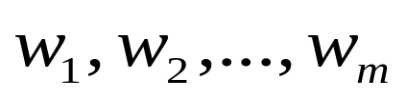
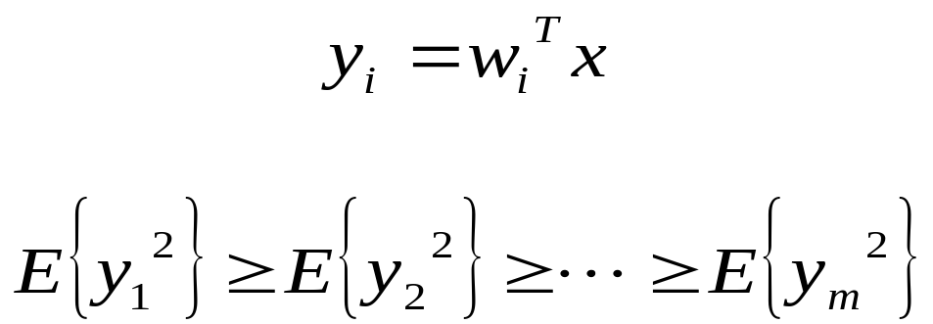
Review of PCA Concept
Search m orthogonal directions
so that the data set along these directions has m largest variations.
…
64 pages

Slide 14
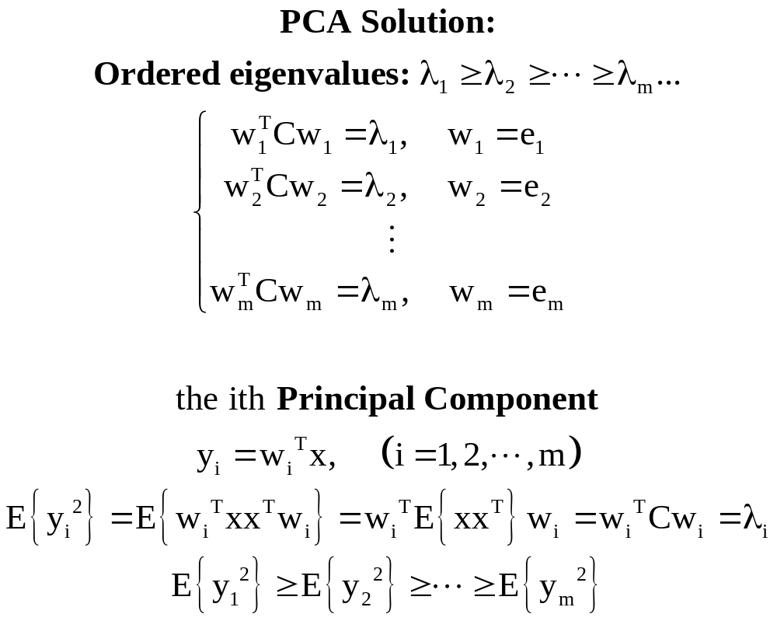

PCA Solution
…
…
…
…

Slide 15


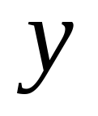


PCA Solution
n-dimension
n-dimension
m-dimension(m<n)
compression
recover
How to search the weight matrix ?
64 pages

Slide 16




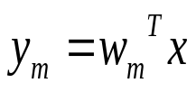

GHA Learning Algorithm
Sanger proposed the Generalized Hebbian Algorithm (GHA)
64 pages

Slide 17




The Case J=2
Learning algorithm of the 1st neuron such that
(Oja Algorithm)
Learning algorithm of the 2nd neuron such that
64 pages

Slide 18

The Case J=2
Learning algorithm of the 1st neuron
Learning algorithm of the 2nd neuron
z(k)
virtual input to the 2nd neuron
64 pages

Slide 19


Learning algorithm of the 1st neuron
(Oja Algorithm)
After convergence of the 1st neuron,
Learning algorithm of the 2nd neuron
(Oja Algorithm)
Question:

Slide 20

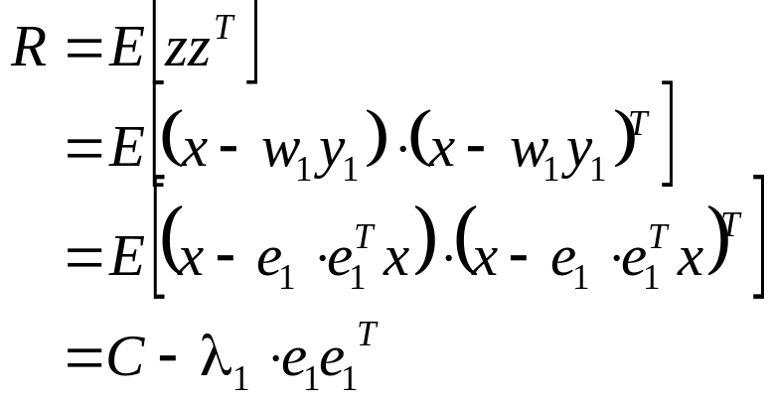

After convergence of the 1st neuron,
where
is correlation matrix of data set.

Slide 21
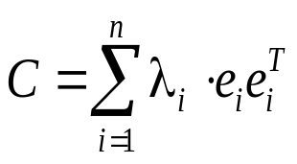
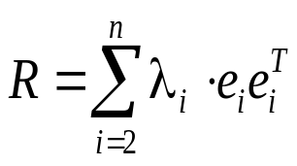




Since
, then
Eigenvectors of the matrix R are:
…
The corresponding eigenvalues are:
…
Conclusion:
the largest eigenvalue of the matrix R is:
Its corresponding eigenvector is:

Slide 22



Learning algorithm of the 2nd neuron
(Oja Algorithm)
will converge to the eigenvector associated with the largest eigevalue of
the correlated matrix
of input data z
Therefore,

Slide 23
Application: Image Compression
64 pages

Slide 24
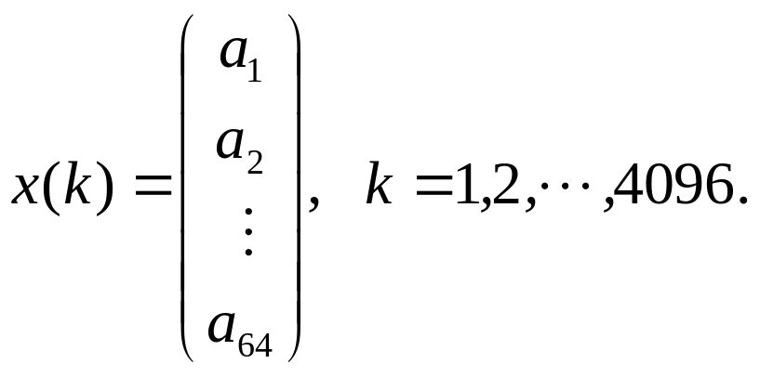
Application: Image Compression
…
…
64 pages

Slide 25




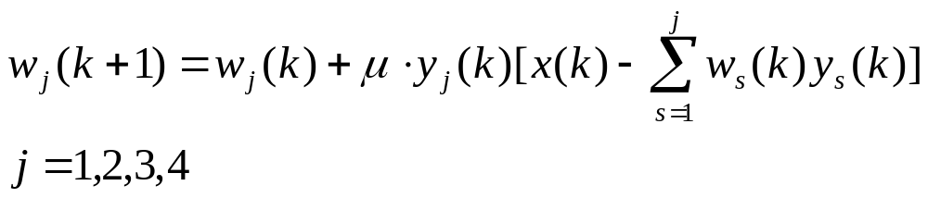
GHA Learning Algorithm
64 pages

Slide 26


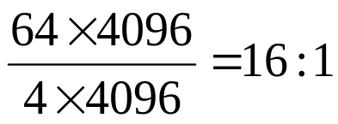
Application: Image Compression
compression
recover
4-dimension
64-dimension
64-dimension
Compressed rate
64 pages

Slide 27
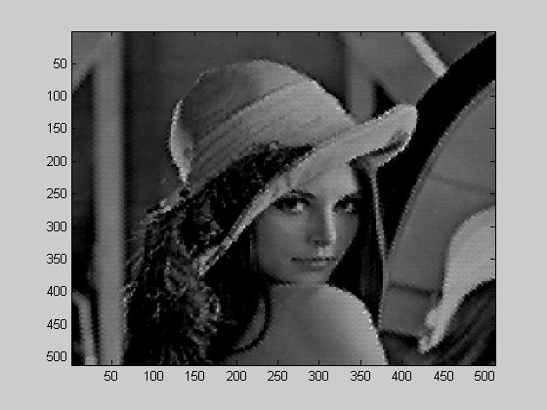
The Reconstructed Result
64 pages

Slide 28
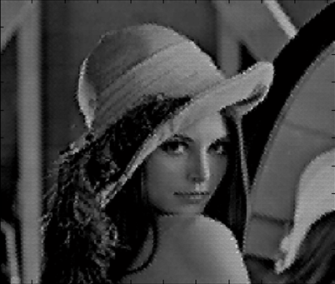
Comparison
Original
Reconstructed
64 pages

