Slide 1
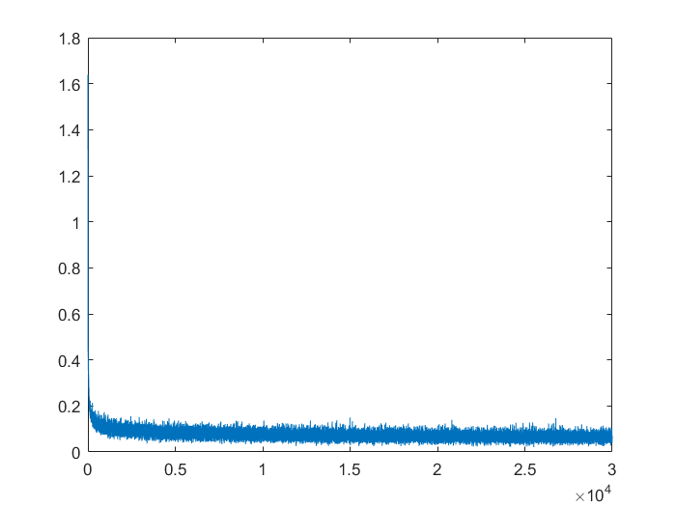
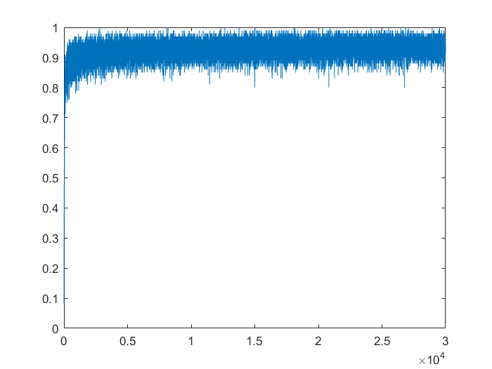
L=2
alpha = 0.005
max_epoch = 300
layer_size = [
784
10];

Slide 2
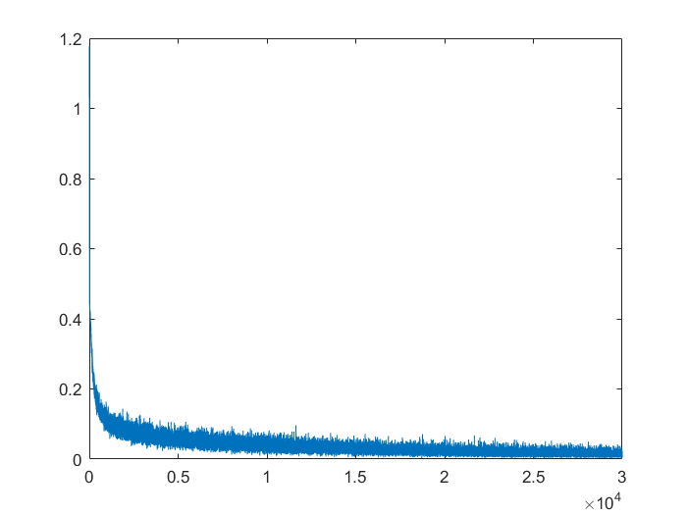
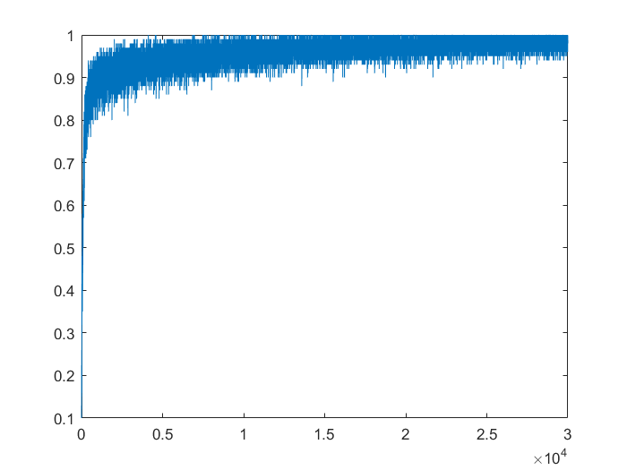
L=3
alpha = 0.005
max_epoch = 300
layer_size = [
784
128
10];

Slide 3
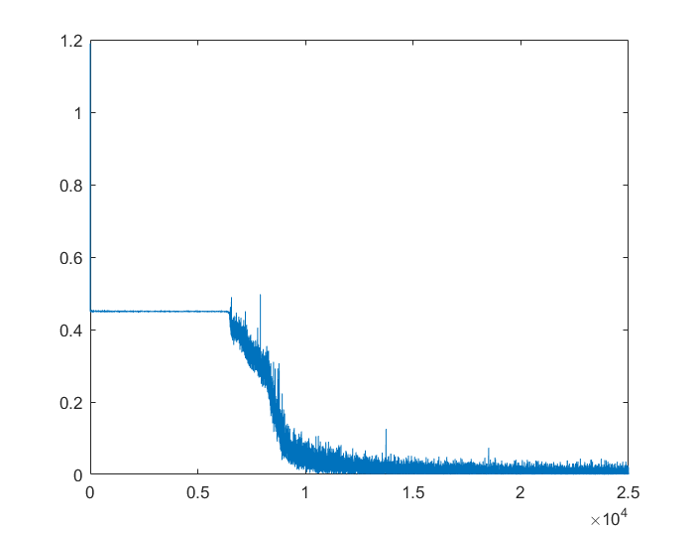
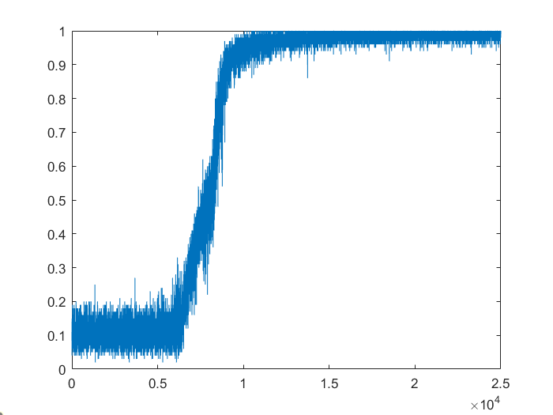
L=8
alpha = 0.05
max_epoch = 250
layer_size = [
784
512
261
128
65
34
18
10];

