Slide 1
Dynamic Modelling

Slide 2
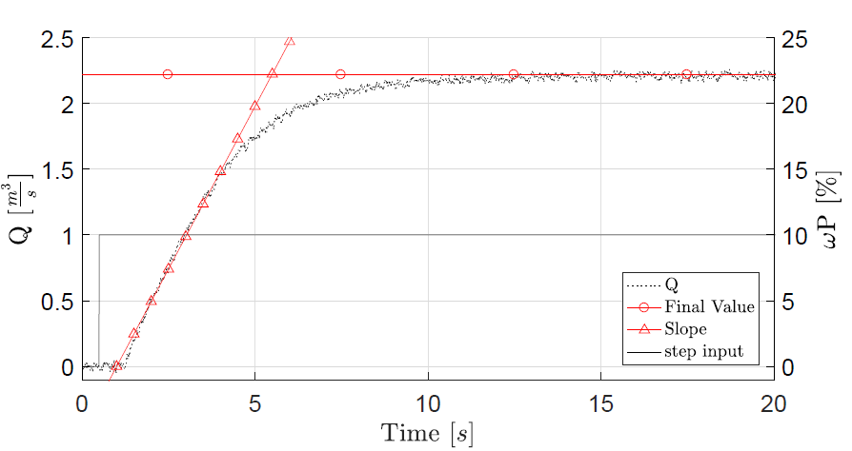
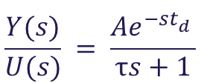
Unit Step Response
Process Reaction Curve
give a unit step input to the system
obtain process reaction curve
determine variables
model the system according to the transfer function
$$\frac{Y(s)}{U(s)} = \frac{Ae^{−st_{d}^{}}}{τs+1}$$
Step Response
Notes:
In order obtain a model for our system, and be able to develop a PID controller,
we have determined the process reaction curve of our system. This has allowed us to
develop a model and test different controllers on it.
The S – shape can be approximated using a first order transfer function, shown in the slides.
All the coefficients can be obtained from the figure.

Slide 3
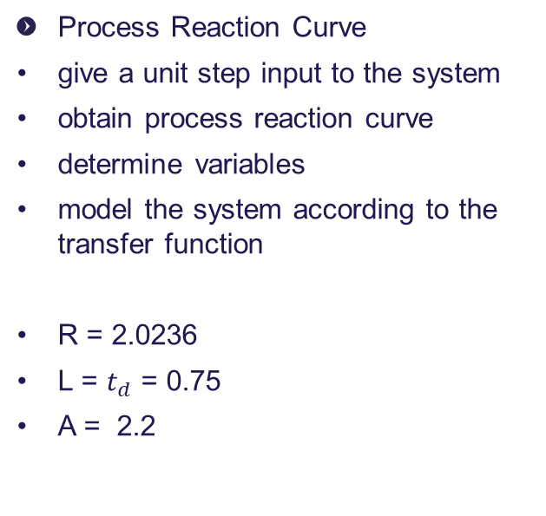
Unit Step Response
Process Reaction Curve
give a unit step input to the system
obtain process reaction curve
determine variables
model the system according to the transfer function
R = 2.0236
L = $t_{d}$ = 0.75
A = 2.2
Step Response
Notes:
After obtaining the values we were able to model the reaction curve, and test different controllers on the models.

Slide 4
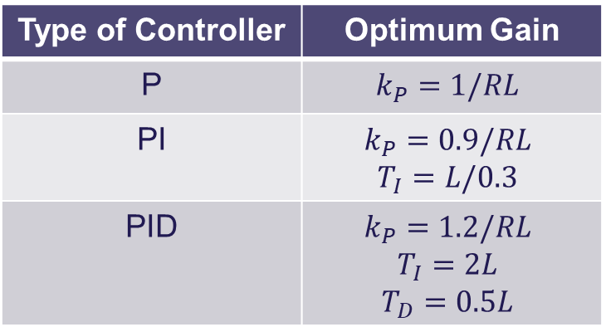
Ziegler-Nichols
Type of Controller | Optimum Gain
P | $$k_{P}=1/RL$$
PI | $$k_{P}=0.9/RL$$ $$T_{I}=L/0.3$$
PID | $$k_{P}=1.2/RL$$ $$T_{I}=2L$$ $$T_{D}=0.5L$$
Step Response
Notes:
We used Ziegler – Nichols tuning method. The coefficients are determined as shown in the table,
according to the type of controller that needs implementing. Results of the controllers on the models
can be seen in the following slides.

Slide 5
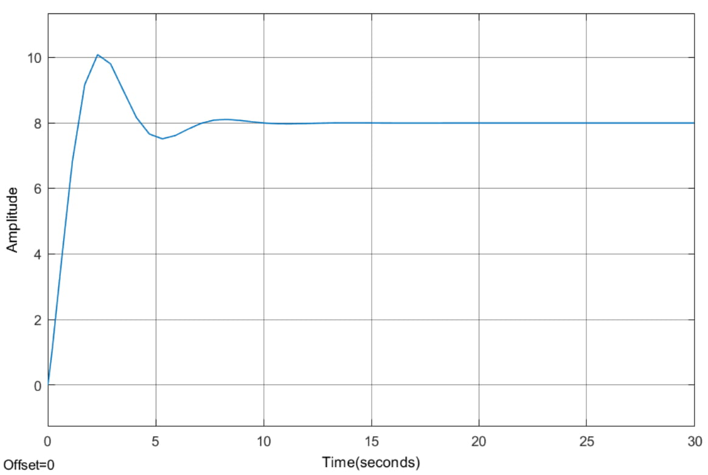
Model Testing – PI Controller
Notes:
The PI controller shows good behavior. With a slight overshoot but stabilizing relatively rapidly.
As noticed the quarter decay ratio seems to work, the second oscillation being approximately a quarter of the first,
With the third disappearing almost completely

Slide 6
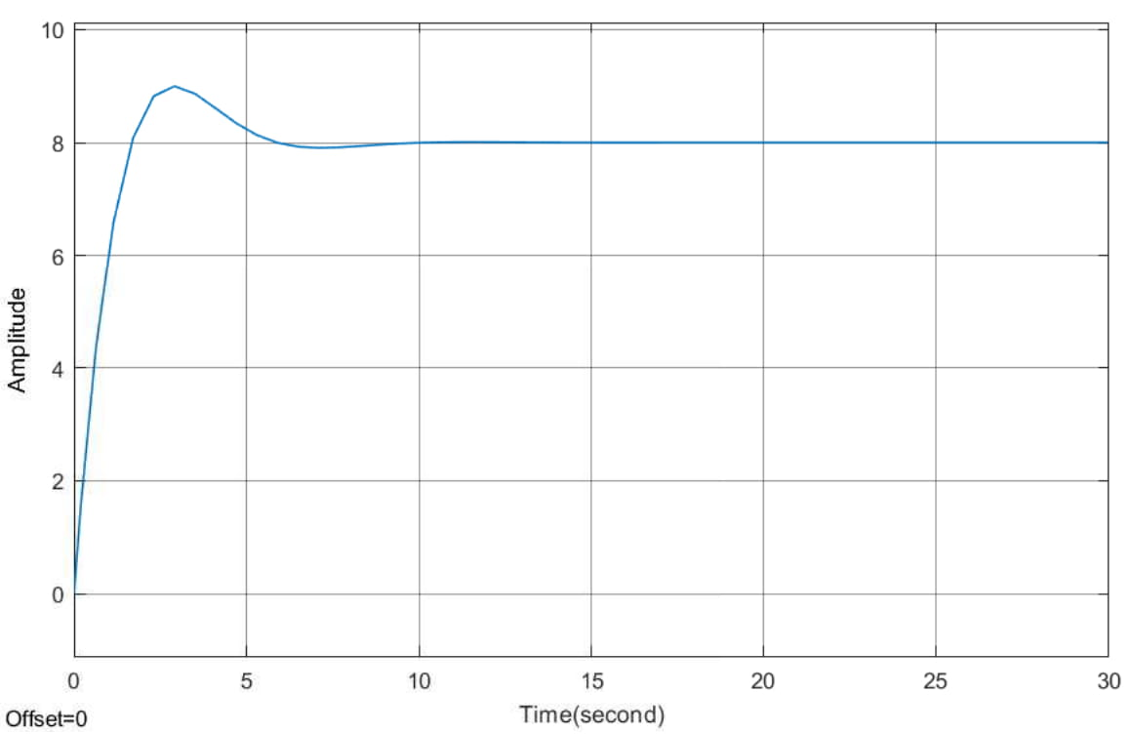
Model Testing – PID Controller
Notes:
The PID controller still presents some overshoot. We expected that to come from the aggressiveness of the controller.
The matter will be further discussed later on.

Slide 7
Controller Design

Slide 8
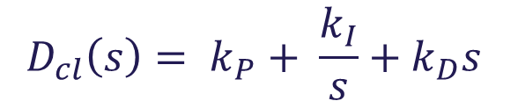
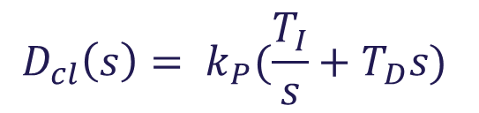
PID Controller
Continuously calculates an error as a difference between a setpoint and a measured variable, and applies a correction based on proportional, integral and derivative terms.
Proportional term produces an output proportional to the current error value
Integral term produces an output proportional to both the magnitude of the error and the duration of the error
Derivative term produces output determined by the slope of the error over time and multiplying this rate of change by the derivative gain
$$D_{cl}\left(s\right)= k_{P}+ \frac{k_{I}}{s}+k_{D}s$$
$$D_{cl}\left(s\right)= k_{P}(\frac{T_{I}}{s}+T_{D}s)$$
Notes:
A PID consists of a proportional, integral and derivative part.
The gains have to be tuned according to the dynamics of the plant, and the desired characteristics of the controller.
Manually or using certain tuning methods.
Used Ziegler – Nichols. Quarter Decay or Ultimate Sensitivity.
Standard and Ideal PID equations. Ideal PID more used in the industry.

Slide 9
Ziegler-Nichols
Quarter Decay Ratio
Requires Stable System
Unit Step Response
Open Loop Tuning Method
Step Response
Notes:
As stated we implemented the tuning method in practice and we got the following results.

Slide 10
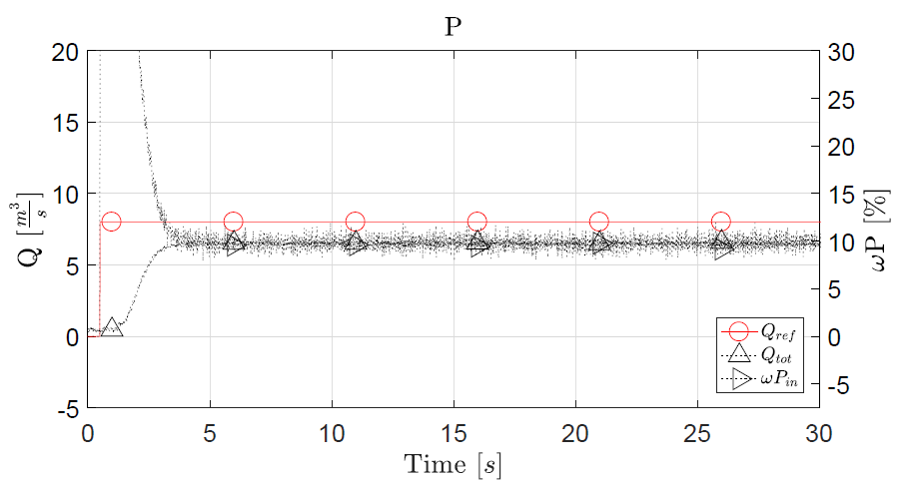
Results-P Controller
Notes:
The P-controller with the calculated value did not achieve any results,
as the error was too small to start the pump. To overcome this issue,
we multiplied kP with 10. This was solely done for the P-controller,
because the PI- and PID-controller gave proper results without this correction.
We expect this to be caused by the scaling factor before the input to the pumps.
However, it presents a high steady-state error. This being merely a P-controller,
further improvement is possible.

Slide 11
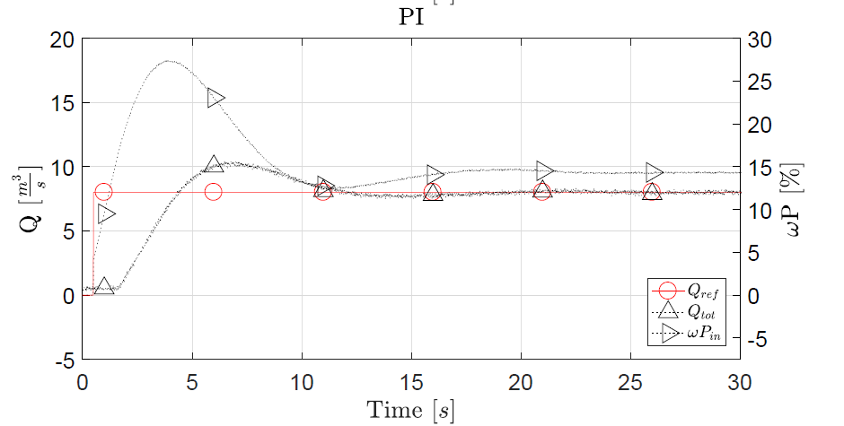
Results-PI Controller
Notes:
The PI-controller does not have a steady-state error, but the overshoot of approximately 25% doesn’t
fulfil our requirements either. The quarter decay ratio tuning method holds in practice as well as it does in theory.

Slide 12
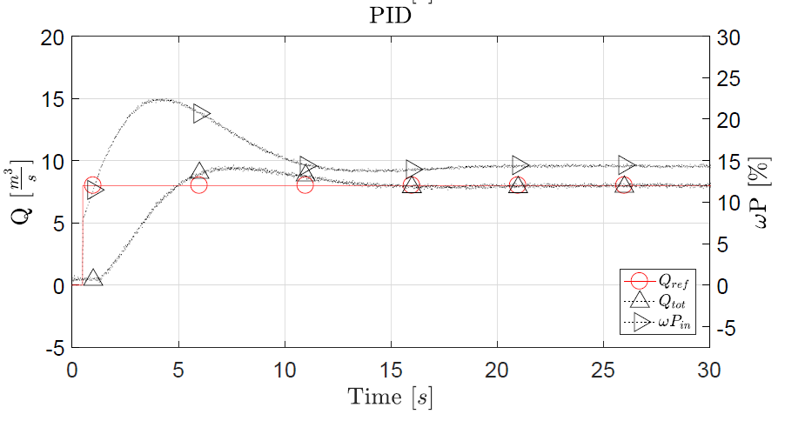
Results-PID Controller
Notes:
Interestingly, the PID-controller also has an overshoot above our limits,
which we expect to be caused by the ZN tuning. In the next step we tried
manually tuning the kD coefficient, to get an overshoot inside
our requirements.

Slide 13
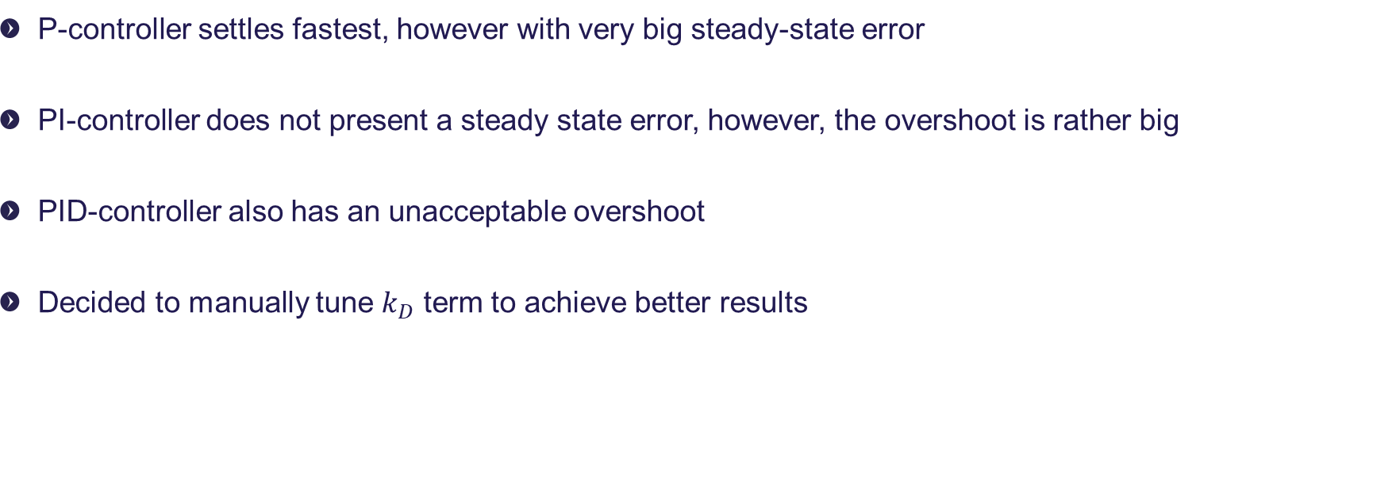
Observations
P-controller settles fastest, however with very big steady-state error
PI-controller does not present a steady state error, however, the overshoot is rather big
PID-controller also has an unacceptable overshoot
Decided to manually tune $k_{D}$ term to achieve better results

Slide 14
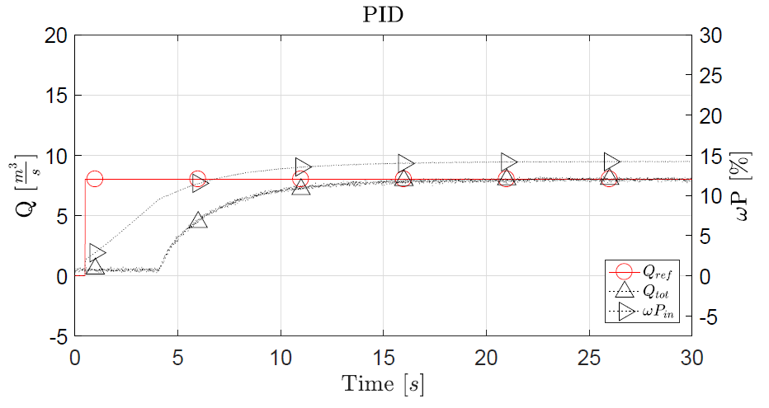
Results-Manually Tuned PID Controller
Notes:
It reacts almost 4 seconds later, than the reference point is given

Slide 15
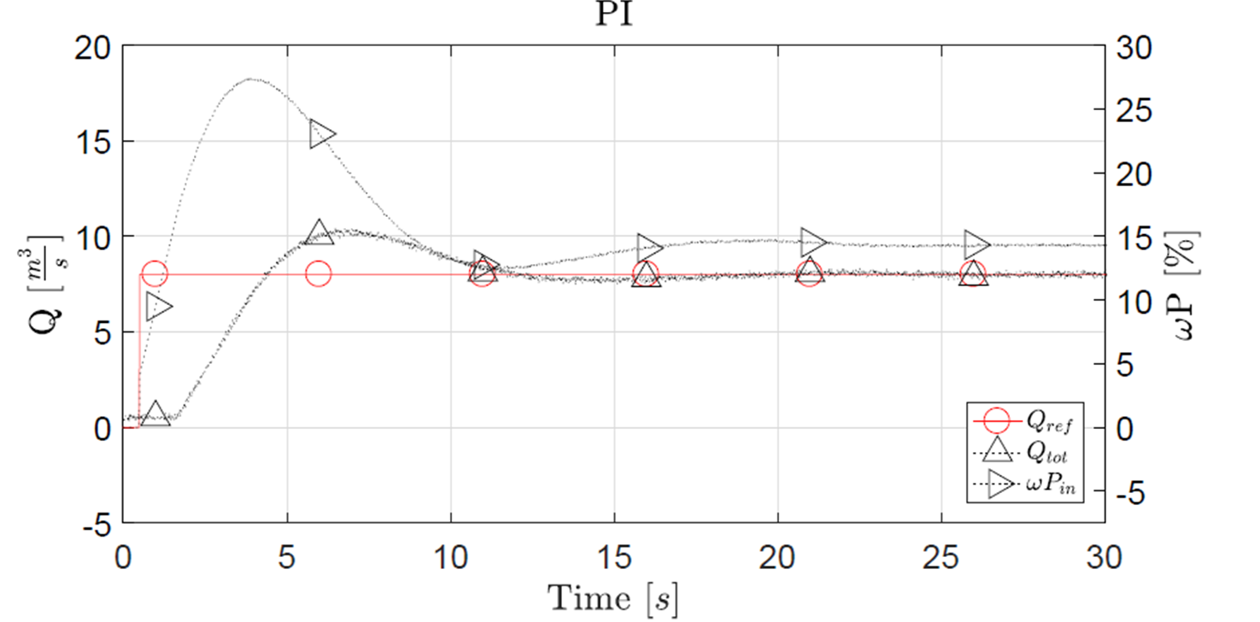

Comparison – PI Controller

Slide 16
Comparison – PID Controller

