Slide 1

CHESS / SOCIAL NETWORK ANALYSIS
Can an opening
spread between
players?
Evidence from Lichess games and a live analysis demo
Chess Openings as Contagion
Notes:
Opening: We tested whether seeing an opening from an opponent predicts later use of that opening. Names and registration details can be added to this cover before submission.

Slide 2

02 / 13
The question starts at the board
You face the Sicilian today. Do you play it yourself later?
One opponent may be enough. Or the opening may need to appear through several different opponents before you adopt it.
Notes:
Define simple contagion as one exposure potentially being enough. Complex contagion predicts reinforcement from multiple structurally distinct opponents. We only observe game records, so we speak about association rather than proof of influence.

Slide 3
03 / 13
What went into the analysis
249,505
6,881
40
filtered games
players
ECO opening codes
SELECTION RULES
FULL STUDY + LIVE DEMO
Rated games, 1800–2200 Elo, eligible speeds, common ECO codes, and players with enough activity to study.
The findings use all 249,505 filtered games. The classroom demo recomputes a fixed 60,000-game sample from the same slice.
Source: Lichess January 2016 archive, filtered project slice
Notes:
The sample is observational. The archive was filtered according to project configuration; do not call it representative of all Lichess chess or all players. The bundled classroom sample is for live recomputation only.

Slide 4
04 / 13
How an exposure becomes a trial
We follow a specific behaviour: an opening played with the same colour.
01
Encounter
An opponent plays that opening against the player.
02
Follow-up
We observe the player’s next 14 days of games.
03
Outcome
Adoption means the player later plays that opening and colour.
Reported rates include only trials with a complete 14-day observation window.
Notes:
The unit is an exposure trial with full 14-day follow-up. Playing a colour matters: an opening played as White and Black are distinct behaviours. One later adoption can contribute to more than one earlier trial row.

Slide 5
05 / 13
From games to a testable curve
01
02
03
04
Games
Trials
Network
Checks
Read PGN moves, player IDs and timestamps.
Build exposure and 14-day adoption windows.
Link opponents and detect communities.
Compare shuffled time and matched peers.
OUTPUT
Observed curve • shuffled reference • matched comparison • held-out prediction
Notes:
In the working UI, these stages update one after another. For a smooth live demo, run the bundled real-game sample. It executes the same analysis modules used for the full result.

Slide 6
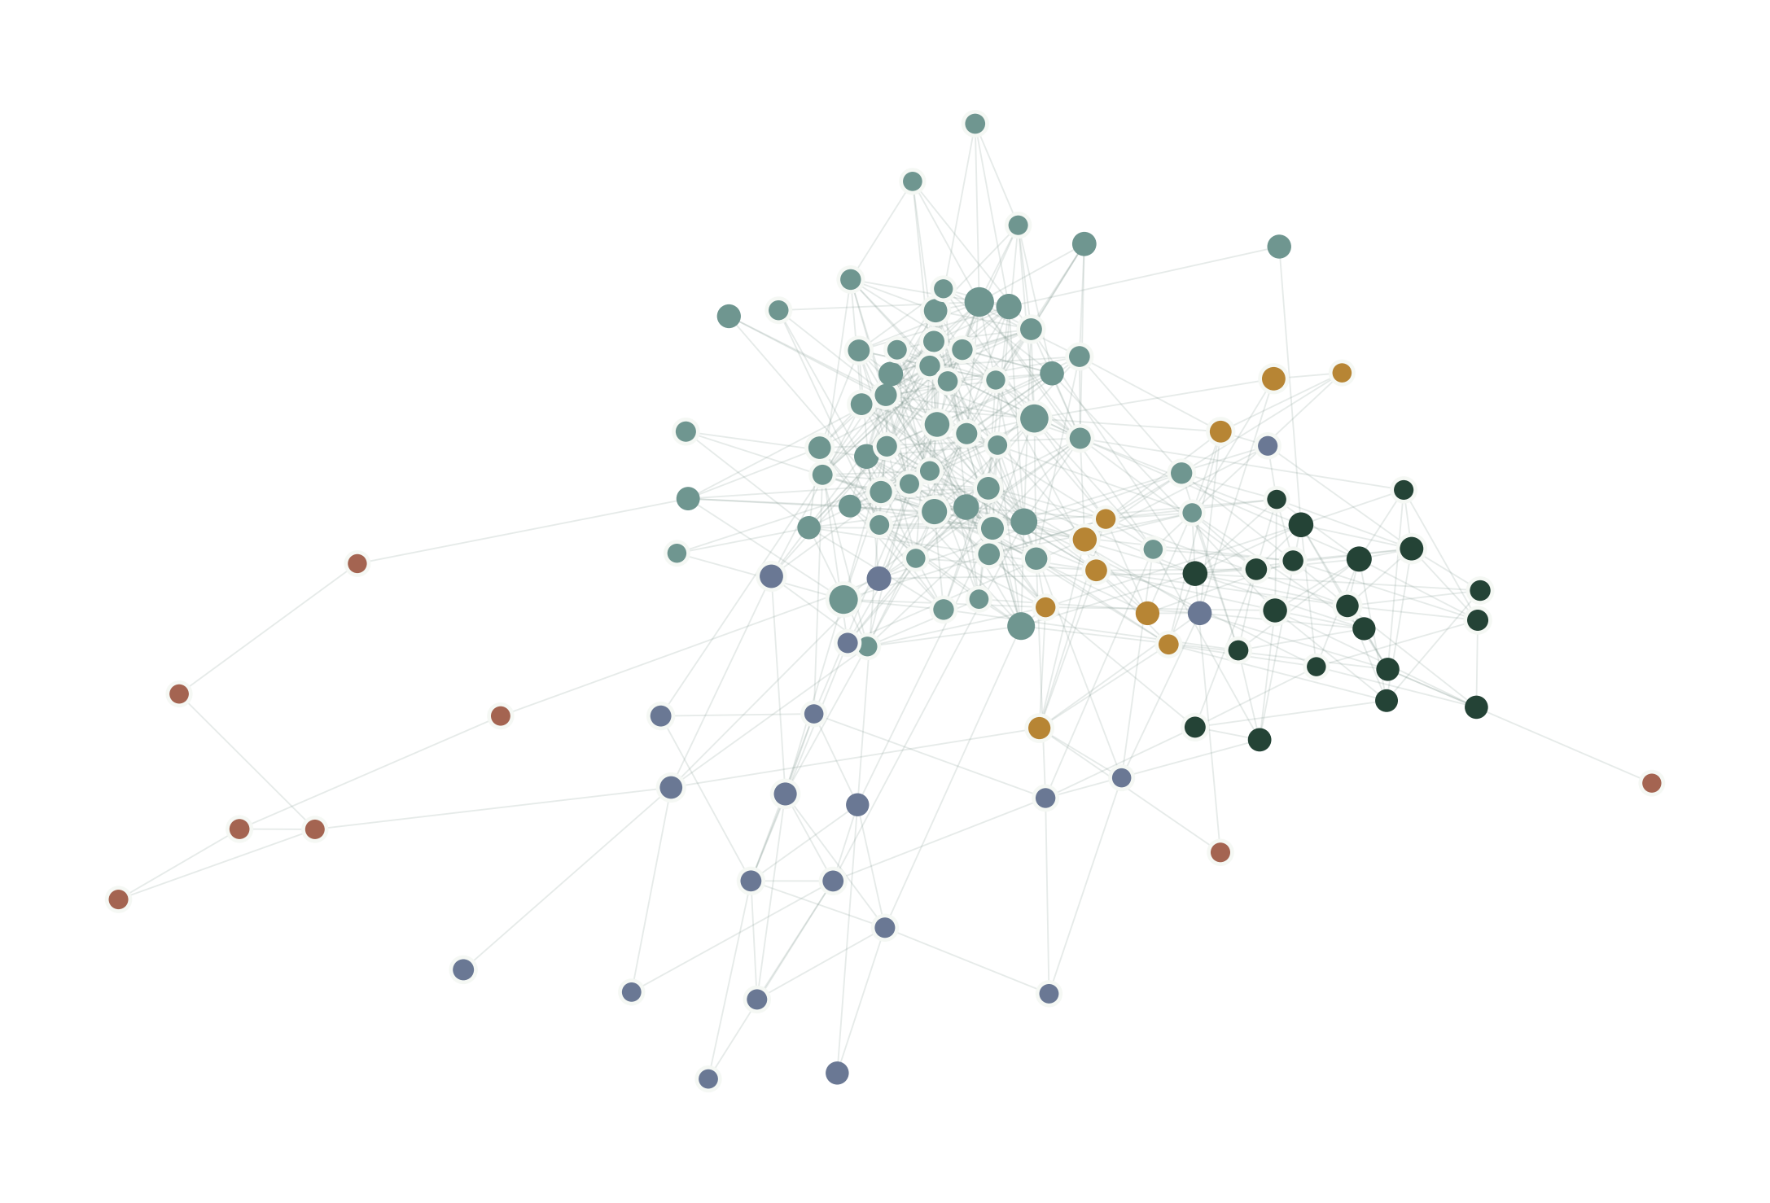
06 / 13
The player network is large and connected
173,944
distinct opponent links
5
detected communities
72%
of recorded pre-adoption exposures stayed within a community
High-degree player preview; node colour shows community and lines show games.
Source: results/report.json, January 2016 full slice
Notes:
The network includes 6,881 nodes and one connected component. The communities come from the project’s network analysis. A within-community exposure share is descriptive and does not establish transmission.

Slide 7
07 / 13
The raw rate rises at higher exposure counts
Raw adoption reaches 16.0% after six or more distinct opponents.
But the shuffled reference reaches 16.7% at the same point.
Source: results/tables/null_comparison.csv; complete 14-day trials
Notes:
Explain why the reference matters. Popular openings and active players create more exposure and adoption even without reinforcement. The raw curve alone could suggest complex contagion; comparison with shuffled time changes the interpretation.

Slide 8
08 / 13
The reference changes the interpretation
Distinct opponents | 1 | 2 | 3 | 4 | 5 | 6+
Observed / shuffled | 1.084 | 1.038 | 1.019 | 1.017 | 1.003 | 0.959
1.084
0.959
The excess over shuffled time falls as distinct opponents increase. We see a simple-contagion pattern without clear reinforcement.
first opponent
six or more
Source: results/tables/null_comparison.csv, 20 timestamp shuffles
Notes:
The ratio is observed adoption rate divided by shuffled reference rate. It declines across exposure counts. Twenty shuffles estimate a reference mean but are insufficient for a precise permutation tail probability. Avoid claiming causal diffusion.

Slide 9
09 / 13
Matched players provide another check
+2.55
percentage points
56,459 matched pairs. Descriptive player-cluster interval: +1.82 to +3.13 points.
Source: docs/RESULTS.md, matched controls with prior rating and activity
Notes:
Controls had not yet played or seen that opening at matching time. Rating and activity were calculated from earlier games. 16.16% of controls were exposed later. The comparison remains observational and susceptible to confounding.

Slide 10
10 / 13
Network information improves prediction
Exposure and network features help rank later adoption in held-out player–opening groups.
Prediction is useful evidence of signal, not proof of influence.
Source: docs/RESULTS.md, group-held-out test set
Notes:
Baseline uses popularity, rating, and activity. The test set contains 50,929 trials, with entire player-opening-colour spells held out together. Training AUC is materially higher, so acknowledge overfitting.

Slide 11
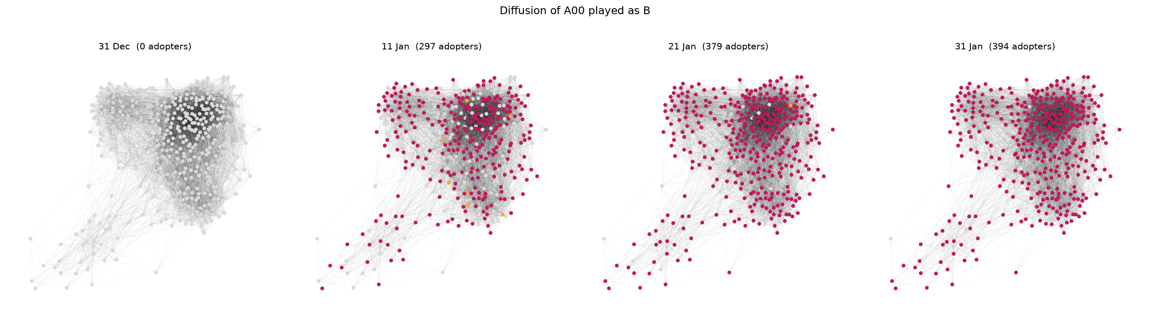
11 / 13
What the project lets us inspect
The findings page shows the curve, sample sizes and opening-level filters.
The console adds a playable board, live stage updates and a network view as the pipeline runs.
Notes:
Switching from this slide to the browser makes the project tangible. In the console, the board has server-validated moves and looks up opening evidence in the selected run. The findings page presents the full study.

Slide 12
12 / 13
Live demo: start a fresh analysis
01
OPEN
02
CHOOSE
Start the local server; open 127.0.0.1:8124.
Select “January 2016 quick live demo”.
03
RUN
04
EXPLORE
Click Run analysis and watch each stage complete.
Play moves on the board, then open Findings.
The 60,000-game sample runs fresh on real games; its one-shuffle verdict is exploratory.
Notes:
Before presentation, launch the local server and leave it on the console page. When this slide appears, Alt-Tab to the browser, select the quick demo, and click Run analysis. This is a fresh computation on real sampled games, not a playback. Wait for the verdict, then use the board and Findings page. If it takes longer on the classroom laptop, narrate each stage.

Slide 13
13 / 13
What we can conclude
OBSERVED PATTERN
IMPORTANT LIMIT
One exposure shows a small excess over shuffled time. More distinct opponents bring no clear added reinforcement.
Opponents and openings are selected by players. These observational data show association, not causation.
NEXT TEST
Repeat the pipeline on a second archive month and compare the same exposure curve and checks.
Notes:
Close with the distinction between the full January analysis and the quick classroom run. A second archive month is planned but currently blocked by certificate verification on the local connection. Student details should be added to the cover.

