Slide 1
CS x476 Project 5
Bipin Koirala
bkoirala3@gatech.edu
bkoirala3
9037.15.285
Section - 6476

Slide 2
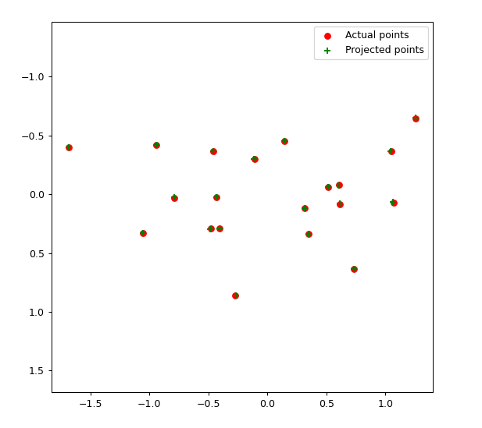
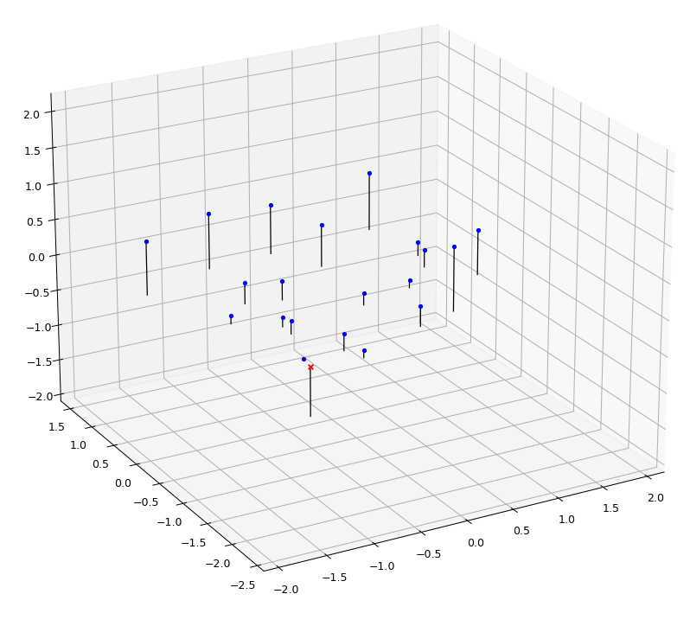
Part 1: Projection matrix
[insert visualization of projected 3D points and actual 2D points for the CCB image we provided here]
[insert visualization of camera center for the CCB image here]

Slide 3
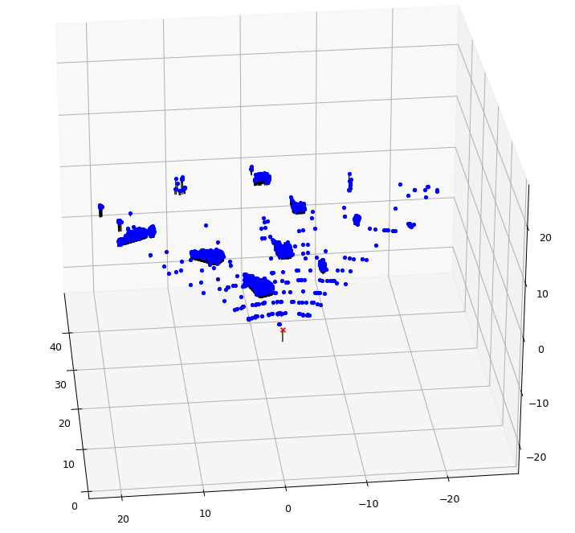
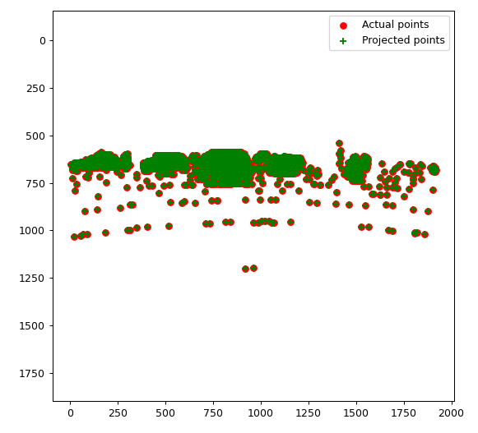
Part 1: Projection matrix
[insert visualization of projected 3D points and actual 2D points for the Argoverse image we provided here]
[insert visualization of camera center for the Argoverse image here]

Slide 4
Part 1: Projection matrix
[What two quantities does the camera matrix relate?]
Camera matrix relates 3D world coordinates to 2D image coordinates through linear transformation.
[What quantities can the camera matrix be decomposed into?]
The camera matrix can be decomposed into twi quantities i.e. intrinsic and extrinsic paramters.
[List any 3 factors that affect the camera projection matrix.]
Following three factors affect the camera projection matrix.
Camera (projection) center
Camera orientation
3D rotation

Slide 5
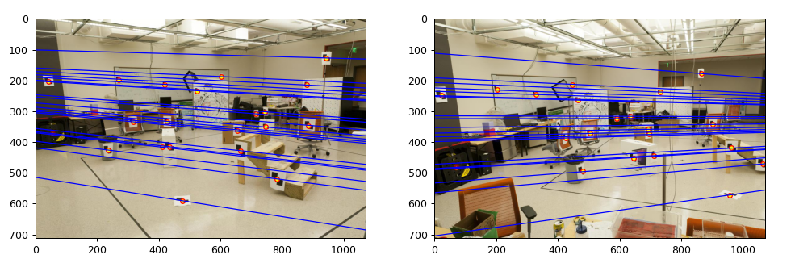
Part 2: Fundamental matrix
[insert visualization of epipolar lines on the CCB image pair]

Slide 6
Part 2: Fundamental matrix
[Why is it that points in one image are projected by the fundamental matrix onto epipolar lines in the other image?]
Given a set of two images, the point on the first image might exist in the second image as well. These points line on the epipolar lines i.e. it is the straight line of intersection of epipolar plane with the image plane. Thus there exists a linear function that provides a mapping between the points in one image to its epipolar line in the second image.
[How many minimum points do we need to estimate the Fundamental matrix. Explain?]
We need a minimum of 8 points to estimate the Fundamental matrix. Given a pair of corresponding points between two images, we get one equation per point pair which contributes to one constraint (row). To maintain the consistentency in solving the linear set of equations we need eight image point pairs.

Slide 7
Part 2: Fundamental matrix
[What does it mean when your epipolar lines are all horizontal across the two images?]
When epipolar lines are all horizontal across the two images it means that the image planes are parallel with respect to each other and have the same camera center, same focal length and orientation.
[Why is the fundamental matrix defined up to a scale?] (Hint: you can reason using the equation for F)
We have, i^{T}₁*F*i₂ = 0 where F maps i to i’. In this equation, any solution to F spans the solution set i.e., if we have a solution, it can be multiplied by a scalar which also is a solution. Therefore, F is defined up to a scale.
[Why is the fundamental matrix rank 2?]
Fundamental matrix must be singular i.e, it should have 0 determinant and has rank 2 because it is essential for the matrix to have a left and right nullspace (epipoles). And these nullspaces are not just the zero vectors.

Slide 8
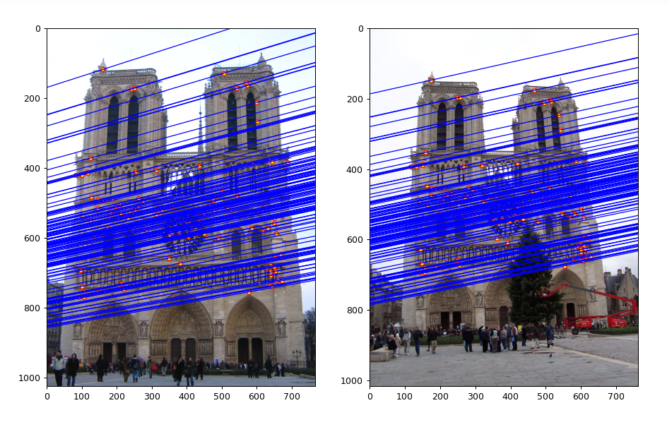
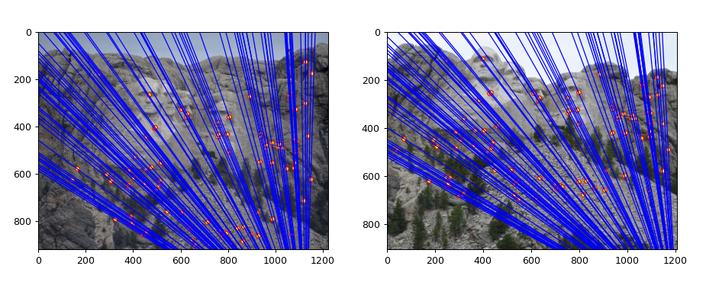
Part 4a: Visualize Fundamental Matrices (EC for 4476, required for 6476)
[insert visualization of epipolar lines for Notre Dame]
[insert visualization of epipolar lines for Mount Rushmore]

Slide 9
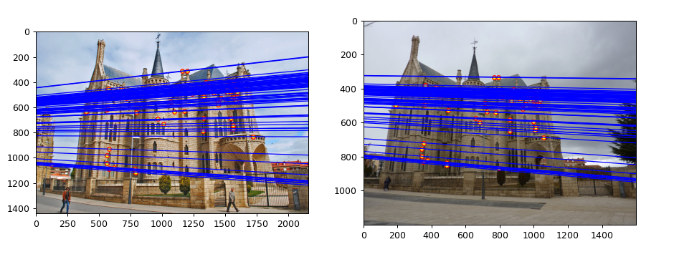
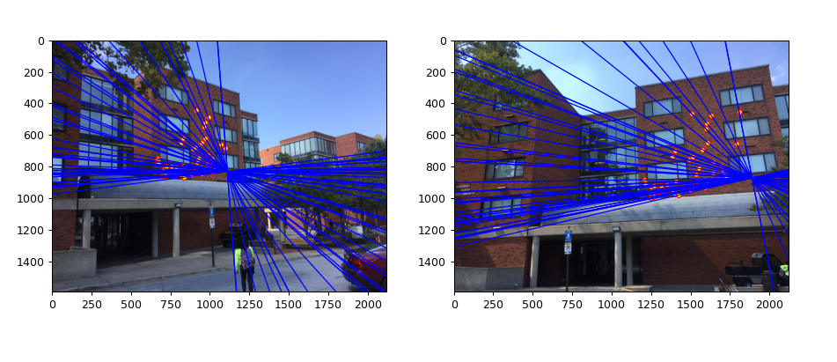
Part 4a: Visualize Fundamental Matrices (EC for 4476, required for 6476)
[insert visualization of epipolar lines for Gaudi]
[insert visualization of epipolar lines for Woodruff]

Slide 10
Part 4a: Visualize Fundamental Matrices (EC for 4476, required for 6476)
[Explain any one difference you noticed in the feature detection/matching for these 4 pair of images]
For each point in one image, its corresponding point in another image can be found by looking along its respective epipole line.
Unlike any other image pair, Woodruf image pair planes are aligned in a way that their optical axes are parallel and the epipolar lines appear to converge at the same point.

Slide 11
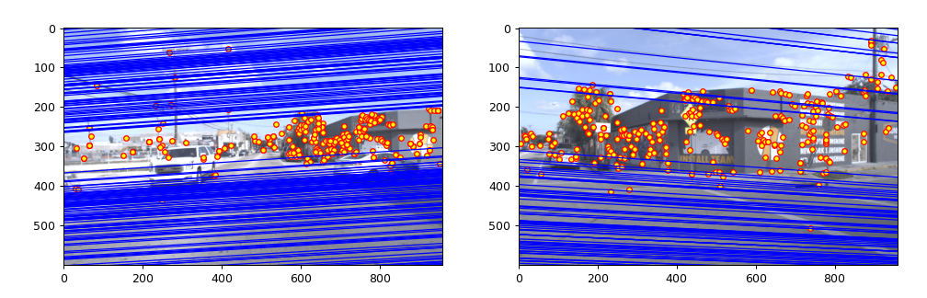
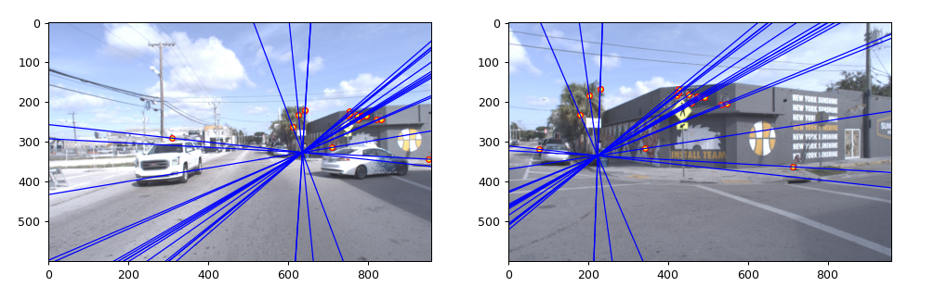
Part 4b: Performance comparison (EC for 4476, required for 6476)
[insert visualization of epipolar lines on the Argoverse image pair using the linear method]
[insert visualization of epipolar lines on the Argoverse image pair using RANSAC]

Slide 12
Part 4b: Performance comparison (EC for 4476, required for 6476)
[Describe the different performance of the two methods.]
When RANSAC is not used in determining corresponding point, there are a lot of parallel lines that do not meet or show epipoles correctly and do not converge at a point. However, with RANSAC implementation, the result looks better, and we can see epipoles that converge at a point in corresponding images.
[Why do these differences appear?]
RANSAC is less susciptible to outliers. When using all the points in images to compute the fundamental matrix, RANSAC does a better job in estimating it.
[Which one should be more robust in real applications? Why?]
As seen from the result in previous slide, RANSAC alogrithm is more robust in determining the fundamental matrix. It is because RANSAC uses random sample to predict fundamental matrix and then discards outliers to better estimate the fundamental matrix with the increase in iteration step. With each iteration RANSAC looks for the greatest number of inliers.

Slide 13
Part 5: Visual odometry
[How can we use our code from part 2 and part 3 to determine the “ego-motion” of a camera attached to a robot (i.e., motion of the robot)?]
From part 2 and part 3 we get fundamental matrix of between two images using RANSAC algorithm. This is followed by getting the essential matrix to recover the camera rotation and translation between two frames. Ego-motion can then be obtained through the rotation between two successive world frames. i.e.
Ego-motion = (Fundamental matrix + essential matrix ) -> recover rotation and translation
[How many outputs (poses) does the get_visual_odometry function return?]
19 poses
[How many outputs (poses) does the compute_absolute_poses function return?]
19 poses

Slide 14
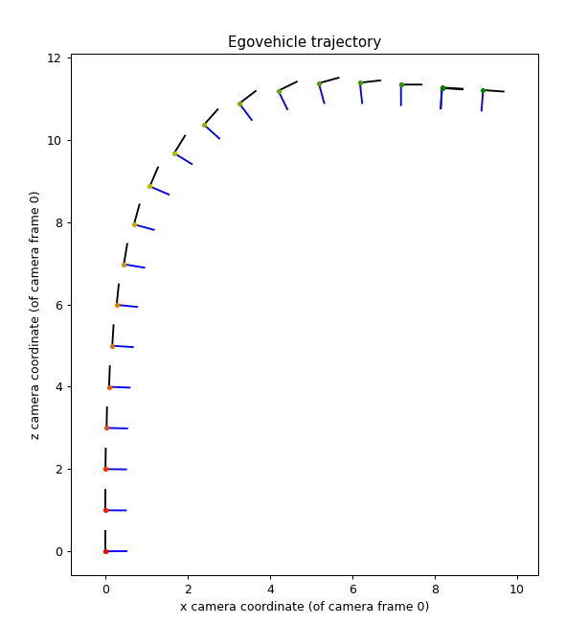
Part 5: Visual odometry
[Attach a plot of the camera’s trajectory through time]

Slide 15
Part 6: gtSAM (EC for Grad Students Only, no credit for UG)
[Attach a plot of the camera’s trajectory through time as computed using gtSAM w/o skip connections]

Slide 16
Part 6: gtSAM (EC for Grad Students Only, no credit for UG)
[Attach a plot of the camera’s trajectory through time as computed using gtSAM with skip connections]

Slide 17
Part 6: gtSAM (EC for Grad Students Only, no credit for UG)
[Explain the differences in the individual factor errors in both the results (optimized_poses1 & optimized_poses2)]
[Of all the factor errors, how many of these correspond to skip connections?]

