Slide 1
CS x476 Project 1
Bipin Koirala
bkoirala3@gatech.edu
bkoirala3
GT ID: 9037.15.285

Slide 2
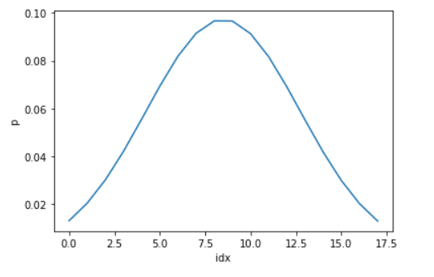
Part 1: 1D Filter
<insert visualization of the low-pass filter from proj1.ipynb here>

Slide 3
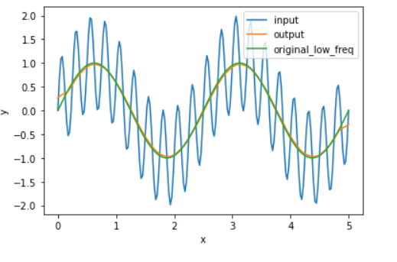
Part 1: 1D Filter
Describe your implementation in words and reflect on the checkpoint questions.
We created our low pass filter based on one-dimensional normal gaussian distribution function.
This distribution takes in standard deviation as a function of cut-off frequency. After filtering, it attenuates any signals that are higher than cut-off frequency and retains frequencies that are lower than cut-off frequency.
We define kernel parameter for filtering based on standard deviation.
After kernel is setup, we pad the signal in 1D so that the filtered signal do not lose its resolution.
Then, we correlate the padded signal with kernel to achieve gaussian distribution in the overall signal
<insert visualization of filtered combined signal from proj1.ipynb here>

Slide 4
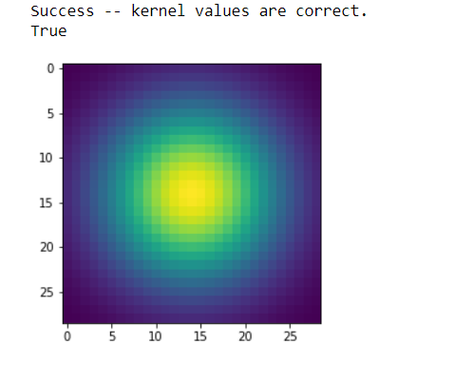
Part 2: Image Filtering
<Describe your implementation of my_imfilter() in words.>
*my_imfilter()* takes in an image, applies filter and returns the filtered image after processing.
I first created a tensor of same shape like the original image. Then row pads and column pads were created based on the formula:
#pad = (#kernel-1)/2; since the output image and input image must have same size.
Then I padded zeros around the image using F.pad function followed by loop over each rows and columns to implement the filter.
<insert visualization of the 2D Gaussian kernel from proj1.ipynb here>

Slide 5
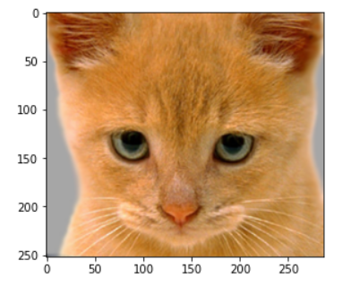
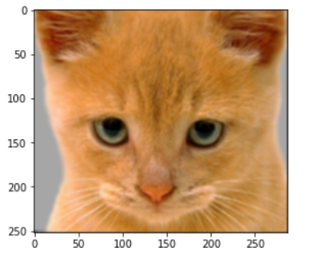
Part 2: Image filtering
Identity filter
<insert the results from proj1_test_filtering.ipynb using 1b_cat.bmp with the identity filter here>
Small blur with a box filter
<insert the results from proj1_test_filtering.ipynb using 1b_cat.bmp with the box filter here>

Slide 6
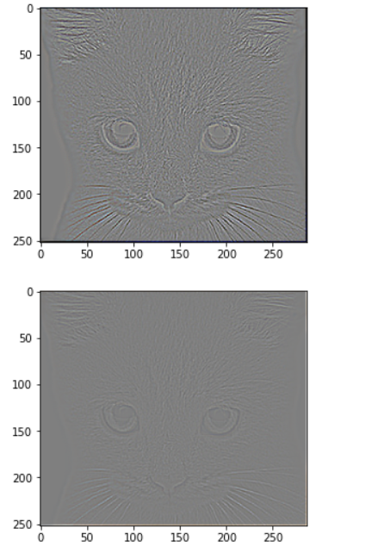
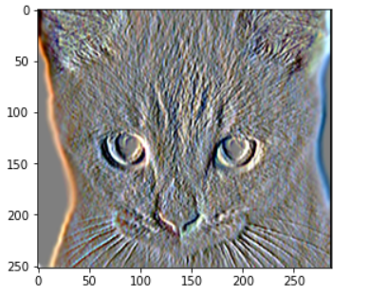
Discrete Laplacian filter
<insert the results from proj1_test_filtering.ipynb using 1b_cat.bmp with the discrete Laplacian filter here>
Part 2: Image filtering
Sobel filter
<insert the results from proj1_test_filtering.ipynb using 1b_cat.bmp with the Sobel filter here>

Slide 7
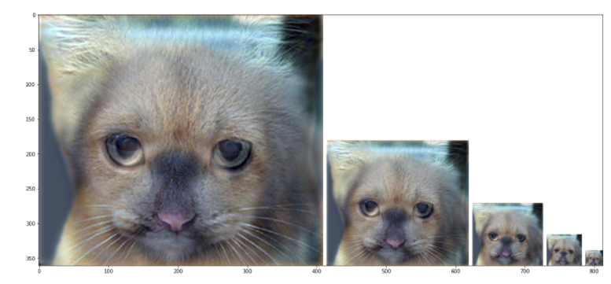
Part 2: Hybrid images manually using Pytorch
<Describe your implementation of create_hybrid_image() here.>
First two images i.e. image1 and image 2 corresponding to dog and cat were loaded along with a low pass gaussian filter. Both images were appied with low filter. However, in the case of cat image the low pass filtered tensors were removed from the original image tensors. Thus, creating a high pass filter in this case.
Finally both images were stacked together to create a hybrid image that contained low frequencies of dog image and high frequencies of cat image.
Cat + Dog
<insert your hybrid image here>
Cutoff frequency: 5. Although, using 7 produced a more consistent cat image on the first plot

Slide 8
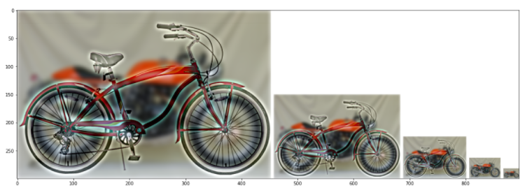
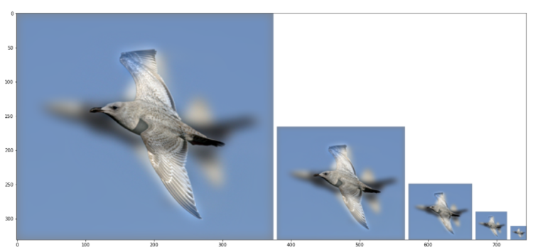
Part 2: Hybrid images manually using Pytorch
Motorcycle + Bicycle
<insert your hybrid image here>
Cutoff frequency: 4
Plane + Bird
<insert your hybrid image here>
Cutoff frequency: 8

Slide 9
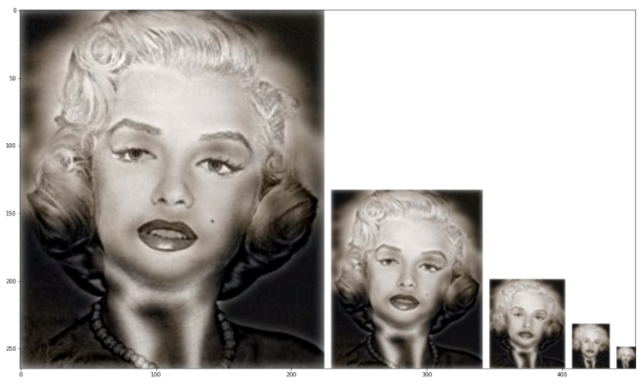
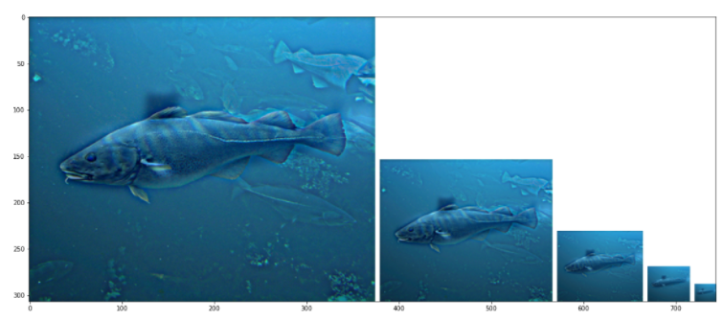
Part 2: Hybrid images manually using Pytorch
Einstein + Marilyn
<insert your hybrid image here>
Cutoff frequency: 4
Submarine + Fish
<insert your hybrid image here>
Cutoff frequency: 4

Slide 10
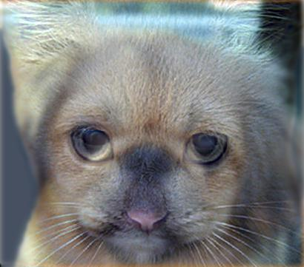
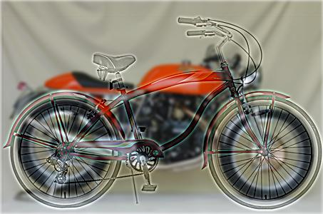
Part 3: Hybrid images with PyTorch operators
Cat + Dog
Cutt-off frequency: 4
Motorcycle + Bicycle
Cutt-off frequency: 2

Slide 11
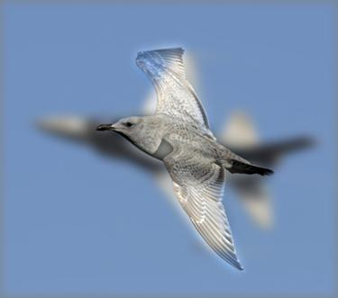
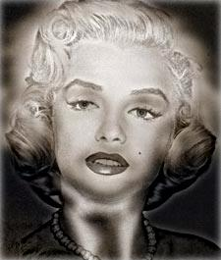
Part 3: Hybrid images with PyTorch operators
Plane + Bird
Cutt-off frequency: 6
Einstein + Marilyn
Cutt-off frequency: 4

Slide 12
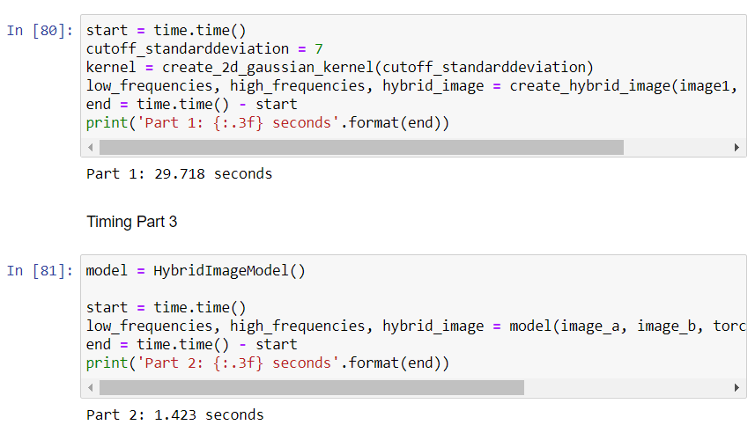
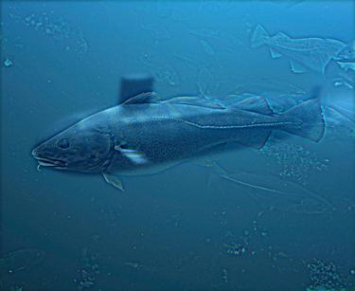
Part 3: Hybrid images with PyTorch operators
Part 1 vs. Part 2
<Compare the run-times of Parts 1 and 2 here, as calculated in proj1.ipynb. What can you say about the two methods?>
Runtime for part 3 is 19.88% faster than runtime for part 2. It is because we have created the filter manually in part 2 and this method of implementing kernel contributes to slower computing because of lack of robust algorithm on user’s end. In part 2 function is explicitly written but in part 3 the in-built function is simply called.
Submarine + Fish
Cutt-off frequency: 2

Slide 13
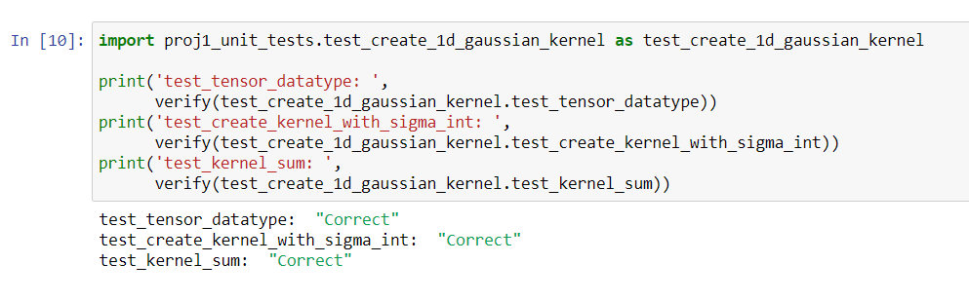
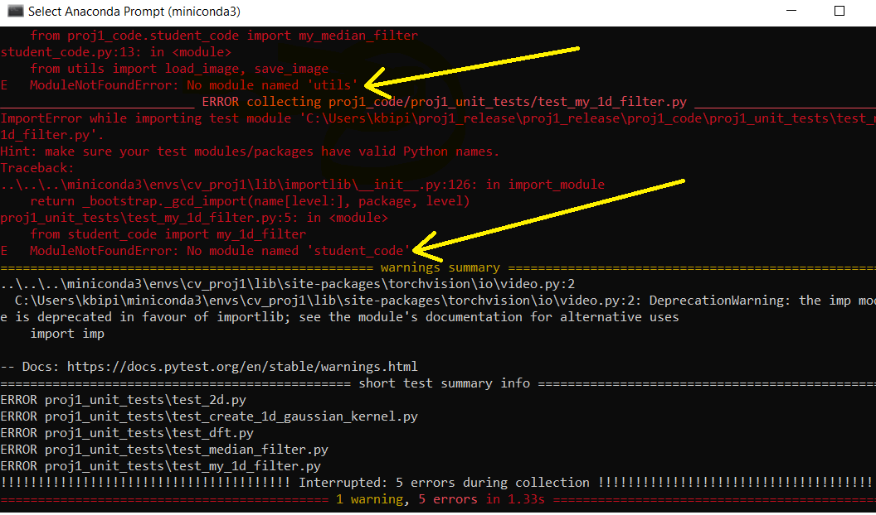
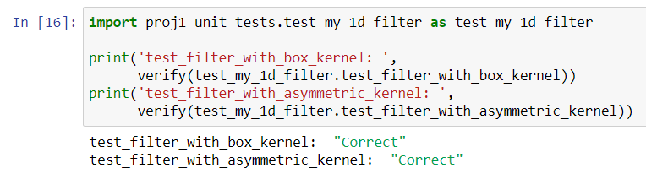
Tests
<Provide a screenshot of the results when you run `pytest proj1_unit_tests/` in proj1_code folder on your final code implementation (note: we will re-run these tests).>
Note: due to directory mismatch; I had to remove “proj1_code.” from both ‘proj1.ipynb’ as well as files under proj1_unit_tests; before importing test cases. Unit test ran from .ipynb file are attached here.

Slide 14
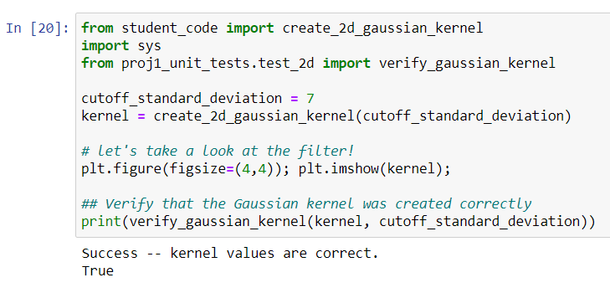
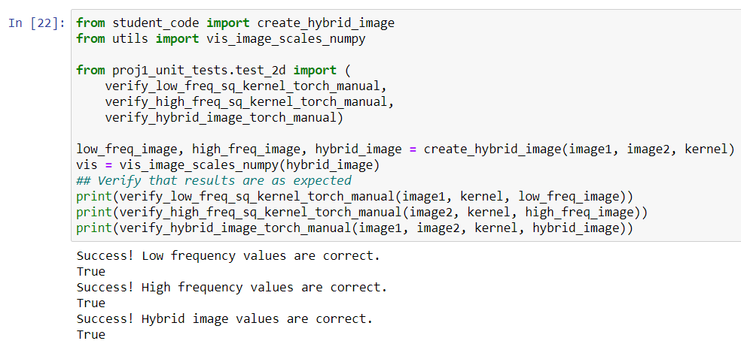

Slide 15
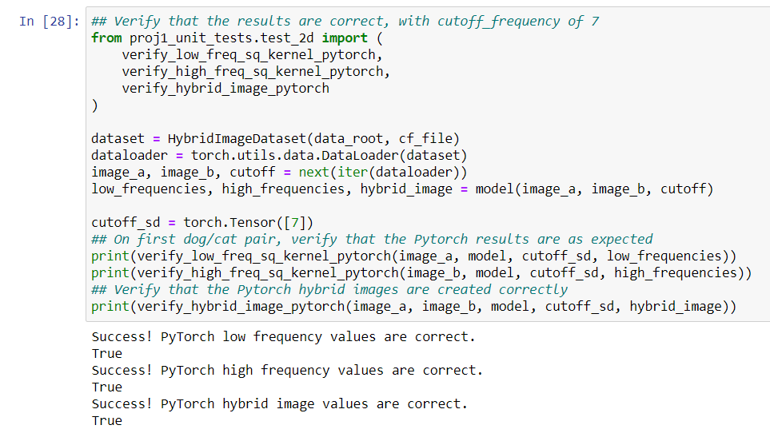
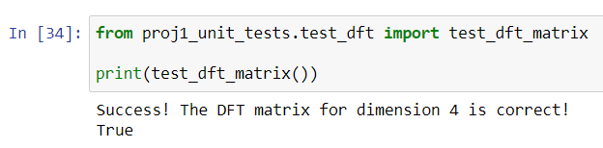
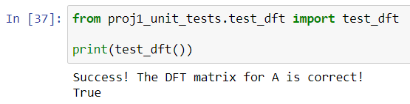

Slide 16
Conclusions
<Describe what you have learned in this project. Consider questions like how varying the cutoff standard deviation value or swapping images within a pair influences the resulting hybrid image. Feel free to include any challenges you ran into.>
* Lower values for cutoff standard images makes the first image less blur and more prominent. This also has an opposite effect on high frequency of the second image. The hybrid image shows the first image dominant over the second image.
* Increasing the value of cutoff frequency has the opposite effect. In this case the first image is blurred more, and the second image appears prominent in the hybrid image when viewed closely.
* Being able to manipulate an image based on my own filter design was exciting. I had hard time in implementing dataset for hybrid images.

Slide 17
Note
The following slide is:
REQUIRED for 6476 students
Extra credits for 4476 students.

Slide 18
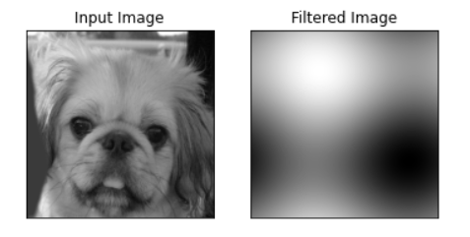
Image Filtering using DFT
Describe your implementation in words.
*2D DFT involves complex array structure. Therefore, it needs complex multiplication and addition. First the exponential term was broken down using Euler's rule and computed for all rows and columns in a loop. The real part consisted of cosine term and imaginary part consisted of sine term. Thus generated DFT matrix was used to get the DFT result of an image using complex*real and complex*complex. Then, the filter was applied to the image.
<insert visualization of the DFT filtered 6a_dog.bmp from proj1.ipynb here>

Slide 19
Note
The following slide is:
Extra credit for ALL (4476+6476)

Slide 20
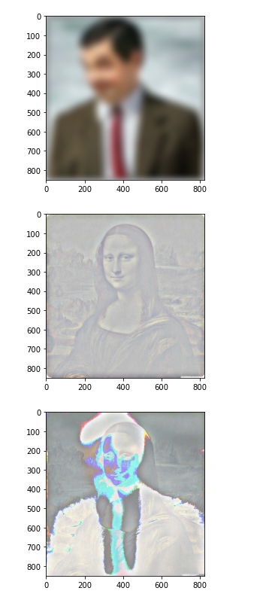
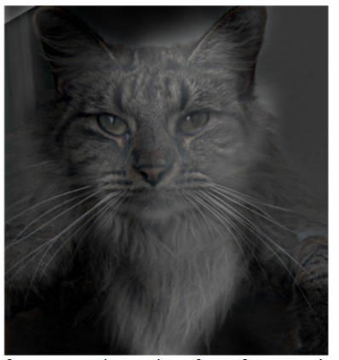
Add some cool hybrid images!
Here is my failed attempt to create hybrid image of Mr.Bean and Mona Lisa. I should have picked a set of image with a similar background and similar subject shape.
Found on web. https://courses.grainger.illinois.edu/cs445/fa2015/projects/hybrid/ComputationalPhotography_ProjectHybrid.html

