Slide 1
CS x476 Project 3
Bipin Koirala
bkoirala3@gatech.edu
bkoirala3
9037.15.285
Section (6476)

Slide 2
Part 1: Dataloader
Report the classes and the number of instances in the dataset, both train and test. (1pt)
Training Set (classes: 15 , Instances:1500)
Test Set (classes: 15 , Instances:1500)
100 instances in each class for both training and test sets.
Part 1: Please briefly explain the structure of ImageLoader class and how it works (how to use it to load data)? (2pts)
<text answer here>

Slide 3
Part 2:
Report the dimensions of the input that is passed to and the output you obtain the SimpleNet you created. Express the answer in variables and clearly mention what each variable specifies. (1pt)
<text answer here>

Slide 4
Part 3: Loss function. Why do we need a loss function? (1pt)
<text answer here>
Part 3: Explain the reasoning behind the loss function used. (1pt)
<text answer here>

Slide 5
Part4: Optimizer.
Please briefly explain how an optimizer works? (2pts)
<text answer here>

Slide 6
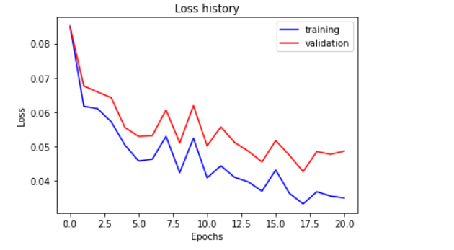
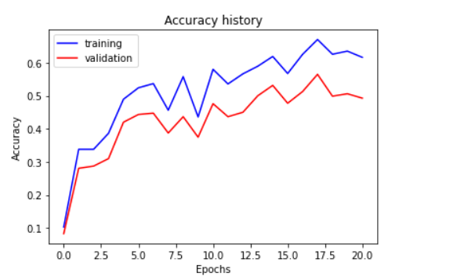
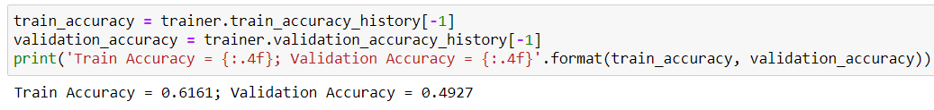
Part 5: Training SimpleNet (5pts) – You need to get >45% validation accuracy as stated in notebook
<Loss plot here> <Accuracy plot here>
Final training accuracy value: 0.6161 (61.61%)
Final validation accuracy value: 0.4927 (49.27%)

Slide 7
Part 5: Training SimpleNet (3pts)
<Paste here the final hyperparameters you arrived at>

Slide 8
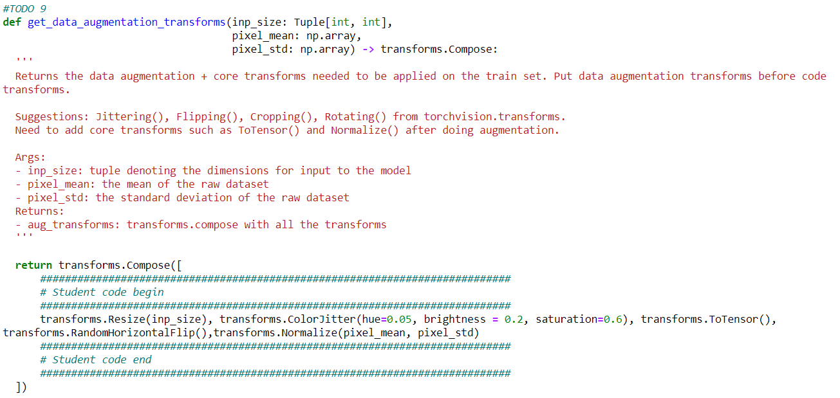
Part 6.1 : Screenshot of the functions you used in get_data_augmentation_transforms() (3pts)
<Screenshot here>

Slide 9
Part 6.2: Building AlexNet: why do we want to “freeze” the conv layers and some of the linear layers in pretrained AlexNet? Why CAN we do this? (0.5pt)
<Text solution here>
Part 6.2: Building AlexNet: Why don’t we have to freeze MaxPool and RELU layers? (0.5pt)
<Text solution here>

Slide 10
Part 6.3: Training AlexNet: what does fine-tuning a network mean? (1pt)
<Text solution here>

Slide 11
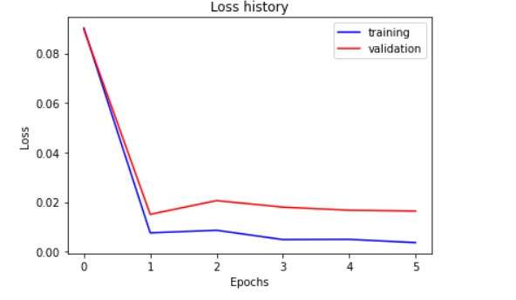
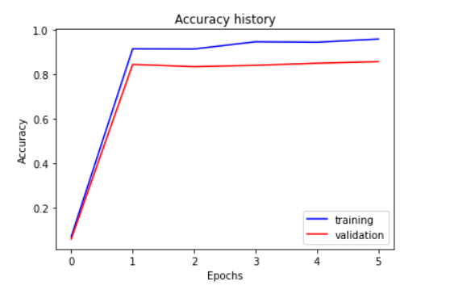
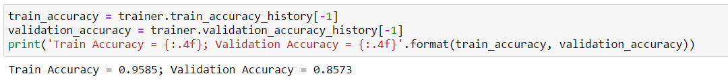
Part 6.3 : Training Alexnet (5pts) – you need to get >85% validation accuracy as stated in the notebook
<Loss plot here> <Accuracy plot here>
Final training accuracy value: 0.9585
Final validation accuracy value: 0.8573

Slide 12
Part 6.3: Training AlexNet (3pts)
<Paste here the final hyperparameters you arrived at>

Slide 13
Conclusion: briefly discuss what you have learned from this project. (3pts)
<Text solution here>

Slide 14
EC1: SimpleNetDropout: How do dropout and data-augmentation help? (1pt)
<Text solution here>

Slide 15
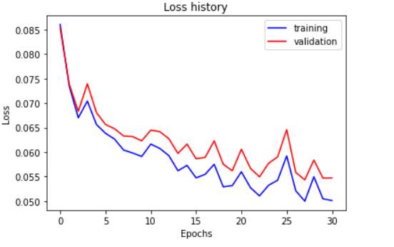
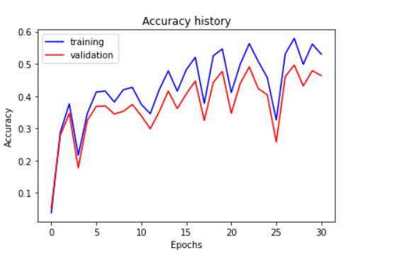
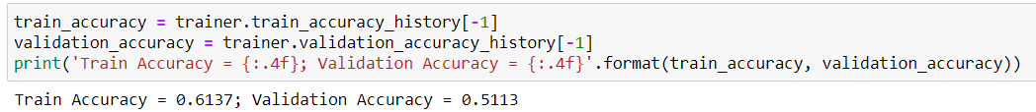
EC1: Training SimpleNetDropout (3pts) – you need to get >52% validation accuracy as stated in the notebook.
<Loss plot here> <Accuracy plot here>
Final training accuracy value: 0.6137
Final validation accuracy value: 0.5113

Slide 16
EC1: Training SimpleNetDropout (1pt)
<Paste final hyperparameters here>

Slide 17
EC1: SimpleNetDropout: compare the loss and accuracy for training and testing set, how does the result compare with that of SimpleNet without Dropout? How to interpret this result? (1pt)
<Text solution here>

Slide 18
EC2: Quantization. Paste the code of the quantize function here. (3pts)
<Screenshot here>

Slide 19
EC2: Quantization. Briefly discuss the steps you followed. You cannot use code and should describe the intuition behind each step. (3pts)
<text answer here>

Slide 20
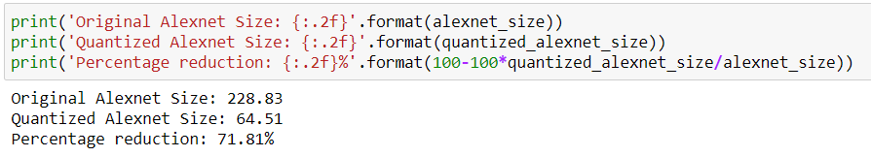
EC2: Quantization. Paste your results here (3pts) – If you satisfy the below limits.
Size comparison: <text answer here> { should be >50% reduction}
Processing Time comparison: <text answer here> { should be >10% reduction}
Accuracy comparison: <text answer here> { should be <5% reduction}

