Slide 1
New GUI in
Unity

Slide 2
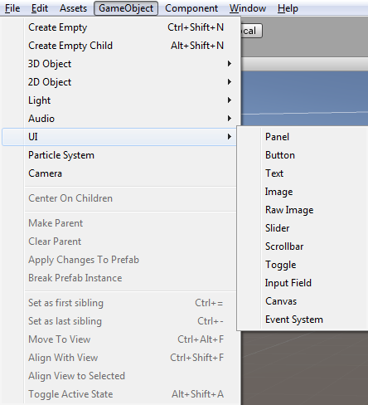
Creating Elements
All UI Elements are child of a canvas
Multiple canvas‘s can co-exist
Problem: Position probably not scaling
properly for different screen sizes!
  Solution: Create script for each canvas where
  the position of child elements is calculated
  Need to test if this is necessary!

