Slide 1
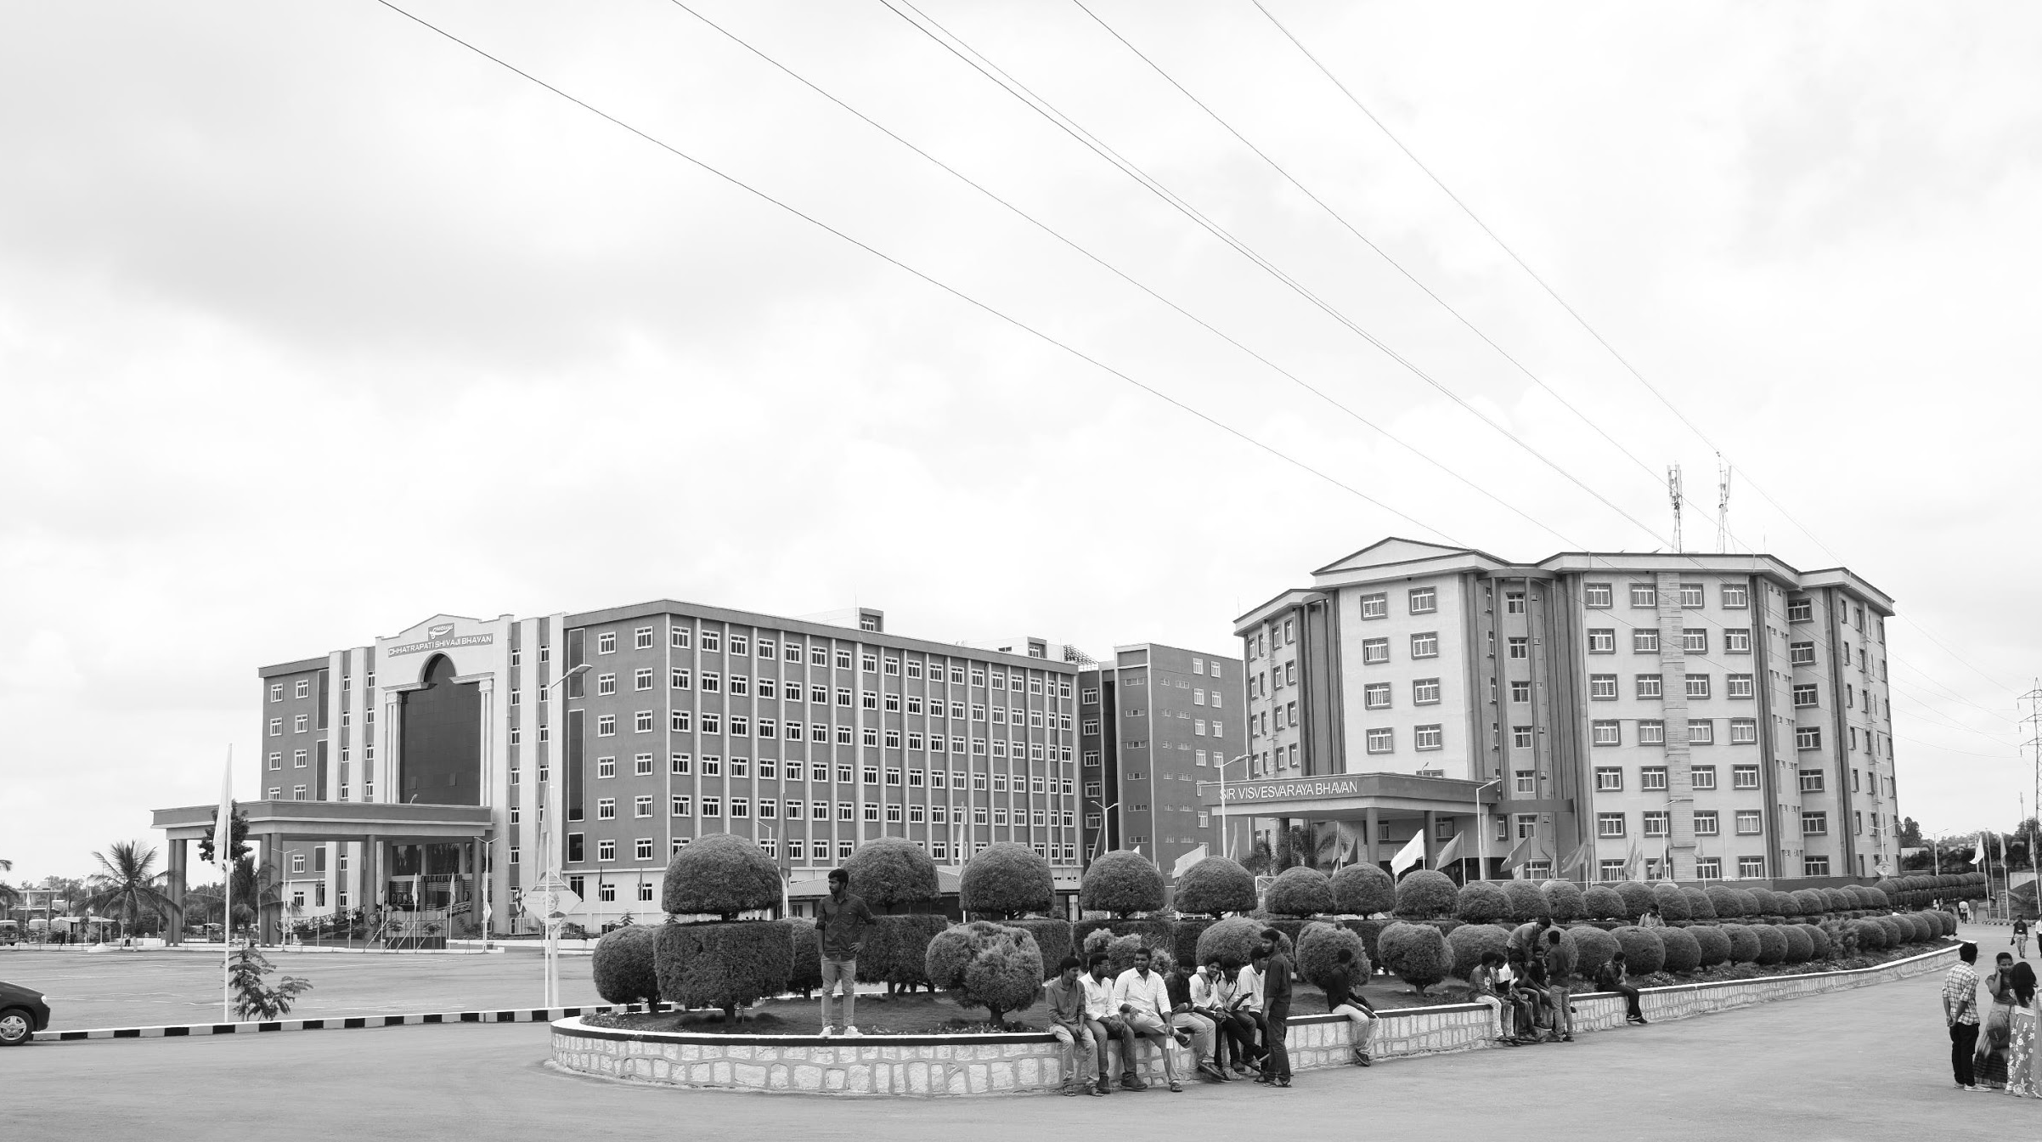

ECG Arrhythmia Classification using Deep Learning
AY 2021-25
GITAM UNIVERSITY
Capstone Project
Project ID: PROJ2999
A University should be a place of light, of liberty, and of learning.
Department of Electrical Electronics and Communication Engineering
Project Team:
Golla Vishnu Karthik Yadav
B. M. Aakash
P. V. Muni Krishna
Project Mentor:
Dr. Jaya Prakash Sahoo
www.gitamedu.com

Slide 2




Project Group – Details
Photo
Track
Roll No
Name
EECE AI/ML
BU21EECE0100318
Golla Vishnu Karthik Yadav
EECE AI/ML
BU21EECE0100209
B. M. Aakash
EECE AI/ML
BU21EECE0100408
P. V. Muni Krishna

Slide 3
Objective and Goals
Objective
The primary objective of this project is to develop a accurate deep learning model for the automatic classification of ECG arrhythmias.
The goal is to leverage deep learning techniques to diagnosis of cardiac abnormalities.
Objective is to improve patient outcomes and reducing the workload on healthcare professionals.
Goals
Design and implement a deep learning architecture tailored for ECG signal
analysis, selecting the most effective model for arrhythmia classification.
Train the deep learning model using annotated ECG datasets and optimize
it to improve accuracy and generalization.
To develop a highly accurate deep learning model for classifying ECG arrhythmias
using deep learning techniques.

Slide 4
Literature Survey
S.NO | TITLE | AUTHOR | YEAR OF PUBLISHING | PARAMETERS MENTIONED
1 | Cardiologist-Level Arrhythmia Detection with Convolutional Neural Networks | Awni Y. Hannun, Pranav Rajpurkar | 2019 | 34-layer deep CNN (convolutional neural network) 30-second ECG segments MIT-BIH Arrhythmia Dataset
2 | ECG Heartbeat Classification Using Convolutional Neural Networks | Jiun-Yan Su, Wen-Chung Kao | 2020 | CNN with max-pooling layers Input: Pre-processed ECG signals with R-peak detection Datasets: MIT-BIH Arrhythmia Dataset
3 | A Deep Learning Approach to Predicting Cardiac Abnormalities Using ECG Data | Rajat K. Gupta, Arun K. Majumdar | 2021 | LSTM (Long Short-Term Memory) network Input: Raw ECG data Datasets: PTB Diagnostic ECG Database

Slide 5
Literature Survey
4 | Transfer Learning for Arrhythmia Classification Using Deep Neural Networks | Xueheng Zhou, Songnan Yang, Hongyi Wu | 2021 | Transfer learning with pre-trained ResNet Input: 12-lead ECG signals Datasets: PhysioNet Challenge 2017 dataset
5 | Arrhythmia Classification from 2-Lead ECG Signals Using Deep Neural Networks | Shashank Reddy, Rahul Mittal, Amritanshu Pandey | 2022 | Deep CNN with attention mechanism Input: 2-lead ECG data Datasets: MIT-BIH Arrhythmia Dataset Application: 2-lead ECG data could be in real-time arrhythmia monitoring for wearable health devices.

Slide 6
ECG signal parts and description:
P Wave
Description: The P wave represents the depolarization of the atria, which is the electrical activity that leads to the contraction of the atria. It is usually a small, rounded waveform that occurs before the QRS complex.
QRS Complex
Description: The QRS complex represents the rapid depolarization of the ventricles, leading to their contraction. This is the most prominent feature on the ECG signal and is typically composed of three parts:
Q wave: A small downward deflection following the P wave.
R wave: A large upward deflection following the Q wave.
S wave: A downward deflection following the R wave.

Slide 7
T Wave
Description: The T wave represents the repolarization of the ventricles, which is the process of the ventricles returning to their resting state after contraction. It typically appears as a modest, rounded waveform following the QRS complex.
PR Interval
Description: The PR interval is the time between the onset of the P wave and the start of the QRS complex. It represents the time taken for the electrical impulse to travel from the atria to the ventricles.

Slide 8
ABSTRACT
The primary objective of this project is to develop a deep learning-based system for accurate classification of ECG arrhythmias. By leveraging state-of-the-art deep learning techniques, we aim to enhance the precision of arrhythmia classification. The publicly available ECG datasets such as the MIT-BIH Arrhythmia Database, which contains a diverse set of annotated ECG recordings from various patients. Electrocardiogram (ECG) arrhythmias are irregularities in coronary heart rhythm which could signal severe cardiovascular conditions, necessitating accurate and well- timed detection for powerful intervention. CNNs offer a powerful approach for ECG arrhythmia detection due to their ability to automatically learn and extract features, recognize patterns, and handle large amounts of data, all of which contribute to more accurate and efficient arrhythmia diagnosis. The steps to be followed to the classification of ECG arrhythmia are as follows: pre-processing, feature extraction, classification of ECG arrhythmias, real-time testing, and analysis. Publicly available dataset of annotated ECG recordings can be used to train and validate the developed models, that specialize in their ability to discover various arrhythmias with high precision. The outcomes of this mission have the capacity to seriously strengthen the field of cardiac health tracking, providing a scalable and green solution for early arrhythmia detection and control. Future work will attention on integrating those models into realistic healthcare packages and exploring their potential for broader clinical use.
Keywords: ECG, Filtering, Feature extraction, Convolutional neural networks, arrhythmia classification.

Slide 9
Introduction to Arrhythmia:
Arrhythmia refers to an irregular heartbeat caused by abnormal electrical activity in the heart. The heart may beat too fast (tachycardia), too slow (bradycardia), or with an erratic pattern. While some arrhythmias are harmless, others can lead to serious health issues, including stroke, heart failure, or sudden cardiac arrest.
The detection and classification of arrhythmias are critical for timely intervention and treatment. Electrocardiograms (ECGs), which record the electrical activity of the heart, are commonly used for this purpose. However, the manual interpretation of ECGs is time-consuming and prone to error, especially with large datasets. This has led to increased interest in automated arrhythmia detection using advanced deep learning techniques, which can analyze ECG signals with high accuracy and efficiency.

Slide 10
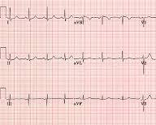
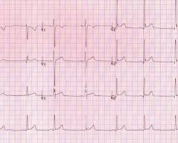
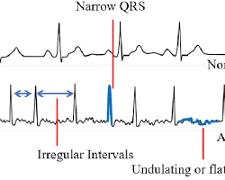
Normal Person
An Athlete
Arrhythmia Patient

Slide 11
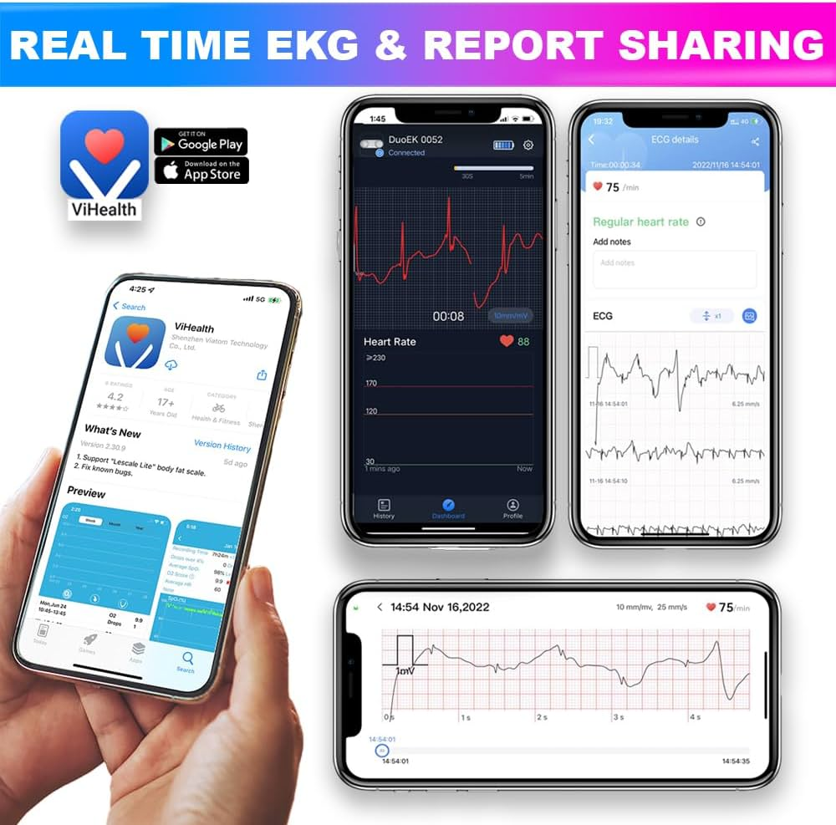
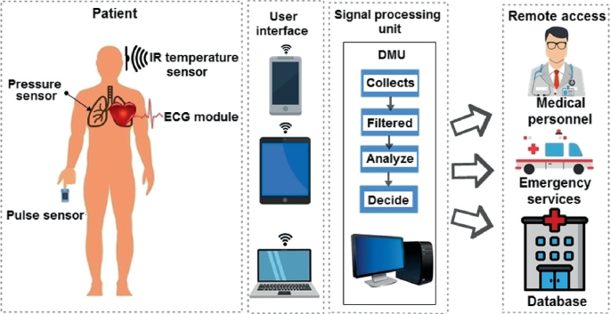
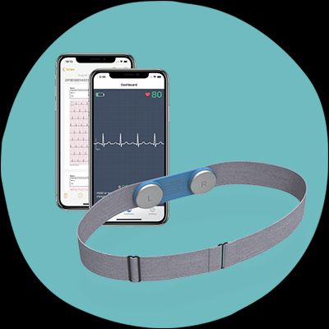
Applications:
Mobile Health App Monitoring ECG
Telemedicine Platform for ECG Analysis
Wearable ECG Monitor

Slide 12
Architecture
Structural Block Diagram
ECG Data Acquisition
Preprocessing
Feature Extraction
Deep Learning Model
Classification Output
Evaluation
Model Training
Deployment

Slide 13
Analysis - SWOT
Strengths
Weaknesses
W1. Data Dependency
W2. Complexity in Interpretation
W3. Limited Generalization
S1. High Accuracy Potential
S2. Automated Diagnosis
S3. Scalability
S4. Continuous Learning
Opportunities
Threats
T1. Data Privacy Concerns
T2. Regulatory Challenges
T3. Model Bias
O1. Integration with Wearable Devices
O2. Personalized Medicine
O3. Healthcare Accessibility

Slide 14
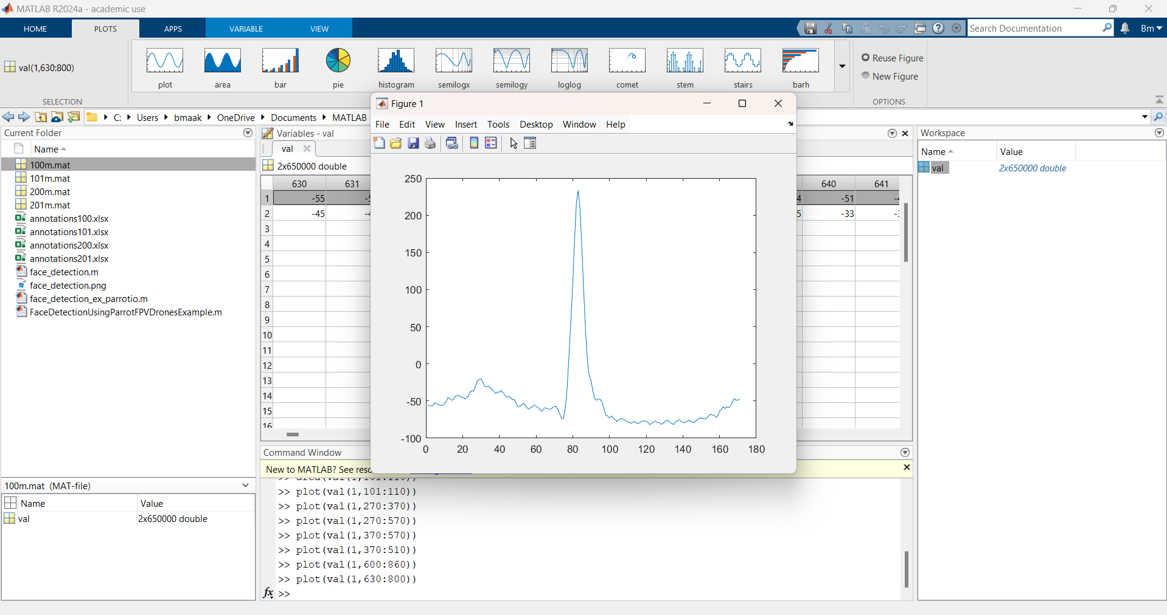
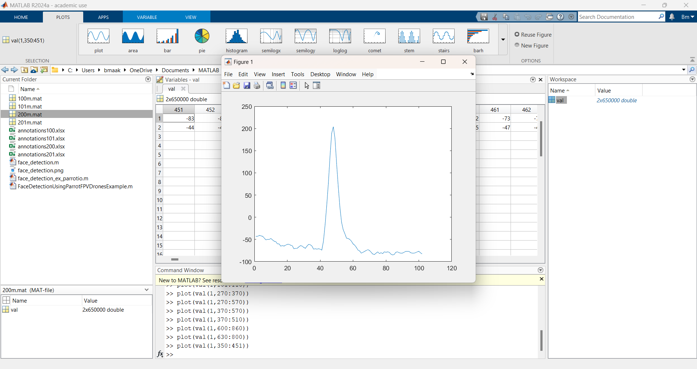
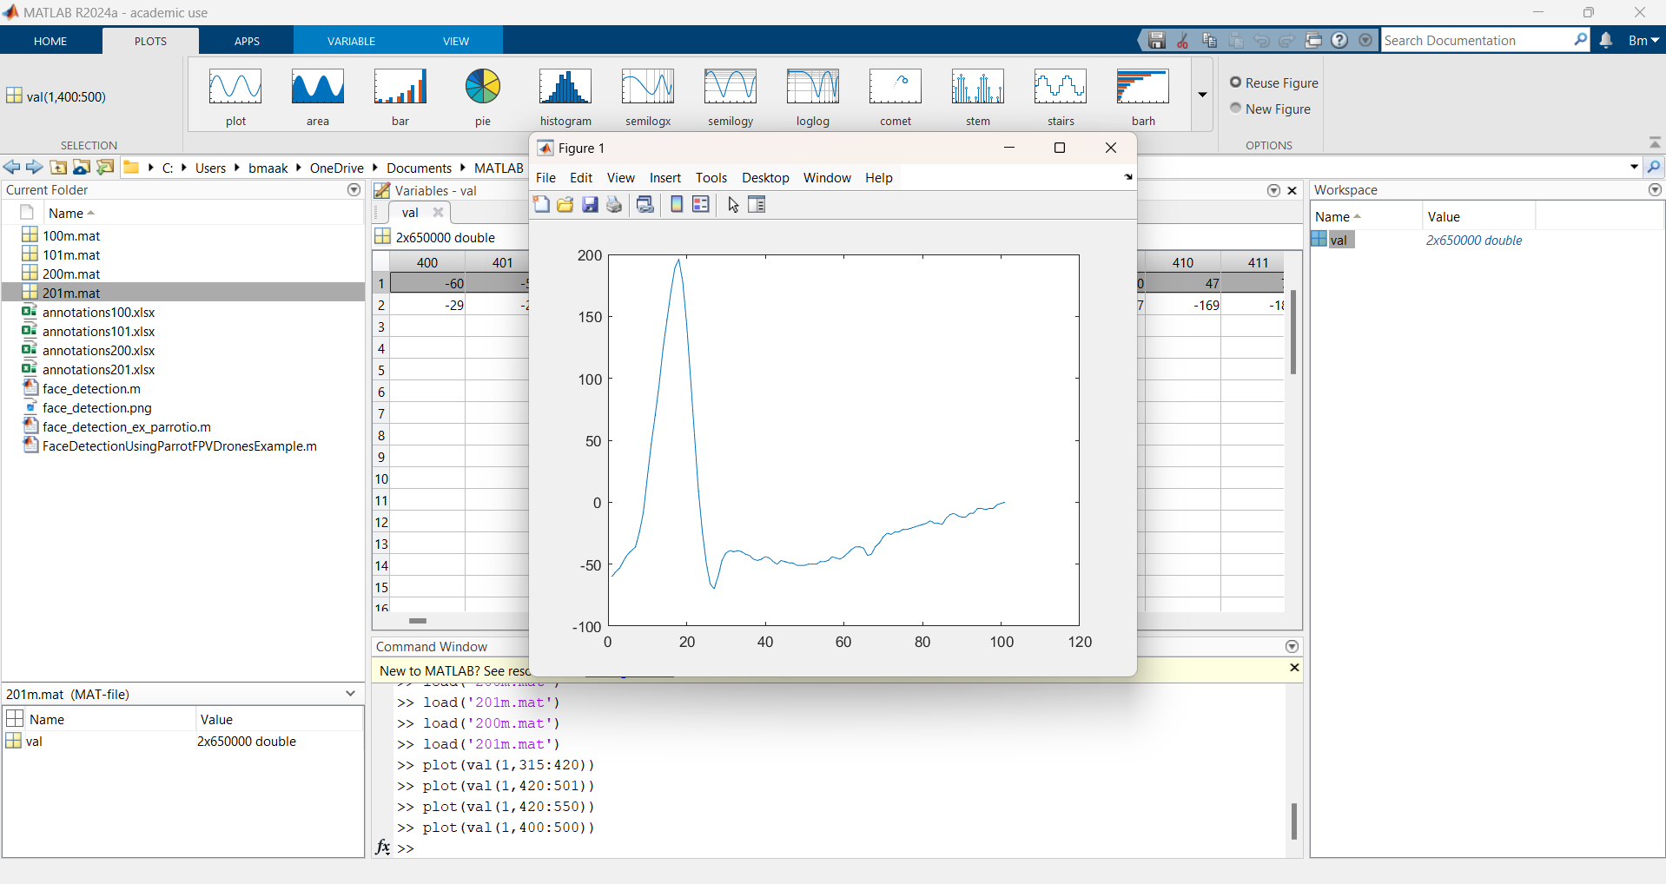
Implementation and Results

Slide 15
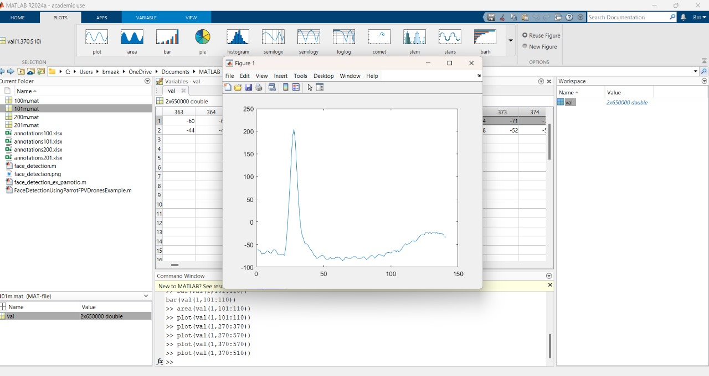
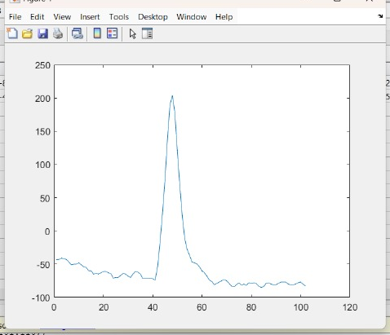
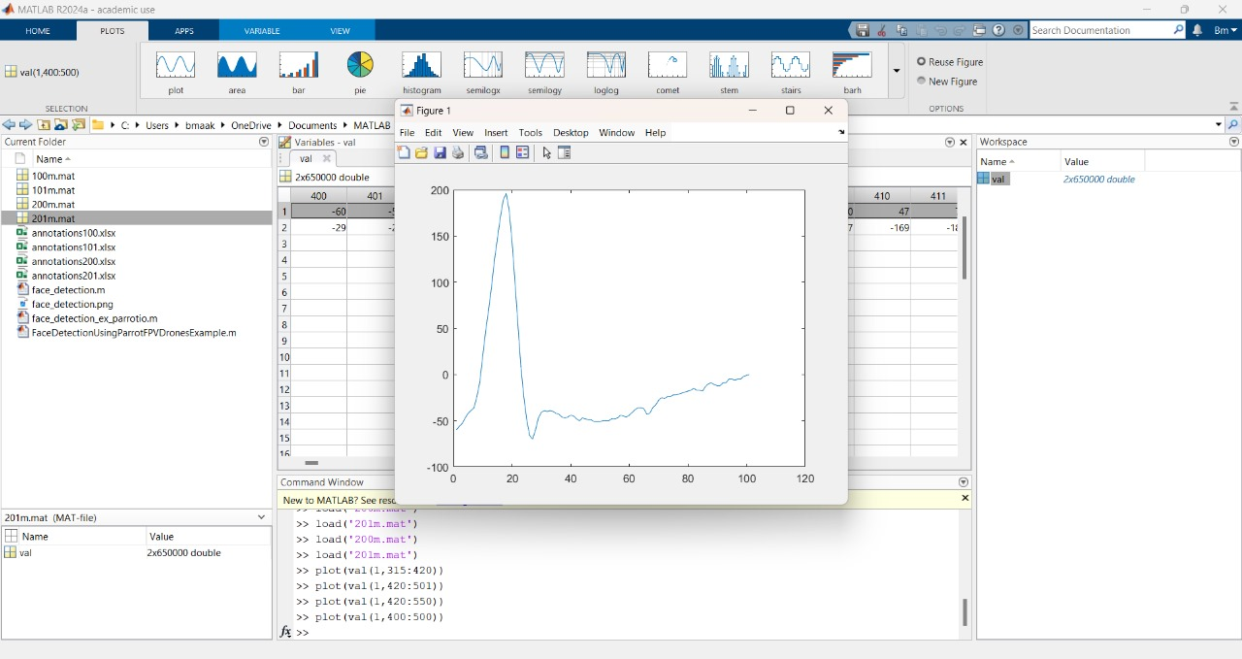
101
200
100
TABLE
 | N | S | V | F | Q
100 | 29 | 59 | 82 | 98 | 125
101 | 20 | 35 | 43 | 54 | 85
200 | 20 | 25 | 47 | 63 | 82
201 | -60 | 15 | 20 | 23 | 63
201

Slide 16
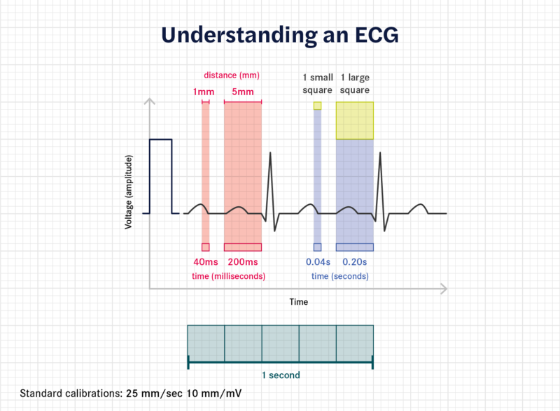
The above image explains the relationship between the time and voltage of an ECG (Electrocardiogram) waveform based on standard calibrations.
Voltage (Amplitude): The y-axis shows the voltage, which represents the heart's electrical activity. Each small square on the graph corresponds to a voltage of 0.1 mV.
Time: The x-axis shows time. Each small square represents 0.04 seconds (40 ms), and each large square (which contains 5 small squares) represents 0.2 seconds (200 ms).
Distance: Each small square is 1 mm, and each large square is 5 mm. This distance helps to measure time intervals in the ECG.
Calibration: The standard ECG calibration speed is 25 mm/sec, meaning the paper moves 25 mm every second, and the voltage scale is 10 mm/mV, so 10 mm represents 1 mV of electrical activity.

Slide 17
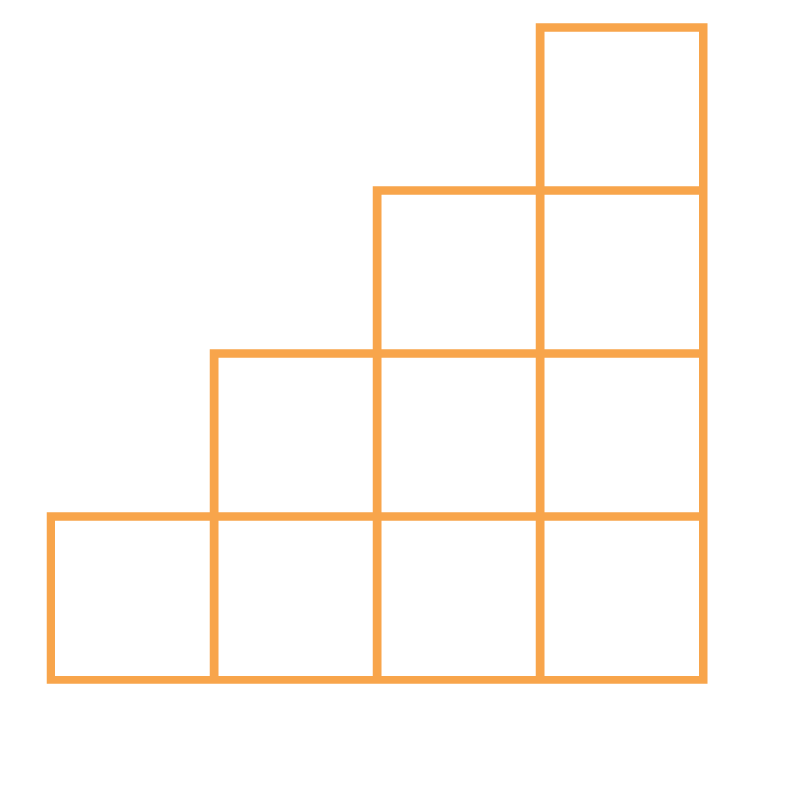
THANK YOU

