Slide 2
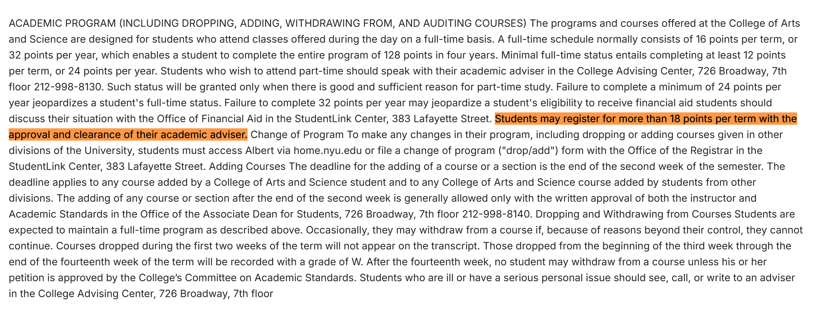
Why RAG reduces the performance
Question: What is the maximum number of credits a student can take in one term without needing permission?
A. 18 B. 16 C. 20 D. 12
Response: The answer you are looking for is not found in the knowledge base.
Information in database: The similarity rank is 12th.

Slide 3
Why RAG reduces the performance
Randomly check 15 wrong answers, all of them have the same problem: Answers do not appear in the top k (8) text chunks retrieved from the document.
Similarities are very close between each chunk:
1st: 30.28
8th: 28.5
14th (the correct chunk): 27.91

Slide 4
How to improve the performance?
Better embedding models: OpenAI text-embedding-3-large, BGE-large, GTE-large...
Add the number of k (top 12 or top 16): increase the computational cost but increase the hit rate of retrieval.
Reranking: re-rank the chunks after the first retrival.

Slide 5
How to improve the performance?
Better embedding models: OpenAI text-embedding-3-large, BGE-large, GTE-large...
Add the number of k (top 12 or top 16): increase the computational cost but increase the hit rate of retrieval.
Reranking: re-rank the chunks after the first retrival.

