Slide 1
AI Chatbot for NYU Academic Advising
David Dai, Keven Ni, and Kelly Lin
Link to Github repo
05.09.25

Slide 2
Executive Summary
Problem
No instant advising at NYU CAS
Incapability of vanilla LLM in this specific domain
Goal
Build a specialized LLM advisor to ease workload and improve access
Solution
RAG/Finetune/Prompt Embedding open source LLM

Slide 3
Motivation
Students need timely, reliable advising.
Related Work: RAG / LoRA / Finetuning for Academic Advising
RAG: Lewis, Patrick, et al. “Retrieval-Augmented Generation for Knowledge-Intensive NLP Tasks.” arXiv, 2020, arxiv.org/abs/2005.11401.
Hu, Edward J., et al. “LoRA: Low-Rank Adaptation of Large Language Models.” arXiv, 2021, arxiv.org/abs/2106.09685.
Akiba, Daisuke, and Michelle C. Fraboni. “AI-Supported Academic Advising: Exploring ChatGPT's Current State and Future Potential toward Student Empowerment.” Education Sciences, vol. 13, no. 9, 2023, p. 2085, doi:10.3390/educsci130902085.

Slide 4
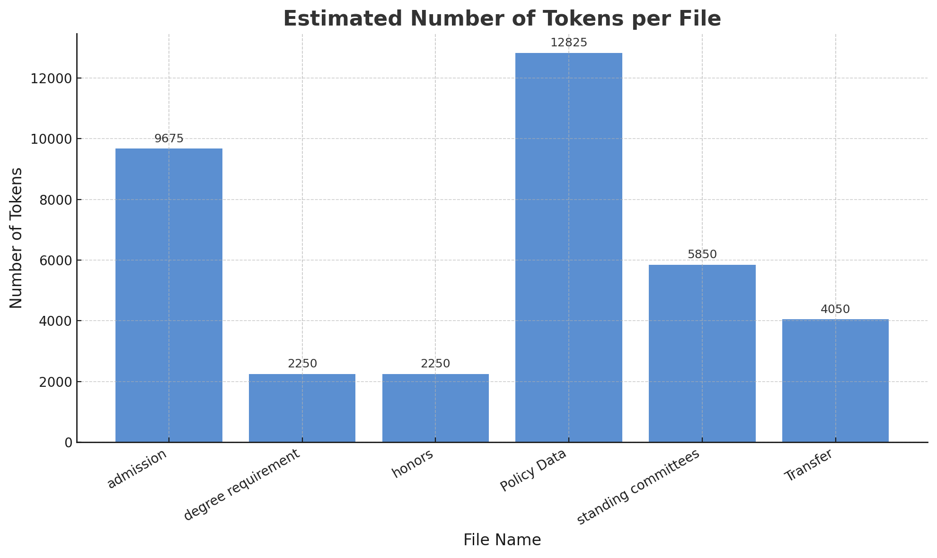
Data Preparation
1. Raw NYU CAS academic policy text (around 40k tokens)
2. Synthetic instruction format QA-Pairs generated by LLM (around 2k+ QA-pairs)

Slide 5
Model Choice
Target model: Open source (easy to finetune and deploy), Long context window (64k - 128k)
We want to concatenate all policy texts together and send to the model.
Llama-3.1-8B-Instruct
Gemma-3-27b-it
Mistral-Small-24B-Instruct

Slide 6
Experiment Structure
Benchmark
Finetuning
Embedding
RAG

Slide 7
LoRA Configuration
Benchmark vs LoRA
Hyperparameters:
Rank: 8
Lora alpha: 2 x rank =16
Lora dropout: 0.05
Learning Rate: 0.0002
3 Epochs

Slide 8
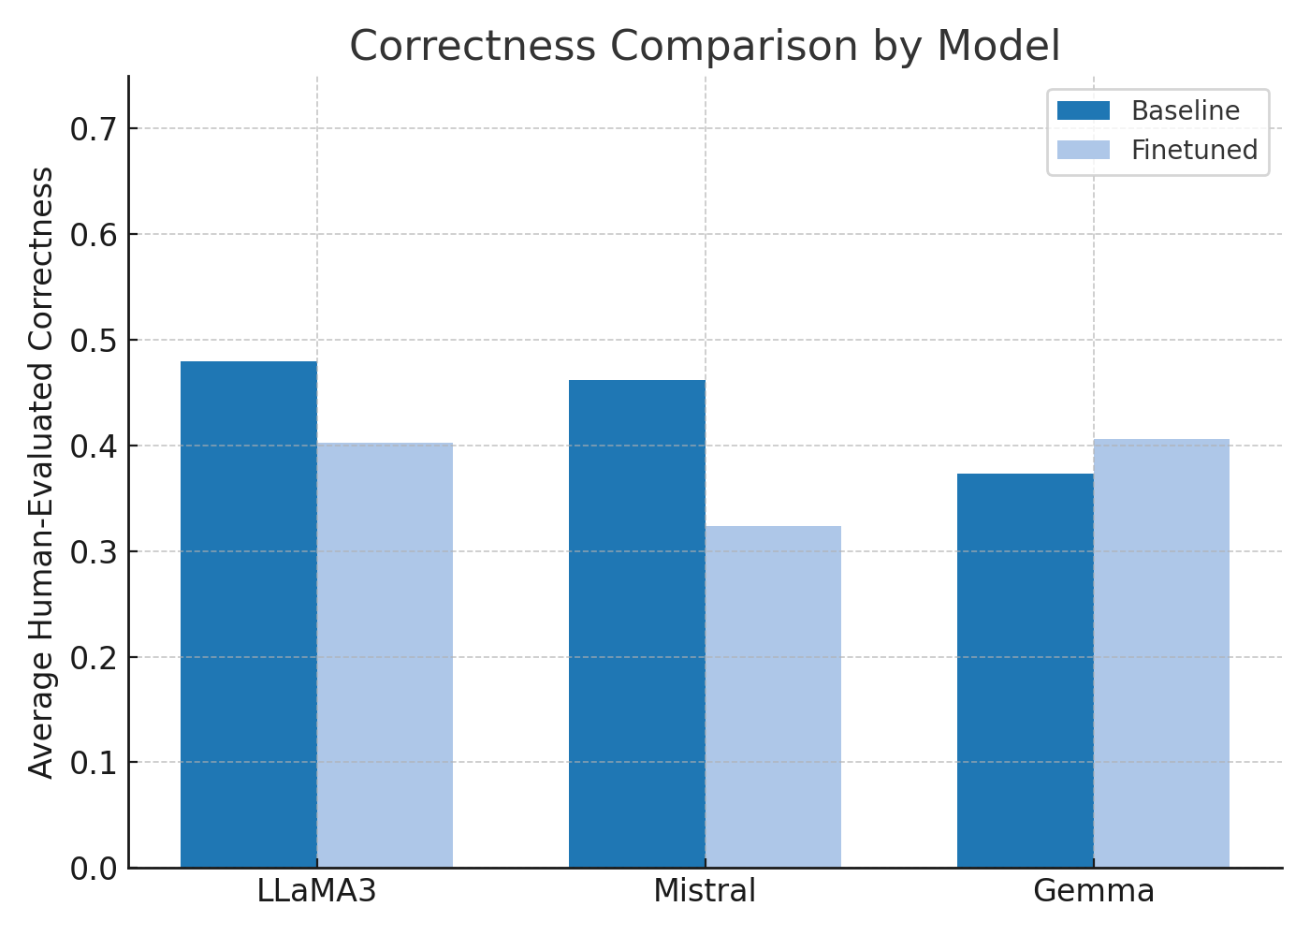
Performance Comparison via MCQs
Model learned to explain, not to choose
→ Finetuning reinforced language generation, not option selection
Logit-based discrimination not optimized
→ LoRA tuning affects generation layers, not classification decision-making
Switch to similarity based scoring

Slide 9
Incapability of Similarity-Based Metrics
"question": "How many CAS credits must be completed in residence?",
"expected_output": "At least 64 CAS credits",
"benchmark_gemma3_output": "According to the university regulations, a minimum of 24 CAS credits must be completed in residence.",
"bertscore_f1": 0.7609
"lora_gemma3_output": "At least 64 credits must be completed in residence, including at least 32 credits in upper-division courses.",
"bertscore_f1": 0.7316
Fundamentally different answers have close similarity -> unable to grade

Slide 10
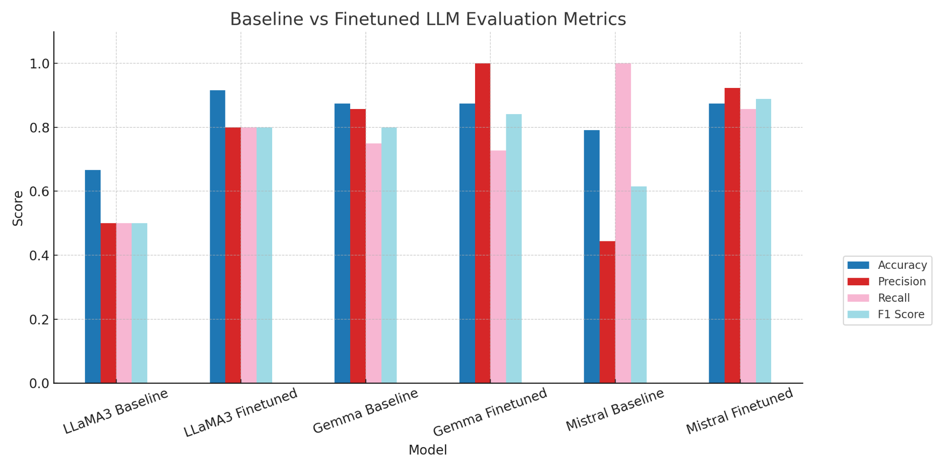
Grading Finetuned LLM by Using ChatGPT-4o

Slide 11
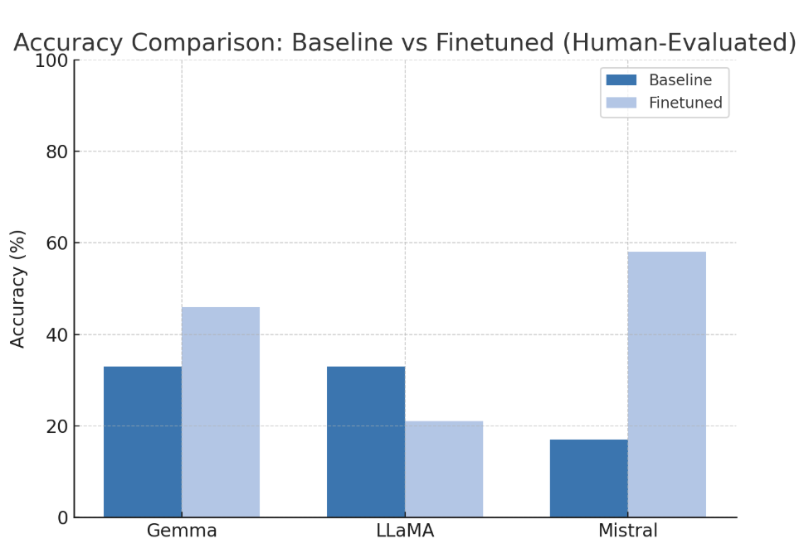
Grading Finetuned LLM by Using ChatGPT-4o
Problem with finetuning:
Performance not satisfying
Inefficient when synthesising data to cover all information
Training is time consuming
Case to use finetuning:
Require high inference speed
Fixed dataset/few updates
Offline deployment

Slide 12
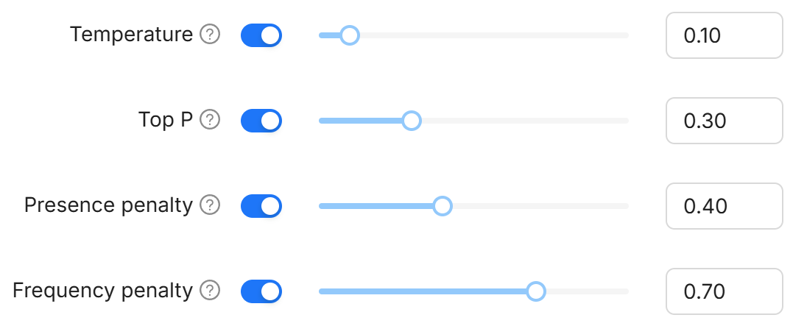
RAG: Settings and Hyperparameters
Framework: RAGFlow
Embedding model: BGE-Large
Chunk token number: 512
Top N (selects N chunks from the retrieved ones) : 8
Similarity: weighted keyword similarity + cosine similarity
Similarity threshold: 0.2

Slide 13
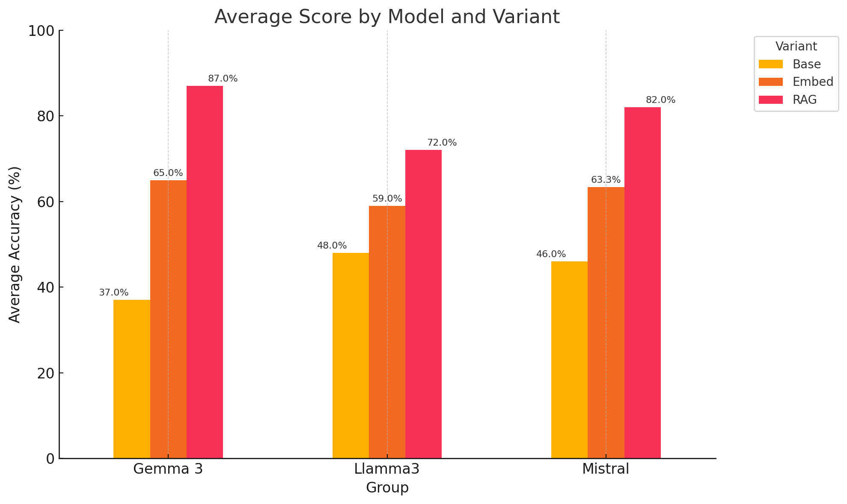
RAG Performance

Slide 14
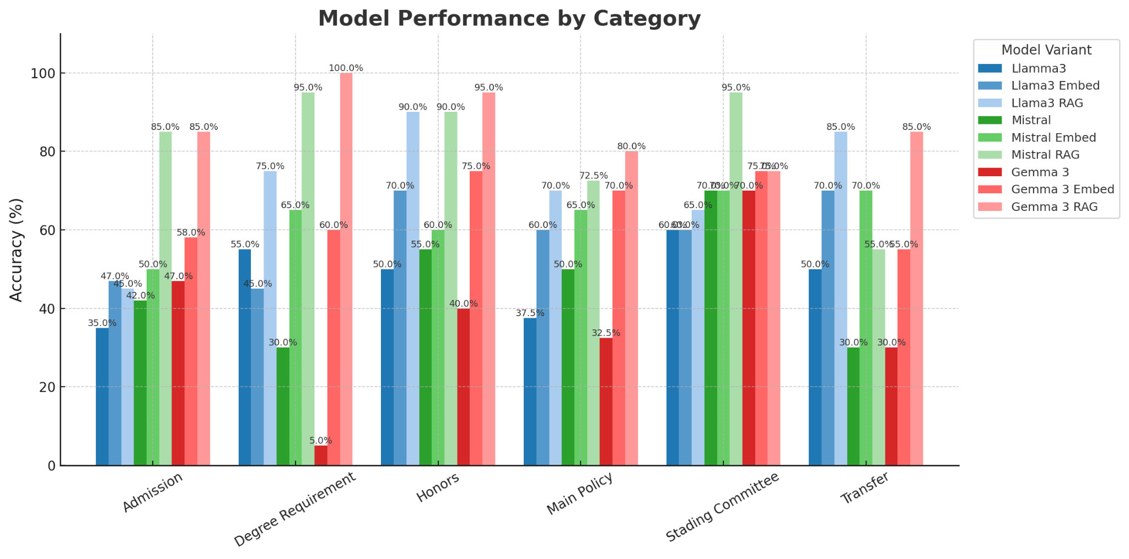
RAG Performance
Looks good, but can we get better performance?

Slide 15
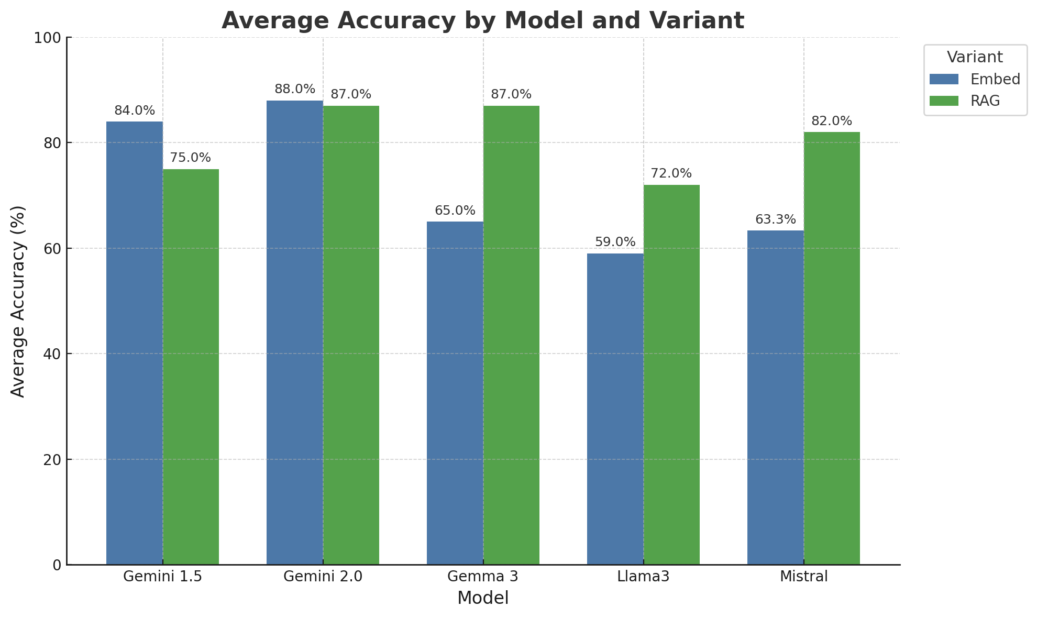
What would happen if we used a better LLM

Slide 16
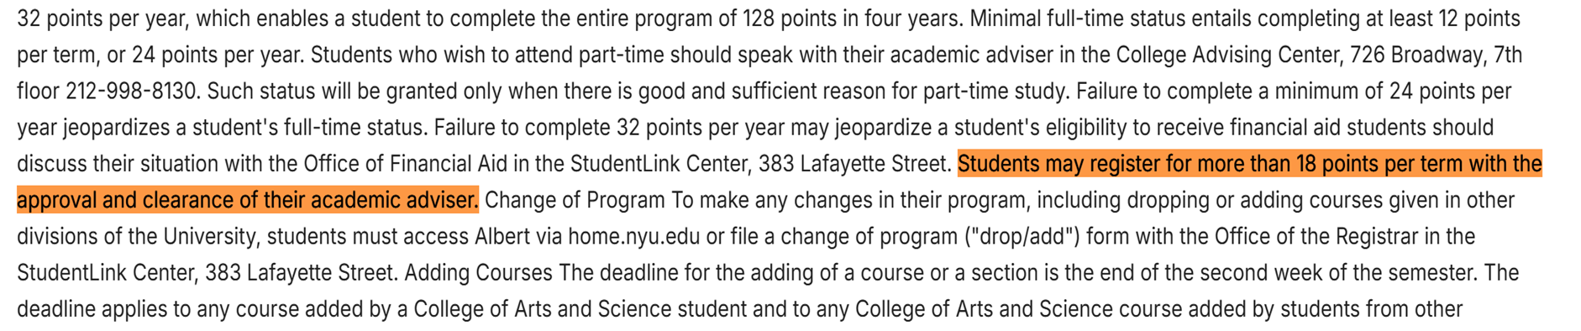
Why RAG reduces the performance
Question: What is the maximum number of credits a student can take in one term without needing permission?
A. 18 B. 16 C. 20 D. 12
Response: The answer you are looking for is not found in the knowledge base.
Information in database: The similarity rank is 12th.

Slide 17
Why RAG reduces the performance
Randomly check 15 wrong answers, all of them have the same problem: Answers do not appear in the top k (8) text chunks retrieved from the document.
Similarity scores are very close between each chunk:
1st: 30.28
8th: 28.5
12th (the correct chunk): 27.91

Slide 18
How to improve the performance?
Better embedding models: OpenAI text-embedding-3-large, E5-Mistral-7B-embed, Jina-embeddings-v2...
Add the number of N (top 12 or top 16): increase the computational cost but increase the hit rate of retrieval.
Reranking: re-rank the chunks after the first retrieval.

Slide 19
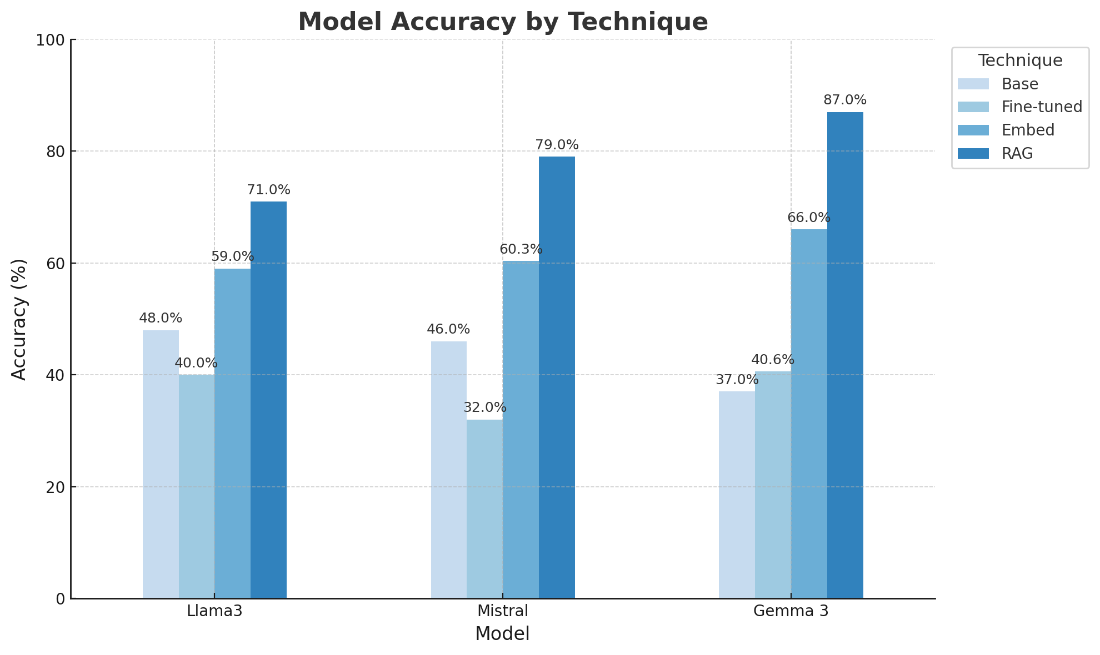
Overall Performance: RAG outperformed

Slide 20
Conclusion and Future Work
Conclusions:
Finetuning is not ideal for this task but suitable for some use cases
RAG can significantly improve the performance of models with limited long-context capabilities, making it suitable for low-cost deployment.
Future work:
Find out why finetuning performance is worse than benchmark
Develop more complex metrics for evaluation
Try better embedding models and hyperparameters (such as N) to improve the performance of RAG.

