Slide 1
Genre Identification on Gutenberg Corpus
Submitted by:
Group 05
Aishwarya Suresh
Deeksha Ramakrishna
Priyamvada Bhardwaj
Sathya Sudha Murugan
Snigdha Mohapatra

Slide 2
Contents
The Problem and Motivation
Highlights of Dataset
Few Quick Insights
Concept/Methods
Feature representation and extraction
Class imbalance
Model Selection and Evaluation
Conclusion

Slide 3

The Problem and Motivation
Books are lengthy in nature
Cost reduction due to auto labelling

Slide 4
Highlights of Dataset
996 books with labels
9 Genres, Multi Class classification
19th century English book in HTML format
imbalanced
Literary,794
Allegories,2
Severely imbalanced classes
Supervised learning
AuthorName, BookNames given
Mostly pages of a book

Slide 5
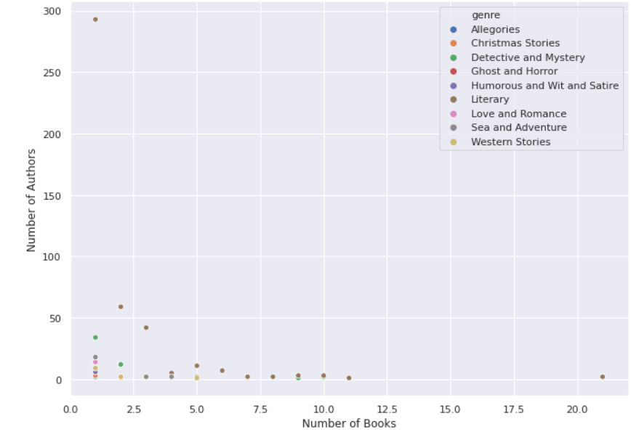
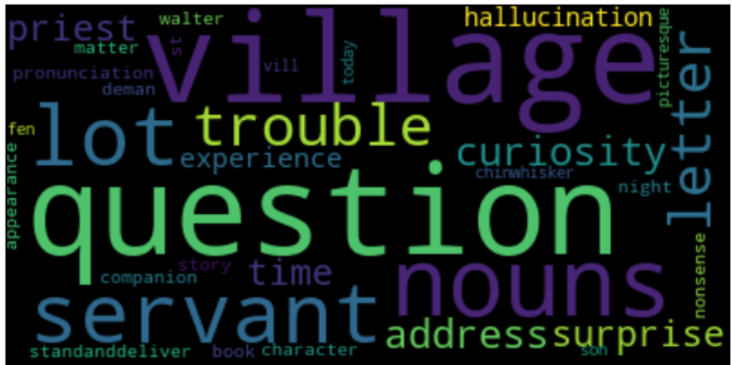
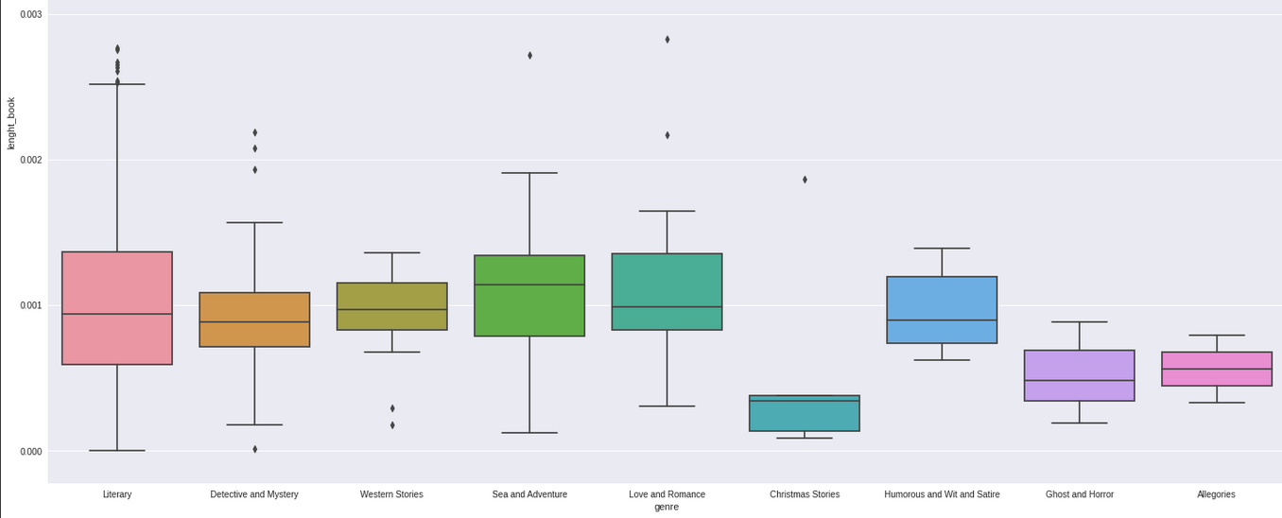
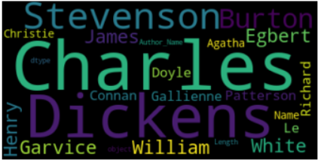
Few Insights
For all genres
Average length

Slide 6
Concept-Options
Bag of words
Meta data features
Sentiment /Emotion Analysis
Derive positive/negative/neutral sentiment of the book
Sentiments of the dominant character. emotions like fear, happiness, sadness etc
Quantitative features
Key words which identify a genre of book
Western stories- “man”,”rider”,”horse”
Romace-”love”,”romance”,”forever”
Loosing order
More well known and tested method
Average length of book
Avg number of words
Ave number of common words
Use of punctuations etc
Quantitative features

Slide 7
Concept- Selected
Method 1- Bag of words, Baseline
Method 2- Metadata + sentiment analysis
Extract key words which uniquely identifies the genre using term document frequency
Tried LDA to get topics in the given books and use those words
Meta data features which falls as per elements of fiction
Sentiment analysis on complete book, first , last, random 1500 sentences
Emotion analysis as above
Emotion analysis around dominate characters

Slide 8
Method 2 features
Character=Number of proper nouns
Plot=Number of verbs+ sentiments/emotions
Point of View=number of pronouns , Pronouns to noun ratios
Setting=dates ,year, historic places mentioned
Style=number of colons, period, dialogue breaks, stop words, foreign words etc
Theme(s)=emotions and sentiment overall in a book, in conclusion, around dominant characters, female oriented, male oriented

Slide 9
Method 2 Meta data features
Using NLTK
After removing only HTML tags
Pre processed with tokenisation, word/sentence level
Extended stop list to include common English names
Noun, verbs, proper nouns, ratios using part of speech tagging
Names entity recognition
Extract (.),(!),(“”),(,),dialogue breaks etc
Lemmatization

Slide 10
Method 2 Vader sentiment analysis
Lexicon and rule based, mostly used for social media
Quick , Efficient for large data
“This is cool.” “This is cool !” has different positive scores
May not work with sarcasm or irony
Compound score range between -1 to 1, threshold can be set
Positive
Negative
Neutral
Compound
Notes:
The compound score is computed by summing the valence scores of each word in the lexicon, adjusted according to the rules, and then normalized to be between -1 (most extreme negative) and +1 (most extreme positive). This is the most useful metric if you want a single unidimensional measure of sentiment for a given sentence. Calling it a 'normalized, weighted composite score' is accurate.
It is also useful for researchers who would like to set standardized thresholds for classifying sentences as either positive, neutral, or negative.
Typical threshold values (used in the literature cited on this page) are:
#. positive sentiment: compound score >= 0.05 #. neutral sentiment: (compound score > -0.05) and (compound score < 0.05) #. negative sentiment: compound score <= -0.05
The pos, neu, and neg scores are ratios for proportions of text that fall in each category (so these should all add up to be 1... or close to it with float operation). These are the most useful metrics if you want multidimensional measures of sentiment for a given sentence.

Slide 11
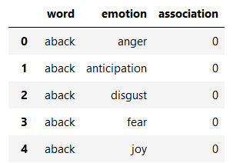
Method 2 Emotion analysis
NRC, lexicon based, set of English words and their associations with 8 emotions
>14,000 unigrams, around 25000 word sense
Binary association
only verbs after tokenisation & lemmatization
sadness
fear
anger
Disgust
Joy
Anticipation
Trust
surprise

Slide 12
Method 1 Bag of words
Using only uni grams
With extended stop words list
Keeping only verbs and nouns
Used TF-IDF vectorizer

Slide 13
Class Imbalance
With imbalanced data ,classification models favours majority class
Accuracy isn’t the right measure
Methods to address class imbalance-
Collect more data?
Under sampling
Over sampling
Combination of above 2
Cost sensitive training
Tree based algorithms
Evaluation measures change

Slide 14
Sampling using imblearn
Under Sampling majority class
Risk of loosing relevant information
Randomly removed books from majority class by authors who had written more than 2 books
Tried methods, Tomek links, one-sided selection and nearest neighbour variations
Over sampling Minority class
Methods used,
SMOTE-NC
Random Under sampler
Both generate duplicate data
Risk of overfitting
Notes:
Undersampling for Imbalanced Classification
Imbalanced-Learn Library
Methods that Select Examples to Keep
Near Miss Undersampling
Condensed Nearest Neighbor Rule for Undersampling
Methods that Select Examples to Delete
Tomek Links for Undersampling
Edited Nearest Neighbors Rule for Undersampling
Combinations of Keep and Delete Methods
One-Sided Selection for Undersampling
Neighborhood Cleaning Rule for Undersampling

Slide 15
Evaluation measure
Confusion matrix, actual/predicated matrix for each class
Precision , how exact ?
Recall, how complete?
F1 Score, weighted avg of precision and recall
Balanced Accuracy, macro average of recall scores per class
Train, validation, test split after under sampling and oversampling ,50,25,25
Notes:
which avoids inflated performance estimates on imbalanced datasets. It is the macro-average of recall scores per class or, equivalently, raw accuracy where each sample is weighted according to the inverse prevalence of its true class. Thus for balanced datasets, the score is equal to accuracy.
https://scikit-learn.org/stable/modules/model_evaluation.html#balanced-accuracy-score

Slide 16
Model selection
10-fold cross validation on training data
Chose with best weighted f1 score
For meta data features , scaled and ran PCA to reduce the number of features
PCA with k-fold cross validation
Naïve Bayes
SVM
KNN
Decision Tree
Random Forest
Logistic Regression

Slide 17
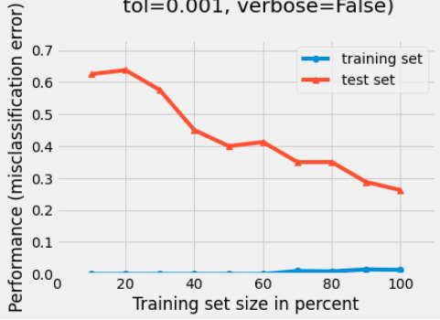
Hyper parameter tuning
Used learning curve using validation set to tune the kernel and C value
Clearly overfitting, as expected because of oversampling

Slide 18
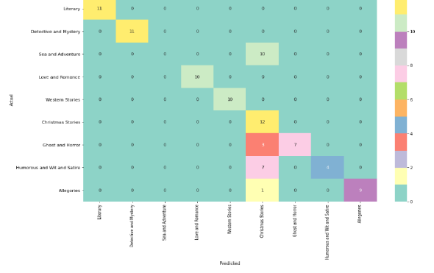
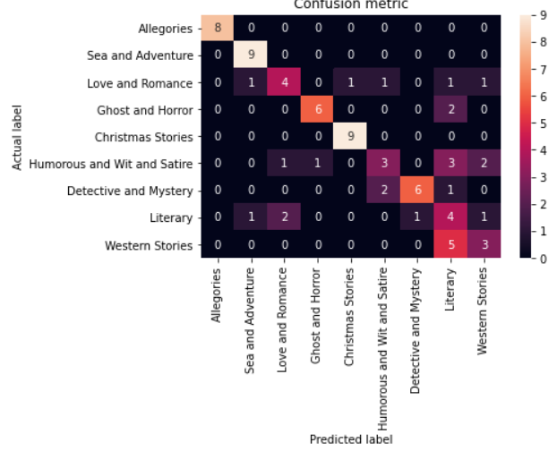
Confusion matrix on unseen test books
Method 1
Method 2

Slide 19
Conclusion
Method 2 could have been better for few classes
Better assumptions for fictional books like literary, western stories needs to be made, with expert’s inputs
Combination of both method would have been better
Needed to opt for better imbalance strategy
Decision trees also did good but less than SVM
Could try neural networks

Slide 20
Thank you !
Questions please.

