Slide 1
Rare itemsets mining algorithm based on RP-Tree and Spark Framework

Slide 2
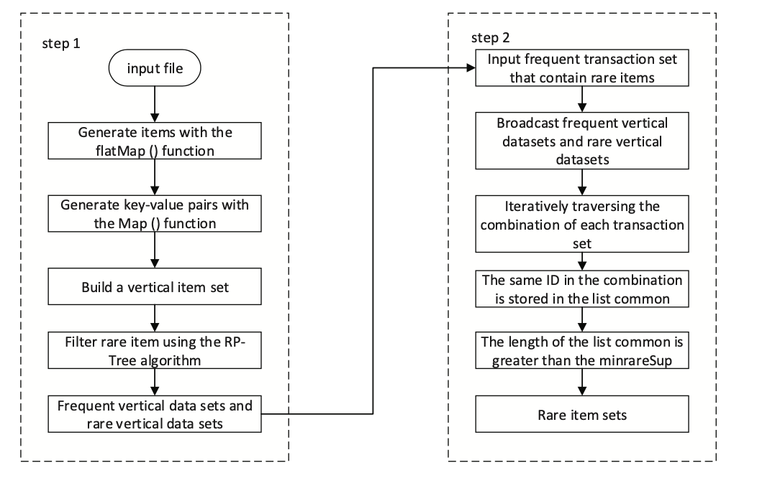
Approach
RP-Tree avoids the expensive item set generation and pruning steps by using a tree data structure, based on FP-Tree 7, to find rare patterns. RP-Tree is based on FP- Growth 8, which is efficient at finding long patterns, since the task is divided into a series of searches for short patterns. So, RP-Tree algorithm is an improvement over these existing algorithms.

Slide 3
The algorithm adopts the idea of vertical datasets and divides the datasets into frequent vertical datasets and rare vertical datasets, which are used to calculate the support degree of different itemsets.
At the same time, in order to improve the efficiency of the algorithm, delete the combination that does not contain rare items, and do not duplicate the itemsets that have been stored in the rare vertical datasets. Thus, the number of candidate itemsets is reduced.
Implemented on the Spark framework. It can effectively solve the problem of batch processing and interactive processing.

Slide 4
Results
Dataset | Number of items | Number of transactions
T1014D100k | 870 | 10000
T40I10D100k | 942 | 10000
The execution time of the algorithm decreases with the increase of the min Rare Sup threshold. This is because with the increase of the min Rare Sup threshold, the rare itemsets are mined less. In addition, the algorithm execution time decreases faster when the min RareSup is in the range of 0.5% to 1.5%.

Slide 5
Rare Association Rules Mining of Diabetic Complications Based on Improved Rarity Algorithm
Qiao Pan, Lan Xiang, Yanhong Jin
School of Computer Science and Technology, Donghua University Shanghai, China

Slide 6
Limitations of the other algorithms
Most of the algorithms need to scan the database multiple times in order to evaluate support of the candidate itemsets, which is time- consuming and inefficient.
Rarity algorithm reduces the scan number to two, yet it uses the tree structure to record all possible combinations of all items. If there are many types of items, the tree will be too large to store in the memory, resulting in failure of mining.

Slide 7
Approach
This paper presents an efficient method of rare pattern mining that can be divided into two steps, i.e., find all rare itemsets based on the improved Rarity, and rely on these rare itemsets to mine their association rules.
Area of application: Medical field to mine useful association rules in the clinical data of diabetic complications.

Slide 8
Approach continued.
To solve the limitations of other algorithms stated above, this paper uses the graph structure to indicate all items’ possible combinations, defines the pattern matrix to record every itemset and its support_count in the database, and combines the hash table to accelerate calculation of support and efficiently mine all rare itemsets, and then quickly find interesting association rules via calculating their interesting rate.
It is a top-down approach which obviously reduced the time consumption and the space waste.

Slide 9
Pattern Mining Predictor System for Road Accidents
Sisir Joshi1, Abeer Alsadoon1, S. M. N. Arosha Senanayake2, P. W. C. Prasad1(B), Shiaw Yin Yong2, Amr Elchouemi3, and Trung Hung Vo4

Slide 10
Problem
The aim of this research is to propose a novel predictive model based on the pattern mining predictor which improves the accuracy of acci- dent prediction in frequent accident locations.

Slide 11
Approach
Area of Study: Road Traffic
The experiment was conducted by clustering dataset generating the rules based on Apriori algorithm, which then decomposed into set of training and test data for predicting the severity of accident as reported
This model consists of five stages : Data Pre-processing, Clustering, Association rules mining, Classification and Prediction.
Enhanced Apriori algorithm is used which generates the candidate item sets faster, which in turn reduces the processing time. This algorithm reduces the number of candidate item sets that is needing to be scanned and by reducing the number of candidate item sets.

Slide 12
Conclusion
Use of Apriori Algorithm switched its performance from low to high by the reduction of processing time and helps create prediction model for the traffic road accident. Despite voluminous data, Improved Apriori Algorithm helps in search of most frequent item just once rather than in every repetition. Thus, use of Improved Apriori Algorithm for the prediction improved the processing time and accuracy for the traffic road accident prediction.

