Slide 1
A01G49Q03 : Nearest prime number in the least possible time
Harsh Kochar (IIT2018049) Sanjay Swami(IIT2018014)
IV Semester B.Tech, Department of Studies in Information Technology,
Indian Institute of Information Technology Allahabad, India

Slide 2
Abstract:
Finding nearest prime number to the given number. Using sieve to reduce time complexity.
Introduction
Algorithm Description
Algorithm and Analysis
Experimental Analysis
Conclusion
References

Slide 3
INTRODUCTION
Prime numbers are natural numbers which are not divisible by any other natural number other than 1 or itself. In this paper we tried to find the fastest way to find out the nearest prime number of a given number. We used Sieve of Eratosthenes. Sieve is a technique in which we iteratively mark composite numbers. This was given by Eratosthenes.
The original way would be to check on one by one on every number if it is prime or not, by dividing it by all other numbers smaller than itself. This will take time.

Slide 4
ALGORITHM DESCRIPTION
Stage 1:
Choose n, where n is the minimum number bigger than given number which is
prime. We approximate it to be within range of x and ([√x]+1)², where [y] is the smallest integer less than equal to y (It is approximated by observation, and can be proven). And x is the given number.
Stage 2:
We make a list of consecutive integers

Slide 5
Initially, let p equal 2, the smallest prime number.
Enumerate the multiples of p by counting in increments of p from 2p to n, and mark them in the list (these will be 2p, 3p, 4p, ...; the p itself should not be marked).
Find the first number greater than p in the list that is not marked. If there was no such number, stop. Otherwise, let p now equal this new number (which is the next prime), and repeat from last step.
When the algorithm terminates, the numbers remaining not marked in the list are all the primes below n.
Stage3:
We go on both direction from x until we find a number which is prime, as stored in our sieve.

Slide 6
ALGORITHM AND ANALYSIS
Algorithm Sieve of Eratosthenes is
input: an integer x> 1.
output: all prime numbers from 2 through n. Where n is ([√x]+1)².
Method: (Making Sieve)
let A be an array of Boolean values, indexed by integers 2 to n
Step1-> initially all set to true.

Slide 7
Step2-> for i = 2, 3, 4, ..., not exceeding √n do
Step 3-> if A[i] is true
Step 4-> for j = i², i²+i, i²+2i, i²+3i, ..., not exceeding n do
Step 5-> A[j] := false
Step 6-> return all i such that A[i] is true.
A is our required Sieve which has list of all the numbers which who are assigned true is prime, rest false.

Slide 8
(Finding the number)
Input: x, sieve from previous stage
Output: nearest prime
step7-> less=:x, more:=x
step 8-> While(less>0)
step 9-> if Sieve[less] return less
step 10-> if Sieve[more] return more
step 11-> less--, more++

Slide 9
Apriori Analysis
Stage I : A one step process , to find the n for given x
Stage II : Sieve of Eratosthenes.
Space complexity of Sieve is O(n), as we store n*(int) spaces.
Time complexity of Sieve is O(nlog(logn)).
Explaination of nlog(log(n)):
We assume thet time required to mark a number as composite is constant. Then the number of times loop run is n/2 + n/3 + n/5 + n/7 …. n/p where p is the biggest prime number until n.

Slide 10




Taking n common: n*(1/2 + 1/3 + 1/5 + 1/7 …. 1/p)
Summation of harmonic prime series is log(log(n)), for large n.
It is a harmonic series, which converges close to log(log(n)).
>> By Eulers product Formula:
>> By Taylor series expansion
>> The above series is convergent. So, the above series can be approximated to 1/p
Hence, nlog(log(n))

Slide 11
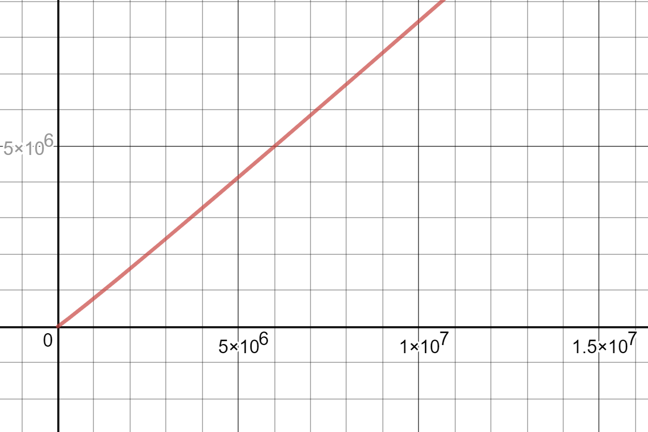
Stage III : Finding nearest prime near x, using the sieve made earlier.
Best case, the number x is prime. O(1)
Else, it will try to find prime number before and after the x. Still O(1).
Time Complexity

Slide 12
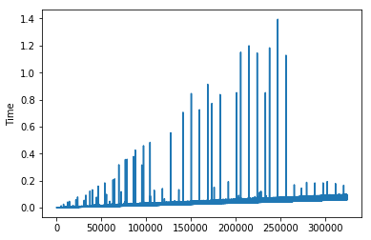
EXPERIMENTAL ANALYSIS
In the above graph, the input ‘n’ is considered along x-axis and time along y-axis. The graph represents Time v/s n. The above graph shows that the Aposteriori analysis is consistent with Apriori analysis.

Slide 13
CONCLUSION
From this we can safely conclude that algorithm has time complexity O(nlog(log(n)).
Best is also Ω(nlog(log(n)))
And Space complexity O(n) even for best.

Slide 14
References
https://en.wikipedia.org/wiki/Sieve_of_Eratosthenes
https://en.wikipedia.org/wiki/Prime_number_theorem
https://math.stackexchange.com/questions/411126/space-complexity-of-the-segmented-sieve-of-eratosthenes
https://www.geeksforgeeks.org/how-is-the-time-complexity-of-sieve-of-eratosthenes-is-nloglogn/
https://www.geeksforgeeks.org/sieve-of-eratosthenes/
https://en.wikipedia.org/wiki/Divergence_of_the_sum_of_the_reciprocals_of_the_primes

Slide 15
Thank you!
Group Members:
Harsh Kochar IIT2018049
Sanjai Swami IIT2018014

