Slide 1
A02G48Q25 : Sorting a sequence in ‘N’ format
Harsh Kochar (IIT2018049) Madhu(IIT2018068)
IV Semester B.Tech, Department of Studies in Information Technology,
Indian Institute of Information Technology Allahabad, India

Slide 2
Abstract:
In this paper we have first sorted the sequence by tim sort algorithm and then rearranged it in a manner such that, when plotted it’s index against the values it makes ‘N’ shaped pulse.
Introduction
Algorithm Description
Algorithm and Analysis
Experimental Analysis
Conclusion
References

Slide 3
INTRODUCTION
Timsort is a hybrid sorting algorithm derived from merge sort and insertion sort. Because merge function performs well when sizes subarrays are powers of 2 and insertion sort performs well for small arrays.
We divide the Array into blocks known as Run. We sort those runs using insertion sort one by one and then merge those runs using a combined function used in merge sort. If the size of Array is less than run, then Array get sorted just by using Insertion Sort. Now we merge them one by one. We double the size of merged subarrays after every iteration. After this sorting we rearrange it by reversing the mid two third region, ie swapping the elements.
The algorithm works is described in detail in part II.

Slide 4
ALGORITHM DESCRIPTION
This algorithm works in mainly 4 stages.
If n is the size of sequence.
Stage 1: We have a suitable run size (32 this time). Then we divide our sequence into n/32 parts.
Stage 2: Run an insertion sort algorithm for every run (parts). It operates by assuming first i elements are sorted. The inner loop moves element A[i] to its correct place so that after this i+1th element is sorted.

Slide 5
Stage 3: Merging the sorted sequence in pairs by making a new sequence of twice the size. .This can also exploit the parallel processing hence divide and conquer to give complexity of (log3(n)).
Stage 4: Rearrangement by swapping each (n/3+i)th term with (2n/3-i)th term.

Slide 6
ALGORITHM AND ANALYSIS
Main
Input: array of integer
Output: sorted array
i← 0 Step 1
run← 32 Step 2
for i<n, i← i+run Step 3
insertion(arr[], i,min(i+run,n)) Step 4
size← run Step 5
while size<n Step 6
left← 0 Step 7
while left<n Step 8
mid← left + size -1 Step 9
right ← min((left + 2*size - 1), (n-1)) Step 10
merge(arr, left, mid, right) Step 11
left← size*2 Step 12
size← size*2 Step 13
rearrange(arr,n/3,2*n/3) Step 14
return arr
Insertion sort
input : array of a fixed range (less than equal to run) A
i ← 1 Step 15
while i < length(A) Step 16
x ← A[i] Step 17
j ← i - 1 Step 18
while j >= 0 and A[j] > x Step 19
A[j+1] ← A[j] Step 20
j ← j - 1 Step 21
end while Step 22

Slide 7
A[j+1] ← x[3] Step 23
i ← i + 1 Step 24
end while Step 25
Merge sort
intput : array A, left bound l, mid bound m, end bound r
index1← l , index2← m+1 Step 26
newlist← empty list Step 27
while index1<m and index2<r Step 28
If A[index1] <= A[index2] Step 29
newlist.append(A[index1]) Step 30
index1← index1+1 Step 31
else
newlist.append(A[index2]) Step 32
index2← index2+1 Step 33
i← 0 Step 34
while l<m: Step 35
A[l]← newlist[i] Step 36
l← l+1, i← i+1 Step 37
Rearrange
Input an array A, left bound l,right bound r
for l<(l+r)/2 Step 38
swap(A[l],A[r]) Step 39

Slide 8
Apriori Analysis
Step 1,2,5: have a frequency of 1, and will take 1 unit of time.
Step 3: The loop has a frequency of O(n), as it runs for n/Run times.
Step 4: It is insertion sort of 32 pisces, O(1). (Should have been O(n2), but n in here is Run, which is 32, so constant)
Step 6: Loop will run for log(n) times (with the base 2, as size←size*2).
Step 7,13: Will just have the loop frequency, and will take 1 unit of time.
Step 8: This loop will run n/2*size times, where size changes from 32, 64,128… to nearest value of 2^([log(n)]), which means log(n) - log(32) number of times. Giving a frequency of O(log(n)).

Slide 9
Step 9,10,12: Will take 1,2,1 unit of time.
Step 11: It will run for Size*2 times giving a complexity of O(n). (And Space complexity =Size*2) Which is best as it is merging of two sorted array of same size. But with a best complexity of O(1)
Step 14: Swapping n/3th term with 2n/3th term, this will be O(n). (n/3) swaps, each with 3 steps.
>>This merging could have exploited parallel processing, giving a complexity of log(n). This would make overall complexity (log(n))^3.
This results in overall complexity to be:
T α n + log(n)*n +n
T best α n + log(n) + n

Slide 10
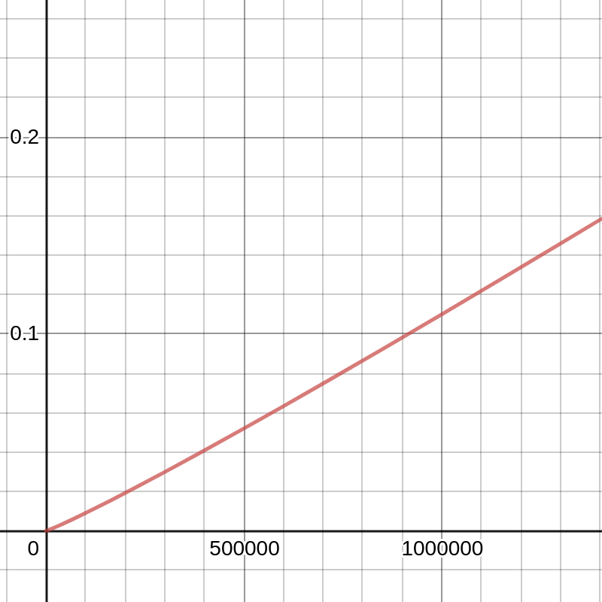
Which gives average time complexity of O(nlog(n)). And Space complexity of O(n), as n is the size of extra space (maximum) was used.
It happened while merging.
Time Complexity

Slide 11
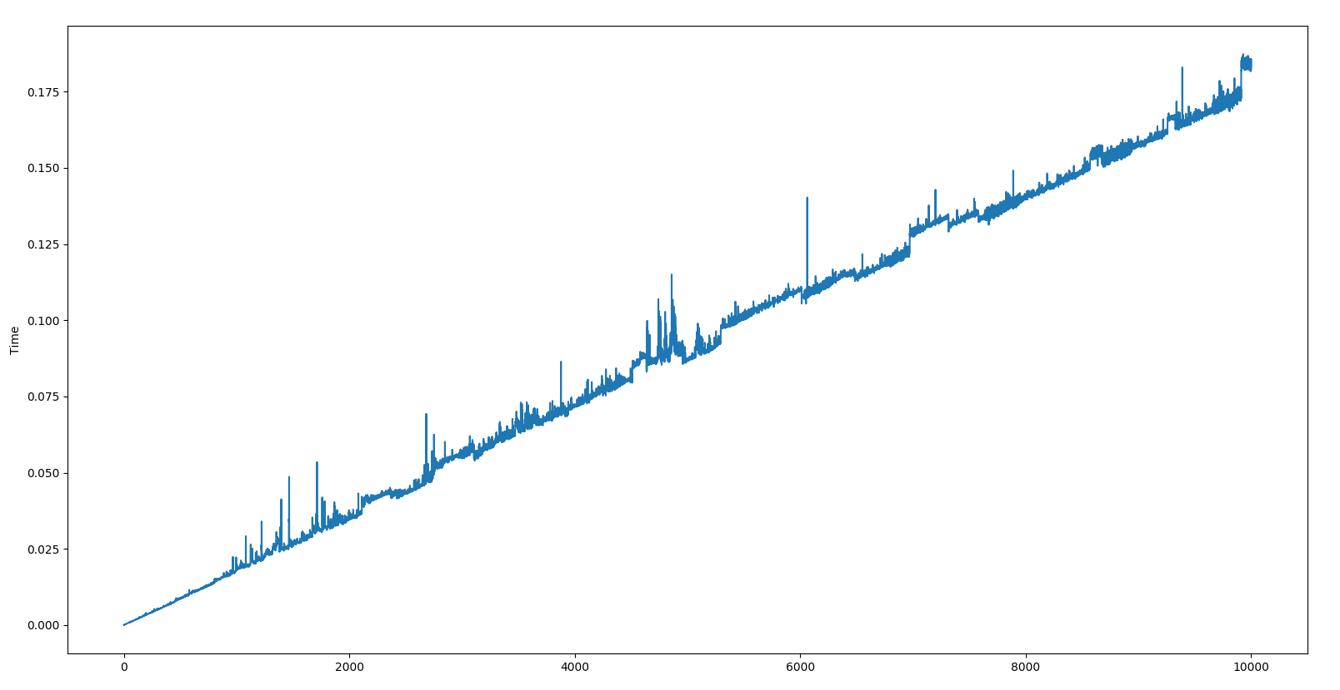
EXPERIMENTAL ANALYSIS
In the above graph, the input ‘n’ is considered along x-axis and time along y-axis. The graph represents Time v/s n. The above graph shows that the APosteriori analysis is consistent with Apriori analysis.

Slide 12
CONCLUSION
From this paper we can conclude that algorithmic best is O(n), worst and average is O(nlog(n)) and space complexity is O(n)

Slide 13
References
https://www.khanacademy.org/computing/computer-science/algorithms/insertion-sort/a/analysis-of-insertion-sort
https://en.wikipedia.org/wiki/Insertion_sort#Best,_worst,_and_average_cases
https://www.i-programmer.info/news/181-algorithms/12111-timsort-really-is-onlogn.html
https://en.wikipedia.org/wiki/Timsort#Analysis
https://www.geeksforgeeks.org/timsort/
https://en.wikipedia.org/wiki/Merge_sort
https://www.tutorialspoint.com/design_and_analysis_of_algorithms/design_and_analysis_of_algorithms_merge_sort.htm
https://www.khanacademy.org/computing/computer-science/algorithms/merge-sort/a/analysis-of-merge-sort

Slide 14
Thank you!
Group Members:
Harsh Kochar IIT2018049
Madhu IIT2018068

