Slide 1
A06G17Q17: Locating vertically and horizontally aligned points in cartesian plane using parallel programming.
IIT2018049-Harsh Kochar, IIT2018050-Avneesh Gautam, IIT2018051-Avishek
IV Semester B.Tech, Department of Studies in Information Technology,
Indian Institute of Information Technology Allahabad, India

Slide 2
Abstract:
In this paper, we have devised an algorithm to locate vertically and horizontally aligned points given the points with (x, y) coordinates in the cartesian plane by using parallel programming.
We have discussed the time complexity of the algorithm by both Apriori and Aposteriori analysis.
Introduction
Algorithm Description
Algorithm and Analysis
Experimental Analysis and Profiling
Conclusion

Slide 3
INTRODUCTION
In sequential programming, a problem statement is broken into discrete instructions. Then the instructions are executed one by one. Only one instruction is executed at any moment of time.
Parallel programming is the use of multiple processing elements simultaneously for solving any problem. It reduces the number of instructions that the system must execute in order to perform a task on large-sized data. In parallel computing, a computational task is typically broken down into several, often many, very similar sub-tasks that can be processed independently and whose results are combined afterwards, upon completion.

Slide 4
ALGORITHM DESCRIPTION
In this algorithm, we have divided the task in two threads: vertical thread and horizontal thread. In both the threads there is a mapping of vectors to integers value, this integer value determines the vector in which we have to push back the point. Also this integer value is the x coordinate or y coordinate according to the thread. From that type of mapping we get all the points which are on the same x coordinates or on the same y coordinates. Now we have to check whether already there is a vector for that value or not and if there is already a vector mapped to that value then we have to push back the point in that vector otherwise we have to map a empty vector to that value and then push back point to that vector. For result if any mapped vector has more than one value then these will be vertically or horizontally aligned points.

Slide 5
We don’t need to manually set semaphore as the critical section will only be read and is not modified.
A more complex approach would dividing the dataset into x parts and then making 2x threads x will do horizontal and the remaining x will do vertical. This would also require semaphores as the vector (dictionary/map) saving each of horizontal and vertical differently would become a critical section. We would expect the complexity to be decreased by x times but this critical section would bottleneck the performance.

Slide 6
ALGORITHM AND ANALYSIS
Algorithm: locating vertically and horizontally aligned points in cartesian plane
Input: set of points (x, y)
Output: vector containing the vertically and horizontally aligned points
Algorithm 1: vertical_thread(string id, const set<pair<int, int>> &points)
map(int, vector<pairs>) vert
for each pair x in points
if x.first is present in vert then
push x in vert[x.first]
else
create a new vector<pair<int,int>> v
push x in v
vert[x.first] v
Algorithm 2: horizontal_thread(string id, const set<pair<int, int>> &points)
map(int, vector<pairs>) horz
for each pair x in points
if x.second is present in horz then
push x in horz[x.second]
else
create a new vector<pair<int,int>> v
push x in v
horz[x.second] v
Algorithm: main()
set<pair<int, int>> points
Do in parallel:
std::thread t1(vertical_thread, “t1”, points).start()
std::thread t2(horizontal_thread, “t2”, points).start()
t1.join()
t2.join()

Slide 7
Table 1: Table 2:
Step | Time | Time(Worst) | Iteration
1 | 1 | 1 | 1
2 | 2 | 2 | n
3 | 1 | n | n+1
4 | 1 | 1 | n+1
5 | 1 | 1 | 1
6 | 1 | n | 1
7 | 1 | 1 | 1
8 | 1 | 1 | 1
Complexity in average and best case:
T=(1*1)+(2*n)+(1*(n+1))+(1*(n+1))+
(1*1)+(1*1)+(1*1)+(1*1)
T=5+2n+2(n+1)
T=4n+7
T O(n)
Complexity in worst case:
Tworst=(1*1)+(2*n)+(n*(n+1))+(1*(n+1))+
(1*1)+(n*1)+(1*1)+(1*1)
Tworst=4+3n+(n+1)+n(n+1)
Tworst=n²+5n+5
Tworst O(n²)
Table1: Complexity analysis of vertical thread
Complexity in average and best case:
T=(1*1)+(2*n)+(1*(n+1))+(1*(n+1))+
(1*1)+(1*1)+(1*1)+(1*1)
T=5+2n+2(n+1)
T=4n+7
T O(n)
Complexity in worst case:
Tworst=(1*1)+(2*n)+(n*(n+1))+(1*(n+1))+
(1*1)+(n*1)+(1*1)+(1*1)
Tworst=4+3n+(n+1)+n(n+1)
Tworst=n2+5n+5
Tworst O(n²)
Step | Time | Time(Worst) | Iteration
1 | 1 | 1 | 1
2 | 2 | 2 | n
3 | 1 | n | n+1
4 | 1 | 1 | n+1
5 | 1 | 1 | 1
6 | 1 | n | 1
7 | 1 | 1 | 1
8 | 1 | 1 | 1
Table 3:
Table2: Complexity analysis of horizontal thread
Table3: Complexity analysis of final algorithm
Complexity in average and best case:
T=(1*1)+(n*1)+(1*1)
T=n+2
T O(n)
Complexity in worst case:
Tworst=(1*1)+(n2*1)+(1*1)
Tworst=n²+2
Tworst O(n²)
Step | Time | Time(Worst) | Iteration
1 | 1 | 1 | 1
2 | n | n2 | 1
3 | 1 | 1 | 1

Slide 8
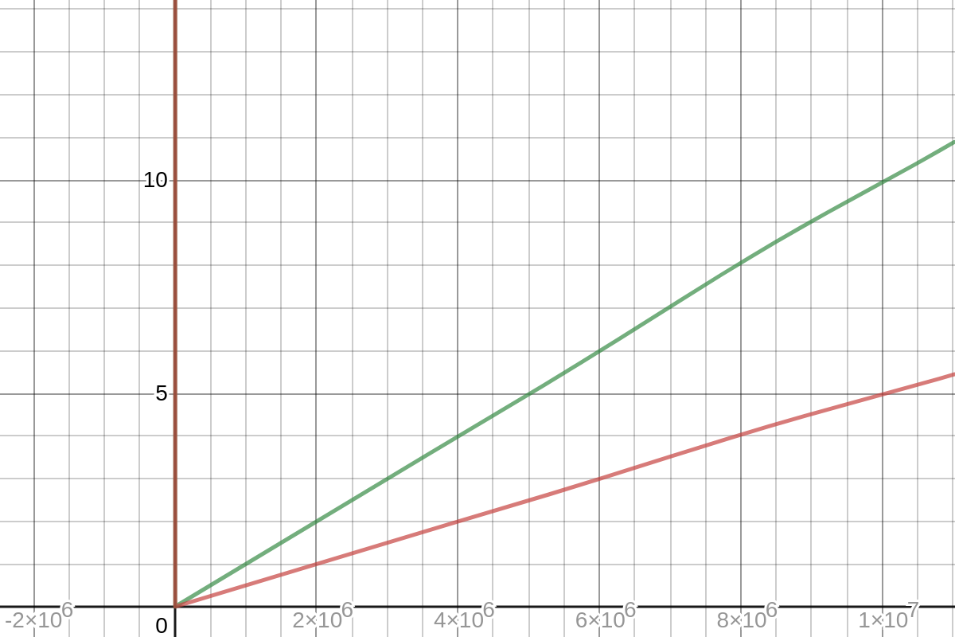
Hence, we can say that the overall complexity in best and average case comes out be O(V(n)+H(n)) and the complexity in worst case comes out to be O(V(n²)+H(n²)), where Vand H denotes the vertical and horizontal thread respectively. We have calculated this complexity in parallel approach. The complexity of the algorithm in sequential approach will be of the same order as in the case of parallel approach. The space complexity is O(n)as it saves the copy of the twice in vector(dictionary) form for vertical and horizontal process(threads).
Figure 1:Comparison of Time complexity for Apriori analysis of Algorithm.

Slide 9
Experimental Analysis and Profiling
The algorithm was run on a data set which generated random numbers varying between -10,000 and 10,000. In Fig.2 and Fig.3 we have run this algorithm for upto 1000 points increasing the number of points by 10 each time. Hence running the whole algorithm for a 100 sets of samples. In Fig.4 and Fig.5 we have run this algorithm for upto 10^7 number points increasing the number of points by 50000 each time. Hence running the whole algorithm for a 200 sets of samples.
For the practical purpose the timing calculation was done in 2 different manners getting us 2 types of graph for parallel namely Parallel and ParallelCS. One of them takes an absurdly high amount of time then the other (multiple fold higher then even sequential) for a small number of points. For an increased number of points the time ratio decreases to a reasonable number which is again lower than sequential.

Slide 10
Difference Parallel and Parallel CS:
In parallel CS a two new processes are initiated every time we increase the number of points. Which seems more reasonable as it will explain the time needed for running the algorithm once/twice. For small values this proves costly as the algorithm is CPU bound . The other way we used it was we started off with 2 threads. One would run throughout all the sets of points for horizontal and the other would do it in vertical. The same process will work even when the set of points are increased.

Slide 11
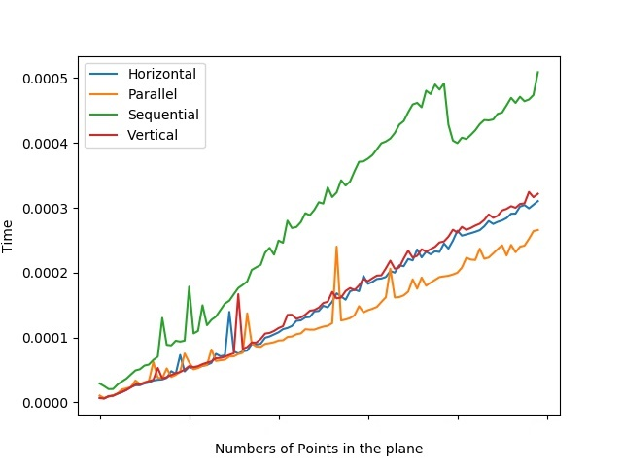
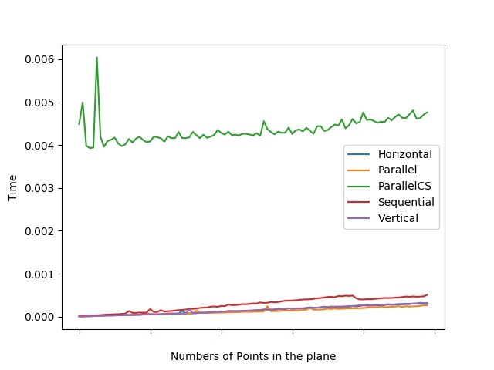
Figure2: Parallel algorithm run with less context Switch on 1000 points
Figure3: Parallel algorithm run with context Switch on 1000 points
What is happening: The ParallelCS, for small numbers, requires many context switches hence takes more time, a lot more than the sequential.

Slide 12
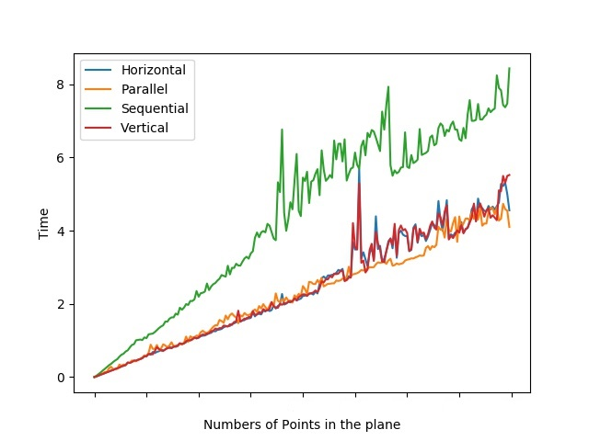
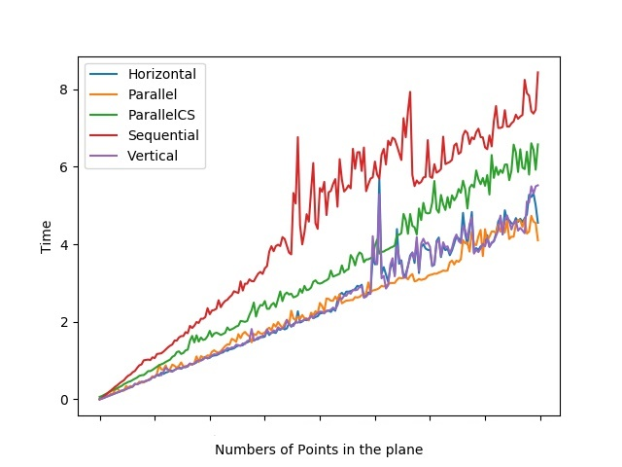
Figure4: Parallel algorithm run with less context Switch on 1,00,00,000 points
Figure5: Parallel algorithm run with context Switch on 1,00,00,000 points
What is happening: As the number of points in the plane increases to 10,000 times the previous it catches up and is now faster than the sequential. But still slower than fully parallel and optimized one.

Slide 13
Explanation:
The above graph shows that the Apriori analysis is consistent with the Aposteriori analysis as the theoretical graph and the experimental graph has the same nature and hence we could say that the analysis made is true to a certain extent. Parallel algo in practice should have proven worse than either of horizontal and vertical but proved somewhat close enough. Denying the theoretical estimation. The most understandable reason is that the cache memory would already have the coordinate asked by horizontal as it was asked by vertical or vice-versa. But further research can be done, as for small numbers it is clearing showing significant advantage

Slide 14
CONCLUSION
From this paper we can conclude that the algorithm is an O(V(n)+H(n)) algorithm in best and average case and O(V(n²)+H(n²)) in the worst case, where V and H denote the vertical and horizontal threads respectively. The final equations will be the same in both parallel and sequential approach but the time taken by the algorithm in parallel approach will be somewhat less than half the time taken by the sequential approach as we can see from the graphs.

Slide 15
Thank you!
Group Members:
Harsh Kochar IIT2018049
Avneesh IIT2018050
Avishek IIT2018051

